Slide 1
A V Dissociation
Dr.Anjos

Slide 2
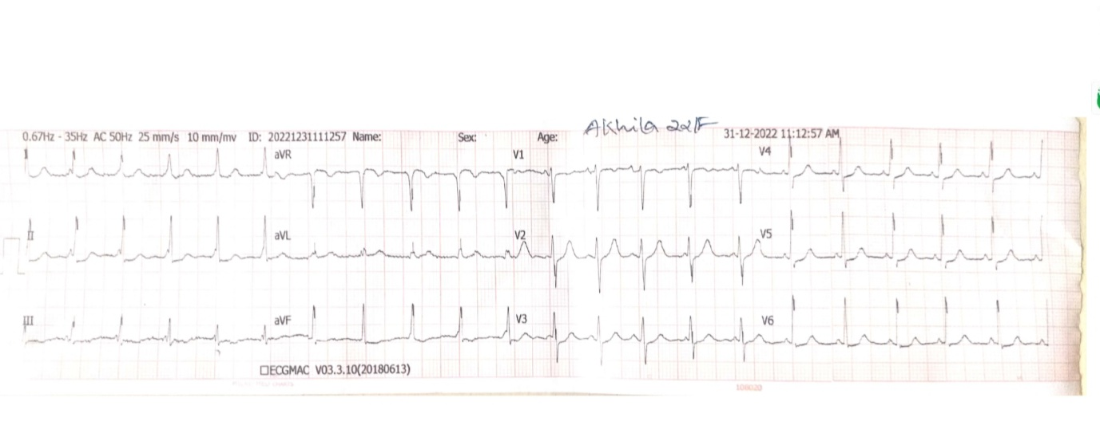

Slide 3
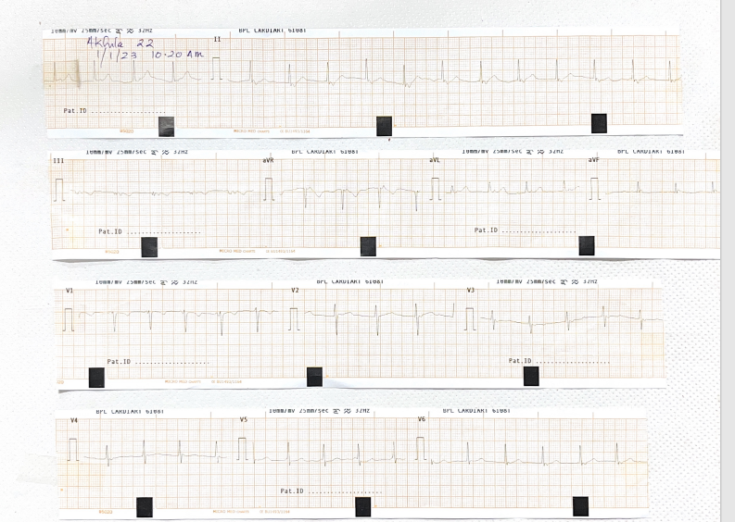

Slide 4
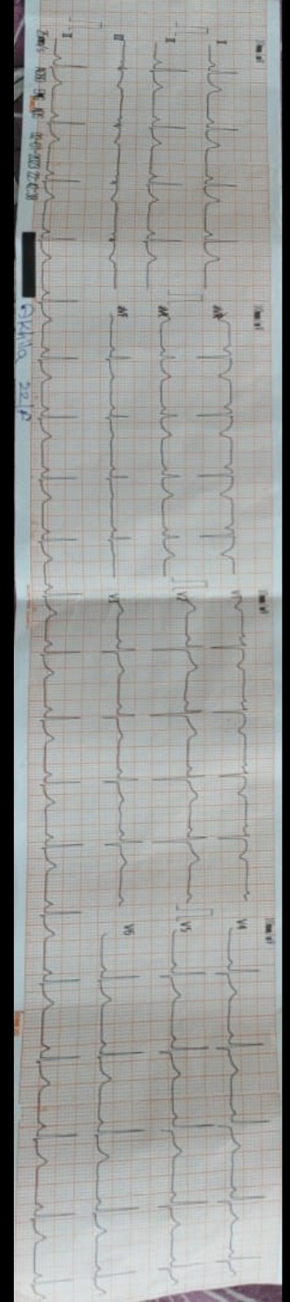

Slide 5
A V Dissociation
A dual rhythm in which atria are activated independently, where atria is completely or dominantly activated by one pacemaker and ventricle by another.
Never a primary or complete diagnosis,always secondary to another arrythmic disturbance.

Slide 6
Underlying rhythm disturbance produced by 3 causes or their combinations
1.sinus bradycardia with junctional escape
2.accelerated junctional /ventricular rhythm including tachycardia.
3.complete av blocks

Slide 7
Types of AV Dissociation
1.Heart block-CHB
2.Isorhythmic AV Dissociation
3.Interference AV Dissociation

Slide 8
Mechanisms of AV Dissociation
1.Disorders of Impulse formation
2.Disorders of Impulse Conduction

Slide 9
Disorders of Impulse formation
1.Ventricular/AV nodal Extrasystole
2.Ventricular/AV Nodal tachycardia –complicated by interference
3.AV Nodal/Ventricular escape beats-escaping focus discharge at same time of delayed sinus discharge

Slide 10
Interference Dissociation
Called interference dissociation because impulses conducted down from SA Node and up from ventricle interfere with each other in AV Node

Slide 11
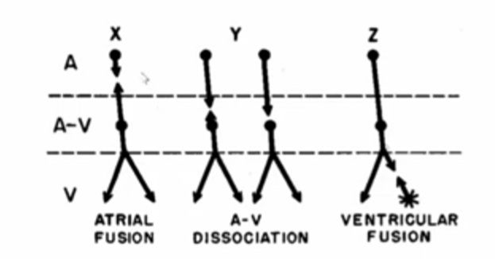

Slide 12
Isorhythmic AV Dissociation
Occur when sinus rate is slowed down and junctional rate in accelerated so that they are almost equal .
Atria is captured by sinus impulse and ventricle by
junctional impulse.

Slide 13
Isorhythmic AV Dissociation
2 forms of isorhythmic AV dissociation described
Pattern1-p wave fluctuates cyclically back and forth across QRS Complex
Pattern 2-p wave fairly constant.it usually coincides with QRS or occurs on ST segment or first half of T wave

Slide 14
Idionodal tachycardia
Expression of accelerated idionodal rhythm.
First described by Pick and Dominiquez in 1957-called non-paroxysmal AV nodal tachycardia.
Newer terminology-accelerated junctional rhythm/Idionodal tachycardia

Slide 15
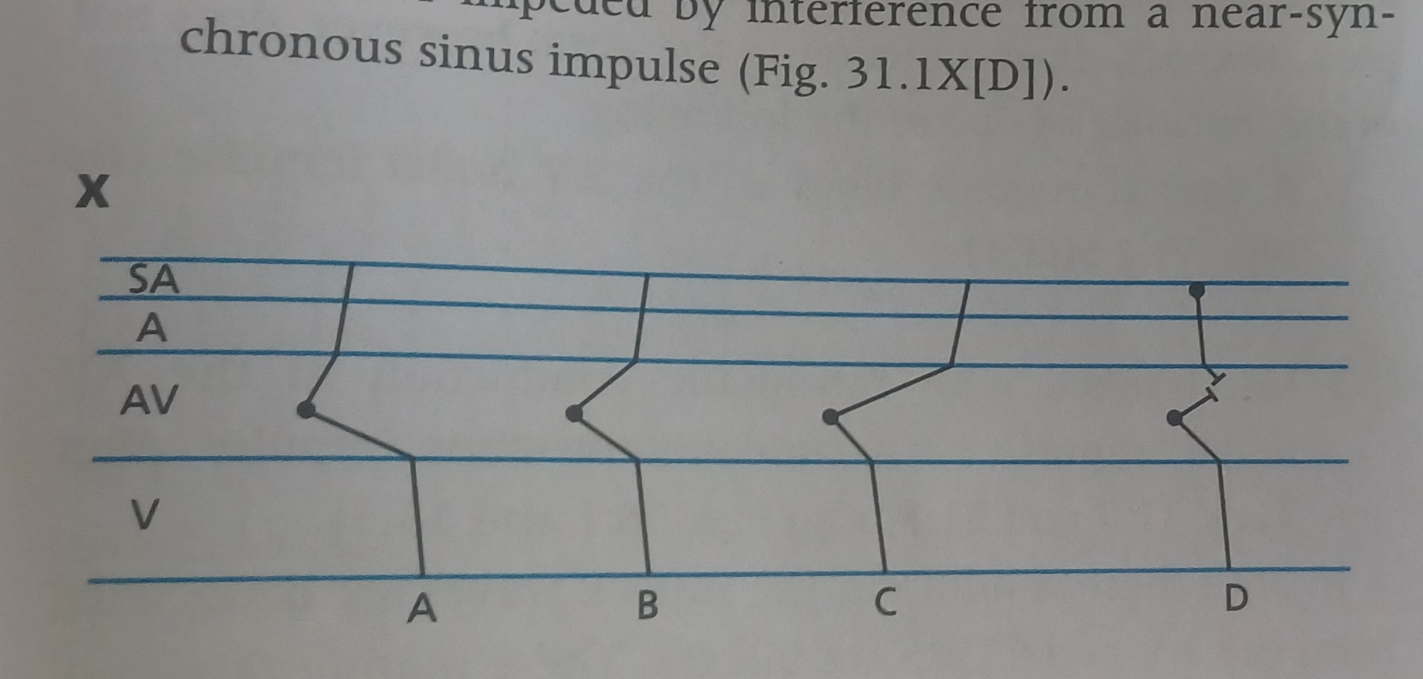

Slide 16
Critera for Idionodal tachycardia
1.normal QRS complex or QRS complex that has same configuration of conducted sinus impulse
2.Enhanced idionodal rate
Inherent idionodal rate-50-60/min
Idionodal tachycardia->70/min
Commonly between 70-100(Schamroth)/90-120(chou)

Slide 17
3.AV dissociation
4.Absence of Pacemaker protection
Abolition of idionodal tachycardia if sinus rhythm accelerates
Abolition of ectopic rhythm by capture beat

