Slide 1
Principles of management of ACS- evidence review
DR SANCHNA DEV S
DEPT OF CARDIOLOGY
GOVT TDMCH

Slide 5
1. TRIAGE AND DIAGNOSIS
CLINICAL PRESENTATION-
Angina —> heavy chest pressure or squeezing, a burning feeling, or difficulty breathing
—> often radiates to the left shoulder, neck, or arm
—> typically builds in intensity over a period of a few minutes
—>may begin with exercise or psychological stress, but ACS most commonly occurs without obvious precipitating factors.
CARDIAC / POSSIBLE CARDIAC (chest pain symptoms that suggest a cardiac origin)/ NON CARDIAC chest pain.

Slide 7
Atypical descriptions of chest pain (ACC/AHA)
Pleuritic pain
Primary or sole location of the discomfort in the middle or lower abdominal region
Pain that may be localised by the tip of one finger, particularly over the left ventricular apex
Pain reproduced with movement or palpation of the chest wall or arms
Constant pain that persists for many hours
Very brief episodes of pain that last a few seconds or less
Pain that radiates into the lower extremities

Slide 9
2.Diagnostic tools-ECG
1. ECG in STEACS

Slide 11
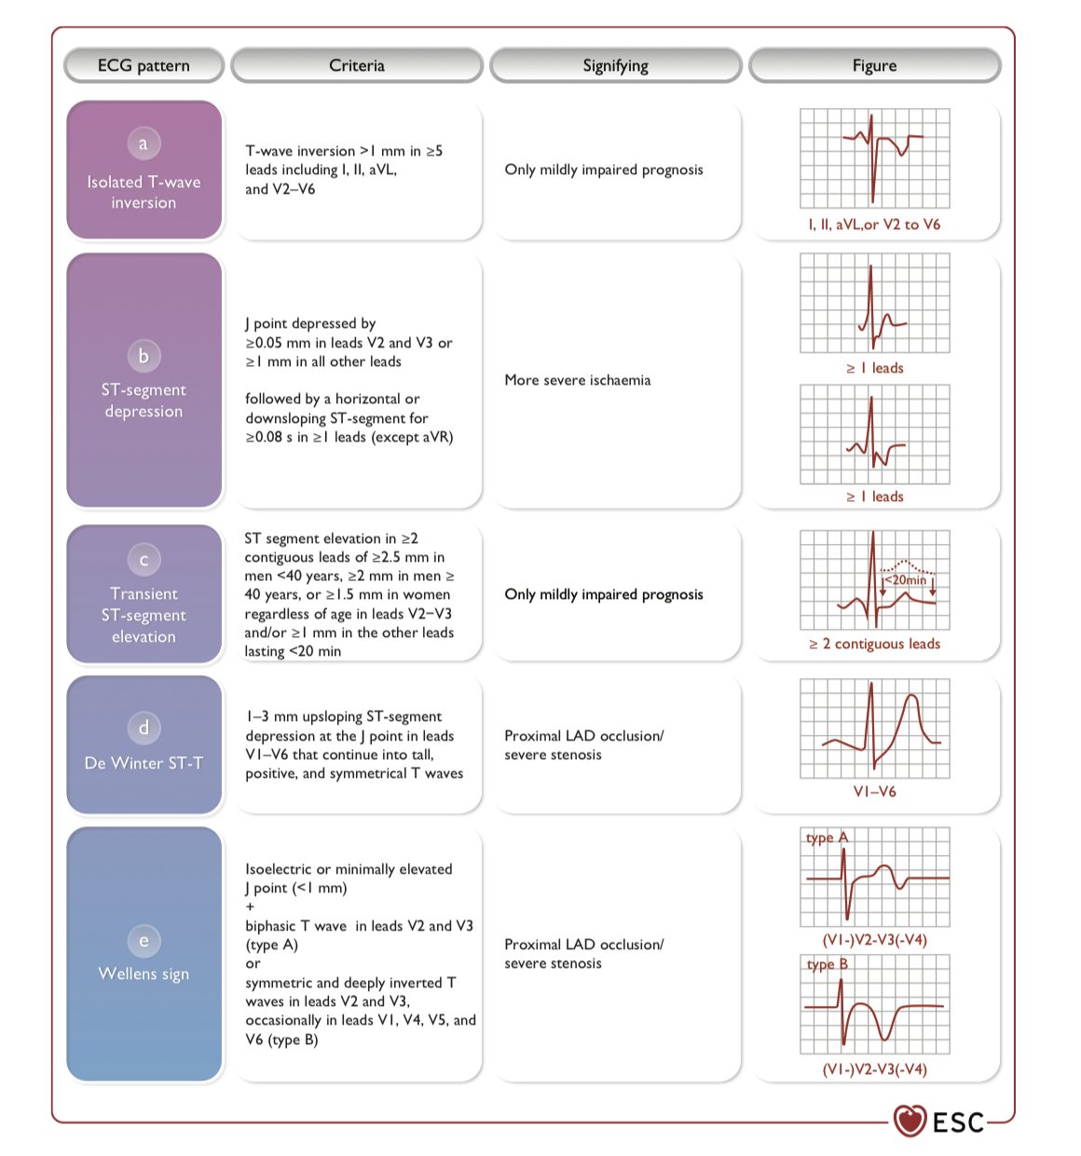
2. ECG in NSTE ACS

Slide 12
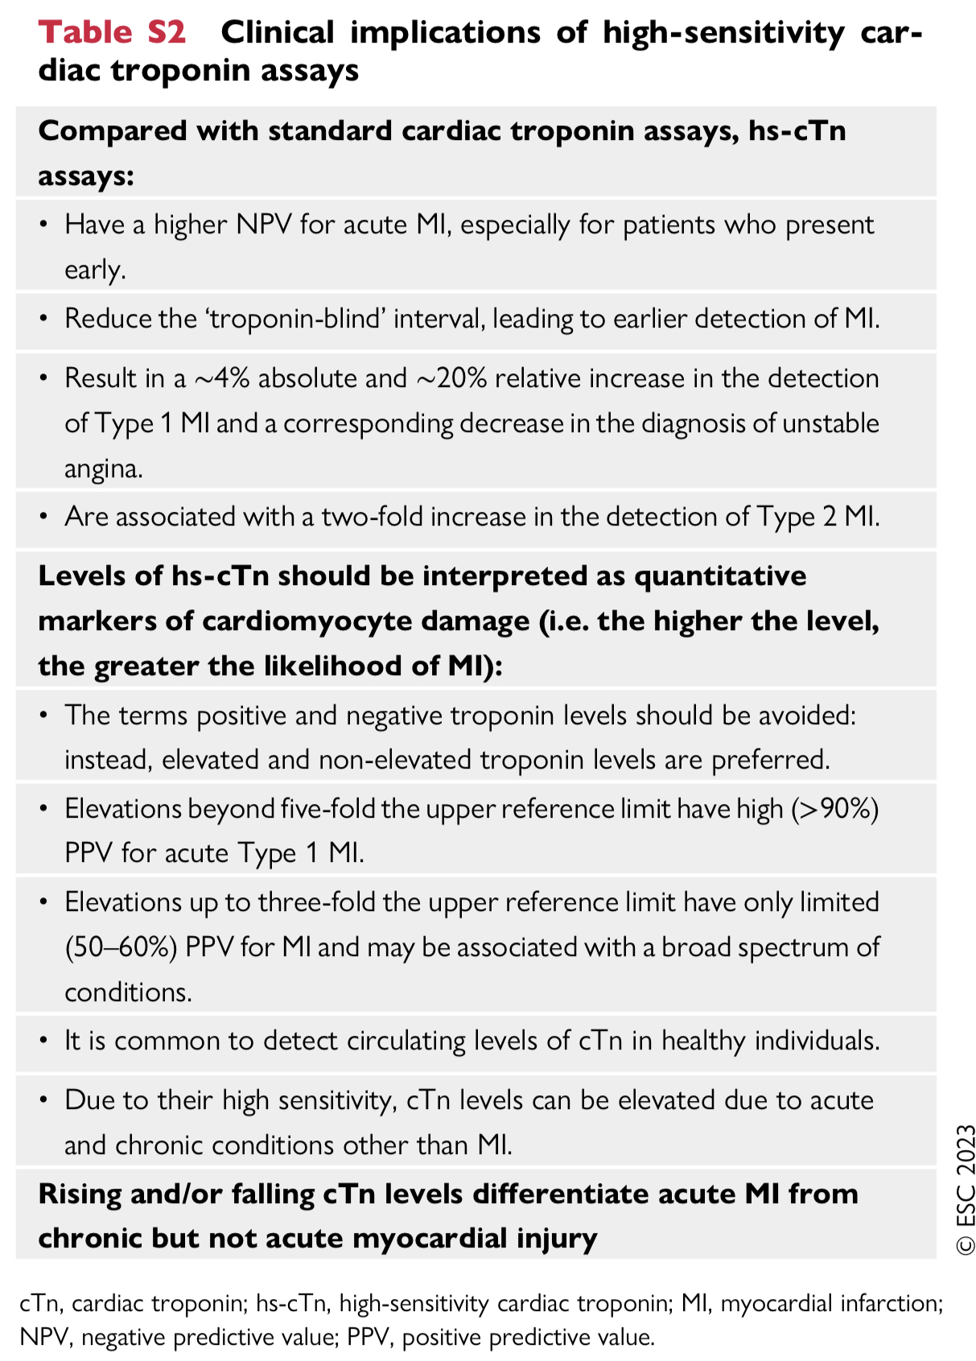
2.Diagnostic tools - Biomarkers
High-sensitivity cardiac troponin

Slide 13
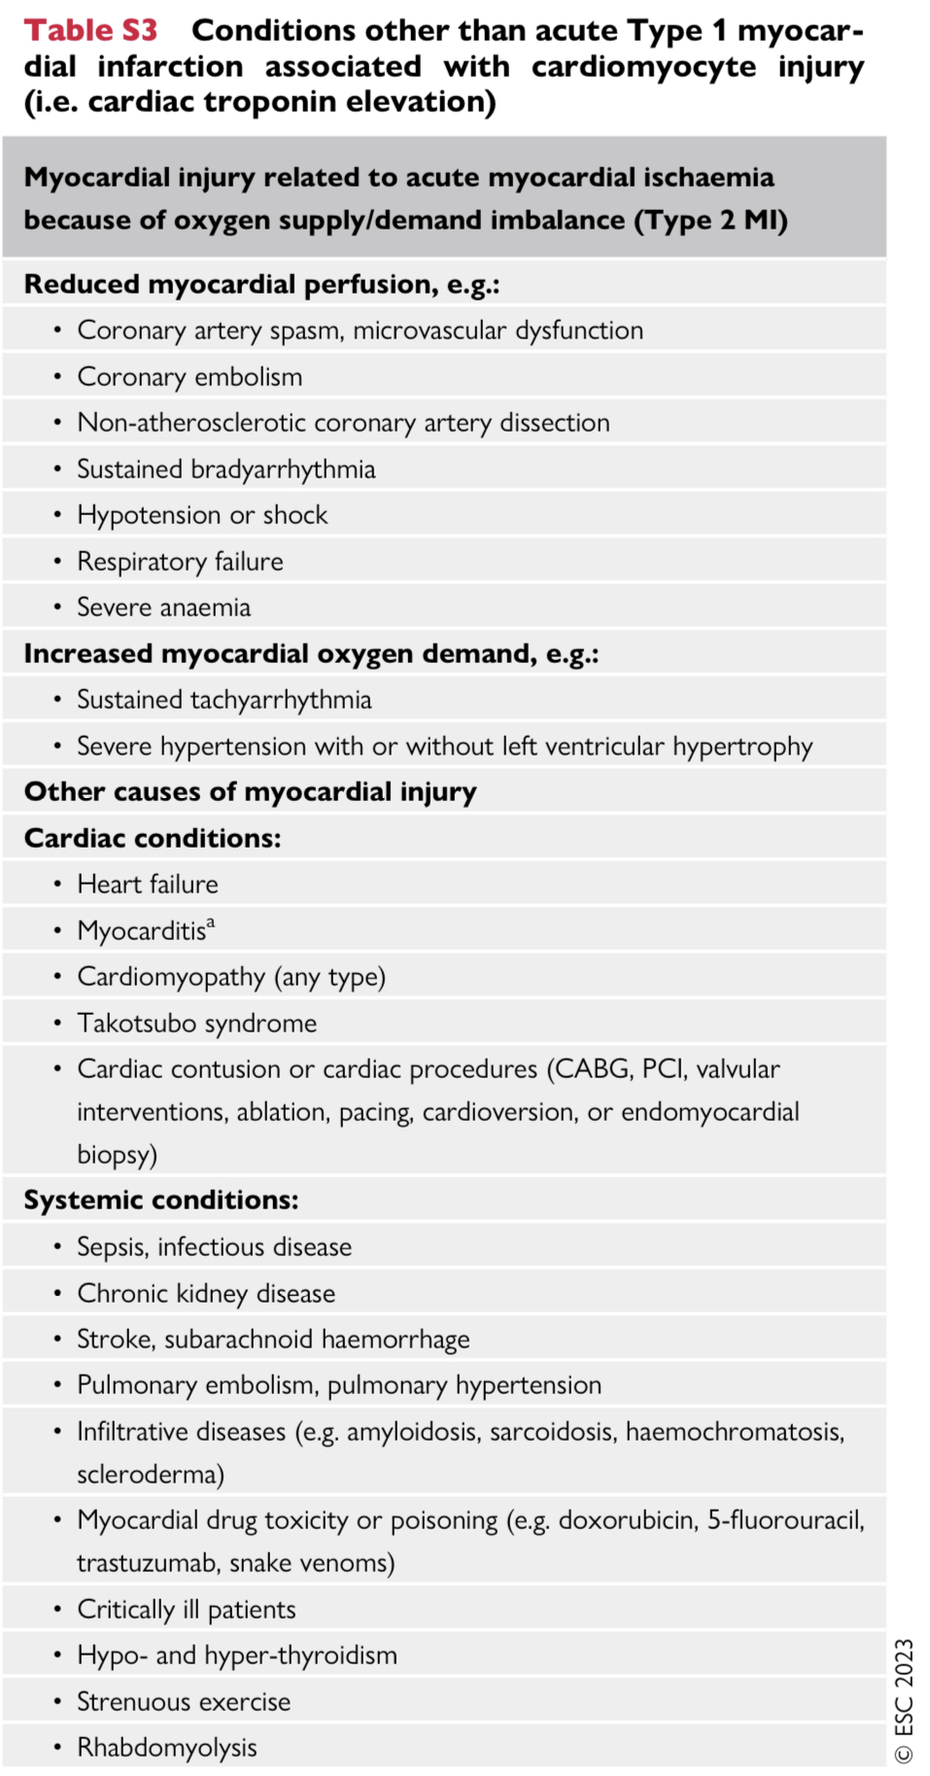
Conditions other than acute Type 1 myocardial infarction associated with cardiomyocyte injury

Slide 14
Fourth universal definition of MI

Slide 15
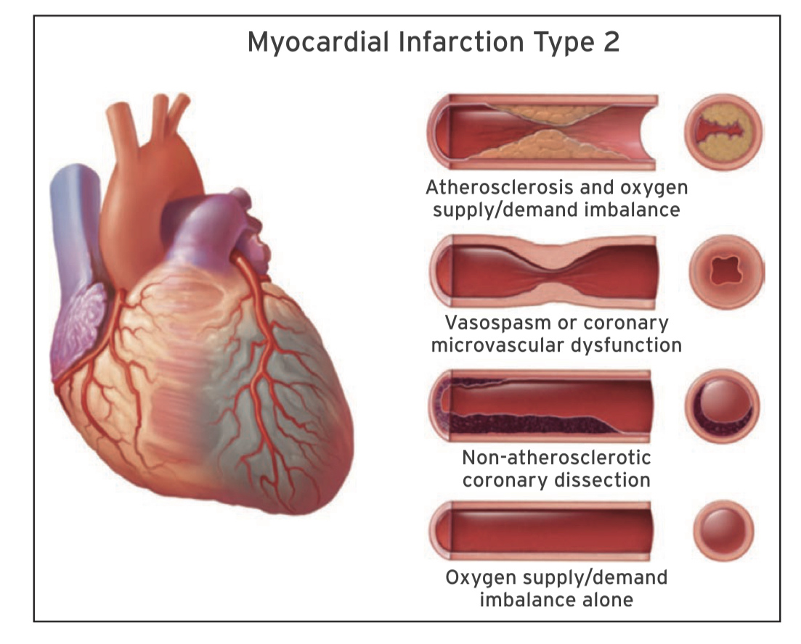

Slide 16
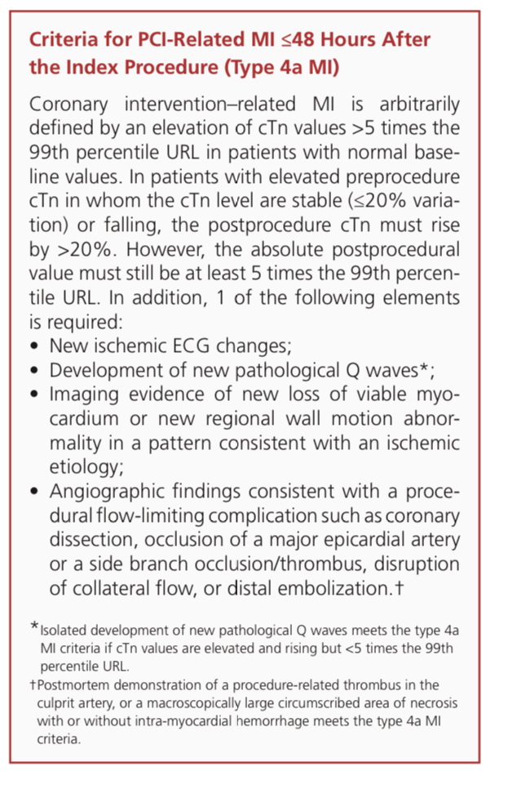
What is type 4 B ?

Slide 18
Conditions other than acute Type 1 MI associated with cardiomyocyte injury

Slide 19
Confounders of cardiac troponin concentration
four clinical variables —> affect hs-cTn concentrations
age (concentrations in healthy very young vs.‘healthy’ very old individuals differ by up to 300%)
renal dysfunction (differences between otherwise healthy patients with very high vs.very low eGFR of up to 300%)
time from chest pain onset (>300%)
sex(≈40%)
Despite the potential baseline differences in hs-cTn values based on these four variables, absolute changes in hs-cTn levels are still of diagnostic and prognostic value.

Slide 20
Rapid ‘rule-in’ and ‘rule-out’ algorithms

Slide 21
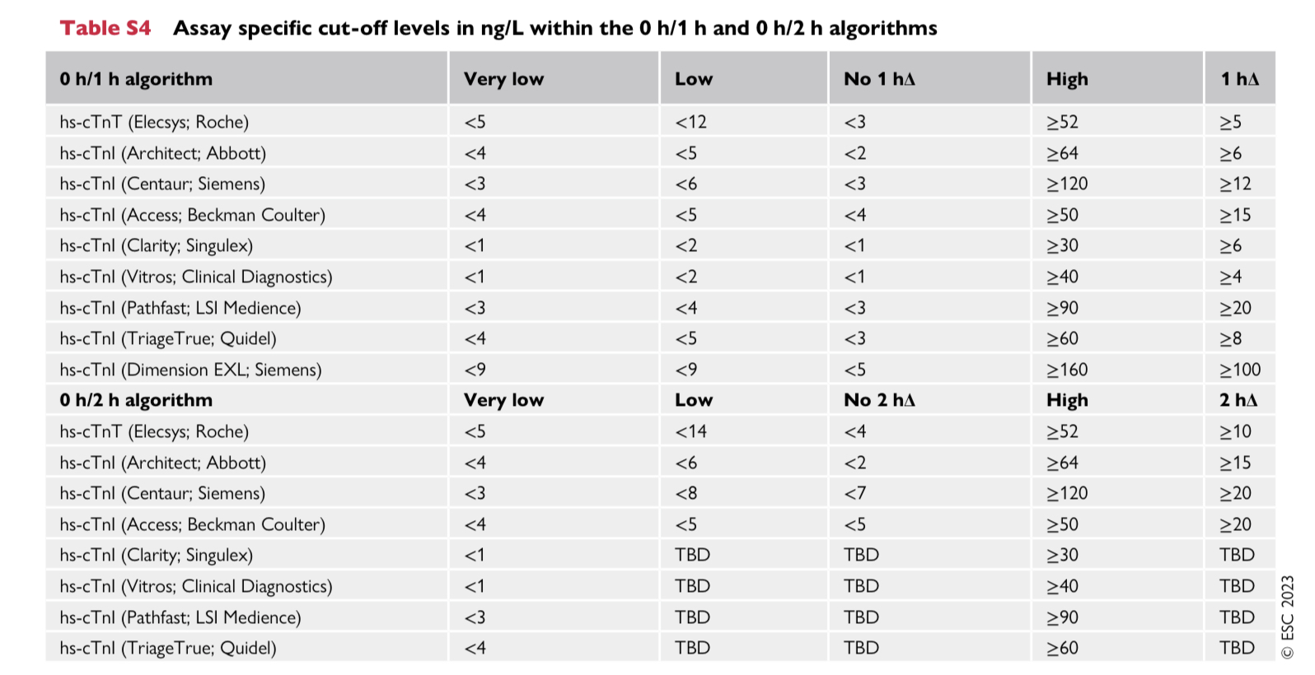
NSTEMI can be ruled out at presentation —> 0 h hs-cTn concentration is very low and the chest pain onset was >3 h prior to the 0 h hs-cTn measurement.
NSTEMI can also be ruled out by the combination of low baseline levels of hs-cTn and the lack of a relevant increase within 1 h
high likelihood for NSTEMI if the hs-cTn concentration at presentation is at least moderately elevated or shows a clear rise within the first hour (1 hΔ)
Cut-offs are assay-specific
only CKMB, myosin-binding protein C, and copeptin may have clinical relevance — when used in combination with (standard) cTn T/I —> not recommended

Slide 22
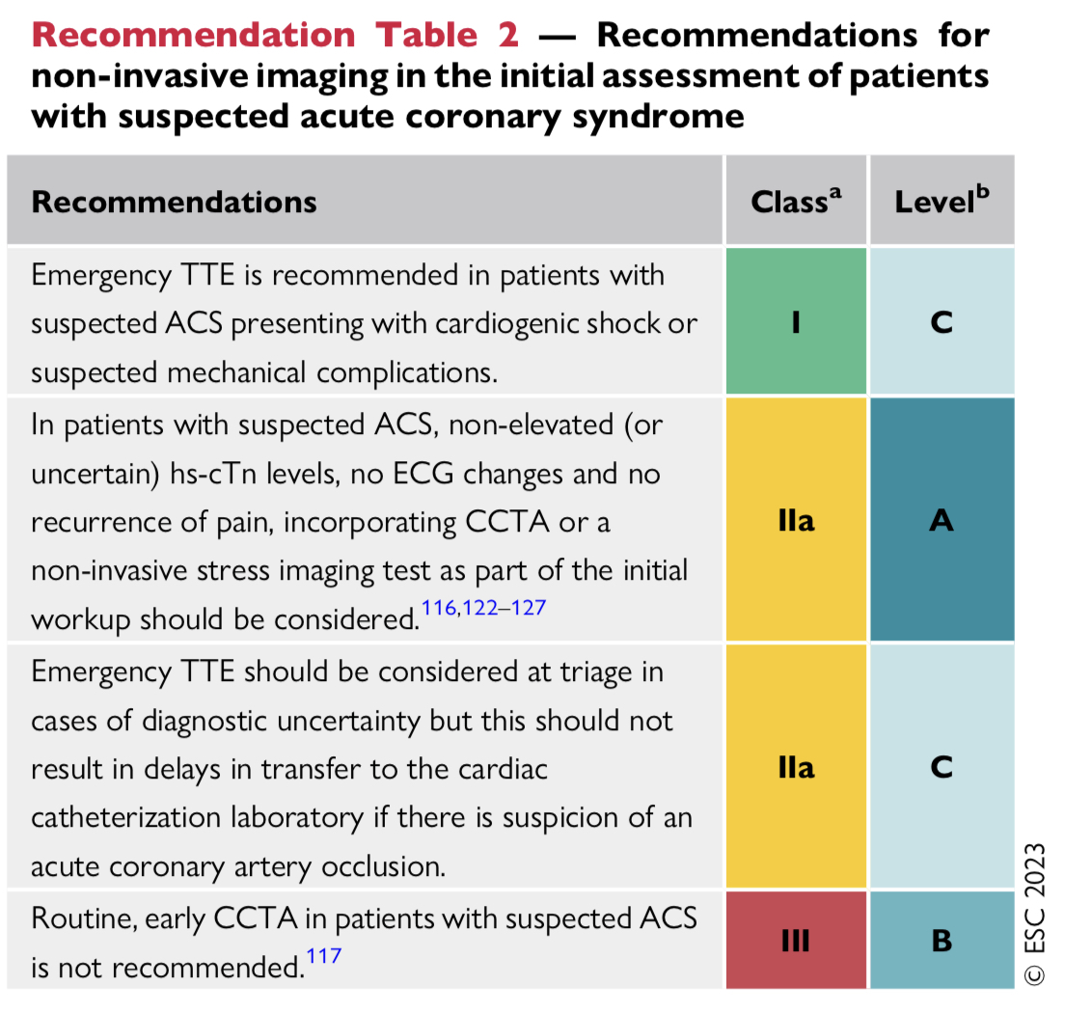
2. Diagnostic tools- non invasive imaging
BEACON (Better Evaluation of Acute Chest Pain with Coronary Computed Tomography Angiography) study —no reduction of in hospital duration of stay or hospital admission in the CCTA arm compared with patients investigated with hs-cTn
ROMICAT II (Rule Out Myocardial Ischemia/Infarction by Computer Assisted Tomography)
RAPID-CTCA (Rapid Assessment of Potential Ischaemic Heart Disease with CTCA) – did not improve clinical outcome at 1 year and was associated with modest increase in duration and cost of hospital stay
TTE
CCTA
Cardiac MRI
CARMENTA (CARdiovascular Magnetic rEsoNance imaging and computed Tomography Angiography) trial compared a CMR or CCTA -first strategy with a control strategy of routine clinical care in 207 patients with acute chest pain, elevated hs-cTn T levels (>14 ng/L), and an inconclusive ECG
CMR and CCTA-first strategies reduced ICA compared with routine clinical care (87% [P = 0.001], 66% [P < 0.001], and 100%, respectively), with no differences in major adverse cardiac events (MACE) at 1 year.
implementing CMR or CCTA first in the diagnostic process for patients with NSTEMI safely reduces the need for ICA and is diagnostically useful for identifying alternative diagnoses as compared with management guided by invasive angiography.

Slide 23
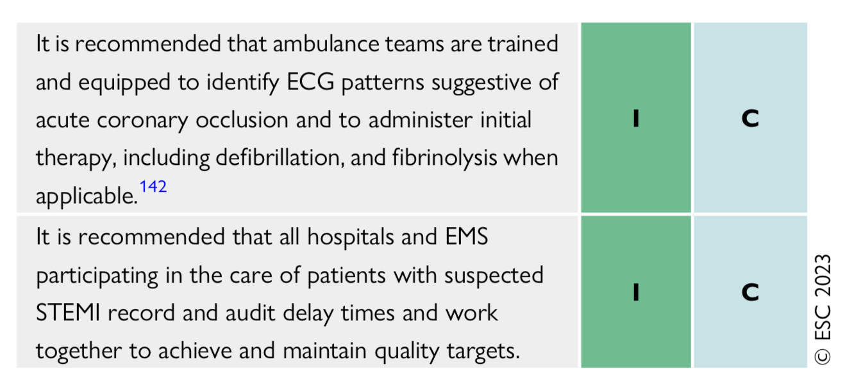
3.Acute-phase management of patients with ACS
Acute pharmacotherapy

Slide 24
2. Reperfusion strategy
STEMI —> triaged for immediate reperfusion therapy
(PPCI strategy or fibrinolysis if PPCI is not possible within 120 min of diagnosis)
NSTE-ACS —>
inpatient invasive strategy is recommended
immediate invasive strategy is recommended when any very high-risk feature is present
early (i.e. within 24 h) invasive strategy should be considered when any high-risk features are present

Slide 25
1. STEMI patients

Slide 26
Primary PCI strategy for STEMI
PPCI strategy (immediate angiography and PCI as needed) -preferred reperfusion strategy, provided it can be performed in a timely manner (within 120 min of the ECG-based diagnosis)
RCTs have shown that if the delay to treatment is similar, PPCI is superior to fibrinolysis in reducing mortality, non-fatal reinfarction, and stroke.
Where PPCI is not an immediate option and fibrinolysis should be initiated as part of a pharmaco-invasive strategy, provided the patient has presented within 12 h of symptom onset
lack of data —> the treatment delay limit at which the advantage of PCI over fibrinolysis is lost

Slide 27
For simplicity, an absolute time of 120 min from STEMI diagnosis to PCI-mediated reperfusion (i.e. wire crossing of the IRA)
For patients who undergo fibrinolysis, rescue PCI is indicated
fibrinolysis fails (ST-segment resolution <50% within 60–90 min of fibrinolytic administration)
presence of haemodynamic or electrical instability, worsening ischaemia, or persistent chest pain.
Patients with successful fibrinolysis should undergo early invasive angiography (i.e. within 2–24 h from the time of the lytic bolus injection)
→transfer to a PCI centre without waiting for signs of reperfusion.
For patients presenting after 12 h from symptom onset, a PPCI strategy is preferred over fibrinolysis in all cases

Slide 28
Emergency CABG — should be considered
patients with a patent IRA but with unsuitable anatomy for PCI
large myocardial area at jeopardy
Cardiogenic shock
MI-related mechanical complications —>CABG is recommended at the time of surgical repair
failed PCI or with an acute coronary occlusion not amenable to PCI, emergency CABG is infrequently performed because the benefits of surgical revascularization in this setting are less certain
Because there will be a delay to reperfusion with CABG , the probability of myocardial salvage to a degree sufficient to impact on prognosis is considered low + the surgical risks of CABG in this setting ll be elevated.

Slide 29
STEMI late presenters ??
routine immediate angiography and PCI (if indicated) are clearly associated with clinical benefit in patients presenting within 12 h of symptom onset
the value of a routine PPCI strategy in STEMI patients presenting later than 12 h after symptom onset is less well established
A small RCT in 347 STEMI patients presenting 12–48 h after symptom onset and without persistent symptoms reported that a routine PPCI strategy improved myocardial salvage and long-term survival compared with conservative treatment
recent analysis of data from 3 nationwide observational studies from the FAST-MI (French Registry of Acute ST-elevation and non-ST-elevation Myocardial Infarction) programme showed a significant lower rate of all-cause death at 1 month (2.1% vs. 7.2%) and after a median follow-up of 58 months (30.4% vs. 78.7%) with an invasive strategy in comparison to conservative treatment

Slide 30
Occluded Artery Trial (OAT) —large (n = 2166) study —stable patients with persistent occlusion of the IRA 3–28 days after MI—> reported no clinical benefit from routine coronary intervention with medical management in comparison to medical management alone.
A meta-analysis of trials testing whether late recanalization of an occluded IRA is beneficial also showed no benefit of reperfusion
Therefore, routine PCI of an occluded IRA in STEMI patients presenting >48 h after onset of symptoms and without persistent symptoms is not indicated
managed in the same way as patients with chronic total occlusion according to management of chronic coronary syndromes(CCS)

Slide 31
Fibrinolysis
within 12 h of symptom onset when PPCI cannot be performed in a timely manner prevents 30 early deaths per 1000 patients treated within 6 h of symptom onset
A fibrin-specific agent ( tenecteplase, alteplase, or reteplase) is the preferred agent
goal —> to start fibrinolytic therapy within 10 min of the STEMI diagnosis
STREAM (Strategic Reperfusion Early After Myocardial Infarction) trial demonstrated that pre-hospital fibrinolysis followed by an early PCI strategy was associated with a similar outcome to transfer for PPCI in STEMI patients presenting within 3 h of symptom onset who could not undergo PPCI within 1 h of FMC
—slight excess of intracranial bleeding was observed with the investigational strategy
—excess in intracranial bleeding was blunted by halving the dose of tenecteplase in patients >75 years of age.

Slide 36
2. NSTE-ACS patients

Slide 37
Very high risk criteria : any 1 of the following
Haemodynamic instability or CS
Recurrent or ongoing chest pain refractory to medical treatment
Acute HF presumed secondary to ongoing myocardial ischaemia
Life-threatening arrhythmias or cardiac arrest after presentation
Mechanical complications
Recurrent dynamic ECG changes suggestive of ischaemia (particularly with intermittent ST-segment elevation).

Slide 38
high risk criteria : any 1 of the following
A confirmed diagnosis of NSTEMI based on current recommended ESC hs-cTn algorithms
Dynamic ST-segment or T wave changes
Transient ST-segment elevation
A GRACE risk score >140

Slide 39
In several trials, subgroup analysis of patients with GRACE risk score >140 showed that they benefitted from an early invasive strategy as opposed to those with a GRACE risk score <140
TIMACS [Timing of Intervention in Acute Coronary Syndromes] trial
VERDICT [Very EaRly vs. Deferred Invasive evaluation using Computerized Tomography]
GRACE risk score may overestimate risk in ethnic minorities with NSTEMI

Slide 40
meta-analysis.-Largest to date (17 RCTs >10 000 patients) ——all-comers with NSTE-ACS—> early ICA only significantly reduced the risk of recurrent ischaemia and duration of stay, with no significant reductions in all-cause mortality, MI, admission for HF, or repeat revascularization
main limitation of the meta-analyses —variability of the time to invasive angiography in individual trials , the diagnosis of NSTEMI - not based on current ESC hs-cTn algorithms , GRACE score to guide timing not used

Slide 42
Patients not undergoing reperfusion
Patients who are not candidates for invasive coronary angiography
—>Advanced age, female sex, CKD , diabetes mellitus, prior HF/revascularization, history of cancer, and frailty
Patients with CAD not amenable to revascularization
—>frequently female, elderly, and/or suffering from severe CKD, have multivessel CAD, and a history of prior MI/revascularization
The decision not to perform revascularization – only in selected patients—> risk of revascularization outweighs the benefit for clinical or anatomical reasons.
aggressive secondary prevention treatment with potent antiplatelet therapy and anti-anginal agents

Slide 43
Anti thrombotic therapy

Slide 44
Anti thrombotic therapy

Slide 47
1. Anti platelet therapy in the acute phase

Slide 48
1. Oral anti platelet therapy
PLATO (PLATelet inhibition and patient Outcomes) –PHASE III
TRITON-TIMI 38 (TRial to Assess Improvement in Therapeutic Outcomes by Optimizing Platelet InhibitioN with Prasugrel Thrombolysis In Myocardial Infarction 38 )
DAPT including aspirin and a potent P2Y12 receptor inhibitor (prasugrel or ticagrelor) is recommended as the default DAPT strategy for ACS patients
Clopidogrel - characterized by less effective and more variable platelet inhibition, should only be used when prasugrel or ticagrelor are contraindicated/not avail- able, or in some patients — HBR
clopidogrel may be considered in older patients (e.g. ≥70 years)

Slide 49
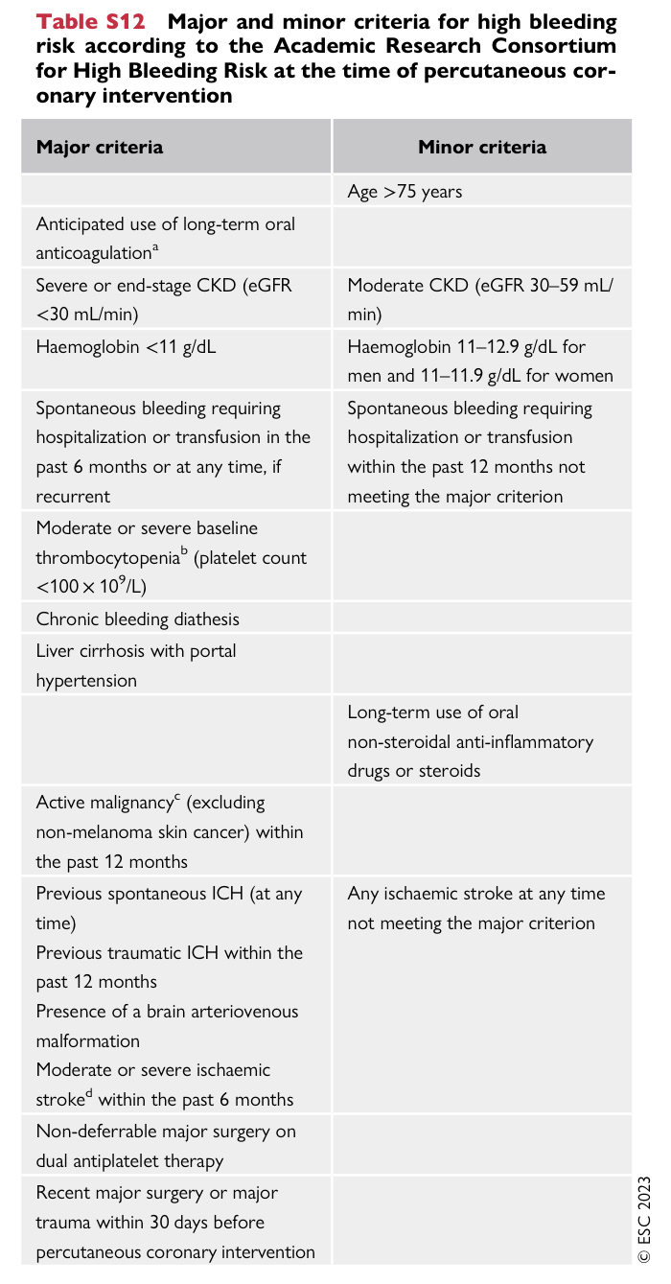
The choice of antiplatelet regimen should take the bleeding risk into account
The presence of one major or two minor ARC-HBR risk factors indicates high bleeding risk (HBR)

Slide 50
PRASUGREL VS TICAGRELOR ?
ISAR-REACT 5 ( Intracoronary Stenting and Antithrombotic Regimen Rapid Early Action for Coronary Treatment )
largest head-to-head comparison of 1-year DAPT with prasugrel vs. DAPT with ticagrelor in patients with ACS planned for invasive evaluation……… >80% underwent PCI
treatment strategy with prasugrel vs. ticagrelor significantly reduced the composite endpoint of death, MI, or stroke (6.9% vs. 9.3%, P = 0.006) without any increase in bleeding complications (4.8% vs. 5.4%, P = 0.46)
Limitations - open-label design and limited data on medically managed or CABG-treated patients.
Prasugrel should be considered in preference to ticagrelor for ACS patients who proceed to PCI.

Slide 51
WHEN TO LOAD IN STEMI SUSPECTS ? ( PRE TREATMENT)
ATLANTIC trial (Administration of Ticagrelor in the Cath Lab or in the Ambulance for New ST Elevation Myocardial Infarction to Open the Coronary Artery)
only randomized study— testing the safety and efficacy of different timings of P2Y12 receptor inhibitor initiation in patients with STEMI undergoing PPCI
Patients- randomized to receive a ticagrelor LD either during transfer to a PPCI centre or immediately before angiography
Median difference between the timing of P2Y12 receptor inhibitor loading with the two treatment strategies was 31 min
Pre-treatment strategy failed to meet the prespecified primary end point ( improved STR or TIMI flow before intervention )
Rates of major and minor bleeding events were identical in both treatment arms
Results – supported by SWEDEHEART (Swedish Web-System for Enhancement and Development of Evidence-Based Care in Heart Disease Evaluated According to Recommended Therapies) registry in STEMI patients
Prasugrel pre-treatment has not been directly investigated in patients with STEMI

Slide 52
Pre treatment in NSTEACS
ACCOAST trial (A Comparison of Prasugrel at the Time of PCI or as Pretreatment at the Time of Diagnosis in Patients with NSTEMI)
prasugrel pre-treatment
lack of benefit w.r.t ischaemic outcomes
substantially higher bleeding risk.
ISAR-REACT 5 trial – Prasugrel > ticagrelor
DUBIUS trial (Downstream Versus Upstream Strategy for the Administration of P2Y12 Receptor Blockers)
stopped early for futility — no difference between upstream vs. downstream oral P2Y12 administration in patients with NSTE-ACS (both NSTEMI and UA) scheduled for CAG within 72 h of hospital admission

Slide 53
2.Intravenous antiplatelet drugs
GP IIb/IIIa inhibitors (eptifibatide and tirofiban) –
Most of the trials evaluating GP IIb/IIIa inhibitors in PCI-treated ACS patients pre-date the era of routine DAPT
no strong evidence for any additional benefit with the routine use of GP IIb/IIIa inhibitors in ACS patients scheduled for CAG
use should be considered for bailout if there is evidence of no-reflow or a thrombotic complication during PCI
in the setting of high-risk PCI not pre-treated with P2Y12 receptor inhibitors

Slide 54
2. CANGRELOR –
CHAMPION PCI (Cangrelor versus Standard Therapy to Achieve Optimal Management of Platelet Inhibition) - before PCI
CHAMPION PLATFORM and CHAMPION PHOENIX (A Clinical Trial Comparing Cangrelor to Clopidogrel Standard Therapy in Subjects Who Require Percutaneous Coronary Intervention) - after PCI
meta-analysis of these trials—> benefit of cangrelor w.r.t major ischaemic endpoints was counterbalanced by an increase in minor bleeding complications
benefit of cangrelor with respect to ischaemic endpoints was attenuated in CHAMPION PCI with upfront administration of clopidogrel
data for use in conjunction with ticagrelor or prasugrel — limited
proven efficacy in preventing intra-procedural and post-procedural stent thrombosis in P2Y12 receptor inhibitor-naïve patients—>cangrelor may be considered on a case-by-case basis (not feasible to give oral drugs in the setting of emergent PCI—> CS /on MV

Slide 55
Summary of pre treatment strategy

Slide 56
2. Anti coagulant therapy in the acute phase

Slide 58
1. Anticoagulation in patients with STEMI undergoing PPCI
parenteral anticoagulation is recommended for patients with STEMI undergoing PPCI
UFH is the default choice of anticoagulant at present
ALTERNATIVES TO UFH
LMWH -ATOLL (STEMI Treated With Primary Angioplasty and Intravenous Lovenox or Unfractionated Heparin) trial —>reported a reduction in the primary endpoint at 30 days (incidence of death, complication of MI, procedure failure, or major bleeding) with enoxaparin in comparison to UFH in patients with STEMI undergoing PPCI
BIVALIRUDIN-

Slide 59
BIVALIRUDIN —BRIGHT-4 (BivaliRudin with prolonged full-dose Infusion durinG primary PCI versus Heparin Trial 4 )
6016 patients with STEMI undergoing PPCI were randomized to either bivalirudin (with a full dose post-PCI infusion) or UFH
primary endpoint (a composite of all-cause mortality or Bleeding Academic Research Consortium [BARC] type 3–5 bleeding at 30 days), the individual components of the primary endpoint, and definite or probable stent thrombosis were all significantly reduced in the bivalirudin group
Bivalirudin is the recommended alternative to UFH in patients presenting with ACS who have a history of heparin-induced thrombocytopaenia

Slide 60
Based on OASIS-6 (The Safety and Efficacy of Fondaparinux Versus Control Therapy in Patients With ST Segment Elevation Acute Myocardial Infarction) trial→ fondaparinux is not recommended in patients with STEMI undergoing PPCI

Slide 61
1. Anticoagulation in patients with NSTEACS
parenteral anticoagulation is recommended for patients with NSTEACS
For patients with NSTE-ACS undergoing immediate or early angiography —>UFH is recommended / enoxaparin should be considered as an alternative to UFH
For patients with NSTE-ACS who are not anticipated to undergo early angiography—>fondaparinux (with a UFH bolus at time of PCI —> fonda a/w high risk of guiding catheter thrombus) is recommended in preference to enoxaparin (OASIS-5 TRIAL)
although enoxaparin should be considered if fondaparinux is not available.

Slide 62
2. Maintenance antithrombotic therapy after revascularization

Slide 64
Shortened DAPT therapy
TWILIGHT (Ticagrelor With Aspirin or Alone in High-Risk Patients After Coronary Intervention) trial
examined the effect of ticagrelor monotherapy vs. ticagrelor plus aspirin for 1 year after 3 months of DAPT (ticagrelor and aspirin) on clinically relevant bleeding
study enrolled ‘high-risk’ patients = at least one clinical feature and one angiographic feature associated with a high risk of ischaemic or bleeding events.
Bleeding events (BARC type 2, 3, or 5 bleeding) were significantly reduced by omitting aspirin after 3 months + without an increased ischaemic risk
TICO (Ticagrelor Monotherapy After 3 Months in the Patients Treated With New Generation Sirolimus Stent for Acute Coronary Syndrome) trial, ticagrelor monotherapy vs. ticagrelor plus aspirin for up to 1 year after 3 months of DAPT (ticagrelor and aspirin)
Net adverse clinical events and major bleeding events were significantly reduced with ticagrelor monotherapy

Slide 65
STOPDAPT-2-ACS (ShorT and OPtimal Duration of Dual AntiPlatelet Therapy-2 Study for the Patients With ACS) trial
At 1–2 months —>patients were randomized to either clopidogrel monotherapy or continued DAPT for 12 months
Negative trial —> very short duration DAPT (i.e. <3 months) followed by clopidogrel monotherapy is not a useful strategy in ACS patients
MASTER DAPT (Management of High Bleeding Risk Patients Post Bioresorbable Polymer Coated Stent Implantation With an Abbreviated Versus Prolonged DAPT Regimen) trial -2021
strategy of abbreviated DAPT (1 month) followed by either aspirin or P2Y12 inhibitor monotherapy vs. DAPT ≥3 months (standard therapy) in a cohort of 4579 HBR patients undergoing PCI
Net adverse clinical events and major adverse cardiac or cerebral events were comparable between the groups, whereas bleeding events were significantly reduced in the abbreviated therapy group.

Slide 66
De-escalation from potent P2Y12 inhibitor to clopidogrel
TROPICAL-ACS (Testing Responsiveness to Platelet Inhibition on Chronic Antiplatelet Treatment For Acute Coronary Syndromes) trial
DAPT de-escalation from prasugrel to clopidogrel (at 2 weeks after ACS) was guided by platelet function testing and was non-inferior to standard treatment with prasugrel at 1 year after PCI in terms of net clinical benefit
POPular Genetics trial (Cost-effectiveness of CYP2C19 Genotype Guided Treatment With Antiplatelet Drugs in Patients With ST-segment-elevation Myocardial Infarction Undergoing Immediate PCI With Stent Implantation: Optimization of Treatment)
DAPT de-escalation from ticagrelor/prasugrel to clopidogrel guided by CYP2C19 genotyping in ACS patients undergoing PPCI within the previous 48 h was non-inferior to standard treatment with ticagrelor or prasugrel at 12 months with respect to thrombotic events and resulted in a lower incidence of bleeding.
need to switch is not uncommon —>consequence of bleeding complications , non-bleeding side effects (e.g. dyspnoea on ticagrelor, allergic reactions) and socioeconomic factors
de-escalation strategy is not recommended in the first 30 days after the index ACS event

Slide 67
TOPIC (Timing of Platelet Inhibition After Acute Coronary Syndrome) trial —>single centre trial used an unguided de-escalation approach from ticagrelor/prasugrel to clopidogrel after 1 month of DAPT with ticagrelor/prasugrel and aspirin
Net adverse clinical events and bleeding events were reduced, whereas the rate of ischaemic endpoints was unchanged
TALOS-AMI (TicAgrelor versus CLOpidogrel in Stabilised Patients with Acute Myocardial Infarction) trial investigated unguided de-escalation from ticagrelor to clopidogrel after 1 month of DAPT with ticagrelor and aspirin.
significant 12-month reductions in net adverse clinical events and bleeding events
HOST-REDUCE-POLYTECH-ACS (Harmonizing Optimal Strategy for Treatment of Coronary Artery Diseases Trial—Comparison of REDUCTION of PrasugrEl Dose & POLYmer TECHnology in ACS Patients) trial
tested a different method of de-escalation—a reduction in prasugrel dose rather than switching to clopidogrel
2338 low-risk ACS patients <75 years of age were randomized to low-dose prasugrel (5 mg daily) or standard-dose prasugrel (10 mg daily) after 1 month of DAPT with standard-dose prasugrel
Reduced bleeding events + no increase in ischaemic events

Slide 70
3. Long term treatment

Slide 72
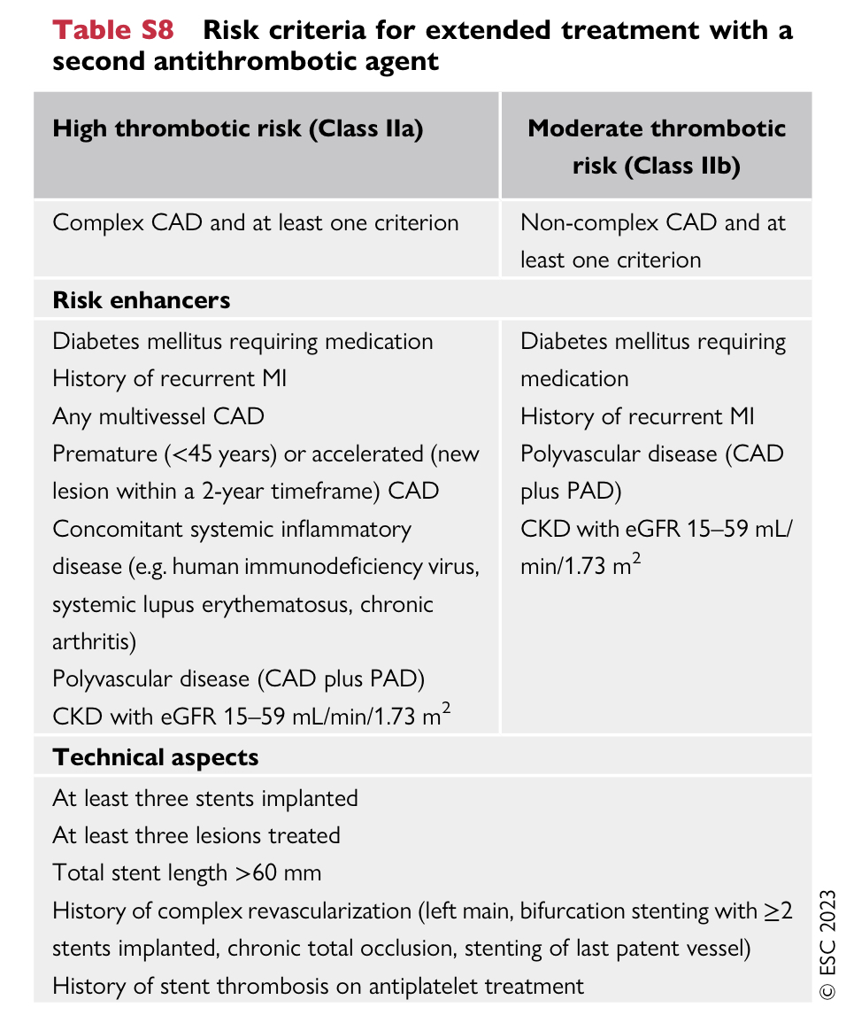

Slide 73
APPRAISE-2 (Apixaban for Prevention of Acute Ischemic Events 2) trial –
patients with recent ACS and at least two additional risk factors for recurrent ischaemic events
apixaban at a dose of 5 mg b.i.d. (mostly in combination with DAPT) was not associated with a lower risk of CV death, MI, or ischaemic stroke but was associated with a more than two-fold increase in major bleeding risk.

Slide 74
ACS with AF ??

Slide 77
Q1. GRACE RISK SCORE includes all except :
Age
Sex
HR
SBP
Creatinine

Slide 78
Q2. Trials on use of CCTA in the initial assessment of ACS are all except
BEACON
ROMICAT II
RAPID CTCA
CARMENTA
NONE

Slide 79
Q3. All are absolute CI to lysis except :
Central nervous system damage or neoplasms, or arteriovenous malformation
Recent major trauma/surgery/head injury (within the preceding month)
Gastrointestinal bleeding within the past month
Acid peptic ulcer

Slide 80
Q4. All are “ very high risk “ criteria for NSTEACS except :
Haemodynamic instability or CS
Recurrent or ongoing chest pain refractory to medical treatment
Acute HF presumed secondary to ongoing myocardial ischaemia
Life-threatening arrhythmias or cardiac arrest after presentation
GRACE risk score >140
GRACE risk score <140

Slide 81
Q5. Prasugrel preferred over ticagrelor for patients going for PCI – evidence based on which trial ?
ISAR-REACT 5
ACCOAST
ATLANTIC
DUBIUS

Slide 82
Q6.IDENTIFY GUIDED DE ESCALATION TRIALS :
TROPICAL- ACS
TALOS- AMI
TOPIC
POpular GENETICS

Slide 83
Q7.Cangrelor trials are all except :
CHAMPION AF
CHAMPION
CHAMPION PCI
CHAMPION PLATFORM
CHAMPION PHOENIX

