Slide 1
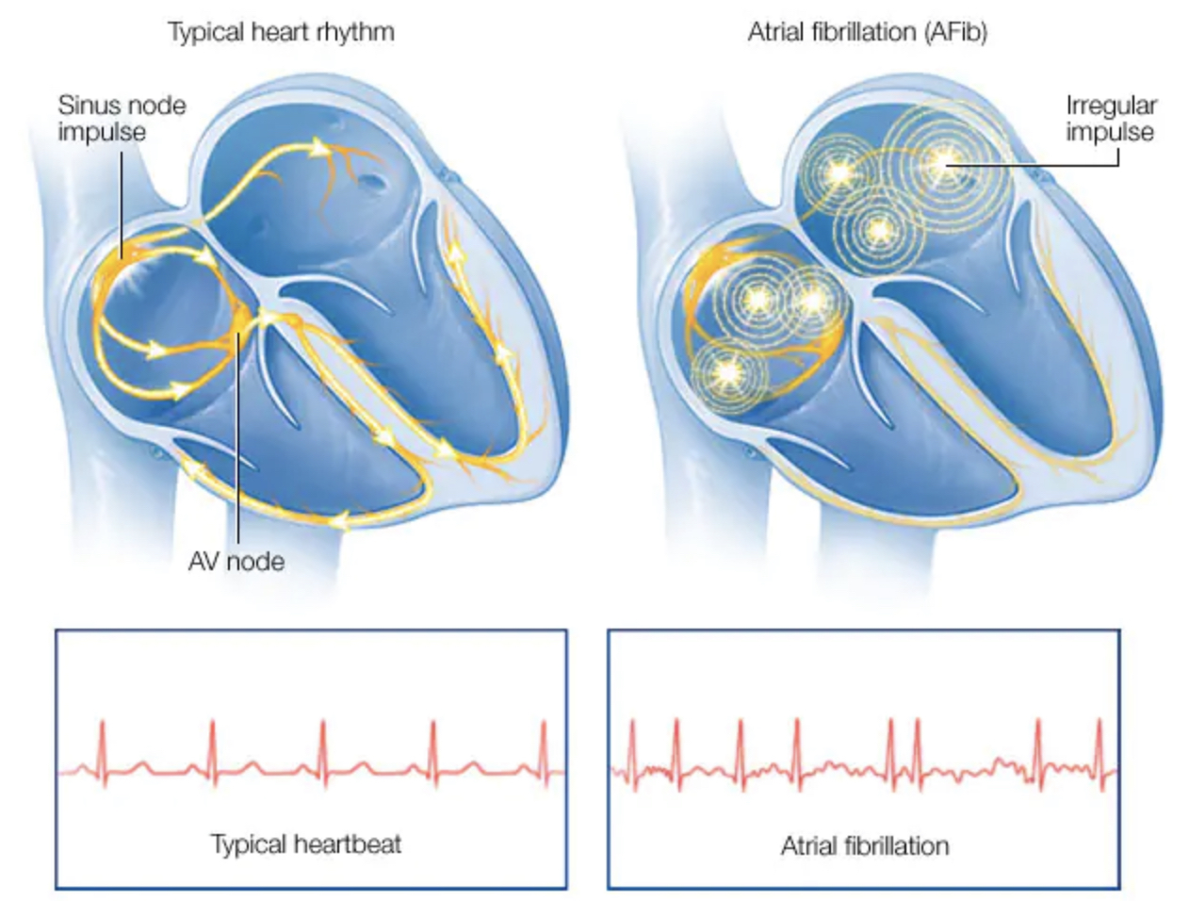
Management of AF – Evidence Review
Dr Sanchna Dev S

Slide 2
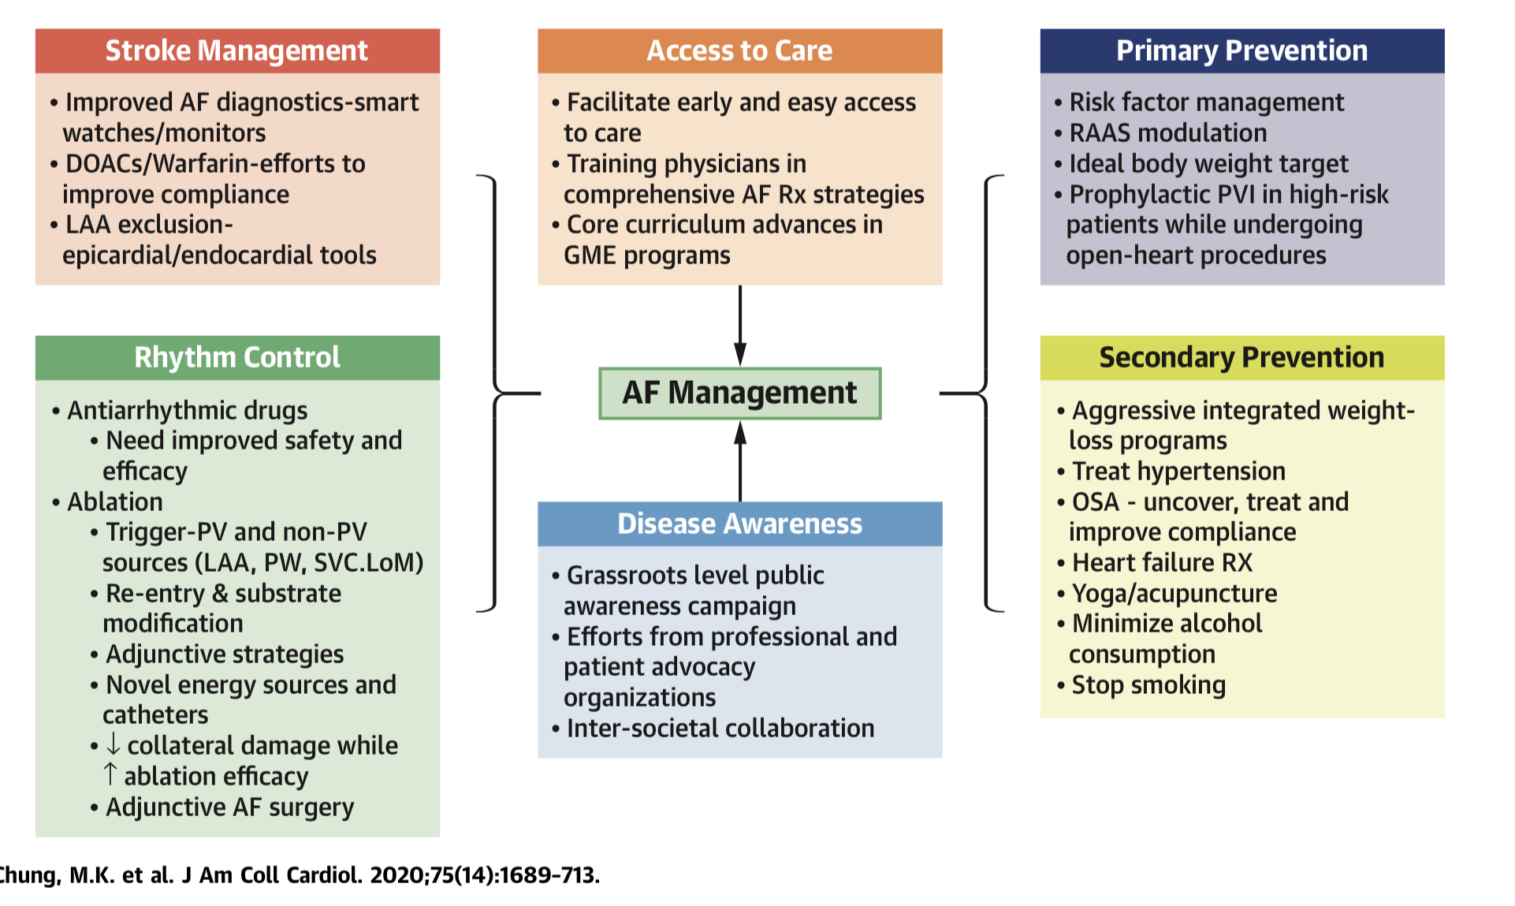

Slide 3
1. PRIMARY PREVENTION
Prediction models for assessing AF risk has been developed
CHADS2 >=2 and CHA2DS2-VASc >=3 …..independently associated with increased risk of subsequent new-onset AF in patients presenting with symptoms or signs suggestive of cardiac arrhythmia but no documented AF
Both scores are significant predictors of post-cardiac surgery AF
The most recent scoring system - CHARGE-AF (Cohorts for Heart and Aging Research in Genomic Epidemiology—Atrial Fibrillation) model -excellent discrimination, but overestimated the risk of AF
CHARGE-AF risk score appears superior to CHA2DS2-VASc in predicting risk of AF

Slide 4
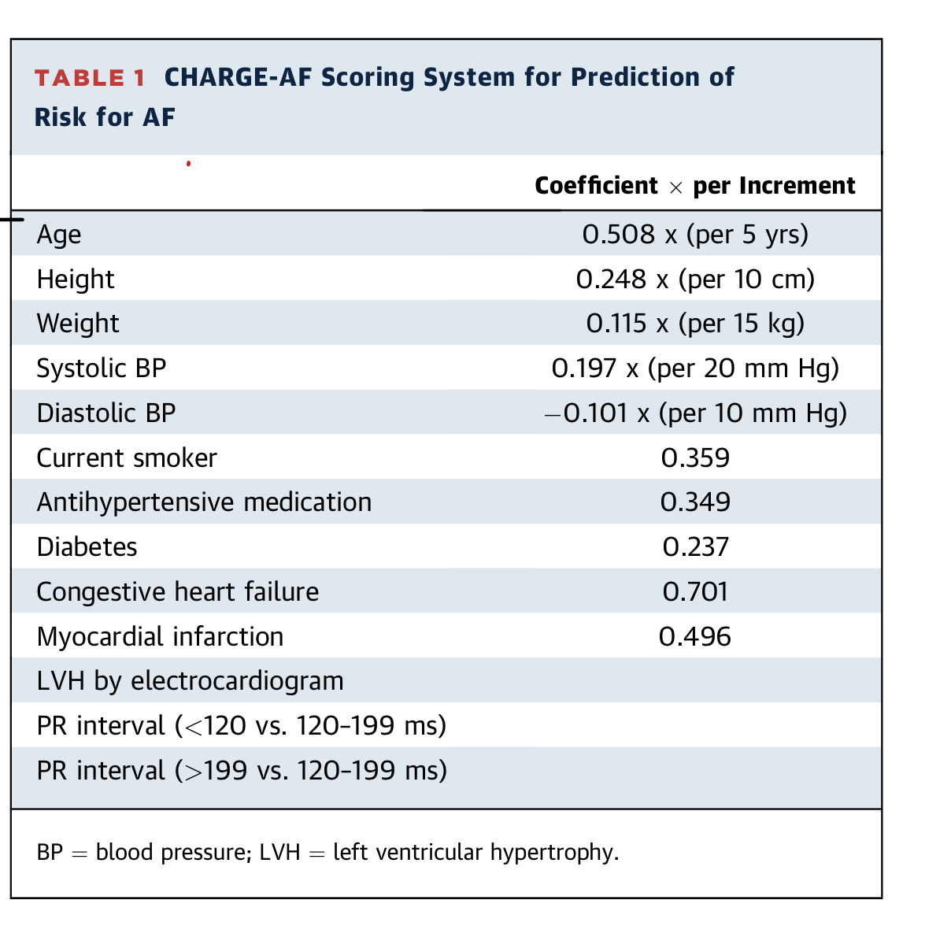

Slide 5
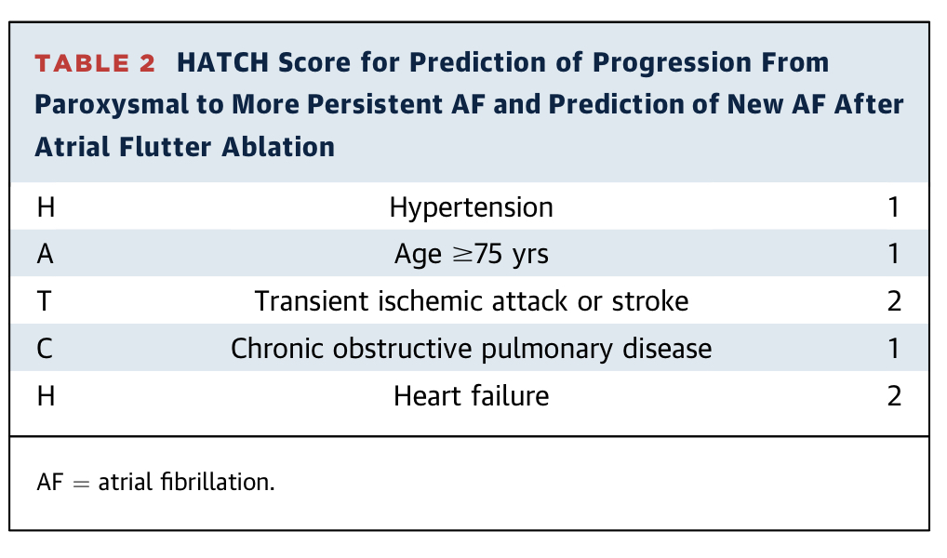
Other predictors of AF risk
  echocardiographic LA diameter
  tissue Doppler imaging–derived atrial conduction time
  MDCT estimation of periatrial epicardial adipose tissue - for new-onset AF in coronary artery disease patients
  frequent atrial ectopy (>76/day) or (>32 beats/h) —> >90% specificity for predicting AF at 15 years (Cardiovascular Health Study)
HATCH score- predicts progression from paroxysmal to persistent AF and also new- onset AF after atrial flutter ablation.
Late gadolinium enhancement MRI - used to triage AF patients prior to ablation
Extensive late gadolinium enhancement (>= 30% LA wall enhancement), indicates LA wall structural remodeling —> predicts high recurrence rates after catheter ablation

Slide 6
Transesophageal echocardiography (TEE) predictors of thromboembolism
LA thrombus (relative risk, 2.5),
Complex aortic plaques (relative risk, 2.1),
spontaneous echo contrast (relative risk, 3.7),
low LAA velocities (up to 20 cm/s; relative risk, 1.7)
LA size >40cm

Slide 7
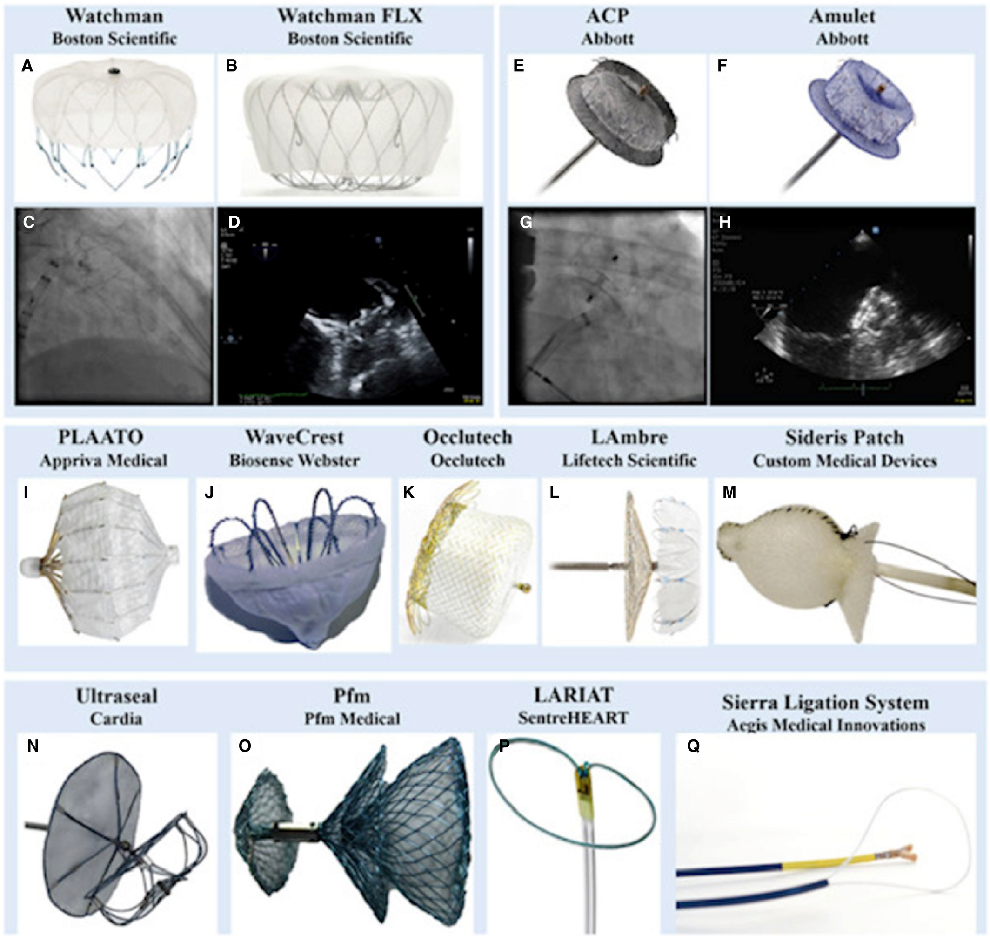
2. Prevention of Systemic Embolization
Prediction of thromboembolic risk from AF, coupled with prediction scores for bleeding risk from anticoagulation —> basis of anticoagulation strategies to reduce stroke risk in AF patients
LAA closure

Slide 8
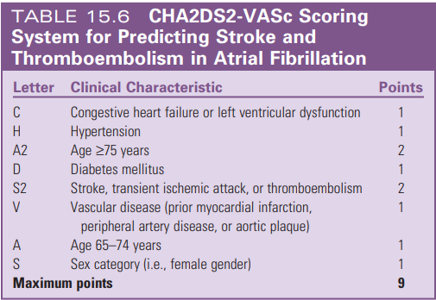
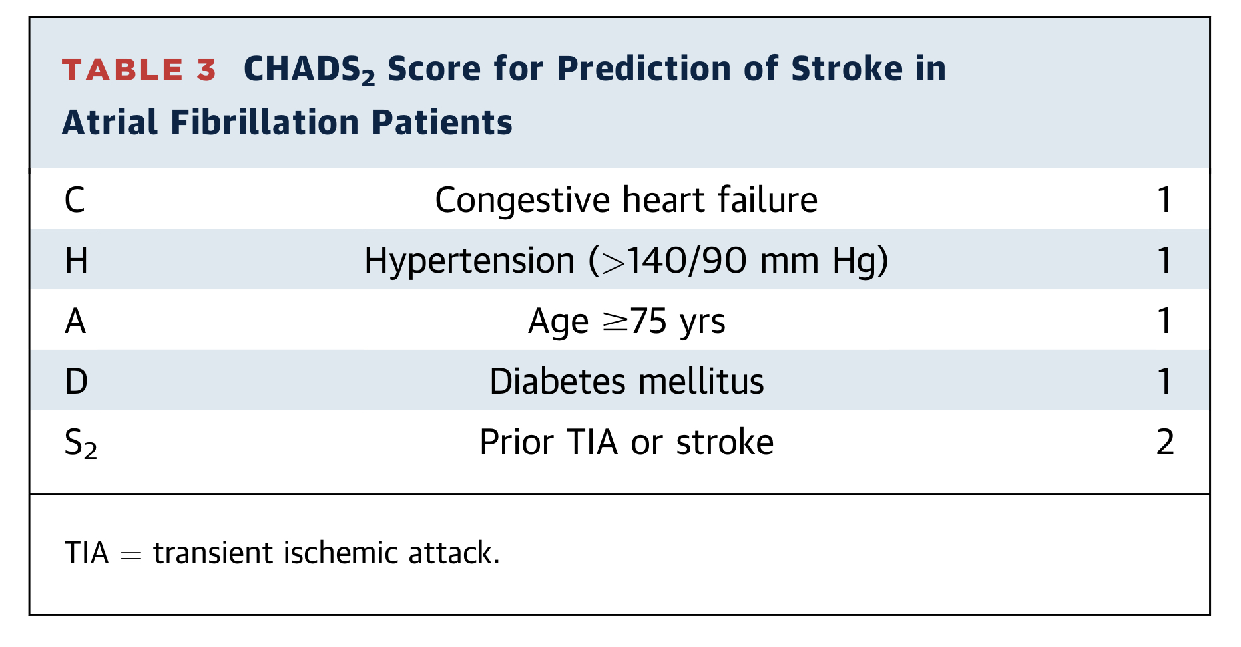
Stroke Risk Stratification
CHA2DS2-VASc score
-for nonvalvular AF
- high accuracy/ specificity for low or intermediate risk, but low specificity for high risk

Slide 9
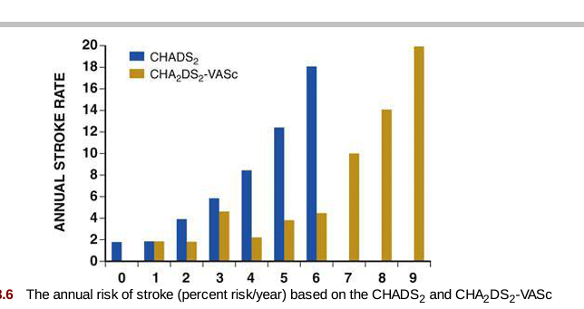
Stroke risk with chads2 score

Slide 10
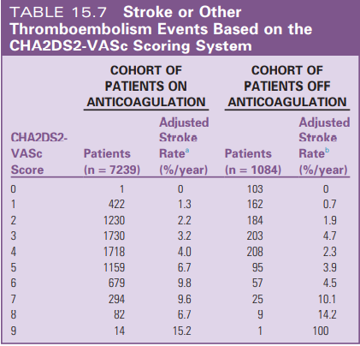

Slide 11
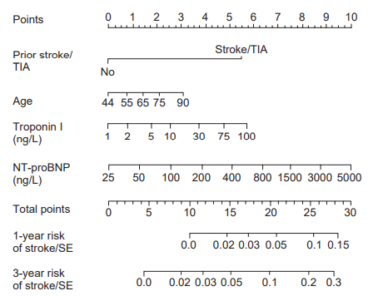
ABC risk Score – Age, Bio markers, Clinical history

Slide 12
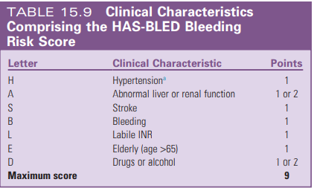
Bleeding Risk Stratification
44% of patients with AF have one or more absolute or relative contraindications for long-term oral anticoagulation therapy.
Low- 0 to 1
intermediate-2
high - 3 or above

Slide 13
Components of HASBLED
Hypertension - SBP >160 mm Hg.
Abnormal kidney function -presence of long-term dialysis or renal transplantation or serum creatinine concentration of at least 200 µmol/L.
Abnormal liver function
chronic hepatic disease (e.g., cirrhosis)
bilirubin->2X ULN
SGOT/PT/ALP-3X ULN
Bleeding -previous bleeding history or predisposition to bleeding, or both (e.g., bleeding diathesis, anemia).
Labile INRs refers to unstable or high INRs or poor time in therapeutic range .

Slide 14
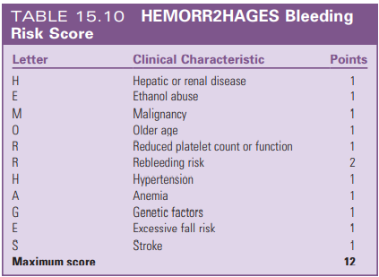
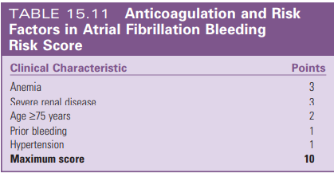

Slide 15
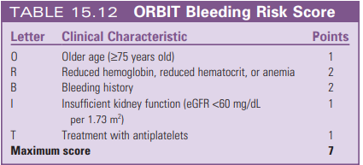

Slide 16
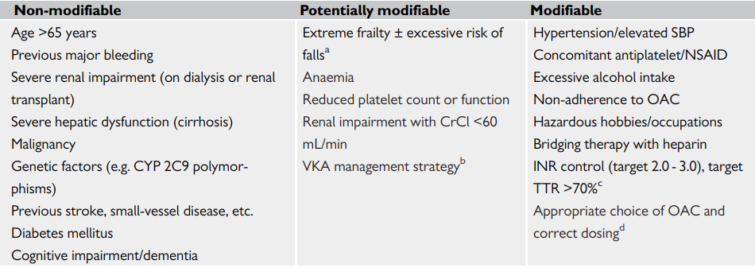
RISK FACTOR FOR BLEEDING

Slide 17
Principles of Bleeding Scores
Not a static phenomenon
Reversible
A high bleeding risk score is not a reason to withhold anticoagulation therapy.

Slide 18
Oral
Vitamin K Antagonists
Warfarin reduce stroke risk by approximately 64%, corresponding to an absolute annual strokes risk reduction of 2.7% as compared with placebo.
Warfarin increases the risk of major bleeding by approximately 70% compared with aspirin.
Combinations of warfarin + antiplatelet therapy - no incremental benefit in stroke risk reduction while they increase the risk of bleeding.

Slide 19
Bleeding risks of Warfarin
Bleeding risk for warfarin- 0.6% for fatal bleeding, 3.0% for major bleeding, and 9.6% for major or minor bleeding/year.
Risk of intracranial hemorrhage- 0.2% per year.
aspirin +warfarin -3X intracranial hemorrhage.
the risk of major bleeding in older patients (greater than 80 years)-2.5%.

Slide 20
Warfarin Limitations
a narrow therapeutic window
periodic INR monitoring
frequent dose adjustments
multiple drug and dietary interactions
genetic variability in response (accounting for 39% to 56% of the variability in the warfarin dose)
long half-life (36 to 42 hours)
slow onset of action.
< 50% of eligible patients were treated with warfarin
there is ongoing attrition of its use to approximately 40% by 4 years.

Slide 21
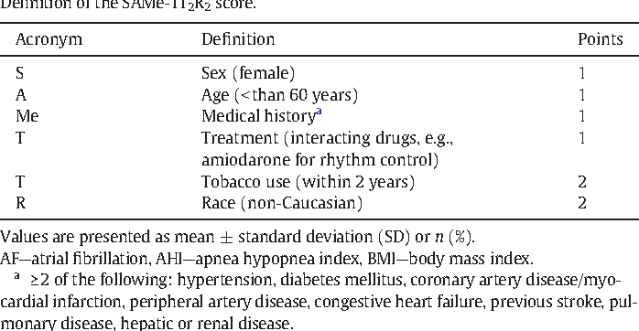
SAMe-TT2R2 scores
Which can help to identify patients who are less likely to achieve a good TTR on VKA therapy (score >2) and would do better with a NOAC.
If such patients with SAMeTT2R2>2 are prescribed a VKA, greater efforts to improve TTR, such as more intense regular reviews, education/counselling, and frequent INR monitoring are needed or, more conveniently, the use of a NOAC should be reconsidered.

Slide 22
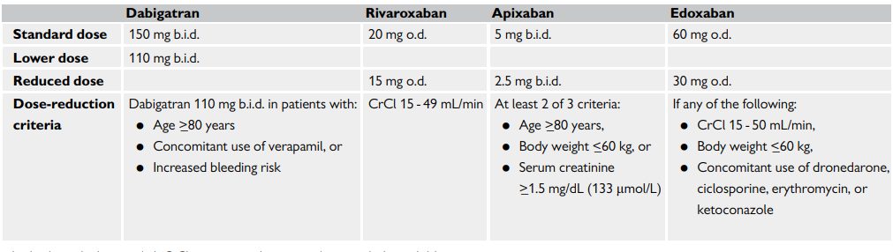
NOACS IN AF

Slide 23
Trials of noacs
RE-LY-Dabigatran (Randomized Evaluation of Long Term Anticoagulant Therapy),
ROCKET-AF (Rivaroxaban Once Daily Oral Direct Factor Xa Inhibition Compared with Vitamin K Antagonism for Prevention of Stroke and Embolism Trial in Atrial Fibrillation),
ARISTOTLE (Apixaban for Reduction in Stroke and Other Thromboembolic Events in Atrial Fibrillation)
ENGAGE AF TIMI 48-Edoxaban (Effective Anticoagulation with Factor Xa Next Generation in AF)

Slide 24
Absolute contraindications to oral anticoagulants
Active serious bleeding (where the source should be identified and treated)
Associated comorbidities (e.g. severe thrombocytopenia <50k , severe anaemia under investigation, etc.)
A recent high-risk bleeding event such as intracranial haemorrhage (ICH).
Notes:
sfdsf

Slide 25
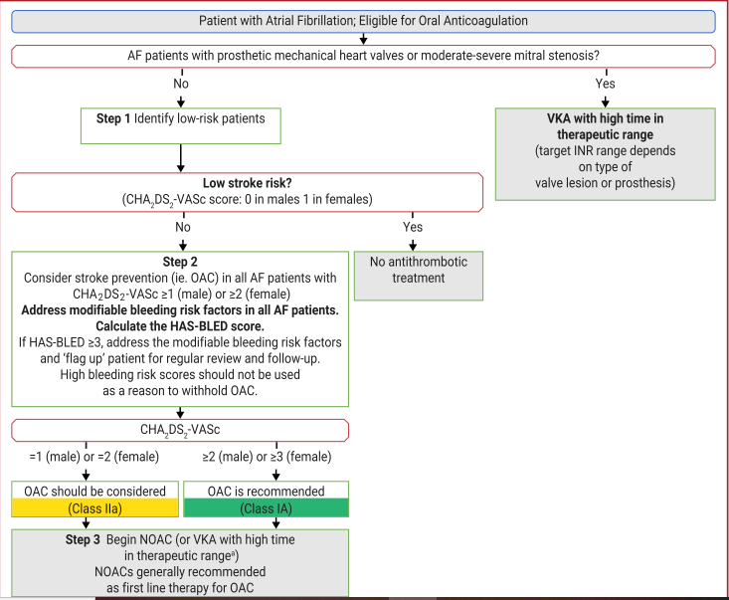

Slide 26
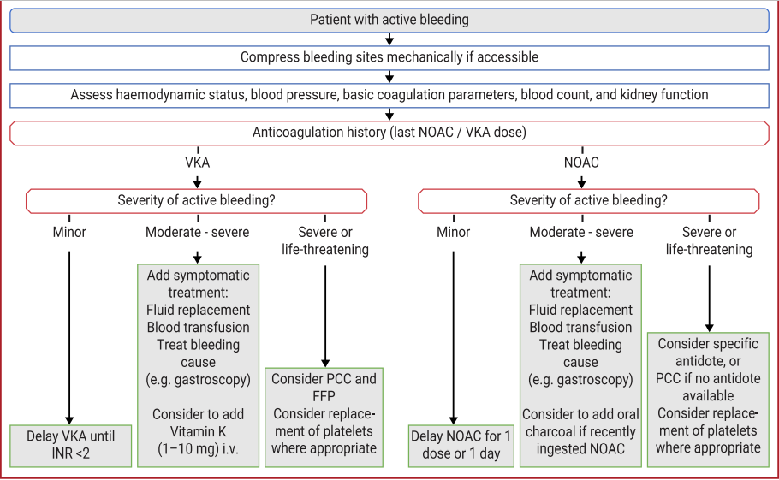
ANTICOAGULANT BLLEDING MANAGEMENT
For DOACs, the U.S. Food and Drug Administration recently approved 2 reversal agents:
Idarucizumab- a monoclonal antibody that binds to dabigatran and is excreted renally
Andexanet-which is a modified recombinant derivative of factor Xa that acts as a decoy receptor with a higher affinity to Xa inhibitors, including rivaroxaban, apixaban, and edoxaban, and binds the drug in the vascular system preferentially

Slide 27
RCTs of NOACs in AF patients after a recent ACS/PCI
Four RCTs compared dual therapy with a P2Y12 inhibitor (mostly clopidogrel) plus a NOAC—
dabigatran 110 mg or 150 mg b.i.d. (REDUAL PCI)
rivaroxaban 15 mg o.d. (PIONEER AF-PCI)
apixaban 5 mg b.i.d. (AUGUSTUS)
edoxaban 60 mg o.d. (ENTRUST-AF PCI)vs. triple therapy with a VKA in AF
Reported a significant reduction of major/clinically significant bleeding, comparable rates of ischaemic stroke, similar or non-significantly higher rates of myocardial infarction and stent thrombosis, and a neutral effect on trial-defined major adverse cardiovascular events and all-cause mortality with dual (NOAC + P2Y12) vs. triple (VKA + P2Y12 + aspirin) therapy

Slide 28
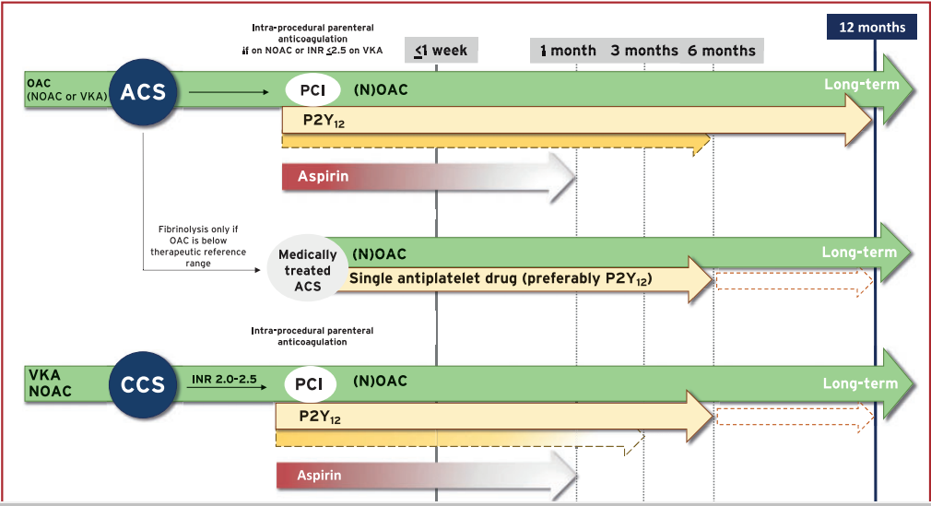
AF IN ACS

Slide 29
3.Rhythm Control
Benefits of rhythm control
relief of symptoms,
improved functional status
quality of life
prevention of tachycardia-induced cardiomyopathy.
Attenuation of electrical and structural atrial remodeling associated with AF (and hence retarding the progression of AF)
improvement in LV function

Slide 30
Conditions where Rhythm control preffered
Hemodynamic compromise attributed to AF
hypotension, acute heart failure, myocardial ischemia
ventricular preexcitation, when rate-control drug therapy is unsuccessful or not tolerated.
symptomatic patients with persistent AF, especially when ventricular rate control remains suboptimal.
young AF patients
newly diagnosed AF

Slide 31
Timing of cardioversion.
In stable patients with AF >48 hours or of unknown duration, any mode of cardioversion (electrical, pharmacological, or ablation) should be delayed until the patient has been anticoagulated at appropriate levels for 3 to 4 weeks or TEE has excluded atrial thrombi.
If urgent cardioversion -LMWH,UFH,NOAC prior to cardioversion, followed by long-term anticoagulant therapy.

Slide 32
Electrical cardioversion.
success rate of electrical cardioversion for AF -90%
initial use of maximum-energy shocks, biphasic waveform, and anterior–posterior electrode placement -improve the efficacy of cardioversion.
AF recurs early after a successful cardioversion-pretreatment with amiodarone, dofetilide, flecainide, ibutilide-enhance success rate.

Slide 33
Electrical cardioversion
Benefits of electrical cardioversion over pharmacological
High success rate
Low risk of proarrythmia
Contraindication to electrical cardioversion
Digitalis toxicity
Hypokalemia

Slide 34
Pharmacological cardioversion
efficacy modest- (30% to 70%),
highest efficacy-when initiated within 7 days of the onset of an episode of AF.
ibutilide and dofetilide are the most effective agents

Slide 35
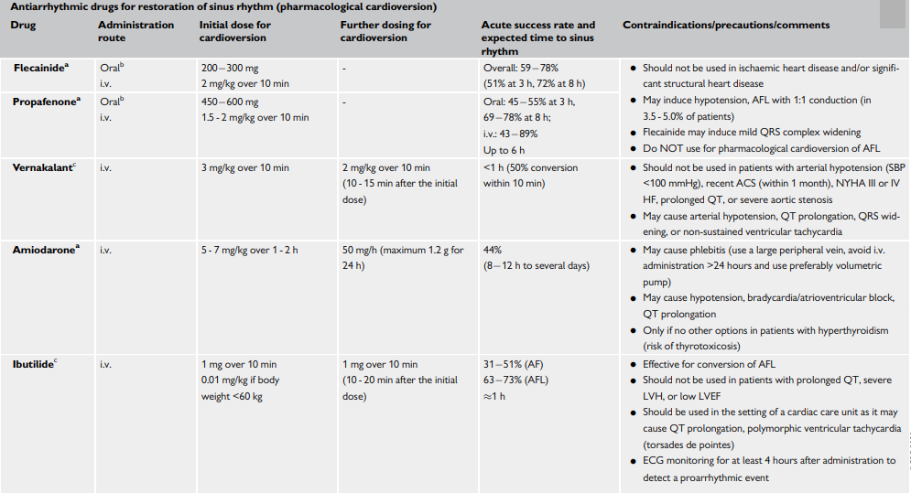
PHARMAC CARDIOVERSION

Slide 36
Rhythm Control Versus Rate Control
AFFIRM (Atrial Fibrillation Follow-Up Investigation of Rhythm Management)
RACE (RAte Control versus Electrical Cardioversion for Persistent Atrial Fibrillation)
embolic events occurred with equal frequency
equal functional status or quality of life
Both needed long term anticoagulation
AF-Congestive Heart Failure (AF-CHF) -similar results among patients with AF with concomitant heart failure.

Slide 37
Conditions where rate control preffered
asymptomatic or mildly symptomatic patients
those older than 65 years,
persistent AF

Slide 38
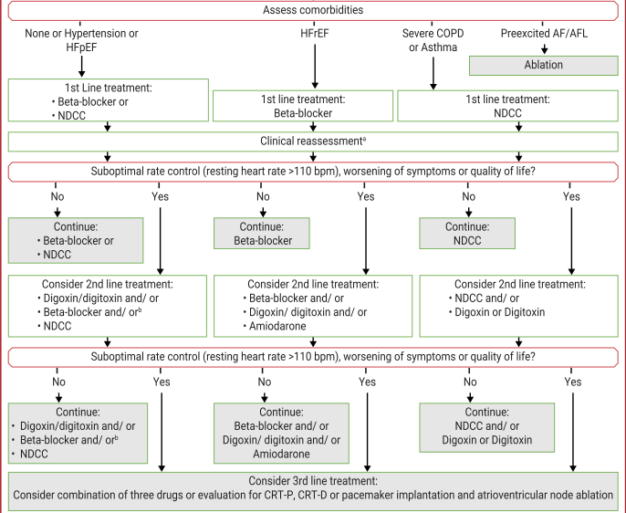
DRUGS FOR RATE CONTROL

Slide 39
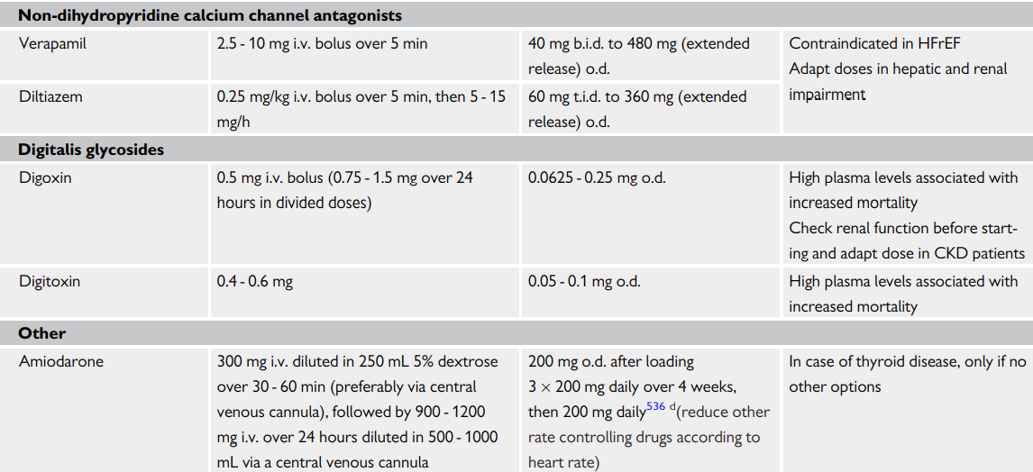
DRUGS FOR RATE CONTROL

Slide 40
Rate control therapy in AF
Acute rate control– beta blockers and diltiazem/verapamil is preferred
Critically ill patients/ severely impaired LV systolic function– IV amiodarone.
AV node ablation can be considered for tachycardia induced cardiomyopathy when rate or rhythm control is not achievable despite medical therapy.

Slide 41
LONG TERM MANAGEMENT
Only 20% to 30% of patients who are successfully cardioverted maintain NSR for more than 1 year without chronic antiarrhythmic therapy.
Likely to occur in patients with AF for less than 1 year, no enlargement of the LA (less than 4.0 cm), and a reversible cause of AF (such as hyperthyroidism, pericarditis, pulmonary embolism, or cardiac surgery).

Slide 42
LONG TERM MANAGEMENT
There is therefore a strong rationale for antiarrhythmic drug therapy in patients who have a moderate to high risk of recurrence, provided that the therapy is effective and that toxic and proarrhythmic effects are low.
Seldom indicated in patients with a first-detected episode of AF and can also be avoided in patients with infrequent and well-tolerated paroxysmal AF.

Slide 43
LONG TERM MANAGEMENT-efficacy to maintain sinus rhythm
1-year rate of maintaining NSR of
Amiodarone-65%.
Dofetilide -50% to 65%
Other antiarrhythmic -30% to 50%

Slide 44
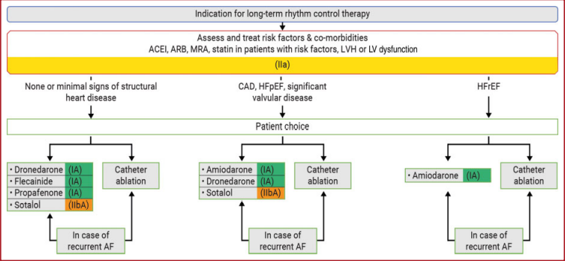
LONG TERM RHYTHM CONTROL

Slide 45
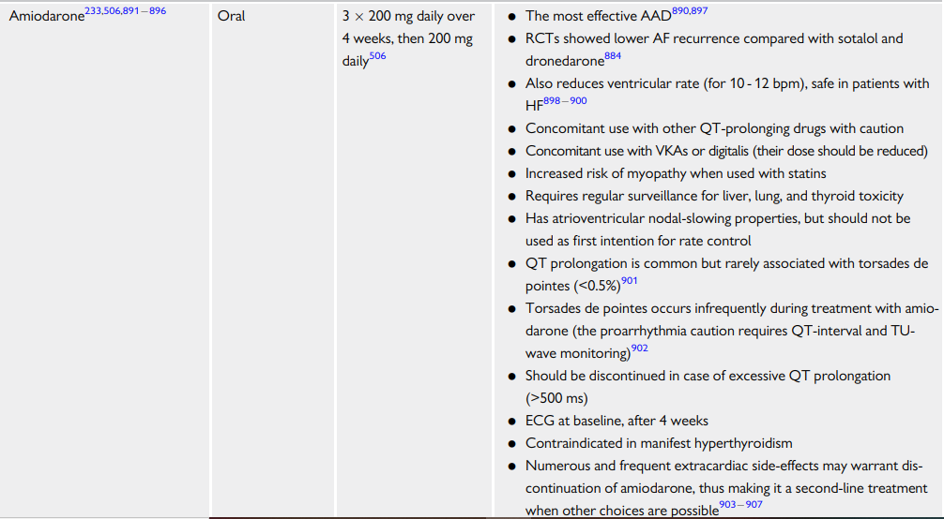
LONG TERM DRUGS

Slide 46
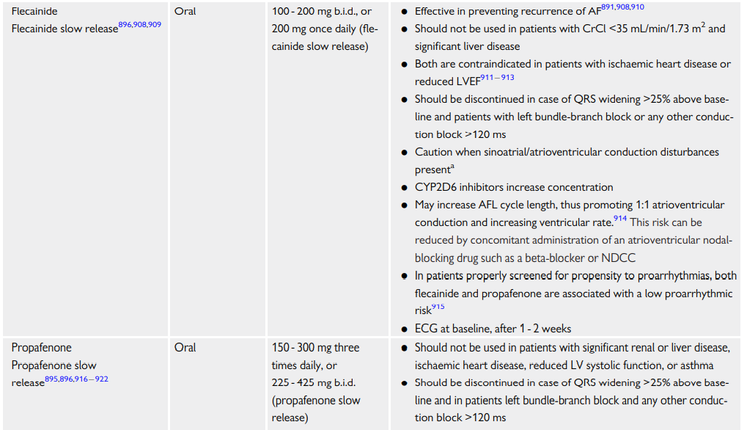
LONG TERM DRUGS

Slide 47
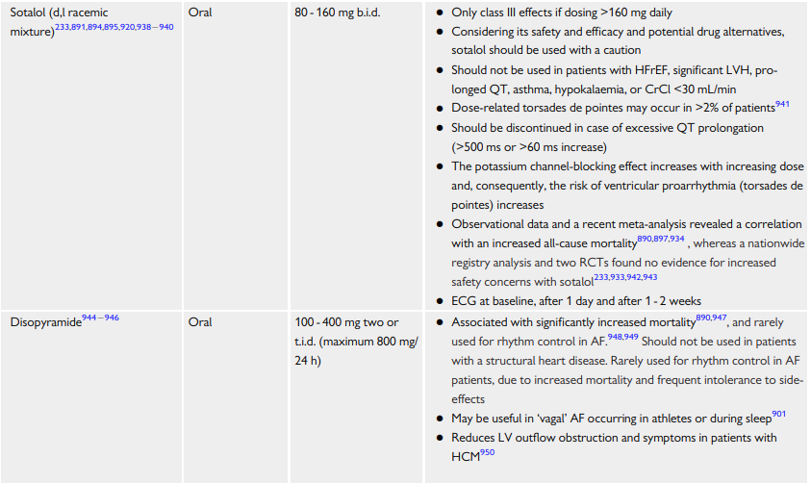
LONG TERM DRUGS

Slide 48
Wolff-Parkinson-White syndrome and AF
Electrical cardioversion -haemodynamically compromised patients with pre-excited AF
atrioventricular node-modulating drugs (e.g. verapamil, beta-blockers, digoxin) should be avoided.
Pharmacological cardioversion can be attempted using ibutilide
AADs class Ia (procainamide) and Ic (propafenone, flecainide) should be used with caution owing to their effect on the atrioventricular node.
Amiodarone may not be safe in pre-excited AF as it may enhance pathway conduction.

Slide 49
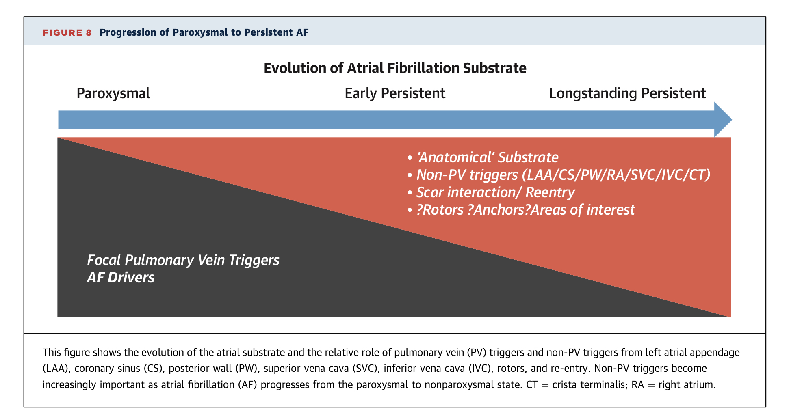
NONPHARMACOLOGICAL RHYTHM CONTROL STRATEGIES
Ablation therapy
Catheter ablation for symptomatic paroxysmal AF is recommended if
  AF is refractory or intolerant to at least 1 Class I or III AAD (Class I, LOE: A)
  is reasonable prior to initiation of antiarrhythmic therapy with a Class I or III AAD (Class IIa, LOE: B-R)

Slide 50
Non AAD with anti-arrhythmic property (UPSTREAM THERAPY )
ACEI/ARB’s
MRA
BETA BLOCKERS
STATINS

Slide 51
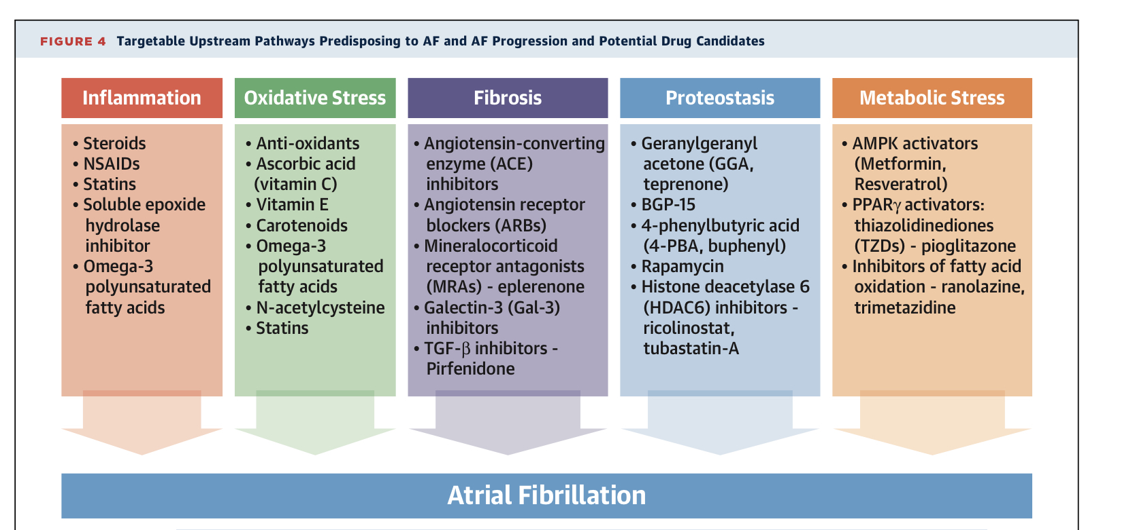

Slide 52
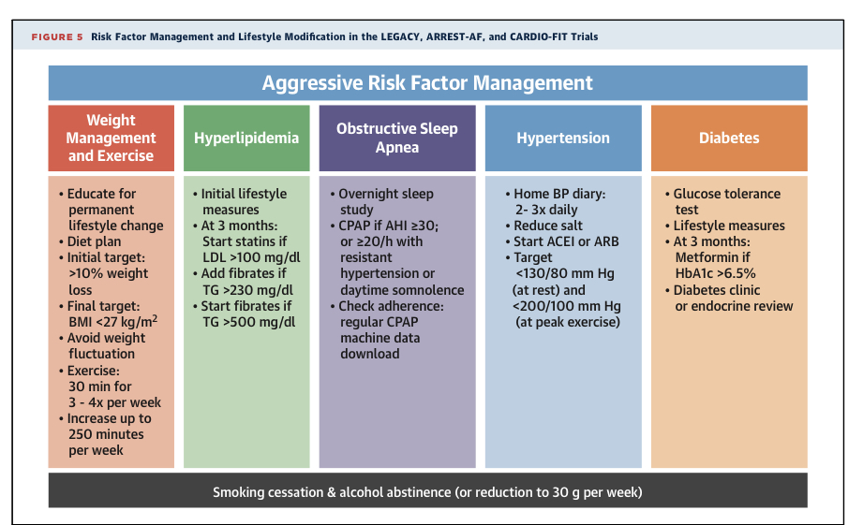

Slide 53
Using genetics to target AF therapy – AF ABLATOGENOMICS & GENE THERAPY
As AF has been strongly associated with over 100 genetic loci , personalized genomics-based treatment could potentially guide AF therapy.
With ongoing advances in gene transfer, vector delivery, and AF target gene selection, gene therapy might be anticipated to affect AF treatment in the future
Epicardial gene painting, a novel method of vector delivery, might be suitable for the treatment of post-operative AF applied to the PVs
Although significant challenges remain, post-operative AF may be the first area targeted for AF gene therapy.
This evolving area will continue to benefit from the rapid pace of discoveries that elucidate new molecular targets for AF.

Slide 54
RECOMMENDATIONS

Slide 55
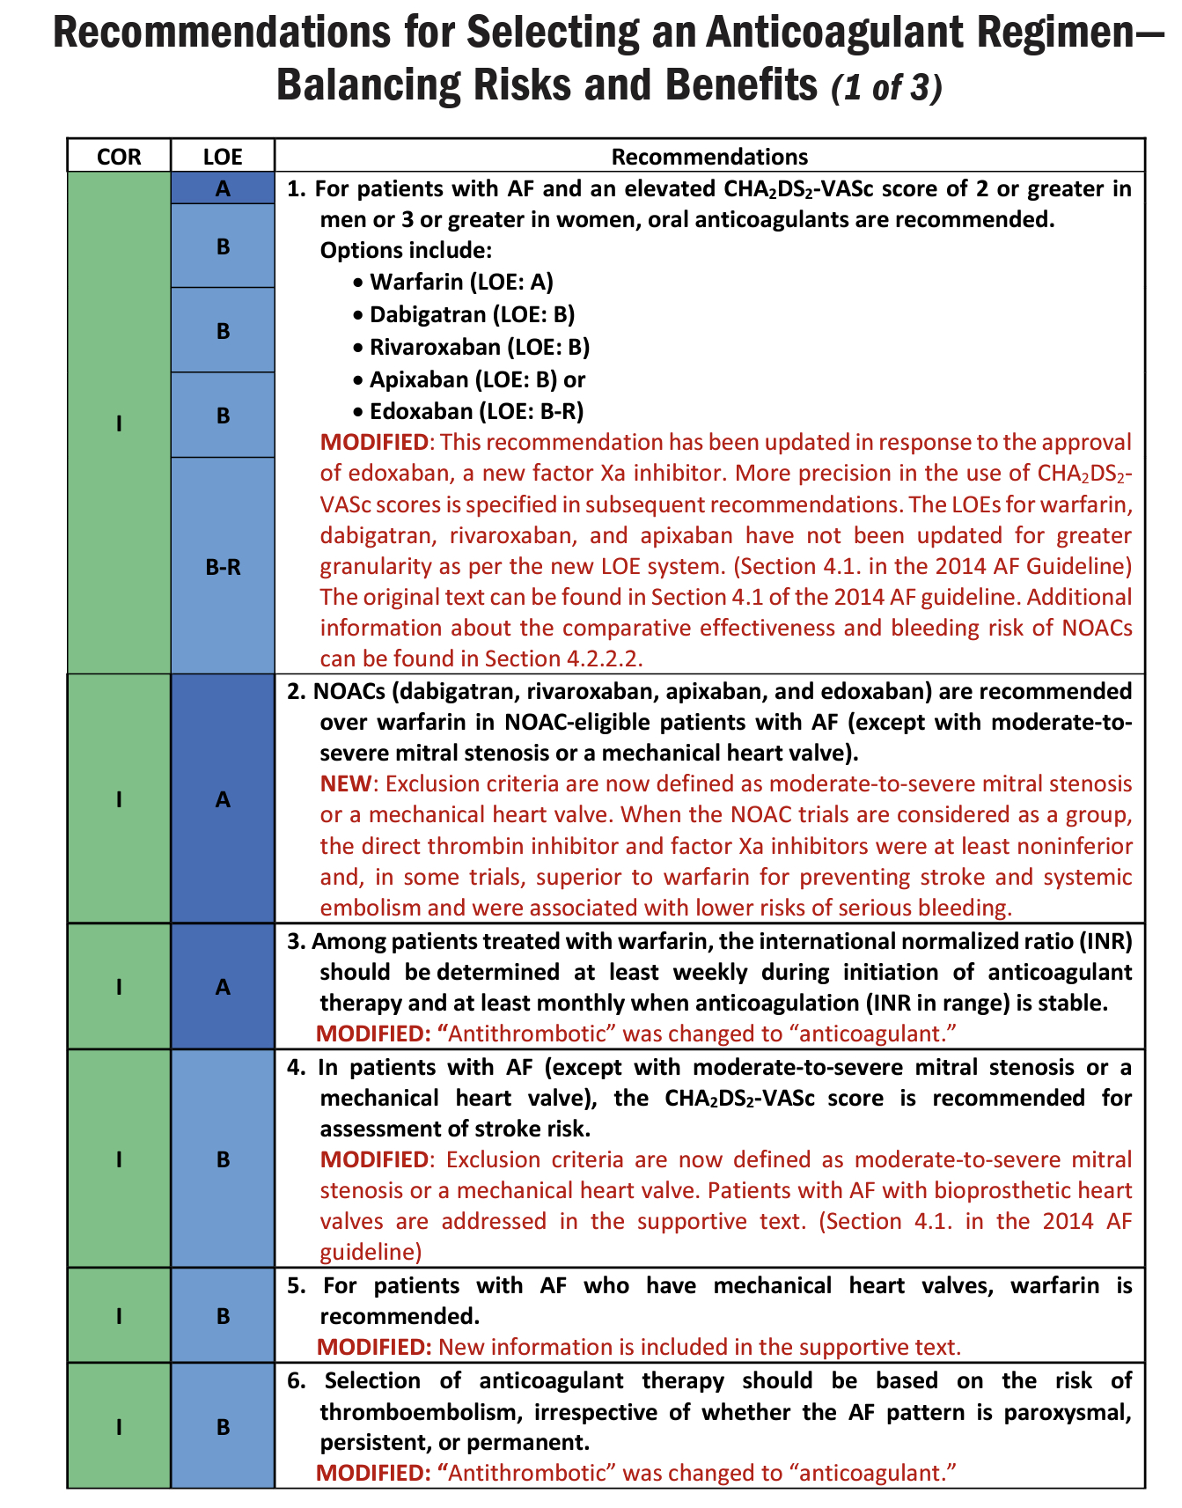

Slide 56
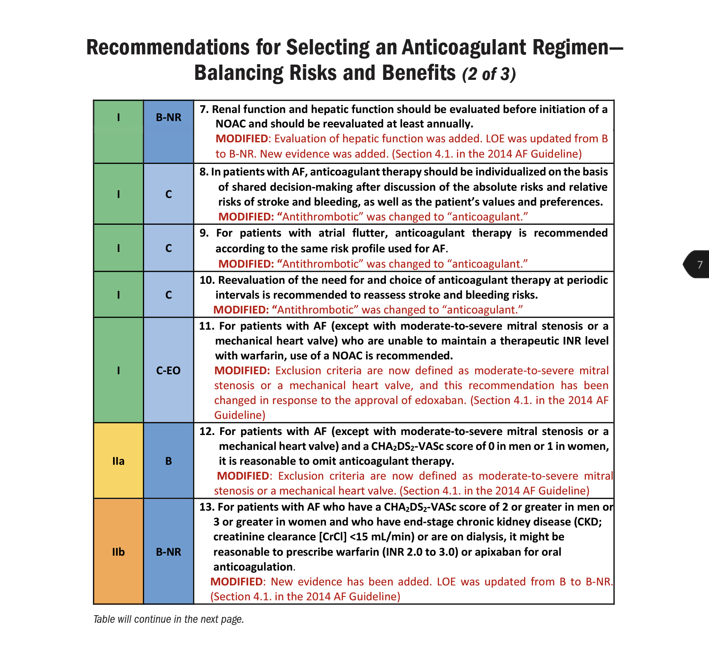

Slide 57
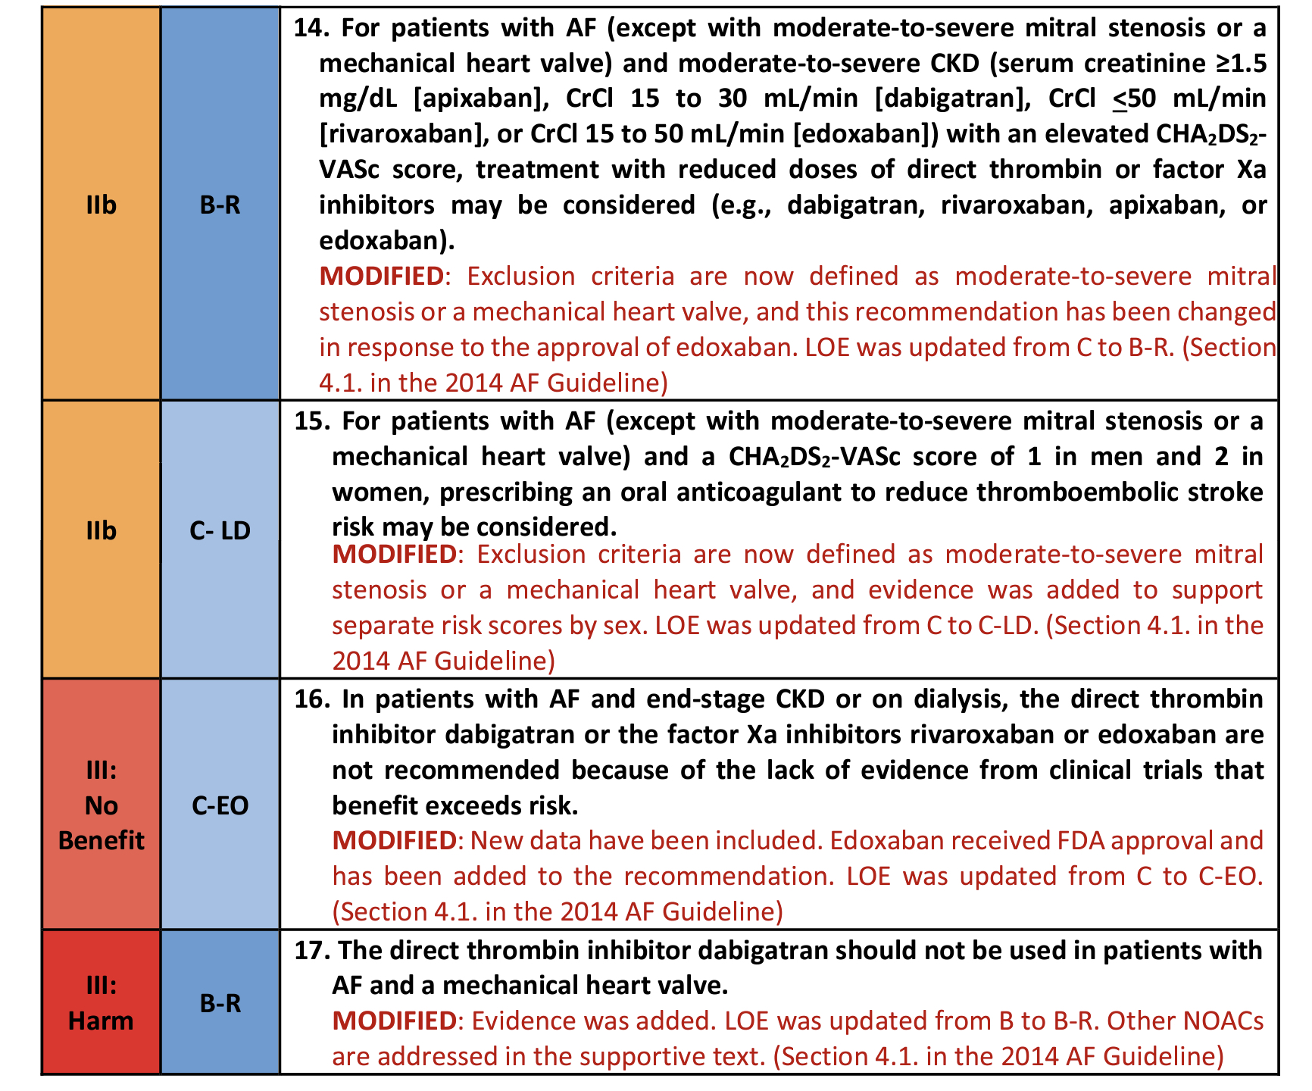

Slide 58
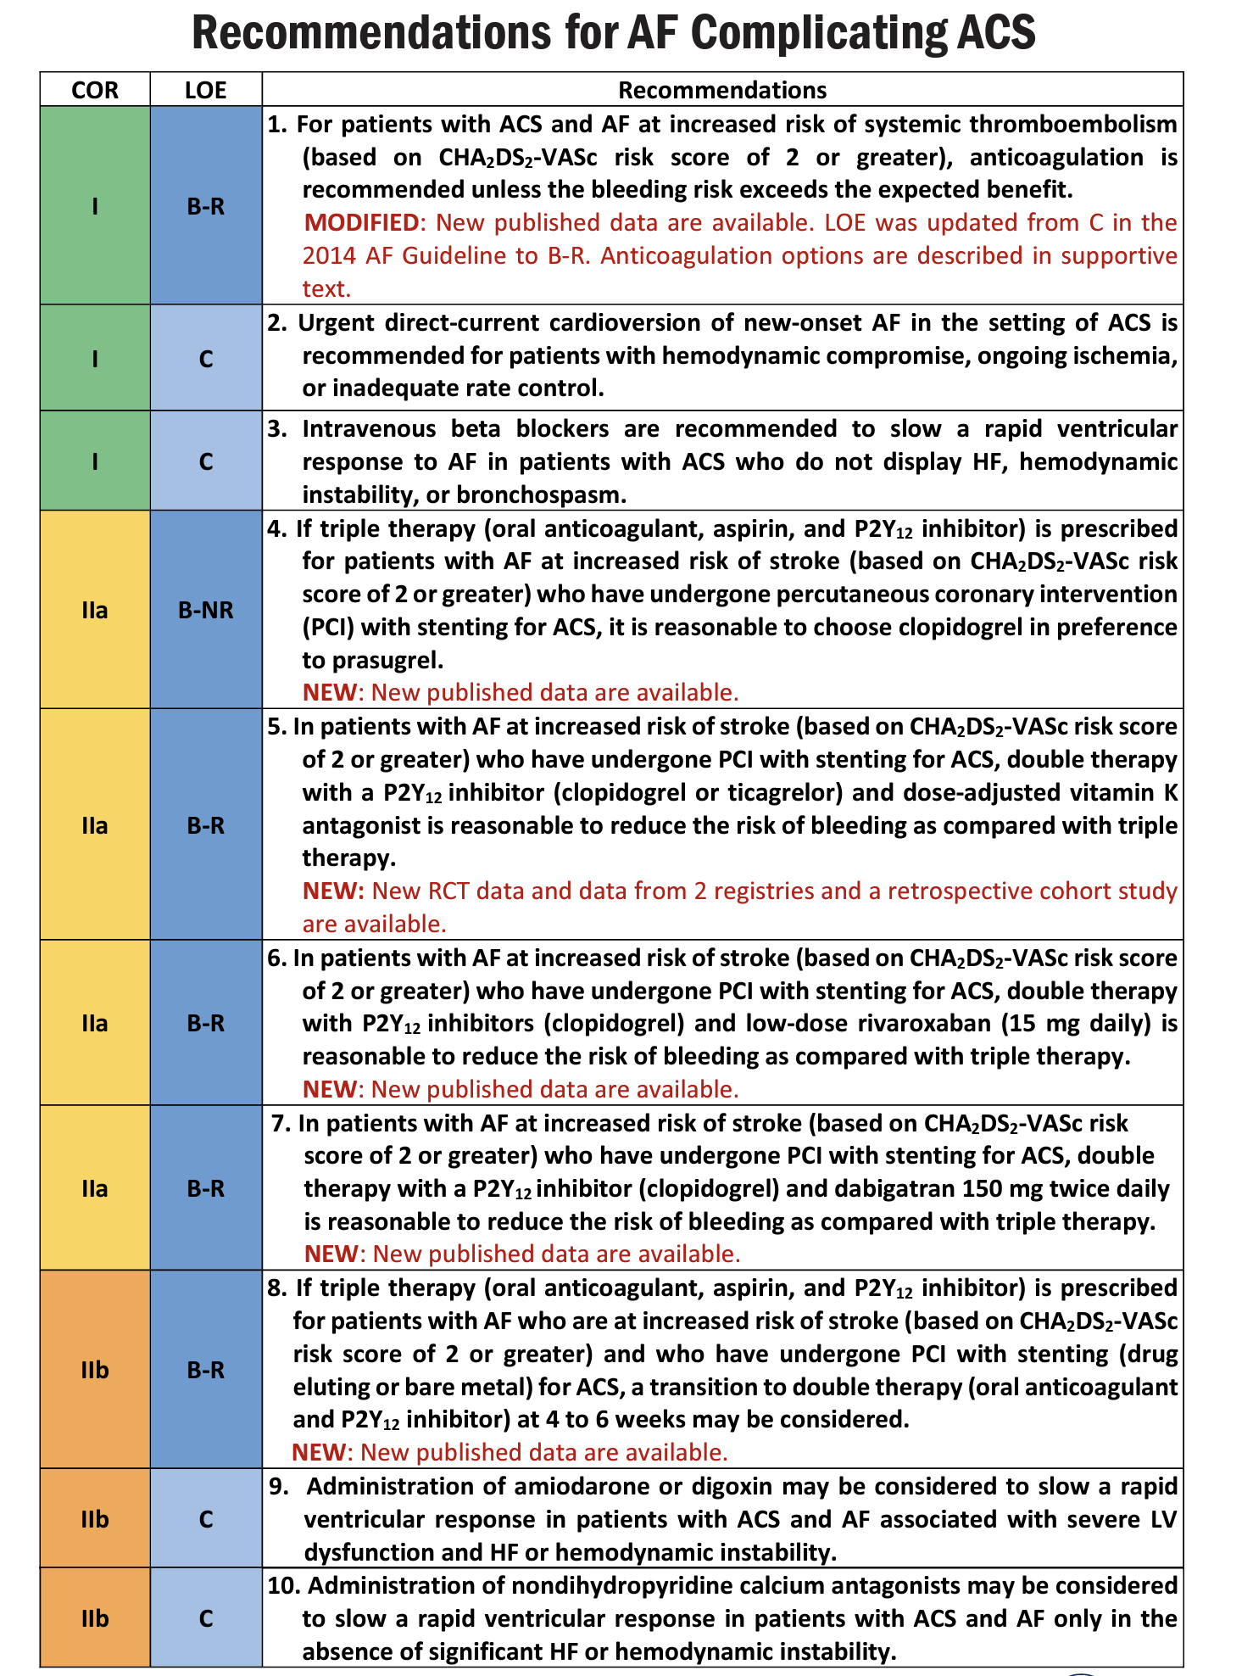

Slide 59
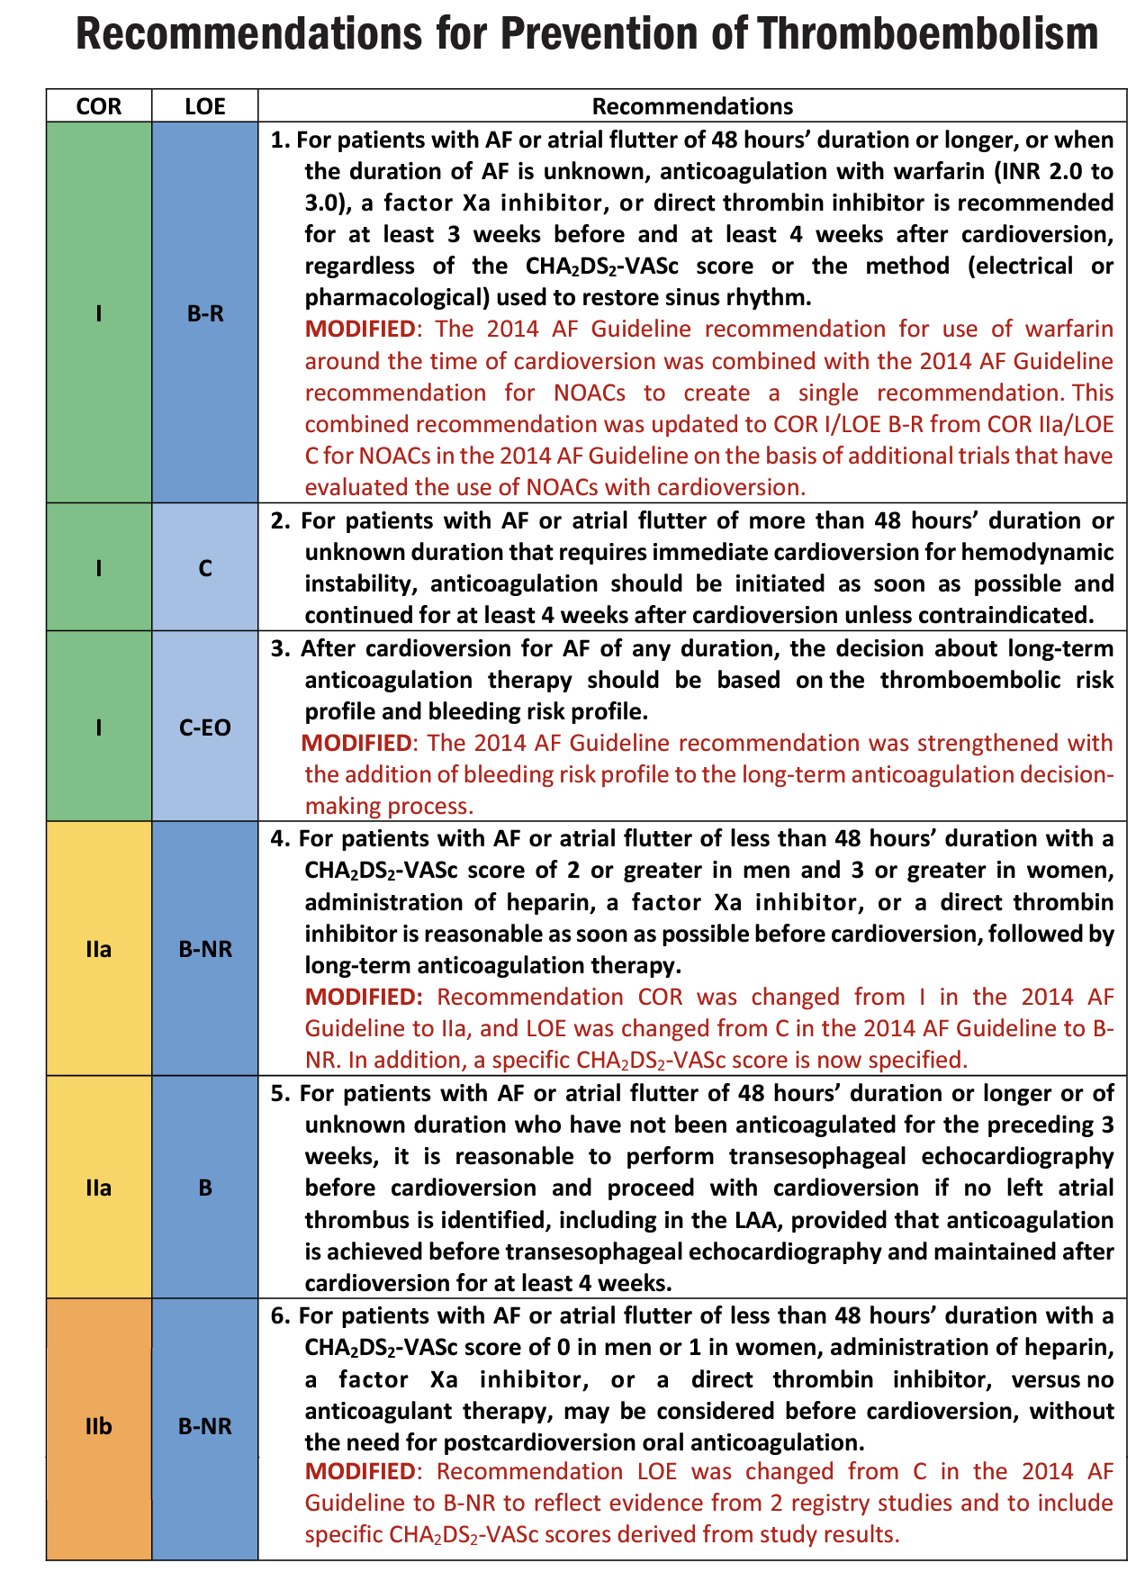

Slide 60
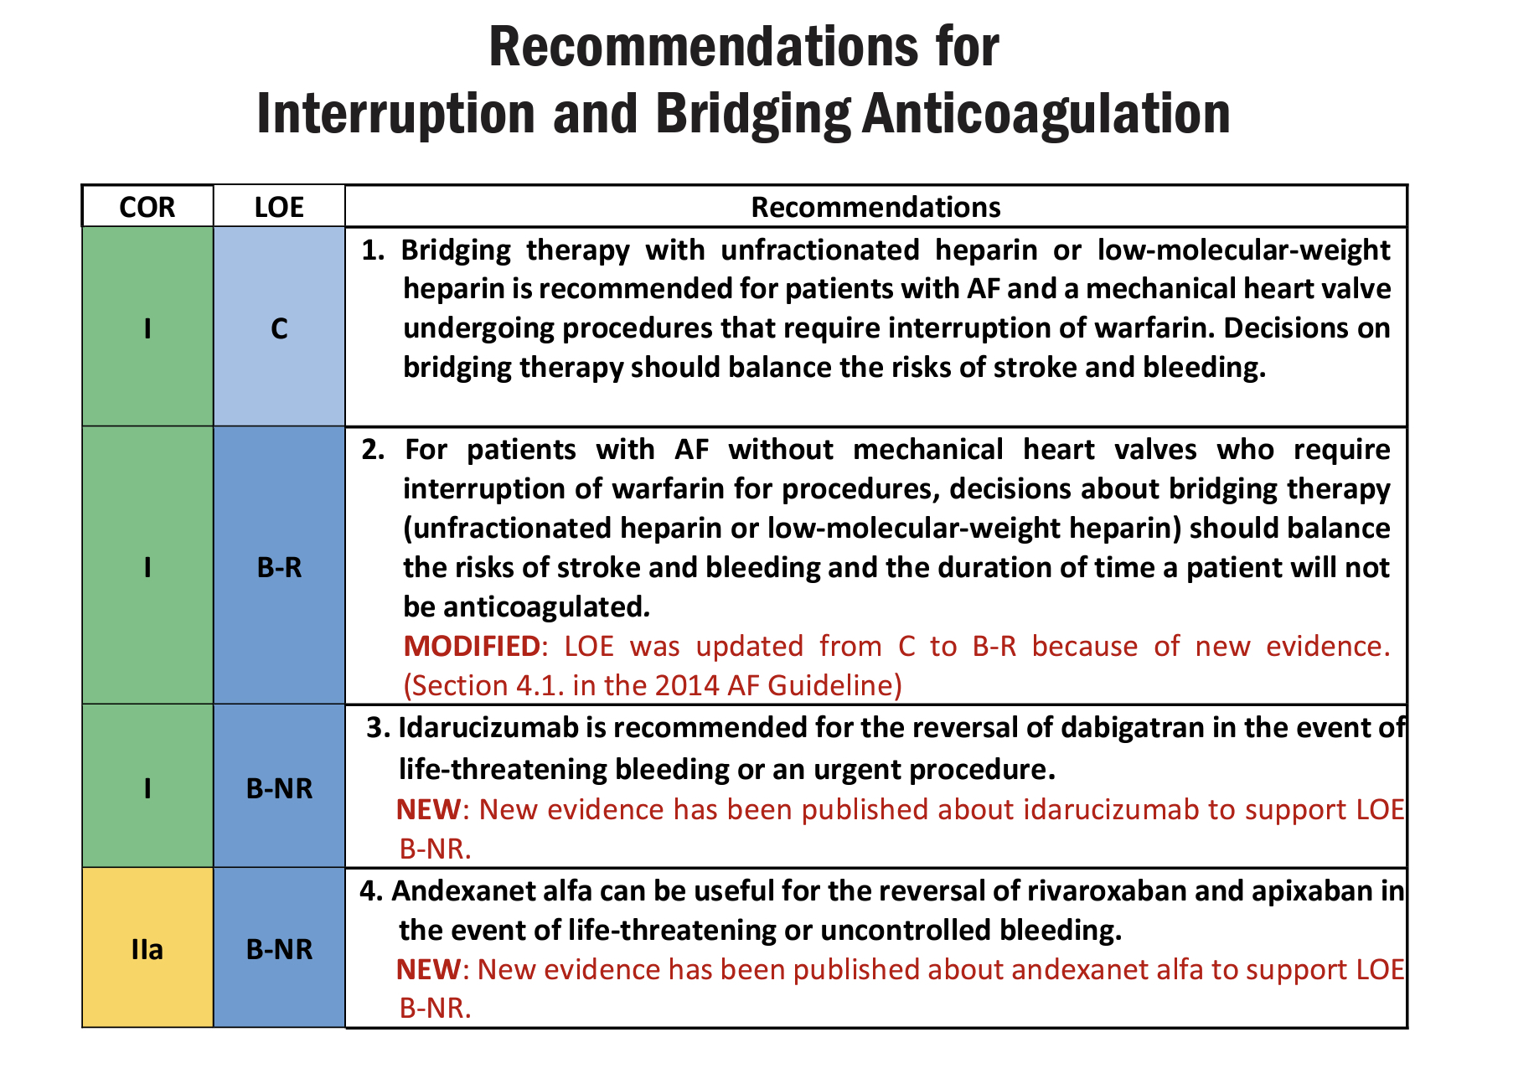

Slide 61
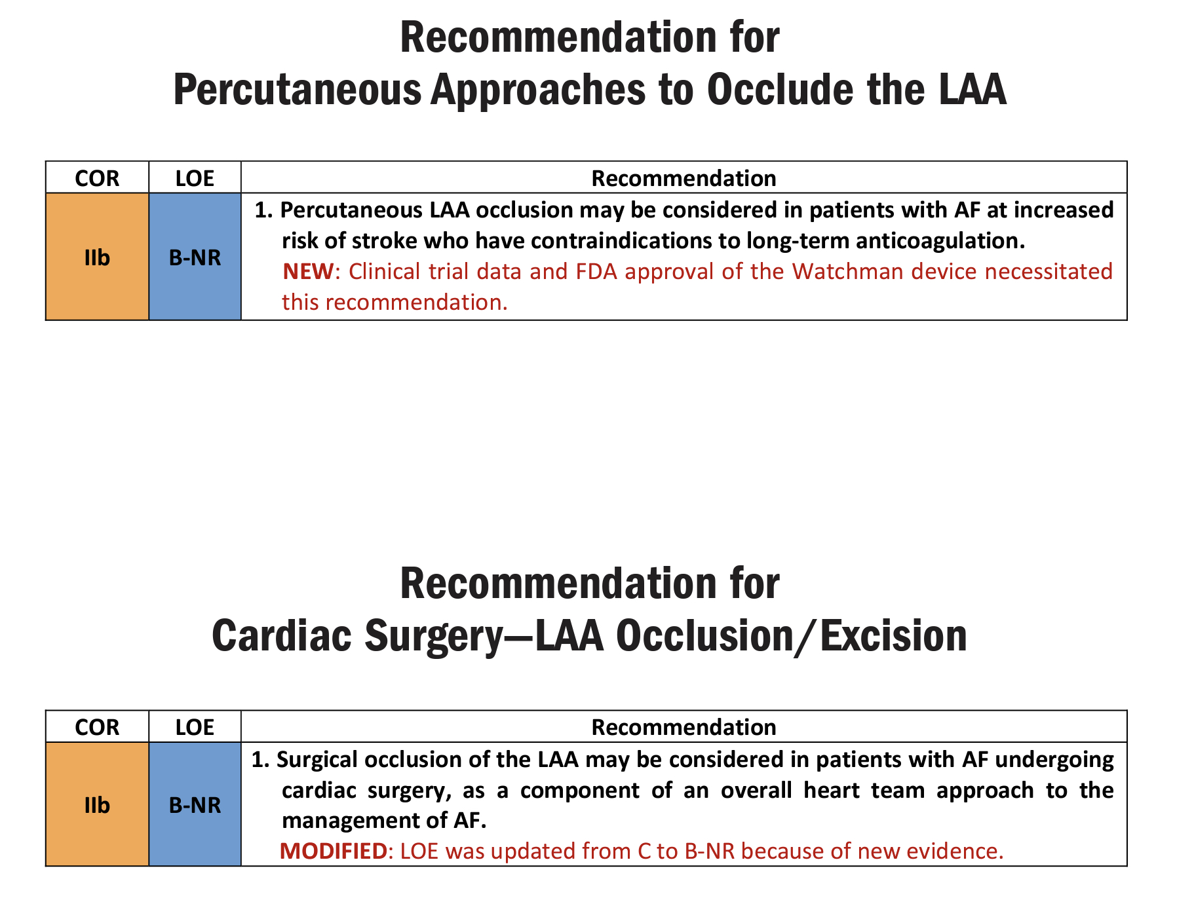

Slide 62
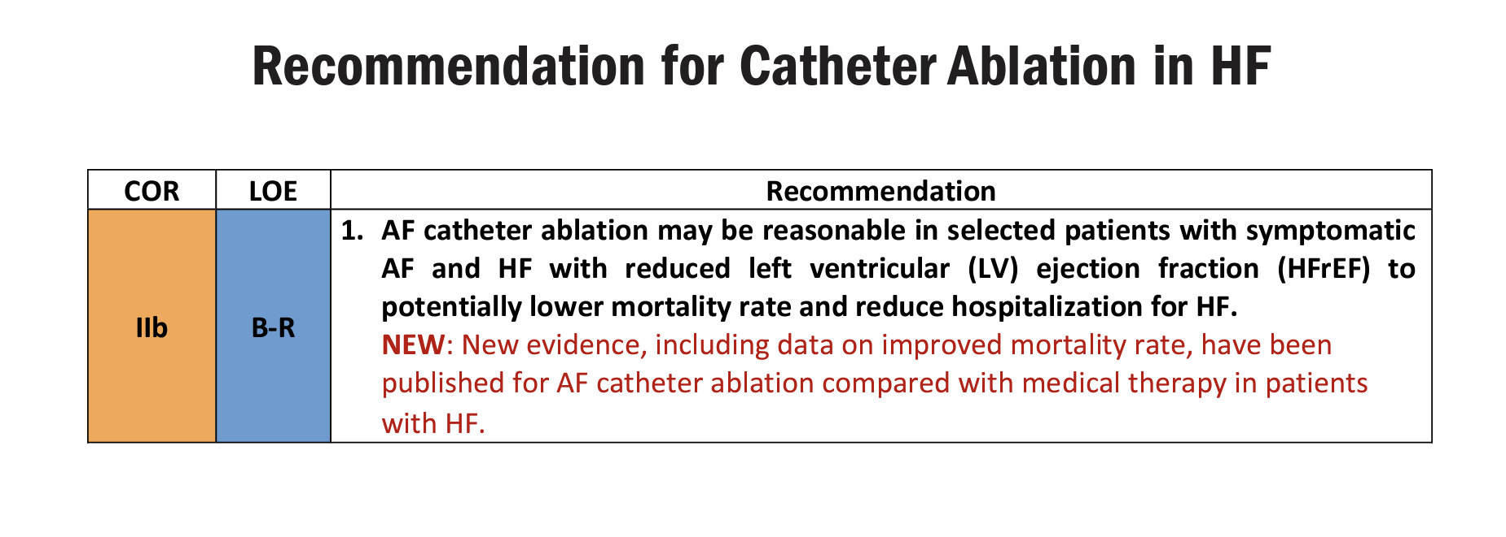

Slide 63
MCQ

Slide 64
1. All are used for thromboembolic risk assessment in AF except
CHADS2
CHA2DS2-VASC
ABC RISK
CHARGE AF

Slide 65
2. Components of HASBLED score are all except:
Labels INR
Hypertension
Heart failure
Abnormal liver function

Slide 66
3.RCTs of NOACs in AF patients after a recent ACS/PCI are all except :
REDUAL PCI
PIONEER AF –PCI
AUGUSTUS
ENTRUST AF PCI
NONE

Slide 67
4. PHARMACOLOGICAL CARDIOVERSION –DRUG NOT RECOMMENDED IN IHD IS
FLECAINIDE
PROPAFENONE
AMIODARONE
BOTH A and B

Slide 68
5. Upstream therapy include all except
MRA
ACEI/ARB
STATIN
ASPIRIN

Slide 69
THANK YOU

