Slide 1
AF-Part 2
Dr.Anjos

Slide 2
Statistics
major risk factor for thromboembolism.
15% of the ischemic strokes .
36% of strokes in patients older than 80 years
20% of cryptogenic strokes.
a 50% likelihood of death within 1 year(v/s 27% in non AF strokes)
rheumatic heart disease and AF had a 17-fold increased risk of stroke.
For nonvalvular AF, the risk of stroke is estimated to be two to seven

Slide 3
Statistics
Incidence of stroke-nonvalvular AF 1.5% in <59 years
more than 10% per year in older patients.
persistent and permanent AF is associated with an almost twofold higher rate of stroke or systemic embolism than paroxysmal AF after adjustment for other independent predictors

Slide 4
Transesophageal echocardiography (TEE) predictors of thromboembolism
LA thrombus (relative risk, 2.5),
Complex aortic plaques (relative risk, 2.1),
spontaneous echo contrast (relative risk, 3.7),
low LAA velocities (up to 20 cm/s; relative risk, 1.7)
LA size >40cm

Slide 5
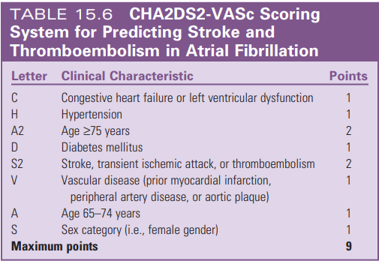
Stroke Risk Stratification
CHA2DS2-VASc score
For nonvalvular AF

Slide 6
Stroke risk with chads2 score

Slide 8
ABC risk Score

Slide 10
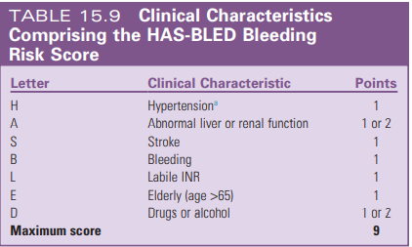
Bleeding Risk Stratification
44% of patients with AF have one or more absolute or relative contraindications for long-term oral anticoagulation therapy.
Low- 0 to 1
intermediate-2
high - 3 or above

Slide 11
Components of HASBLED
Hypertension - SBP >160 mm Hg.
Abnormal kidney function -presence of long-term dialysis or renal transplantation or serum creatinine concentration of at least 200 µmol/L.
Abnormal liver function
chronic hepatic disease (e.g., cirrhosis)
bilirubin->2X ULN
SGOT/PT/ALP-3X ULN
Bleeding -previous bleeding history or predisposition to bleeding, or both (e.g., bleeding diathesis, anemia).
Labile INRs refers to unstable or high INRs or poor time in therapeutic range .

Slide 12
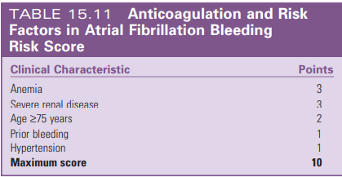

Slide 14
RISK FACTOR FOR BLEEDING

Slide 15
Principles of Bleeding Scores
Not a static phenomenon,
Reversible.
A high bleeding risk score is not a reason to withhold anticoagulation therapy.

Slide 16
PRINCIPLES OF MANAGEMENT of AF
(1) prevention of systemic embolization
(2) ventricular rate control
(3) restoration and maintenance of NSR
(4) risk factor modification

Slide 17
Prevention of Systemic Embolization
Vitamin K Antagonists
Warfarin reduce stroke risk by approximately 64%, corresponding to an absolute annual strokes risk reduction of 2.7% as compared with placebo.
Warfarin increases the risk of major bleeding by approximately 70% compared with aspirin.
Combinations of warfarin + antiplatelet therapy - no incremental benefit in stroke risk reduction while they increase the risk of bleeding.

Slide 18
Bleeding risks of Warfarin
Bleeding risk for warfarin- 0.6% for fatal bleeding, 3.0% for major bleeding, and 9.6% for major or minor bleeding./year.
Risk of intracranial hemorrhage- 0.2% per year.
aspirin +warfarin -3X intracranial hemorrhage.
the risk of major bleeding in older patients (greater than 80 years)-2.5%.

Slide 19
Warfarin Limitations
a narrow therapeutic window
periodic INR monitoring
frequent dose adjustments
multiple drug and dietary interactions
genetic variability in response (accounting for 39% to 56% of the variability in the warfarin dose)
long half-life (36 to 42 hours)
slow onset of action.
< 50% of eligible patients were treated with warfarin
there is ongoing attrition of its use to approximately 40% by 4 years.

Slide 20
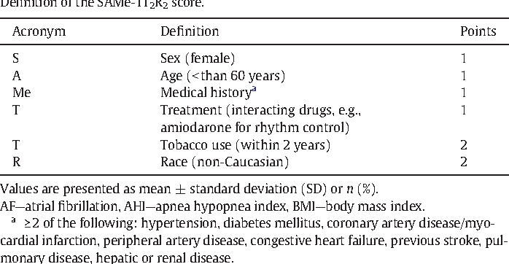
SAMe-TT2R2 scores
Which can help to identify patients who are less likely to achieve a good TTR on VKA therapy (score >2) and would do better with a NOAC.
If such patients with SAMeTT2R2>2 are prescribed a VKA, greater efforts to improve TTR, such as more intense regular reviews, education/counselling, and frequent INR monitoring are needed or, more conveniently, the use of a NOAC should be reconsidered.

Slide 21
NOACS IN AF

Slide 22
Trials of noacs
RE-LY-Dabigatran (Randomized Evaluation of Long Term Anticoagulant Therapy),
ROCKET-AF (Rivaroxaban Once Daily Oral Direct Factor Xa Inhibition Compared with Vitamin K Antagonism for Prevention of Stroke and Embolism Trial in Atrial Fibrillation),
ARISTOTLE (Apixaban for Reduction in Stroke and Other Thromboembolic Events in Atrial Fibrillation)
ENGAGE AF TIMI 48-Edoxaban (Effective Anticoagulation with Factor Xa Next Generation in AF)

Slide 23
Absolute contraindications to oral anticoagulants
Active serious bleeding (where the source should be identified and treated)
Associated comorbidities (e.g. severe thrombocytopenia <50k , severe anaemia under investigation, etc.)
A recent high-risk bleeding event such as intracranial haemorrhage (ICH).
Notes:
sfdsf

Slide 25
ANTICOAGULANT BLLEDING MANAGEMENT

Slide 26
RCTs of NOACs in AF patients after a recent ACS/PCI
Four RCTs compared dual therapy with a P2Y12 inhibitor (mostly clopidogrel) plus a NOAC—
dabigatran 110 mg or 150 mg b.i.d. (REDUAL PCI)
rivaroxaban 15 mg o.d. (PIONEER AF-PCI)
apixaban 5 mg b.i.d. (AUGUSTUS)
edoxaban 60 mg o.d. (ENTRUST-AF PCI)vs. triple therapy with a VKA in AF
Reported a significant reduction of major/clinically significant bleeding, comparable rates of ischaemic stroke, similar or non-significantly higher rates of myocardial infarction and stent thrombosis, and a neutral effect on trial-defined major adverse cardiovascular events and all-cause mortality with dual (NOAC þ P2Y12) vs. triple (VKA þ P2Y12 þ aspirin) therapy

Slide 27
AF IN ACS

Slide 28
Rhythm Control
Benefits of rhythm control
relief of symptoms,
improved functional status
quality of life
prevention of tachycardia-induced cardiomyopathy.
Attenuation of electrical and structural atrial remodeling associated with AF (and hence retarding the progression of AF)
improvement in LV function

Slide 29
Conditions where Rhythm control preffered
Hemodynamic compromise attributed to AF
hypotension, acute heart failure, myocardial ischemia
ventricular preexcitation, when rate-control drug therapy is unsuccessful or not tolerated.
symptomatic patients with persistent AF, especially when ventricular rate control remains suboptimal.
young AF patients
newly diagnosed AF

Slide 30
Timing of cardioversion.
In stable patients with AF >48 hours or of unknown duration, any mode of cardioversion (electrical, pharmacological, or ablation) should be delayed until the patient has been anticoagulated at appropriate levels for 3 to 4 weeks or TEE has excluded atrial thrombi.
If urgent cardioversion -LMWH,UFH,NOAC
prior to cardioversion, followed by long-term anticoagulant therapy.

Slide 31
Electrical cardioversion.
success rate of electrical cardioversion for AF -90%
initial use of maximum-energy shocks, biphasic waveform, and anterior–posterior electrode placement -improve the efficacy of cardioversion.
AF recurs early after a successful cardioversion-pretreatment with amiodarone, dofetilide, flecainide, ibutilide-enhance success rate.

Slide 32
Electrical cardioversion
AF of recent onset (less than 48 hours), newly started (less than 12 hours) AF episodes can be more difficult to terminate with electrical cardioversion than AF episodes lasting 12 to 48 hours, and failure of electrical cardioversion in the acute phase does not predict later successful cardioversion or spontaneous conversion to NSR in these patients.

Slide 33
Electrical cardioversion
Benefits of electrical cardioversion over pharmacological
High success rate
Low risk of proarrythmia
Contraindication to electrical cardioversion
Digitalis toxicity
Hypokalemia

Slide 34
Pharmacological cardioversion
efficacy modest- (30% to 70%),
highest efficacy-when initiated within 7 days of the onset of an episode of AF.
ibutilide and dofetilide are the most effective agents

Slide 35
PHARMAC CARDIOVERSION

Slide 36
Rhythm Control Versus Rate Control
AFFIRM (Atrial Fibrillation Follow-Up Investigation of Rhythm Management)
RACE (RAte Control versus Electrical Cardioversion for Persistent Atrial Fibrillation)
embolic events occurred with equal frequency
equal functional status or quality of life
Both needed long term anticoagulation
AF-Congestive Heart Failure (AF-CHF) -similar results among patients with AF with concomitant heart failure.

Slide 37
Conditions where rate control preffered
asymptomatic or mildly symptomatic patients
those older than 65 years,
persistent AF

Slide 38
DRUGS FOR RATE CONTROL

Slide 39
BETA BLOCKERS FOR RATE CONTROL

Slide 40
DRUGS FOR RATE CONTROL

Slide 41
Rate control therapy in AF
Acute rate control– beta blockers and diltiazem/verapamil is preferred
Critically ill patients/ severely impaired LV systolic function– IV amiodarone.

Slide 42
LONG TERM MANAGEMENT
Only 20% to 30% of patients who are successfully cardioverted maintain NSR for more than 1 year without chronic antiarrhythmic therapy.
Likely to occur in patients with AF for less than 1 year, no enlargement of the LA (less than 4.0 cm), and a reversible cause of AF (such as hyperthyroidism, pericarditis, pulmonary embolism, or cardiac surgery).

Slide 43
LONG TERM MANAGEMENT
There is therefore a strong rationale for antiarrhythmic drug therapy in patients who have a moderate to high risk of recurrence, provided that the therapy is effective and that toxic and proarrhythmic effects are low.
Seldom indicated in patients with a first-detected episode of AF and can also be avoided in patients with infrequent and well-tolerated paroxysmal AF.

Slide 44
LONG TERM MANAGEMENT-efficacy to maintain sinus rhythm
1-year rate of maintaining NSR of
Amiodarone-65%.
Dofetilide -50% to 65%
Other antiarrhythmic -30% to 50%

Slide 45
LONG TERM RHYTHM CONTROL

Slide 46
LONG TERM DRUGS

Slide 47
LONG TERM DRUGS

Slide 48
LONG TERM DRUGS

Slide 49
Non AAD with anti-arrhythmic property (UPSTREAM THERAPY )
ACEI/ARB’s
MRA
BETA BLOCKERS
STATINS

Slide 50
Wolff-Parkinson-White syndrome and AF
Electrical cardioversion -haemodynamically compromised patients with pre-excited AF
atrioventricular node-modulating drugs (e.g. verapamil, beta-blockers, digoxin) should be avoided.
Pharmacological cardioversion can be attempted using ibutilide
AADs class Ia (procainamide) and Ic (propafenone, flecainide) should be used with caution owing to their effect on the atrioventricular node.
Amiodarone may not be safe in pre-excited AF as it may enhance pathway conduction.

