Slide 1
ARTIFACTS IN ECHO
Dr.Anjos

Slide 2
Properties of Ultrasound
Acoustic impedance- It is determined by the tissue density multiplied by the velocity of sound waves in the tissue. Differences in acoustic impedance cause reflections (echoes).
Absorption -The conversion of sound energy to heat as it travels through a medium.
Attenuation The gradual loss of ultrasound energy as the wave propagates through tissue; it is caused by reflection, scattering, and absorption

Slide 3
Properties of Ultrasound
Reflection- The redirection of a transmitted sound wave, usually at an interface between 2 media with different acoustic impedance.
Refraction- The change of propagation direction (bending) of ultrasound wave as it travels through media with different propagation speeds. This can only occur when the incident angle is different from 90°.
Scattering -The reflected echoes propagate at various directions; it occurs when the reflector has a small surface (i.e., red blood cells).

Slide 4
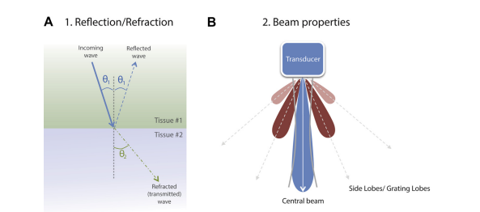
Attenuation

Slide 6
False Assumptions in ECHO that causes artifacts
1. Pulses and echoes travel in straight lines -Refraction
2. Waves are infinitely thin or pulses are extremely small -Beam width
3. Echoes return to the transducer after a single reflection -Reverberation, mirror image
4. Echoes originate from the main beam -Side-lobe, grating lobe
5. The depth of an object is directly related to the travel time for an ultrasound pulse to return to the transducer(speed of sound = 1540 m/s) -Refraction
6. Pulses and echoes are attenuated uniformly by all tissues- Shadowing, enhancement

Slide 7
Types of Artifacts

Slide 8
Facts v/s Artifacts

Slide 9
Reverberation Artifact

Slide 10
Reverberation Artifact
Reverberation results in a pattern of regularly spaced artifacts; the spacing represents the distance between the proximal and the distal reflector
The intensity of the reverberation is directly related to the difference in acoustic impedance between the reflector and its surroundings .
.In reverberations, the assumption that the ultrasound has returned to the transducer after only a single reflection is violated.
With reverberation artifacts, the ultrasound beam bounces multiple times between 2 highly reflective surfaces during the listening phase before returning to the transducer.

Slide 11
Reverberation Artifact
When the distance between the reflectors is small, the artifact appears as a smear of signal rather than a discrete anatomic feature. In this case, these reverberations are referred to as “comet-tail” or “ringdown” artifacts.
Changing the probe position will eliminate these artifacts.

Slide 12
Clinical Application
In patients who may benefit from electrical cardioversion for atrial fibrillation, the distinction between left atrial appendage thrombi and a reverberation artifact is an important one to make.
many linear artifacts mimicking aortic dissections have been attributed to reverberation of the posterior wall, particularly in a dilated ascending aorta, and may result in unnecessary interventions.
Comet-tail artifacts -in the presence of any closely spaced reflectors, such as pacing wires or pulmonary artery catheters.
They are often seen radiating from the distal wall of a descending aorta

Slide 13
Reverberation Artifact

Slide 15
Ring Down Artifacts
Ring-down artifacts occur when bubbles within a fluid background reflect or resonate sound waves .
The appearance of ring-down artifacts should alert the echocardiographer to the presence of gas (e.g., air embolism or post-cardiopulmonary bypass air

Slide 16
Ring down artifacts

Slide 18
Shadowing and Enhancement Artifact
Enhancement artifacts resulting in the appearance of extra-anatomic features may occur when the ultrasound beam travels through tissue that attenuates less than its surroundings.
Shadowing occurs when the transmitting beam encounters a structure with high attenuating properties.
For example, the highly reflective portions of prosthetic or heavily calcified valves prevent the comprehensive evaluation of left ventricular wall motion in the midesophageal views by displaying anechoic regions distal to the valves.

Slide 19
Shadowing

Slide 21
Mirror-Image Artifact
Create the appearance of additional structures on the monitor display.
The duplicated structure is deeper, equidistant, and occasionally lateral to the reflector.
Mirror-image artifacts occur when the assumption that the ultrasound echo returns to the transducer after only a single reflection is violated.
Instead, the ultrasound beam first hits a large, smooth (mirror-like) reflector during the transmission phase, which directs it to a second reflector (i.e., target).
The beam then bounces from the target back to the mirror-like surface on its return to the probe

Slide 23
Mirror-Image Artifact

Slide 24
Mirror-Image Artifact

Slide 25
Beam Width Artifacts
Lateral resolution refers to the ability to distinguish 2 or more structures side-by-side on the monitor as separate.
Poor lateral resolution may be the result of beam width artifacts.
These artifacts occur when the assumption that ultrasound waves are infinitely thin throughout is violated.
Adjusting the focal zone with the focus knob may help to eliminate these artifacts .
Beam width artifacts have been attributed to false positives for thrombus in the left atrial appendage for patients undergoing TEE with atrial fibrilla

Slide 26
Mechanism of Beam width Artifact

Slide 27
Refraction Artifact
A refraction artifact, also called a ‘‘lens artifact,’’ is the false duplication of an object behind a structure that acts as a wave refractor and thus behaves as a lens.
Ultrasound waves directed through the ‘‘lens’’ are refracted toward the respective cardiac object and then rerefracted back to the original direction of transmission on the return acoustic path, resulting in a duplicate image of this object but in the original direction of the beam.
These artifacts occur mostly in subcostal and parasternal imaging planes, with costal cartilage, fascial structures and fat, and pleural and pericardial surfaces acting as the medium inducing refraction of the ultrasound beam

Slide 28
RefractionArtifacts

Slide 29
Refraction Artifact-Double Aorta

Slide 30
Side and grating lobe artifacts

Slide 31
Side-lobe artifacts
The assumption that the ultrasound waves are infinitely thin is violated.
Side and grating lobes are secondary beams around the central ultrasound beam and are produced by nonaxial vibrations of the piezoelectric elements.
it can be difficult to differentiate between side and grating lobe artifacts.

Slide 32
Side-lobe artifacts
Differential diagnosis for masses in the left atrial appendage.
Side-lobe–generated artifacts may contribute to making normal, stented bioprosthetic aortic valve appear abnormally bent.

Slide 33
Side-lobe artifacts

Slide 34
Side-lobe artifacts

Slide 36
Near Field Clutter
Structures in the near field are sometimes obscured because of the high amplitude of oscillations by the transducer itself, causing near-field clutter.
This is especially relevant in case an apical ventricular thrombus is suspected .

Slide 37
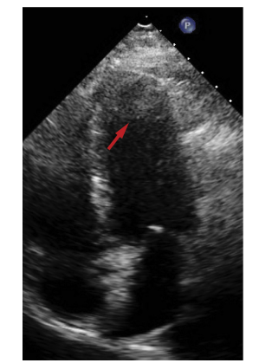
Near Field Clutter

Slide 38
Blooming
In “blooming,” soft tissues are color-coded as if they contain true blood flow.
Also known as “color bleed,” this artifact results from abnormally high-gain settings and the artifact may potentially obscure pathology such as severe atherosclerosis in the aorta .
Doppler gain does not affect the intensity of the transmitted pulse.

Slide 39
Blooming

Slide 40
Pseudoflow
Motion of fluids other than blood, such as ascites, amniotic fluid, pleural effusion, and urine can be imaged with CFD
This “pseudoflow” is an artifact because spectral imaging
will not typically show characteristic arterial or venous waveforms.
Pericardial effusions seen during an echocardiographic examination may demonstrate flow because of their proximity to the heart.

Slide 41
Pseudoflow

Slide 42
Twinkling
Used for diagnostic purposes in noncardiac imaging “twinkling” artifacts are a mosaic of rapidly changing blue and red patches of color near strongly reflective surfaces resulting in patterns that imitate abnormal flow.
Twinkling may be the result of a type of intrinsic scanner noise dubbed “phase” or “clock jitter.”

Slide 43
First described in 1996, this artifact may mimic blood flow such as a regurgitant jet, paravalvular leak, or shunt.
described in association with echogenic intracardiac foci in the fetal heart,as well as calcified and noncalcified cardiac valves.
Vena contracta measurements become inaccurate in association with a twinkling artifact.

Slide 44
Twinkling

Slide 45
Figure of 8 Artifacts-Intracardiac Devices

