Slide 1
ATRIAL SEPTAL DEFECT INVESTIGATION AND MANAGEMENT
- DR. AJU AJAY

Slide 2
INVESTIGATIONS

Slide 3
Electrocardiography
Secundum atrial septal defect (ASD):
Right-axis deviation
rSR' pattern in V₁
IVCD & RBBB(represents delayed posterobasal activation of the ventricular septum and enlargement of the right ventricular outflow tract).
RV hypertrophy
First degree AV block (20%)
RA enlargement – prominent P wave in lead II

Slide 4
Electrocardiography
Ostium primum ASD:
Left-axis deviation
rSR' pattern in V₁
IVCD & RBBB
prolonged P-R interval secondary to left atrial enlargement and an increased distance for internodal conduction.
Sinus venosus defect:
Left-axis deviation and negative P wave in lead III

Slide 7
IMAGING STUDIES:
CHEST RADIOGRAPHY:
cardiomegaly because of dilatation of the right atrium and right ventricular chamber.
Prominent pulmonary artery, pulmonary plethora
proximal dilatation of the superior vena cava can be seen in sinus venosus defect.

Slide 8
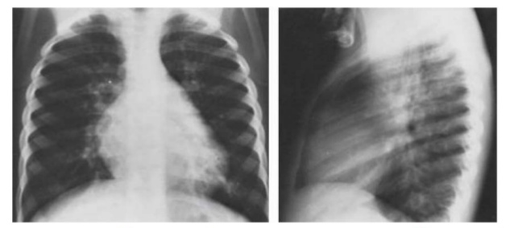
CXR P/A and lateral views of a 10 year old oy with ASD.
Heart is mildly enlarged with involvement of RA ( P/A view) and RV (lat view with obliteration of retrosternal space)
Pulmonary vascularity is increased and the main pulmonary artery segment is prominent.

Slide 9
TRANSTHORACIC 2-DIMENSIONAL (2-D) ECHOCARDIOGRAPHY
Direct noninvasive visualization of most types of ASDs.
Evaluation of the RA,RV and pulmonary arteries, as well as other associated abnormalities.
Most beneficial - subcostal view.
Diagnosis of a sinus venosus defect – TEE.

Slide 10
Pictorial representation:
A- SVC type shows defect in the posterosuperior atrial septum.
B- Secundum ASD – a dropout can be seen in the mid atrial septum.
C- Primum ASD – a defect in the lower atrial septum.

Slide 11
Parasternal short axis: RV dilation with RV pressure overload as evidenced by flattening of the interventricular septum in systole.

Slide 12
M- mode echocardiography show increased RV dimension and paradoxical motion of the interventricular septum, which are signs of RV volume overload.

Slide 13
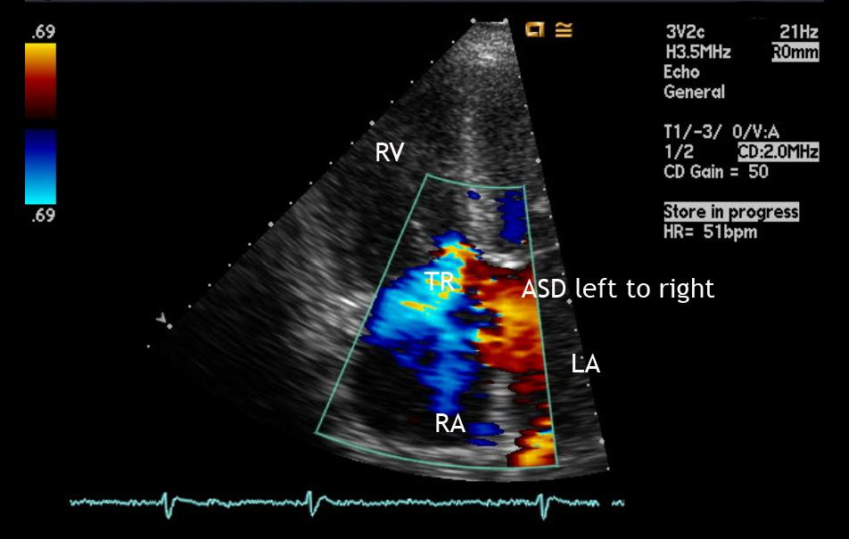
Apical 4-chamber view:

Slide 14
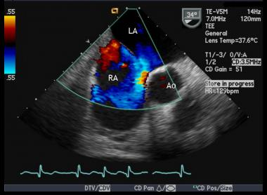
Transesophageal echocardiogram: Moderate-large ASD with left-to-right shunt across the interatrial septum.

Slide 15
Transesophageal echocardiogram:
Ostium primum ASD

Slide 16
Transesophageal echocardiogram -
Provide excellent definition of the atrial septum.
Useful in guiding device placement during catheter ASD occlusion procedures
Immediate intraoperative assurance
Real-time (RT) 3-dimensional (3D) Doppler TEE –
Selection of the appropriate occluder device

Slide 17
Diagnostic Procedures:
CARDIAC CATHETERIZATION:
Useful if the clinical data are inconsistent.
Clinically significant PAH is suspected.
Concurrent CAD in patients over 40 years.
May be confirmed by directly passing the catheter through the defect

Slide 18
Cardiac catheterization:
Serial oxygen saturation measurements - to estimate the magnitude of the shunt
High oxygen saturation is present in the SVC or if the catheter enters a pulmonary vein directly from the right atrium, sinus venosus type is likely.

Slide 19
Cardiac Magnetic resonance imaging (MRI)
Identify the size and position of small ASD.
To quantify RV size, volume, and function along with the ability to identify the systemic and pulmonary venous return.

Slide 20
MANAGEMENT

Slide 21
Medical therapy:
No specific or definitive medical therapy is available.
Significant volume overload or atrial arrhythmias may require specific drug therapy.

Slide 22
Surgical or transcatheter therapy:
Timing of surgery:
In childhood, spontaneous closure of secundum ASD may occur. However, in adulthood, spontaneous closure is unlikely.
Children - 2 to 4 years-clinically significant symptoms or congestive heart failure (CHF).
Adult – best is before age 25 years.

Slide 23
Indications for surgery:
Elective closure is advised for all ASDs with evidence of:
Right ventricular overload
A clinically significant shunt Qp/Qs >1.5
Qp/Qs<1.5
Prevent paradoxical embolization
With PAH ,net left to right shunt is at least 1.5 or + pulmonary artery vasoreactivity test

Slide 24
Contraindications:
Closure of an ASD is not recommended in patients with:
A Small size of the defect and a clinically insignificant shunt (Qp-Qs ratio 0.7 or below).
Severe pulmonary arterial hypertension.
Severe left or right ventricular dysfunction.
Diagnosis during pregnancy (intervention can be deferred until after)
Whether the patient whose condition is diagnosed well in the sixth decade of life would benefit from surgical closure remains controversial.

Slide 25
Percutaneous transcatheter closure:
Suitable for isolated secundum ASD (measuring ≥ 5mm but less than 32mm for Amplatzer septal occluder and less than 18mm for HELEX septal occlude).
The first transcatheter closure of a secundum ASD was performed by Drs King and Mills in the mid-1970s.
Four major devices have become available:
-CardioSEAL
-Amplatzer septal occluder (ASO)- most widely used
-HELEX septal occluder
-Sideris patch

Slide 26
Amplatzer septal occluder (ASO)
ASO device consists of two disks made of Nitinol wire mesh filled with polyster fabric and separated by a narrower waist which is approximateky fitted by balloon sizing.

Slide 27
HELEX septal occluder
Approved in august 2006
Dislike and consists of expanded polytetrafluoroethylene patch material.

Slide 29
Surgical Closure:
Indications:
When device closure is not appropriate
Treatment of choice for ostium primum and sinus venosus defects.
Patients with secundum ASD and anatomy that is not amenable for device closure:
ASD with diameter > 35mm
Inadequate septal rims to permit device deployment
Close proximity to AV valves , coronary sinus or vena cavae

Slide 30
Secundum ASD can be closed by primary suture or autologous pericardial or synthetic patch

Slide 31
Ostium primum defects patch closure

Slide 32
Repair of sinus venous defects and rerouting of anomalous pulmonary venous drainage

Slide 33
Postsurgical prognosis
Pre-operative risk factors:
Older age at operation
Presence of atrial fibrillation
Elevated pulmonary pressure and resistance.
Mortality:
Mortality rate of surgical repair is less than 1% for patients younger than 45 years without heart failure and who have systolic pulmonary artery pressures less than 60 mm Hg.
The morbidity rate is low.
The surgical mortality rate increases with increasing age and pulmonary artery pressures.

Slide 34
Complications of surgery:
Congestive heart failure
Arrhythmias
Pulmonary hypertension
Paradoxical embolization
Stroke
Infective endocarditis

Slide 35
Complications specific for transcatheter occlusion devices:
Device embolization and malpositioning (<1%)
Postimplantation arrhythmias (1%)
Thrombus formation and Thromboembolic events (1.2%)
Cardiac perforation (0.1-0.4%)
Device erosion (0.1-0.15%) leading to Aortic–right atrial fistula , pericardial tamponade.
Residual shunts
Others: pericardial effusion, transient ischemic attack, and sudden death.

Slide 36
Postoperative management and Follow-up:
Six months of treatment with aspirin with or
at least 1 follow-up echocardiogram to confirm complete closure of the atrial septal defect (ASD)
a yearly appointment after the immediate postoperative period is adequate
Anti-arrhythmic drugs for atrial or nodal arrythmias.
Pacemaker therapy may require for sick sinus syndrome after the repair of a sinus venous defect

Slide 37
THANK YOU

