Slide 1
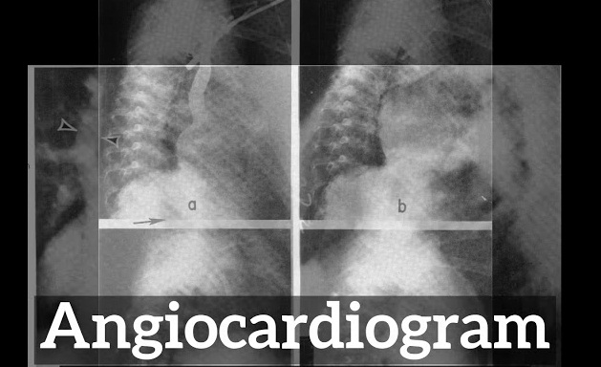
Angiocardiogram- Basics of interpretation
Dr Arun Jude Alphonse
DM Cardiology Resident
Govt TDMC Alappuzha

Slide 2
Basic rules of description

Slide 3
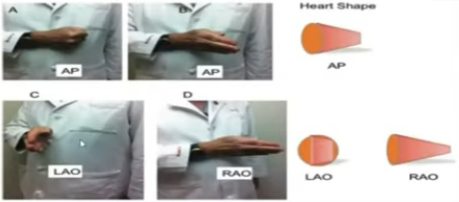

Slide 10
Q1)Describe the view

Slide 11
Angiocardiogram via probable side hole venous catheter
AP view
IVC –RA –RV (coarsely trabeculated IVS)
RV-MPA(Pul Valve)-RPA/LPA(confluent)

Slide 12
LV Cardiogram

Slide 15
VIEWS

Slide 16
LAO

Slide 18
LAO Cranial -1)Basal 2)Lateral 3)Apical 4)Septal
RAO-1)AnteriorBasal 2)Anterior 3)Apical 4)Inferior 5)InferiorBasal

Slide 19
Muscular VSD ASD

Slide 20
Q2)Describe the view?

Slide 21
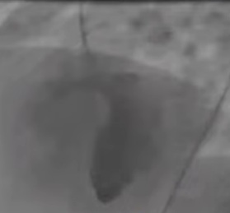
Retrograde cardiogram via Femoral artery(arterial catheter)
LAO Cranial view
Posterior chamber,smooth IVS,continuation with aorta-LV
Horizontal jet(filling chamber) with discontinuation of septum-VSD (Muscular vs Perimemb vs Inlet vs Outlet)
Negative shadow(AML)-Aorto mitral continuity
Coronary origin

Slide 23
MR Quantification-RAO view

Slide 24
Q3)Describe the view? Likely diagnosis?

Slide 25
RAO view
Arterial catheter(pigtail)..descending aorta-LV
Smooth IVS(LV)..LV angiogram
Good LV contractility,No RWMA
MV visible, Grade 3 MR

Slide 26
Angiographic assessment of AR (LAO,Aortic root angiogram)

Slide 27
Q4)Describe the view? Likely diagnosis?

Slide 28
Aortic root angiogram(Desc Ao-Arch of aorta-Aortic root)
LA0 Cranial view, pig tail arterial catheter
Coronary origin
Regurgitation of contrast to chamber connecting to Aorta(LV)- Grade 2 AR

Slide 29
Q5)Likely diagnosis

Slide 30
Aortic root angiogram with hour glass appearance
Supravalvular aortic stenosis

Slide 31
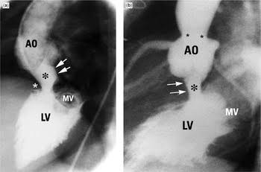
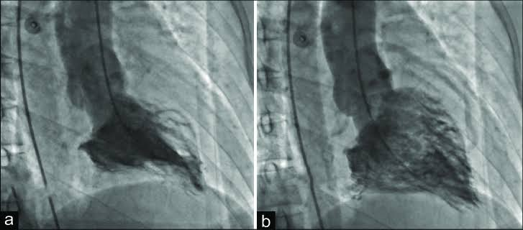
Aortic stenosis,Subarotic stenosis Apical HCM

Slide 32
Q6)Describe the view? Likely diagnosis?

Slide 33
Aortic root angiogram(Desc Ao-Arch of aorta-Aortic root)
LA0 view, pig tail arterial catheter
Coronary origin –RCA normal
LCA not originating from left cusp,fills at end of levophase from PA—course backward
ALCAPA

Slide 34
Q7)Describe the view? Likely diagnosis?

Slide 35
AP view, Aortogram,pigtail catheter in arch of Ao
N –BC ,lt SC,lt CC artery
Brach from Descending Ao to Rt lung
MAPCA

Slide 37
Q8)Describe the view? Likely diagnosis?

Slide 38
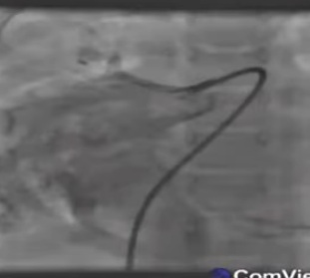
AP view ,catheter in RPA(IVC-RA-RV-MPA-RPA)
Levophase-opacification of RA from venous structure below diaphragm
PAPVR –Scimitar syndrome

Slide 39
Q9)Describe the view? Likely diagnosis?

Slide 40
Rt Brachiocephalic vein-SVC-RPA
MPA-RPA-LPA confluent filling,LPA origin stenosed
Bidirectional Glenn shunt with branch PS at LPA level

Slide 41
Angiographic views in VSD

Slide 42
Q10)Describe the view? Likely diagnosis?

Slide 43
Better profiled in RAO
Outlet VSD(RVOT-PA filled before RV)

Slide 45
Q11) Likely diagnosis?

Slide 46
Mid muscular VSD

Slide 47
Q12)Likely diagnosis

Slide 48
PDA –before and after device closure

Slide 49
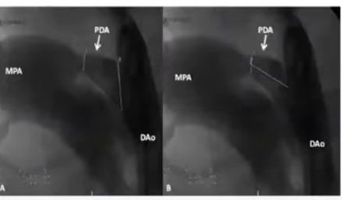
PDA
RAO 30/Lateral

Slide 50
Q13)Describe the view? Likely diagnosis?

Slide 51
AP Cranial,Catheter –venous anterior chamber,Septal coarse trabeculation(RV)_RV angiogram
Infundibular hypertrophy, thick doming PV-Valvular PS
Dilated MPA /N-RPA

Slide 52
Q14)Describe the view? Likely diagnosis?

Slide 53
AP cranial, Catheter in RVOT
VSD RV-LV-Ao filling(after PA filling)
MPA/Infundibular stenosis with small PA
Dilated Aorta
TOF

Slide 54
Q15)Describe the view? Likely diagnosis?

Slide 55
AP view,
Catherter Ao-Morphological RV
Another catheter IVC-RA-?Morpholical LV
Situs inversus,Dextrocardia
ccTGA

Slide 56
Q16)Likely diagnosis?

Slide 57
RA-SVC(aneurysmal)-Vertical vein
PAPVC

Slide 58
THANK YOU

