Slide 1
BASICS OF PACEMAKER
Dr.Aju Ajay

Slide 2
Topics
History of Pacemaker
Components of Pacemaker System
Ohms law
Resistance/Impedence
Threshold
Output Pulse
Pacemaker Sensing

Slide 3
History
1930s --> Hyman’s “artificial pacemaker” -hand cranked current directed to RA intercostal space.
Walton Lillehei –(1957)had performed over 300 open-heart operations on young adults and children with congenital defects.
Earl Bakken, battery-powered device
Modified it and named the company he founded MEDTRONIC

Slide 4
1960, Rune and Senning of Stockholm -->first fully implantable pacemaker in Arne Larsson.
Arne Larsson ultimately went on to undergo over 20 pacemaker replacements

Slide 5
Implantable Pacemaker Circuit
Pulse Generator
Battery
Circuitry
Connectors
Leads/Wires
Cathode(-electrode)
Anode(+electyrode)
Body tissue

Slide 7
The Pulse Generator
Common battery compositions
Lithium Iodide
Lithium Vanadium Oxide with carbon monofluride
Starting battery voltage will vary depending on composition

Slide 8
Pacemaker Battery
Longeivity of battery depends on output and resistance
Usually 6-12 yrs

Slide 9
Pacemaker Battery
Most LiI battery have BOL-2.8V
RRT/ERI-2.6V(recomended replacement time/elective replacement indicator)
EOL/EOS-2.5V(end of life/end of service)
As battery depletes its internal resistance goes up,BOL-100 ohm,
EOL->5000 ohms

Slide 11
Battery Properties
Reliability
Hermeticity
Low self discharge
High volumetric energy density
Battery Life=Capacity/Current Drain
eg.
=25Ah/25microampere
=80,000 hrs
=9.3 yrs

Slide 12
LEADS
Insulated wires
Deliver electric impulses from PG to heart
Sense cardiac depolarisation

Slide 14
Unipolar Pacing System

Slide 15
Bipolar Pacing System

Slide 18
Transvenous leads
Passive fixation (tined)
Tines lodge in the trabeculae of thr apex or the pectinate of the appendage which are fibrous meshwork
Active fixation (screw in)
Helix/screw extends into the endocardial tissue
Allows for lead positioning anywhere in heart chamber.

Slide 19
Passive And Active lead Fixations

Slide 21
Lead Insulators
Silicon insulations
inert
biocompatible
biostable
Polyurethane insulations
biocompatible
high tear strength
low friction co efficient
smaller lead diameter

Slide 24
Polarisation Phenomenon

Slide 25
Polarization
After an output pulse positive charges gather near the electrode
Represents 30-40% of the total pacing impedence
Ists directly proportional to Pulse duration and inversly to functional electrode size

Slide 26
Characteristics of an electrical circuit
Voltage
Impedence
Current

Slide 28
Resistance v/s Impedence
Opposition to current flow in a circuit-Resistance
Measured in ohms (Ω)
Function detrmined by conductor electrode tissue interface
Resistance is used for simple circuits (constant V & I)
Impedence for complex circuits (varying V & I)

Slide 31
Impedence in Insulation Failure

Slide 32
Lead fracture

Slide 34
Summary of Impedence
Normal lead impedence-300-1500 ohm
Lead fracture->2000
Insulation failure-<200

Slide 35
THRESHOLD
The minimum electrical stimulus needed to consistently capture the heart outside of hearts own refractory period
2 components
Amplitude-Voltage
Pulse width-Time

Slide 39
Factors that affect threshold are
Characteristics of electrode
Pacemaker circuit integrity
Insulation break
Wire fracture
Pacemaker placement within heart
Drugs
Electrolytes

Slide 42
Lead Maturation

Slide 44
Steroid Eluting Electrode
Reduces the inflammation
No acute stimulation threshold peaking
Maintain low chronic threshold

Slide 45
Energy

Slide 48
Sensing of intrinsic beat
Ability to see when an intrinsic depolarisation occurs
EGM recorded between anode and cathode
Cardiac waveform within the heart
2 characteristics of EGM
Signal amplitude and slew rate

Slide 50
Slew rate
Change in voltage wrt change in time
Longer the signal takes to move from peak to peak
Lower the slew rate
Flatter the signal
Higher slew rate translates to better sensing

Slide 51
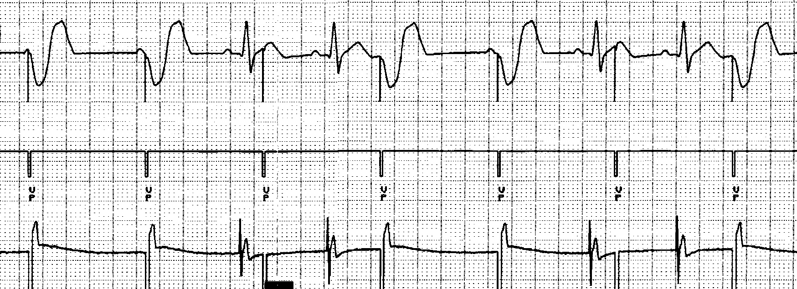
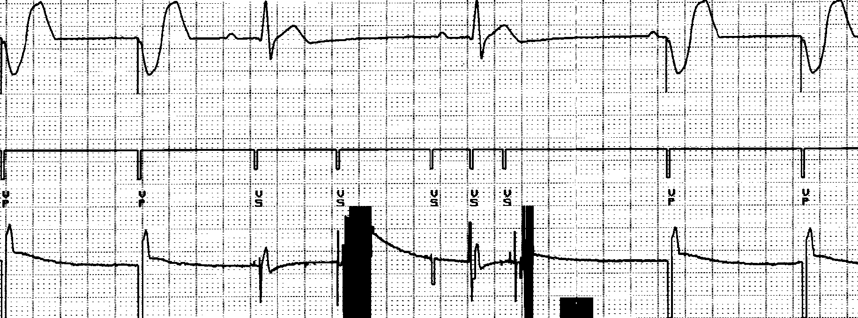
Definition
The ability of a pacemaker to sense an intrinsic electrical signal (mV)
When programming sensitivity
Raising the sensitivity number makes the pacemaker less sensitive !

Slide 53
PACEMAKER NOMENCLATURE AND MODES

Slide 54
History
1987
NAPSE- North American Society of Pacing And Electrophysiology (HRS)
BPEG - British Pacing and Electrophysiology Group
NBG code →NAPSE/BPEG GENERIC CODE

Slide 56
Code combinations
SINGLE CHAMBER MODES
VOO
VVI
AOO
AAI
DOUBLE CHAMBER MODES
DDD
VDD
DDI
DOO

Slide 57
SINGLE CHAMBER MODES
VOO
VVI
AOO
AAI

Slide 58
VOO(asynchronous pacing) VVI
FUSION
V-PACNG IN VENTRICLES
O-SENSING IS OFF
O-RESPONSE TO SENSING IS OFF
V-PACNG IN VENTRICLES
V-SENSING IN VENTRICLES
I- INHIBIT

Slide 59
AOO AAI
A-PACNG IN ATRIUM
O-SENSING IS OFF
O-RESPONSE TO SENSING IS OFF
A-PACNG IN ATRIUM
A-SENSING IN ATRIUM
I-INHIBIT

Slide 60
DUAL CHAMBER MODES
TRACKING MODES
DDD
VDD
NON TRACKING MODES
DDI
DOO

Slide 61
DDD tracking mode
LRL=60bpm & AV delay=200ms
As
Ap
Ap
Vs
Ap
Vp
Vp
Vp
Vs

Slide 62
4 DISTINCT PACING PATTERNS
AsVs
AsVp( p wave tracking)
ApVs
ApVs

Slide 63
AsVs
ApVs
AsVp
ApVp

Slide 64
VDD Tracking mode
200ms
↑
V -PACING IN VENTRICLE
D -SENSING IN V & A
D -INHIBIT AND TRIGGER

Slide 65
VDD mode
Pace and inhibit in the ventricle
Sense in A &V
MAINTAIN AV SYNCHRONY
Only in patents with good sinus node function
Used in situation where there is high pacing threshold in Atrium
Major downfall- if at any time the Atria rate falls below the pacemaker’s LRL →loss of AV synchrony

Slide 66
DDI non-tracking mode
D-PACING IN A & V
D- SENSING IN A & V
I-RESPONSE TO THAT SENSE WILL EITHER PACE OR INHIBIT
AAI AND VVI OPERATING AT THE SAME TIME BUT INDEPENDENT OF EACH OTHER

Slide 67
DOO -NON TRACKING MODE
Uses
Magnet mode
When trouble shooting
Surgery

Slide 68
RATE RESPONSE
Chronotropic incompetence
Uses sensors
Accelerometer
Minute ventilation

Slide 69
MSR
Maximum sensor rate
DDDR,VVIR…
Used when pacemaker is pacing in response to the sensors

Slide 70
Pacemaker timing cycles
PACING AND SENSING
Single chamber timings
LRL-base rate
Restarts with each paced and sensed beat
1min=60s =60,000ms
2 timers are always on in SCP
LRL
REFREACTORY PERIOD-SENSE THE EVENT BUT DOES NOT RESPOND

Slide 71
Refractory Periods ARP -Atrial Refractory Period(AAI mode) PVARP- Post Ventricular Atrial Refractory Period VRP - Ventricular Refractory Period
Escape beat
VVI

Slide 72
AAI
SINGLE CHAMBER TIMINGS

Slide 74
DUAL CHAMBER TIMINGS
Example
LRL =60bpm(1000ms)
AV delay = 200ms
VA Delay = 1000ms-200ms=800ms

Slide 75
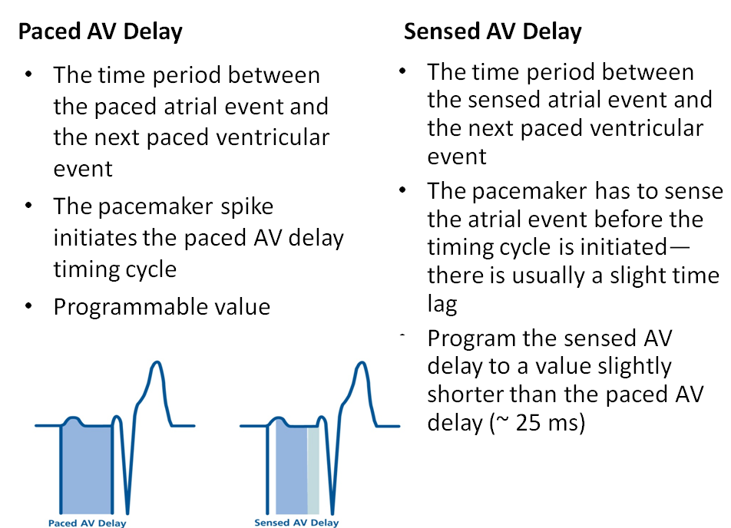

Slide 76
ApVp(AV sequential pacing)

Slide 77
AsVs (complete inhibition)

Slide 78
ApVs(A pace with intrinsic AV conduction )

Slide 79
AsVp (P wave tracking )

Slide 80
Blanking period
Disables its sensing amplifiers after a pacing pulse
To prevent cross talk
A BLANK AND V BLANK

Slide 81
Blanking
A Blanking
Occurs after V pace
Blanking time for atrial channel
V blanking
Occurs after atrial pace
Blanking time for ventricular channel

Slide 82
URL(MTR)
Maximum speed limit for how fast the pacemaker can pace in response to increased intrinsic atrial rate
A safety feature in the context of A fib

Slide 83
MSR
Maximum sensor rate
DDDR,VVIR…
Used when pacemaker is pacing in response to the sensors

Slide 85
Upper rate behavior
Only occurs when p wave tracking occurs at URL/MTR
Happens when certain sensing occurs during the right timer, funny behavior follows.
NOT A MALFUNCTION
Occurs when an intrinsic atrial beat occurs before the following timers end.
PVARP
TARP( AV delay + PVARP)
MTR/URL

Slide 86
3 types
2:1 block
Pacemaker Wenckebach
PMT

Slide 87
2:1 BLOCK

Slide 88
How to calculate 2:1 block point
60,000/TARP
Example
TARP=500ms
BLOCK POINT =60000/500=120bpm

Slide 89
Pacemaker Wenckebach
When sinus rate increases
Atrial sense can occur bfr the MTR expires
So it has to wait to pace the ventricle by extending the AV delay
This progresses eventually p occurs within the REFRACTORY period leading to missed Vp

Slide 93
UPPER RATE BEHAVIOUR
Minimised by using
RATE RESPONSE MODES
When sinus rate hits 2:1 block point (instead of reducing to half )
Sensor indicated rate ~ 90bpm

Slide 94
PMT(Pacemaker Mediated Tachycardia)
Caused by the pacemaker where it is tricked into thinking that it is P wave tracking at or near the upper rate limit
Endless loop and req an outside interaction to terminate it
Appear a AsVp at or near MRT/URL

Slide 97
3 pre requisites for PMT
Loss of AV synchrony
Intact retrograde AV conduction
VA > PVARP
PREVENTION OF PMT
Increasing the PVARP
PMT termination algorithm
PVARP prolongation after PVC
PROGRAMMABLE FEATURES

Slide 98
PACEMAKER SYNDROME
MC seen in the setting of a VVI
loss of AV synchrony which leads to a loss in stroke volume and cardiac output.
Incidence varies widely (20% with VVI in MOST trial )
AV & VV dyssynchrony
Decreased CO and increased back-pressure

Slide 99
Cntd,
Symptoms
Neurologic: Fatigability, memory loss, confusion, and often transient blackouts
Cardiovascular: exertional dyspnea, orthopnea, palpitations, decrease in exercise capacity, syncope
Hemodynamic: Prominent neck pulsations, abdominal pulsations, right upper quadrant (RUQ) pain

Slide 100
Examinatons
Hypotension, tachypnea, low oxygen saturation, lung rales
Narrow pulse pressure and low pulse volume
Neck vein distension and cannon a wave
Regurgitant murmurs and variability in the intensity of s1
Pulsatile liver and ascites may be present in severe cases
Treatment →switching to DDD/VDD modes

Slide 101
Pacemaker related dysarrythmias

Slide 102
Runaway pacemaker
Pacemaker malfunction resulting in an inappropriately fast pacing rate (100 to 2100 ppm has been reported).
Unpredictable, can be intermittent
Represents a medical emergency → removal of the pulse generator
Reports were published 1965
The mortality of runaway in unprotected pacemakers was 34% in a series of 44 case
Two categories

Slide 103
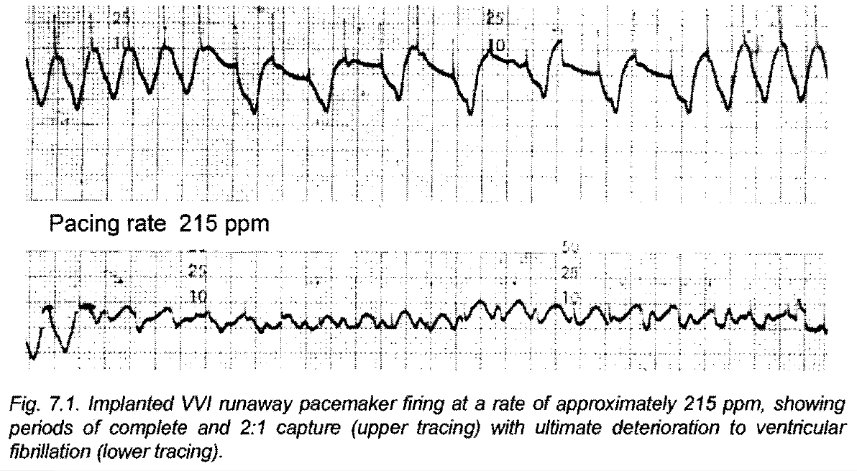

Slide 104
Spontaneous runaway pacemaker
Battery depletion or the influx of body fluids into the electric circuitry.
This body fluid affected the electrical components resulting in changes in pacemaker timing thus allowing high pacing rates
Hermetically sealed pacemaker housing

Slide 105
Externally induced runaway pacemaker
following electrocautery, application of a coil of a pacemaker analyzer, radiation therapy
All reported cases were irreversible
Incorporating runaway protection circuits.
A runaway protection rate of 140 ppm in single chamber.
The runaway protection rate in dual chamber systems varies from 180 to 200 ppm.

Slide 107
Management of runaway pacemaker
Two reports describe successful inhibition of the implanted device by overdrive chest wall stimulation.
Recommended therapy is immediate replacement or disconnection of the pulse generator
Magnet application no effect

Slide 108
Sensor Mediated Tachycardia (SMT)
False triggering of the sensor, which subsequently gives rise to an inappropriate high pacing rate.
l. SMT induced by sensor detected "interference".
2. SMT induced by positive sensor feedback.

Slide 109
Sensor mediated tachycardia induced by interference
SMT induced by interference is caused by lack of specificity
When interference stops or is eliminated, normal pacemaker function is restored.
SMTs related to interference have been reported for activity, temperature and respiration sensors.

Slide 110
Sensor Mediated Tachycardia induced by positive feedback
Secondary reaction to the pacemaker stimulus (e.g. muscle twitching) is detected by the sensor thus increasing the pacing rate.
Pacing rate can rise to the programmed upper rate.
Positive feedback SMT is usually sustained but is easily terminated and prevented by reprogramming the pacing system.
Rate never exceeded the MTR

Slide 111
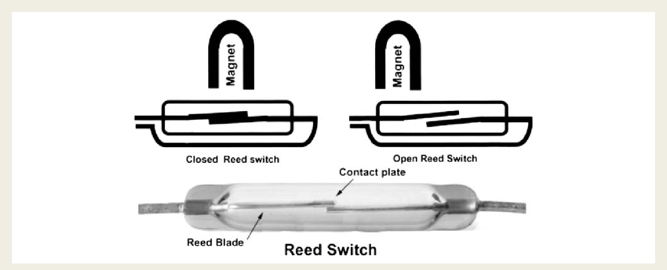
MAGNET MODE
Pacemakers have metallic REED SWITCH
On & off possible with external magnet
SWITCH ON→SENSING FUNCTION NULL AND VOID
ASYNCHRONOUS MODE

Slide 112
Effect of magnet applicaton
VVI→VOO
AAI→AOO
DDD→DOO
USES
Safety mechanism to prevent external sensing
Detect the ERI
During electrocautery and related procedures

Slide 113
Magnet rate
Pacing rate will be 85 bpm for pacemaker battery levels above ERI
65 bpm for battery levels below ERI(This operation is specific to Medtronic devices)
When the magnet is removed, the previously programmed mode returns

Slide 114
Programing

Slide 118
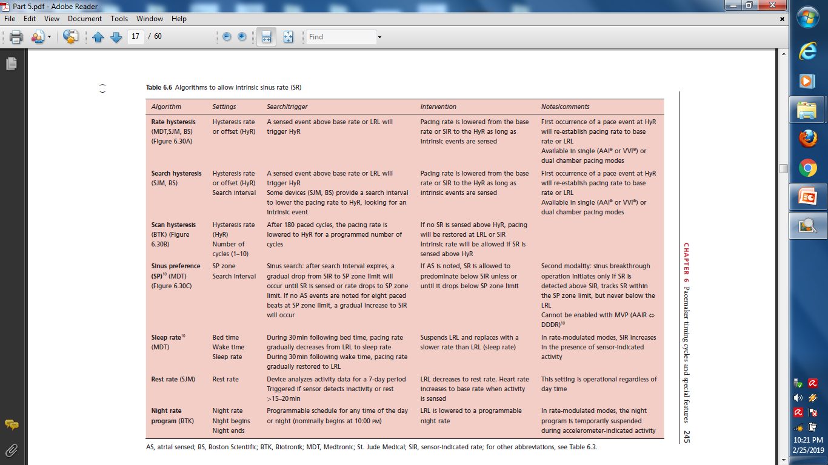

Slide 125
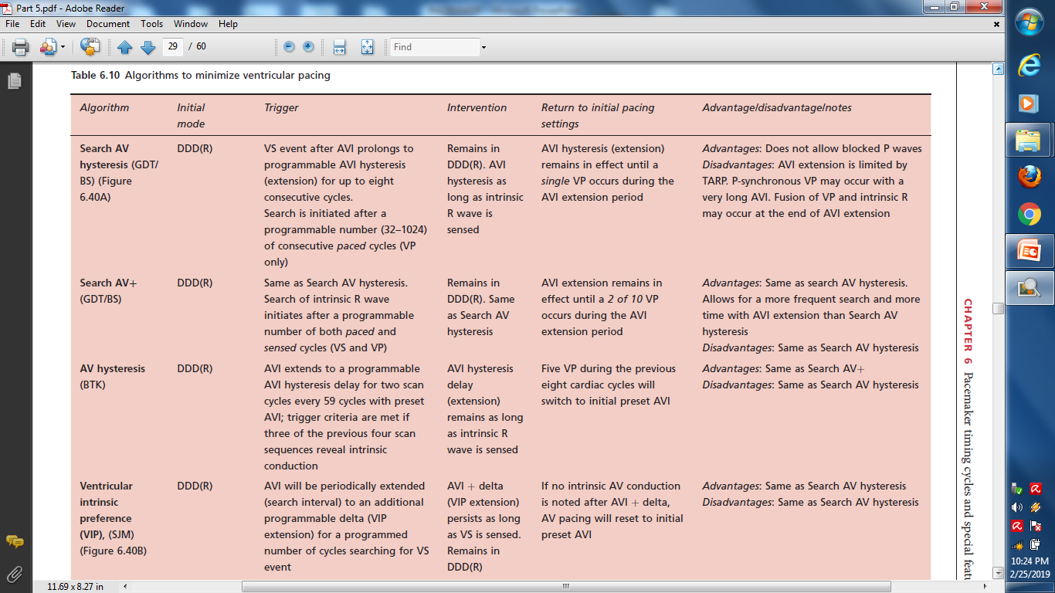

Slide 127
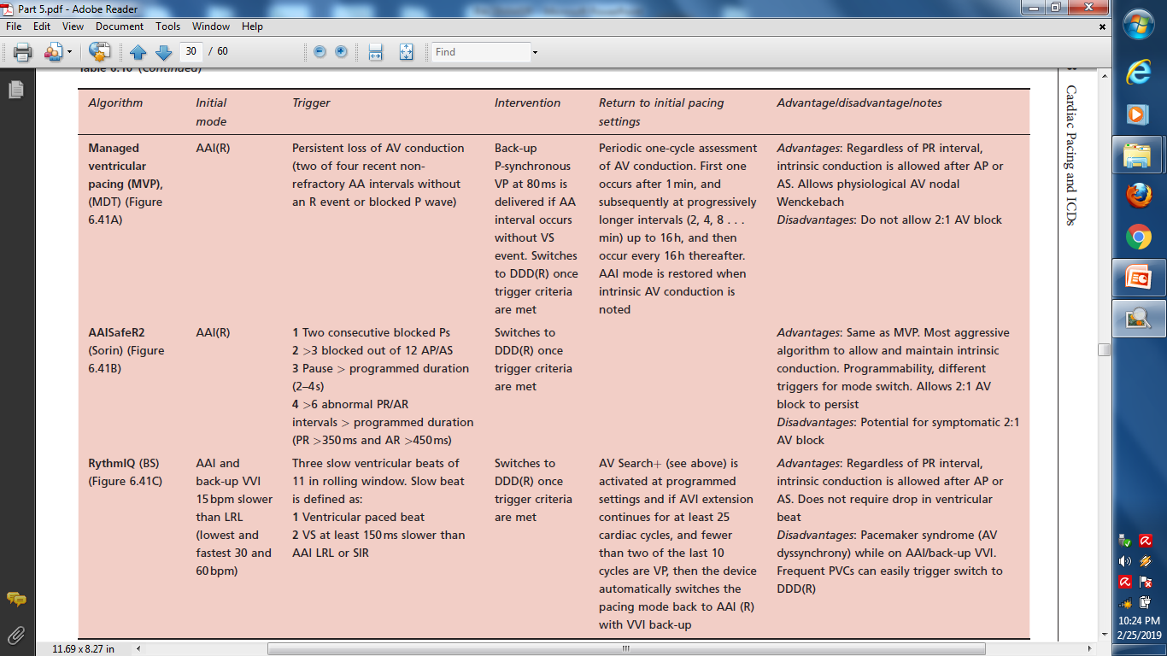

Slide 129
Thank you

