Slide 1
BIORESORBABLE SCAFFOLDS
Dr.Anjos

Slide 2
BIORESORBABLE SCAFFOLDS

Slide 3
BIORESORBABLE SCAFFOLDS
Metallic Stents Disadvantages
Characteristics of Optimal BRS
Restrict physiological vasomotion & adaptive arterial remodelling
Chronic foreign body reaction-inflammation.
Impair placing bypass grafts
Neoatherosclerosis-late stent thrombosis
Permanent side branch jailing
Opaque to CT/MRI
Short term scaffolding
Radial strength to avoid recoil
Biocompatable
Absorb completely
Deliverable and flexible
“SCAFFOLDING IN SHORT TERM& DISAPPEAR LONGTERM”

Slide 4
MATERIALS USED FOR BRS
Bioabsorbable polymers
Corrodable metal based alloys
Polylactic acid
Polyglycolic acid
Polycaprolactone
Tyrosine derived polycarbonates
Magnesium alloy
Iron alloy

Slide 5
Evolution of BRS
Igaki Tamai
ABSORB Bioresorbable Scaffold
PLLA
Self expanding
Followup(n=50) @ 3 y
TLR-28%,1 cardiac death,4 MI
PLLA backbone+coated with PDLLA
Abbot Vascular

Slide 6
Clinical Trials of Absorb BRS
ABSORB A
ABSORB B
N=30
2 year MACE incidence (3.4%)
Noninferior to DES
MACE(7% at 12 months & 11% at 3 yrs)

Slide 7
Clinical Trials of Absorb BRS
ABSORB II
ABSORB III
RCT(n=508)
ABSORB BVS v/s Xience
Scaffold Thrombosis
(2.8% v/s 0% p=0.03@3 y)
RCT
N=2008
End point=TLF,target vessel MI
1year-noninferior(7.8 v/s 6.1 p=0.007)
2y=11v/s 7.9(p=.03)
Overall device thrombosis high in BVS

Slide 8
Clinical Trials of Absorb BRS
AIDA
Different METAANALYSIS
N=1845
2y high rate of Scaffold thrombosis(3.5 v/s 0.9 ,p<0.0001)
N=5580
Higher 2 year relative risk for device related adverse end points

Slide 9
Lessons from ABSORB trials-reasons for suboptimal perfomance
Device related
Patient related
Thicker strut-hinder endothelisation
Struts protruding to lumen-promote thrombosis
Dismantling phenomenon
Loss of structural integrity during resorbtion-resemble stent fracture-increases inflammation&structural deformation-late ScT
DM,CKD,Low EF,smokers,age
ACS-high thrombotic burden,vasoconstriction-inappropriate sizing
DAPT discontinuation
DAPT(ticagrelor /prasugrel *30 days)
Followed by clopidogrel

Slide 10
Lessons from ABSORB trials-reasons for suboptimal perfomance
Lesion related
Procedure related
Vessel size-below 2.25 mm
Bifurcation lesion
Ostial lesion
Longer lesion
Calcified lesion
Predlation->/=1:1 reference vessel diameter NC ballon
Sizing
Postdilation-NC ballon,16-25 atm sized upto 0.5mm nominal vessel diameter

Slide 11
Other BRS
 | DESolve | ART PURE | FANTOM | MeRes 100 | Magmaris
STRUT MATERIAL | PLLA | PDLLA | TYROSINE POLYCARBONATE | PLLA | Mg
DRUG | Novolimus | None | Sirolimus | Sirolimus | Sirolimus
THICKNESS |  | 170 mcm(thickest) |  | Thinnest(100 mcm)
RESORPTION TIME | 2y | 2y | 3 y | 2y | 1 year

Slide 12
Bioresorbable Metal Scaffolds
Magmaris
Magnesium alloy coated with PLLA ,tantalum radioopaque marker at both ends.
95% resobtion in first year.
Mghydroxide ->Mgphosphate->calcium phosphate(Mg removed by diffusion)
MAGSTEMI- magmaris v/s DES –magmaris worse performance

Slide 13
Bioresorbable Metal Scaffolds
Iron Alloy based scaffolds
Slow degradation rate
Involve oxidation of ferrous to ferric iron
Interfere with MRI
Special storage conditions

Slide 14
Conclusion
2 decades ago concerns were raised regarding efficacy of metallic DES,it has evolved over multiple generations to reach current efficacy.
More RCTs are needed to determine whether theoretial advantage of BRS offset its limitations.

Slide 15
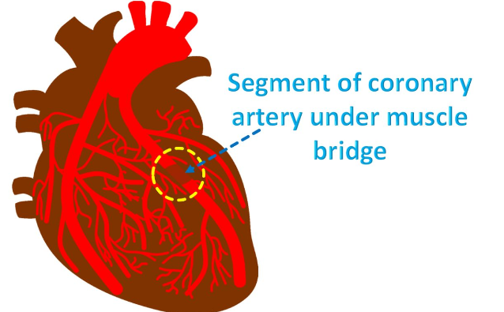
MYOCARDIAL BRIDGE

Slide 16
MYOCARDIAL BRIDGE
Tunneling of epicardial coronary under myocardium.
Prevalence-0.5-16%
Common-mid segment of LAD

Slide 17
Classification of myocardial bridge
Superficial variant-involve LAD in groove between ventricle
Deep variant-seeps in between intraventricular septum

Slide 18
Clinical presentation
Asymptomatic /benign
Chestpain or SOB mimicking ACS
Arrythmia
Diastolic dysfunction,coronary vasospasm or ventricular hypertrophy –symptoms in previously asymptomatic

Slide 19
Pathophysiology
Increased atherosclerosis
Variant wall shear stress in pre and post bridge portion-increased VCAM1 and ROS-proatherogenic environment.
Sometimes poor coronary perfusion due to bridging extending to diastole.

Slide 20
Diagnosis
1.CAG
Milking effect-systolic narrowing.
2.CTCA
3.IVUS
Halfmoon sign-echo lucent area
4. Diastolic FFR
Asses pathophysiology of bridging

Slide 21
Special consideration in athletes
Autopsy and CCTA suggest increased prevalence of myocardial bridge
Hypertension &LVH pecpitate symptoms
Hence many become symptomatic later in life

Slide 22
Schwartz classification of myocardial bridge&Management
A- only symptoms ,no signs of ischemia
B-Signs of ischemia on non invasive stress test
C-signs of ischemia with altered intracoronary hemodynamics
A-No treatment
B-Medical
C-Medical if still symptomatic revascularisation

Slide 23
Medical management
Betablockers
CCB
Nitrates –contraindicated
Dilated adjacent nonbridged vessel and worsen compression
Antiplatelet
Statins

Slide 24
PCI in myocardial bridge
Increased chance of perforation,stent thrombosis,fracture
Not widely used.
Conclusion from studies
1.Symptomatic patients undergoing PCI has high rate of ISR
2.DES have better result compared to BMS
Absence of RCTs
Medical therapy better than PCI

Slide 25
Surgical therapy
CABG
Myotomy
Surgical therapy better than PCI
Done only if symptomatic despite OMT
CABG preffered if bridge
deep(>5mm)
long (>25 mm)
Failed myotomy
Muscle fibres overlying bridge resected.
No RCTS comparing both.

Slide 26
Noncardiac Surgery in Patients with Heart Disease
Exercise tolerance is one of the strongest determinants of perioperative risk and the need for invasive monitoring.
Several scales based on activities of daily living have been proposed to assess exercise tolerance current guidelines advocate the Duke Activity Scale Index

Slide 27
Risk stratification of procedures

Slide 28
Cardiac condition for which patient should undergo cardiac evaluation and treatment

Slide 30
Risk Calculators
RCRI(Revised Cardiac Risk Index)
ACS-NSQIP
1.high-risk type of surgery
2. history of ischemic heart disease
3 history of congestive HF
4 history of cerebrovascular disease
5 preoperative treatment with insulin
6. preoperative serum creatinine concentration greater than 2.0 mg/ dL
0/1-low,2-intermediate,3/more-high
type of surgery,
dependent functional status,
abnormal creatinine level,
American Society of Anesthesiologists class
age.

Slide 31
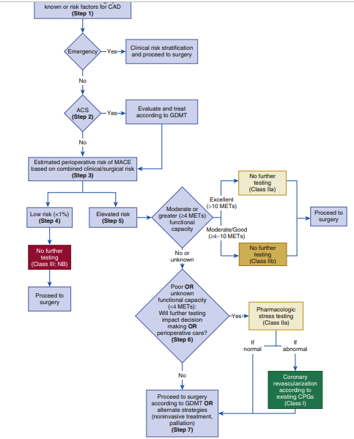

Slide 32
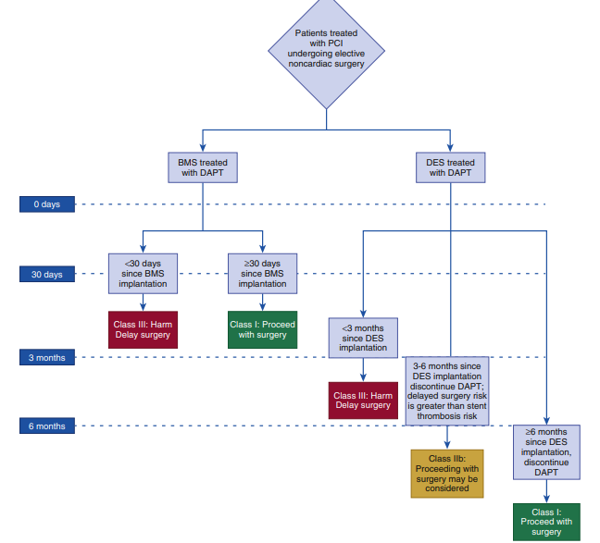
Surgery in patients post PCI

Slide 33
Proteomics and Metabolomics in Cardiovascular Medicine
Proteomics aims to catalogue the entire protein products of the human genome.
Metabolomics attempts to systemically capture smaller biochemical compounds, including simple amino acids and related amines, as well as lipids, sugars, nucleotides, and other intermediary metabolites.(<2kDa size)
“Snapshots” of the state of a cell or organism.
Identify novel biomarkers
Provide information on biology and highlight potential therapeutic target.

Slide 34
Environment and microflora contribute to metabolome.

Slide 35
Classification
Nontargeted-identify all the metabolites in a sample.
Targeted-only specific metabolites identified

Slide 36
Tools of proteomics and metabolomics
1.Nuclear magnetic Resonance
1H,13C,15N,31P based
2.Mass spectrometry
Based on mass to charge ratio(m/z )
-Gas chromatography based
-Liquid chromatography based

Slide 37
Application in Cardiovascular Diseases
Heart failure
Healthy heart-mitochondrial fatty acid oxidation
Pathological hypertrophy –glucose metabolism.
HF ACTION trial-circulating level of long chain acylcarnitine as independent predictor of mortality and functional status in cnronic heart failure
Myocardial Ischemia & Infarction
Tissue succinate levels regulate production of reactive oxygen species in reperfusion
Modulation of succinate metabolism is considered as option to reduce ischema reperfusion injury.

Slide 38
Indian BRS
1.Me Res 100
2.Magmaris
3.DESOLVE
4.FANTOM

Slide 39
Choose the odd one out
1.ABSORB
2.DESOLVE
3.FANTOM
4.ME RES

Slide 40
Halfmoon sign seen in
1.CAG
2.CCTA
3.IVUS
4.FFR

Slide 41
Which of the following is a low risk surgical procedure(AHA guidelines 2016)
1.Thyroidectomy
2.TURP
3.Mastectomy
4.THR

Slide 42
Metabolomics attempt to catalogue molecules below
1.5 Da
2.5 kDa
3.2 Da
4.2 kDa

