Slide 1
Bifurcation stenting
Dr.Aju Ajay

Slide 2
Bifurcation lesions
Its a lesion at, or adjacent to, a significant division of a major epicardial coronary artery equal to or more than 50% stenosis within 3mm from bifurcation carina in vessels with >=1.5mm in size.
Incidence is approx 20%
Conventional MB stenting results in 14%-18% periprocedural MI in bifurcation lesions.

Slide 3
True bifurcation – main branch (MB) & side branch (SB) are both significantly narrowed (> 50% diameter stenosis).
Non true bifurcation – includes all other lesions involving a bifurcation
6 different classifications of bifurcation lesions.

Slide 4
MEDINA CLASSIFICATION
Most simplified & widely used approach.
The presence of “1” means >50% diameter stenosis & “0” means the absence of stenosis, in each of the 3 bifurcation segments, starting with proximal MB, distal MB & prox SB.

Slide 5
MEDINA CLASSIFICATION

Slide 6
Limitations of Medina classification
It doesn’t mention about side branch size & area of myocardial supply.
Doesn’t mention about side branch anatomy & length of stenosis.
Bifurcation angle is not denoted.

Slide 7
Bifurcation anatomy
The proximal angle (proximal main branch – side branch) is called the TAKE OFF angle.
The distal angle (distal main branch – side branch) is called the CARINAL angle.
The point bifurcation is the point where the central lines from the 3 segments meet.
According to MURRAY’S description of anatomy
r3 = r13 +r 23, where r is the radius of the proximal main branch, r1 is the radius of the distal main branch & r2 is radius of side branch.

Slide 8
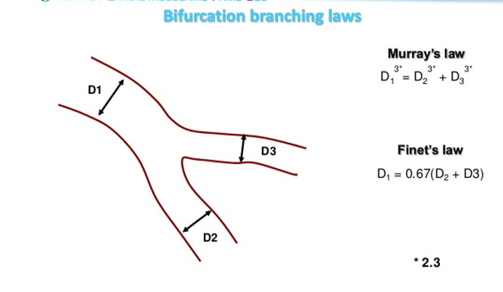
Finet decribed this relation as follows
D/(d1+d2) = 0.67, where D is the diameter of PMB, d1 that of DMB and d2 the diameter of side branch

Slide 9
Carinal angle
Has a role in determining the procedural success.
“Y” shaped (<70) or” T” shaped (if the angle is > 70)
According to Lefevre et al “Y” shaped carinal angle increases the risk of periprocedural complications such as side branch occlusion, deformation of the side branch stent & inadequate side branch ostial coverage with stent.
Y shaped angle permits easy wire, balloon & stent delivery
Carinal angle determines
The risk of side branch compromise.
The ease of side branch rewiring & ballooon , stent delivery.
Coverage of the side branch ostium & deformation of the side branch stent.

Slide 10
DUKE CLASSIFICATION

Slide 11
SANBORN CLASSIFICATION

Slide 12
SAFIAN CLASSIFICATION

Slide 13
LEFEVRE CLASSIFICATION

Slide 14
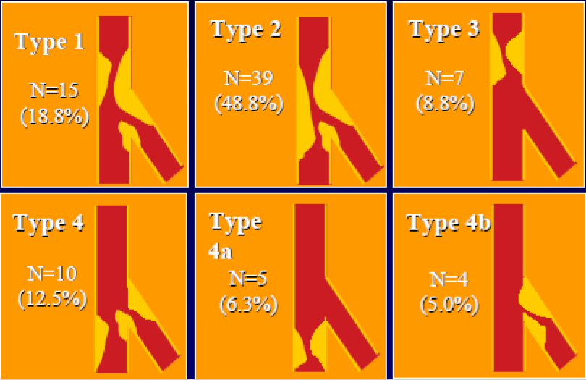
Type 1 & 2 are most difficult to treat (constitute 70%)

Slide 15
SYNTAX STUDY

Slide 16
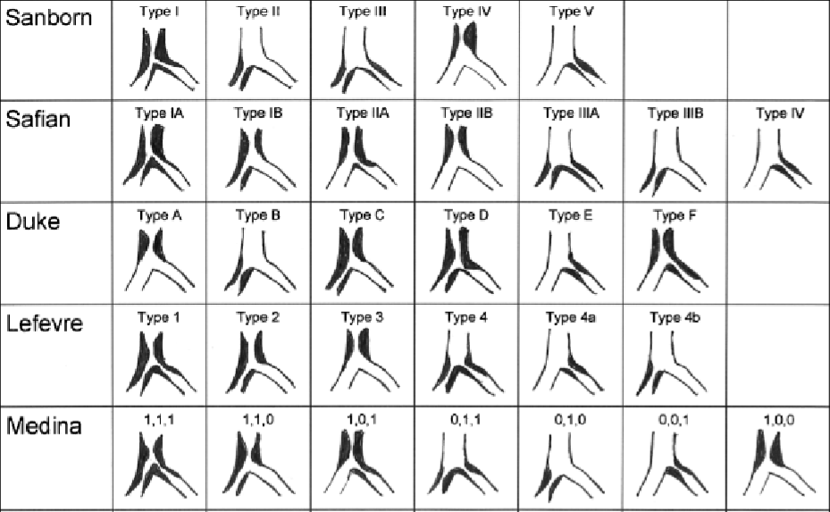

Slide 17
Sirolimus eluting stent (SES) bifurcation study,Colombo et al
1st attempt to provide specific information in this subset of lesions.
85 pts were randomly assigned to either stenting both branches or stenting the MB only with PS of the SB.
Restenosis at 6 months did not differ significantly between SS & the SB groups

Slide 19
During 6 months follow up, there was no significant difference between groups in death, MI, TVR or TVF (19% vs 13.6%).
This study also demonstrated that compared with historical studies, utilising BMS a clear improvement has been achieved in the treatment of bifurcation lesion when 1 or 2 DESs were implanted.

Slide 21
Pan et al
Assessment of side branch predilation before a provisional T-stent strategy for bifurcation lesions.
372 pts Randomised
predilation
no predilatation

Slide 22
Predilation of the SB resulted in improved TIMI flow after MB stenting
less indication to treat the SB

Slide 23
Nordic Bifurcation Study

Slide 25
The Nordic Bifurcation Study
Cross over from PS to stenting 2 branches was allowed if TIMI flow following SB dilation was 0 & was only 4.3%.
At 6 months, there was no difference between the 2 groups regarding cardiac death, MI, TVR, TLR & stent thrombosis.
At 5 yr follow up, the combined safety & efficacy end point of cardiac death, non procedure related MI, & TVR remained similar & were seen in 15.8% of pts in the PS group, as compared with 21.8% in the 2 stent group.

Slide 27
CONCLUSION
Independent of stenting strategy, excellent clinical and angiographic results were obtained with sirolimus-eluting stents
MV group was associated with reduced procedure and fluoroscopy times

Slide 28
Nordic Bifurcation Stent Technique Study (BIF II)
This is a study of crush- or culotte stenting of bifurcation lesions using drug eluting stents.

Slide 30
Both the crush and the culotte bifurcation stenting techniques were associated with similar and excellent clinical and angiographic results.
Angiographically, less in-segment restenosis and significantly reduced ISR following culotte stenting.

Slide 31
the Nordic-Baltic Bifurcation Study III
Randomized Comparison of FKBD Versus No FKBD in Patients With Coronary Bifurcation Lesions Treated With Main Vessel Stenting

Slide 33
Conclusions
MV stenting with and without FKBD was associated with favorable and similar 6-month clinical outcomes
No-FKBD procedure resulted in reduced use of contrast media and shorter procedure and fluoroscopy times
Angiographic SB outcome was improved by FKBD, especially in patients with true bifurcation lesions.

Slide 34
Bifurcation Bad Krozingen (BBK) Study
Ferenc et al, compared 202 pts randomly allocated to either provisional T stenting or routine T stenting utilising SES.
Primary end point was % diameter stenosis of the SB at 9 month angiographic follow up & similar between the 2 groups (p=15).
The overall 1yr incidence of TLR after provisional & routine T stenting was also similar, as well as the primary clinical outcome (composite of death, MI, TLR was 12.9% vs 11.9%, p=0.83)

Slide 35
BBK II trial
300 pt`s with bif lesions requiring SB stenting were randomized to undergo T stenting and TAP or culotte stenting. ▪
9-month angio follow-up, which was available for 91% of the pt`s, revealed higher binary restenosis rate after TAP as compared with culotte (17.0% vs. 6.5%, P = .006), ▪
1-year incidence of TLR was 12% in the TAP group and 6% in the culotte group (P = .069).

Slide 36
CACTUS TRIAL
350 pt`s were randomly allocated to either provisional T (173) or crush (177) SES implantation, with mandatory FKBI in both groups.
92% pt`s had true bifurcations, crossover rate in the prov. T group was 31%. ▪
@ 6 months; angio restenosis rates were not diff. b/w the crush group (4.6% and 13.2% in the MB and SB, respectively) and the PS group (6.7% and 14.7% in the MB and SB, respectively; P = not sig.). ▪
Pre clinical outcome (death, MI, revas.) was also similar in both groups (15.0% prov. vs. 15.8% crush, P = NS).

Slide 37
Conclusion
In most bifurcation lesions with significant stenosis in both branches, a strategy to stent the MB is effective, with the need to implant a 2nd stent in the SB occuring approximately in 1/3rd of the time.
The implantation of 2 stents does not appear to be associated with a higher incidence of adverse events, taking into account that the follow up was limited to 6 months & that most pts were still on dual antiplatelet therapy.

Slide 38
BBC ONE (British Bifurcation Coronary Study: old, new & evolving strategy
500 pts were randomly allocated to either a simple strategy (minimalist provisional T) or a complex strategy (either crush or culotte) using paclitaxel- eluting stents.
In the simple strategy , the MB was stented, folowed by optional Kissing Balloon dilatation/T stent utilising the following criteria:
TIMI flow <3 in the SB
Severe ostial pinching of the SB (>90%).
Threatened SB closure or SB dissection

Slide 39
Only 30% of SB underwent further treatment after MB stenting (27% balloon dilation & 3% stenting).
In the complex strategy, both branches were systematically stented (culotte or crush techniques) with mandatory kissing balloon dilatation.
At 9 month clinical follow up there was a significant difference between the 2 groups in term of death, MI, or revascularisation (simple 8% vs complex 15.5%).
This difference was largely driven by the higher incidence of MI in the complex group (11.2% vs 3.6%, p=0.001)

Slide 40
DK CRUSH II (DOUBLE KISSING CRUSH vs PROVISIONAL STENTING TECHNIQUE FOR BIFURCATION)
Investigated the difference in MACE (cardiac death, MI, or TVR) at 12 months in 370 pts with coronary bifurcation lesions after DOUBLE KISSING crush (DK CRUSH) or PS technique.
MACE & definite ST rates were similar between DK (10.3% & 2.2%) & PS groups (17.3% & 0.5%, p=0.07 & p=0.372 respectively).
Angiographic restenosis rates in the main vessel(MV) & the SB were lower in the DK group (3.8% & 4.9%) than the PS group (9.7% & 22.2%, p=0.36 & p <0.001 respectively), as well as TVR (6.5% vs 14.6%, p=0.017).

Slide 41
At 5 yrs MACE occurred more frequently in the provisional strategy, as opposed to DK –crush (23.8% vs 15.7%, p=0.051).
TLR rate was higher in pts with PS versus DK crush (16.2% vs 8.6%, p= 0.27), particularly in pts with anatomically more complex lesions

Slide 42
DK CRUSH III STUDY
Investigated the difference in, MACE rates at 1 yr after DK crush & culotte stenting in 419 pts with unprotected LMCA distal bifurcation lesions.
Pts in the culotte group had higher 1 yr MACE rate compared with the DK group (16.3% v 6.2%, p = 0.001), which was mainly driven by the TVR rate (11% vs 4.3%, p= 0.016).
In all prespecified subsets, pts with
bifurcation angle> =70,
NERS (NEW RISK STRATIFICATION)score >=20,
SYNTAX score >=23,
Mace rates at 1 yr were consistently lower in the DK group

Slide 43
At 3 yrs, the occurrence of MACE remains more frequent in the culotte vs DK crush group (23.7% vs 8.2%, p < 0.001) & MI (8.2% vs 3.4%, p=0.037).
The rate of definite ST was 3.4% in pt treated with culotte, where as no definite ST was documented in the DK crush group (0.007)

Slide 44
DK CRUSH V
DK CRUSH vs Provisional stenting for left main distal bifurcation randomised trial showed a reduction in 12 month target lesion failure (TLF) rate with DK- crush versus PS (5% vs 10.7%, p= 0.02) in pts with true distal left main bifurcation lesions.
DK crush was associated with a tendency toward less clinically driven TLR (3.8% vs 7.9%, p=0.06) & surprisingly, it also resulted in lower rates of MI (0.4% vs 2.9%, p= 0.03) & ST (0.4% vs 3.3%, p=0.02)

Slide 45
Conclusion
The clinical implication of these trials is that in most cases, provisional rather than elective stenting of the SB should be performed.
PS appears less expensive , simpler & can be performed at the same time, the evidence of comparable results in the 2 arms does not contradict the choice of crush/culotte stenting in selected cases with complex anatomy or with diffuse disease on the SB.

Slide 46
The consensus from randomised trials was that routine 2 vessel stenting did not improve either angiographic or clinical outcomes for most pts with coronary bifurcation lesions, although routine dual vessel stenting did not involve a significant penalty either.
Short comings – treatment groups including 2 stents were heterogenous & the techniques used may have resulted in different clinical outcomes

Slide 49
Thank you

