Slide 1
Brugada syndrome
Dr Arun Jude Alphonse
DM Cardiology Resident
Govt TDMC Alappuzha

Slide 2
South East Asian folkfore
Bangungot in Filipino folkfore –rising(bangon) & moaning(ungol)
Lai Tai –Thailand –death during sleep
Pokkuri – Japan
Dream disease - Hawai
We sleep to wake. . . but sometimes, sleep becomes brother to death. . . leads us helpless to a nightmare's dance. . .
and we waken no more.

Slide 3
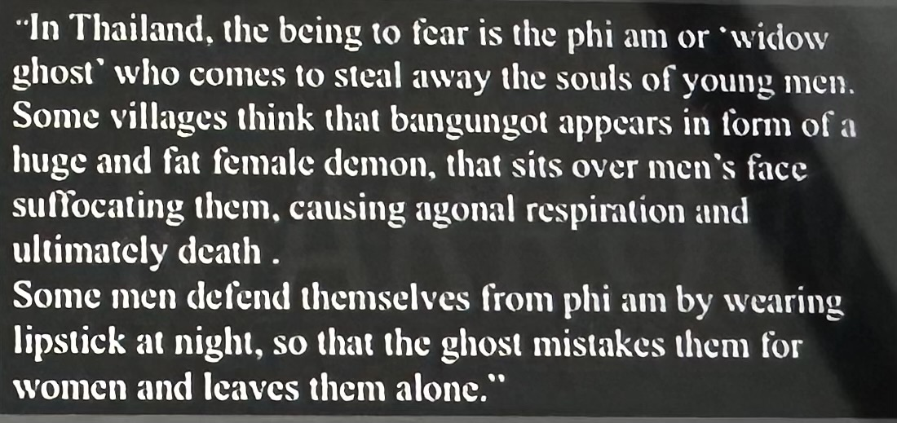
SUDS or Sudden unexplained death syndrome
Bangungot = Lai Tai = Pokkuri = Brugada syndrome

Slide 4
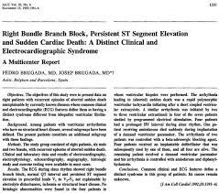
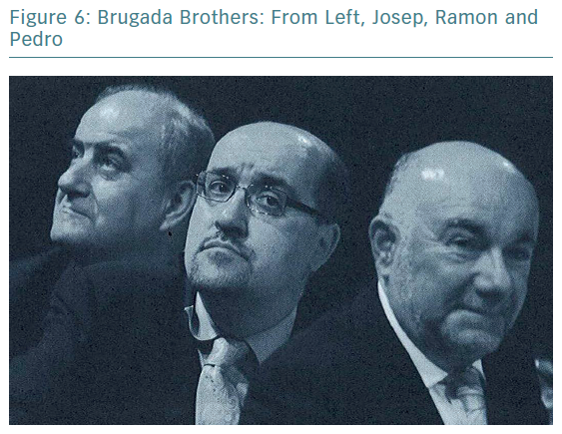

Slide 5
Autosomal dominant
Male predominance -8:1
Average age 35 -40
South East Asia most common
Events during sleep/rest
Polymorphic VT
4 - 12% of all sudden death and 20% of sudden death in patients with structurally normal heart.
Leading cause of death of men under age 40 in regions where the inheritance is endemic

Slide 6
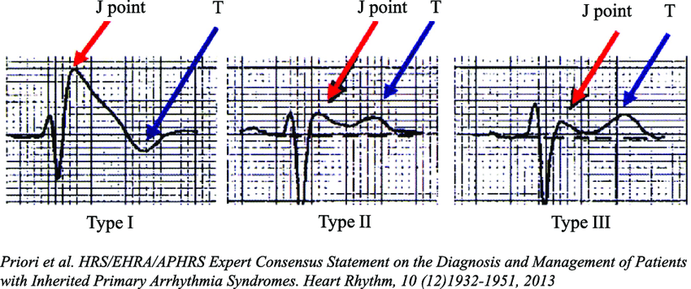

Slide 7
SCN5A –Loss of function

Slide 8
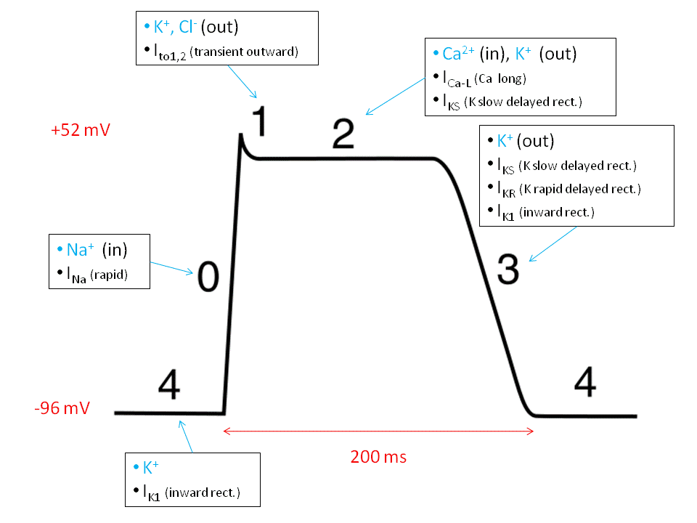
Mechanism of Brugada-LOF SCN5A
Diminished sodium current in epicardium of RVOT

Slide 9
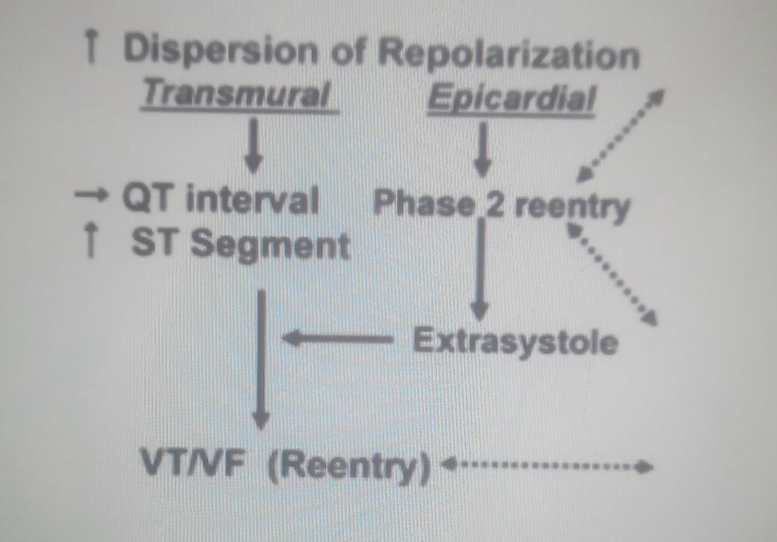
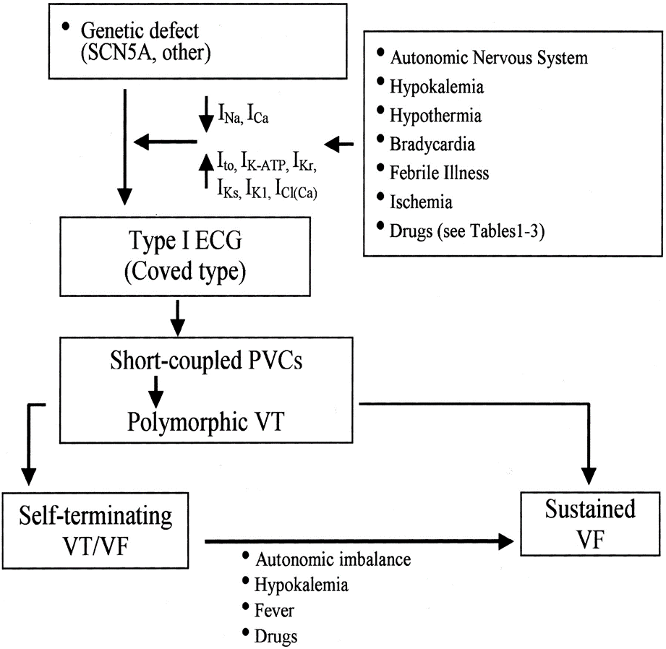

Slide 10
Triggers for Brugada pattern
Fever –MC(pyrexia related loss of function of sodium channel)
Sodium channel blockers –Ajmaline,Flecainide,Propofenone
TCA
Hypokalemia,Hypomagensemia
Ischaemia
Cocaine/Alcohol intoxication
Brugada syndrome –Brugada pattern(type1) +family history/event

Slide 11
Brugada pattern vs Syndrome Brugada Syndrome has increased cardiac risk not Brugada pattern Diagnostic Criteria of Brugada Syndrome
Appearance of on a type 1 ST segment elevation (coved type) ≥ 2mm in >1 right precordial lead (V1-3)
(either spontaneously or after Na channel blocker exposure)
AND
One of the following:
Documented VF
(Self-terminating) polymorphic VT
Inducibility of ventricular arrhythmias with programmed electrical stimulation
Family history of sudden death before age 45
Presence of of a coved-type ECG in family members
Syncope
Nocturnal agonal respiration
Other factors accounting for the ECG abnormality should be ruled out

Slide 12
Brugada syndrome: Diagnosis
type 2 or type 3 ST segment elevation in >1 right precordial leads under baseline conditions with conversion to type 1 following challenge with a Na channel blocker is considered positive
One or more of the clinical criteria should also be present
Drug induced ST elevation to <2mm is considered inconclusive
Drug-induced conversion of type 3 to type 2 ECG pattern is considered inconclusive

Slide 13
Drugs used to unmask Brugada syndrome
Ajmaline 1mg/kg over 5min. IV
Flecainide 2mg/kg over 10 min. IV (max 150mg)
Procainamide 10mg/kg over 10min. IV
Pilsicainide 1mg/kg over 10min. IV
)

Slide 14
Arrythmias in Brugada
Polymorphic VT
AF (10-20%)
Brugada Syndrome has increased cardiac risk not Brugada pattern

Slide 15
Symptoms
SCD
Syncope
Palpitations

Slide 16
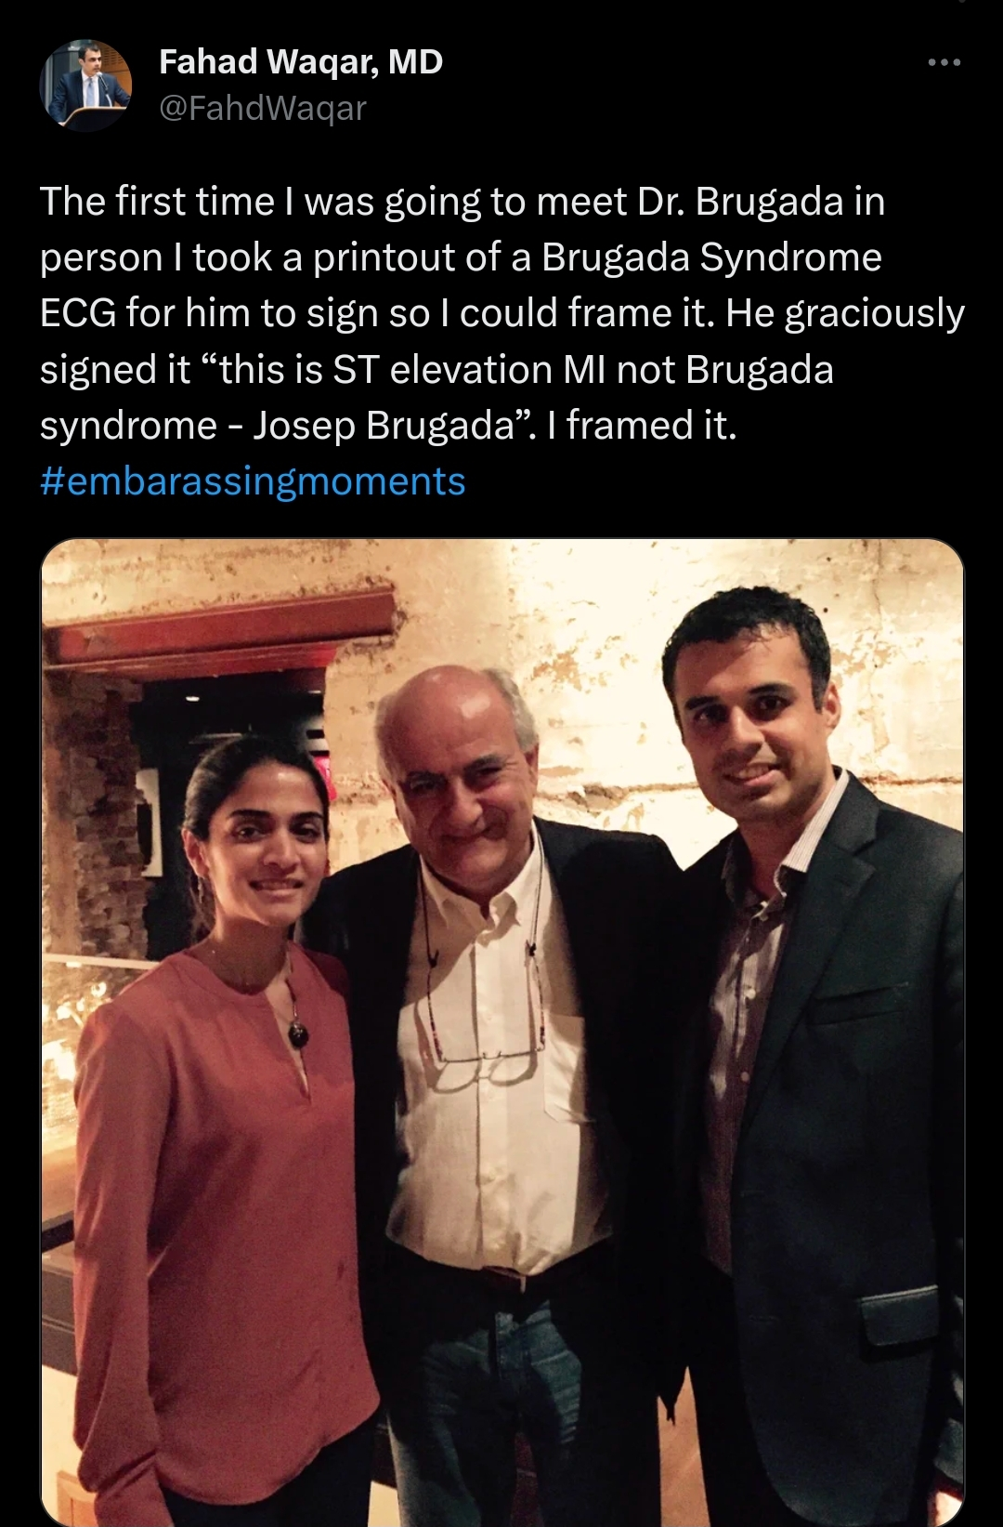
DD of Brugada pattern
ECG leads kept one ICS higher
Chest wall abnormalities(Pectus excavatum)
Anterior wall MI
Hyperkalemia/Hypokalemia
Atypical RBBB

Slide 17
Treatment
General measures
ICD
Drugs

Slide 18
Therapeutic recommendation for Brugada syndrome
ICD is the only proven effective treatment of BrS.
Drugs reported to exacerbate the ECG pattern of ST segment elevation and trigger arrhythmias in BrS should be avoided
Antiarrhythmics (class Ia Ic betablockers), CCB, nitrates, TCA, phenothiazines, SSRI like fluoxetine, bupivacaine, propoxyphene, propofol, pinacidil, nicorandil (K channel activators), Li, cociane, methoxamine (alpha- agonists)
Avoid excessive alcohol, large carbohydrate meal, very hot baths, hypokalemia
Hyperpyrexia should be treated promptly

Slide 19
Pharmacological approach to therapy of Brugada syndrome
Quinidine –Block sodium channel +Ito
DOC –Brugada syndrome+VT storm
Amiodarone

Slide 20
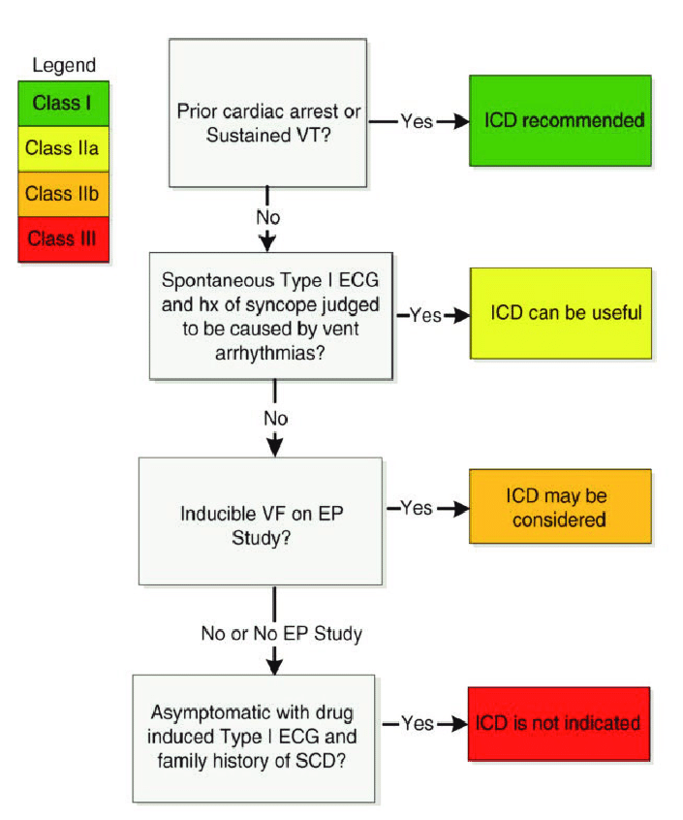
Concensus recommendations for ICD in patients diagnosed with Brugada syndrome

Slide 21
Brugada syndrome+VT strom
Quinidine
Isoproterenol
Catheter ablation of RVOT

Slide 22
Prognostic model by Brugada group

Slide 23
Vasovagal syncope vs BrS : coexistence
Neurally mediated syncope and Brugada syndrome share common pathophysiological mechanism particularly sympatho-vagal imbalance.
High incidence of neurally mediated susceptibility (positive Head-up Tilt test) has been demonstrated in asymptomatic subjects with Brugada pattern. (Letsas et al. PACE 2008)

Slide 24
Do no harm is not always easy
Overprotecting a patient with vasovagal syncope and Brugada pattern with ICD?
vs
just accepting a vasovagal origin for all syncope episode: a false sense of security?

Slide 25
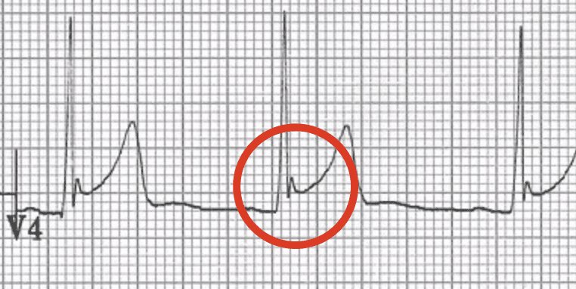
Early Repolarisation Syndrome
Mostly benign
Mostly in healthy individuals with higher vagal tone
Minor subset with increased risk if arrhythmias(VT/VF)

Slide 27
Type 1 –Benign
Type 2 –Usually benign,occassional idiopathic VF
Type 3 –Often associated with VT/VF storms
Type 4 -Brugada

Slide 28
MCQ’S
Q1) Brugada syndrome is characterised by:
A. Left bundle branch block pattern with ST segment elevation in right precordial leads.
B. Right bundle branch block pattern with ST segment depression in left precordial leads.
C. Left bundle branch block pattern with ST segment elevation in left precordial leads.
D. Right bundle branch block pattern with ST segment elevation in leads V1 to V3

Slide 29
Q2) Which of the following is not usually used as drug challenge to unmask the Brugada Type I ECG pattern?
A)Propranolol
B)Ajmaline
C)Flecainide
D)Procainamide

Slide 30
Q3) Which of the following is true about Brugada syndrome?
A)AR inheritance
B) Exertional syncope
C) Functional phase 2 re-entry
D) Female preponderanc

Slide 31
Q4)Most common cause of Brugada pattern?
A)Brugada syndrome
B)Sodium channel blockers
c)Hypokalemia
D)Fever

Slide 32
Q5)Drug of choice in VT storm secondarry to Brugada syndrome?
1)ICD insertion
2)Quinidine
3)Amiodarone
4) Isoproterenol

Slide 33
THANK YOU

