Slide 1
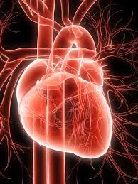
HISTOLOGY & PHYSIOLOY OF CARDIAC MUSCLE
Dr.Anjos

Slide 2
IMPORTANT HISTOLOGICAL FEATURES
Striated
Branching
Uninuclleated,peripheral nucleus
Intercalated discs
Gap junction
Lenghtwise relation between cells

Slide 7
Physiology of Cardiac Muscle
The heart is composed of three major types of cardiac muscle:
Atrial muscle, ventricular muscle, and specialized excitatory and conductive muscle fibers

Slide 8
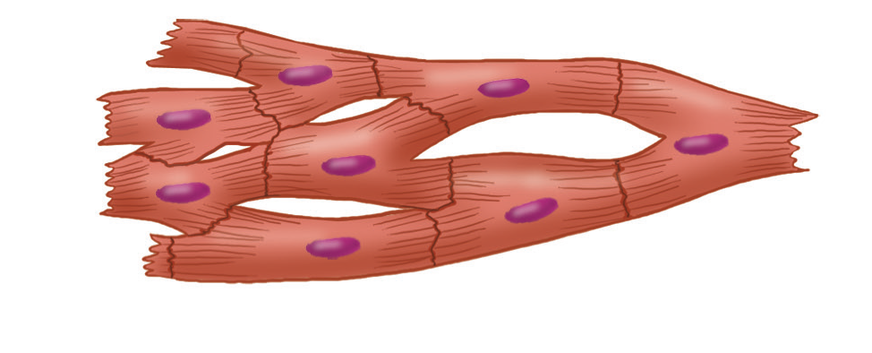
CARDIAC MYOCYTE
cardiac muscle fibers are arranged in a latticework, with the fibers dividing recombining and then spreading again
Notes:
The dark areas crossing the cardiac myocytes are called intercalated discs.they are actually cell membranes that separate individual cardiac muscle cells from one anotherAt each intercalated disc the cell membranes fuse with one another to form permeable “communicating” junctions (gap junctions) that allow almost totally free diffusion of ions
Therefore action potentials travel easily from one cardiac muscle cell to the next

Slide 9
MICROANATOMY OF CONTRACTILE CELLS AND PROTEINS
The major function of cardiac muscle cells (CARDIOMYOCYTES OR MYOCYTES)is to execute the cardiac contraction-relaxation cycle
A group of myocytes held together by surrounding collagen connective tissue is a MYOFIBER

Slide 10
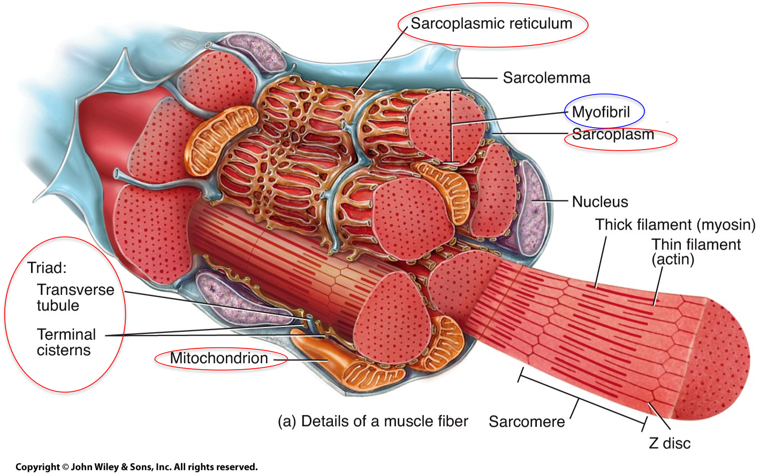

Slide 12
Notes:
Each myocyte is bounded by a complex cell membrane the sarcolemma and is filled with rodlike bundles of myofibrils which are the contractile elements. The myocyte sarcolemma invaginates to form an extensive tubular network (the T tubules) that extends the extracellular space into the interior of the cell. Rows of mitochondria are located between the myofibrils and also immediately beneath the sarcolemma. Mitochondria function mainly to generate the energy in the form of adenosine triphosphate (ATP) needed to maintain the heart’s contractile function and the associated ion gradients

Slide 13
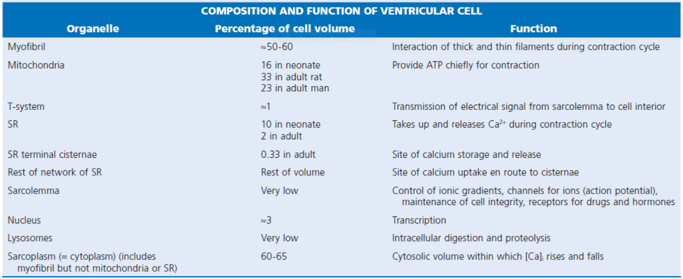

Slide 14
Sarcolemma
The sarcolemma is composed of a lipid bilayer
The sarcolemma forms 2 specialized regions of the myocyte
1. the intercalated disks
2. the transverse tubular system(T tubular system)
INTERCALATED DISKS are a specialized cellcell junction which serves both as a strong mechanical linkage between myocytes and as a path of low resistance that allows for rapid conduction of the action potential between myocytes

Slide 15
Sarcoplasmic reticulum
An intracellular membrane network is a highly efficient Ca2+ handling organelle specialized for the regulation of cytosolic Ca2+ concentration
Contains three important components that participate Ca2+ homeostasis:
Sarcoplasmic reticulum Ca2+ATPase (SERCA-2)
Regulatory protein of SERCA-2 phospholamban
Ca2+ release channel

Slide 16
Sarcoplasmic reticulum
Notes:
The sarcoplasmic reticulum (SR) is a specialized form of endoplasmic reticulum that is critical for calcium (Ca2+) cycling.When the wave of electrical excitation reaches the T tubules, voltage-gated Ca2+ channels open to provide relatively small entry of Ca2+, which triggers additional
release of Ca2+ from the SR via closely apposed release channel.This is the Ca2+ that initiates myocardial contraction. Ca2+ sequestration by the SR causes relaxation

Slide 17
Notes:
Transverse tubules(Ttubules) are invaginations of the sarcolemma into the myocyte, which form a barrier between the intracellular and extracellular spaces.These extensions bring in close apposition the L-type Ca2+ channel and the sarcoplasmic reticulum Ca2+ discharge system thus making the T-tubular system an important structural component in excitation-contraction coupling

Slide 18
SR PROTEINS

Slide 19
SERCA-2
ATP-dependent Ca2+ pump distinct from that found in the sarcolemma
Fundamental determinant of Ca2+ accumulation within the myocyte
For every 1 mol of ATP hydrolyzed, 2 mol of Ca2+ is transported back into the sarcoplasmic reticulum, thereby decreasing cytosolic Ca2+

Slide 20
Phospholamban
colocalized with SERCA-2
an important regulatory protein for SERCA-2 function
Phosphorylated-phospholamban facilitates SERCA-2 uptake into the sarcoplasmic reticulum
dephosphorylation of phospholamban results in decreased sensitivity of SERCA-2 to cytosolic Ca2+

Slide 21
The calcium release channel(ryanodine receptor channel)
A small but rapid influx of Ca2+ through the Ltype Ca2+ channel will result in an immediate release of a large bolus of Ca2+ into the myocyte cytosolic space

Slide 22
Contractile apparatus
The fundamental contractile unit within the myocyte is the SARCOMERE
The sarcomere is composed of thick and thin interdigitating filaments
The fundamental proteins of the contractile apparatus are myosin, actin, tropomyosin,and the troponin complex
Notes:
In the presence of increased extracellular Ca2+, interactions occur between these proteins, causing the hydrolysis of ATP and changes in physical-chemical dynamics
These processes result in the development of tension within the myocyte

Slide 23
"bands" and "lines"
I-band - actin filaments
A-band - myosin filaments which may overlap with actin filaments
H-band - zone of myosin filaments only) within the A-band
Z-line - zone of apposition of actin filaments belonging to two neighbouring sarcomeres M-line - band of connections between myosin filaments
Notes:
The sarcomere is limited on either side by a Z-line, which with the thin filaments creates a sort of cage around the thick myosin filament that extends from the center of the sarcomere outward toward, but not reaching the Z-line. During contraction, the myosin heads grab onto actin and pull the actin filaments toward the center of the sarcomere.The thin and thick filaments can thus slide over each other to shorten the sarcomere and cell length (without the individual actin or myosin molecules actually shortening)

Slide 24
MYOSIN
Notes:
Myosin the thick filament is composed of a filamentous tail and a globular head region .Each myosin head is the terminal part of a heavy chain
The bodies of two of these chains intertwine and each terminates in a short“neck” that carries the elongated myosin head.This globular head contains the site for actin binding as well as a catalyzing site for ATPase activity.The molecular structure of the myosin head, based on Rayment and colleagues is composed of heavy and light chains. The heavy head chain in turn has two major domains: one of 70 kDa (i.e., 70,000 molecular weight) that interacts with actin at the actin cleft and has an ATP binding pocket. The “neck” domain of 20 kDa, also called the “lever,” is an elongated alpha helix that extends and bends and has two light chains surrounding it as a collar. The essential light chain is part of the structure. The other regulatory light chain may respond to phosphorylation to influence the extent of the actin-myosin interaction.

Slide 25
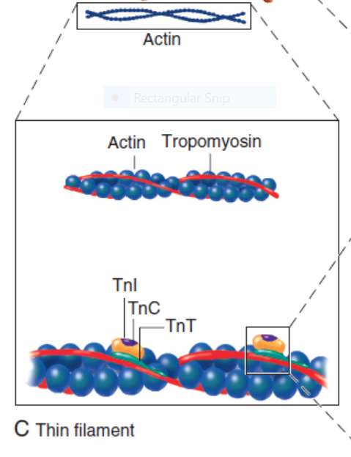
THIN FILAMENT
Notes:
The thin filaments are composed of two helical intertwining actin filaments with a long tropomyosin molecule that spans seven actin monomers located in the groove between the two actin filaments. At every seven actin molecules (38.5 nm along this structure) sits a three protein regulatory troponin complex: troponin C (Ca2+ binding), I (inhibitory), and T (tropomyosin binding

Slide 26
ACTIN
Notes:
Actin is the major contractile protein found in the thin filament
Has two forms G and F
F-actin is the backbone of the thin filament with G-actin working as a stabilizing protein
Each G-actin monomer has two myosin binding sites
The interaction between the myosin globular head and the G-actin monomer in the presence of ATP results in crossbridge formation and sarcomere shortening

Slide 27
TROPOMYOSIN
Notes:
Tropomyosin is another protein found in the thin filament.This rigid molecule lies on either side of actin adding rigidity to the thin filament.Tropomyosin influences actin-myosin crossbridge formation by physically interdigitating between the actin-myosin cleft thus preventing Ca2+ binding.When [Ca2+]i is low, the tropomyosin molecule is positioned in such a way that it blocks the myosin heads from interacting with actin. As a result, most cross bridges are in the “blocked position,” although some might visit the weak binding state

Slide 28
TROPONIN
Notes:
The troponin complex also present in the thin filament is composed of three proteins: troponin T, I, and C.Troponin regulates the extent of crossbridge formation as well as contributing to the structural integrity of the sarcomere
Troponin T binds the troponin complex to tropomyosin and anchors the complex to the thin filament
Under normal conditions phosphorylated troponin I weakens the affinity of Ca2+ for troponin C. Ca2+ binding to troponin C results in a conformational change of the complex with subsequent actin-myosin interaction thus initiating crossbridge formation.As [Ca2+]i increases and binds with troponin C, troponin C binds more tightly to troponin I. This pulls the entire troponin complex (including troponin T) away from tropomyosin (Fig. 21-4), which allows tropomyosin to roll deeper into the thin filament groove,4 thereby largely disinhibiting the actin-myosin interaction Binding of calcium to TnC induces a conformational change in TnC, which elongates (compare systole with diastole). TnI closes up to TnC, and the normal inhibition of TnI on actin-tropomyosin is lessened; however, the interaction between TnC and TnT is strengthened

Slide 29
CALCIUM ION FLUXES IN THE CARDIAC CONTRACTION-RELAXATION CYCLE
Excitation-contraction coupling
Refers to the mechanism by which an action potential leads to contraction of the myocyte
The fundamental ion for inducing the excitation-contraction coupling complex is Ca2+
Achieved through the increase in cytosolic Ca2+ levels from 100 nmol/L to 10 micromol/L concentrations

Slide 30
The arrival of Ca2+ at the contractile proteins is a crucial link in excitationcontraction Coupling
Binding of Ca2+ to troponin C shifts the troponin tropomyosin complex on the actin filament which permits the myosin heads to form strong binding cross bridges with actin molecules
Conversely when ATP is hydrolyzed to ADP and inorganic phosphate (Pi) the strong binding state is again favored
Notes:
Hence the ATPinduced changes in the molecular configuration of the myosin head result in corresponding variations in its physical properties. Lengthdependent activation also promotes the strong binding state Conversely, the weak binding state predominates when [Ca2+]i falls
and thereby allows relaxation during diastole. As Ca2+ dissociates from troponin C during the decline in [Ca2+]i, the troponin-tropomyosin
complex resumes its inhibitory configuration to prevent strong binding.

Slide 31
Contraction
As action potential reaches the myocyte the wave of depolarization particularly at the T-tubular system results in the activation of sarcolemmal voltage-sensitive L-type Ca2+ channels and Ca2+ conductance
This rapid but small influx of Ca2+ through the L-type Ca2+ channels called as trigger ca 2+ curent causes activation of the Ca2+ release channel resulting in an immediate release of large amounts of Ca2+ into the cytosol
Notes:
The Ca2+ that flows through the L-type Ca2+ channel is referred to as the trigger Ca2+ current.
The absolute amount of trigger Ca2+ is very small in relation to Ca2+ release from the sarcoplasmic reticulum; therefore, trigger Ca2+ does not significantly contribute to crossbridge formation

Slide 33
Sliding Filament Theory
After release of Ca2+ from the sarcoplasmic reticulum a series of interactions occur within the contractile protein of the sarcomere
The sliding filament theory explain the interaction of the various contractile proteins

Slide 34
Sliding Filament Theory
Under resting conditions concentrations of cytosolic Ca2+ are low
Phosphorylated troponin I decreases the affinity of cytosolic Ca2+ for troponin C favoring a stronger interaction between troponin I and the actin molecule
Therefore the troponin-tropomyosin complex is shifted toward the outer grooves of the actin filament thus blocking actin-myosin interaction.
An increase in cytosolic Ca2+ allows for the binding of Ca2+ to troponin C resulting in a shift of troponin I affinity from the actin filament to troponin C

Slide 35
CROSS BRIDGE CYCLING
Notes:
The interaction of the myosin heads with actin filaments when sufficient Ca2+ arrives from the SR is called cross-bridge cycling
As the actin filaments move inward toward the center of the sarcomere they draw the Z-lines closer together so that the sarcomere shortens
The energy for this shortening is provided by the breakdown of ATP made chiefly in the mitochondria

Slide 36
CALCIUM FLUXES IN MYOCARDIUM
Notes:
L-type Ca2+ channels, which act as a trigger for the release of Ca2+ from the SR; (2) the effect of beta-adrenergic stimulation with adenylyl cyclase to form cAMP, the latter helping open the Ca2+ channel and increase the rate of uptake of Ca2+ into the SR; and (3) exit of Ca2+ ions chiefly via Na/Ca exchange, with the sodium pump thereafter extruding the Na+ ions thus gained.
The latter process requires ATP. Note the much higher extracellular (mM) than intracellular cytosolic [Ca2+] (<μM) and much higher [Ca2+] in the SR. Mitochondria can act as a buffer against excessive changes in the free cytosolic calcium concentration

Slide 37
SUMMARY OF CALCIUM

Slide 38
Duration of Contraction.
Cardiac muscle begins to contract a few milliseconds after the actionand continues to contract until a few milliseconds after the action potential ends.
Therefore, the duration of contraction of cardiac muscle is mainly a function of the duration of the action potential,
including the plateau— about 0.2 second in atrial muscle and 0.3 second in ventricular musclE

