Slide 1
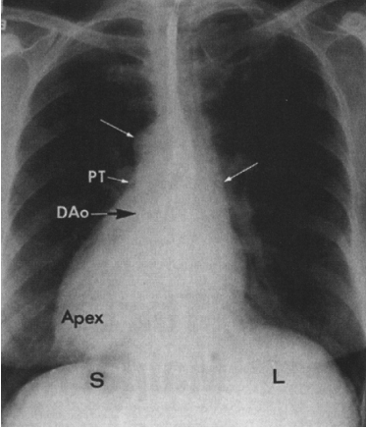
Cardiac Malpositions
Dr SANCHNA DEV S
DEPT OF CARDIOLOGY
TDMC

Slide 2
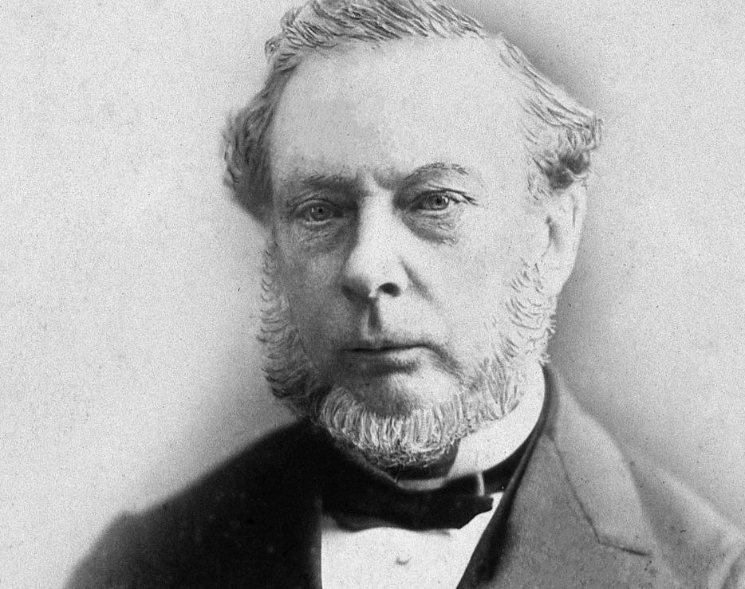
“The heart may be congenitally misplaced in various ways, occupying either an unusual position within the thorax, or being situated external to that cavity”
- Thomas B Peacock , 1858

Slide 3
CONTENTS
HISTORY
TERMINOLOGY
THREE POINT NOTATION -VAN PRAAGH
MALPOSITIONS
HETEROTAXY SYNDROMES

Slide 4
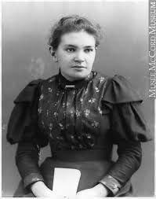
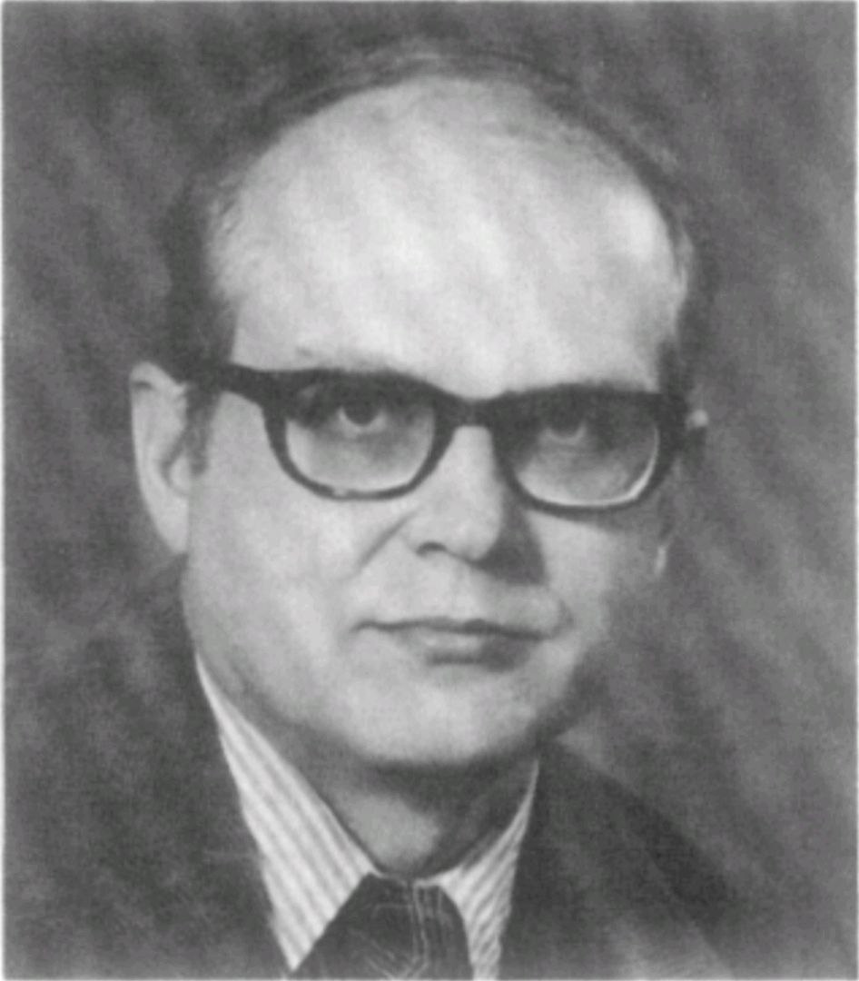
HISTORY
1643 –Dextrocardia in situs inversus - Marco Aurelio Severino ; one of the first recognized congenital malformations of the heart.
1915- Maude Abbott described ectopia cordis.
1931- Maria de la Cruz-embryologic basis of the malpositions
1966 -Elliott et al’s radiologic classification
1977 -landmark observations Van Praagh - segmental classification
Notes:
Dextrocardia was 1 of the first congenital malformations
of the heart to be recognizedEstimated prevalence is
0.10 per 1,000 live births.

Slide 5
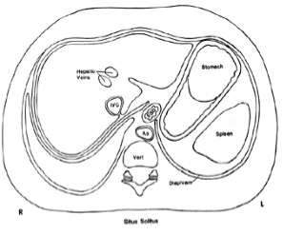
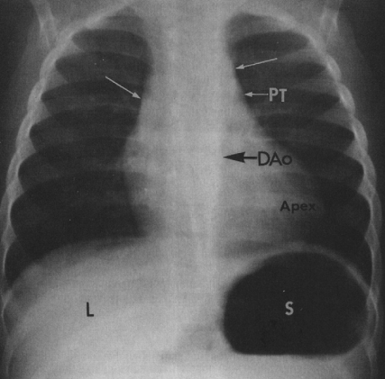
Terminology
Cardiac malposition : An abnormal intra-thoracic position of the heart.
Situs : Site or position of the viscera or atria.
Solitus : Normal or usual.
Situs solitus : Normal position
Notes:
Depends on abdominal Situs and position of heart in the thorax . two logical Situs these are Situs Solitus (Normal) and its opposite Situs Inversus

Slide 6
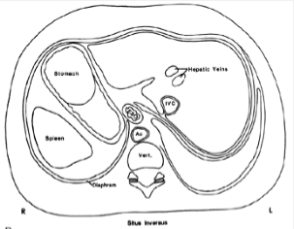
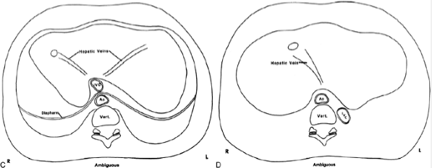
Situs inversus: opposite or reverse of normal
Situs ambiguous : uncertain or indeterminant
Notes:
uncertain or
indeterminate visceral or atrial
position

Slide 7
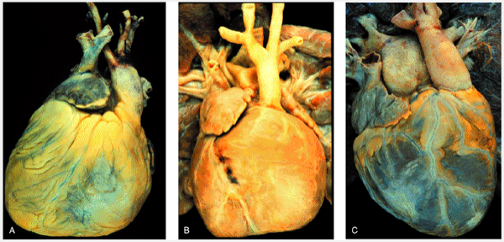
Terminology
Cardiac position - intrathoracic location of the heart
The position of the greater mass of the heart w.r.t sternum is described by using prefix levo- (leftward) , dextro- ( rightward) or meso- ( centered) in combination with the noun position.
When the cardiac axis has the same directional orientation as the greater mass of the heart, the prefix is combined with the root word cardia.
An anomalous cardiac position may also be described as primary or secondary:
primary anomaly —>congenital alteration caused by a cardiac anomaly
Secondary anomalies in cardiac position —>occur because of changes in the lungs, bones, or other extracardiac structures

Slide 8
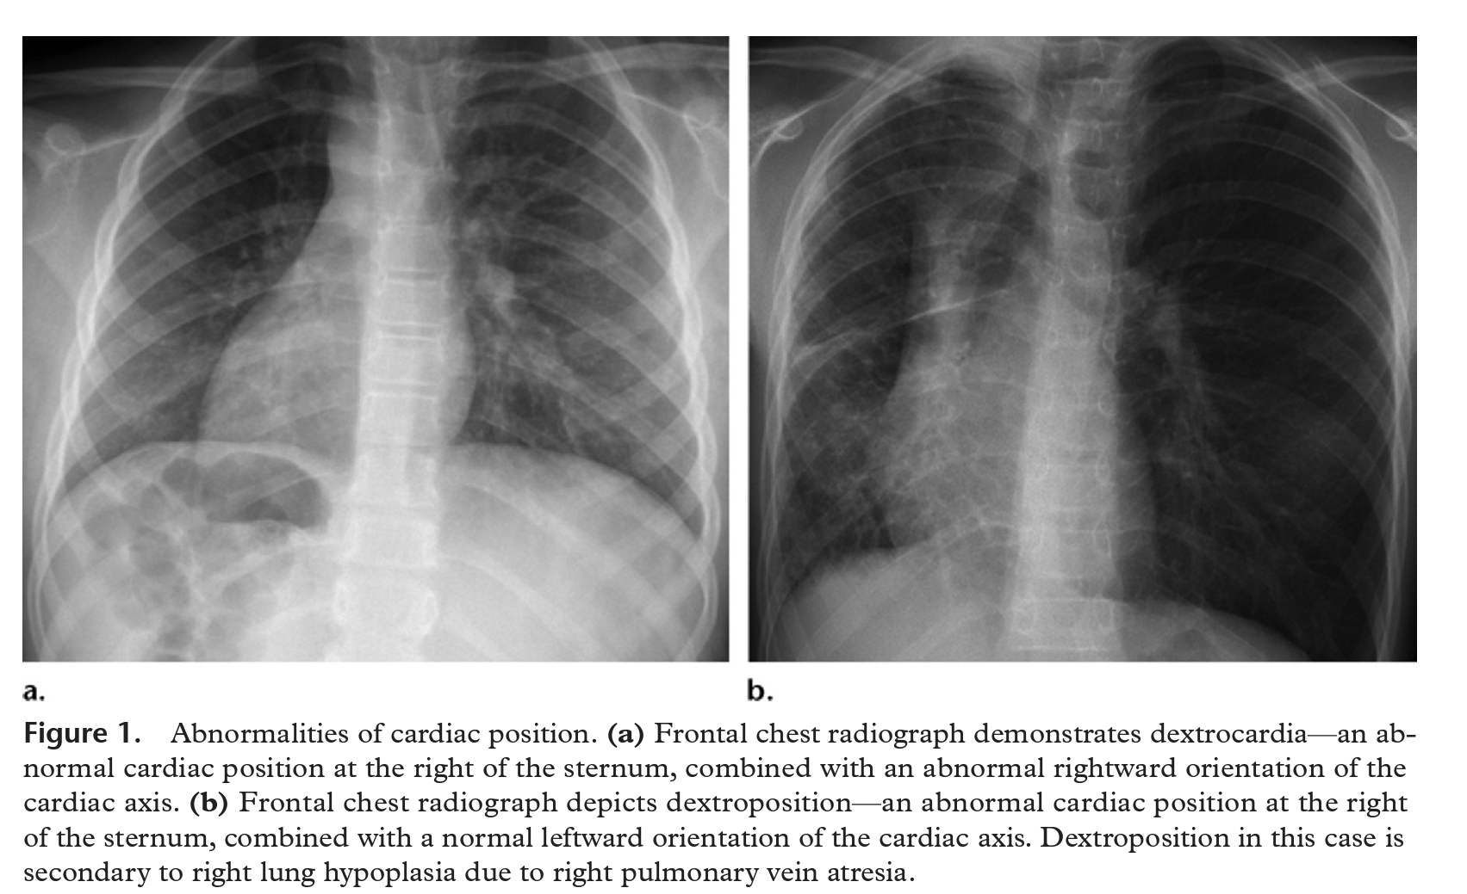
The descriptors of the cardiac location within the thorax (eg, dextrocardia, levocardia, and dextroposition) do not imply a particular internal structure of the heart or a specific location of other thoracoabdominal organs

Slide 9
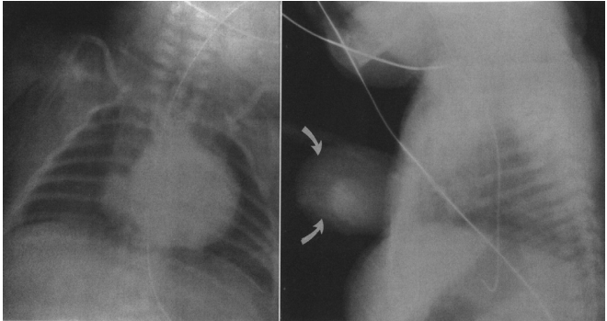
Terminology
Ectopia cordis : Location of the heart outside the thoracic cavity

Slide 10
Terminology
Chamber designation : Right and left refers to the morphology rather than position as right atrium or left atrium, right or left ventricle
Great arterial designations: The ascending aorta and pulmonary trunk defined by their ventricle of origin or their spatial relationship to each other
Heterotaxy : Greek “heteros” : different and “taxis” : arrangement
Isomerism : Greek “isos” : equal and “meros” part.
- similarity of bilateral structures that are normally dissimilar
Notes:
Chamber designations: Right and left, as in right and left atrium and right and left ventricle.

Slide 11
Terminology -Concordance
Latin “concordare” : to agree.
Atrioventricular concordance:
Connection of a morphologic atrium to a corresponding morphologic ventricle.
Ventriculoarterial concordance:
Connection of a morphologic right ventricle to a pulmonary trunk and a morphologic left ventricle to an aorta.
Notes:
A loop that agrees with the visceroatrial situs

Slide 12
Terminology - Discordance
Latin “dis” : apart / Inappropriate.
Atrio-ventricular discordance:
A morphologic RA to LV ; LA to RV.
Ventriculo-arterial discordance:
A morphologic RV gives rise to the aorta, and LV to the pulmonary trunk
Double discordance:
Atrio-ventricular discordance together with ventriculo-arterial discordance.
The result is physiologically correct circulatory flow.

Slide 13
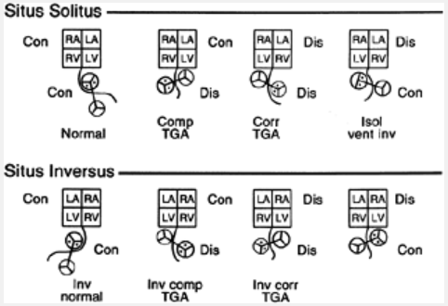
Terminology
Transposition of the great arteries:
Each great artery arises from an morphologically discordant ventricle
Malposition of the great arteries:
Abnormal spatial relations of the aorta and the pulmonary trunk
Either in the lateral or anteroposterior plane
arises from the morphologically correct ventricle.
Isolated ventricular inversion
not associated with transposition of the great arteries
Notes:
Inversion : Mirror imagery

Slide 14
Segmental approach –using Van Praagh notation
The Van Praagh notation is a three-part series of letters or letter-groups, with each part corresponding to a key segment or embryologic region of the cardiac anatomy: the atria, ventricles, and great vessels
The three parts are separated by commas and encompassed by braces.
first letter —> visceroatrial situs
second —> the left- or rightward orientation of the ventricular loop
third —> the position and relation of the great vessels.

Slide 15
STEP 1 : Describe the Visceroatrial Situs {X, _, _}

Slide 16
2. Thoracoabdominal situs
The structure of the bronchopulmonary anatomy can be useful for identifying the morphologic right atrium because pulmonary sidedness usually reflects atrial sidedness.
The main bronchus of the morphologic right lung is located directly behind the pulmonary artery (eparterial position), and the upper lobe bronchus originates at a more proximal level than left
The main bronchus of the morphologic left lung has a position below the pulmonary artery (hyparterial position) and a relatively more distal takeoff of the upper lobe bronchus
The number of pulmonary lobes also helps establish sidedness

Slide 18
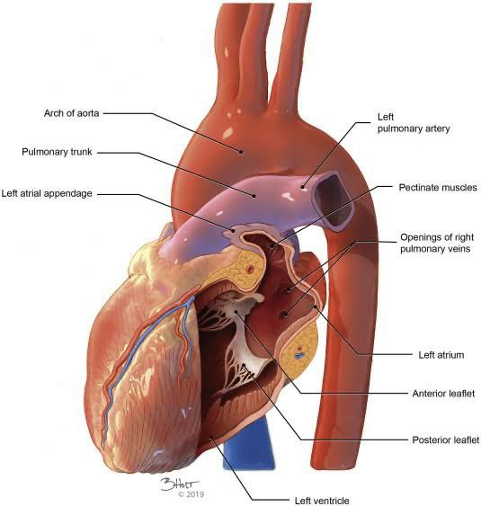
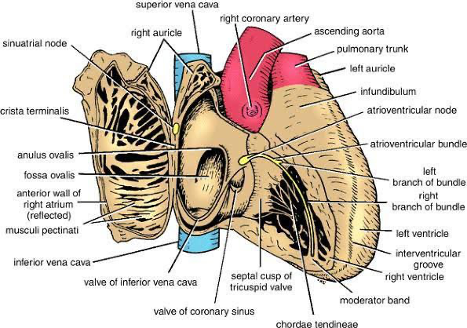
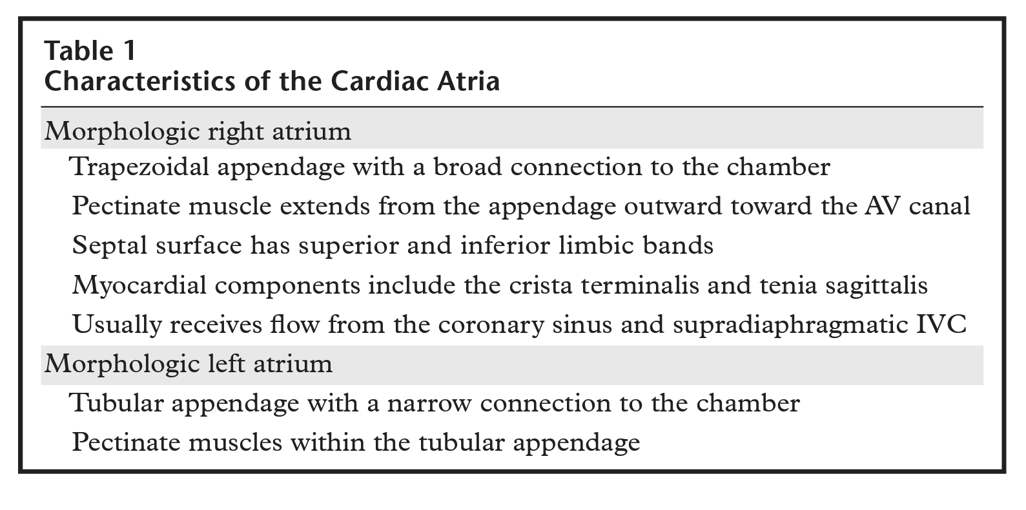
3. Atrial situs
Identify the morphologic right atrium

Slide 19
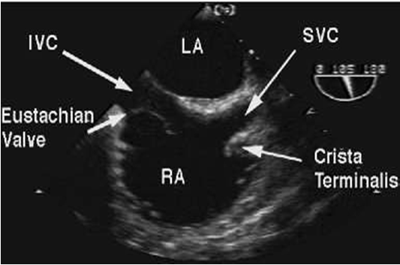
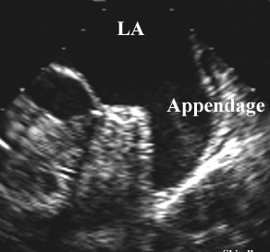
Atrial Morphology

Slide 20
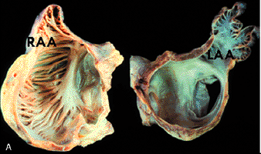
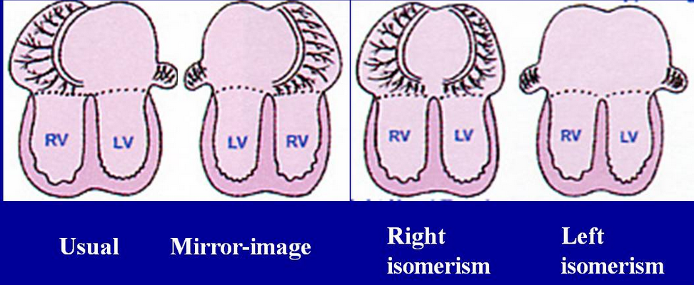

Slide 22
Step 2: Describe the Ventricular Loop Orientation {_, X, _}

Slide 23
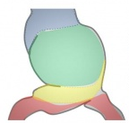
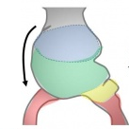
Between days 23 and 28 (week 4) –the cardiac tube elongates with simultaneous growth in the bulbus cordis and primitive ventricle.
bend ventrally and rotate to the right, forming a C-shaped loop with convex side situated on the right.

Slide 24
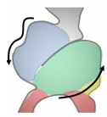
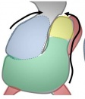
The ventricular bend moves caudally
atrium and sinus venosus become dorsal to the heart loop
Notes:
The embryonic straight heart tube initially bends to the right (d-loop), then moves to the left until the ventricular portion occupies a normal left thoracic positionThe atrial and outflow poles converge and myocardial cells are added, forming the truncus arteriosus

Slide 25
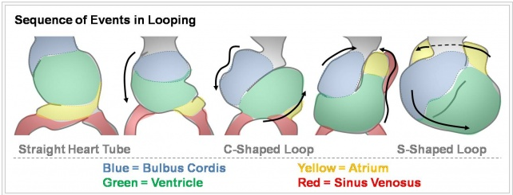

Slide 26
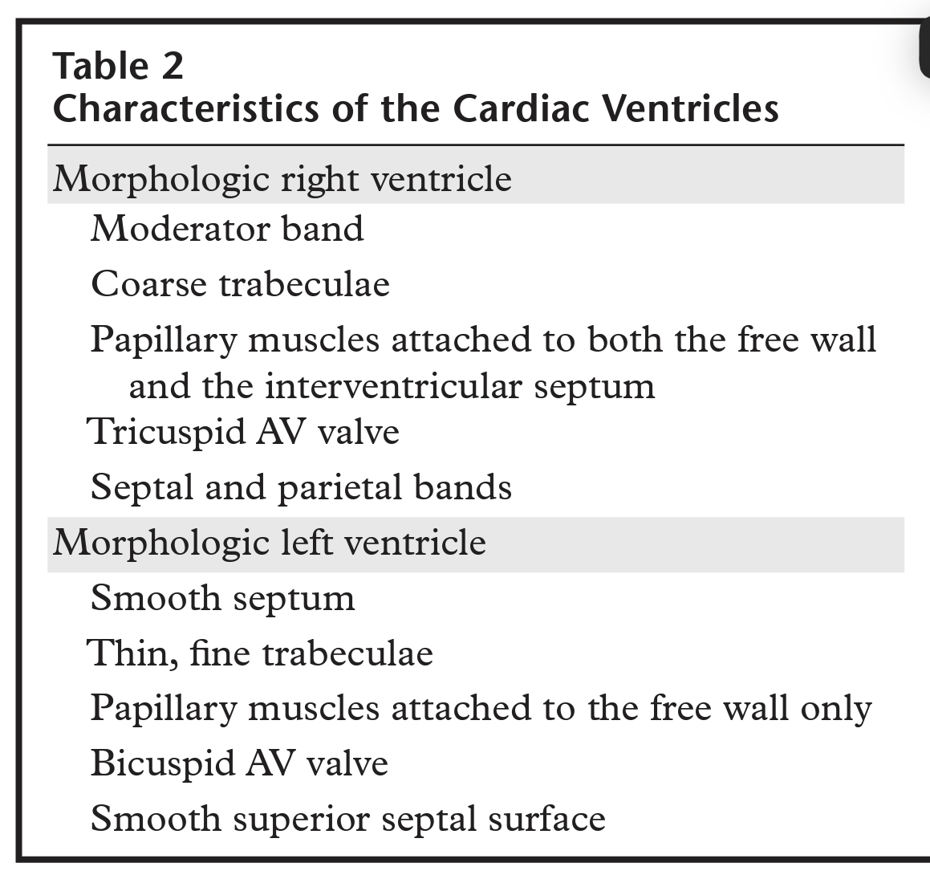
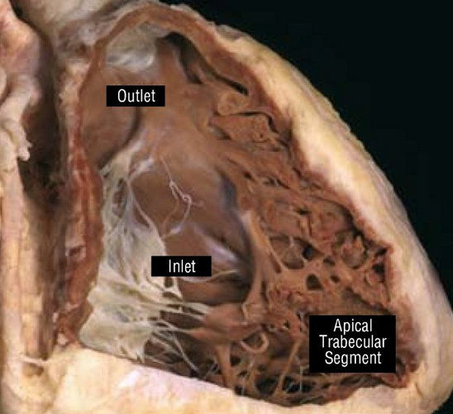
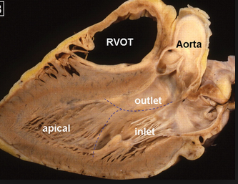
Normally, the tube curves toward the right side, positioning the future right ventricle to the right of the left ventricle, in a configuration known as a d-loop.
If the tube curves toward the left, the right ventricle is positioned leftward of the left ventricle, forming a l-loop
To determine the ventricular loop orientation, first try to identify the morphologic right and left ventricles on the basis of their intrinsic characteristics

Slide 27
In complex cases, the orientation of the ventricular loop may be difficult to discern because the spatial configuration of the ventricles does not fit easily into a right-left plane.
Examples of such configurations -superoinferior ventricles, crisscross AV alignments, and single ventricle.
In these instances, use the “hand” rule or the “loop” rule.

Slide 28
Hand rule
The hand rule reflects the principle of chirality: just as the right hand and left hand are mirror opposites, so too are the d-loop and the l-loop.
To use the hand rule, first identify the right ventricle. Next, imagine approaching the heart from the anterior direction and placing your hand inside the right ventricle with your palm against the interventricular septum, the thumb in the right ventricular inflow tract (AV valve), and the fingers in the outflow tract
If you can accomplish this imaginary exercise with your right hand, the ventricular loop has a rightward orientation (dloop)
If you can do it with your left hand but not your right, the ventricular loop has a leftward orientation (l loop)

Slide 29
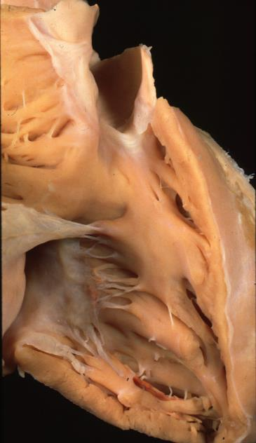
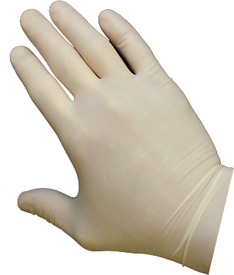
VENTRICULAR TOPOLOGY
Right hand
Left hand

Slide 30
Loop rule
The “loop” rule is based on the observation that the position and relation of the great vessels are predictive of the ventricular loop orientation.
In the presence of a right-sided aortic valve, the right ventricle is located rightward of the left ventricle, signifying the presence of a d-loop; and in the presence of a left-sided aortic valve, the right ventricle is located leftward of the left ventricle, signifying an l-loop .
If all attempts fail and the direction of ventricular folding cannot be determined by using either the hand rule or the loop rule, assign an X

Slide 31
Step 3: Describe the Position and Relation of the Great Vessels {_, _, X}
The aorta and MPA are classified according to their position and relation at the level of the aortic and pulmonic valves
It is usually easier to distinguish between the aortic root and the MPA
In difficult cases, branching vessels can be used as reference points: The aorta supplies at least one coronary artery and most of the systemic arteries, whereas the MPA usually yields right and left pulmonary arteries

Slide 35
Notes:
does not address other lesions discussed in chapters dealing with double-inlet ventricles, double-outlet ventricles, or single-outlet hearts

Slide 36
Segmental Expression
1 . Visceroatrial situs : S , I or A.
2 . Ventricular situs : D or L
3 . Position of great vessels : S , I , D , L or A
Normal : (S , D , S)
Situs Inversus Dextrocardia : (I , L , I )
D TGA : (S , D , D )
L TGA with situs solitus : (S , L , L )
Dextroposition secondary to hypoplasia of the right lung : ( S ,D , S )

Slide 37
CARDIAC MALPOSITIONS

Slide 38
Three major cardiac malpositions occur in the presence of right/left asymmetry
(1) visceroatrial situs inversus with dextrocardia
(2) visceroatrial situs solitus with dextrocardia
(3) visceroatrial situs inversus with levocardia.
Mesocardia, a midline heart, is sometimes regarded as a fourth malposition.

Slide 39
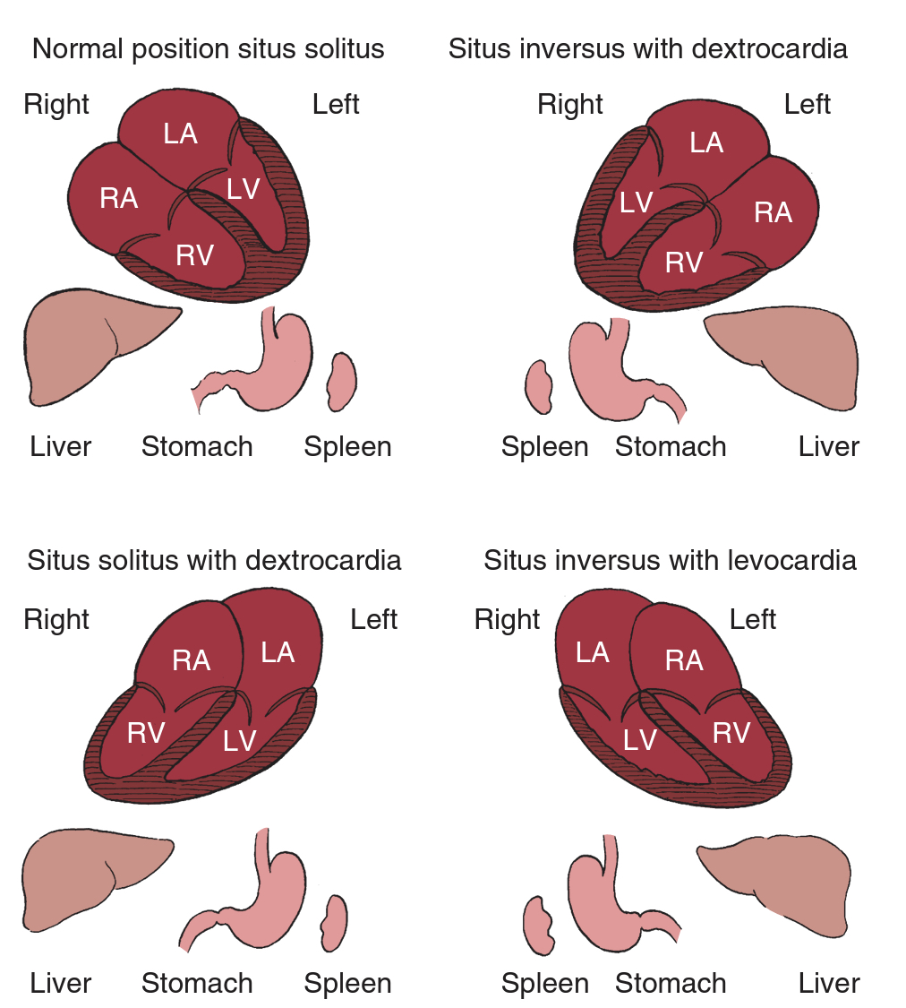
SITUS SOLITUS – D LOOP IS CONCORDANT—> morphologic RV is on the right side of morphologic LV ; Desc Ao on left is concordant
SITUS INVERSUS – L LOOP IS CONCORDANT —> morphologic RV is on the left of morphologic LV ; Desc Ao on right is concordant

Slide 40
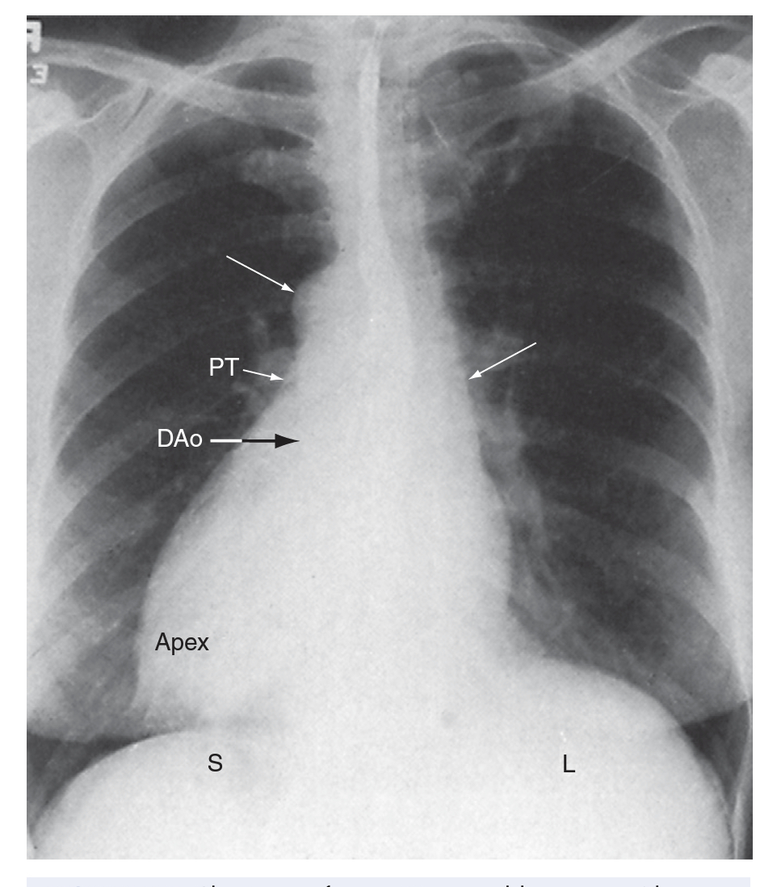
1. SITUS INVERSUS WITH DEXTROCARDIA
The incidence rate in the general population is estimated at 1/8000 to 1/25,000.
usually occurs without coexisting congenital heart disease
Symptoms caused by coexisting acquired cardiac or noncardiac disease may lead to the discovery of hitherto unsuspected situs inversus

Slide 41
Associated congenital heart defects :
VSD
TOF
pulmonary atresia
complete AV septal defect
OS ASD
Clinical –
Right anterior chest bulge
hepatic dullness on left and gastric tympany on right side
Ausculatation –mirror image of normal
Notes:
2. the atria, ventricles, and great arteries are all inverted from their normal location and spatial relationships
Common form of dextrocardia in normal hearts and situs inversus totalis

Slide 42
2. SITUS SOLITUS WITH DEXTROCARDIA
the morphologic right ventricle lies to the right of the morphologic left ventricle (d-loop) because the straight heart tube of the embryo initially bends in a rightward direction (d-loop) but then fails to pivot into the left chest
Varying degrees of incomplete pivoting determine the degree to which the ventricular portion of the heart lies to the right of midline
only occasionally associated with a structurally normal heart.
left-to-right shunts at atrial level or ventricular level usually coexist

Slide 43
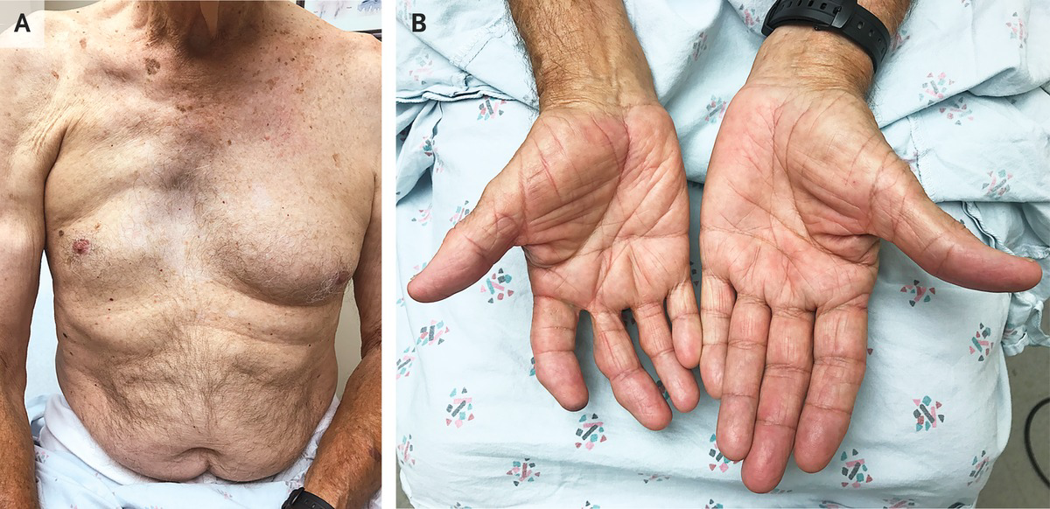
Associated congenital heart defects:
ventricular septal defect
secundum atrial septal defect
complete AV septal defect
left SVC to the coronary sinus
coarctation of the aorta
anomalous pulmonary venous connections
Clinical presentation depends on associated lesions
Poland’s syndrome - characterized by the absence of a pectoralis major muscle (usually right-sided), ipsilateral syndactyly, brachydactyly, and hypoplasia of a hand.

Slide 44
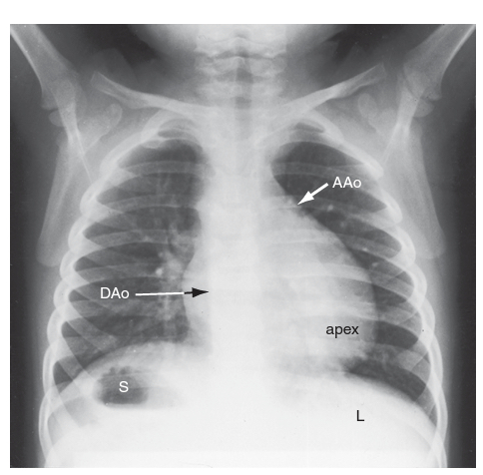
3. SITUS INVERSUS WITH LEVOCARDIA
The major cardiac mass lies in the left chest for one of two morphogenetic reasons.
First, an embryonic l-loop, which is concordant for situs inversus, fails to pivot into the right side of the chest.
Second, an embryonic d-loop, which is discordant for situs inversus, pivots into the left side of the chest.
A discordant d-loop in situs inversus results in ventricular inversion ; the ascending aorta forms a smooth shadow at the left basal aspect of the heart
Consistently associated with coexisting congenital heart disease

Slide 45
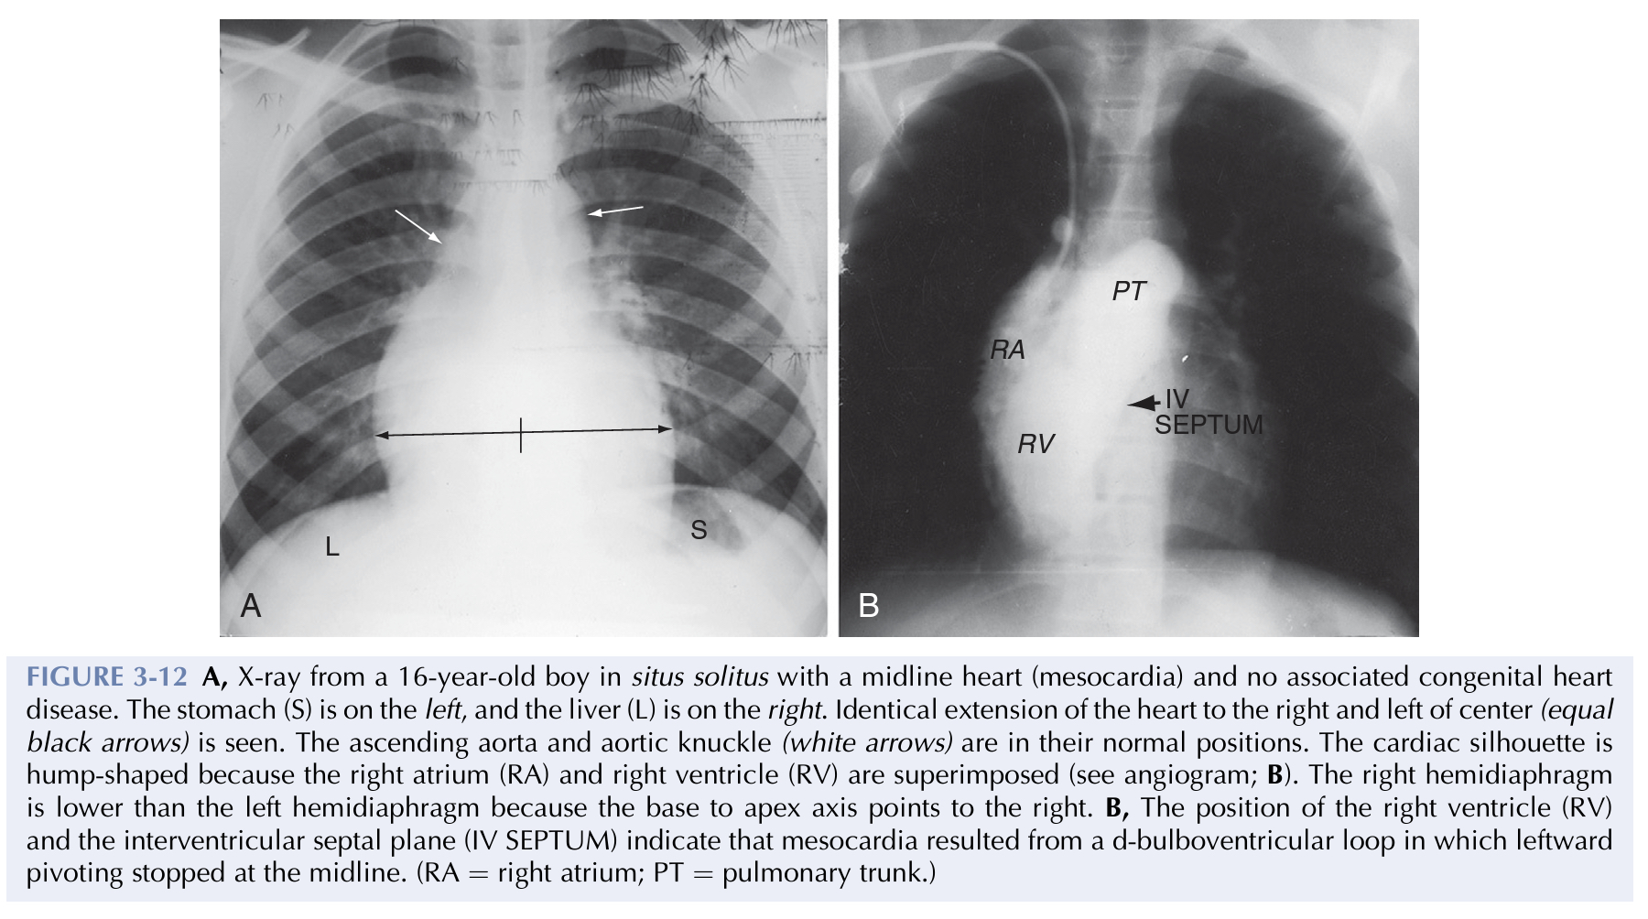
4. MESOCARDIA (MIDLINE HEART)
Two ways —>d-bulboventricular loop stops in the midline as it pivots to the left – variation of normal
Much less commonly, situs inversus and an l-loop that stops in the midline as it incompletely pivots to the right – a/w major congenital malformations
very low incidence
Mostly with situs solitus
consisted of
normal hearts
corrected TGA
complete transposition of the great arteries

Slide 46
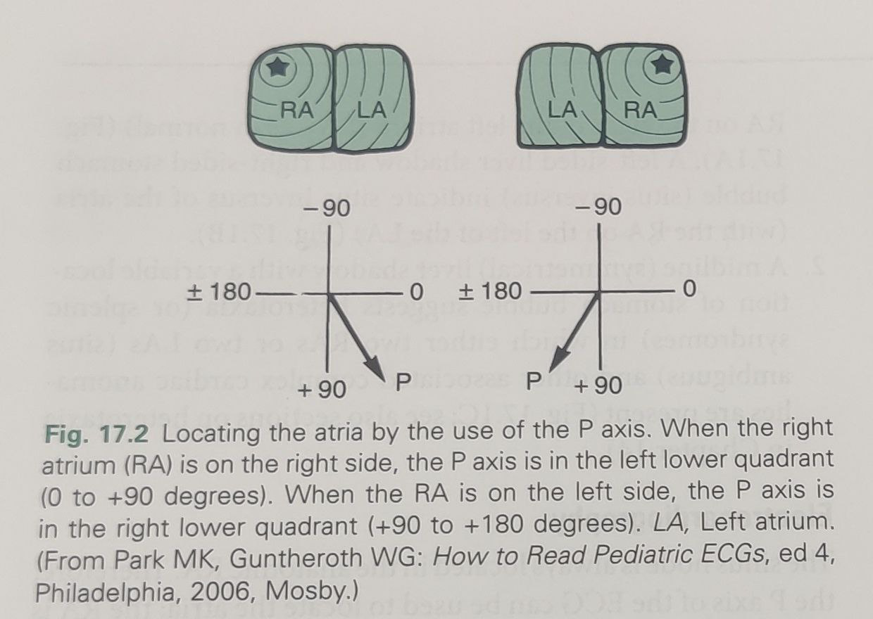
ECG – Chamber localisation
LOCALISATION OF ATRIA – sinus node is always located in the morphologic RA.
P axis can be used to used to locate the atria (RA is located on the opposite side of the P axis)
P axis —> 0 to +90 degrees —> RA on the right side (situs solitus of atria)
P axis —> +90 to 180 degrees —> RA on the left side ( situs inversus of atria)

Slide 47
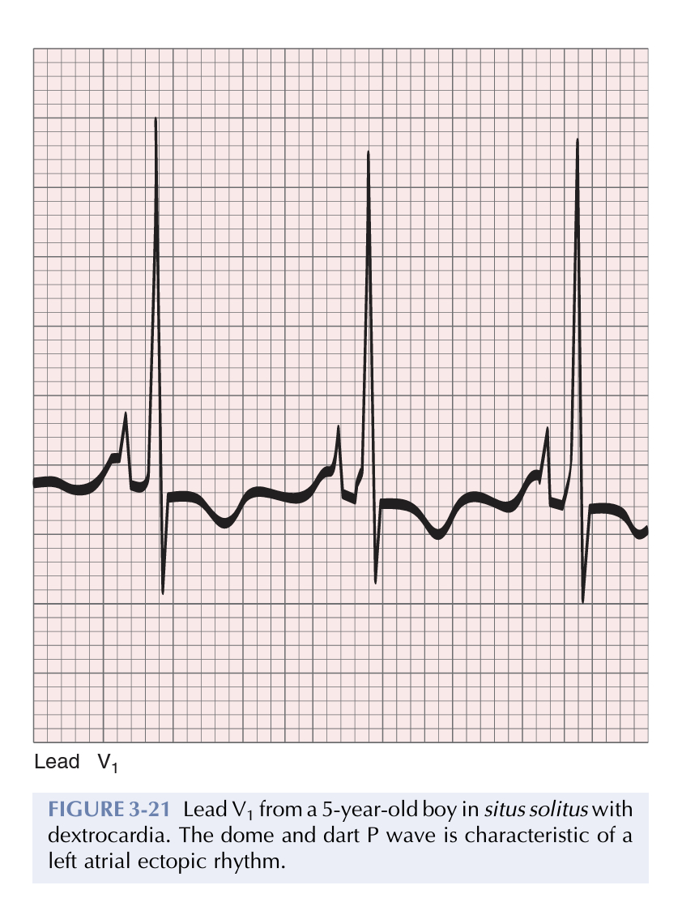
In the presence of a right sinus node, the direction of the P wave can be altered by a left atrial ectopic focus.
Valsalva’s maneuver, ocular pressure, or exercise may transiently shift the ectopic focus to the right sinus node.
Left atrial ectopic rhythm is manifested by a negative P wave in lead 1 and isoelectric or negative P waves in left precordial leads
A less common but more distinctive configuration is the dome and dart P wave in lead V1
A negative P wave in lead 1 or lead V1 does not distinguish situs solitus with a left atrial ectopic rhythm from situs inversus, but a dome and dart P wave in lead V1 or V2 confirms a left atrial ectopic focus irrespective of atrial situs.

Slide 48
ECG –CHAMBER LOCALISATION
LOCALISATION OF VENTRICLE – the depolarisation of the IVS is from the morphologic LV to RV —> produces Q waves in the precordial leads that overlie morphologic LV
Q waves in v5 and v6 , not in v1 —> d loop of the ventricles
Q waves in v4R, v1, v2 ; not in v5,v6 —> l loop of the ventricles

Slide 52
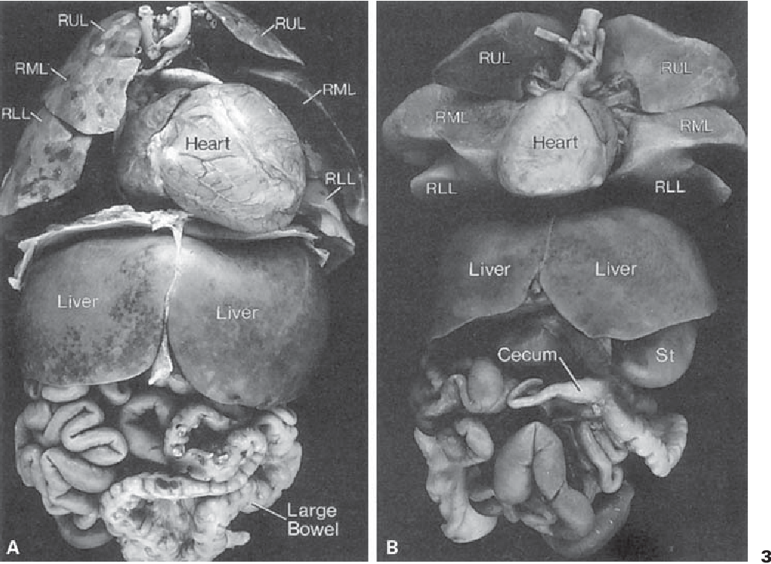
VISCERAL HETEROTAXY

Slide 53
Heterotaxy syndrome
occurs in approximately 1 per 10,000 live births
organs that typically develop asymmetrically are noted to display symmetry and mirror image patterns
usually associated with complex cardiovascular malformations
almost 3% of all congenital cardiac anomalies occur in the setting of HS

Slide 54
Causes of HS
can occur in isolation or could be a feature of other genetic syndromes like primary ciliary dyskinesia (Kartagener syndrome)
rare mutations in genes which control early embryonic left-right patterning like ZIC3
environmental insults during early embryogenesis—
maternal diabetes
Family history of malformations
Cocaine use during first trimester

Slide 55
Criteria for visceral heterotaxy and abnormal visceral symmetry
1 Thoraco-abdominal situs inconsistency
2 Abnormally symmetric lung lobes
3 Abnormally symmetric bronchial branching pattern
4 Abnormal symmetry of the liver
5 Unusual or abnormal systemic venous connections
6 Unroofed coronary sinus
7 Abnormal pulmonary venous connections or drainage
8 Similarities in the shape and morphology of the atrial appendages
9 Abnormal mesenteric attachments
10 Abnormal bowel location +/– malrotation
11 Asplenia, polysplenia or single right-sided spleen
12 Abnormal position and/or size of the pancreas

Slide 56
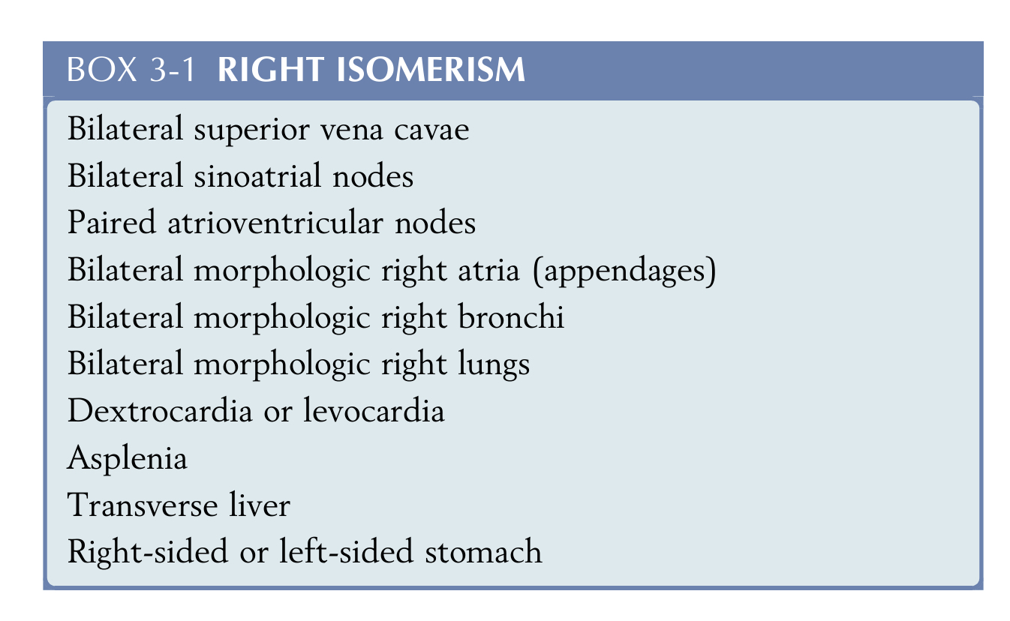
Heterotaxy with right isomerism
Right isomerism— a subset of heterotaxy where some paired structures on opposite sides of the left-right axis of the body are symmetrical mirror-images of each other, and have the morphology of the normal right sides structures
Arrest in cardiac development during the fifth week of gestation

Slide 57
Asplenia/ Ivemark syndrome
Equal or MALE predominance
Asplenia has been reported in siblings and in families.
Cyanosis is often evident in the first 24 hours.
Survival — determined chiefly by coexisting congenital heart disease but also extracardiac anomalies
Most deaths are within the first few months of life, with only sporadic survivals after the first year and a single remarkable survival to age 21 years.
asplenia increases the risk of bacterial infection and septicemia

Slide 58
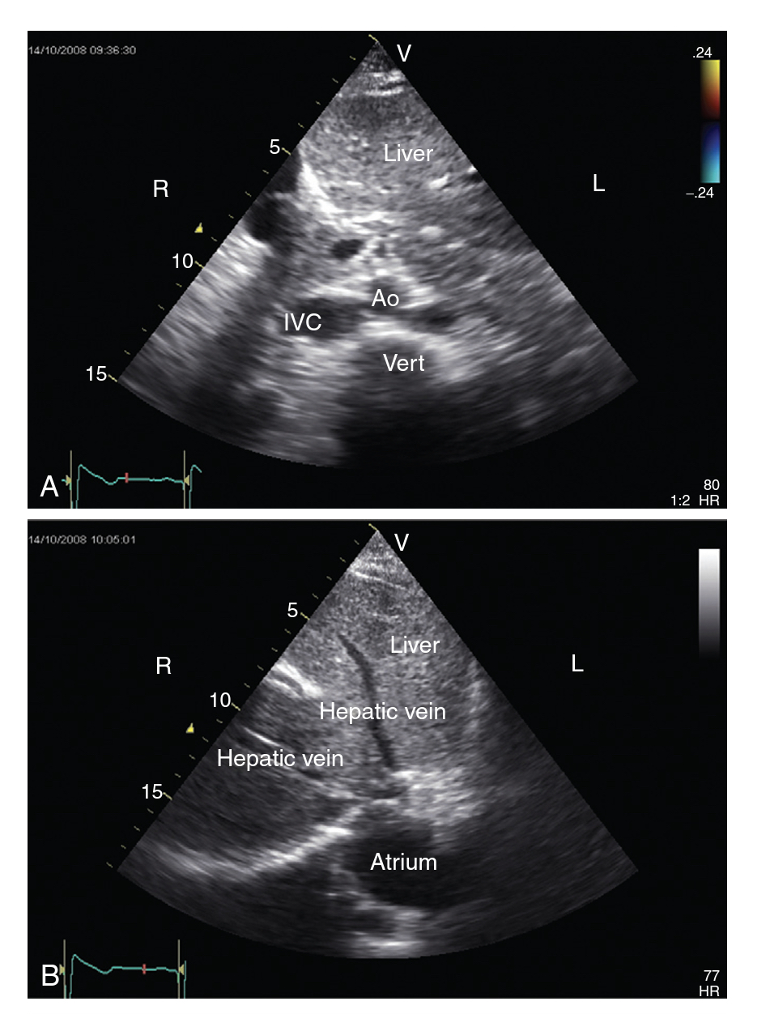
Features of R Isomerism
Cardiac position: Usually abnormal, either dextrocardia or mesocardia ; levocardia may also be seen
Morphology of the atrial appendage: Both atrial appendages display the morphological features of the right atrial appendage
Systemic venous return:
Bilateral SVC occurs in almost 71% of cases. When two SVCs are present, they typically connect to the top corner of corresponding atrium.
IVC drains into one of the atria; hepatic venous drainage may well be to the contralateral atrium.
Coronary sinus is absent in almost 100% cases

Slide 59
Pulmonary venous drainage: Frequent occurrence of extra-cardiac TAPVC with more than 50% incidence. May be obstructed frequently.
Inter artrial septum: Common atrium frequent.
Atrioventricular junction: Complete atrioventricular septal defect (AVSD) with common atrioventricular valve (93%)
Atrioventricular connection: Frequently univentricular in nature (70%) with a solitary ventricular chamber.
Ventricular outflow: Pulmonary stenosis or atresia is frequent (96%); systemic arterial outflow obstruction is rare
Ventriculo-arterial connection: Frequently abnormal (95%).Discordant connections and double outlet right ventricle are common (82%).
Conduction system: Bilateral SAN , one in each atrium.
Two atrioventricular (AV) nodes may be present with sling of conduction tissue —> SVT - reentry
Atrial tachyarrhythmias are common.

Slide 60
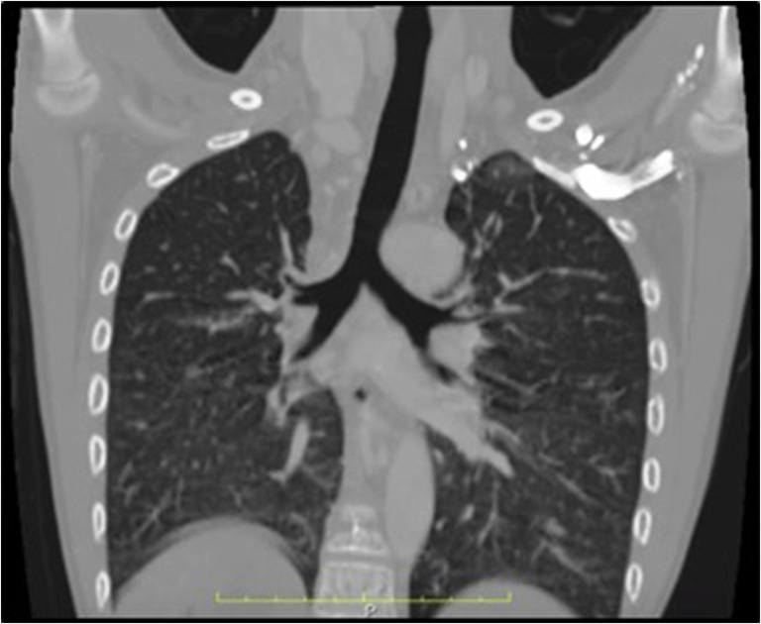
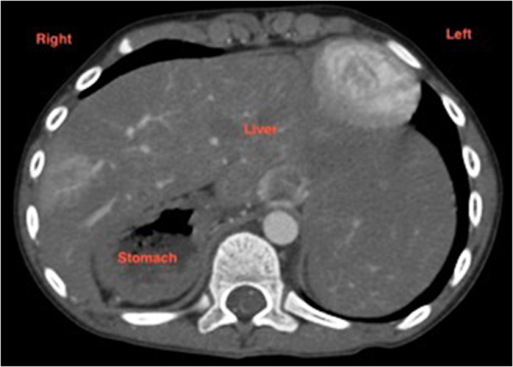
11. Extra-cardiac anomalies
Spleen: Characteristically absent. If present (10–15%), abnormal and hypo functional.
Howell-Jolly bodies and Pitted red cells in peripheral blood smears
A wandering spleen
Lungs and bronchi: Two trilobed lungs with bilateral eparterial bronchi
Liver: Central and transverse
Bowel: Malrotation less frequent
Midline Abnl - tracheoesophageal fistula, meningomyelocele, encephalocele, cerebellar agenesis, cleft lip, cleft palate, and horseshoe kidney

Slide 61
ASSOCIATED congenital heart disease
common atrium,
common atrioventricular valve,
morphologicsingle ventricle,
pulmonary stenosis or atresia,
total anomalous pulmonary venous connection
Ventricular and great arterial connections are usually discordant.

Slide 62
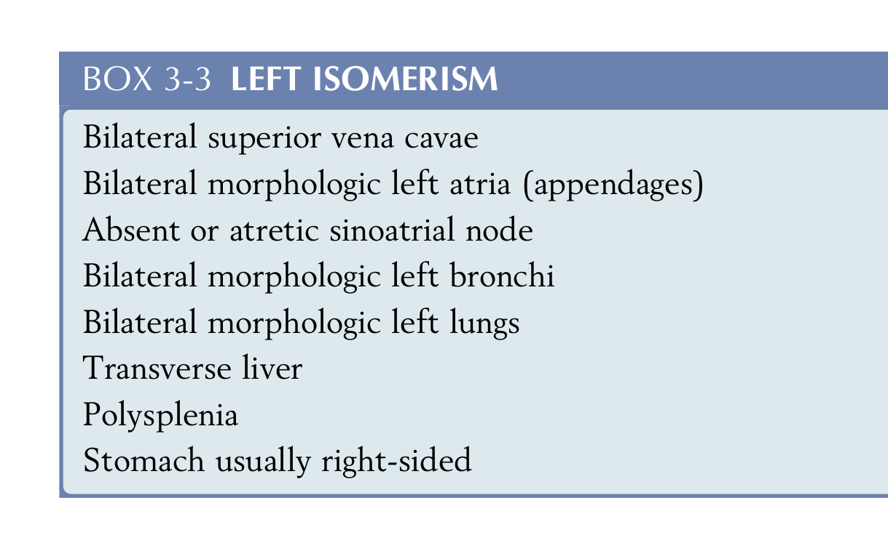
Heterotaxy with left isomerism
more prevalent in women
a subset of Heterotaxy where some paired structures on opposite sides of the left-right axis of the body are symmetrical mirror images of each other and have the morphology of normal left sided structures
Notes:
but it is questionable whether this should be considered partial anomalous drainage

Slide 63
Features polysplenia syndrome
1. Cardiac position: Abnormal in 40–50% cases.
Atrial appendage: Both display morphology of left atrial appendage.
Systemic veins
Bilateral SVC occurs in two thirds of patients; one may connect to the coronary sinus.
IVC interruption and azygous extension to right or left SVC occurs exclusively in patients with left atrial isomerism; incidence -80%.
When the IVC connects directly to atria from below, it may connect to the left- or right-sided atrium. Similarly, hepatic veins may connect to both atria or to both sides of a common atrium

Slide 64
4. Pulmonary venous return: Partial anomalous pulmonary venous connection (PAPVC) can be seen in > 50% cases due to bilateral atrial connection of ipsilateral pulmonary veins or due to septal malalignment. Rarely TAPVC may be present.
5. Interatrial septum: AV septal defect is common (but prevalence is higher in right atrial isomerism), most patients have a common atrioventricular orifice. Very rarely the atrial septum is well formed and intact.
6. Atrioventricular connection: The atrioventricular connection is biventricular but ambiguous in 75%.
7. Ventriculo-arterial connection: Ventriculo-arterial connection is either discordant or double outlet right ventricle in 20–30%.

Slide 65
8. Ventricular outflow: Unobstructed pulmonary outflow is common, 50% have pulmonary stenosis and < 10% may have pulmonary atresia. Sub-aortic obstruction may occur in 22%.
9. Conduction system
Absence of sinus node in most cases; if present, it is abnormally positioned and hypoplastic. Clinically manifests as slow atrial or junctional rhythm and abnormal axis of P waves on electrocardiogram (ECG)
Complete heart block may occur in some neonates with left atrial isomerism.

Slide 66
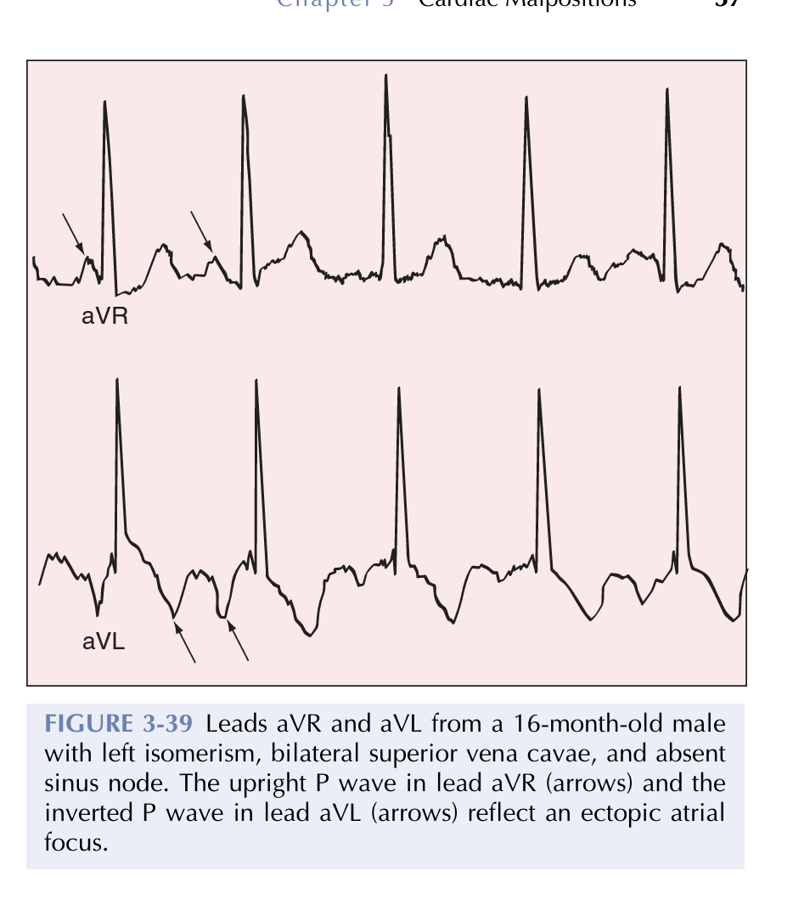
noncardiac anomalies-gastrointestinal(malrotation, biliary atresia, esophageal atresia and congenital short pancreas)
20% die as neonates; 50% survive adolescence
sinus node is absent or hypoplastic.
atrial pacemaker is ectopic –located in atrial wall or coronary sinus ostium
Atrial fibrillation and atrial flutter seen
Complete atrioventricular block occurs in approx. 1 in 5 cases —> blocked at the level of the penetrating bundle, resulting in nodoventricular discontinuity and a narrow QRS interval

Slide 69
Prenatal diagnosis
Fetal echocardiography
Right isomerism is diagnosed in presence of at least two of the following findings:
Situs ambiguous
Structural heart defect i.e. complete AV septal defect
Juxtaposition of inferior vena cava and descending aorta
Left isomerism is diagnosed when two of the following findings are present:
Situs ambiguous
Azygous continuation of interrupted inferior vena cava
Early fetal heart block
Complete AV septal defect or other structural heart disease

Slide 70
MCQ

Slide 71
Interrupted IVC is seen in
Situs inversus
Situs solitus
Right isomerism
Left isomerism

Slide 72
2. Morphological feature of right atrium
Finger like posterior appendage
Smooth surface
Presence of cristae terminalis
D) Septum primum lies on RA side

Slide 73
3. True about right atrial appendage
Narrow based
Triangular
Posterior
None of the above

Slide 74
4.True about ventricular morphology
LV is cresentic in cross section
Moderator band is seen in RV
Trabeculations are more in RV
RV has smooth septal surface
Both b and c

Slide 75
5. In d TGA true about connection is
A) AV discordant , VA concordant
B) AV concordant , VA discordant
C) Both AV and VA concordant
D) Both AV and VA discordant

Slide 76
6. In d malposition of great arteries
Aorta posterior and to right
Aorta posterior and to left
Aorta anterior and to right
Aorta anterior and to left

Slide 77
7.Segmental expression of L TGA is
S , D , S
I , L , I
S, D , D
S , L , L

Slide 78
Identify

Slide 79
Thank you

