Slide 1
CARDIOMYOPATHY
DR PRANAY JAMBHULKAR
DM CARDIOLOGY

Slide 2
DEFINITION
Cardiomyopathy is a heterogenous group of diseases of myocardium associated with mechanical and /or electrical dysfunction that usually exhibit inappropriate ventricular hypertrophy or dilation and are due to a variety of causes and frequently are genetic
It is distinctive because it does not involve valvular , hypertensive , congenital disorders.
Clinically and hemodynamically distinctive.

Slide 3
DILATED CARDIOMYOPATHY

Slide 4
BACK GROUND
The most common cause of the clinical syndrome of chronic heart failure.
Median survival for men is 1.7 yrs ,women 3.2 yrs.---
mortality is high
Primary- Genetic , non-genetic
Secondary - Ischemia,valvular ,HTN
It is defined as a ventricular chamber exhibiting
increased diastolic and systolic volumes and a low
< 45% ejection fraction.

Slide 5
CLASSIFICATION
Based on global anatomic description of chamber dimension in systole and diastole.
Mixed- DCM,RCM
Genetic –HOCM ,ARVD,ARVC
Acquired –peripartum,tachycardia induced cardiomyopathies.
Secondary –Becker ,Duchenne cardiomyopathy.
Valvular ,hypertensive,Ischemic are excluded.

Slide 6
PATHOPHYSIOLOGY
Progressive myocardial failure is most likely caused by myocardial cell loss than by increased load ischemia.
Virtually all dilated cardiomyopathies----progressive dilation—myocardial dysfunction in viable segments.—change in chamber shape—less elliptical ,more round.

Slide 7
POSSIBLE MECHANISMS FOR STABILIZATION
Increased heart rate and contractility
Increased adrenergic signaling
—within seconds
Volume expansion—
Frank starling—stroke volume---hours
Increased contractility
Cardiac myocyte hypertrophy—days
Chronic continued activation of RAS,ANS –
progressive myocardial dysfunction
RAS ,ACE inhibitors
blockers—reverse remodelling,progressive
systolic dysfunction

Slide 8
CLINICAL FEATURES
Pulsus alternans
Pulsus tardus
Systolic blood pressure normal or less than normal.
Raised JVP
Prominent a and v waves tricuspid regurgitation
b/l basal crepts
Pedal edema
Hepatomegaly
Gallop rhythm
Systolic murmurs—MR,TR

Slide 9
ECG
Sinus tachycardia in presence of heart failure.
Atrial and ventricular tachyarryhthmias
Poor r wave progression
Anterior q waves
Intraventricular conduction defects –mostly LBBB
Left atrial abnormality
Hypertensive changes by voltage criteria not evident
ST –T changes are seen.

Slide 10
2D ECHO
Dilated chambers
Left atrium is usualy enlarged
Left ventricle is enlarged(normal 3.8—5.0 cm)
Mitral and tricuspid regurgitation on doppler flow.
Stress testing --tachyarryhthmias

Slide 11
MASSIVE CARDIOMEGALY
WATER BOTTLE SHAPED HEART

Slide 13
IDIOPATHIC DCM
It is by exclusion.
Relatively common.
0.04%.
Increases with age.
M>F.
Myocardial cell hypertrophy,interstitial cell fibrosis
Etiology as
Alcohol >80g/day-M,>40g/day-F-→5 years.
HTN→160/100 ,uncontrolled
Assess TSH levels
Biopsy

Slide 14
PATHOPHYSIOLOGY
35-50% are familial
CARVAJAL syndrome—DCM,wooly hair,keratoderma.
Altered signal transduction—phospholamban gene
High mortality and morbidity—lamin A/C gene
Post mortem—dilation of the chambers
Weight of heart is increased
Visible scars
Mural endocardial plaque

Slide 15
PROGNOSIS
Better than ischemic
50% survival ->5 yrs without ACE
LAMIN A/C gene—worse prognosis
Treatment
NO issue of revascularization
Increased incidence of thromboembolic complications
B blockers are more useful—viable myocardium
All should receive B BLOCKERS unless contraindicated.

Slide 16
Hypertrophic cardiomyopathy
Thickened …… non-dilated left ventricle in the absence of another cardiac/ systemic or metabolic condition (e.g., AS, SHT physiologic athlete's heart)
LV end-diastolic wall thickness of ≥15 mm anywhere in the left ventricle.
Frequency 1: 500→1:200 .
Mutation in gene encoding the Sarcomere proteins
β-myosin heavy chain (MYH7) and myosin-binding protein C (MYBPC3) – 70%
Troponin T (TNNT2), troponin I (TNNI3), and others – 5%
1500 mutations (largely missense) – unique to a family

Slide 17
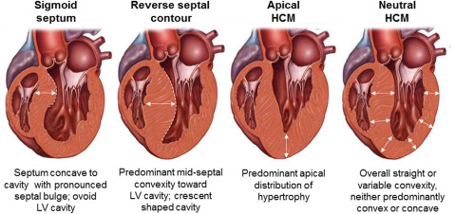
Varients of HCM

Slide 18
CLINICAL FEATURES - SYMPTOMS
Majority are asymptomatic
Dyspnea - 90%( of symptomatic patients)
Syncope and presyncope in 20 and 50% respectively due to either hemodynamic or rhythm abnormality.
Angina -70-80%
small artery narrowing
intramural compression of small arteries
oxygen supply demand mismatch
abnormal coronary flow reserve
Palpitations
SCD

Slide 19
PHYSICAL EXAMINATION
Carotid pulse is brisk upstroke
Spike and dome pattern (in LVOTO)
Early spike – rapid ejection by hypercontractile LV
Pressure dip and doming – reflect the dynamic outflow obstruction.
Carotid thrill or shudder can be heard .
JVP – mean JVP normal .
Prominent “a” wave is characteristic .
Typically palpable S4 +
Apex – early systolic dip/retraction
- LATE SYSTOLIC HEAVE +
palpable in more than 1 ICS
Left Parasternal lift if present is due to ASH in thin pts .

Slide 20
ECG in HCM
12 lead ECG is abnormal in 90% probands and 75% asymptomatic relatives.
ISOLATED SEPTAL HYPERTROPHY
Deep and narrow Q waves in inferior and left leads .
LAD of QRS axis
S in V1 and R in left precordial leads is of low amplitude
Abnormal “q” in the absence of left free wall hypertrophy in a young pt should raise suspicion of dominant septal hypertrophy.
Free Left Wall Hypertrophy
Classic presentation of LVH due to systolic overload
Deep S in V1-V2
Tall R in V5-V6 (V6>V5)
Short PR interval
Shelf like angulation of ST segment in leads V5-V6 .
Wide QRS-T angle

Slide 21
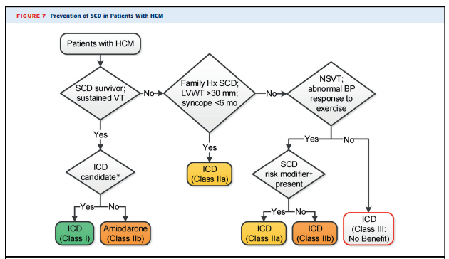
Management

Slide 22
MEDICAL THERAPY
Beta Blockers
Advantages of beta blockers include
1. Decreased heart rate response to exercise
2. Decreased outflow tract gradient with exercise
3.Relief of angina by a decrease in myocardial oxygen demand
4 Improvement in diastolic filling
Calcium Channel Blockers
Decrease inotropy and chronotropy
Improve abnormal diastolic relaxation by preventing calcium influx.
Verapamil -used most frequently due to its minimal effect on afterload.

Slide 23
Disopyramide
The negative inotropic effect - decrease the gradient and improve symptoms.
Concomitant beta-blockade to prevent rapid atrioventricular node conduction.
dosage 300 to 600 mg/d.
corrected QT interval to be monitored

Slide 24
PERIPARTUM CARDIOMYOPATHY

Slide 25
PERIPARTUM CARDIOMYOPATHY
Rare,dilated cardiomyopathy with systolic dysfunction presenting in late pregnancy or the early postpartum period
According to NHLB, in the 1990s
PPCM is defined as heart failure that develops in the last month of pregnancy or up to five months postpartum with left ventricular systolic dysfunction (LVEF <45% or fractional shortening <30%, or both)

Slide 26
RISK FACTORS
Advanced maternal age
Preeclampsia
Multiple gestation
Hypertension, diabetes, and obesity
Thyroid dysfunction
Cocaine use
Smoking
Prolonged tocolysis.

Slide 27
Pathogenesis
Soluble fms-like tyrosine kinase receptor 1 (sFlt-1) is an anti-angiogenic protein secreted by the placenta
Oxidative stress stimulates cardiomyocytes to express cathepsin D which cleaves prolactin into a 16 kDa fragment which causes endothelial apoptosis and capillary dropout.

Slide 28
Clinical feartures
Symptoms of congestion,
Dyspnea on exertion, orthopnea, PND
Edema of the lower extremities.
Less commonly, with cardiogenic shock
Uncommon presentations include symptomatic or even unstable arrhythmias and arterial thromboembolism

Slide 29
PHYSICAL EXAMINATION
Tachycardia
Tachypnea
Evidence of left sided congestion (eg, pulmonary rales)
Right sided congestion (eg, raised jugular venous pressure, edema).
Mitral regurgitation murmur
A left sided or right sided S3 gallop (or both) may be audible
An S3 gallop can also be present in norma pregnancy

Slide 30
PREDICTORS OF RECOVERY
Normal ventricular size
LVEF >30% at time of diagnosis
Lack of troponin leak
Low BNP level
Non African, American race
Absence of LV thrombus
Diagnosis after delivery
Breast feeding
20% - complete recovery
50%- in persistent LV dysfunction

Slide 31
RESTRICTIVE CARDIOMYOPATHY
EMF is an obliterative cardiomyopathy characterized by fibrotic thickening and obliteration of either right , left or both ventricles with a predilection to selectively involve the ventricular apices and inflow region and sparing the outflow tract
Fibrotic process does not involve the valve leaflets, the atria, or the great vessels and extra cardiac involvement is not known
Most common restrictive cardiomyopathy observed world wide

Slide 32
ETIOLOGY
Endomyocardial fibrosis is supposed to be a disease caused by poor diet, low protein and exposure to toxins(cerium)
Laterite soil is the type of soil found in the high rain fall regions of Kerala, here excessive rainfall washes away all the magnesium in the soil (unlike the forests where the retained leaves preserve the magnesium in the soil.)

Slide 33
Isolated or dominant left ventricular EMF
Usually a good general status, pronounced dyspnoea and orthopnoea,
Small displacement of the apex beat that is not particularly hyperdynamic.
There is characteristically a soft and short systolic murmur confined to early systole.
A delayed opening snap is present, due to thickening of the anterior leaflet of the mitral valve, and the pulmonary component of the second sound is loud indicating high pulmonary pressure

Slide 34
Isolated or Dominant right ventricular EMF
Have proptosis, facial oedema, cyanosis, distended jugular veins and finger clubbing.
Retardation of growth and underdevelopment of secondary sexual characteristics.
Some have a variable degree of jaundice
A left parasternal pulsation is usually noted, and corresponds to the compensatory hypercontractile right ventricular outflow tract
The presence and intensity of the systolic murmur from the tricuspid regurgitation is variable, but a third sound is always present.
Ascites is in most cases disproportionate to the almost inexistent pedal oedema and is associated with hepatosplenomegaly

Slide 35
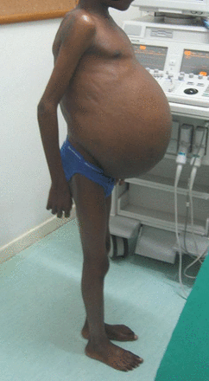
Clinical profile of tropical EMF.
Typical clinical appearance of the disease showing striking ascites, regardless of which ventricle is involved, contrasting with little or no peripheral edema. Usually, when these patients have edema of the lower extremities, they have also an exudative enteropathy with a low serum protein content.

Slide 36
MANAGEMENT
ACE –Inhibitors/ ARBs
B-blockers
OAC
MRA
Diuretics
Surgical management
Endocardial decortication combined with mitral and/or Tricuspid repair or replacement
Operative mortality rate is high (15-20%), but successful surgery has a clear benefit on symptoms and favorably affects survival

Slide 37
ANTHRACYCLINE CARDIOMYOPATHY
Doxorubicin.daunorubicin
Dose related
Dilated
>450mg/m2 with no risk factors.
Prior mediastinal radiation is a risk factor.
Definitive diagnosis is by biopsy
Cell vacuolization 16-25% of sampled cells in biopsy
Presenting late is better prognosis
Carvedilol –beneficiary effect

Slide 38
CHAGAS CARDIOMYOPATHY
MC cause of NICM .
T. cruzi.
Kissing bug.
Blood transfusions.
Initial myocarditis in childhood.
Recovery—DCM after 30 years.
Clinically diagnosed.
BBB—HEMIBLOCKS.
LVH.
Doppler tissue imaging.
Mononuclear infiltrates.
Apical aneurysm.
Ab cross react with myosin.
Prognosis-50%.
Death—arrhtyhmias.
Verapamil,amiodarone,no specific treatment.

Slide 39
TAKE HOME MESSAGE
All should receive beta blockers in DCM unless contraindicated.
Anti thrombotic drugs to be started in the treatment of cardiomyopathy
Amlodipine in case of AR useful.
Alcoholic patients are not good for cardiac
transplantation.
Medical treatment in case of severe LVD in case of valvular DCM.

Slide 40
THANK YOU

