Slide 1
CONSTRICTIVE PERICARDITIS
DR.Anjos

Slide 2
TOPICS
DEFENITION
ANATOMY & PHYSIOLOGY OF PERICARDIUM
HEMODYNAMICS OF CP
ETIOLOGY
PATHOPHYSIOLOGY
SYMPTOMS& CLINICAL FEATURES
DIAGNOSIS
MANAGEMENT

Slide 3
Constrictive Pericarditis
A condition in which a thickened,noncompliant,adherent or calcified
pericardium limits the diastolic filling of cardiac chambers.

Slide 4
Anatomy of the Pericardium
2 layers-
the visceral pericardium, a monolayer of mesothelial cells and collagen and elastin fibers adherent to the epicardial surface of the heart, and the fibrous parietal layer, which is normally about 2 mm thick and surrounds most of the heart.
The parietal pericardium is largely acellular and contains collagen and elastin fibers.
50 mLof serous fluid.
Posterior to the left atrium, the reflection occurs at the oblique sinus of the pericardium. The left atrium is largely extrapericardial.
The parietal pericardium has ligamentous attachments to the diaphragm, sternum, and other structures.

Slide 5
Functions of Pericardium
maintain the heart at a relatively constant position within the thorax,
it provides a barrier to infection.
The pericardium also secretes prostaglandins and related substances that may modulate neural traffic and coronary tone.
restraining effect on cardiac volume
NONVITAL FUNCTIONS

Slide 6
PRESSURE VOLUME RELATIONSHIP OF PERICARDIUM& STRETCH RATIO

Slide 7
Determinants of Ventricular filling
Early rapid filling
Ventricular Relaxation(Negative dp/dt)
Driving pressure gradient across mitral valve
Late diastolic filling(diastasis)
Continued ventricular relaxation
Pericardial restraint
Interventricular interactions
Viscoelastic forces of myocardiym
Atrial contraction

Slide 8
Normal Respiratory Hemodynamics
Pericardium encases both ventricles,RA ,most of LA
Pulmonary & Systemic veins Extrapericardial
Pulmonary veins are intrathoracic while systemic veins are extrathoracic.
Normal inspiratory fall in intrathoracic pressure is uniformly transmitted to pulmonary veins and cardiac chambers but not transmitted to systemic veins So the normal flow in Systemic veins is Respirophasic while in pulmonary veins it is nonrespirophasic.

Slide 10
Hemodynamic of Constrictive Pericarditis
1.Dissociation between intrathoracic and intracardiac pressures(due to thickened & inelastic pericardium)
-respirophasic variation in pulmonary vein flow as well
2.Exaggerated Interventricular dependence-ventricles fill at expense of one another
3.Equalisation of filling pressure-Diastolic democarcy

Slide 11
EXAGGERATED VENTRICULAR INTERDEPENDENCE

Slide 12
Summary of CP hemodynamics
Inelastic& thick pericardium,reduced compliance
Fixed pericardial volume Dissociation of thoracic /card
Mid diastolic restriction
Fail to accommodate increased venous return Reduced lv filling
Shift of ivs to other ventricle
Exaggerated ventricular interdependence

Slide 13
Hemodynamics Of RCM & CP
Both CP & RCM result in impaired diastolic ventricular filling
CCP-External compression
RCM-intrinsic myocardial pathology
Diastolic dysfunction is the hallmark
Elevated ventricular filling pressure
Elevated mean atrial pressure
In CP the early rapid filling is preserved,but in RCM there is pandiastolic impairment.

Slide 14
RCMP hemodynamics
No dissociation between intrathoracic and intracardiac pressure.
No diastolic democracy
Ventricular concordance(septum is involved and noncompliant)
PAH usually more .
Inspiratory flow reversal in hepatic veins due to noncompliant RV

Slide 15
Other condition with restrictive physiology
RV infarction
Acute pulmonary Embolism
Acute /Subacute TR

Slide 16
MIXED Constriction & Restriction
Incidence_12.7% in some case series
Causes
Radiation related
Myopericarditis sequelae
Post surgery
Late stages of CP
Relative contribution of each is difficult to assesS
Poor prognosis

Slide 17
Pathophysiology
Constriction can follow an initial insult by as little as several months and occasionally less, but typically takes years to develop.
The end result is fibrosis, often calcification, and adhesions of the parietal and visceral pericardium.
Scarring is usually more or less symmetric and impedes filling of all heart chambers.

Slide 18
ETIOLOGY
Idiopathic
Infectious
Viral (echovirus, coxsackievirus, adenovirus, cytomegalovirus, hepatitis B virus, infectious mononucleosis, HIV/AIDS
Bacterial* (M. tuberculosis, M. avium-intracellulare, pneumococcus, staphylococcus, streptococcus, Mycoplasma, Lyme disease, H. influenzae, Neisseria meningitides, and many others)
Fungal (histoplasmosis, coccidioidomycosis)
Protozoa
Inflammatory
Connective tissue disease* (systemic lupus erythematosus, rheumatoid arthritis, scleroderma, dermatomyositis, Sjögren syndrome, mixed)
Drug-induced* (e.g., procainamide, hydralazine, isoniazid, cyclosporine)
Arteritis (polyarteritis nodosa, temporal arteritis) Inflammatory bowel disease Postcardiotomy, postthoracotomy,* post–cardiac injury syndrome* Genetic immune system diseases* (tumor necrosis factor receptor-1–associated periodic syndrome [TRAPS], familial Mediterranean fever) Miscellaneous: sarcoidosis, Erdheim-Chester disease, Churg-Strauss disease, immunoglobulin G4–related disease

Slide 19
ETIOLOGY
Post–Myocardial Infarction (Dressler syndrome)*
Cancer Primary: mesothelioma, fibrosarcoma, lipoma, and others Secondary*: breast and lung carcinomas, lymphomas, Kaposi sarcoma
Radiation-Induced Disorders
Early Post–Cardiac Surgery and Post–Orthotopic Heart Transplantation Hemopericardium Trauma Post–myocardial infarction free wall rupture Endomyocardial biopsy Dissecting aortic aneurysm
Device- and procedure-related: percutaneous coronary procedures, implantable defibrillators, pacemakers, post–arrhythmia ablation, post–atrial septal defect closure, post–left atrial appendage isolation, post–percutaneous valve repair/replacement, laparoscopic hiatal hernia repair

Slide 20
ETIOLOGY
Miscellaneous
Stress cardiomyopathy
Cholesterol (“gold paint” pericarditis)
Chronic renal failure,
dialysis-associated
Hypothyroidism and hyperthyroidism Amyloidosis Pneumopericardium
Polycystic kidney disease

Slide 21
Common Etiology
Post-Infectious-TB,purulent bacterial INFECTIONS
Post traumatic- cardiac surgery
Chronic inflammation
Postirradiation
Uremia
Idiopathic

Slide 22
Clinical Features
Initially-symptoms of right heart failure
lower extremity edema,
vague abdominal complaints-anorexia,nausea
Fatigue
Abdominal distention
With progression-anasarca,jaundice
dyspnea, cough, and orthopnea(later in course)
fatigue, muscle wasting, and cachexia( due to chronically low CO)

Slide 23
Physical Examination
External markers of TB
Stigmata of Cirrhosis
Signs of Renal failure
Pallor,pedal edema,icterus,clubbing,lymphadenopathy
JVP-normal x descend,prominent y descend
Kussmaul sign-
an inspiratory increase in mean venous pressure, is usually present
paradoxic pulse-1/3 rd of patients

Slide 24
Frederich Sign-Sudden collapse of previously distented neck veins in early diastole.
pericardial knock-an early diastolic sound best heard at the left sternal border and/or the cardiac apex
Broad bent sign-The apical impulse may retaract in systole and will be difficult to palpate
Other sytems-Ascitis,pleural effusion

Slide 25
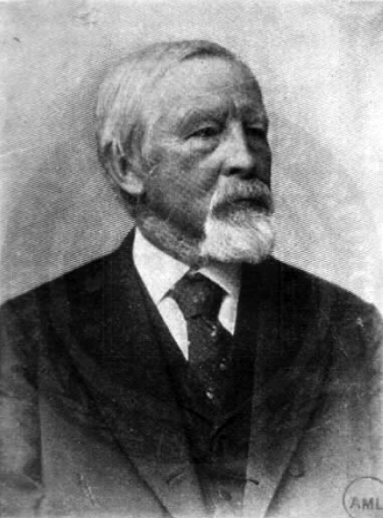
PULSUS PARADOXUS
this affliction results in the symptoms associated with chronic infection of the pericardium, as well as...a pronounced arterial pulse phenomenon...the pulsations of all arteries become smaller or disappear completely...and return with expiration...I propose to call this pulse action paradoxical .-Adolf Kussmaul
the paradox Kussmaul describes is that the peripheral pulse disappears while the central heartbeat is still present.

Slide 26
PULSUS PARADOXUS
Defined as a decrease in systolic blood pressure of more than 10 mmHg during inspiration
pulsus paradoxus is an exaggeration of the cardiovascular physiological response to arterial pressure with normal inspiration.

Slide 27
PULSUS PARADOXUS
ardiac causes
Cardiac tamponade
Pericardial effusion
Constrictive pericarditis
Pulmonary embolism
Cardiogenic shock
Restrictive cardiomyopathy
Acute myocardial infraction
Extracardiac pulmonary causes
Bronchial asthma
Tension pneumothorax
Extracardiac non-pulmonary causes
Extreme obesity
Superior vena caval obstruction
Volvolus of stomach
Diaphragmatic hernia
Anaphylactic shock

Slide 28
Measurement
Sphygmomanometer
The systolic pressure at which the first Korotkoff sounds can be heard during expiration should be recorded.
The cuff is then deflated (1 mm per heartbeat) while listening for uniformly loud Korotkoff sounds in both expiration and inspiration.
The systolic blood pressure at which Korotkoff sounds can be heard during both phases of respiration should be recorded. The second recorded systolic pressure should be subtracted from the first, and if this value is >10 mmHg, pulsus paradoxus is considered to be present.

Slide 29
Pathophysiology of pulsus paradoxus
1.ventricular interdependence.
The increased negative intrathoracic pressure
2.increased blood flow to right side
(3) increases pulmonary blood flow, volume, and pooling of blood resulting in decreased left ventricular filling and stroke volume.

Slide 30
Pathophysiology of pulsus paradoxus

Slide 31
SENSITIVITY AND SPECIFICITY OF PULSUS PARADOXUS
sensitivity of 79% for predicting pericardial tamponade, but its specificity is quite low.
19% of patients with constrictive pericarditis were found to have pulsus paradoxus.
However, in an older series of patients with constrictive pericarditis, 44% of patients had pulsus paradoxus .

Slide 32
KUSSMAULS SIGN
“the jugular veins became considerably swollen” and “by each inspiration, a slight increase of its contents could be noted.”-Adolf Kussmaul.
Defined by a visualized increase in jugular venous pressure or pulse with inspiration.
Physiologically, in healthy individuals, pleural pressure approximates pericardial and mediastinal pressure. Inspiration creates negative intrapleural (intrathoracic) pressure, and enhances the pressure gradient and translocation of blood volume between the positive abdominal pressure and negative intrathoracic pressure.

Slide 33
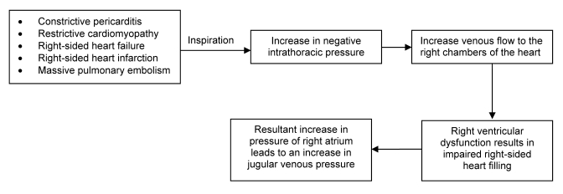
Mechanism of Kussmaul Sign

Slide 34
Clinical features of Differentiation
 | CONSTRICTIVE PERICARDITIS | RCMP
JVP-KUSSMAUL SIGN/FREDERICH SIGN | USUALLY PRESENT | USUALLY PRESENT
APICAL IMPULSE | NOT PALPABLE(BROADBENT SIGN) | PALPABLE
HEART SOUNDS | PERICARDIAL KNOCK | S4
ATRIAL FIB | OCCASIONAL(10%) | VERY COMMON
PULSUS PARADOXUS | 1/3 rd cases | ABSENT
REGURGITANT MURMURS | ABSENT | COMMON
CONDUCTION DISTURBANCES/AV BLOCK | RARE | COMMON
PAH SIGNS | ABSENT | PRESENT

Slide 35
DIAGNOSIS-CXR

Slide 36
ECG
ECG-Nonspecific ST/T changes
AF may be present(10%)
Sometimes LAEmay be present

Slide 37
Other investigation
ECHO
Cardiac catheterization
CT
MRI
Endomyocardial Biopsy

Slide 38
2D ECHO
Anatomy,physiology,etiology
M Mode,2D Echo
Doppler
PW Doppler-
MV& TV inflow
Pulmonary venous flow
Hepatic vein flow
Tissue Doppler
Speckle Tracking& Strain

Slide 39
M MODE& 2D echo
Atrial size-usually normal
Ventricular size-small/normal
Systolic function-normal
Valvular involvement-rare
Pericardial thickness-increased(>3mm)
Septal bounce-present

Slide 40
Pericardial Thickening
Normally <2mm
>4mm –suggestive
>6mm-specific

Slide 41
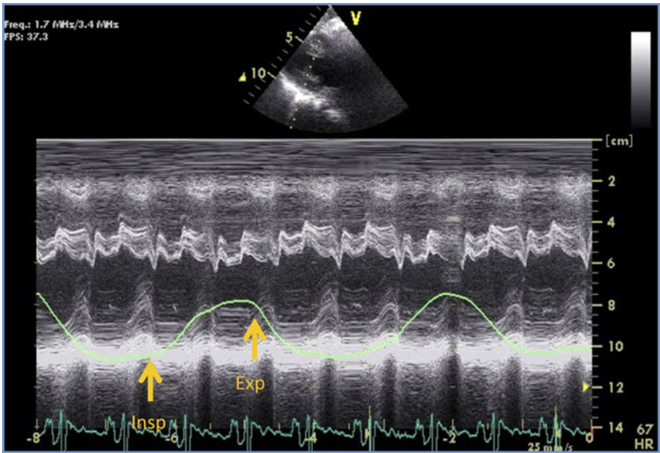
SEPTAL BOUNCE

Slide 42
PW Doppler
Abnormal LV diastolic function.
MV E/A->2
Short deceleration time(<160 ms)..
Phasic variation in mitral &tricuspid inflow as well as hepatic venous flow pattern.
Increase in mitral E velocity(>/=25%) with expiration and Pulmonary vein velocities(>18%)

Slide 43
RESPIROPHASIC VARIATION IN MITRAL INFLOW

Slide 44
DIASTOLIC FLOW REVERSAL HEPATIC VEINS

Slide 45
TISSUE DOPPLER
Single most important parameter differentiating CP from RCMP.
In CP ,mitral medial E’ is INCREASED while in RCMP it is Usually<7 CM/S
Lateral or medial E’ > 8 cm/s –cut off for CP

Slide 46
Annular Velocities
Annulus Reversus-increase in Medial to lateral Annulus E’ velocitie due to tethering in AV groove

Slide 47
Normal to increased E’ Medialvelocity Medial > Lateral ( Annulus Reversus)

Slide 48
Simultaneous LV/RV pressure tracing
Equalisation of RV & LV diastolic pressure
Dip& plateau sign

Slide 49
SIMULTANEOUS RA&LV PRESSURE
Prominent Y descent
Preserved X
Square root sign
Equal A &V wave height
M or W configuration
Lvrapid filling Wave->7 mmHg

Slide 50
The RA and RV diastolic pressure, pulmonary capillary wedge pressure, and pre–a wave LV diastolic pressure are elevated and equal, or nearly so, at around 20 mm Hg.
Differences of more than 3 to 5 mm Hg between the left and right heart filling pressures are rare

Slide 51
SYSTOLIC AREA INDEX(SAI)>1.1 is 97% sensitive & 100 % specific for CP

Slide 52
HEMODYNAMIC DIFFERENCES
 | CCP | RCMP
Prominent Y | Present | Present
X descent | Exaggerated | Blunted
Equal Right & left filling presure | Present | Absent
Square root sign | Present | Absent
Filling pressure>25 mmHg | Rare | Common
PASP>50 | NO | Common
RVEDP/RVSP | >1/3 | <1/3
LV/RV interdependence | Discordant | Concordant
LV rapid filling Wave | >7 | </=7

Slide 53
Tamponade v/s Constriction
Tamponade-pericardial constraint by uniform pressure exerted by fluid( pandiastolic)
Constriction-pericardial constraint by surface pressure of pericardium
(mid-late diastolic)
Higher ventricular interdependence in tamponade than constriction(more pulsus paradoxus)

Slide 55
Pulmonary Hypertension
PASP seldom exceeds 45 mmHg but PAH may be seen in 1/3 rd of patients with CP
Mixed constriction/restriction
Associated pulmonary diseases
Myocardial involvement(late stages)

Slide 56
CT& MRI
Pericardial thickening >4mm –abnormal.
Effusion
Respiratophasic septal motion can be seen in MRI
Relative atrial ratio(LA volume: RA volume)>1.32 Favour CP.

Slide 58
Management
pericardiectomy is the definitive treatment.
2% to nearly 20%mortality
Risk factors for poor outcomes
COPD and renal insufficiency; coronary artery disease and prior cardiac surgery; reduced LV EF; cardiopulmonary bypass; and New York Heart Association (NYHA) stage IV symptoms.
sinus tachycardia is compensatory, beta-adrenergic blockers and calcium antagonists that slow the heart rate should be avoided

Slide 59
I year survival rate 81% to 91%; 5-year rates from 64% to 85%; and 10-year rates from 49% to 81%.
Most survivors are largely free of adverse cardiovascular outcomes.
LV diastolic function returns to normal in about 40% of patients early and about 60% late after surgery.
Tricuspid regurgitation usually does not improve and can cause hemodynamic deterioration.

Slide 60
Effusive-Constrictive Pericarditis
combines elements of effusion/tamponade and constriction.
Constrictive features usually are detected after pericardiocentesis
the failure of RA pressure to decline by at least 50% to a level below 10 mm Hg when pericardial pressure is reduced to almost 0 mm Hg by pericardiocentesis and/or all detectable fluid is removed.
Many cases of “transient” or medically treatable constrictive pericarditis

Slide 61
Causes
cancer,
irradiation,
TB
pericardiotomy
connective tissue diseases
idiopathic

Slide 62
Management
In idiopathic and postpericardiotomy cases, antiinflammatory treatment.
MRI with gadolinium uptake and measurement of hsCRP may be useful to identify patients with active inflammation who are more likely to respond to an antiinflammatory regimen.
Pericardiectomy is ultimately required in many patients.

