Slide 1
CRT

Slide 2
INTRODUCTION
HF VENTRICULAR DYSYNCHRONY
ASSESSMENT OF DYSSYNCHRONY
RATIONALE/ MECHANISM OF CRT
INDICATIONS
PROCEDURE
PROGRAMING
TRIALS

Slide 3
Introduction
Prevalence and economic burden of HF is on the rise
Mainly from the increased incidence of MI and state of the art medicines
5 yr mortality ranges from 15-50%
Pharmacologic therapy for HF, based principally on inhibition of the RAAS and β-blockade, has dramatically improved the outcomes of patients with systolic HF.
despite widespread implementation of guideline-mandated pharmacologic therapies, the prognosis of patients with HF remains poor.

Slide 4
A paradigm shift in the treatment of patients with HF occurred with the introduction of the implantable cardioverter-defibrillator (ICD) devices, but it was even more substantial when biventricular pacing was introduced in clinical practice in the mid-1990s.
Since then, biventricular therapy, or cardiac resynchronization therapy (CRT) as it was later termed, has proved to be one of the most important breakthroughs in the treatment of HF

Slide 5
HF mortality reduction from pharmacological treatment

Slide 6
Cardiac Resynchronization Therapy (CRT)
Cardiac resynchronization therapy (CRT) is the term applied to re- establishing synchrony between left ventricular free wall and ventricular septal contraction in an attempt to improve left ventricular efficiency and subsequently improve functional class.
In the year 2001 FDA approval of the first device for cardiac resynchronization therapy (CRT )

Slide 7
Dyssynchrony
In normal heart electrical activation occurs in 40ms
With myocardial disease ,electrical activation is delayed from one part of the heart to other→ dyssynchrony
Left ventricular (LV) dyssynchrony is a relatively common problem in heart failure patients, in particular those with prolonged QRS complex duration

Slide 8
DEFINITIONS OF DYSSYNCHRONY
Electrical Vs Mechanical Dyssynchrony
Electrical Dyssynchrony refers to a prolonged conduction time in the ventricles resulting in a prolonged QRS duration.
Mechanical Dyssynchrony
Associated with simultaneous contraction and stretch in different regions of the LV as well as delays in the time to peak contraction from one segment to another.

Slide 9
Dyssynchrony results in
Inefficient LV systolic performance
Increased wall stress
Increased end systolic volume
Delayed relaxation– IMPAIRED FILLING
MR

Slide 10
DYSSYNCHRONY
INTRAVENTRICULAR
INTERVENTRICULAR
ATRIOVENTRICULAR

Slide 11
Intra ventricular dyssynchrony
The typical pattern seen with LBBB
Early activation of the IVS and late activation of posterior and lateral walls
Wigger (1925):
(1) Stimulation at any ventricular site disturbs the natural pattern of activation and contraction because the evoked electrical wave front propagates slowly through ventricular myocardium rather than through the Purkinje system
(2) Altered ventricular activation causes an immediate reduction in pump function
Optimal interventricular and intraventricular synchrony is more important than AV synchrony for ventricular pump function.

Slide 12
INTER-VENTRICULAR DYSSYNCHRONY
Dyssynchrony between the left and the right ventricle and can be measured using conventional PWD or TD imaging

Slide 13
AV Dyssynchrony
Optimal AV synchrony contributes to ventricular pump function via starling’s law
Maintains low atrial pressure
Increasing LV filling
Maximizes preload and pump function
Positions the mitral valve for closure during the isovolumetric phase of ventricular systole.
AV conduction delay displaces atrial contraction earlier in diastole & shortens diastolic filling time

Slide 14
Atrioventricular dyssynchrony
AV dyssynchrony reduces the duration of ventricular filling, thus inducing the appearance of diastolic mitral and tricuspid regurgitation and reducing stroke volume.
AV dyssynchrony occurs in patients with dilated cardiomyopathy and first degree AV block and was the first objective of CRT by bicameral pacemakers in the early 1990s.

Slide 15
Desynchrony results in

Slide 16
VENTRICULAR DYSSYNCHRONY- ECHO ASSESSMENT

Slide 17
Interventricular Dyssynchrony
Inter-ventricular mechanical delay (IVMD) is used
PW aortic and pulmonary flow velocities are used.
Then calculate the difference in time between ECG-derived Q wave onset and the onset of LV outflow and the time between the onset of Q and the onset of RV outflow
These values represent left and right ventricular pre-ejection period (PEP)

Slide 18
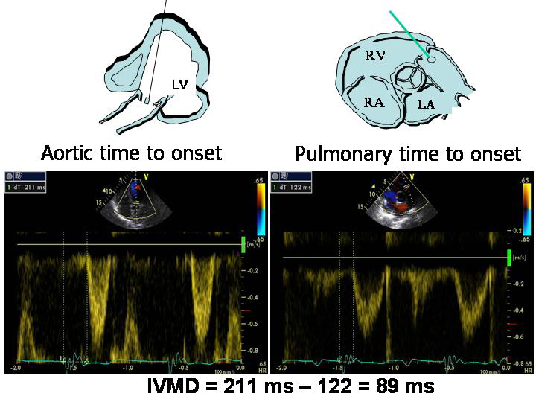

Slide 19
IVMD values of > 40 ms and values of LV PEP of > 140 ms are considered pathological

Slide 20
Intra-ventricular mechanical dyssynchrony
Intra-ventricular dyssynchrony is characterized by either premature or late contraction of LV Wall segments due to delayed electrical Conduction
Methods
M-mode
Pulsed Tissue Doppler
Color Tissue Velocity Imaging
3-D echocardiography

Slide 21
M-MODE
Septal-to posterior wall-motion delay (SPWMD)
It is the difference in timing of septal and posterior wall contraction
Step 1: Select either the parasternal long-axis or short-axis views.
Step 2: Position the M-mode cursor at the midventricular level
Step 3: Set sweep speed to 50 to 100 mm/s
Step 4: Identify the time delay from peak inward septal motion to peak inward posterior wall.

Slide 23
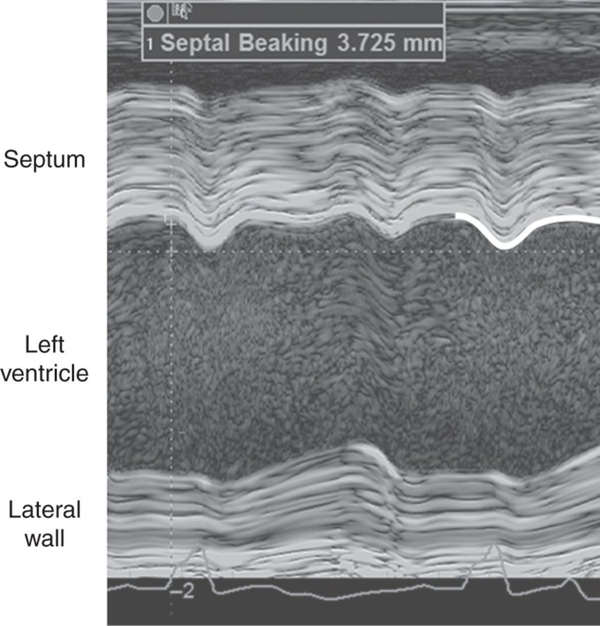
The abnormal motion of the septum during pre-ejection has been referred to as septal beaking when imaged by M-mode

Slide 24
Limitations
Impossible to measure SPWMD in patients
A poor acoustic window
Previous septal or posterior wall MI
Abnormal septal motion secondary to RV pressure or volume overload.

Slide 25
COLOR TD M-MODE
Changes in direction are color coded, which may aid in identifying the transition from inward to outward motion in the septum and posterior wall.
The septal-to-posterior wall-motion delay greater than or equal to 130 milliseconds is considered to be significant dyssynchrony.

Slide 27
LATERAL WALL POST-SYSTOLIC DISPLACEMENT
Reported by sassone et al
Measured as the difference of intervals from QRS onset to maximal systolic displacement of the basal LV lateral wall and from QRS onset to the beginning of Transmitral E velocity
Positive LWPSD i.e . a longer interval to maximal inward displacement of LV lateral wall than the interval to opening of the mitral valve, identifies a severe post-systolic contraction

Slide 28
Why ….LWPSD
With LBBB the lateral wall is the latest to be activated, thus representing the optimal target for LV lead positioning
Despite evaluating intra-ventricular dyssynchrony based on delay of a single myocardial wall, LWPSD could predict CRT response
In absence of LBBB diagnostic accuracy unknown

Slide 29
Lateral wall post-systolic displacement
QRS onset to maximal systolic displacement of the basal LV lateral wall (assessed by M-mode in the apical 4-chamber view)
QRS onset to the beginning of transmitral E velocity (assessed by pulsed Doppler of mitral
inflow)

Slide 30
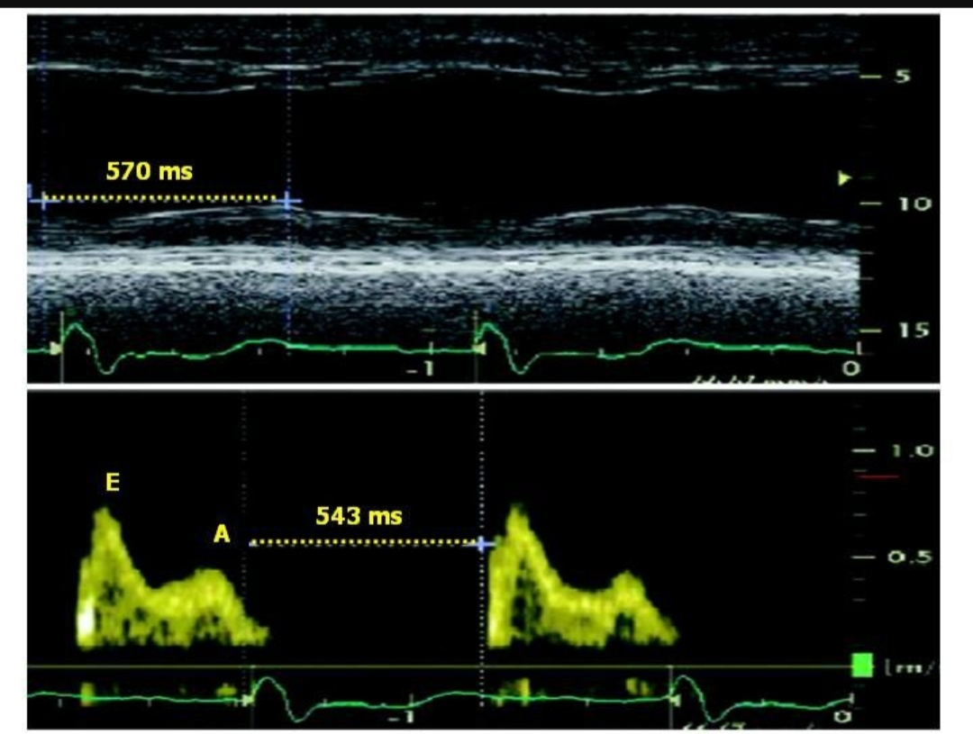
Figure: method for measuring LWPSD

Slide 31
A positive LWPSD, i.e. a longer interval to maximal inward displacement of LV lateral wall than the interval to opening of the mitral valve, identifies a severe post-systolic contraction
It has been demonstrated to be an independent predictor of CRT response in patients with end-stage heart failure and left bundle branch block.

Slide 32
TDI FOR ASSESSMENT OF INTRAVENTRICULAR DYSSYNCHRONY
Measurement of time to peak- systolic longitudinal velocity
Assessment of longitudinal shortening velocities ie the time of myocardial systolic velocities (Sm) from the apical window with
Uses both pulsed-TDI or color-coded TDI

Slide 33
MEASUREMENT OF TIME TO PEAK- SYSTOLIC LONGITUDINAL VELOCITY
Obtain a noise free ECG trace and good quality 2D image from the apical window
Activate color TDI, adjusting the sector width so as to keep the frame rate > 90 frames/second.
Suspend breathing if possible and acquire 3-5 beats (sinus rhythm) or more (in case of ectopics)
The number of LV segments to be evaluated include mainly a 12- segment model (LV basal and middle segments in 4-, 2- and 5- chamber views) whereas LV apical segments are not considered reliable

Slide 34
TIME TO PEAK- SYSTOLIC LONGITUDINAL VELOCITY
Correspond to the time interval between the onset of ECG derived QRS and the Sm peak (= time to Sm peak) and the time interval between the onset of QRS and the onset of Sm (= time to Sm onset), which correspond to LV PEP.
Intra-ventricular mechanical delay has been defined for differences of > 65 ms of time to Sm peak between LV segments

Slide 35
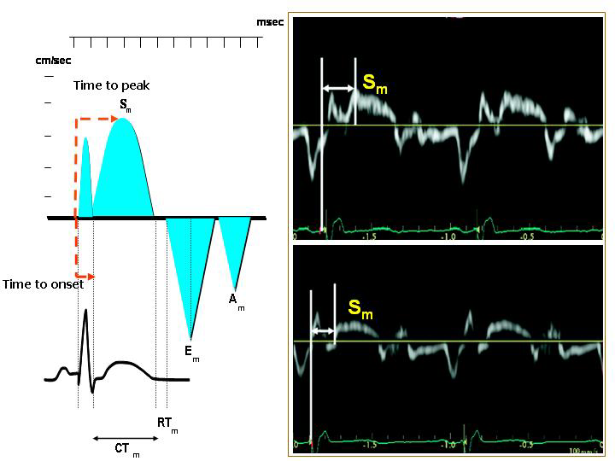
Figure:In the right panel measurement of time to peak Sm (upper panel)& of time to onset Sm(lower panel)are depicted.

Slide 36
Speckle tracking
This is a 2-D strain technique and has been used to assess radial dyssynchrony before/after CRT.
Has been applied to routine mid-ventricular short-axis images to calculate radial strain from multiple circumferential points averaged to six standard segments.

Slide 37
SPECKLE TRACKING
>130MS PEAK ANTSEPTAL TO POST WALL STRAIN PREDICTS CRT RESPONSIVENESS

Slide 38
Notes:
There is a typical early contraction of the anteroseptum and delayed contraction of the posterior wall and lateral wall

Slide 39
Notes:
Mid ventricular Saxis images with 2D speckle tracking radial strain analysis in a heart failure patient with LBBB

Slide 40
Apical rocking and septal flash
Direct mechanical consequences of dyssynchronous contraction induced by LBBB
A short initial septal contraction within the isovolumic contraction period results of a short inward motion of the septum (septal flash) and causes the apex to move septally
The delayed activation of the lateral wall pulls then the apex laterally during the ejection time while stretching the septum. This typical motion pattern of the apex is described “apical rocking”

Slide 41
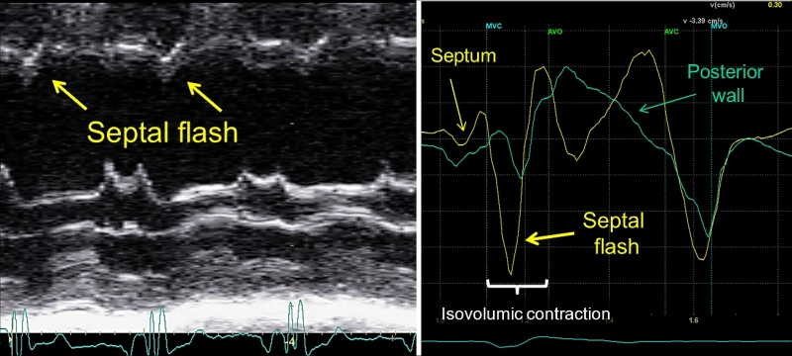

Slide 43
3-D Echocardiography
Real time 3D echocardiography (RT3DE) is a promising tool in the assessment of dyssynchrony.
3D echocardiography allows intraventricular dyssynchrony to be evaluated by analyzing LV wall motion in multiple apical planes during the same cardiac cycle.
It also offers better spatial resolution than a single plane.

Slide 44
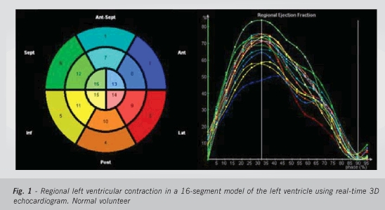

Slide 45
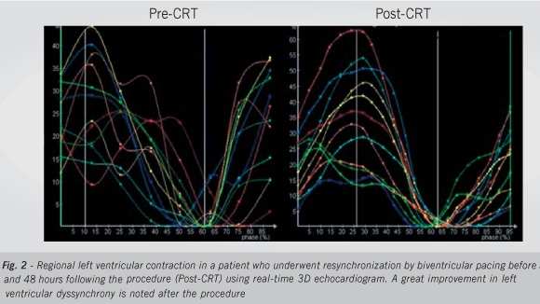

Slide 46
The global LV volumetric dataset has been used to determine a dyssynchrony index that corresponds to the standard deviation of the average of the time intervals needed by multiple LV segments to reach minimal end-systolic volume.
This index is expressed as the percent value of the overall cardiac cycle, in order to be able to compare patients with different heart rates.
CRT responders show a significant reduction of this 3-D dyssynchrony index

Slide 47
TISSUE SYNCHRONIZATION IMAGING (TSI)
TSI is an implementation of TD method.
It displays Ts (time to Sm peak) in multiple LV segments by colour coding wall motion green (corresponding to early systolic contraction) or red(corresponds to delayed contraction)

Slide 48
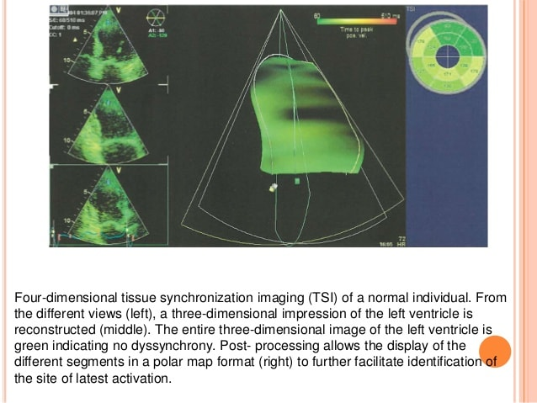

Slide 49
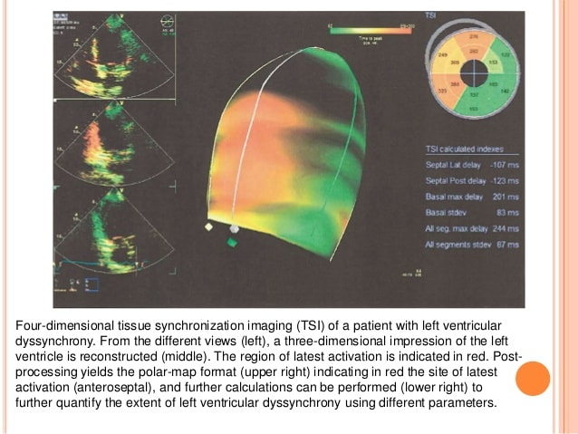

Slide 50
Atrioventricular dyssynchrony
Atrioventricular dyssynchrony- is said to be present when diastolic filling period (DFP) occupies less than 40% of cardiac cycle
To obtain DFP, obtain the apical four-chamber view with mitral valve in the centre of the frame.
Using pulsed Doppler with the sample volume placed at the tips of mitral leaflets; obtain a spectral display of mitral inflow pattern.
Measure the time from the onset to the end of the spectral display- DFP.
Measure the R-R interval using any two consecutive regular beats. Divide DFP with R-R interval and multiply by hundred to obtain a percentage value .

Slide 51
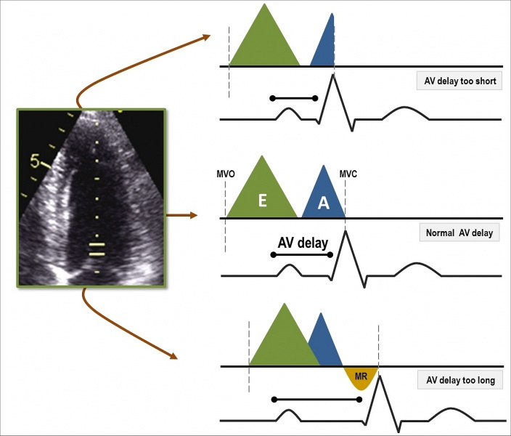

Slide 52
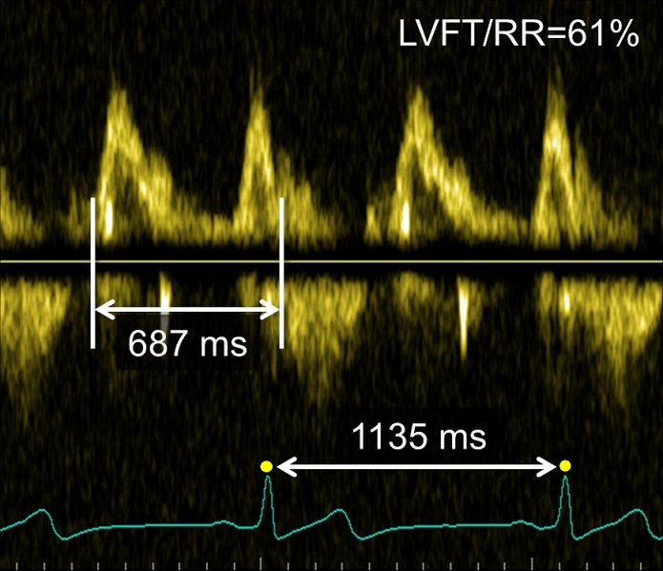

Slide 55
Echocardiographic assessment of dyssynchrony

Slide 56
Why CRT→ Rationale
Coordinating RV and LV contraction
Synchronising the LV segments
Prolonging the diastolic filling period with improvement of both coronary and LV filling
Restoring AV synchrony

Slide 57
Mechanisms of Cardiac Resynchronization Therapy (CRT)
CRT uses timed electrical stimulation to correct electromechanical asynchrony within and between chambers to improve pump function
The first-order effect is minimization of ventricular electromechanical asynchrony (conduction delay), which restores coordinated contraction.
The second-order effect is elimination of atrioventricular asynchrony, which improves diastolic performance and thereby LV pump function. ,MR may be reduced
Restores the normal electromechanical coupling of the heart with LBBB

Slide 59
PATH-CHF
First randomised controlled trial,2001
42 pts,NYHA III/IV,ischemic or non ischemic,SR,QRS 120ms,PR 150ms
Univentricular Vs biventricular pacing
Primary endpoints-Oxygen consumption at peak exercise and at anerobic threshold,6-minute walk distance
Secondary endpoints-changes in New York Heart Association functional class, hospitalization frequency and quality of life
Trend towards improvement in all primary &seccondary endpoints with biventricular pacing

Slide 60
MUSTIC-SR
Single blind,randomised,crossover study
NYHAIII,SR,EF<35%,LVEDD>60,QRS>150ms,6min walk<450m
47pts completed CRT
Randomised to resynchronization or to no pacing for 3 month,crossed over to alternative group for 3months,followed up for 12 mths
Primary endpoint-6-min walked distance
Secondary -peak Vo2, quality of life, NYHA class,worsening HF,total mortality

Slide 62
MIRACLE
First prospective, randomized,double blind clinical trial
Idiopathic or ischemic dilated cardiomyopathy, NYHA class III/IV , LVEF<35 %,LVEDD> 55 mm,QRS>130 ms,6min.walk<450 m
CRT(n=228) Vs control(n=225) for 6 mths

Slide 65
MIRACLE ICD
Trial design similar to MIRACLE
CRT+ICD Vs CRT
Included NYHA II also,all pts had class I indication for ICD

Slide 67
COMPANION
1520 patients,NYHA III or IV ,ischemic or nonischemic cardiomyopathy,LVEF<35%, QRS ≥120 msec,PR int>150 ms, sinus rhythm, no clinical indication for pacemaker or ICD
Randomly assigned in a 1:2:2 ratio to receive OMT,OMT+CRT,OMT+CRT-D
Primary composite endpoint-death from or hospitalization for any cause
Secondary endpoint-death from any cause
Death from or hospitalization for cardiovascular causes and death from or hospitalization for heart failure also noted

Slide 68
Implantation successful in 87% in CRT,91% in CRT-D
Follow-up 11.9 months OMT,16.2 months in CRT,15.7 months in CRT-D
CRT&CRT-D reduced the risk of the primary end point by 20 %

Slide 69
Death from or hospitalization for heart failure
reduced by 34 percent in the pacemaker group(P<0.002)
40 percent in the pacemaker–defibrillator group (P<0.001)
Death from any cause reduced by
24 percent (P=0.059) in CRT
36 percent (P=0.003) in CRT-D

Slide 70
CARE-HF
Mortality benefit with CRT alone not significant in COMPANION
NYHA class III or IV,LVEF<35%,LVEDD>30 mm (indexed to height),QRS≥150 ms/>120 ms +echo evidence of dyssynchrony,SR,no indication for pacing
Primary end point-composite of death from any cause or an unplanned hospitalization for a major cardiovascular event
Secondary outcome-death from any cause,composite of death from any cause and hospitalization with heart failure,NYHA class and quality of life
OMT-404 patients Vs OMT+CRT-409,mean follow-up 29.4 mths

Slide 71
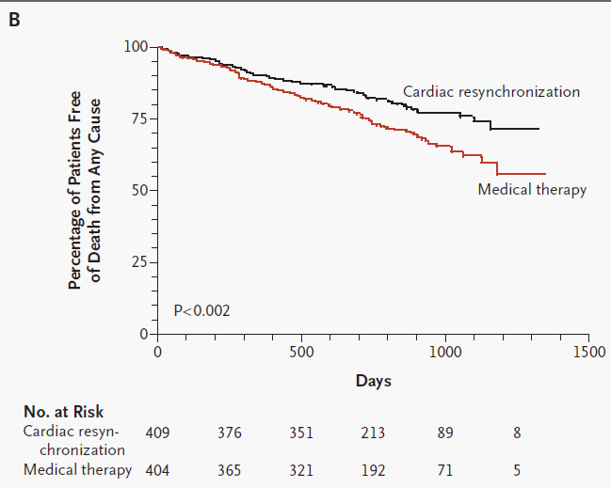

Slide 73
ESC guidelines

Slide 74
CRT in NYHA I/II
MADIT CRT,REVERSE-reduced morbidity
MADIT CRT
1820 patients
Ischemic ( in I/II) or nonischemic cardiomyopathy ( in II)
EF 30% or less
QRS duration of ≥130msec
NYHA I/II
3:2 ratio,CRT+ICD(n=1089) Vs ICD alone (n=731)
Follow-up of 2.4 years

Slide 75
Primary end point:death or heart failure
CRT–ICD group (17.2%)Vs ICD-only group (25.3%) (hazard ratio=0.66; P = 0.001)
34% reduction in the risk of death or heart failure
Superiority of CRT was driven by a 41% reduction in the risk of heart-failure events,primarily in subgroup with a QRS >150 ms

Slide 80
ESC guidelines

Slide 81
CRT in AF
Prevalence of AF in patients with HF-5% in NYHA I as compared with 25–50% in NYHA III/IV
Intrinsic AF rhythm reduces the percentage of effectively biventricular paced captured beats (BVP%).
Effective ‘CRT-dose’ may be reduced compared to atrial-synchronous rhythm with a short AV interval (as in SR)

Slide 83
MUSTIC AF first randomized trial demonstrating possible benefits of CRT in HF in pts with permanent AF
Two trials comparing CRT in SR Vs AF-comparable but benefit more in SR-Leclercq et al (AJC 2000),Molhoek et al (AJC 2004)
OPSITE trial- ‘rate control’ by AVJ ablation significantly improved symptoms &functional status
PAVE trial-‘ablate and pace’ approach-greater benefit of the BVP mode in patients with depressed LVEF (45%) and/or in NYHA functional class III

Slide 84
ESC guidelines

Slide 85
CRT in narrow QRS
RethinQ study
Patients with a indication for ICD,LVEF<35%, NHYA class III heart failure , QRS<130 ms ,echo evidence of dyssynchrony
172 patients,6 months follow up
Primary end point was the proportion of patients with an increase in peak oxygen consumption
CRT group and the control group did not differ significantly in proportion of patients with the primary end point (46% Vs 41%)
No significant difference in HF events

Slide 87
INTRODUCTION
HF VENTRICULAR DYSYNCHRONY
ASSESSMENT OF DYSSYNCHRONY
RATIONALE/ MECHANISM OF CRT
TRIALS
INDICATIONS
PROCEDURE
RESPONSE

Slide 88
INDICATONS FOR CRT
2021 ESC Guidelines on cardiac pacing and cardiac resynchronization therapy

Slide 90
Patients with Afib and heart failure who are candidates for CRT
AF reduces the rate of effective biventricular capture
AF patients undergoing CRT →increased risk of mortality
A substudy of the RAFT trial→ No benefit of CRT without AVJ ablation
The decision to perform AVJ ablation is still a matter of debate
But majority are of the opinion favouring CRT inplantation for patients with permanent AF and NYHA FC III/IV as with similar indication as in SR

Slide 91
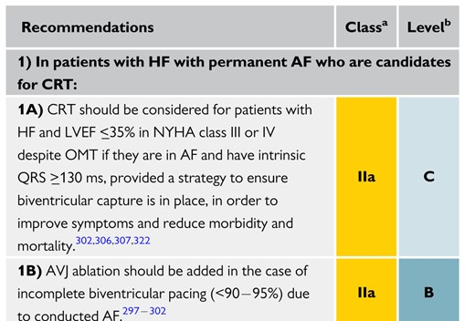

Slide 93
Timing of CRT
Not indicated in pts with non-ischemic cardiomyopathy improving with medical management
In post MI-min 12 weeks post MI if pt is stabe with OMT
In post CABG- min 12 weeks post op
Only consider CRT if HF medication has been titrated upto maximum tolerated dose

Slide 94
ICD or PACEMAKER
A significant proportion of patients suitable for CRT will fulfil indications for an ICD
If the patient fulfils the indications for ICD therapy then a CRT-D device should be considered.
CRT-P should be considered in those patients ineligible for ICD therapy or those who decline an ICD.
The evidence base to support the use of ICDs in patients in NYHA class IV is less compelling than for those in classes II and III.
It is therefore conceivable that CRT-P may be considered for those with more severe heart failure (NYHA class IV) and CRT-D for those in classes II and III who are more likely to die from arrhythmias than pump failure.

Slide 95
CRT IMPLATATION PROCEDURE

Slide 96
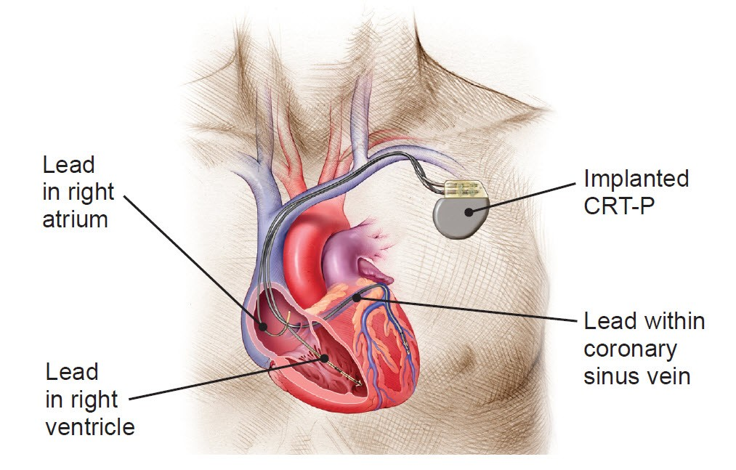
3 Lead positions

Slide 97
Preparation
Attach the monitors
Skin prepp

Slide 98
Pocket formation
Incision approx 2 inches long
Blunt dissection
Pocket is made by blunt dissection large enough to accommodate the pacemakers

Slide 99
Lead insertion
Needle is inserted into subclavian vein
J wire inserted through needle
Needle is removed and the introducer is advanced over the wire

Slide 100
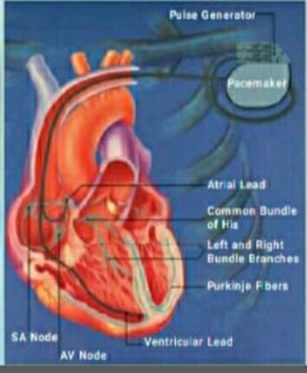
Lead insertion overview
The RV lead is positioned first.
The atrial lead is then positioned and tested.

Slide 101
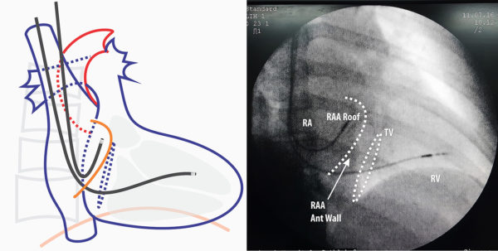

Slide 102
Implant Procedure
RV lead first
Can be used to provide backup pacing
Provide a landmark for coronary sinus ostium (proximal end of distal coil is a good marker for CS)
Helps to visualize tricuspid valve, which can help locate CS ostium
May be more difficult to cannulate the CS with the lead implanted
LV lead first (alternate option)
May be easier to cannulate the CS
Additional method may be necessary to provide backup pacing
May be more likely to dislodge when going to place RV lead

Slide 103
Flouroscopic lead position
Fluroscopic position of ventricular and atrial lead
The ventricular lead is positioned with the tip in the RV apex

Slide 104
Coronary sinus lead positioning

Slide 105
Implant Procedure Six-Step Implant Process
1. Cannulate coronary sinus
2. Perform venograms
3. Select target vein and leads
4. Place leads
5. Remove implant tools
6. Measure final electricals and program device

Slide 106
Step 1: Cannulate the Coronary Sinus

Slide 108
Coronary sinus
It lies in and is the main constituent of the posterior portion of the atrioventricular groove
CS receives the venous drainage of the anterior half of the IVS and the LV anterior wall through the GCV, which opens into the left extremity of the CS
left atrium drains blood into CS via small atrial veins and the oblique vein of left atrium (the vein of Marshall)
lateral wall and a part of the LV posterior region drain blood via the left marginal vein

Slide 109
Right Atrial Anatomical Features
Tricuspid annulus
Fossa ovalis
Eustachian ridge
Coronary sinus
Thebesian valve
Eustachian fossa
Inferior vena cava
Notes:
This slide reviews the various anatomical structures and sites of the right atrium that are deemed necessary knowledge for the success of the procedure.

Slide 119
Identification of coronary anatomy
middle and great cardiac veins are the two most consistently present branches of the coronary venous system
Depending on their position along the lateral border of the heart, the various branches draining into the coronary sinus were identified as posterior, posterolateral, lateral, or anterolateral veins

Slide 121
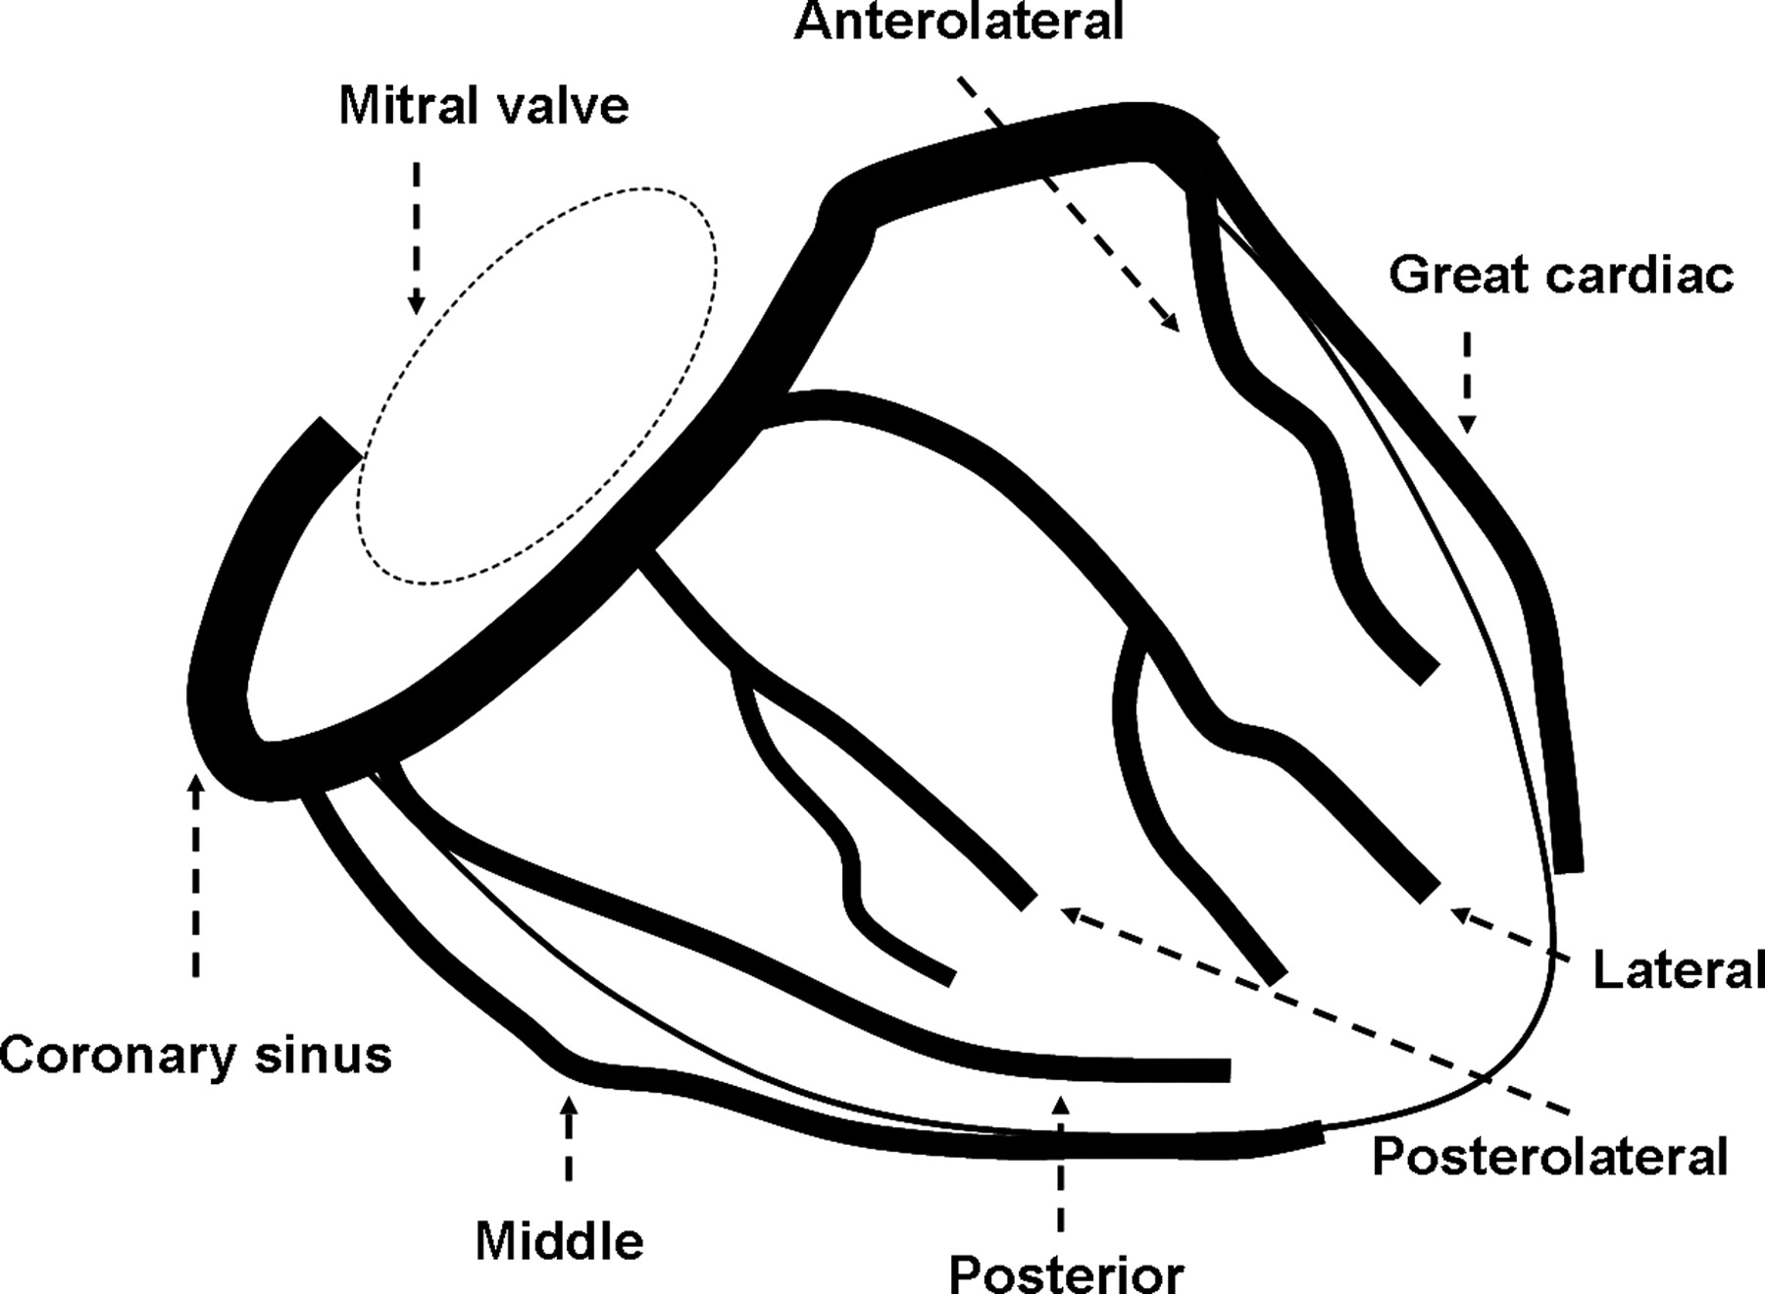
Schematic illustration of the coronary sinus and tributaries in an RAO view to show nomenclature used
Notes:
Figure 1 Schematic illustration of the coronary sinus and tributaries in an RAO view to show nomenclature used to identify coronary venous anatomy.
Unless provided in the caption above, the following copyright applies to the content of this slide: Published on behalf of the European Society of Cardiology. All rights reserved. © The Author 2009. For permissions please email: journals.permissions@oxfordjournals.org.

Slide 122
most challenging stage of CRT is CS canulation
3 techniques are used:
Standard cannulation with coronary sinus placement catheters
EP catheters
Coronary catheters

Slide 123
Methods
Most commonly used is AP or 30° LAO view to “fish” the CS with a catheter or a preshaped lead or special catheters
Continuously record the intracavitary electrogram associated with radiological imaging to determine the CS position.
Phlebography consists of making small injections of contrast near the atrioventricular groove to visualize the CS ostium.
Done in AP or 30° LAO projections.

Slide 124
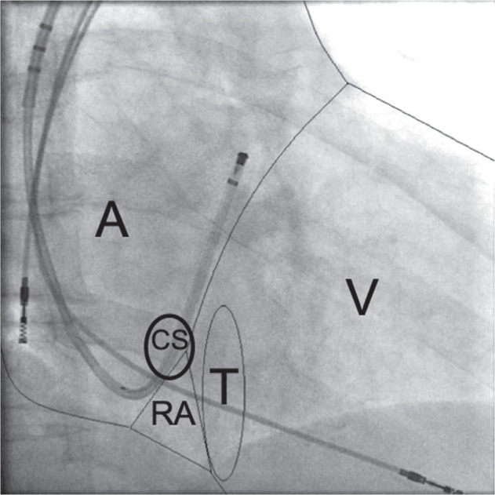
RAO projection at 30°, showing an inserted right atrial lead, a fixed RV lead, a deflectable catheter placed in the CS, and a schematic presentation of the anatomical–radiological cardiac silhouette

Slide 125
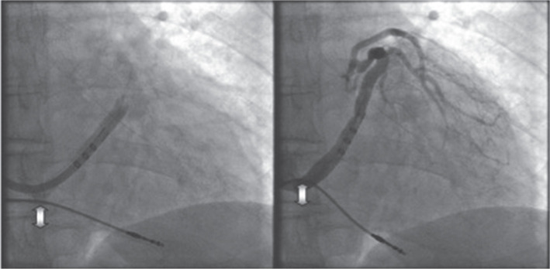
RAO projection at 30° during CS phlebography in the diastole (left) and at the end of systole (right). Arrows indicate RV lead motion at the site of the TAP.

Slide 126
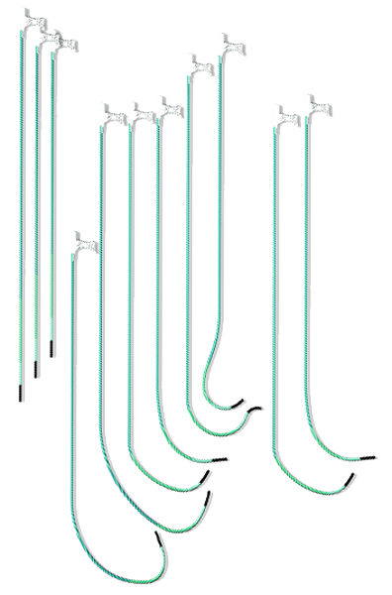
CS Cannulation Catheters
Fixed Shape Catheters are most commonly used
Curve shapes accommodate varying anatomy
Attain Command™ catheter
Attain Command
Notes:
126

Slide 127
Step 1: CS Cannulation with Fixed Shape Catheters
Obtain venous access
Flush components with heparanized saline
Insert dilator through catheter
Pass guide catheter assembly over long introducer guide wire through introducer sheath, to the atrium
It is recommended to use a guide wire when advancing into the heart
Remove dilator
Locate the CS by rotating the guide catheter tip posteriorly and to the patient’s left (typically a counter-clockwise rotation)
Advance the guide catheter 2-3 cm over guide wire to engage the CS

Slide 128
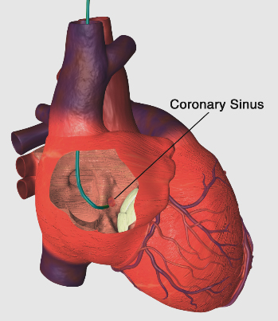
Step 1: Cannulate Coronary Sinus
Use care when passing the guide catheter through vessels
Due to the relative stiffness of the catheter, damage to the walls of the vessels may include dissections or perforations

Slide 129
Step 2: Perform Venogram

Slide 130
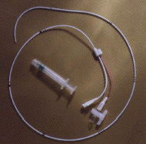
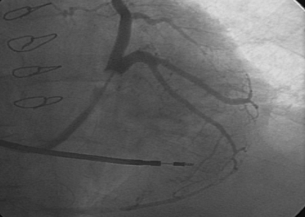
Step 2: Perform Venogram
Balloon occludes most coronary sinuses – inflates to 10 mm (pre-measure 1.25 cc syringe)
Lead with a guide wire
Balloon can be inflated and deflated several times
Contrast solution can be injected through catheter

Slide 131
Invasive coronary venography
Retrograde radio-opaque contrast injection was performed to delineate coronary venous anatomy following coronary sinus intubation
An occlusive balloon catheter was inserted in the coronary sinus to maximize coronary venous opacification
The images were recorded in the left anterior oblique and right anterior oblique (RAO) projections

Slide 132
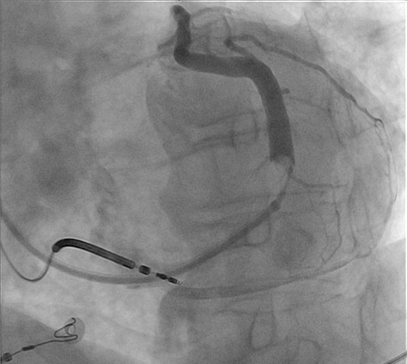
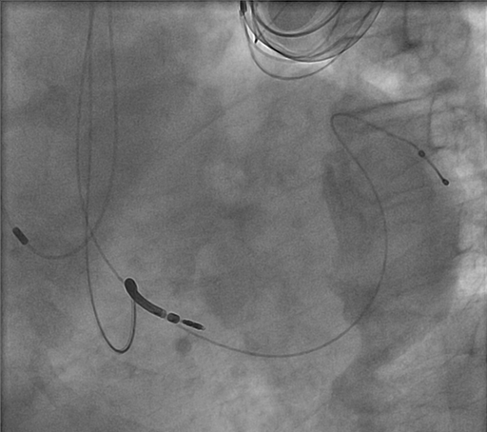
Goal: Place left-heart lead in the target branch vein
Venogram
Final Bipolar Lead Placement

Slide 133
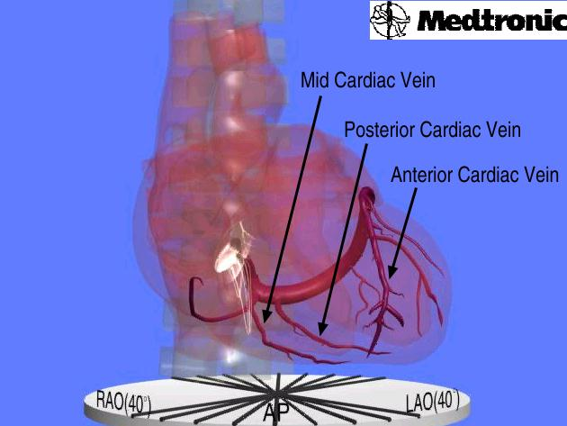
Cardiac Venous Anatomy: AP View

Slide 134
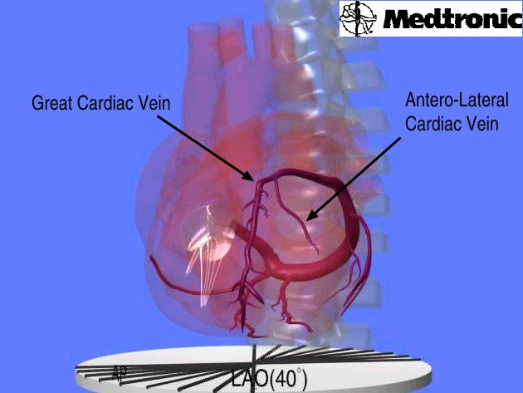
Cardiac Venous Anatomy: LAO View
Notes:
LAO view is best for cannulation and for visualization of lead separation.

Slide 135
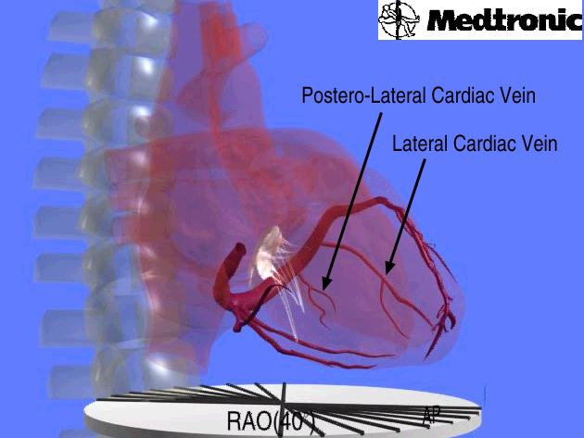
Cardiac Venous Anatomy: RAO View
Notes:
RAO view usually used for visualization of the take off of the branches.

Slide 136
Lead in Lateral Cardiac Vein
Atrial Lead
Left Ventricular Lead
Right Ventricular Lead

Slide 137
Step 3: Select Target Vein and Left Ventricular Lead

Slide 138
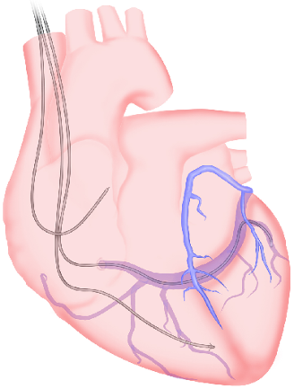
Selecting Vein for LV Lead Placement
Target: Left ventricular free wall
(Lateral, Poster-lateral, Antero-lateral)^{1,2,3}
A. Lateral (marginal) cardiac vein
B. Postero-lateral cardiac vein
C. Posterior cardiac vein
E
A
Sub-optimal lead location:
A
B
D. Middle cardiac vein
E. Great cardiac vein
C
B
D
E
C
D
LAO View
¹ Ansalone G, et al. JACC. 2002;39:489-499.
² Butter C, et al. Circulation. 2001;104:3026-3029.
³ Auricchio A, et al. Am J Cardiol. 1999;83:136D-142D.

Slide 139
Step 4: Place Left-Heart Lead

Slide 140
Left ventricular lead placement is restricted by various reasons
Variability of coronary venous anatomy
Lead instability
Inadequate pacing and sensing thresholds
Diaphragmatic pacing

Slide 141
The LV lead is positioned preferentially in the middle to distal aspect of a posterior or lateral ventricular branch of the coronary sinus
After overnight stay, patients underwent chest radiography to exclude lead displacement
The final goal in LV pacing lead implantation is to achieve theoretically the region of latest intrinsic activation, since this position maximizes the haemodynamic and clinical benefits of CRT

Slide 144
Step 5: Remove Implant Tools

Slide 145
Step 6: Measure Final Electricals

Slide 146
Measure Final Electricals
Test RA, RV, LV leads independently
Test at 10 V for phrenic/diaphragmatic stimulation

Slide 147
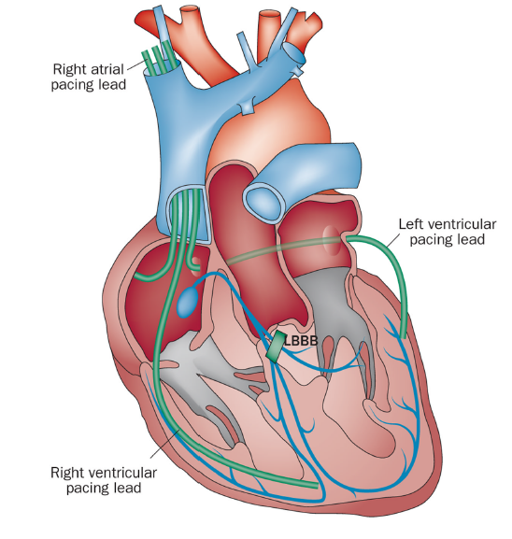

Slide 148
Alternative left ventricular pacing sites
Endocardial biventricular pacing
Approaches- transaortic, trans-interventricular septum, transapical, and trans-atrial septum (via mitral valve)
Leadless pacing

Slide 149
CRT device programming
The basic programming of pacemaker and ICD functions remains unchanged from conventional devices
The specific issues that have to be addressed with CRT are the relative timings of pacing
Atrioventricular (AV) delay.
Interventricular (VV) delay

Slide 150
A reasonable starting point is to leave the settings at default (eg. Av delay 100-120 ms, LV offset 0-20 ms) or to optimize on the basis of 12 lead ECG morphology
Important to reassess the patient after a few weeks
Assessment of functional status such as exercise testing and six-minute walk test may be useful.
Non-responders should be considered for further optimization, most commonly with echocardiography

Slide 151
A-V Delay optimization
This can be achieved by altering the AV delay and aiming for the following
Increased aortic velocity time integral (stroke volume)
Prolongation of diastolic filling: assessed using PW Doppler of transmitral blood flow. If the AV delay is too long there will be fusion of the E and A waves.Optimization of AV delay will lead to separation of E and A waves.
Reduced mitral regurgitation (MR): assessed by colour Doppler and reduction in backward flow signal of CW Doppler of the MR.
A beneficial improvement in one parameter may have a detrimental effect on another, so optimization involves achieving a balanced improvement of all parameters.

Slide 152
Optimization of VV delay
Inter and intraventricular dyssynchrony can be dramatically altered by adjusting the VV delay.
TDI can assess mechanical delay at different myocardial segments. Alteration of the VV delay will allow an assessment of the greatest overall improvement in dyssynchrony.
M-mode septal to posterior wall delay can be corrected by altering the VV delay. The delay that produces least delay should be considered as the optimal setting .
Some devices can automatically optimize based on timing differences in LV and RV electrograms during RV and LV pacing.

Slide 153
CRT response

Slide 166
Tailoring CRT Programming Methods to Guarantee Ventricular Electromechanical Resynchronization
Primary goal of CRT programming is maximal and continuous correction of LV conduction delay.
Maximal means the greatest achievable correction of the delayed LV activation sequence, and
continuous means on every cardiac cycle for the duration of the patient’s lifetime by:
(1) LV stimulation is delivered from a site capable of reversing LBBB conduction delay
(2) LV stimulation threshold is within the output capacity of the pulse generator;
(3) LV pacing occurs on every cardiac cycle; and
(4) LV timing is adjusted to guarantee ventricular activation fusion on every cardiac cycle.

Slide 167
Randomized Controlled Trials of Cardiac Resynchronization Therapy
NYHA III-IV
NYHA I-II
MUSTIC (Multisite Stimulation in Cardiomyopathy) studies
MIRACLE (Multicenter InSync Randomized Clinical Evaluation) trial
MIRACLE ICD trial,
CONTAK CD trial,
CARE-HF ((Cardiac Resynchronization in Heart Failure)
COMPANION (Comparison of Medical Therapy, Pacing and Defibrillation in HeartFailure) trial.
REVERSE (Resynchronization Reverses Remodeling in Systolic Left Ventricular Dysfunction) trial
MADIT-CRT (Multicenter Automatic Defibrillator Implantation Trial with Cardiac Resynchronization Therapy),
RAFT (Resynchronization/defibrillation for Ambulatory Heart Failure Trial).

Slide 168
CRT Devices

Slide 169
Leads

Slide 170
LEADS

Slide 171
MCQs

Slide 172
QN 1)False among the options
IVMD values of > 40 ms is considered pathological
SPWMD is the time delay from peak outward septal motion to peak outward posterior wall
SPWMD > 140 ms is considered pathological
None

Slide 173
QN 1)False among the options
IVMD values of > 40 ms is considered pathological
SPWMD is the time delay from peak outward septal motion to peak outward posterior wall
SPWMD > 140 ms is considered pathological
None

Slide 174
Qn 2) False about coronary venous drainage
A) CS lies in the posterior portion of the AV groove
B) CS receives the drainage from anterior part of IVS and Anterior wall of LV via GCV
C) CS receives the drainage from posterior part of IVS and posterior wall of LV via GCV
D) lateral wall and a part of the LV posterior region drain blood via the left marginal vein

Slide 175
Qn 2)False about coronary venous drainage
A) CS lies in the posterior portion of the AV groove
B) CS receives the drainage from anterior part of IVS and Anterior wall of LV via GCV
C) CS receives the drainage from posterior part of IVS and posterior wall of LV via GCV
D) lateral wall and a part of the LV posterior region drain blood via the left marginal vein

Slide 176
Qn3) CRT response more likely seen in
A) Non ischemic cardiomyopathy
B) LVEDV > 240ml
C) transmural scar burden
D) ivcd

Slide 177
Qn4) CRT response more likely seen in
A) Non ischemic cardiomyopathy
B) LVEDV > 240ml
C) transmural scar burden
D) ivcd

Slide 178
Qn 5) Class Ia Indications for CRT in a pt with LBBB includes
A) QRS < 150 ms ,LVEF < 35%
B) QRS < 150 ms, LVEF < 45%
C) QRS 130-150 ms , LVEF < 45%
D) QRS > 150ms,LVEF < 35%

Slide 179
Qn 5)Class Ia Indications for CRT in a pt with LBBB includes all except
A) QRS < 150 ms ,LVEF < 35%
B) QRS < 150 ms, LVEF < 45%
C) QRS 130-150 ms , LVEF < 45%
D) QRS > 150ms,LVEF < 35%

Slide 180
Qn 6) % of pts responding to CRT
A) 5%
B) 10%
C) 30%
D) 50%

Slide 181
% of pts responding to CRT
A) 5%
B) 10%
C) 30%
D) 50%

Slide 182
Qn 7) Target for LV lead placement
A) IVS
B) Anterior wall
C) LV free wall
D) none

Slide 183
Qn 7) Target for LV lead placement
A) IVS
B) Anterior wall
C) LV free wall
D) none

Slide 184
Qn 8) Trial that studied CRT in pts with NARROW QRS
A) CARE-HF
B) MUSTIC
C)ReTHINQ
D)NARROW-HF
E) COMPANION

Slide 185
Qn 8) Trial that studied CRT in pts with NARROW QRS
A) CARE-HF
B) MUSTIC
C)ReTHINQ
D)NARROW-HF
E)COMPANION

