Slide 1
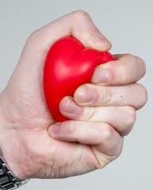
CARDIAC INOTROPES
Dr Arun Jude Alphonse
DM Cardiology Resident
Govt TDMC Alappuzha

Slide 2
OUTLINE
Introduction
Application & indications
Classification
Current cardiac inotropic drugs in use
Action
Pharmacology
Clinical application
Side effects
Evidence & guidelines
Newer cardiac inotropes
General practice guidelines

Slide 3
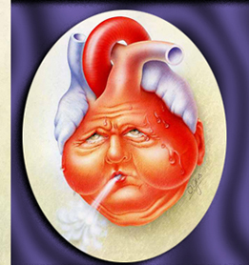
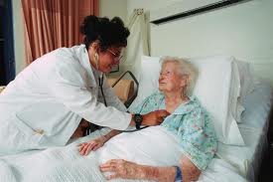
CASE SCENARIO
56 year old gentleman, HTN ,DM-2, CAD, severe LV dysfunction
On proper evidence based CAD & HF medications
Presentation with progressive dyspnoea (NYHA IV), decreased urine output and drowsiness
BP – 96/70 mmHg, JVP elevated, ascites, pedal edema
RFT- 106/2.1
Diagnosis: ADCHF with Type 1 cardiorenal syndrome, hemodynamically stable
Treatment: Diuresis, Vasodilators ….Should an inotrope be added?
Course : Worsening renal function and mentation....BP 100/72….
……..Should an inotrope be added? If yes which one?………..

Slide 4
INOTROPE
Inotrope: A drug that alters the force or energy of myocardial contraction
Greek origin : Ino = fibre, Tropic= relating to
Positive inotropes: Increases myocardial contractility
Cardiac contractile failure (HEART FAILURE)
( Cardiomyopathy, Acute myocardial infarction, Myocarditis, Cardiogenic/septic chock)

Slide 5
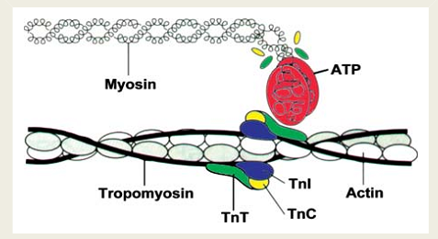
Inotropy --- No. of cross-bridges activated:
Amount of Ca available to bind Troponin C
Ca affinity of Troponin C
Alterations at level of cross-bridging:
- promotion of cross-bridge state
cross-bridge force production
Duration of cross-bridged state

Slide 6
Clinical application of Inotropes
Cardiogenic shock : When SBP <90mmHg
AHFS without shock with evidence of vital organ hypoperfusion
Intermittent outpatient infusions
Bridge until transplantation
Destination therapy for end-of-life care
Cardiopulmonary resuscitation
CHF routine therapy

Slide 7
At what WHO stage to start?

Slide 8
At what NYHA class to start?

Slide 9
Acute Heart failure is a heterogenous syndrome

Slide 10
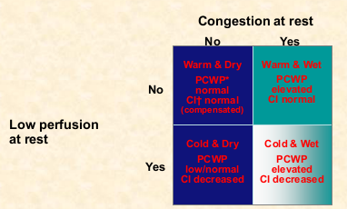

Slide 11
Digoxin: CHF , AF
I.V. Inotropes: Currently used in the clinical setting of SHOCK to preserve end-organ perfusion
SHOCK: The state of inadequate perfusion where oxygen delivery fails to meet tissue oxygen demands.
SHOCK:
- Urine output < 0.5ml/kg/hr
- Cold peripheries
- Capillary filling time >2s
- Confusion
SBP <80-90mmHg, MBP <30mmHg of baseline(<60-70mmHg)
- CI <1.8 l/min/m² ; LVEDP >18mmHg

Slide 12
CLASSIFICATION OF INOTROPES
By mechanism of action:
Class I : Increase intracellular cAMP (Beta adrenergic agonists, PDE inhibitors)
Class II: Affect sarcolemmal ion pumps/channels (Digoxin)
Class III: Modulate intracellular Ca mechanism-
1) Release/Uptake of sarcoplasmic Ca
2) Increase sensitization of proteins to Ca

Slide 13
BETA ADRENERGIC AGONISTS
DOBUTAMINE
DOPAMINE
ISOPRENALINE
NORADRENALINE

Slide 14
Beta Adrenergic agonists -DOBUTAMINE
Directly stimulate β receptors
β1 >>>β2>>α1 (β1: β2 = 3:1)
Developed by Eli Lilly company as a structural analogue of isoprenaline in 1975
Potent inotrope , mild chronotropic and peripheral vascular effects

Slide 15
Dobutamine-Pharmacology
Onset of action: 1-2 mins
Peak effect : ~ 10 mins
Half-life : 1-2mins
Metabolism : Methylation & conjugation --- Urine
250mg/20 ml vials
2-20micg/kg/min( max 40micg/kg/min¹)
Sodabicarb should not be given in the same i.v line (inactivation at alkaline pH)

Slide 16
Dobutamine- Clinical application
Mild vasodilation : <5micg/kg/min
(At higher doses >15, peripheral effect becomes vasoconstriction)
Used mainly for primary low COP states
Better not used as single inotrope for cardiogenic shock
Dose titration required due to variable sensitivity (especially elderly)
? Loss of efficacy in patients on chronic beta blocker therapy/acidosis/hypoxia
.

Slide 17
Dobutamine –Adverse effects
Hypotension
Hypertension and Tachycardia – especially for those with chronic beta blocker therapy
AF with increased ventricular rate
Ventricular arhhythmias (rare)
Worsening ischemia
Phlebitis (rarely)
Nausea, headache, chest discomfort, hypokalemia, hypersensitivity (eosinophilic myocarditis)
No significant drug interactions
Contraindicated in HCM

Slide 18
Dobutamine – Evidence base
Experience from controlled trials do not extend beyond 48 hours
Found superior to isoproterenol for increasing COP
Found equivalent to Dopamine in increasing COP however at lower peak heart rates and LVEDP
Dobutamine has no survival benefit and may even increase mortality in severe heart failure

Slide 19
Dobutamine- Guidelines for HF
In the setting of hypotension (SBP<85-90mmHg) and/or hypoperfusion:
ESC --- IIa, B
ACC/AHA -- IIb, C

Slide 20
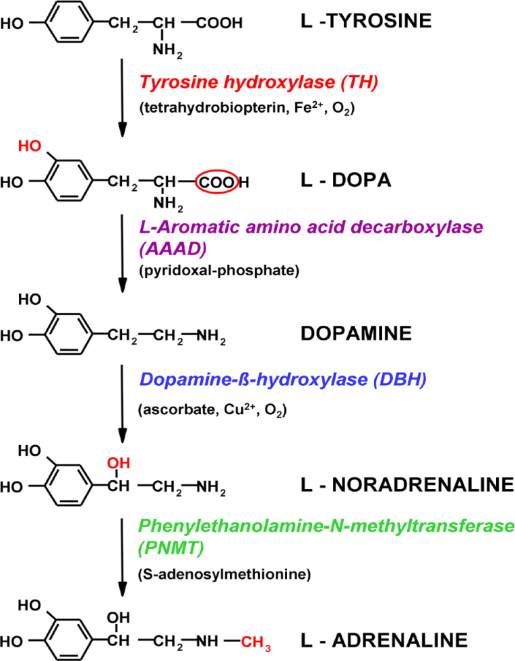
Beta Adrenergic agonists -DOPAMINE
Sympathomimetic & neurotransmitter
Arvid Carlsson in 1957 (Sweden)
(Nobel Prize in 2000)
D > β1> α1>> β2
Dose dependent receptor action

Slide 21
Dopamine- Pharmacology
Low dose (0.5-2µg/kg/min): (Vasodilation)
D1 post-syn receptors -- Cor, ren, mes, cereb
D2 presyn receptors – Renal tissue and vasculature
Intermediate dose (2-10 µg/kg/min): (Inotropic)
β 1 receptors of heart
High dose (10-20 µg/kg/min) : (Vasoconstriction)
α 1 receptors of vessels
200-400mg/5ml vial
Onset of action – 5 mins
T-half – 2 mins
Primarily renal excretion

Slide 22
Dopamine- Side effects
Hypotension at low doses
Hypertension and Tachycardia
Tachyarrythmias
Worsening ischemia
Phlebitis , necrosis and gangrene (rarely) ( Phentolamine to be infiltrated when extravasation is noted)
Nausea, vomiting, azotemia, headache, piloerection, dyspnoea, hypersensitivity
May worsen ventilatory requirements in hypoxic patients
Drug interaction:
- Halogenated anaesthetics – ventricular arrhythmias
- Phenytoin – increased chance for bradycardia
- MAO inhibitors and TCA s – potentiate dopamine effects
Contraindicated in pheochromocytoma & tachyarhythmias

Slide 23
Dopamine- Evidence
Increased mortality in heart failure.
Enthusiasm of low dose Dopamine and renal vasodilation -
Wide variations in dose-dependent renal effects, esp when associated with renal disease/septic shock, and no clinically relevant renal benefits.
However clinical benefit in improving renal function has been reported when used along with diuretics for congestive heart failure

Slide 24
Dopamine – Guidelines for HF
In patients with shock, despite already treatment with an inotrope
ESC -- IIb, C
- ACC/AHA -- IIb, C

Slide 25
Beta adrenergics- ISOPROTERENOL
Potent nonselective pure β agonist
Powerful chronotrope, inotrope and peripheral vasodilator
Net neutral impact on COP.
Used clinically as a positive chronotrope rather than as an inotrope.
Not used for cardiogenic (pump-failure) shock management

Slide 26
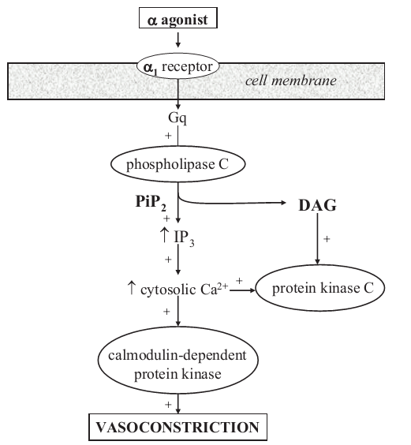
NOREPINEPHRINE
α1>>β1> β2
Powerful vasopressor, modest inotropic effects
Less chronotropic effect than Dob and Dop

Slide 27
Norepinephrine – Clinical applications
In general, better studied and applied for septic shock than cardiogenic shock
Cardiotoxic at high doses due to apoptosis in experimental models
--Side effect profile similar to Dopamine

Slide 28
Dopamine vs Norepinephrine
Shock due to any cause – NE = Dop
Septic shock – NE > Dop
No significant mortality difference, Greater adverse effects due to Dopamine.
Mortality higher for dopamine
Cardiogenic shock – NE > Dop
Mortality as well as arrhythmias higher for Dopamine
AHA /ESC guidelines do not comment on superiority/ priority of any single inotrope…. Dobutamine generally accepted as 1st inotrope of choice for heart failure.
Additional support with ?Dop> NE inspite of contrary evidence....AHA guidelines.

Slide 29
PHOSPHODIESTERASE-3 INHIBITORS (Inodilators)
MILRINONE
AMRINONE
ENOXIMONE
VESNARINONE

Slide 30
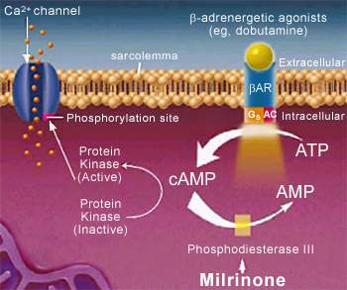
PDIs - MILRINONE
Vasodilation > positive inotropy
Inotropic, Chronotropic, Lusitropic
Systemic circulation effects:
- Vasodilation
- Increased organ perfusion
- Decreased systemic vascular resistance
- Decreased arterial pressure
Cardiopulmonary effects:
- Increased contractility and heart rate
- Increased stroke volume and ejection fraction
- Decreased ventricular preload
- Decreased pulmonary capillary wedge pressure

Slide 31
Milrinone - Pharmacology
Bolus: 50µg/kg bolus over 10 to 30 min (preferably avoided)
Infusion: 0.375 to 0.75µg/kg/min
(Dose adjustment required for GFR<30ml/min)
Half life : 2.5 hours
Renal clearance – prolonged action if renal dysfunction develops

Slide 32
Milrinone- Side effects
Ventricular arhythmias ~ 12% ( serious ~ 1.2%)
SVT ~3.8%
Hypotension, angina
Torsade de pointes
Headaches ~ 2.9%
Hypokalemia, tremor, thrombocytopenia (rare ~ 0.4%)
Transaminitis, hypersensitivity
No significant drug interactions
Should not be injected in same line as furosemide

Slide 33
Milrinone- Clinical application
Acute heart failure
Theoretical advantages compared to β agonists :
Chronotropic effect is less than β agonists
Less tachycardia for AF patients
Better efficacy for those on chronic BB therapy
Lusitropic and vasodilatory effects ( decrease afterload and preload)

Slide 34
Milrinone- Evidence
Increases heart failure and SCD mortality when given for long term treatment iv/ oral for CHF
It causes a higher post discharge 60-day mortality in CAD patients
Present guidelines for HF in acute setting:
ESC --- IIb, C
ACC/AHA --- IIb, C

Slide 35
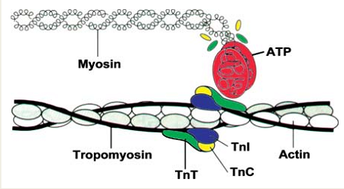
CALCIUM SENSITIZERS- LEVOSIMENDAN
Pyridazone-dinitrile derivative
Dual mechanism of action:
1) Binds to Ca binding site of TnC in sarcomere
2) K_{ATP} channel opener in smooth muscles

Slide 36
Levosimendan – Actions
Binds to Ca binding site (N-terminus) of TnC
Stabilizes the Ca-TnC complex and inhibits TnI -- prolongs actin-myosin cross bridge association rate
The binding affinity depends on the i.c Ca concentration
Hence, inotropic action only during systole (On-off action)
PDI like action at higher concentrations

Slide 37
Levosimendan - Pharmacology
Loading : 12-24µg/kg over 10 min
Infusion: 0.05-0.2µg/kg/min
Can be given orally also (Bioavailability ~85%)
T-half – 0.5-1.4 hours
Hepatic + intestinal metabolism (no renal modification)
Dose dependent action (linear pharmacokinetics)
Active metabolite –(half life of 80 hours) – responsible for prolonged action upto several days after stopping infusion

Slide 38
Levosimendan – Side effects
Hypotension (15- 50%)
Headache
Arrhythmias
No significant drug interactions

Slide 39
Levosimendan – theoretical advantages over Dobutamine
Vasodilatory action– decrease preload, after load and improves coronary blood flow.
Does not increase intracellular Ca/ oxygen demand
Does not impair diastolic relaxation (Positive lusitropy)
Decreases LVEDP during coronary ischemia
By action on mitochondrial K_{ATP} channels – decrease apoptosis– in vitro beneficial effects on remodelling.
Beneficial in CAD, sepsis, paediatric sub groups
Antioxidant and anti-inflammatory effects
Beneficial renal and gastrointestinal effects

Slide 40
Levosimendan - Evidence
Credited with the largest available evidence among iv inotropes
A 24 hour infusion increased COP ~40%, reduced PCWP
( -8.9mmHg) , 30% reduction in SVR & increased HR (~6bpm)
Significant mortality benefit for critically ill patients with heart failure and patients undergoing cardiac surgery
Improves mortality after coronary revascularisation compared to standard therapy
Improves survival as well as hemodynamics compared to dobutamine

Slide 41
Final word on Levosimendan?- guidelines
Only intravenous positive inotrope that has had a mortality benefit consistently.
Plenty of theoretical advantages over standard inotropes
Uniform physiological benefits for coronary, renal and g.i systems
Hypotension may be the main reason negating its efficacy
ESC: Recommended as second line inotrope (IIa,B) for AHFS

Slide 42
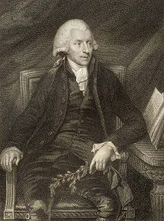
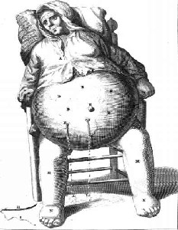
DIGOXIN
A purified glycoside extracted from foxglove plant (Digitalis lanata)
Discovered & described by William Withering in 1785
-English botanist, geologist, chemist & physician
Initially a routine drug for ‘dropsy’ (edema)
Oldest CVS drug that is still being used (>200years)

Slide 43
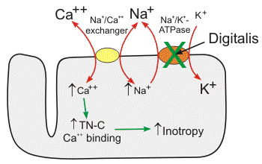
Digoxin - Action
Potent inhibitor of cellular Na-K ATP-ase -- blunts Ca extrusion
Positive inotropy ( LVEDP, LVEDV &LVESV )
Negative chronotropy and dromotropy ( vagal action)
Increased baroreceptor sensitization--withdrawal of sympathetic stimulation-- vasodilation
Decreases neurohormonal activation
Induces diuresis

Slide 44
Digoxin- Pharmacology
Oral administration
T-half = 40 hours ( So steady state in around a week)
----- Digitalization
Bioavailability : 60-80%
Onset ~ 2hours ; Peak effect ~ 2-6 hours
Better taken in empty stomach
Intestinal absorption is inhibited by P-glycoprotein on enterocytes (an efflux protein)
Large volume of distribution (500litres)
Crosses BBB and placenta
25% bound to plasma proteins
Excretion – 70-80% unchanged by renal

Slide 45
Oral digoxin administration
Narrow therapeutic levels (0.5-1.5ng/ml)
Body weight, age, renal function
For sick patients – loading dose(rapid digitalization)
Loading dose: ~20- 45 µg/kg (paed) / 10-15 µg/kg (adults)
1/2 total dose initially--1/4 dose every 4-6 hours twice
(Presently recommended only for AF rate control)
Maintenance dose: ~10µg/kg (paed) & ~5 µg/kg (adult)
(~ 1/4th of loading dose)
~ 0.125- 0.25mg for an adult male with HF and normal renal function

Slide 46
Digoxin – i.v
Can cause systemic as well as coronary vasoconstriction (avoided by administration over 20-30mins)
When carefully used is hemodynamically beneficial for AHFS.
Effects see within an hour.
However not recommended by international guidelines due to lack of evidence.

Slide 47
Digoxin – Drug interactions
No CYP related interaction
Substrate of P-glycoprotein (Pharmacokinetic interaction)
Pharmacodynamic interactions | Mechanism
NSAIDS, ACE inhibitors | Decreasing renal clearance
Diuretics | Hypokalemia, hypomagnesemia
Dofetilide , Sotalol, Dronedarone | Proarrhythmia– sudden death
Teriparatide | Hypercalcemia—dig toxicity
Thyroxine (decrease S.digoxin) | Increased clearance
Other Inotropic agents | Tachyarrhythmias
BBs & CCBs | Bradyarrhythmias
Significant increase in S.Digoxin concentrations (>50%) | Digoxin conc increased (<50%)
Amiodarone | Atorvastatin
Dronedarone | Carvedilol
Captopril | Diltiazem
Clarithromycin | Indomethazine
Gentamicin | Nifedipine
Erythromycin | Tolvaptan
Propafenone , Quinidine | Trimethoprim
Ranolazine | Telmisartan
Ritonavir | Spironolactone
Tetracycline | Quinine
Verapamil
Itraconazole

Slide 48
Digoxin- side effects
Dose dependent
~ 5-20%
( 15-20% serious side effects)
(~ 50% is cardiac toxicity)
GI: nausea, vomiting, intestinal pain, hemorrhagic necrosis
CVS: Almost any arrythmias
CNS: blurring/yellow vision, delirium, headache, confusion, depression, hallucination
Thromobocytopenia, gynaecomastia, skin reaction

Slide 49
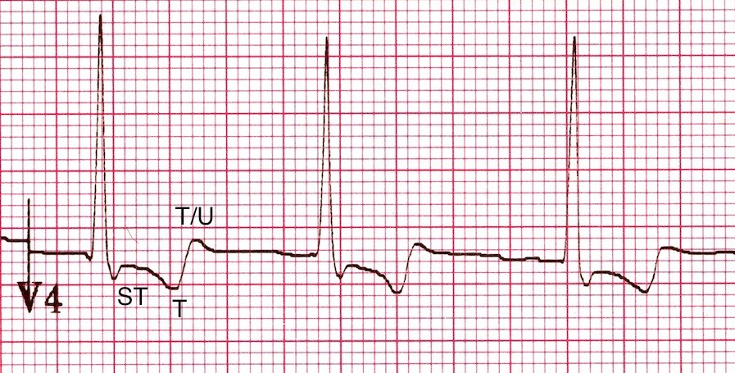
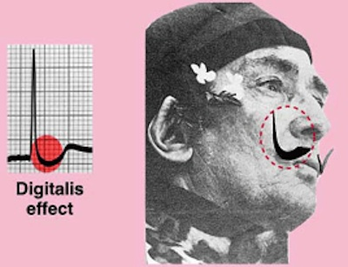
Digoxin effect
Salvador- Dalis moustache sign
STD with inverted/biphasic T waves (‘Inverted tick-mark’)
QT shortening
Prominent U waves
PR prolongation
Peaking of T waves

Slide 50
Digoxin toxicity
Hospitalisation for suspected toxicity in DIG ~ 2%
Dig-arrhythmia at 1.7ng/ml ~ 10% & at 2.5ng/ml ~ 50%
Caution in elderly, females, CKD, drug interaction, cardiac amyloidosis, hypothyroidism, hypokalemia, hypoxia, severe acid-base imbalances
Ideal SDC is 0.7-1.3ng/ml
SDC recommended for high risk patients ~ 14-21 days after initiation atleast 8hours after previous digoxin dose.
GI symptoms, CNS symptoms, various arhhythmias, hyperkalemia should provoke suspicion.
Stop digoxin, correction of precipitants, treatment of arhhythmias, Digibind Abs for lifethreatening arrhythmias and dialysis for hyperkalemia.

Slide 51
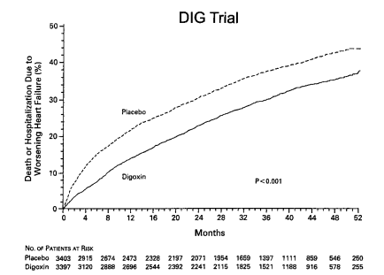
Digitalis Investigation Group trial (NEJM 1997)
Largest digoxin trial ~ 7800 patients
LVEF</= 45%, ischemic /nonischemic
Matched for ACEinhibitors and diuretics
No effect on overall mortality rates
Significantly reduced incidence of death/hospitalization caused by worsening HF
Women had higher mortality at 5 years
(However no gender difference for SDC<1ng/ml)
Ancillary trial with 988 patients with LVEF >45% --- Similar conclusions
For LVEF<25%, CT ratio>55% or NYHA3/4 symptoms, total mortality benefit(RRR~ 39%) & re-hospitalization seen at 2 years

Slide 52
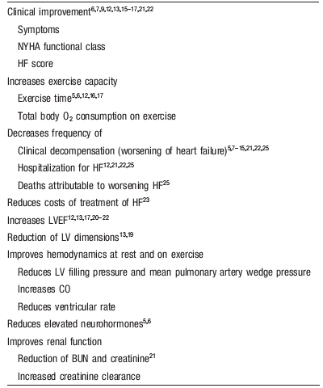
Evidence based beneficial effects of Digoxin in HF
Stood the test of time (>220 years)
Orally once daily dosing
Easily tolerated and less frequency of serious S/E
Inexpensive
Reduces costs of HF treatment
Has multiple actions and hemodynamic benefits
Only inotrope showing long term mortality benefits and fewer side effects in therapeutic range.

Slide 53
Digoxin - Guidelines
Approved by FDA for HF in 1998
ACC/AHA : IIA recommendation for clinical HFrEF and II B for HFpEF
ESC : IIb B for HF, sinus rhythm & LVEF <45%
Decreasing trend in digoxin prescription (80% to <30%):
Not promoted
Fear of drug interaction & toxicity
? Higher mortality in women
No evidence hence not recommended for AHFS/ ACS

Slide 54
Newer inotropic agents
Omecamtiv mecarbil
SERCA gene (gene transfer)
Ryanodine receptor stablilizer (S44121 )

Slide 55
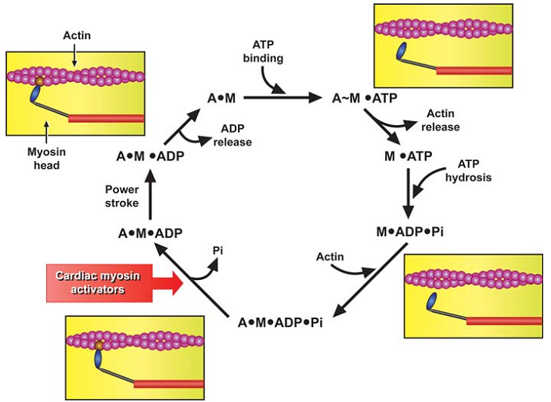
OMECANTIV MECARBIL
Cardiac specific myosin activator
Stimulate myosin-ATPase
Accelerates the rate of actin-dependent phosphate release from the actin-myosin crossbridge
Promotes transition to the force producing on-state of the cross bridge
More cross-bridges activated per unit time
Increased contractile force

Slide 57
GENERAL PRACTICE PRINCIPLES – i.v Inotropes for ADCHF
Unlike the effect of CRT on HF which also improves myocardial function…. Why no definite mortality benefit???
Use of inotropes for heart failure increased all-cause mortality
--i.c. Ca overloading, neurohormonal activation, adverse myocardial energetics, apoptosis

Slide 58
Mortality data from the ADHERE registry

Slide 59
Guidelines on inotropes in HF:
ACC & ESC do not recommend routine use of i.v inotropes for the treatment of Stage D HF (Class III)
However they may be considered for symptom management as a palliative measure (Class IIb)
Both ACC & ESC do recommend i.v inotropes in an appropriate clinical setting of hypotension (SBP<85mmhg) and hypoperfusion in Stage C HF (ACC Class 1C/ ESC IIa,C/ HFSA IIa,C)
- Dobutamine - ESC Class IIa, B / ACC IIb, C/ HFSA IIb, C
- Levosimendan- ESC Class IIb, C (especially for patients on c/c BB therapy)
Milrinone - ESC IIb, C / ACC IIb, C/ HFSA IIb, C
Dopamine – ESC IIb, C / ACC IIb, C
following acute hemodynamic collapse

Slide 60
Inotropes in cardiogenic shock
Goal of positive inotropes:
Increase in BP (COP) -- thus vital organ perfusion-- diuresis
Decrease in LVEDP to unload the heart
Usually Dopamine as 1st choice -- Increases BP without dangerous hypotension
If hypotension is not immediately life-threatening– Dobutamine 1st choice
2nd choice – Vasopressor ( Noradrenaline/ Dopamine)
In ADCHF patients if COP persistently low, Milrinone may be added to Dobutamine (bypasses β-downregulation)
Vasodilators to be added once BP has been stabilized as hypotension does not imply low SVR

Slide 61
Inotropes in ACS with heart failure
Already excessive i.c Ca overloading and inotropes may further worsen ischemia, cause arhhythmias and cell necrosis.
However, recovery of poor hemodynamic parameter may outweigh these complications.
ACC recommends Dobutamine as 1st line agent when SBP is between 70-100mmHg in the absence of shock.
If shock is present ACC recommends Dopamine (??Norepinephrine)
Combination of Dobutamine +Dopamine at 7.5µg/kg/min had been found better than individually uptitrating a single inotrope
If persistent <70mmHg Norepinephrine may be added
For HF a/w RVMI, hypotension even after adequate hydration to an RAP~15mmHg---Dobutamine improves outcomes

Slide 62
Intravenous inotrope titration
- SBP--- invasive arterial BP monitoring
- Urine output – Hourly monitoring
- Ectopics/arrythmias – ECG monitoring
- CVP/PAP monitoring – However ESCAPE trial did not show much clinical benefit
- Heart rate to be monitored
- Should be tapered at steps of 2micg/kg/min

Slide 63
Decision on inotropic therapy for AHFS
ACC/AHA Heart Failure guidelines

Slide 64
Theoretically best inotropes to use
Situation | 1st agent | 2nd agent
Severe persistent shock (any cause) | 1)Noradrenaline (NA) 2) Dopamine (Dop) | 1) Dop 2) NA 3) Levosimendan (esp cardiogenic shock after PCI & cardiac surgery) 4) Dob
Heart failure with borderline hypotension | Levosimendan (Lev) Dobutamine (Dob) (If SBP>70) Dop Milrinone (Mil) | Lev> Dob> Mil > NA >Dop
Heart failure with SBP >90mmHg | Lev Dob Dop | Dob> Dop Lev> Dop Lev>Dob
Notes:
Aim of severe shock---to build a decent blood prssure to support vital organs

Slide 65
Conclusion
Inotropic therapy relieves symptoms but does not affect prognosis, which is more dependent on LV structural improvement.
Inotropes in general causes proarrythmia and maladaptation.
They should be used as short in duration & low in dose as possible.
Moderate doses of inotrope combinations is recommended over high doses of single inotrope.
The ultimate aim of inotrope use should be to tide the ‘crisis’ until definite evidence based therapy is initiated, and hemodynamics & symptoms return to baseline.

Slide 66
THANK YOU
Sky is the limit………………..

