Slide 1
PREOPERATIVE CARDIAC EVALUATION FOR NON CARDIAC SURGERY
Dr Arun Jude Alphonse
Dept of Cardiology
Govt Medical College, Alappuzha

Slide 2
Discussion
A stepwise approach for preop evaluation
Perioperative beta blocker ,aspirin use
Perioperative Cardiovascular investigations
Special scenarios

Slide 3
The purpose of preoperative evaluation is not to give medical clearance but rather to
“Perform an evaluation of the patient’s current medical status;
make recommendations concerning the evaluation, management, and risk of cardiac problems over the entire perioperative period”.

Slide 12
REVISED CARDIAC RISK INDEX (Lee. Circulation 1999; 100:1043-1049)
1. High-risk surgical procedures
• Intraperitoneal
• Intrathoracic
• Suprainguinal vascular
2. History of ischemic heart disease
• History of myocardial infarction
• History of positive exercise test
• Current complain of chest pain considered secondary to myocardial ischemia
• Use of nitrate therapy
• ECG with pathological Q waves
Each risk factor is assigned one point.
3. History of congestive heart failure
• History of congestive heart failure
• Pulmonary edema
• Paroxysmal nocturnal dyspnea
• Bilateral rales or S3 gallop
• Chest radiograph showing pulmonary vascular redistribution
4. History of cerebrovascular disease
• History of transient ischemic attack or stroke
5. Preoperative treatment with insulin
6. Preoperative serum creatinine > 2.0 mg/dL (177 umol/L)

Slide 13
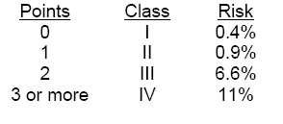
RISK OF MAJOR CARDIAC EVENT
Points Class Risk

Slide 19
Recommendations for Preoperative Resting 12-Lead ECG
CLASS I
1. In patients with at least 1 clinical risk factor who are undergoing vascular surgical procedures. (LOE : B)
2. In patients with known coronary heart disease, peripheral arterial disease, or cerebrovascular disease who are undergoing intermediate-risk surgical procedures. (LOE : C)
CLASS IIa
1. Reasonable in persons with no clinical risk factors who are under-going vascular surgical procedures. (LOE : B)
CLASS IIb
1. May be reasonable in patients with at least 1 clinical risk factor, undergoing intermediate-risk operative procedures.

Slide 20
CLASS III
1. Preoperative and postoperative resting 12-lead ECGs are not indicated in asymptomatic persons undergoing low-risk surgical procedures. (LOE : B)

Slide 21
Recommendations for Preoperative Noninvasive Evaluation of Left Ventricular Function
No CLASS I indication
CLASS IIa
1. Reasonable in Patients with dyspnea of unknown origin. (LOE:C)
2. In patients with current or prior heart failure with worsening dyspnea or other change in clinical status , if evaluation not performed within 12 months.
CLASS IIb
1. Reassessment of LV function in clinically stable patients with previously documented cardiomyopathy
CLASS III
1. Routine perioperative evaluation of LV function in patients is not recommended.

Slide 22
Recommendations for Noninvasive Stress Testing Before Noncardiac Surgery
CLASS I
1. Patients with active cardiac conditions in whom noncardiac surgery is planned should be evaluated and treated per ACC/AHA guidelines before noncardiac surgery
CLASS IIa
1. Noninvasive stress testing of patients with 3 or more clinical risk factors and poor functional capacity (less than 4 METs who require vascular surgery is reasonable if it will change management. (LOE:B)

Slide 23
CLASS IIb
1. Noninvasive stress testing may be considered for patients with at least 1 to 2 clinical risk factors and poor functional capacity (< 4 METs) who require intermediate-risk noncardiac surgery if it will change management.
2. Noninvasive stress testing may be considered for patients with at least 1 to 2 clinical risk factors and good functional capacity (> 4 METs) who are undergoing vascular surgery. \
CLASS III
1. Noninvasive testing is not useful for patients with no clinical risk factors undergoing intermediate-risk noncardiac surgery.
2. Noninvasive testing is not useful for patients undergoing low-risk noncardiac surgery

Slide 25
Recommendations for Preoperative Coronary Revascularization With CABG or PCI
CLASS I
1. Useful in patients with stable angina who have significant left main coronary artery stenosis.
2. Useful in patients with stable angina who have 3-vessel disease. (Survival benefit is greater when left ventricular ejection fraction is less than 0.50.)
3. Useful in patients with stable angina who have 2-vessel disease with significant proximal left anterior descending stenosis and either ejection fraction less than 0.50 or demonstrable ischemia on noninvasive testing.
4. Is recommended for patients with high-risk unstable angina or non–Stsegment elevation myocardial infarction (MI)
5. Is recommended in patients with acute ST-elevation MI. (LOE:A)

Slide 26
What should we do in a patient with prior PCI ?
Should we continue with Surgery after stopping antiplatelets or wait for a while ?

Slide 27
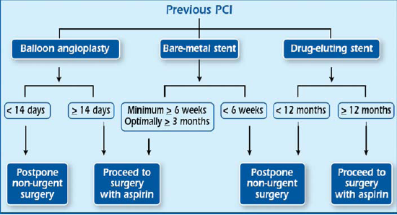

Slide 28
What should be done in case of Patients who require PCI in whom noncardiac surgery is necessary in near future ?

Slide 29
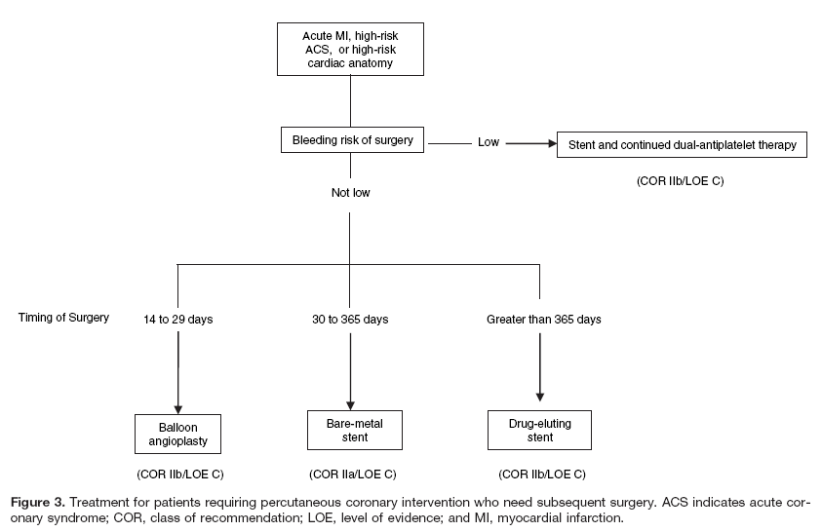
Solution

Slide 30
What about a patient with Pacemaker/ICD implanted, who undergoes a non-cardiac surgery ?

Slide 31
The electrical stimulus from electrocautery may inhibit demand pacemakers or may reprogramme the pacemaker.
Keeping the electrocautery device away from the pacemaker, giving only brief, bursts and using the lowest possible amplitude may decrease the interference.
If a patient is pacemaker dependent, the device should be reprogrammed to an asynchronous mode during surgery (VOO or DOO), or a magnet should be placed over the device during surgery.
ICD devices should have their tachyarrhythmia treatment algorithms programmed off before surgery and turned on after surgery to prevent unwanted shocks due to spurious signals that the device might interpret as VT/VF.

Slide 32
Should anticoagulation be stopped prior to surgery ?
Its decided based on thromboembolic risk and bleeding risk.
In those with high risk of thromboembolism (eg:- AF, Prosthetic mechanical heart valves, recent venous thromboembolism (<3 months) plus thrombophilia), Bridging therapy with therapeutic dose of LMWH/UFH is now most often performed.

Slide 33
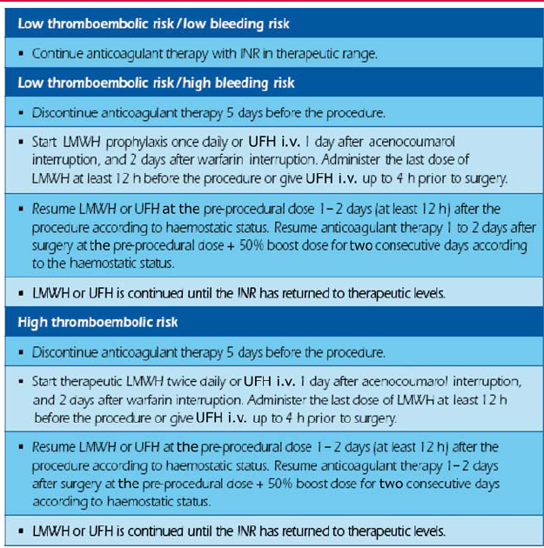
Bridging therapy of VKA with UFH or LMWH in high- and low-risk patients/procedures

Slide 35
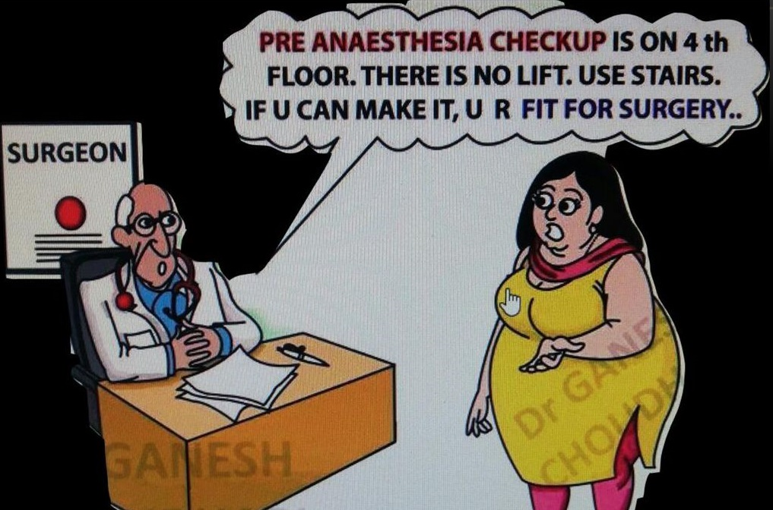
THANK YOU

