Slide 1
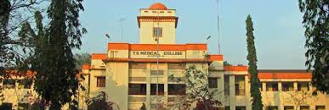
Cardinal manifestations of
heart disease in adults
. . . an analysis
Dr Arun Jude Alphonse
DM Cardiology Resident
Govt TDMC Alappuzha

Slide 2
At the end of a good history analysis
Which system is affected ...Cardiac/Respiratory/Both/Not both?
If Cardiac then which side is affected predominantly..Left or Right?
Mechanism of disease (Haemodynamics)

Slide 3
Complications?
How severe is the problem?
Etiology?

Slide 4
Cardinal symptoms
Dyspnea
Chest pain
Palpitation
Syncope
Fatigue

Slide 5
Dyspnea and Mechanism of Dyspnea

Slide 6
DEFINITIONS OF DYSPNEA
conscious sensation that results from an unusual perception of discomfort during breathing.
Heart Failure- A Companion to Braunwald
subjective experience of breathing discomfort that comprises qualitatively distinct sensations that vary in intensity.
American Thoracic Society

Slide 7
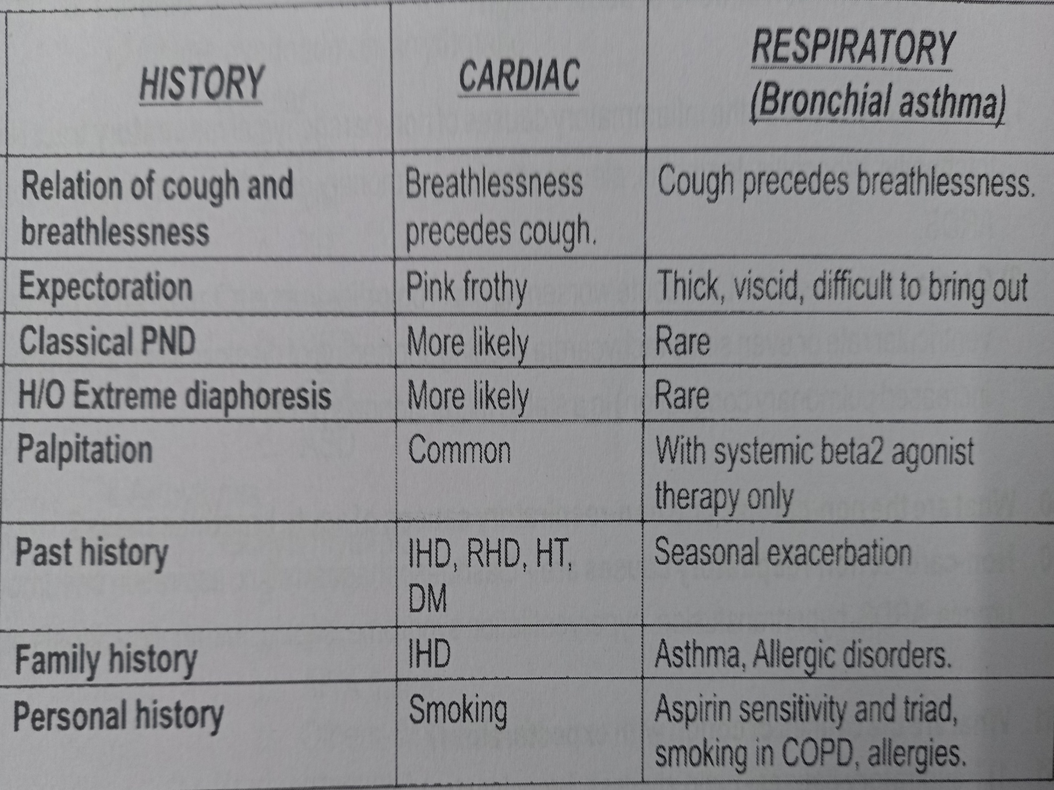

Slide 8
Dyspnea
Heart vs Lung
Grading
Localizing value
Mechanism
Systemic causes

Slide 9
Grading of dyspnea
NYHA
Perloff’s functional classification(CHD)
Goldmans specific activity scale
WHO Classification(PAH)
Visual Analogue Scale
MRC
mMRC
ATS
Sherwood Jones index
Borg scale

Slide 11
Limitations of NYHA classification
1)Doesn’t include orthopnea ,PND
2)Doesn’t consider treatment like diuretics given
3)Doesn’t consider aggravting or relieving factors
4)Inter and intraobserver variability

Slide 13
Valvular
Myocardial
Pericardial
Non cardiac
Systemic

Slide 14
Does dyspnea has localising value ?
Left heart
Right heart

Slide 15
MECHANISMS OF DYSPNEA

Slide 16
Mechanisms of cardiac dyspnea
Increase mechanical workload of breathing
Reduced lung compliance/Increased pulmonary interstitial pressure/Increased pulmonary vascular pressure/Airway edema/Increased airway resistance/Bronchiolar cpmpression
Increased ventilator drive
Hypoxaemia/VQ mismatch/Increased lactic acid/Increased PaC02
Fatigue of respiratory muscles
Decreased cardiac output

Slide 17
Mechanisms of dyspnea in Left heart disease
Juxtapulmonary capillary /J receptors…
Prime physiological stimulus –PCWP increase
Response –Rapid shallow breathing
Campell & Howel theory of length tension inappropriateness– Mismatch between tension generated in respiratory muscles and change in tidal volume
Bernheim effect
Pulmonary hypertension

Slide 18
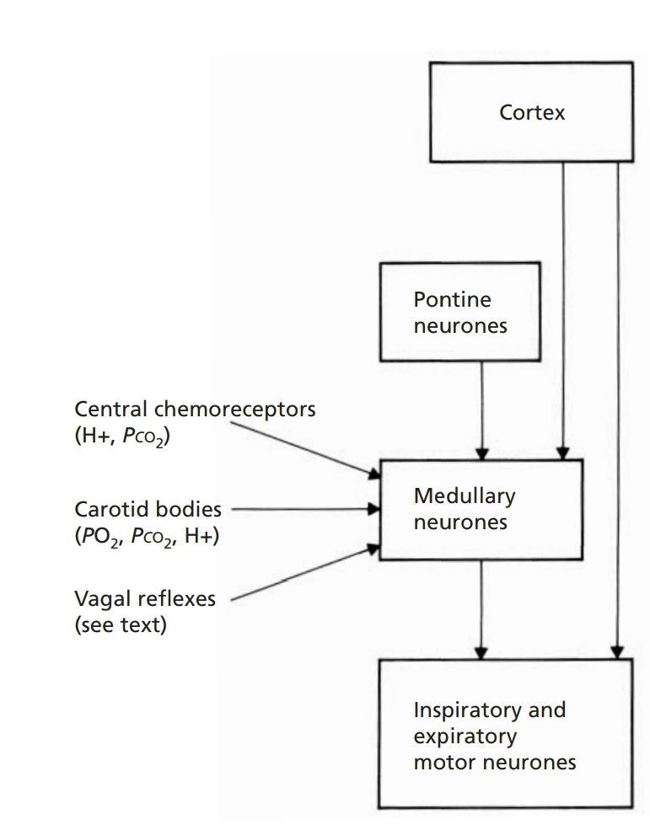
Mechanoreceptors in respirtory muscles and the thoracic cage
Respiratory muscle receptors
Chemoreceptors in carotid artery ,aorta

Slide 19
Decreased tidal reserve
Increased transpulmonary pressure
Increased transpulmonary gradient
Dyssynergy of intercostal muscles
Imapaired respiratory drive

Slide 20
Mechanisms of dyspnea in Right heart disease
Pulmonary Hypertension
Reverse Bernheim effect
Coronary vascular turgor effect
RV hypertrophy –RV Ischaemia
Cardiac synctium
Pulmonary Artery stretch receptors

Slide 22
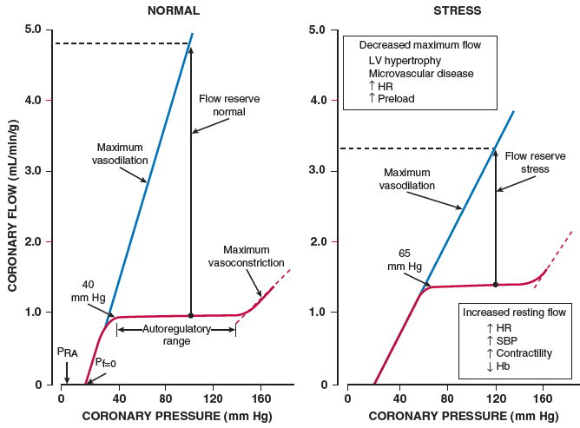
EXERTIONAL DYSPNEA & CFR
CFR – Vd flow/ resting flow
Effort intolerance primarily due to respiratory & skeletal muscle fatigue

Slide 23
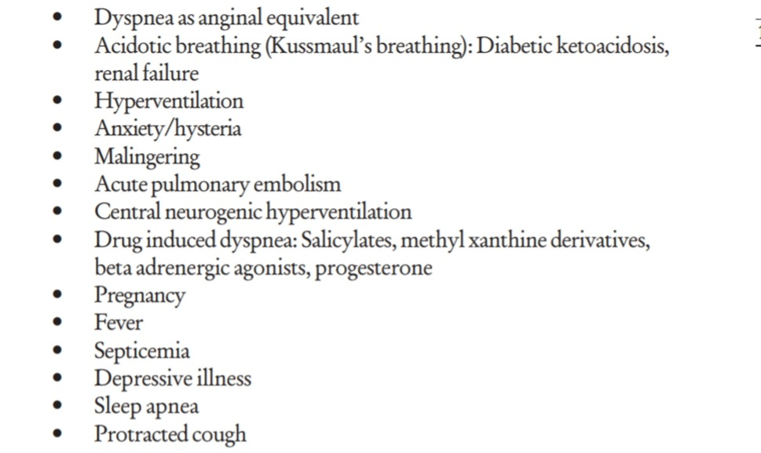
Conditions simulating dyspnea

Slide 24
Grading of dyspnea

Slide 25
Mechanisms of PAROXYSMAL NOCTURNAL DYSPNEA
1)Fluid shift –Extravascular to intravascular Augmented venous return from lower limbs-pulmonary and capillary pressure increases –increase interstitial edema(Slow redistribution) ….(PND only in the background of pedal edema)
RV output> LV Emptying
2)Reduced sympathetic/increased parasympathetic activity during sleep..Reduced LV contractibilty

Slide 26
3)Depression of respiratory drive
4)Nocturnal Arrhythmia(REM sleep)
5)Night mare(REM sleep) with increase emotional activity-Increased myocardial oxygen demand
6)Reduced Natriuretic peptide,Increased AVP
7)Diaphragm in a position of mechanical disadvantage

Slide 28
Mechanism in Orthopnea
Augmented venous return
pulmonary and capillary pressure increases
interstitial edema (fast Redistribution)-400 ml
Elevation of diaphragm
Occur 1-2 min of recumbency
Improves on sitting up

Slide 29
Causes
Left heart failure
COPD
Significant Ascites/Obesity/Diaphragmatic paralysis

Slide 30
Grading PND and orthopnea :Where does it fit in NYHA ?

Slide 31
PND –New observations
Acute diastolic dysfunction
Reversible episodes of Pulmonary edema
PCWP variable
Hidden CAD commoner than expected
Some events may precipitate an ACS

Slide 32
Other forms of dyspnea
Platypnea
Trepopnea
Bendopnea

Slide 33
Dyspnea equivalent ?
Nocturnal Cough
Extreme fatigue
?Is activity limitation masking the culprit
ACITIVITY LIMITING DYSPNEA-ANGINAL EQUIVALENT

Slide 34
Fatigue

Slide 35
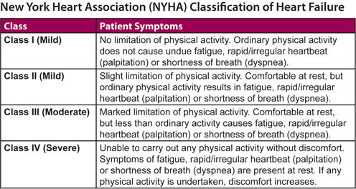

Slide 36
Fatigue
Efficacy of the effector muscle
Mismatch of cardiac output during exercise,
Muscle and microcirculatory deconditioning
Associated metabolic disorders
UNDUE FATIGUE (Inappropriately severe) not reduced with appropriate measures -?Cardiac cause

Slide 37
Chest pain

Slide 38
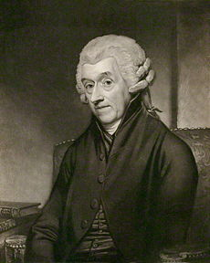
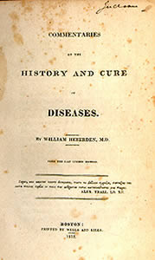
“Dolor pectoris" to the Royal College of Physicians in 1768

Slide 40
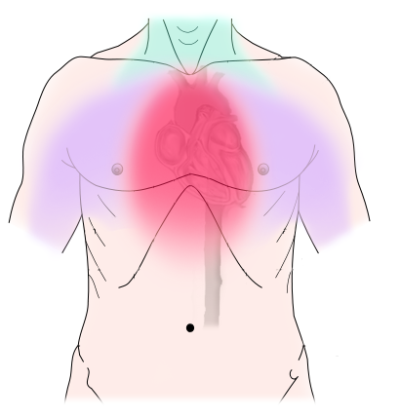
Compressing
Constricting
Squeezing
Strangling
Band like
Non cardiac : Pricking / Lightening /Catching

Slide 42
T1 - T5 segments ( Range C3 -T10)

Slide 43
Chest pain
Anginal
Non Anginal
Non Cardiac
Typical
Atypical

Slide 44
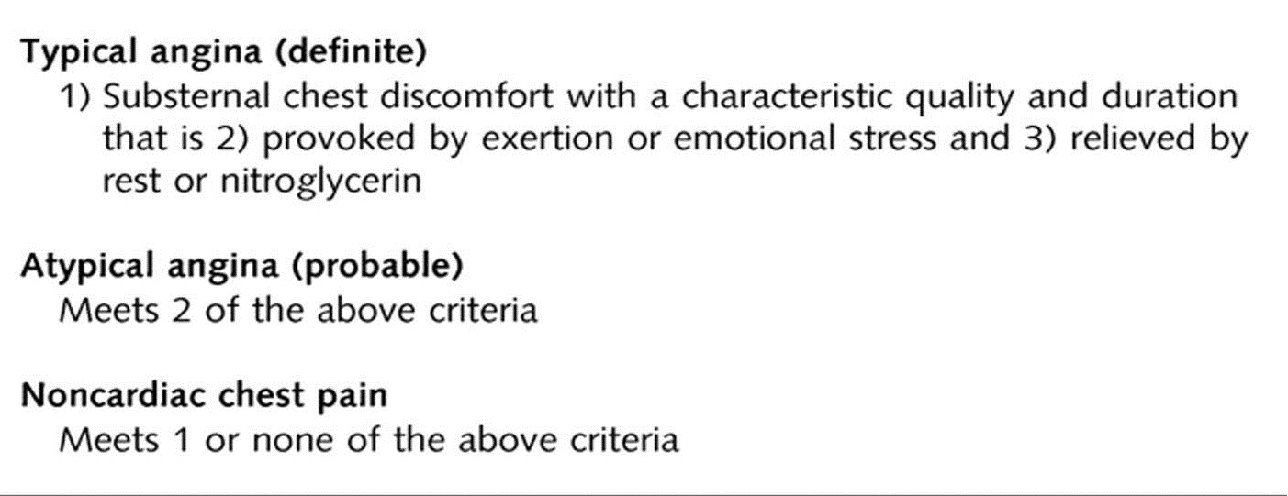

Slide 45
Diamond and Forrester NEJM 1979 Prediction rule
Typical Angina | 90%
Atypical Angina | 50%
Non Cardiac | 16%
Asymptomatic | 3-4%

Slide 46
LOCATION
CHARACTER
RADIATION
ASSOCIATED SYMPATHETIC/PARASYMPATHETIC
All 4 – Angina
2-3 - Likely to be angina
1- Angina unlikely

Slide 48
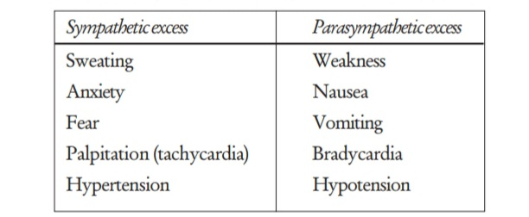
Associated phenomenon

Slide 49
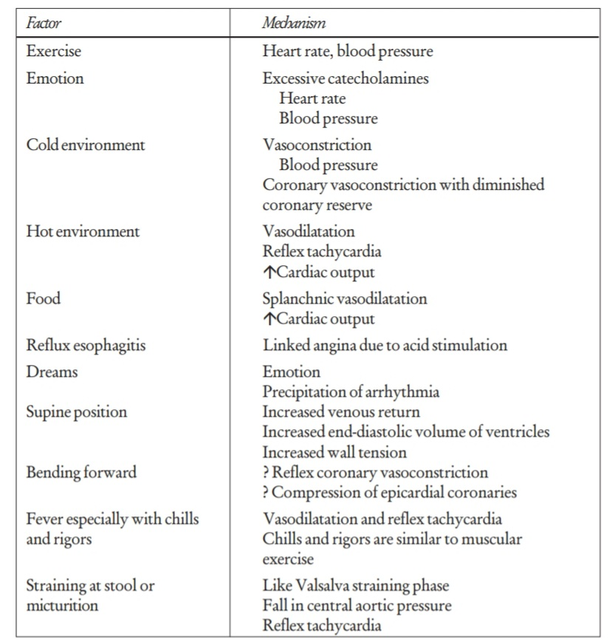
Aggravating factors and mechanism

Slide 50
Relieving factors and mechanism

Slide 51
Atypical features in
Long standing Diabetes mellitus
Elderly with autonomic dysfunction
On betablockers and antianginals
Post CABG(Denervation)

Slide 52
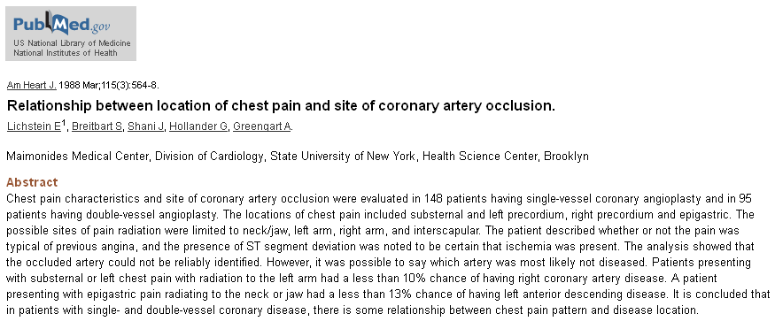
Localising value of Angina
RCA vs LAD ?
Epigastric –Jaw-neck – 90% RCA

Slide 53
Chest pain :Clinical vs Physiological discrepancy

Slide 54
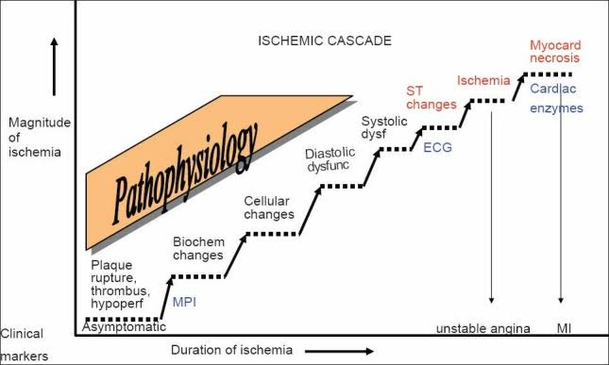

Slide 55
Special Types of Angina
Rest angina
Nocturnal Angina
Post prandial angina
Second wind phenomenon
Variable threshold angina

Slide 56
Mechanism of rest pain

Slide 57
CCS vs ACS
?Frequency
?Duration
?Threshold of walking before angina occurs
In last month..Any increase ?

Slide 58
Unstable Angina
Absence of ECG and enzymatic evidence of acute MI
Either one of
1)Crescendo angina on a preexisting chronic stable angina
2)Angina at rest or minimal excertion
3)Angina of new onset(<1 MONTH)
Heterogenous subset of syndromes
Preinfarction Angina/Crescendo angina/Acute coronary insufficicency/Intermediate coronary syndrome

Slide 60
Circadian periodicity for Acute coronary syndromes
Increase plasma catecholamines
Increase cortisol
Increase blood pressure and heart rate
Increased platelet aggregation
Increased tissue plasminogen activity
Increased fibrinolytic inhibitor(PAI-I)

Slide 61
Non Ischemic cardiac pain

Slide 62
Pericarditis
Aortic Dissection
Acute pulmonary hypertension
Infective endocarditis
Mitral valve prolapse

Slide 63
Pericardial pain
Sharp
Postural
Pleuritic component
Very rare to radiate to hand

Slide 64
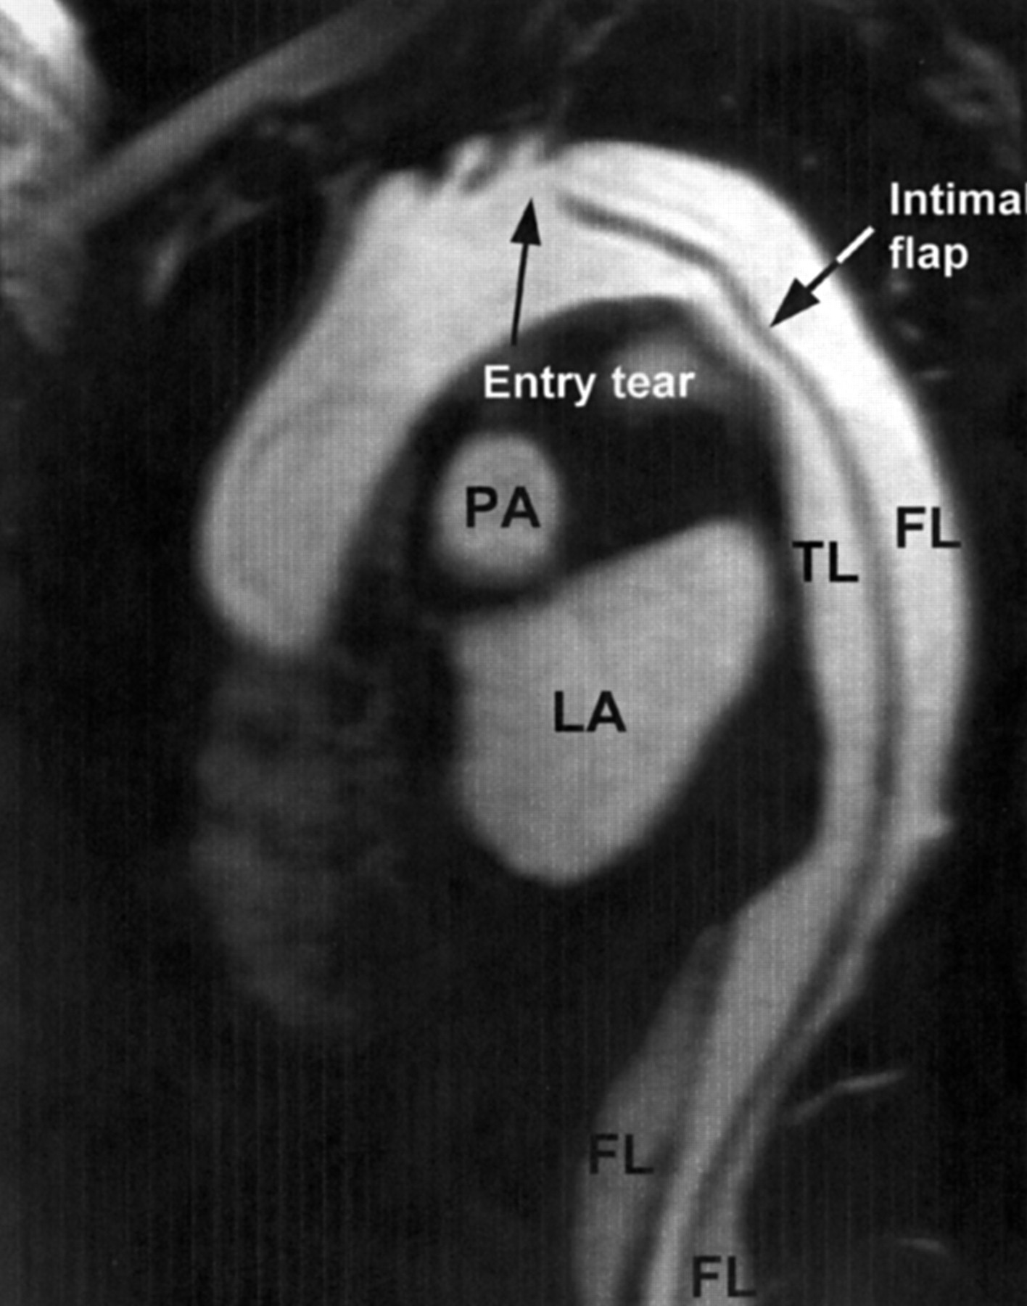
Chest pain of dissection
Mayo Clin Proc. 1993 Jul;68(7):642-51.Clinical features and differential diagnosis of aortic dissection: experience with 236 cases (1980 through 1990).
Spittell PC¹, Spittell JA Jr, Joyce JW, Tajik AJ, Edwards WD, Schaff HV, Stanson AW.

Slide 65
Anginal equivalents
Diabetics
In elderly with autonomic dysfunction
Patients with chronic beta blocker and other anti anginal drugs.
Post CABG patients -Denerved heart
ACTIVITY LIMITING DYSPNEA
FLASH PULMONARY EDEMA
SYNCOPE ON EFFORT

Slide 66
Chest pain evaluation – Summary
Most important symptom
Quiet challenging in triaging
Combination of cardiac /Non cardiac rampant
Be meticulous and listen . . .
Even an Instant CAG is not going to the answer your suspicion ?

Slide 67
Palpitation

Slide 68
Abnormal awareness or normal awareness of ones heart beat
?Onset/Offset
?Skipping/Gap
?Excertional/Rest
?Lasting how long
?Clinical status during the episode
?Previous history of similar episode

Slide 69
Palpitation –Etiological basis
Non Cardiac
Valvular (Stenotic vs Regurg)
Arrhythmic
Combined
Hyperdynamic states
Primary myocardial cause rare : Generally for palpitation to occur there should be well preserved LV function

Slide 70
Aware of heart activity/Predominantly in excertion – Volume overload ventricle(AR/MR/TR/Shunts/Anaemia/Hyperthyroid/Physiologic –Excertion/Stress)
Rapid heart activity- Hints at dysarthymia
?is it skipping –regular or irregular
?onest-sudden/gradual
?lasting-mins/hrs
?clinical status during episode-giddiness/dyspnea/blackout
?Drug induced(Eg-Prokinetics/Macrolides-QT prolongation)

Slide 72
Associated symptoms

Slide 73
Palpitation in Systemic Hypertension
Pheochromocytoma
Isolated use of vasodilators
Associated CAD –Angina,Arrhythmia
Hypokalemia –Diuretic induced,primary aldosteronism
Psychogenic-After knowledge of hypertension

Slide 74
Palpitation may be an anginal equivalent in high risk patients
ALL PALPITATIONS ARE NOT ARRHYTHMIAS AND MANY ARRHYTHMIAS DO NOT PALPITATE

Slide 75
Syncope

Slide 76
DEFINITION
Syncope is- transient loss of consciousness (LOC)
caused by transient global cerebral hypoperfusion
Characterized by rapid onset,short duration, and spontaneous recovery

Slide 77
Conditions incorrectly diagnosed as syncope

Slide 78
Syncope
Prodrome ?
Exertional /Non exertional ?
Prolonged standing?
Activity-?Situational/prolonged cough/micturation/deglutination/prolonged standing

Slide 79
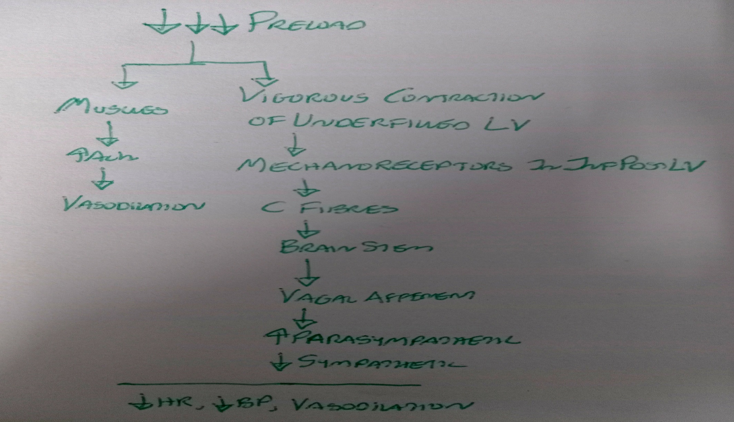
Neural circuits : Neuro cardiogenic syncope
Heightened Sympathetic tone
Cardiac (stretch )
Reflex parasympathetic overshoot
(Cardio Inhibitory/Vasodepressive)

Slide 80
Vasovagal syncope-Profile

Slide 81
Suggestive of cardiac syncope
Severe structural heart disease
Syncope during excertion or while supine
Palpitation/Chest pain at time of syncope
F/H/O SCD
Bifascicular block/QRS>120ms
Severe sinus bradycardia in absence of medicines or physical training
Preexcitation/Prolonged or short QT
ECG pattern suggestive of HCM/Brugada/ARVD
Clinical evidence of Pul Embolism
Male >35 years

Slide 82
Causes of cardiac syncope

Slide 83
Nitrate syncope

Slide 84
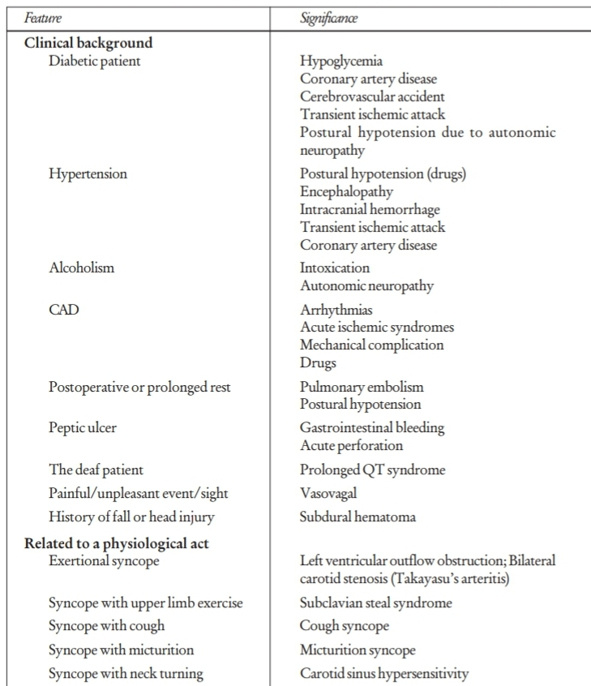
Important aspects in the history of a patient with syncope

Slide 85
Refferences
Braunwald’s Heart Disease :A text book on cardiovascular medicine(12th edition)
Hurst’s the heart: 14th edition
Clinical methods in Cardiology –B Somaraju
Kerala Journal of Cardiology

Slide 86
THANK YOU

