Slide 1
CHEST XRAY IN HEART FAILURE
Dr Arun Jude Alphonse
Dept of Cardiology
Govt TDMC Alappuzha

Slide 2
What is the most likely diagnosis?
11-08-2020; Before treatment
14-08-2020;After treatment

Slide 3
Heart Failure
Chest x-ray findings include
1.pleural effusions,
2. cardiomegaly
3.Kerley B lines
4.upper lobe pulmonary venous congestion
5.interstitial edema.

Slide 4
What happens in LV Dysfunction
LV Dysfunction> Increased LV end diastolic pressure>
back flow to LA(increased LA pressure) >
back flow to PV> increased Pulmonary Capillary Wedge Pressure (PCWP)> increased hydrostatic pressure in vessels >fluid will escape the vessels and enter the interstitial spaces and within the alveoli

Slide 5
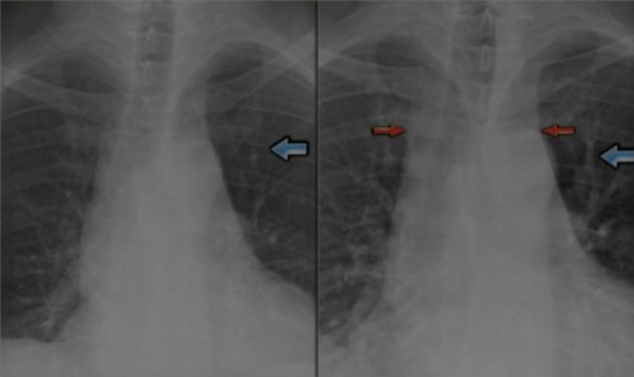
RADIOLOGICAL STAGES
Stage 1(Redistribution) – PCWP 13-18mm hg
Vascular engogement ,upper zone vascular predominace , cardiomegaly

Slide 6
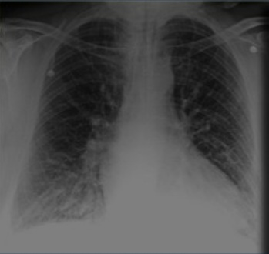
Stage 2(Interstitial edema) – PCWP 19 -25mm hg
Kerley lines , fissural thickening(congestion),peribronchial cuffing,
bilateral small pleural effusions

Slide 7
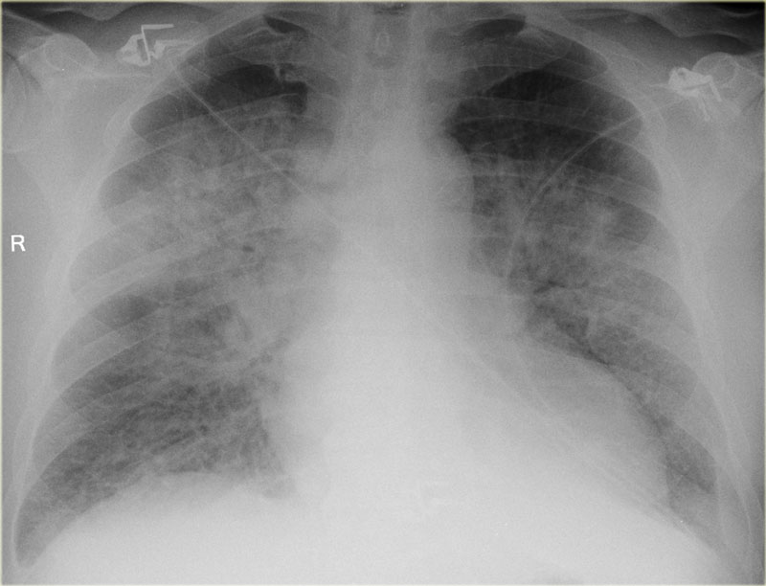
Stage 3(Alveolar edema) – PCWP >25mm hg
Alveolar edema , fluffy cotton wool opacities, symmetrical air space consolidation

Slide 9
Yellow , Blue , Red?

Slide 10
Kerley lines

Slide 11
YELLOW - KERLEY A
BLUE – KERLEY B
RED – KERLEY C

Slide 12
Cardiogenic vs Non Cardiogenic Pulmonary edema
Cardiogenic – Cardiomegaly , upper zone vessel congestion, kerley lines ,lung shadow central hazy ,air bronchogram unusual ,resolves in few days with appropriate management
Non Cardiogenic –No cardiomegaly ,no upperzone vessel congestion , no kerley lines , lung shadow central or peripheral , air bronchogram frequent , takes time for radiological resolution

