Slide 1
Clinical Evaluation of Valvular Heart Diseases
Dr Arun Jude Alphonse
DM Cardiology Resident
Govt TDMC Alappuzha

Slide 2
HOW WE WILL GO ABOUT
1)General approach to a cardiovascular case
2)Clinical evaluation of Mitral valve disease
3)Clinical evaluation of Aortic valve disease
4)Clinical evaluation of Tricuspid valve disease
5)Clinical evaluation of Pulmonary valve disease
6)Clinical evaluation of Multiple & Mixed valvular heart diseases
7)Summary

Slide 3
General Approach to patient’s symptom
Is CVS involved ?
Is it left sided or right sided problem? or both involved? Interval between Lt & Rt heart failure ?
Is it pressure or volume overload situation?
Altered physiology? Complications?
Severity of the condition?
Acute, subacute or a chronic problem
Most probable aetiology?

Slide 4
Converting symptom to altered physiology
PND = increased Pulmonary Venous Pressure
Regular Heavy palpitation at rest = Volume overload
Dependent oedema+ Abdominal distension+ fullness of neck = elevated mean RA pressure
Fatigue = Decreased Cardiac Output(CO)
Exertional greying of vision = Fixed CO, failure of CO to increase with exercise
Severe LVOT or RVOT obstruction
Angina = decreased supply to myocardium/Increased demand.

Slide 5
V = TR
Slow y = TS
a = High RV pr
Slow rising & low volume=AS
Prominent Pulsation, Palpable S2
Pressure/Flow in PA high or
L- posed Aorta
LA pulsation in severe MR
RVOT pulsation in Ebstein/EMF
Hyperdynamic apex
Volume overloaded LV
Heaving/Sustained
Pressure overloaded LV/increased LVET of dysfunctional LV
Left parasternal heave
Pressure or volume overloaded RV
Systolic Liver Pulsation = TR
Hepatojugular reflux
RV epigastric Impulse
Pressure/Volume overloaded RV

Slide 6
General Examination Findings in VHD
“In Isolated regurgitant lesions….look beyond rheumatic heart disease.”
Markers of rheumatic fever – subcutaneous nodules, Jaccoud’s arthritis
Markers of connective tissue disorders – Marfan, EDS, SLE, RA, Ankylspon…
Vasculitis - Takayasu’s in AR cases
Features of infective endocarditis

Slide 7
Q1)Can you identify this distinguished lady “star”? & her contribution to valvular heart disease?

Slide 9
The Braunwald’s
Dr Nina Starr Braunwald
First female cardiothoracic surgeon
First female to perform open heart surgery
Developed first mitral valve prosthesis

Slide 10
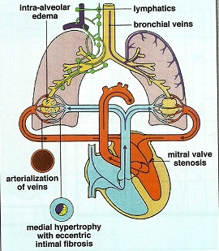
MITRAL STENOSIS
Lost in AF

Slide 12
Clinical assessment of Mitral Stenosis
Severity
Pliable valve for a BMV
Rhythm? Does the pt need anticoagulation.
Is there PAH/ How severe is it?
Associated lesions?
If there is TR, is it secondary to PAH or Organic TV disease?
Discrepancy between the symptoms and signs?
MS !

Slide 13
Symptoms
Gradually progressive DOE –(PND in severe disease)
PVH-capillary & venous engorgement -Increased effort to open up alveoli-Excertion-Increased venous return-increase in cardiac output/HR-reduced diastolic filling period-Increased LAP-Increased PVH
PCWP>25mm hg- Interstitial edema/alveolar edema
Interstital edema-dyspnea with clear chest
Alveolar edema – dyspnea with basal crepitations

Slide 14
Severe MS with no PND
RV failure/Sev PH
Development of precapillary stenosis
Development of organic TS

Slide 15
Q2)Which lesion will have an earlier onset of dyspnea?
1)MS
2)MR

Slide 16
MR-Systolic
MS-Diastolic(more duration),doesn’t fully empty to LV at any time..throughout the cardiac cycle LAP remains high

Slide 17
Q3)Which lesion will have a long assymptomatic period?
1)MS
2)MR

Slide 18
Natural history of MR vs MS
MR….assymptomatic(on and off palpitation)…..symptomatic only when lv fails(or A/C Sev MR)
MS ..symptoms(dyspnea-LAP )-PH(Assymptomatic)..RV failure(symptomatic)..can have intermittent paroxysms of respiratory symptoms/systemic embolism

Slide 19
Hemoptysis
Pink frothy sputum of pulmonary edema
Blood stained sputum of PND
Blood streaked sputum a/w bronchitis
Pulmonary infarction ( MS+CHF & AF-> RAA thrombus source of embolism)
Pulmonary apoplexy
Sudden,profuse,bright red
Sudden increase in pulmonary venous pressure&rupture of bronchial vein collateral

Slide 20
Bronchitis in MS
Oedematous mucosa secondary to rise in pressure in bronchial veins
Rarely dilated left atrium can compress the left bronchus and cause collapse of lung

Slide 21
Q4)MS patients deteriorate when AF develops due to all underlying mechanisms except?
1)Increase in heart rate
2)Loss of atrial kick
3)Long cycles correspond with higher LA pressures

Slide 22
Atrial fibrillation
Not associated with only severity of MS- Not a marker of severe MS
Age of individual , initial age of rheumatic fever , number of recurrences, severity and extent of carditis in previous recurrence
AF-Increased heart rate-reduced diastolic filling period-Increased LAP-worsening of FC

Slide 23
Pregnancy poorly tolerated in significant MS
Increased heart rate,blood volume,cardiac output-
Increased LAP/PVH
max symptomatic in second second trimester when hemodynamic abnormalities are pronounced

Slide 24
Pulse
JVP
LLLL
Associated RVF/Organic tricuspid disease
Prominent a wave-Sev PAH/TS
a wave absent in AF
V wave indicate severe TR/RVF
Slow y descent indicate TS
Elevated JVP in MS with no dyspnea & PND suspect TS.
Positive Hepato jugular reflux may be the earliest sign to appear in TS
Low volume-severe MS
Normal volume-Mild to moderate MS
High volume-Associated AR/Anaemia
Irregular – AF
Regular on digoxin –digoxin toxicity with junctional rhythm

Slide 25
Cardiac impulse in MS
Apical impulse site- Mild MS-Normal site, tapping in character
Mod-Sev MS- Lateral displacement
TAPPING IMPULSE – LOUD S1/PALPABLE S1
Diastolic thrill – can give clue to Severe MS
THRILL –ANTERIORLY DIRECTED JET
IN BASE IS SYSTOLIC/APEX IS DIASTOLIC
Localized impulse-Mild MS
Diffuse impulse –Mod to Sev MS(RV)

Slide 26
Low volume-severe MS
Normal volume-Mild to moderate MS
Irregular – AF
Regular on digoxin –digoxin toxicity with junctional rhythm

Slide 27
Left parasternal impulse –
Mild MS –Normal
LPH>2/3- Mod to Sev MS with PH
Palpale P2/RVS4 – Significant PH

Slide 28
Auscultatory triad in MS
LOUD S1
OPENING SNAP
MDM @ Apex

Slide 29
Q5)Which is the first auscultatory feature to be heard in MS?
1)Loud S1
2)Opening snap
3)MDM/Presystolic murmur
4) Presystolic accenuation

Slide 30
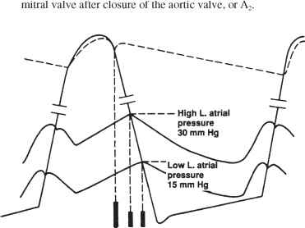
Loud S1 in MS
Increased range of excursion of mitral valve
Closes at a higher dP

Slide 31
Situations where S1 not loud in MS
Heavily calcified MV
Associated MR
Associated Severe AR
Severe RVH, RV occupying apex.

Slide 32
Opening Snap. Sudden tensing of the leaflet after the valve cusps completes the doming movement into LV A2- OS interval is a reliable indicator of severity of MS.
A2-OS interval & MS Severity
Mild MS 80-120 ms(>60ms)
Mod MS 60-80 ms
Severe MS 40-60 ms(<60ms)
IVRT-60-70ms
Increased LA pressure cause earlier opening of Mitral valve

Slide 33
Q6)How is “A2-0S” duration clinically classified?
1)By experience of multiple auscultations
2)Comparing with normal S1 split duration
3)Comparing with normal S2 split duration
4)Comparing with S4-S1 duration

Slide 34
Interval for sounds following Aortic Valve closure

Slide 35
Q7)Single best clinical indicator of pliability of valve for BMV?
1)Loud S1
2)OS
3)MDM
4)Presystolic accenuation

Slide 36
Pliability of valve – Loudness, pitch and crispness of Opening snap

Slide 37
Q8)Opening Snap corresponds to which stage in cardiac cycle?
1)IVR
2)Early rapid filling
3)Late slow filling
4)Diastasis

Slide 38
OS- Early rapid filling(begining)

Slide 39
DIFFERENTIATING A2-P2 vs S2-OS
Site of best audibility Pulm area
heard localized to PA
Palpability Palpable
Inspiration widens split
Standing No change
Medial to apex
Widely audible
Not palpable
No effect
Widens

Slide 40
Absent OS in MS
Severly calcified MV
Significant MR
Sever AR
Severe AS
LVF
Very close A2-OS(<30ms)
Mistaken as wide split S2

Slide 41
The Mitral MDM
Low-pitched rough & rumbling, at apex with bell, pt in left lateral position.
Pitch & duration correlate with severity.
Higher in pitch in high gradient.
Loud murmur with thrill suggest severe MS. BUT A LOW INTENSITY MURMUR DOESN’T EXCLUDE SEVERE MS.

Slide 42
Q9)Minimum transmitral gradient for MDM in MS?
1)1 mm Hg
2)2 mm Hg
3)3 mm Hg
4)4 mm Hg

Slide 43
Q10)MDM murmur of MS is decreased by all except?
1)Anemia
2)Severe MS
3)Severe PAH
4)AR

Slide 44
Factors that decrease intensity of diastolic murmur of MS
Low flow states
Severe MS
Severe PAH
CCF
AF with rapid ventricular rate
Associated cardiac lesions
Aortic stenosis-LVH,decreased compliance-decreased opening motion of mitral valve
Aortic regurgitation
ASD
PHT with marked RV enlargement
Characteristics of mitral valve
Extensive calcification
Others
Inability to localise apex
Obesity
Muscular chest
COPD

Slide 45
Causes of MDM at apex
Inflow Obstruction
1. MS
2. LA myxoma
3. Cor-triatriatum
4. AV groove narrowing – constriction, EMF
Increased Flow across MV
1. Severe MR, 2. Post tricuspid shunts- VSD, PDA 3. RSOV to RV
4. Hyperkinetic circulatory states.
Other machanisms
1. Austin-Flint murmur
2. Carey-Coombs murmur.

Slide 46
Differential diagnosis of apical mid diastolic murmurs

Slide 47
Pre-systolic accentuation
LV contraction in pre-systole narrowing mitral funnel.
Atrial contraction.
Persistent atrio-ventricular gradient.
FALSE POSITIVE CARVALLO SIGN : On inspiration → HR increase → Murmur increases.

Slide 48
MILD MS- MDM/Late
MOD MS – MDM with late systolic accenuation
SEV MS - HOLO DIASTOLIC MURMUR

Slide 49
Q11)Following AF presystolic accenuation?
1)Remains same
2)Dissappears
3)Increases
4)Present in short cycle of AF
5)Present in long cycle of AF

Slide 50
CRILE Hypothesis – AF can still cause pressytolic accenuation
Short cycle of AF(LAP)
Due to annular constriction during ventricular contraction

Slide 51
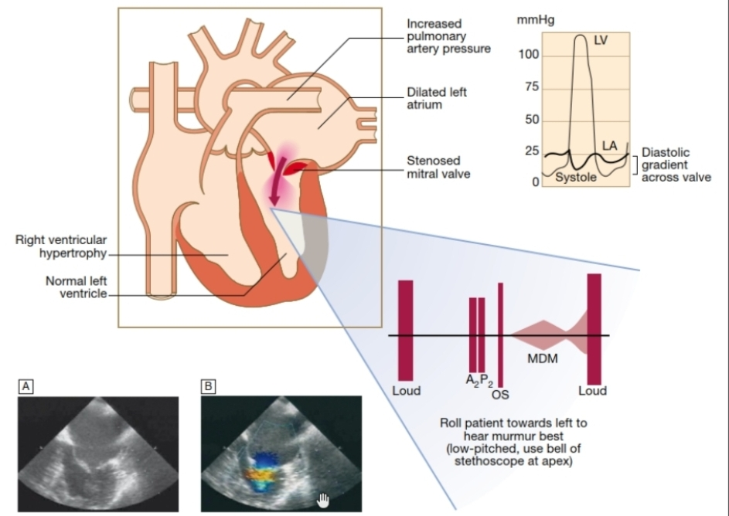

Slide 52
Q12)All indicate severe MS clinically except?
1)Severe symptoms(FC3/4)
2)AF
3)Shot A2-OS interval
4)Longer MDM with high pitch
5)Severe PH

Slide 53
When MS is severe clinically?
Severe Symptoms – NYHA class III/ IV
Long Mitral MDM, higher pitch(Following AF longer MDM in long cycle)
Short A2-OS interval
Severe PAH
Mitral facies – long standing untreated MS

Slide 54
Silent MS- MS with no MDM(Very mild MS,Very severe MS, associated PH,AV disease, poor auscultation)
Dampened MS- MDM+, OS absent – when PAH establishes

Slide 55
Pulmonary hypertension in MS
(1) passive backward transmission of the elevated left atrial pressure
(2) pulmonary arteriolar constriction, triggered by left atrial and pulmonary venous hypertension (reactive pulmonary hypertension)
(3) organic obliterative changes in the pulmonary vascular bed

Slide 56
Cause of reactive pulm HTN
Doesn’t occur unless mean LA is 20 mm Hg.
Wood-pulmonary vasoconstriction
Doyle-↑pul venous pressure prominent in the lower lobes,produce reflex arterial constriction
constriction

Slide 57
Jordan-
↑pul venous pressure-transudation of fluid
causes thickening and fibrosis of alveolar walls
hypoventilation of lower lobes-hypoxemia in lower lobe vessels
Sensed by chemoreceptors in pulmonary veins
Pulmonary arteriolar vasoconstriction in regions supplying these alveoli
Lower lobe perfusion decreases
This process eventually involve middle and upper lobe

Slide 58
Severity of PAH? – clinical findings of severe PAH
Prominent a in JVP in pts with SR.
Palpable P2
Palpable PA pulsation.
Significantly Loud P2
Ejection Click
Gr III Left Parasternal Heave
Loud Hypertensive TR, easily audible during inspn & expn
Hypertensive PR (Graham Steell)
RV S3/S4

Slide 59
Severity of PAH? – clinical findings of severe PAH
Prominent a in JVP in pts with SR.
Palpable P2
Palpable PA pulsation.
Significantly Loud P2
Ejection Click
Gr III Left Parasternal Heave
Loud Hypertensive TR, easily audible during inspn & expn
Hypertensive PR (Graham Steell)
RV S3/S4

Slide 60
Hypertensive vs Non hypertensive(Organic) TR
Hypertensive TR
Organic TR
Pansystolic usually
High frequency murmur
Rapid y descent in JVP, No slow
3/3 LPH – sustained
Non pansystolic
Low frequency
Slow y descent may be seen if TS
Hyperkinetic without increased duration

Slide 61
Hypertensive PR vs
Non-hypertensive PR
Timing Early diastolic,decrescendo
Length Short to pandiastolic
Pitch High
Conduction Lower Sternal border
Signs of PAH yes
Mid diastolic(PressureEq at mid to late diastole)
never pandiastolic
Low frequency, rumbling
Usually localised to PA
No signs of PAH.

Slide 62
LV dysfunction in MS
Restriction of posterobasal myocardium by the scarred mitral apparatus
Abnormal interventricular motion due to RV overload
AF – Tachycardiomyopathy
CAD,coronary embolisation

Slide 63
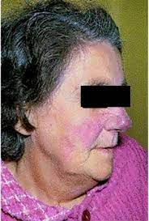
MITRAL FACIES
Rosy cheeks (bright circumscribed flush over the malar bones) with a bluish tinge.
The rose colour is because of the dilatation of malar capillaries while the bluish tinge is because of the cyanosis
Seen in long standing cases of severe mitral stenosis associated with pulmonary hypertension and low cardiac output.

Slide 64
Q13)Can you identify these legendary gentlemen & their contribution to valvular heart disease?

Slide 66
Dr Charles Hufnagel Dr M.S Valiathan
Dr Charles Hufnagel –Developed first artificial heart valve (ball&cage), mentor of Dr M.S Valiathan
Dr M.S Valiathan- Founder director of SCT Institute
Pioneer dev of Chithra TTK valve(tilting disc)

Slide 67
.
MITRAL REGURGITATION
Regurgitant orifice in MR
fixed regurgitant orifice
rheumatic heart disease
annular calcification
endocarditis
dynamic regurgitant orifice
mitral valve prolapse
dilated cardiomyopathy
ischemia
The abnormal coaptation of the mitral leaflets creates a regurgitant orifice during systole.

Slide 68
Clinical impact of MR
Determined by 1. the magnitude of the regurgitant leak
2. Time course of development of the regurgitation
Abrupt onset of severe MR→ markedly ↑pul venous pressure
C/c MR→ exhibit prominent ventricular enlargement with ↑ chamber compliance & ↓ pulmonary venous pressure

Slide 69
Clinical features &HD

Slide 70
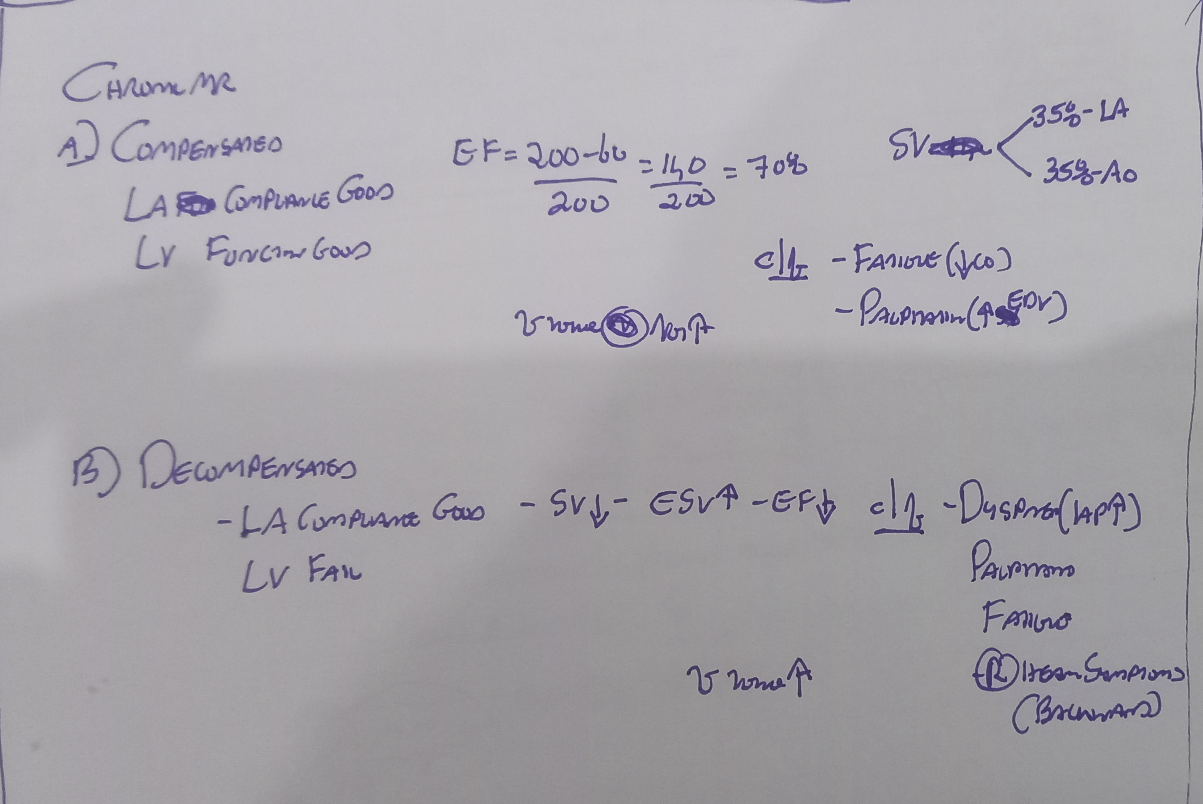

Slide 71
With exercise
Increased HR-Systtole more-MR increases
Increase in SBP –MR increases
Increase in Contractility –MR increases

Slide 72
Q14)Which regurgitant lesion is responsible for maximum volume overload?
1)MR
2)AR
3)TR
4)PR

Slide 73
Degree of Volume overload in MR vs AR LESS SEVERE IN MR THAN IN AR.WHY? “Cor Bovinum in AR”
DESPITE LARGER ROA & GRADIENT IN MR ( 120-15 mm Hg ) COMPARED TO AR ( 80- 10 mm Hg ), DURATION OF MR IN CARDIAC CYCLE IS SHORTER THAN AR

Slide 74
Pulse Mild – Normal Moderate to Severe- Pseudocollapsing,brisk Precordial findings
Hyperdynamic apex
LV type cardiomegaly
Diastolic apical thrill
Late systolic parasternal LA pulsation. ( ?LPH of RV enlargement)

Slide 75
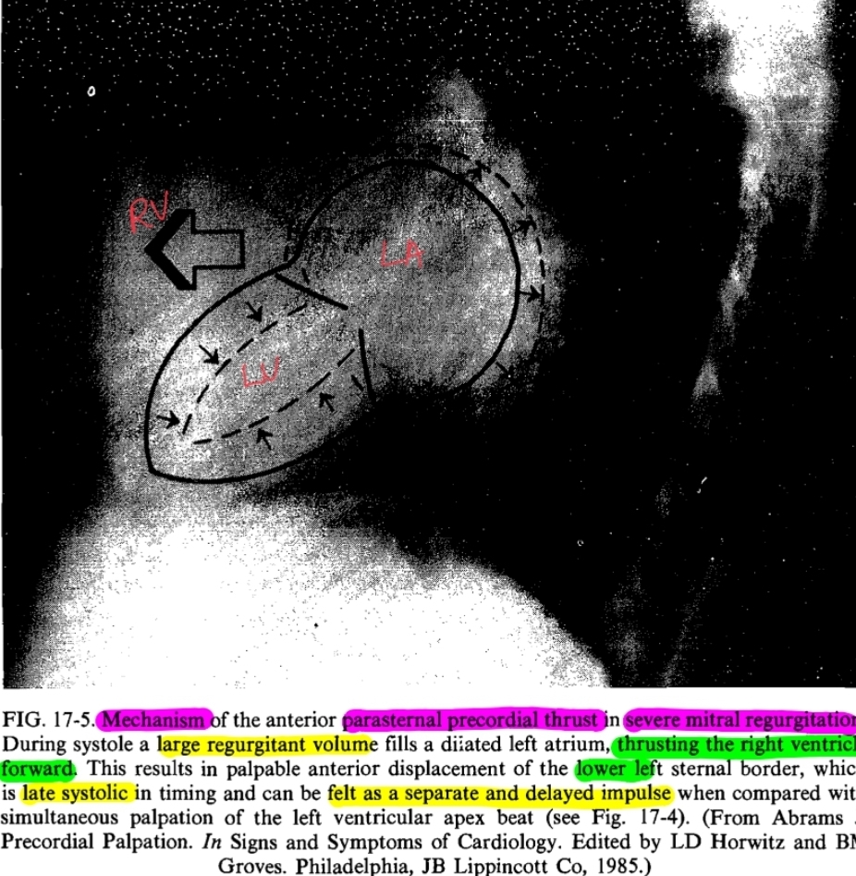
Parasternal impulse in MR
Regurgitant jet into LA- Late systolic impulse in lower left para sternum and 2/3 lateral to paraternal
RV hypertrophy&dilation due to PAH-Pan systolic impulse

Slide 76
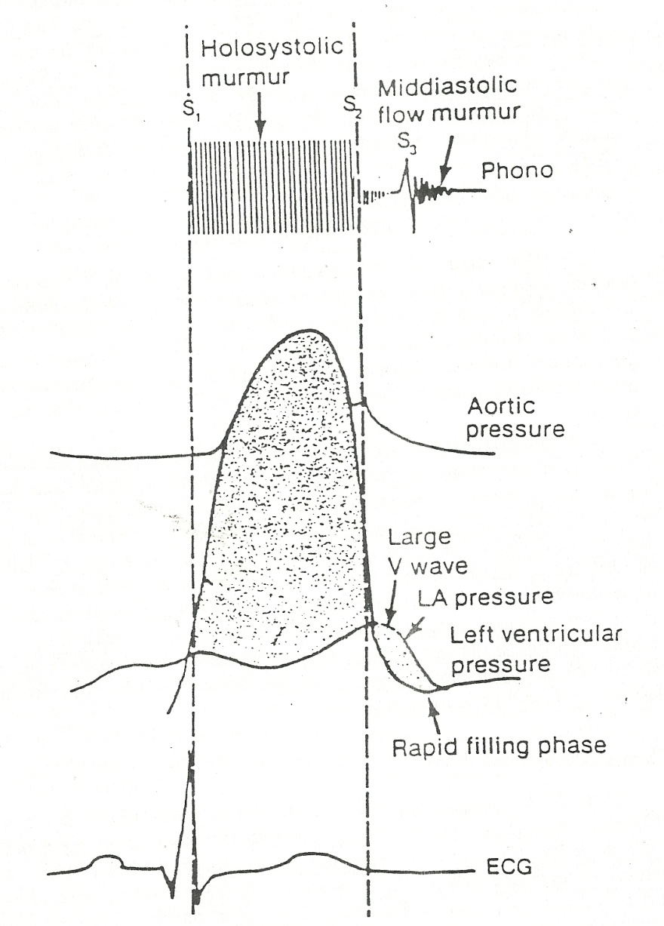
S1 in MR
S1 intensity is usually SOFT.
Why S1 soft in c/c severe MR
1.associated with defective leaflets
2.early onset of regurg during isovolumic
LV contraction(Ineffective IVC)
3.loud systolic murmur beginning with the rise of LV Pr masks S1

Slide 77
Q15)All are causes of loud S1 in MR except?
1)Rheumatic etiology
2)Anaemia
3)Thin chest wall
4)MVP etiology

Slide 78
Loud S1 in MR
Tachycardia
MVP-MR
Associated MS
Thin chest wall
Anaemia

Slide 79
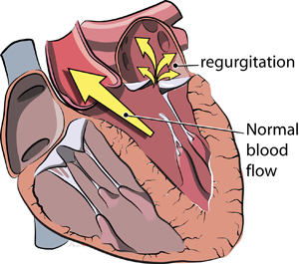
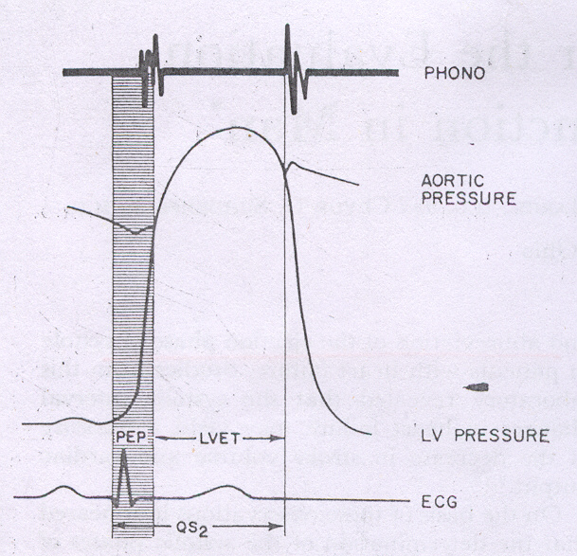
S2
Wide variable split in SEVERE MR
LV unloads easily -> ↓ LV Ejection time -> early closure of aortic valve.
A2-P2 Interval ↑ with severity of regurgitation & parallels the ↓ LVET
P2 if accentuated ….
pulm HT
abnl anterior displacement of PA - dilated LA

Slide 80
S2 in MR - clues to aetiology of MR
Wide fixed split
1. ASD + MR
2. AVCD + MR
Reversed/paradoxic split
1. Ischemic MR
2. MR in HOCM
3. DCM,LBBB with MR
Loud single S2
MR with CCTGA/LTGA

Slide 81
Q15)Pick the correct statement
1)LV S3 in MR correlates with LV dysfunction
2)LV S3 in AR correlates with severity of the disease
3)LV S3 in MR correlates with severity of the disease
4)LVS4 in MR correlates with severity of the disease

Slide 82
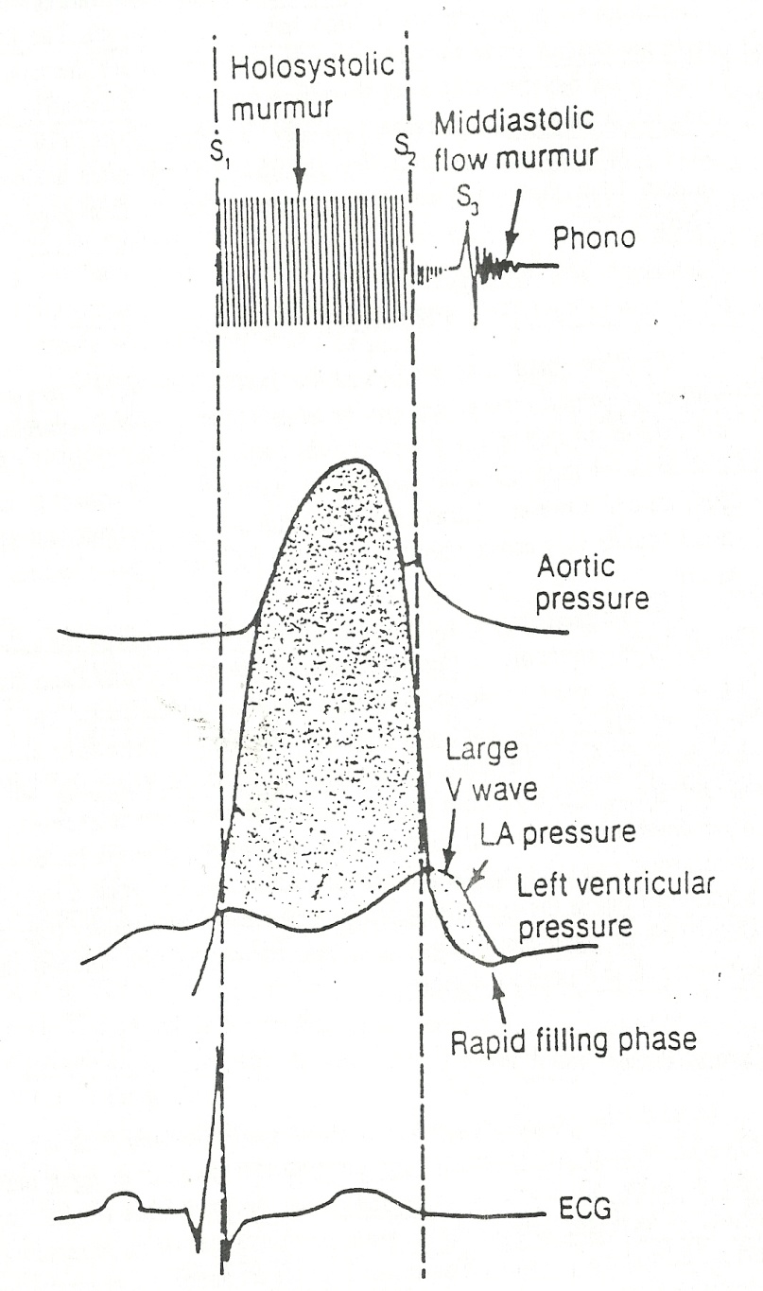
S3
Presence of S3 is directly related to MR degree in organic MR
(large RF rather than LV failure)
In ischemic/functional MR -S3 reflects more restrictive LV filling than severity of MR
Excludes significant MS
2 situations 1) large RF with good LVFN
2) diseased LV with ↓ EF

Slide 83
OS vs LV S3 in Mitral regurg
OS
LV S3
Closer to S2, < 100 ms
May have Wider audibility
Sharp click heard with diaphragm
Sharp S1
On standing OS moves away from A2
Away from A2, > 120 ms
Localized to apex
Thud audible with bell
S1 soft
No change

Slide 84
S4 in MR
In Rheumatic MR, S4 is CONSISTENTLY ABSENT.
LA in c/c MR - dilated & NC → unable to generate an S4
MR WITH S4
A/C MR
CAD with ischemic MR
HOCM with MR
A/c MR → nl sized LA → high pr and ↑ vol→ contracts more forcefully than nl.

Slide 85
Different contours of murmur of MR

Slide 86
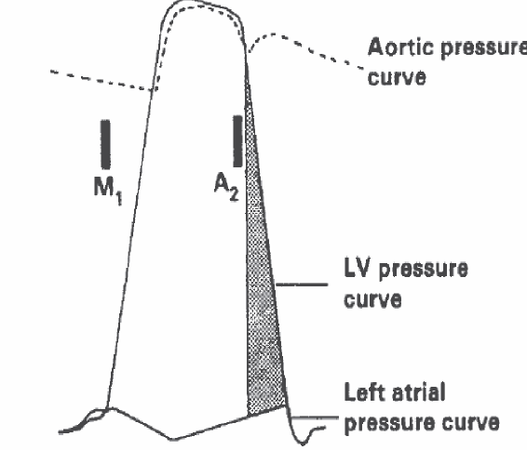
Systolic pr gradient between the LV &LA begins with closure of the mitral valve (S1)and persists after closure of the aortic valve (S2) up to mitral opening

Slide 87
Non pansystolic Murmurs in MR
MVP
Papillary muscle dysfunction
Acute MR
Mild MR

Slide 88
Silent MR
LV dysfunction
A/C MI
Mild MR
Obesity/Emphysema

Slide 89
Mitral flow MDM in MR
Reverberations from rapid & excessive filling of a distented LV -> Severe MR
Diff from MS
MDM ends well before S1, no presystolic
component
Low pitched thud assos S3 than OS

Slide 90
Q16)All are features of MR murmur except?
1)Increases with isometric handgrip
2)Fails to increase with inspiration
3)Increases post VPC/long cycle AF
4)Best heard in left lateral position with diaphragm of stethescope with breath held in expiration

Slide 91
LOOK FOR BEAT TO BEAT VARIATION OF MURMUR
A distinguishing feature is the lack of murmur intensity beat-to-beat variation with MR
MR actually does not increase during the isovolumic contraction phase in the beat after the long pause.
LV has two outlets during systole, after ectopic aortic resistance falls - the amount of regurgitate is not increased

Slide 92
Differentiating Acute vs C/C MR
ACUTE
CHRONIC
Symptom onset Acute
Cardiomegaly No
S1 Loud +
S4 Present
Murmur Decrescendo
Pulmonary Hypertension ++
Insidious
Yes
Soft
Absent
Holosystolic
+/-

Slide 93
Q17)All are features of MR murmur associated with CAD except?
1)Can present as ESM,LSM,PSM
2) Preseved S1
3)May increase or decrease with time
4)LV S4

Slide 94
MR in CAD
ESM(A/C MR, Chordae rupture/PM rupture)
PSM(LA/LV remodelling-Annular dilation)
LSM(papillary muscle ischaemia-at higher dp/dt demand supply mismatch)

Slide 95
Ischaemic MR vs Rheumatic MR
Ischaemic MR-
S1 less likely to be preserved, S4, More commonly increases/decrease with time , Lesser loud
Rheumatic MR –
S1 may be presrved,No S4,More loud

Slide 96
Q18)All favour MR over AS except
1)Slow peaking pulse
2)S3 corresponds with severity
3)Apical thrill
4)Max intenity of murmur early

Slide 97
MR with out of proportion cardiomegaly
1)Myocardial disease with LV dysfunction
2)CAD

Slide 98
Chronic MR without increased LA compliance
RHD
LVEMF

Slide 99
SYSTOLIC MURMUR OF HOCM & MVP

Slide 100
Rheumatic MVP Ischemic HCM
DIFFERENTIATING CAUSES OF MR
Timing of Murmur Pansystolic Late systolic Late sytolic
Site of Murmur Apex May be LSB Apex Apex
Character of Murmur Soft blowing Rasping/musical
Conduction of murmur Axilla & Back May be along LSB
Standing Decrease Increase - Increase
Strain of Valsalva Decrease Increase -
NEC - +
S1 Soft/loud LOUD SOFT
Reverse split S2 No No + +
S4 - - +/- ++
Hyperdynamic apex ++ ++ - Heaving
Dyskinetic impulse - - ++ -

Slide 101
Secondary MR

Slide 103
Q19)All are clinically suggestive of severe MR except?
1)GRADE 4/6 PSM at apex
2)Wide split S2
3)LV S3
4)LA pulsations

Slide 104
Clinical signs of Severe MR ?
Cardiomegaly, hyperkinetic LV apical impulse
LA pulsations
Wide split S2
LV S3
Mitral flow MDM
Very loud, widely conducted murmur (though this correlation between intensity of murmur & severity is weak.)
Signs of significant PH

Slide 105
Q20)In context of MS+MR, all are features of predominant MR except
1)LV S3
2)MDM without presystolic accenuation
3)Wide split S2
4)Loud S1

Slide 106
MS+MR - WHO PREDOMINATES?
MS – Loud S1, OS, Presystolic accenuation
MR – LV type cardiomegaly, Hyperdynamic apex,
LVS3,PSM@apex,Wide split S2(Early A2)

Slide 107
Q21)Can you identify this gentleman & his 2 contributions to valvular heart disease?

Slide 108
Dr. Louis Gallavardin 1) Gallavardin dissociation/phenomenon 2) Reticissimente de Gallavardin

Slide 109
Aortic stenosis
Etiology based on - level of obstruction to LVOT
Supravalvular
Valvular
- Congenital AS
- BAV ± calcification
- Rheumatic
- Senile degenerative
Subvalvular

Slide 110
Clinical Evaluation of LVOT obstruction
Level of Obstruction ? Valvular, Subvalvular, Supravalvular
If valvular- ?Unicuspid,Bicuspid,Tricuspid, Quadricuspid valve
If subvalvular -? Dynamic or Fixed Obstruction
Severity of the obstruction
Associated lesions

Slide 111
Q22) In rule of 5,3,2 rule in AS 5 years is for?
1)Angina
2)Syncope
3)Dyspnea
4)Palpitations

Slide 112
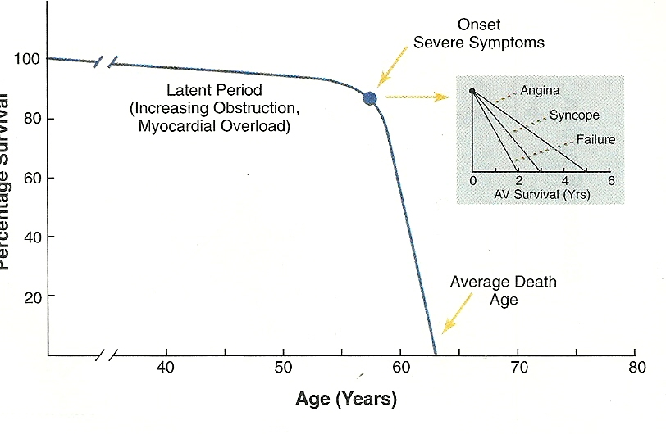

Slide 113
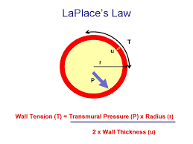
Compensatory Mechanisms
Chronic pressure overload ➨ concentric LV hypertrophy
increased wall thickness
normal chamber size
⇈ed myocardial cell mass and ⇈ed interstitial fibrosis
- diastolic dysfunction
dilation

Slide 114
Angina
Progressive LVH → increased myocardial oxygen needs
Hypertrophy may compress the coronary arteries
Associated Epicardial CAD
35% presentation
Occur in 2/3 rds of Severe AS.
50% die in 5 years

Slide 115
Syncope
Cardiac output no longer increases with exercise.
A drop in SVR → BP decrease → syncope
Malfunction of Baroreceptor mechanism.
Vasodepressor response to greatly increased LV Pr with exercise.
Arrhythmias Tachy & AV block
15% presentation
50% die in 3 years

Slide 116
Heart Failure
Changes in LV function may no longer be adequate to overcome the outflow obstruction
Afterload excess –> systolic dysfunction
Hypertrophic remodeling& Fibrosis -> diastolic dysfunction
50% die in 2 years

Slide 117
Q23)Contribution of LA in LV filling in AS
1)5%
2)10%
3)20%
4)40%

Slide 118
Q24)Critical AS in an infant includes all features except
1)Shock
2)Absent pulse
3)Heart failure
4)Cyanosis

Slide 119
Clinical features s/o of critical aortic stenosis in a infant
1)Shock
2)Absent pulse
3)Heart failure

Slide 120
Pulse
Normal-Low volume-Low volume slow rising
(parvus-weak/tardus-late)
Where to look?- Carotid
APICO CAROTID DELAY-Sev AS
JVP
Sev AS/Preterminal
Prominent a wave(Berheim effect)
Apex
LV type ,Heaving
Cardiomegaly-If associated AR/MR or LV Dysfunction

Slide 121
APICO CAROTID DELAY

Slide 122
Bernheim effect

Slide 123
Soft S1 in AS
High LVEDP
Lower Dp/Dt due to pressure overload
Associated LV dysfunction
Associated AR/MR
Associated AV conduction delay
If Loud S1
?Associated MS, AEC

Slide 124
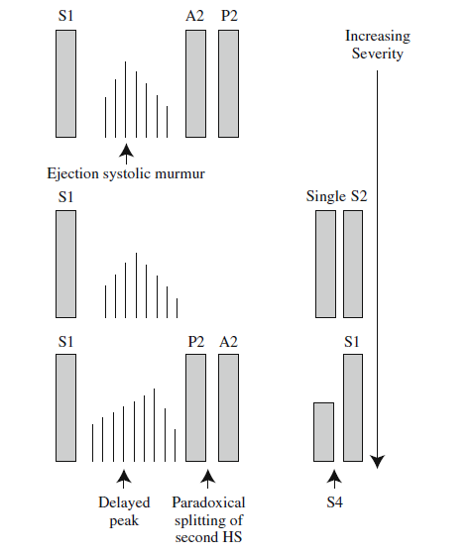
S2 in AS
Normal splitting excludes Severe AS.
In calcific AS – S2 single
Paradoxical split in noncalcified severe AS
MILD AS-Normal Split
MOD AS/Calcific- SingleS2
SEV AS(Non calcified) – Paradoxical split

Slide 125
Q25)Clinical identification of loud P2 is by all except?
1)P2 louder than normal A2 at pulmonary area
2)P2 heard beyond pulmonary area
3)Palpable P2
4)Throug clinical experice of multiple auscultations

Slide 126
Q26)Clinical identification of loud A2 is by ?
1)A2 louder than normal P2 at pulmonary area
2)A2 heard beyond aortic area
3)Palpable A2
4)Throug clinical experice of multiple auscultations

Slide 127
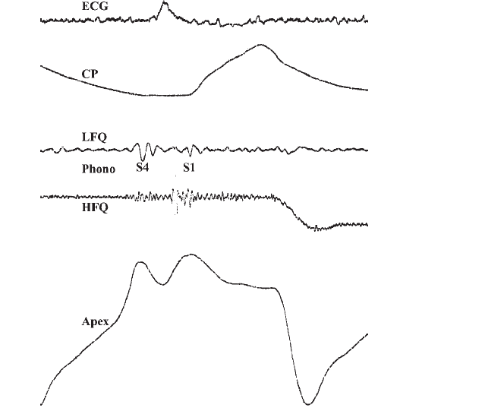
S4
Correlates wit large LV-AO gradient and abnormally elevated LVEDP
S4-S1 gap correlate with severity
Normal above 50 years
Palpable +Audible S4 significant
Sig mean gradient more than 70 mm hg

Slide 128
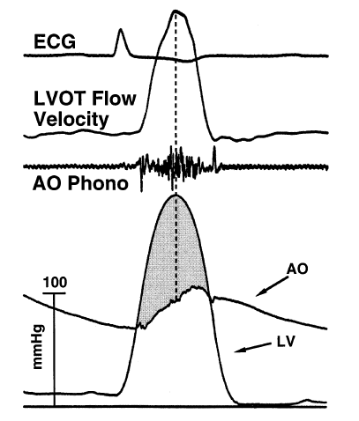
MURMUR OF AS
Crescendo –decrescendo – shape of the pr diff bet LV-Ao
Length of the murmur-severity
Gr 3 or more murmur specific for severe AS, NOT SENSITIVE FINDING.
Late peaking = gr > 75 mm Hg.
Frequency and pitch- rough ,grunting
Harsh- mixed frequency at base – effect of jet to Ao
high freq musical murmur at apex -> Gallavardin
Phenomenon.
Gallavardin mistaken for MR.
1.Intensity of murmur varies beat to beat in AF, or
after Ectopic -> AS & not in MR
2.cessation of murmur before S2 -> AS

Slide 129
? Supravalvular, Valvular, Subvalvular
Supravalvular -,Elfein facies,Coanda effect, Rt 1st ICS/Carotid , Normal S2, AR unlikely
Valvular-Rt 2st ICS/AEC
Subvalvular-Lt3rd ICS/NAA , AR+

Slide 130
If valvular- ?Unicuspid, Bicuspid,Tricuspid,Quadricuspid
Unicuspid – Accelerated AS, first to second decade
Bicuspid – AEC+,4^{th -} 5th decade
Tricuspid – Elderly
Quadricuspid –AR>AS

Slide 131
FIXED LVOTO vs DYNAMIC LVOTO
If subvalvular ?Dynamic or fixed
1.POST PRANDIAL WORSENING &
VARIABLE THRESHOLD FOR SYMPTOM No
2.TRIPLE APEX No
3.CAROTID Slow rising
4.MURMUR
Standing Decrease
Squatting Decrease
Valsalva Decrease
YES
YES
Brisk
Increase
Increase

Slide 132
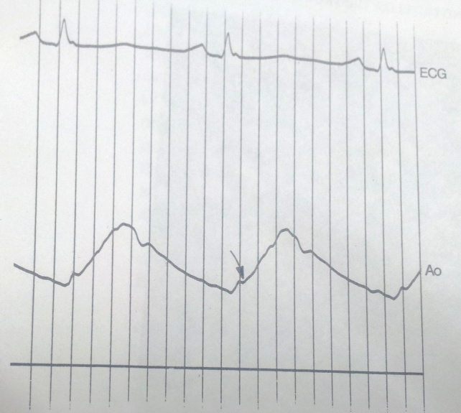
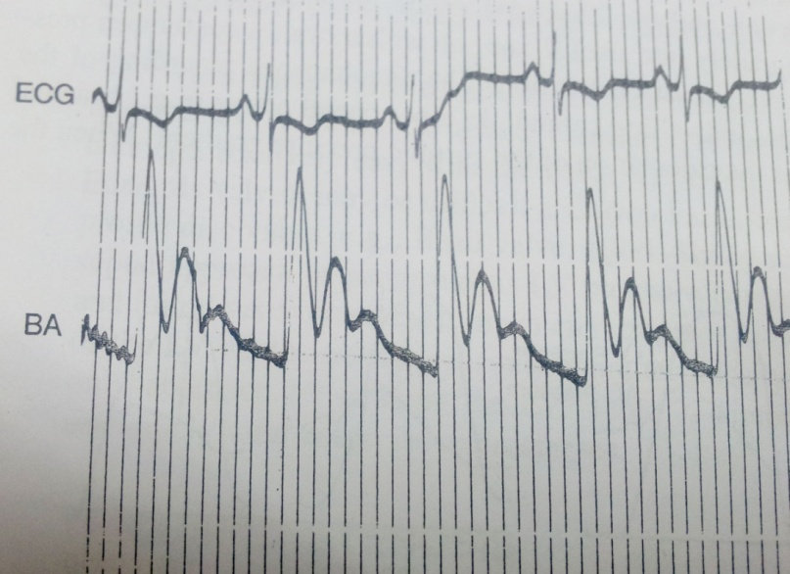
Valvular AS
# Slow systolic rise
# prominent anacortic notch
# late peak
HOCM
# rapid upstroke
# absence of anacortic notch
# early systolic dip
# second peak in late systole

Slide 133
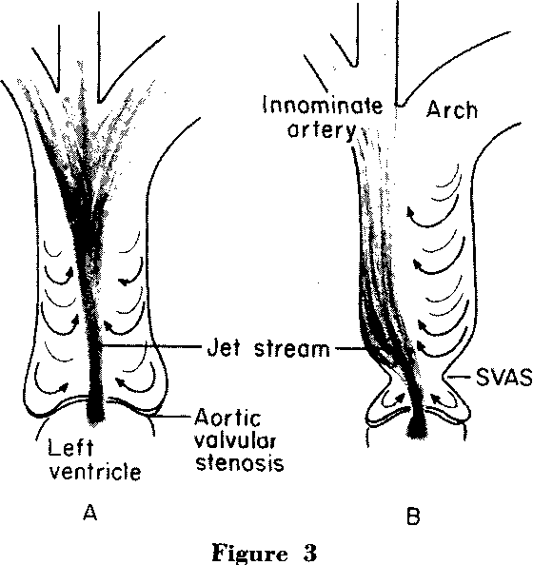
Supra valvular AS - pulse disparity (Coanda effect)
- systolic pressure in the right arm > left arm.
- relate to the tendency of a jet stream to adhere to a vessel wall
selective streaming of blood into the innominate artery
Streaming of the jet
toward the innominate, RCCA, and right SCA

Slide 134
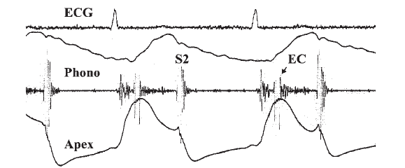
AEC
Localises to valve and suggests etiology
sudden cessation of opening motion of abnormal valve leaflets(doming)
Lost with calcification and thickening
High frequency- 40-80 msec after S1

Slide 135
Aortic ejection sounds and clicks, when present, are usually heard over the left sternal border and the apex.
However, when caused by aortic root dilation(Vascular) they may be louder at the second and third right intercostal space
Vascular click-Resonace of sound of opening Aortic valve to a dilated vessel
VAVat the sternal border

Slide 136
Some clinical clues in a pt with ESM
S4
S4 + Long ESM → AS
Long ESM + Brisk Carotid → HOCM
Long Systolic murmur + Normal carotid → MR/VSD
Pulse feels like AR, auscultation feel like AS → HOCM

Slide 137
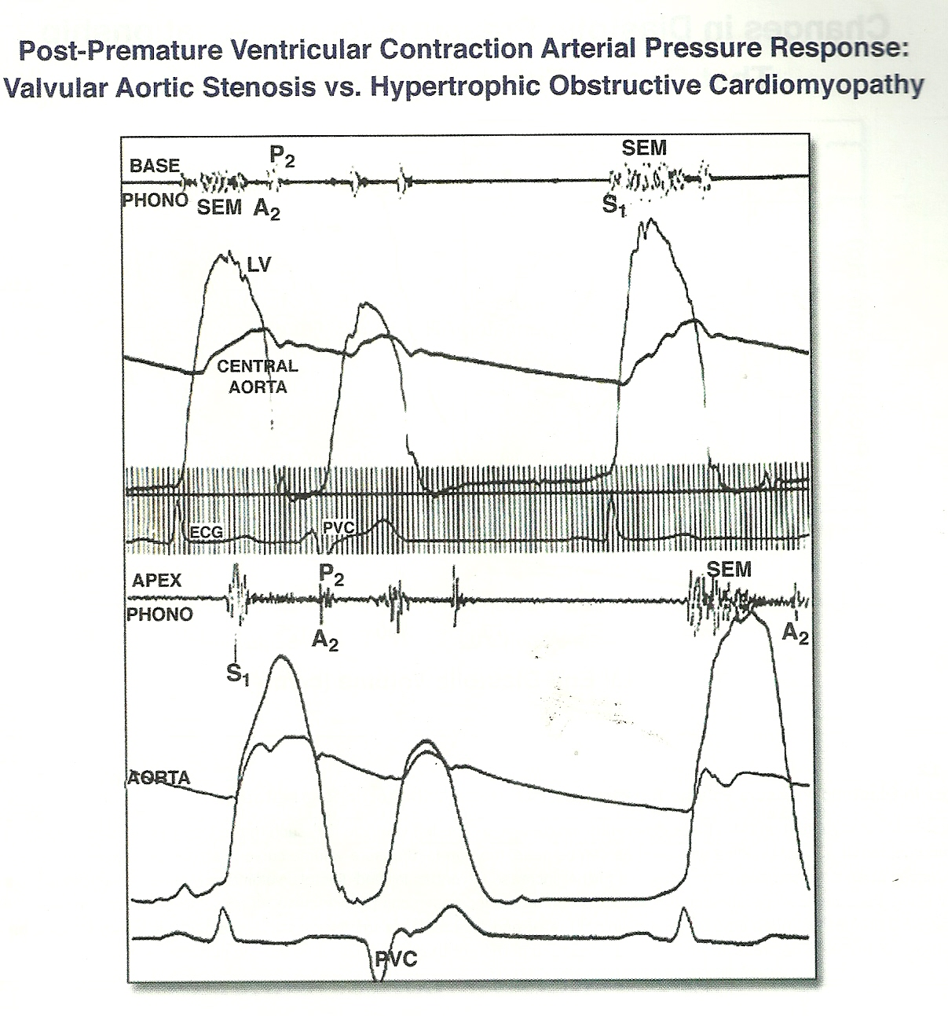

Slide 138
Q27)Gallavardin dissociation –Pick the wrong statements
1)Seen in calcified aortic stenosis but not aortic sclerosis
2)Seen in calcified aortic stenosis and aortic sclerosis
3)Seen in AS of rheumatic etiology
4)Due to periodic wake phenomenon

Slide 139
Gallavardin dissociation
Aortic valve calcification-Stenosis & Sclerosis (Not commisural fusion)
Periodic wake phenomenon
Mixed frequency ejection sound @base(Non laminar turbulent flow)
High frequency vibration of fibroelatic aortic cusps transmitted to LV cavity-Musical at apex

Slide 140
Aortic Sclerosis vs Aortic Stenosis
Early to mid peaking
Pulse –Not late leaking/low volume
Normal split S2
A2 intensity not muffled
No heaving apex

Slide 141
AS vs MR

Slide 142
Q28)All are suggestive of AS of rheumatic origin except?
1)History of rheumatic fever
2)Absence of other valvular involvement
3)Absence of AEC
4)A2 intensity accenuated

Slide 143
In RHD MV>AV>PV>TV (Haemodynamic shear stress)

Slide 144
Q29)All are suggestive of severe AS clinically except?
1)Low volume slow rising carotid
2)Soft S1
3)Heaving apex
4)Paradoxical split
5)Late systolic peak

Slide 145
Why Severe AS clinically.
Symptomatic – angina, syncope, CHF
Low volume slow rising carotid.
Heaving apex with S4 in young patients.
Thrill in children gr > 50
Paradoxical split = gr > 100, LVSP > 160
Late systolic peak gr > 75
Colon) – occur in severe AS, correct by AVR

Slide 146
Q30)Silent AS is associated with all conditions except
1)CCF
2)MS
3)Tricuspid disease
4)Anaemia

Slide 147
Conditions where AS severity likely to be under assessed
Heart Failure
Associated proximal obstruction – Severe MS, TS, Severe TR, PAH
Elderly patients
Hypertension

Slide 148
AS with LV dysfunction
Contractile dysfunction
Afterload mismatch (Laplace law- increased wall stress)
Reduced preload(Thick non compliant LV)

Slide 149
Dilated LV in AS
1)LV dysfunction
2)AR
3)MR
4)Chest wall deformity(Pectus excavatum/Scoliosis)

Slide 150
Summary of AS evaluation
Valvular, Subvalvular, supravalvur ?
Rheumatic, Bicuspid AV, Degenerative
Ejection Click of BAV
? Severity
Associated lesions. coarctation in BAV with AS may be missed!!

Slide 151
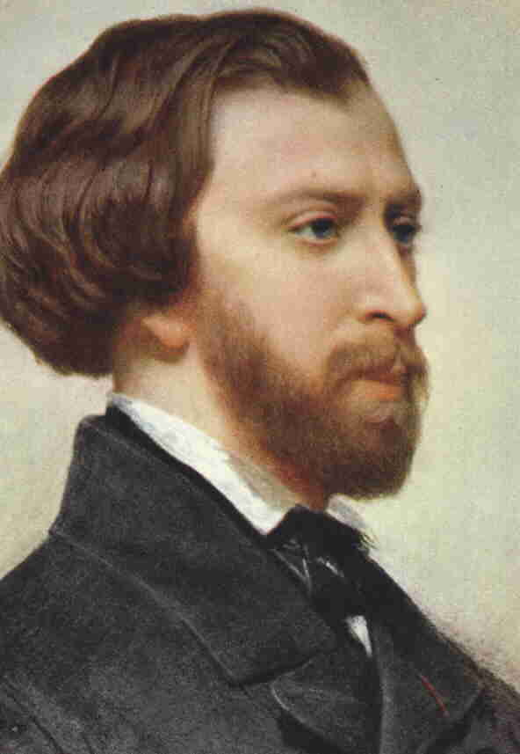
Q31)Can you identify these two gentleman & their contribution to valvular heart disease?

Slide 152
What is common to both of them?

Slide 153
Only 2 non doctors in whose names are given to peripheral signs of Aortic regurgitation

Slide 154
AORTIC REGURGITATION
Volume overload → compensatory mechanisms.
LV EDV increases without increase in diastolic pressure due to increased compliance.
Increased afterload
Increased chamber volume,increased systolic pressure
Increased systolic wall stress
STARTS AS VOL OVERLOAD-
ENDS AS VOL+PRESSURE OVERLOAD
Elevated Ao. syst pressure
Lowered Ao. diastolic pressure

Slide 156
c/c Vs a/c AR-hemodynamic response
Variable | A/c AR | C/c AR | c/c AR decompensated
LVEDV | Slight ↑ | marked↑ | Marked ↑
LV compliance | normal | increase | Increased
LVEDP | Marked ↑ | modest↑ | Marked increase
Forward stroke volume | decreased | normal | decreased
Aortic systolic presure | normal | increased | increased
Pulse pressure | normal | increased | normal
Peripheral vascular resistance | increased | decreased | increased

Slide 157
Clinical features
Asymptomatic phase longer.
Angina in 20% patients
Nocturnal, associated flushing,diaphoresis.
Decreased perfusion-low aortic diastolic pressure
Increased myocardial oxygen demand
Associated coronary atherosclerosis
Osteal coronary narrowing in syphilitic AR, takayasu arteritis
ANGINA in AS vs AR – Increased LVEDP(Reduced CPP) , Reduced DBP(Reduced CPP)
Palpitations-
awareness of forceful ventricular contraction, VPCs -> distress
Ventricular arrhythmias in decompensated stage
Dyspnoea late symptom(Only when LV fails)
Syncope-5 to 10%

Slide 158
Q32)Collapsing pulse –Pick the wrong statements
1)Can be seen in hyperdynamic state
2)Is seen in Severe free flowing AR with good LV systolic function
3) Is seen in Severe free flowing AR irrespective of LV systolic function
4)In AR signifies aortic run off and emptying of arteries
5)Best appreciated in carotid

Slide 159
Physical examination
Pulse- Normal-High vol-Collapsing pulse
Collapsing pulse/
Watson’s waterhammer pulse/Corrigan pulse
A pulse that is bounding and forceful, rapidly increasing and subsequently collapsing, as if it were the sound of a water hammer that was causing the pulse.

Slide 161
Physical findings
Elevated systolic pressure
Low diastolic pressure
Korotkoff sound may persist to zero- intra arterial never < 30
High PVR-DBP when sounds disappear
Low PVR –DBP when sounds muffle
Peripheral signs of AR-large stroke volume in early systole with subsequent run off
Hill s sign-exaggeration of peripheral amplification
Displacement of apex beat(Down and out) = severe AR
Hyperdynamic apex/Can be heaving also

Slide 162
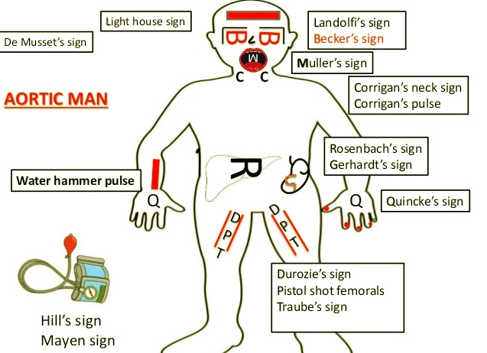

Slide 164
HILLs sign

Slide 165
AR with normal/low pulse pressure
1)Acute AR
2)With AS/Sev MS/PS
3)With CHF
4)With Syst HTN

Slide 166
Q33)Of all the peripheral signs in AR which sign corresponds haemodynamically with diastolic flow reversal?
1)Duroziez’s murmur
2)Hills sign
3)Waterhammer pulse
4)Demusset sign

Slide 167
Peripheral signs of AR can be present in any vasodilatory state
Duroziez murmur(diastolic murmur on proximal compression) most specific for severe AR diastolic run off

Slide 169
Q34)AR with no peripheral signs is seen with assocaited all except
1)Mild AR
2)LV dysfunction
3)MS/PS
4)PAH
5)Rheumatic etiology

Slide 170
S1-soft
Increased LVEDP-earlier closure of MV
Elevated diastolic pressure-less valve excursion
S2
Soft A2 –valve structurally abnormal
Delayed A2-prolonged LV ejection time
Lod A2(Tambour A2)- Root dilatation, BAV, TOF with AR, Subpulm VSD + AR
S3
in failure
Can occur even in presence of MS- rapid LV filling from aorta
S4-
Suggest decreased LV compliance & increased LVEDP

Slide 171
Early diastolic murmur of AR
high pitched in mild to moderate, pitch decreases as severity increases.
Duration
correlates with severity in most cases
severe AR can have shorter murmur due to high LVEDP
Murmur shorter in decompensation
Murmur in 3rd RICS louder than 3rd LICS -AR due to aortic root disease.
rightward and superior displacement of dilated proximal aorta.
Seagull murmur-eversion or perforation of a valve cusp
Notes:
Proctor Harvey

Slide 173
Functional Systolic murmur
AEC(Valvular)

Slide 174
Causes of Ejection systolic murmur(Mid systolic murmur)
Flow across stenotic valve(Late peaking)
Flow across sclerotic valve(50% above 50 years)
Flow across non stenotic structutrally abnormal valve(Eg-BAV)
Increased flow across the valve
Vasodilatory states(Early rapid ejection)
Flow to dilated vessel
M/C murmur heard over precordium

Slide 175
Q 35)All are causes of Early diastolic murmur except?
1)AR
2)PR
3)Truncal regurgitation
4)Docks murmur
5)Austin Flint murmur

Slide 176
Systolic ejection murmur in AR vs AS + AR
ESM IN AS + AR
Systolic Thrill precordium + carotid
Murmur length Long
Time of peaking Late
ESM IN AR
Carotid may be there
No precordial thrill
Short
Early

Slide 177
MR begets MR but AR doesn’t easily beget AR

Slide 178
Q 36)All are suggestive of AR of rheumatic origin except?
1)Ascending aorta dilation
2)Coexisting mitral valve involvement
3)History of rheumatic fever
4)Nodular thickening of valve

Slide 179
AR along Right Sternal border – usually missed !!
Cole Cecil murmur
AR murmur audible only at apex
Marfan’s
Annuloaortic ectasia
Syphilis
Aortic Aneurysm
Ankylosing spondylitis
Rheumatoid arthritis
AR with TOF

Slide 180
Austin Flint murmur
low pitched,mid or late diastolic murmur
Mechanism
AR jet pushing AML to partially closed postion
AR jet hitting AML causing it to flutter
2 jets in LV(from LA and Ao) hitting each other causing turbulence
Diastolic MR
AR jet hitting LV free wall
Severity of AR and AFM
Mild-absent
Moderate-may be present in late diastole
Severe-earlier in timing,extend into presystole
Very severe AR-premature closure of MV-absent presystolic component

Slide 181
Differentiating MS from Austin Flint Murmur
MS
S1 loud
OS +
LV S3 Never
Presystolic accentuation yes
PAH ++
Diastolic Thrill +
AF
Austin Flint
Soft
-
+
No
-
-
SR

Slide 182
Q37)All are suggetive of clinically severe AR except
1)Duroziez murmur
2) Length of murmur > ½ diastole
3)Rough quality of murmur
4)Heaving apex

Slide 183
Why severe AR
Bisferiens character in isolated AR
Peripheral signs of AR- Durozeiz
Cardiomegaly, hyperdynamic impulse
Length of murmur > ½ diastole
Rough quality than high pitched (Braunwald)
Gr 3 or more murmur
Mid + Late diastolic Austin Flint murmur (Braunwald).

Slide 184
Summary of AR evaluation.
Acute vs C/C AR?
? Valvular , ? Vascular, Sub-aortic obstruction
Quality of S2 in AR
? Murmur along right sternal border
Severity?
MDM at apex – MS vs AF murmur
LV dysfunction – S3?
ESM in aortic area- ? AS , Coexisting other lesion

Slide 185
TRICUSPID REGURGITATION
GI symptoms,inappropriate fatigue/exercise intolerance
Pedal edema/ascites
JVP -obliterated x descent, prominent CV wave (systolic wave), tall V waves and prominent y descent
Functional>Secondary>Primary

Slide 186
Q38)Identify the sign?

Slide 187
Lancisi sign

Slide 188
Q39) All are causes of tall v wave in JVP except?
Severe TR
ASD with MR
Gasul VSD
Gerbode VSD

Slide 189
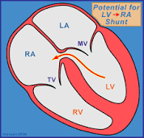
V wave in JVP –systolic filling to RA
Tall v wave
1)Moderate to severe TR (RV to RA)
2)ASD with MR (LA to RA)
3)Gerbode VSD (LV to RA)
4)RSOV to RA (Ao to RA)
5)Coronary cameral fistula to RA (Cor Art to RA)

Slide 190
HYPERTENSIVE TR –
JVP –cv ,Features of PAH, Systolic hepatic pulsations
High pitched pan systolic murmur maximally audible over the lower left sternal border characteristically increasing with inspiration(Lost/reduced with RV dysfunction)
May have associated RVS3 and MDM(Severe TR)
May become widely audible even upto apex (depending on degree of RV enlargement)
PRIMARY TR
No features of PAH
Murmur -low to medium pitched- soft and has a late systolic decrescendo due to equalisation of pressures between RV and RA.
Inspiratory augmentation is usually less striking

Slide 191
Hypertensive vs Non hypertensive(Organic) TR
Hypertensive TR
Organic TR
Pansystolic usually
High frequency murmur
Rapid y descent in JVP, No slow
3/3 LPH – sustained
Non pansystolic
Low frequency
Slow y descent may be seen if TS
Hyperkinetic without LPHncreased duration

Slide 192
TRICUSPID STENOIS
Etiology -Rheumatic TS (almost always occur with mitral valve disease and associated aortic valve disease),Carcinoid disease,Congenital(Ebstein’s)
Left heart symptoms will be attenuated
Clinical picture-low cardiac output and systemic venous congestion.
Fatigue, pedal oedema and abdominal distension
AF is common

Slide 193
Low volume pulse
JVP will be elevated -“a” waves will be prominent and the
Y descent will be slow because of the slow emptying of blood from RA to RV
Presytolic expansion of liver
Auscultation over the lower left sternal border will reveal a mid diastolic murmur, characteristically increasing with inspiration (Carvallo’s sign).

Slide 194
Q40)Name 2 right heart conditions where associated sounds/murmurs will reduce with inspiration?

Slide 195
1)Pulmonary valvular ejection click(dommoing position of valve at end of inspiration –reduced valvular excursion)
2)TR murmur in presence of TS(Reduced RV-RA gradient with inspiration)

Slide 196
PULMONARY REGURGITATION
Functional>Secondary to PAH>Congenital(low pressure)/
Post OP(TOF with trans annular patch repair)
Left 2/3rd parasternal pulsations +/- LPH

Slide 197
Hypertensive PR vs
Non-hypertensive PR
Timing Early diastolic,decrescendo
Length Short to pandiastolic
Pitch High
Conduction Lower Sternal border
Signs of PAH yes
Mid diastolic(PressureEq at mid to late diastole)
never pandiastolic
Low frequency, rumbling
Usually localised to PA
No signs of PAH.

Slide 198
LOUD P2
1)At PA P2>A2
2)P2 heard beyond PA
3)Palpable P2

Slide 199
For a given closing pressure P2> A2
PA more anterior, pulmonary valves more longer,more surface area

Slide 200
PULMONARY STENOSIS
Can be valvular, supra valvular and subvalvular / infundibular
“Mobile dome-shaped” pulmonary valve stenosis is the most common type

Slide 201
?Syndromic
Noonan syndrome- dysplastic pv( three thickened immobile cusps without commissural fusion and a non dilated pulmonary trunk)
Congenital Rubella Syndrome, William syndrome and Alagille syndrome (The predominant site of obstruction is usually in the pulmonary artery and the branches -supra valvular or peripheral PS).

Slide 202
Round bloated facies – infants with mobile dome shaped PS
JVP- prominent a wave(presystolic)
LPH – moderate-sev PS

Slide 203
Systolic thrill -second left intercostal space with radiation upward and to the left because the intra pulmonary jet is directed upward and towards the left pulmonary artery
Pulmonary valvular ejection click –phasic , better heard in expiration(absent with immobile dysplastic valve)
S1 – EC interval –correlates inversely with the degree of stenosis

Slide 204
Severity –directly correlates with length of the ejection systolic murmur
Mild PS- systolic murmur symmetric and ends before the A2. S2 split preserved.Normal P2 intensity
Mod PS- systolic murmur ends at A2.S2 widely split(variable).P2 intensity reduced
Sev PS- murmur tends to be longer,late peaking and extend inaudible. S2 widely split with muffled P2
Very severe PS- murmur has an asymmetric kite –shape (late peaking) reaching upto a delayed inaudible P2. A2 will also be inaudible as the loud murmur extends well beyond A2

Slide 205
Q41)Pick the correct statements?
1)In Sev AS ,S2 is widely split with murmur extending beyond A2
2) In Sev AS ,S2 is paradoxically split with murmur extending beyond P2
3) In Sev PS ,S2 is widely split with murmur extending beyond A2
4) In Sev PS ,S2 is paradoxically split with murmur extending beyond P2

Slide 206
Q42)Which heart sound is heard in TOF
1)Aortic Valvular EC
2) Aortic Valvular EC
3) Pulmonary Valvular EC
4) Pulmonary Vascular EC

Slide 207
Multiple & Mixed Valvular Heart Disease
MULTIPLE VHD – combination of stenotic and regurg lesions occurring on > 2 valves.
MIXED VHD – Stenotic and regurg lesions on same valve.
51% cases rheumatic
Degenerative 41%

Slide 209
Hemodynamic interactions that may impact on the diagnosis of multiple and mixed VHDs
low-flow, low-gradient stenosis is frequent.
(2) mixed VHD may be associated with increased anterograde flow and gradient.
(4) any severe valvular lesion may induce or increase upstream secondary MR or TR.
(3) the continuity equation is inapplicable when transvalvular flows are unequal.
(5) pressure half-time– derived methods may be invalid in the presence of altered LV compliance/relaxation in the presence of mixed VHD.

Slide 210
1. MS + MR
Rheumatic heart disease. MAC(pred MR),Congenital mitral valve disease
MR enhance features of MS(Increase mitral inflow)
Identify if early diastolic sound is Opening snap or S3
murmur

Slide 211
Opening snap-loud,high pitch,widely audible,crisp , best heard midway of LSB & apex
LV S3- Low pitch,left lateral,localized at apex,may be palpable
MDM(MS)- Follows OS, may have presystolic accenuation
MDM(MR)-Folows S3,decrescendo,no presystolic accenuation
S1-often loud in MS, often soft in MR

Slide 212
Q43)In context of MS+MR, all are features of predominant MR except
1)LV S3
2)MDM without presystolic accenuation
3)Wide split S2
4)Loud S1

Slide 213
WHO PREDOMINATES?
MS – Loud S2, OS, Presystolic accenuation
MR – LV type cardiomegaly, Hyperdynamic apex,
LVS3,PSM@apex,Wide split S2(Early A2)

Slide 214
2. MS + AR
MS being proximal affect assessment of AR.
Severe MS & PAH – 1/3rd have reduced LV preload → low cardiac output → pulse pressure less wide & peripheral signs less than expected.
When to suspect MS in Severe AR?
1.AF
2.Loud S1(Absence of non soft S1)
3.OS
4.Diastolic thrill
5.Presystolic accentuation of MDM
6.PAH

Slide 215
3. MS + AS
MS + SEVERE PAH & TV disease → Reduce CO → UNDER ESTIMATE severity of AS.
ESM shorter, softer
LV S4 absent due to MS.
Severe AS → LVH → Elevated LVEDP → Increased LAP(Transmitral gradient depend on stenosis/ flow across valve) →MS more symptomatic
A2-OS not reliable(Increased LAP/Prolonged IVR)Murmur short

Slide 216
MS + AS

Slide 217
4. AS + AR
Bisferiens Pulse → Dominant AR
Peripheral signs of AR masked
Systolic decapitation of BP, < 130 → AS
(Less reliable in elderly- Inelastic aorta & reduced compliance of vasculature)
Heaving apex & late peaking Murmur → AS
Systolic Thrill → AS

Slide 218
Q44)In context of AS+AR, all are features of predominant AS except
1)Systolic thrill
2)Heaving apex
3)Diastolic decapitation
4)Late peaking murmur

Slide 219
Q45)Of all multiple VHD’s the worst possible combination haemodynamically is
1)MS + MR
2)AS + AR
3) MS+ AR
4)AS + MR

Slide 220
5. AS + MR - Worst hemodynamic combination.
Mechanism of MR in AS
Annular dilatation
Ischemic MR
MAC
Primary MR
Chordal rupture

Slide 221
How AS affect MR
How MR affect AS

Slide 222
Propably the worst haemodynamic combination
Sev AS-Increase LVSP-Increase lv-la gardient in systole
Regurgitant fraction increases and forward stroke volume comes down

Slide 223
AS + MR
As both affect same phase of cardiac cycle(systole) one influence the other strongly.
MR tends to be progressive.
Finding of MR accentuated.
Findings of AS attenuated.
AF, PAH, Cardiomegaly, LA pulsation, LV S3, wide split → MR

Slide 224
6. AR + MR
Severe volume overload caused by the two regurgitations + some pressure overload associated with AR, is usually poorly tolerated.
AR → High systolic Pr → High LV-LA Gr → MR more prominent
FINDINGS OF MR ACCENTUATED BY AR
MR → reduce forward stroke volume → Systolic decapitation of BP→ diastolic (peripheral signs of AR attenuated)BP, peripheral signs of AR usually unaffected.

Slide 225
MR- S2(Wide split),LV S3, MDM(decrescendo),AF,Sig PAH
AR –S2(Narrow split),MDM(mid diastolic &presystolic)

Slide 226
7.Tricuspid valve disease & left sided lesions
Reduction in LA volume and pressures.
Left heart symptoms come down with the onset of significant organic tricuspid valve disease.
The trans -mitral gradient comes down -MS underestimated.
. Low cardiac output due the proximal tricuspid valve disease- attenuate AS/AR findings(Even with severe AS, the ejection systolic murmur tends to become short and soft)

Slide 227
Questions in VHD

Slide 228
THANK YOU

