Slide 1
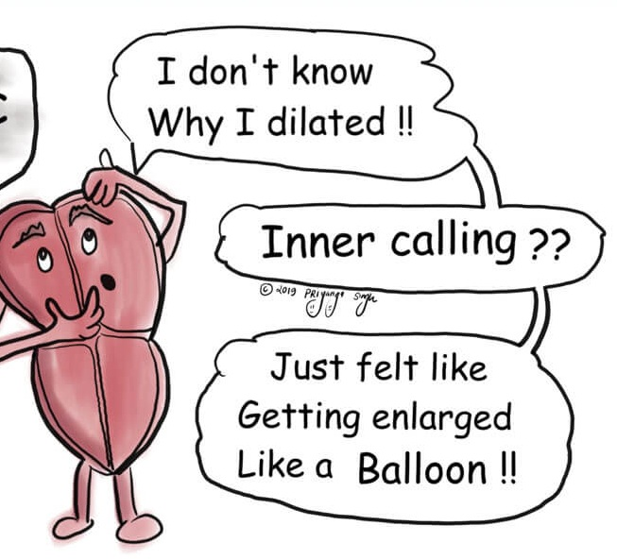
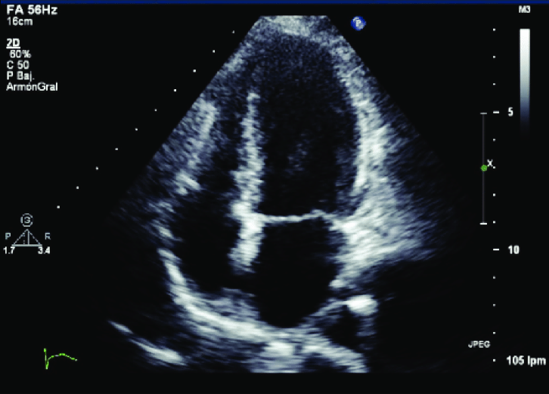
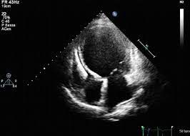
Dilated Cardiomyopathy
Dr ArunJude Alphonse
DM Cardiology Resident
Govt TDMC Alappuzha

Slide 2
Cardio –Heart Myo – muscle Pathy –Disease
Term first used by Dr Wallace Brigden-1957
“Disease of myocardium of non-coronary origin”
Intrinsic disease of the cardiac muscle

Slide 3
AHA scientific statement-2006
Cardiomyopathies are a heterogeneous group of diseases of the myocardium associated with mechanical and/or electrical dysfunction that usually (but not invariably) exhibit inappropriate ventricular hypertrophy or dilatation and are due to a variety of causes that frequently are genetic. Cardiomyopathies either are confined to the heart or are part of generalized systemic disorders, often leading to cardiovascular death or progressive heart failure–related disability

Slide 4
AHA scientific statement-2006

Slide 5
AHA scientific statement-2006
….no past, present, or future classification of cardiomyopathies is likely to satisfy the purpose of all users

Slide 6
ESC statement -2007
A myocardial disorder in which the
heart muscle is structurally and functionally abnormal, in the absence of coronary artery disease, hypertension, valvular disease and congenital heart disease sufficient to cause the observed myocardial abnormality.

Slide 7
ESC statement(cont)

Slide 8
MOGES classification-2013(WHF)

Slide 10
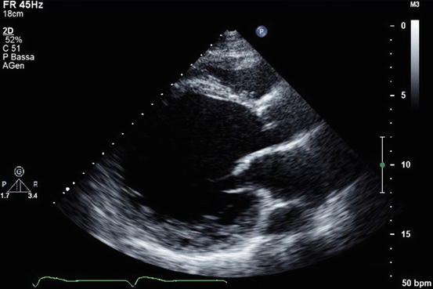
DCM – Dilated LV with systolic dysfunction
not due to valvular causes/CAD

Slide 12
Genetic causes – familial/non familial
30 % first degree relatives likely to have DCM(clinical/subclinical) –familial DCM
30% of familial DCM – gene mutation identified
M/C gene mutation -TvTTN(truncated variant of Titin)

Slide 15
Pancardiomyopathy screening- 150 associated with all cardiomyopathies
Inheritance-AD/AR/XL/Mitochondrial
Age related penetrance/variable penetrance
Variable expression

Slide 16
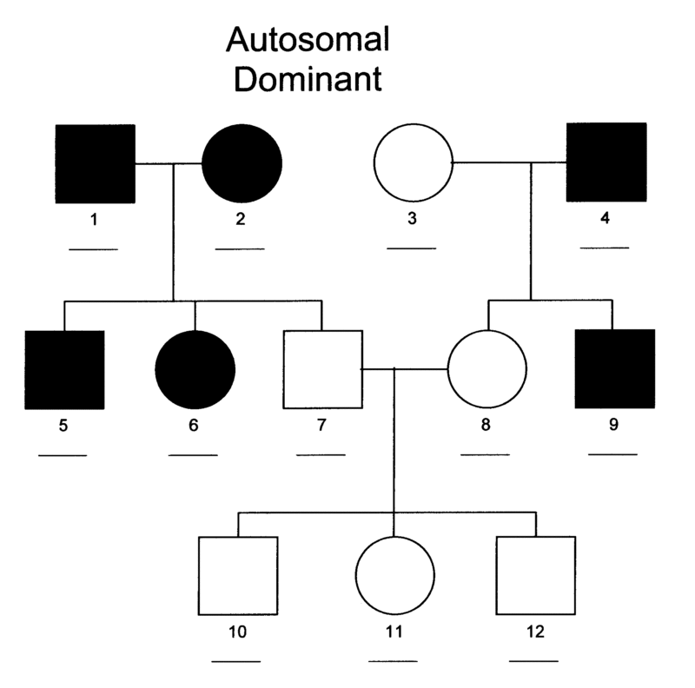
AD inheritance-MC
Pure DCM –TTN,MYH7,troponin
DCM+Conduction block-LMNA,SCN5A,Desmin
Arrhythmogenic –Troponin,LMNA

Slide 17
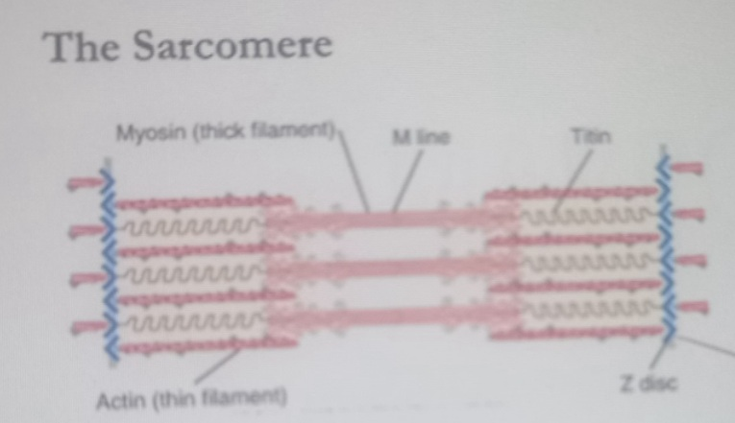
Truncation of TITIN – 15-20% of all DCM

Slide 18
AR – Trop I
Mitochondrial –Mutations in mitochondrial tRNA
DCM + SNHL , maternal inheritance
X linked – Dystrophin mutation
(Duchene muscular dytrophy , Beckers muscular dystrophy)
Barth syndrome –
Congenital DCM,short stature,neutropenia(Tafazzin mutation)

Slide 19
Spectrum of DCM

Slide 20
Symptoms
Maybe assymptomatic for decades
Usual age of presentation-4th decade(4th-7th decade)
HF symptoms –once symptomatic may have rapid progression
Arrythmia
SCD
Angina (microvascular dysfunction)

Slide 21
Signs
Tachychardia ,tachypnea
Elevated JVP ,dependant edema
Displaced apex beat(down and out) ,normal-heaving in character
LV S3
Basal crepitations

Slide 23
Diagnosis
ECG
Echo
CAG
CMR
Genetic testing

Slide 24
ECG
LV hypertrophy/volume overload
nonspecific ST-T wave changes,
bundle branch block ,condunction abnormalities
Pathologic Q waves may be present, although their presence should also raise the possibility of advanced atherosclerotic heart disease
In advanced cases with extensive fibrosis, low-voltage limb leads may be seen

Slide 25
Diagnosis?

Slide 26
Goldberger's electrocardiographic triad
SV1 or SV2 + RV5 or RV6 ≥ 3.5 mV
Total QRS amplitude in each of the limb leads ≤ 0.8 mV
R/S ratio < 1 in lead V4
70% sensitive and > 90% specific for detecting DCM + severe left ventricular (LV) dysfunction

Slide 27
ECHO……..
LV systolic dysfunction that may also show biventricular dysfunction in at least one third of cases
LV wall thickness is almost always within the normal range
the LV mass is invariably increased
Most commonly, global LV hypokinesis
but regional wall motion abnormalities may also be seen
septal dyskinesis in those with left bundle branch block (LBBB)
Disproportionate thinning of a dyskinetic wall should raise the possibility of CAD
Mitral and tricuspid regurgitation is frequently present and may be severe (impaired leaflet coaptation )

Slide 30
Coronary angiography
should be considered in all patients who have
Risk factors for CAD
Cigarette smoker
prominent family history of early-onset CAD
Familial hypercholesterolemia
Age above 40 years in males and above 45 years in females
functional significance of any obstructive coronary lesions found should be carefully evaluated insofar as their presence may be coincidental to DCM

Slide 31
Cardiac magnetic resonance imaging (CMR) :
Pattern of non transmural delayed gadolinium enhancement in a noncoronary distribution in a dilated left ventricle suggests a nonischemic cause
Certain conditions, such as sarcoidosis, may have a rather typical appearance
CMR is able to evaluate the extent of myocardial fibrosis in DCM
Biopsy
Genetic evaluation

Slide 36
Management
GDMT for HFrEF

Slide 37
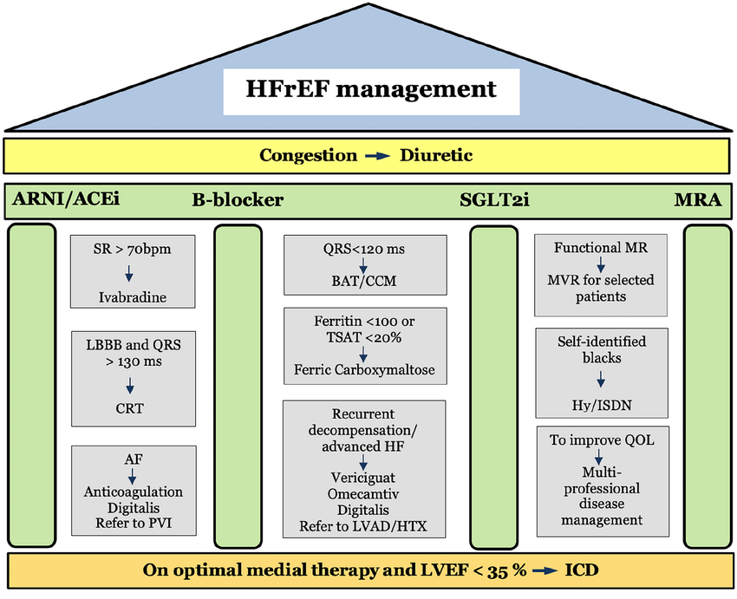

Slide 39
Summary
One gene –variable manifestations
AD –TvTTN –MC mutation
Only arrythmia can be a manifestation
Work up for a genetic cause
Pancardiomyopathy gene screening
GDMT

Slide 40
Q1)
MH OH GAD EMYH7 S C4 stands for?

Slide 41
Q2)Most common cause for DCM
1)Genetic
2)Idiopathic
3)Inflammatory
4)Drug induced
5)Secondary to systemic diseases

Slide 42
Q3)Most common genetic abnormailty associated with DCM?
1)Troponin mutation
2)Desmin muatation
3)Truncated variant of Titin
4)SCN5a mutation

Slide 43
Q4)Components of Golberg’s ECG triad are all except?
1)SV1 or SV2 + RV5 or RV6 ≥ 3.5 mV
2)Total QRS amplitude in each of the limb leads ≤ 0.6 mV
3)Total QRS amplitude in each of the limb leads ≤ 0.8 mV
4) R/S ratio < 1 in lead V4

Slide 44
Q5)Following patterns of LGE in CMR suggest ischaemic etiology except
1)Sub endocardial
2)Transmural
3)Mid myocardial
4)All of the above

Slide 45
Q6)All are pillars of management of HFrEF except
1)Betablockers
2)ACEI
3)MRA
4)SGLT2
5)Statins

Slide 46
Thank You

