Slide 1
EISENMENGER SYNDROME
KAPIL R
DEPT OF CARDIOLOGY

Slide 2
DEFINITION
CAUSES
CLASSIFICATION ( CLINICAL /HEMODYNAMIC/PATHOLGICAL)
CURRENT CHANGES & RATIONALE
MODES OF PRESENTATION & CLINICAL FEATURES
NATURAL COURSE
COMPLICATIONS & SURVIVAL
ASSESMENT (NON INVASIVE & INVASIVE )
TREATMENT
PREGNANCY
PRIMARY PHT OF NEW BORN
EISENMENGER & MAJOR SURGERY

Slide 3
DEFINITION
VICTOR EISENMEGER (1897)- 1st PM description of 32 y ♂ – VSD + Cyanosis
EISENMENGER SYNDROME : PHT due to a high (PVR) with reversal or BD shunt → aorto-pulmonary / ventricular / atrial level
EISENMENGER COMPLEX (term- Maude Abott) :
VSD with reversed shunt +PHT in absence of pulmonary stenosis
Reversed shunt was initially attributed to overriding of aorta → PAUL WOOD - ↑ PVR

Slide 4
EISENMENGER SYNDROME- CAUSES
SIMPLE
Pre tricuspid - ASD
Post tricuspid - VSD / PDA /
AP Window / AVSD
COMPLEX
Ventricular –SV
Great vessel -Truncus / d-TGA
SURGICAL PALLIATION Waterston (AA-RPA)
Potts shunt ( DA-LPA) Central shunt (AA – MPA)

Slide 5
CAUSES & FREQUENCY OF EISENMENGERS SYNDROME ( PAULWOOD’S STUDY)
DEFECT | TOTAL NO. OF CASES | NO. WITH EISENMENGER RN. | % OF CASES WITH EISENMENGER
1) PDA | 180 | 29 | 16
2) AP WINDOW | 10 | 6 | 60
3) TRUNCUS A. | 4 | 4 | 100
4) TGA WITH VSD | 12 | 7 | 58
5)CCTGA WITH VSD | 3 | 3 | 100
6) SINGLE VENTRICLE | 6 | 6 | 100
7) COMMON AV CANAL | 21 | 9 | 43
8) ASD | 324 | 19 | 6
9) PAPVC | 3 | 0 | 0
10) TAPVC | 6 | 1 | 17
11) VSD | 136 | 21 | 16
UNCERTAIN | 22 | 22
TOTAL | 727 | 127 | 17.5
Notes:
127 CASES STUDIED BY WOODS FOR 11 YRS .NEARLY ALL WERE CATHETRIZED ,ANGIOCARDIOGRAPHY DONE WHEN AND LATTERLY DYE DILUTION CURVES HAVE BEEN RECORDED.
18 DIED AND NECROPSY OBTAINED IN 15

Slide 6
INDIAN DATA SCTIMST (1976-1992 ) N=201
LESIONS | FREQUENCY | PERCENTAGE %
VSD | 67 | 33
ASD | 60 | 30
PDA | 29 | 14.4
VSD +PDA | 6 | 3
VASD+ASD / Primum ASD | 4,4 | 2,2
ASD +PDA, shunt lesion +MS, L-TGA +VSD , TAPVC | 1,1,1,1 | 0.5,0.5,0.5,0.5
Shunt lesion +AS,shunt +CoA ,complete AVCD ,d-TGA ,AP window | 3,3,3,3,3 | 1.5,1.5,1.5,1.5
DORV+VSD | 8 | 4
Single atrium , Sinus venosus ASD | 2,2 | 1,1

Slide 7
CLINICAL CLASSIFICATION ( GROUP -1 )
1.EISENMENGER :
Intra& extra cardiac defects / S→ PA shunt → progress - ↑ PVR → bidirectional → shunt reversal (R→L)
Cyanosis / polycythemia / multiorgan involvement
2. L→ R SHUNTS :
Correctable / non correctable
Moderate defects , PVR mild ↑ / L→ R shunt
No cyanosis
3. PAH with coincidental CHD
PVR ↑ ↑ ↑
Presentation = idiopathic PAH
Small defects (ASD < 2 cm , VSD < 1 cm ≠ PVR)
Cyanosis
4.Post operative PAH
Repaired CHD → PAH persist immediately after Sx / mnths-years after Sx → no significant postop hemodynamic condtions
1.

Slide 8
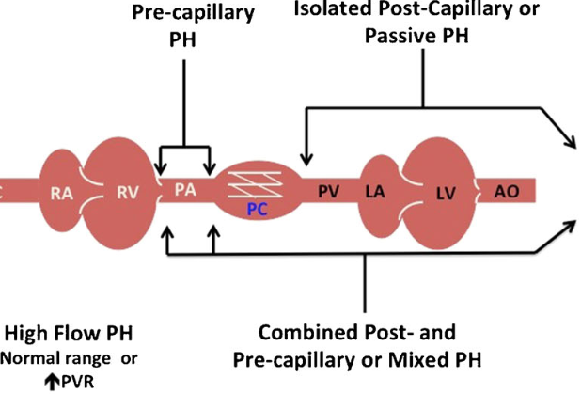
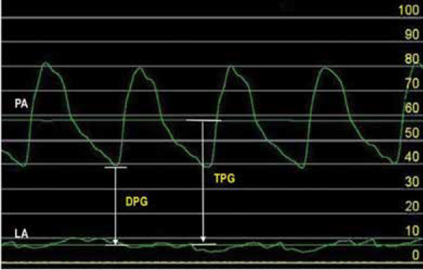
PRE CAPILLARY &POST CAPILLARY HYPERTENSION
DPG = PADP − PCWP / TPG = mPAP − PCWP
TPG → mean PA pressure ( 1. flow – c.o /exercise 2. filling pressure 3. pulsatile flow in PA – PASP & mPAP – altered )

Slide 9
CURRENT CLASSIFICATION( 6th WPSH →ESC 2020 )
>20
>20
>20
Shunt lesions prior to & after repair (Eisenmenger )
Complex CHD ( SV)
LV dysfunction
CORTRIATRIATUM
Pulmonary vein obstruction
Gr 1- PAH
Gr 2- left heart
Gr 3- lung
Gr 4 – CTEPH
Gr 5 –MultiF.+complex CHD
Adjunct criterion - children

Slide 10
6th WSPH CHANGES – RATIONALE OF CHANGES
Group 1 - PAH
Sub Group 1
Long term responders to CCB
Sub Group 2
Vein- Pul. Veno occlusive disease
Capillary- hemangiomatosis
SITBON criteria -Acute pulmonary vasoreactivity( idiopathic, hereditable or drug-induced PAH )
mPAP ↓ ⩾10 mmHg / absolute fall ⩽40 mmHg / ↑ or ↔ c.o
Long-term response to CCBs – NYHA I/II + sustained benefit – 1 yr
PRE POST CAPILLARY
Good response to PAH targeted Rx
Complex CHD – SV → ↑ LVEDP
Segmental PAH
Poor response to PAH targeted Rx

Slide 11
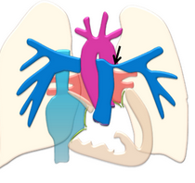
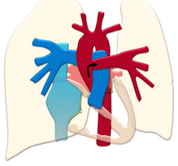
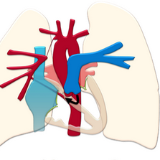
SEGMENTAL PAH
LARGE VSD + LEFT PA stenosis
segments of the lung / part of ≥ 1 lobe /single lung (≠ entire lung )→ PH
segment of pul. Vasculature – non hypertensive
Pulmonary atresia+ large VSD
Hemitruncus
Atresia of single PA
Large post TR shunt ( VSD / AVSD / PDA/ AP window / Truncus )
↓
Eisenmenger + branch PA stenosis
surgical shunts (eg, Potts or Waterston shunt)
Alagille syndrome→ branch PA stenosis
↓
PH in unobstructed segments
HEMITRUNCUS
RT PA atresia

Slide 12
Current AHA 2018 guidelines adapted → ACHD –AP classification ?
ANATOMY (complexity of lesions )
PHYSIOLOGY
Simple – small OS-ASD / VSD /PDA + repaired defects
Moderate - primum ASD ,AVSD , ALCAPA
Great – cyanotic HD
Aortopathy , arrhythmia , VHD ,end organ failure , exercise capacity , hypoxia , PHT , venous & arterial stenosis , NYHA class
A/B/C/D

Slide 13
HEATH EDWARDS CLASSIFICATION
Pulmonary venous hypertension never > Gr III- reversible with Rx
GRADE I – Medial hypertrophy in small PA
GRADE II – Medial hypertrophy + intimal proliferation
GRADE III- Progressive intimal fibrosis + lumen occlusion of smaller PA
GRADE IV- Plexiform lesions in muscular arteries & plexiform capillary channels
GRADE V – Complex plexiform l +angiomatosis + cavernous lesions
GRADE VI- Necrotizing arteritis & fibrinoid necrosis
REVERSIBLE

Slide 14
MECHANISM-PAH
Passive transmission of PA pressure
Vasoreactive pulmonary hypertension ( young pts india – 6-8 % )
Pulmonary vascular disease (structural changes )

Slide 15
PATHOGENESIS
ARTERIAL REMODELLING
ENDOTHELIAL DYSFUNCTION
Failure of regression - thickened muscular arteries (fetus)
Persistence of long densely packed elastic fibres in large pulmonary arteries resembling aorta
↓Spo2 ( any cause)
Abnormal contractile response of pul. Vasc. to increase flow
Imbalance b/w vasoconstrictor & vasodilators
↑Endothelins,thromboxane A2
↓prostacyclin, NO
L→R shunt
↑ PBF
Endothelial dysfunction & Remodelling
↑ PVR
BD→R-L shunt
PA=Ao
EISENMENGER (cyanosis)
PA>Ao

Slide 16
TYPES OF PRESENTATION
CHF During infancy & cyanosis later
( POST TRICUSPID SHUNT)
Low Level Symptoms-Childhood
PAH In Adulthood
(PRE-TRICUSPID )
Cyanosis From Beginning
(COMPLEX CHD’s-pul.atresa)

Slide 17
CLINICAL FEATURES
SYMPTOM | FREQUENCY
D.O.E | 84%
INCREASED CYANOSIS | 59%
HYPERVISCOSITY | 39%
ANGINA | 13%
SYNCOPE | 10%
CHF | 8%
COMPLICATION | FREQUENCY
HAEMOPTYSIS | 20%
PULMONARY THROMBOEMBOLISM | 13%
STROKE | 8%
CEREBRAL ABSCESS | 4%
I.E | 3%

Slide 18
SYMPTOMS –INDIAN STUDY SCTIMS (n= 201 )
Effort intolerance - 97.5 %
Palpitation - 79.6 %
Oedema - 13.4 %
Haemoptysis - 16.9 %
Syncope - 1.5 %
Squatting - 7.0 %
Angina -4.5 %

Slide 19
FACTORS INFLUENCING PRESENTATION
SIZE
( small / moderate / large )
LOCATION
(Pre & Post tricuspid )
RV COMPLIANCE ( Low & High )
COMPLEXITY
(d- TGA / TA / ECD )
LEFT SIDE
( Mitral atresia / Aortic stenosis )

Slide 20
POST TRICUSPID
PRE TRICUSPID
postnatal fall in PVR
↓
↑ PBF( CHF symptoms / no cyanosis )
↓
PVD ($≅$ 2yrs )- CCF improve / murmur↓ /no cyanosis
↓
suprasystemic PA pressure- R→ L Shunt
↓
Cyanosis, reappearance of murmur and Symptoms
Child → Asymptomatic → RRTI → FTT
↓
↑ PBF
↓
Adolescents - exertional dyspnea & Fatigue (CCF rare)
↓
Suprasystemic PA & RV pressure – R –L shunt
↓
Cyanosis In Adulthood

Slide 21
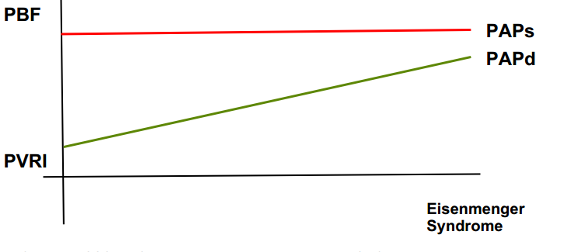
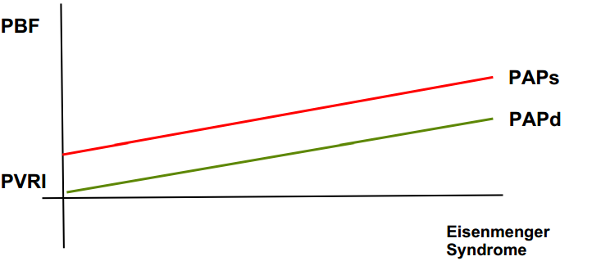
POST TRICUSPID
PRE TRICUSPID
Direction of shunt –RV compliance - no shunt till 3 m
↓
PVR reaches normal by 3 mths
↓
PAH & ES - late in life( large ASD )
High pressure flow from infancy
↓
Failure of medial hypertrophy regression RVH
↓
PAH & shunt reversal at early age
PAH –ASD → acquired or unrelated to ASD

Slide 22
 | EISENMENGER | IPAH
Age of onset | Childhood--> adolescent ( F+ ) | Any age ( F +++ )
Stimulus | Large defect | None
Development of high PVR | Predictable | Not predictable
Progression | Steady | Rapid
Resting cyanosis | ++ | Rare
RVH with strain qR in V1 | Less common | ++
Syncope | + / exercise ind. ↑c.o + | +++ ↓↓ exercise ind. co
SCD | + | +++
Complications | ↑↑ cerebral abcess , arrhythmia | ↓↓
ES behaves better than IPAH ?
sub pulm. ventricle – exposed to ↑ pressures since birth -better RV adaptation - long standing P+V overload
R→ L shunt serves as an excess flow valve → ↑ c.o

Slide 23
ASD
Spontaneous closure
< 3 mm (<3 mnths)- 100% closure - 1½ years
>80% 3- 8 mm - 1½ years
8mm / > 4yrs → spontaneous closure rare
Progressive shortness of breath with exertion
Pulmonary vascular obstructive disease
Sinus venosus defect - 26 %
Isolated OS- ASD - 9 %
Sinus venosus & OP-ASD earlier > OS-ASD
Atrial arrythmia
May be 1st presenting sign - 13% in > 40 years and 52% in >60 years of age
RF:Age at closure( >25 yrs )→ post op AF + / LA > 40mm , MR & TR +
Stroke or other systemic ischemic event

Slide 24
VSD
Cardiac failure
large defects ͠ 6m-1yr ) / RVF – Eisenmenger / LV- VSD + AR )
Spontaneous diminution in size or closure
perimembranous , muscular , < 10 yrs 75% -small VSDs / 83% of muscular defects Malalignment VSD –no spont. Closure
Right or Left ventricular outflow tract obstruction (3-7%)
Hypertrophy of malaligned infundibular septum / RV muscle bundles /AV prolapse (↑ ↑ ↑ RT aortic arch & horizontal RVOT
Aortic regurgitation (10%)
RCC (outlet ) > NCC(perimembranous ) > LCC (rare) → ↓ PVD → earlier Sx
Pulmonary vascular obstructive disease
Infective endocarditis
18.7 per 10000 person yrs , small defects , >20yrs , male

Slide 25
PDA
CCF
Infants < 3mnths –failure / 1-2 yrs → ↑ PVR → failure ↓
Beyond early infancy & > 20-30 yrs – FAILURE rare
Infective endarteritis
2nd decade ↑ / Silent PDA→ recurrent embolism
Pulmonary vascular disease
2nd decade → ↓ CCF
Exercise induced leg fatigue + cyanosis
Aneurysmal formation
Thromboembolism /Dissection /Rupture
Inspiratory stridor / LRLN palsy
Pulmonary artery obstruction
Calcification
1st decade – CCF
2nd decade – IE > CCF
3rd decade – PVD > CCF

Slide 26
GASUL’s PHENOMENON
Large VSD -RVOT obstruction as child grows - CCF improves at expense of cyanosis like TOF Large subaortic VSD
Oblique RVOT angle >40 degrees
Rt aortic arch

Slide 27
COMPLICATIONS
CARDIAC
HEMATOLOGIC
OTHERS
Heart failure
Arrhythmias
Infective endocarditis
Bleeding
Thrombosis
Hyperviscosity
Thrombocytopenia
Renal failure
Hepatic dysfunction
Cerebral abscess
Cholelithiasis
Gout
Paraganglioma

Slide 28
SURVIVAL
Years | % surviving
1 | 97
5 | 87
10 | 80
15 | 77
25 | 42
Survival Pattern(Life expectancy reduced ≈ 20 years )
In IPAH 3YR SURVIVAL < 20 – 30%
Eisenmenger pregnancy – 30-50%
INDIAN DATA - SCTIMST
Level of shunt (atrial, ventricular or aortopulmonary) did not influence survival (P > 0.5)
Years | Actuarial survival %
5 | 87
10 | 79
15 | 77

Slide 29
INDIAN DATA - MORTALITY N=20 ( 9% )
CAUSES | FREQUENCY | PERCENTAGE %
SCD | 6 | 30
CCF | 5 | 25
HEMOPTYSIS | 3 | 15
BRAIN ABSCESS | 2 | 10
UNSPECIFIED | 2 | 10
PREGNANCY RELATED | 1 | 5
CARDIAC CATHETERISATION | 1 | 5
PREDICTORS OF POOR PROGNOSIS
History of syncope at presentation
↑ Mean RAP > 8 mmHg
Systemic Spo2 <85 %

Slide 30
CLINICAL EXAMINATION
GENERAL +VITALS
INSPECTION +PALPATION
Skin signs(per. Telangiectasia , raynauds , digital ulceration )
Clubbing (differential –PDA)
Cyanosis (differential -PDA / peripheral –IPAH )
Pulse N / BP N - ↓ warm peripheries
JVP –Large a ( except VSD / PDA – never suprasystemic )
JVP – N→ INTACT IVS LPH ( ≠ VSD , PDA ) , epigastric puls+
Palpable P2 ( PASP = 75 mm / MS –PASP> 50 )
Loud P2 / click
Absent flow murmur /TR+PR murmur +
P2 Grading 1+ ( A2=P2) 2+ (P2>a2 ) 3+ (P2+ apex)
RV S3 ,hepatomegaly , peripheral edema – RVF ±TR

Slide 31
HIGH VOLUME- LOW PRESSURE SHUNTS
HIGH PRESSURE – HIGH VOLUME SHUNTS
ASD
P/TAPVC
Partial AVCD
Large VSD
PDA
AVCD
TGA
AP window
TRUNCUS
SV
DORV

Slide 32
PALPATION +AUSCULTATION
CLINICAL SIGNS OF MODERATE PAH
LPH ( ≠ VSD , PDA ) , epigastric puls+
Palpable P2 ( PASP = 75 mm / MS –PASP> 50 )
Loud P2 / click
Absent flow murmur /TR+PR murmur +
1+ ( A2=P2) 2+ (P2>A2 ) 3+ (P2+ apex)
RV S3 ,hepatomegaly peripheral edema – RVF ±TR
• Prominent “a + v ” wave
• Hepatojugular reflux
• Grade 3 LPH
• Loud P2 (audible at apex in over 90%)
• Ejection systolic click
• RV S4 (in 38%)
• TR+PR
• Pulsatile liver

Slide 33
Differentiation based on S2
VSD – hyperkinetic → ES | Wide variable split → single loud P2
ASD –hyperkinetic → ES | Wide fixed split S2 → Narrow fixed split S2
PDA- Hyperkinetic → ES | Normal / reverse split → Normal split
IPAH | Narrow split
RV failure | Wide fixed split

Slide 34
ECG
GENERAL
ECG & hemodynamics
ES/IPAH /CTEPH
poor predictors
RAE,RVH (type A – tall R wave in V1 + S wave V5/V6 ) –OS- ASD
LVH→ RVH – PDA/VSD
KATZ-WACHTEL – equiphasic QRS (>40 mm)mid precordial leads –VSD
RV strain + NT- pro BNP< 80→ r/o precapillary HT ( sens 100 % /spec 20 %)
Axis > 110→ PASP> 60mm
qR → RVSD(≈ CMR )
T ↓ (v1,2,3 +aVL ) + S v1 < 2 mm → RAP = 8± 4
RV I > 1.2 mV and R/SVI >7 ↓
↑ PA pressure
CI ↓ - AQRS > 100°, R V6< 1 mV, S - V6 > 0.7 mV, R/S in V6 < 1
qR - V1
P amp+durn - L II
Resting HR
R V1 + S V5/6
QRS &QT duration

Slide 35
CXR
↓↓peripheral pulmonary vessels
Disproportionately ↑↑ MPA
Tortuous hilar arteries
small cardiac size
LA enlargement disappears.
RV enlargement
RA↑ may be enlarged (TR + RVF )
Aortic knob normal to unapparent

Slide 36
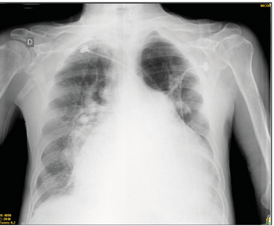
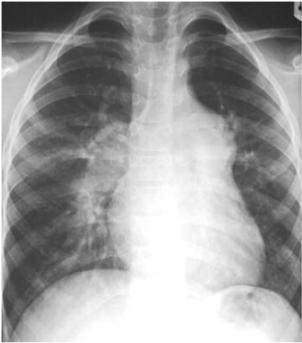
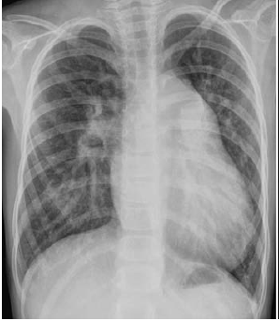
ASD
VSD
PDA

Slide 37
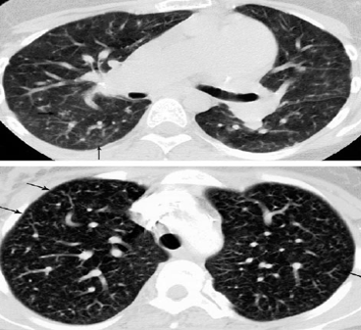
PULMONARY NEOVASCULARISATION
Distinctive vascular lesions on CXR &CT correlated histologically with collateral vessels seen in posttricuspid communications.

Slide 38
TR jet not indicative of RVSP
Univentricular circulation
Nonrestrictive VSD
ccTGA and post-atrial switch for TGA
Double-chambered RV
RV outflow tract obstruction → sub-valve-supra valvular PS / Pul. Atresia
Branch PA stenosis
Torrential TR ?
IVC not directly communicating with RA -(eg, TCPC)
Mechanical ventilation

Slide 39
RISK ASSESSMENT
NON INVASIVE
INVASIVE
CLINICAL
FUNCTIONAL ASSESMENT
ECG
CXR
ECHO
6MWT
BIOMARKERS
CPET
CATHETERISATION
HEMODYNAMICS

Slide 40
CLINICAL & FUNCTIONAL ( 1yr motality >10%)
Right heart failure
Rapid progression of symptoms
Syncope
(occasional – brisk physical activity / repeated – daily activities )
WHO III/IV

Slide 41
6MWT
Risk Assessment & Rx Follow Up
Pulmonary + Cardiovascular System
Systemic Circulation
Peripheral Circulation
Neuromuscular Units
Metabolism
6MWD (in metres ) | 1 yr mortality
>440 | Low ( <5 %)
165-440 | Intermediate (5-10%)
<165 | High (>10%)
3 m
30 metres
Post test
BP
HR
Spo2
Distance
Pre test
BP
HR
Spo2
Never stop timer
Encourage +
Pt can take rest
O2- supplement +

Slide 42
BIOMARKERS – BNP & NT- pro BNP
BNP (ng/ml) | NT- pro BNP (ng/ml) | I yr mortality
<50 | <300 | <5%
50-300 | 300-1400 | 5-10%
>300 | >1400 | >105
CBC
Hcr
RFT/LFT
S.ferritin
NT-pro BNP >128 pg/ml at 20 wks – predictive of later events in pregnancy

Slide 43
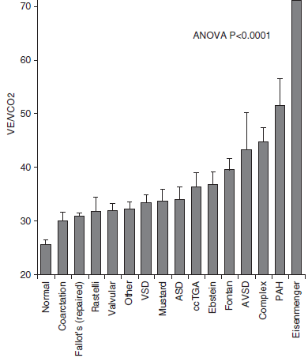
CPET
PEAK V02 consumption
Highest oxygen uptake reached in a 30-s interval during exercise
Maximal functional endurance capacity( pulmonary, cardiovascular, and muscular function )
Anaerobic threshold (AT)
aerobic→ aerobic + anaerobic metabolism to meet heart demand during exercise (secondary ↑ lactate conc.)
VE/VCO2 slope ( N ≤ 30 degrees )
CO2 production proportionate to ventilation
EISENMENGER
PAH
FONTAN
AT - aerob→ aer + anaerob.

Slide 44
CPET
1 yr mortality | Peak VO2 (ml/min/kg (% predicted of normal value) | VE/VCO2 slope (ventilatory equivalents for CO2)
Low <5% | >15 (>65% pred ) | <36
Intermediate 5-10% | 11-15 (35-65% pred) | 36-44.9
High >10% | <11 (<35% pred ) | >45

Slide 45
IMAGING + HEMODYNAMICS
 | RA area ( ECHO /MRI) m2 | RA pressure | CARDIAC INDEX (ml/min/ m2) | Mixed venous saturation (%)
Low <5% | <18 | <8 | >2.5 | >65
Intermediate 5-10 % | 18-26 | 8-16 | 2-2.4 | 60-65
High > 10% | >26 | >16 | <2 | <60

Slide 46
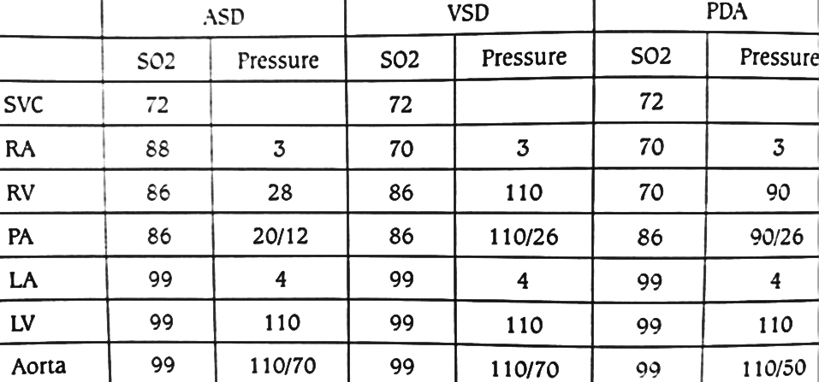
CATHETERISATION
ASD → PA << Ao
VSD PASP,RV =Ao
PA DP – normal
PDA PASP ≈ Ao
PA DP normal

Slide 47
EISENMENGER – SHUNT LESIONS
PASP – suprasystemic
VSD , PDA → PA diastolic prsessure ↑↑

Slide 48
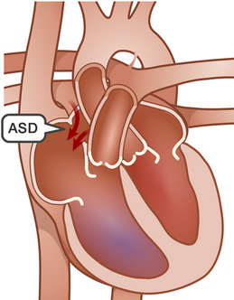
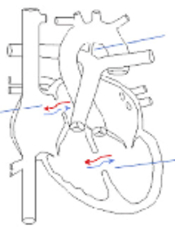
ELDERLY ASD L→R shunt suspected LV disease (comorbidities ) BALLOON OCCLUSION
VSD / PDA → direct - systemic → PAP
ASD ( LA-RA-TV-RV-PA )
no direct transmission
↓
No advantage in balloon occlusion
↑ PAP , RAP , ↓ C.O
↓
risk of RV failure post closure
AVOID CLOSURE
↑ PCWP, LAP
↓
risk of acute LVF- pul edema
↓
Rx- anti - SHT / failure

Slide 49
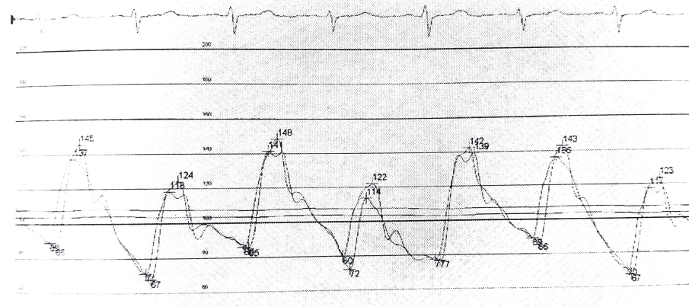
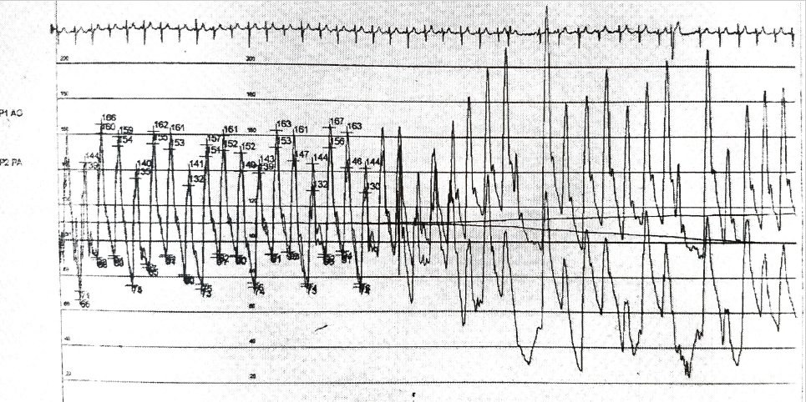
PDA BALLOON OCCLUSION -NICOLADANI-BRANHAM SIGN
BALLOON OCCLUSION
No change in Ao & PA pressure
↓
INOPERABILITY
↓ PA pressure / ↑ AO pressure sys +dias/ reflex bradycardia
↓
NICOLADANI-BRANHAM SIGN -OPERABILITY
Ao
Ao
PA
PA

Slide 50
VASODILATOR TESTING
response to pul. V.d - idiopathic PAH or drug / toxin induced PAH
pre- and post-tricuspid S→ PA shunts – operability
SITBON criteria
mPAP ↓ ⩾10 mmHg
absolute fall ⩽40 mmHg
↑ or ↔ c.o
100% oxygen (10 L /min )
Inhaled nitric oxide (iNO) at 10 to 40 ppm
i.v adenosine = 50–250 μg/kg/min dose titration: 50 μg/kg/min every 2 min
Oral Sildenafil - Single dose 25 mg (Hemodynamics - every 15 minutes for 60 minutes after admin.
i.v Sildenafil - 10 mg

Slide 51
PRETRICUSPID LESIONS – ASSESSING OPERABILITY
OXYGEN SATURATION :
Spo2 < 90- 95 % ( r/o : unroofing coronary sinus , severe TR , IVC streaming )
Basal desaturation ↓↓ with exercise (1.Pre & Post exercise pulse oximetery 2. radial cannula → Pre & post ABG )
CXR- Peripheral oligemia
ECHO - R → L shunt ( Lim : obligatory shunt PAPVC , severe TR , IVC streaming
CATHERISATION PVRI – 6-8 woods / PA pressure > 2/3rd of systemic pressure

Slide 52
POST TRICUSPID LESIONS
Clinical → N spo2 (pulse oximetry ) & Pa O2 ( ABG ) – good operability
PVD ( young age 2nd – 3rd decade )→ R/O lung disorders ( hypoxia)
Down syndrome → central hypoventilation ( hypoxia )→ Pvein ↓ spo2
CXR Small heart , ↓ precordial activity – inoperable ( N→ Large heart – regurgitation )
Spo2 leg < arm – R→ L shunt ( inoperable ) [ r/o anomalous SCA ,severe AR , interrupted aortic arch )
ECG - Soft indicator of operability → q V6
ECHO – PA = Ao pressure → colour doppler unreliable [ small R→L shunt in operable candidates also )
CATHERISATION PVRI – 6-8 woods / PA pressure > 2/3rd of systemic pressure

Slide 53
INTERVENTION
ESC 2020 -PVRI , Qp/Qs
AHA 2018
Qp/Qs ratio
PVR <1/3 rd SVR
PASP <50% systemic pres.
Shunt lesions ASD/VSD/PDA
PVRI < 3 WU
Qp/Qs >1.5:1
PASP < 50% systemic pressure
PVR <2/3 rd SVR
3-5 WU
> 5 WU
LV disease – balloon occlusion testing
PAH Rx – PVR < 5 WU
Class IIb
Fenestrated closure
Class I
Class II a
Class III

Slide 54
TREATMENT
Baseline assessment of the disease severity
General measures and supportive care
Primary therapy - directed at the pathophysiology of disease
Advanced therapy - directed at PH “per se”

Slide 55
BASELINE ASSESMENT
(Estimated 1 yr mortality ( low < 5% / intermediate – 5-10 % / high > 10%)
PHYSICAL ACTIVITY & EXERCISE
Exercise - ↑ RV contraction - ↑ PVR ( no new capillaries )→ identify RV reserve (RV function, RV Tei, RV afterload response to exercise (P/Q relationship), ↑ PAP - exercise ( >30 mm Hg)
SUPPLEMENTAL O2 → if spo2 persistently < 60 %
OAC ( not indicated in PAH Gr 1 ) - Atrial tachycardia – VKA +
Sinus -Large PA aneurysm with thrombus
VACCINES :Influenza & pneumococcal
HYDRATION
PHLEBOTOMY ( Hcr > 65 %)
IRON DEFICIENCY ANEMIA
GOUT ( prevention : allopurinol / Rx – febuxostat )

Slide 56
CLASS | DRUGS | WHO CLASS
CCB | High dose amlodipine/nifedipine | IPAH Drug PAH
ERA | Ambrisentan Bosentan (1st choice WHO CLIII –ESC ) Macitentan | II + III
PDE-5 inh | Sidenafil Tadalafil Vardenafil | II + III
Guanylate cyclase agonist | Riociguat | II + III
Prostacyclin analogues | Epoprostenol (i.v) Iloprost (i.v+inh ) Treopostinil(i.v+inh+s.c+o ) Beraprost | III + IV (epoprostenol)
Selective Prostacyclin agonist | Selexipag (o) | II+III
PAH directed Rx
UPFRONT DUAL RX
PDEi+ERA
Best–Ambris + Tadal
Avoid : Bosen+ Silden
SEQUENTIAL DUAL Rx
PDEi
↓ 4wks
ERA
TRIPLE Rx
PDEi+ERA
↓
PROSTACYCLIN ANALOGUES
BEST COMBINATION – WHO III/IV
Sildenafil → Macitentan
Bosentan→ Riociguat
Selexipag - ERA and/or PDE5i
Sildenafil → Epoprostenol

Slide 57
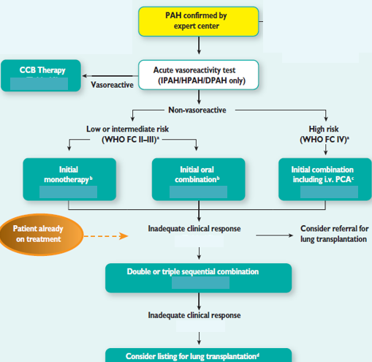
PEDIATRIC AGE

Slide 58
SURGICAL ASSESMENT
STS – EACTS → procedure type risk assessment ( eg : ASO- high risk ) – difference in children & adult
ACC (Aristotle comprehensive complexity ) – ABC (Aristotle basic score ) – procedure dependent + proc. Independent ( eg . Endocarditis ) + patient characteristic ( eg . Comorbidity )
GUCH ( Grown up children with heart disease ) score
patient characteristic(comorbidity )
procedure character
Age
GUCH mortality = STS-EACTS + (ACC – ABC) x 0. 1 + Age x 0.01

Slide 59
SURGERY
Heart lung transplantation
Pulmonary thromboendarterectomy
(CTEPH - only group with benefit - V/Q scan → CTPA (collaterals )

Slide 60
PREGNANCY & EISENMENGER
EFFECTS OF PREGNANCY ON EISENMENGERS
↑ blood volume- compromised RV may not compensate
↓ SVR - ↑ R→L shunt
Fixed PVR - ↓ cardiac output
Hypercoagability during pregnancy -- risk of DVT, pulmonary infarction, stroke
ES – thrombocytopenia & acquired clotting factor abnormalities → LMWH bleeding
FETAL COMPLICATIONS
IUGR
Premature delivery
MATERNAL COMPLICATIONS
Sudden Cardiac Death
Heart Failure( RV)
Thromboembolism
Arrhythmia

Slide 61
Modified WHO class IV (40-100% mortality )
PAH
EF <30% NYHA III/IV
PPCM with residual LV dysfunction
Severe MS + severe symptomatic AS
Systemic RV + mod- sever e TR
Severe aortic dilatation (>45 mm -Marfan syndrome / >50 mm –BAV ,
Turner syndrome ASI(aortic size index >25 mm/m2)
TOF >50 mm
Severe (re)coarctation
Fontan with any complication

Slide 62
2015- FDA changes – PLLR (Pregnancy & Lactation Labelling Rule )
PREGNANCY
LACTATION
FEMALES & MALES OF REPRODUCTIVE POTENTIAL
A – well controlled studies no risk in 1st trim – no evidence in 2/3
B – animal studies no risk, no human studies
C- benefit > risk Animal studies –adverse +
D- fetal risk + Life threatening benefit > risk
X – contraindicated

Slide 63
TREATMENT
Adequate hydration
Thromboembolic risk – LMWH
SILDENAFIL,VARDANAFIL (B)( CI : bosentan ) EPOPROSTENOL (B)
ILOPROST (C) , TREPROSTINIL (C) ,MACITENTAN,BOSENTAN (X)
Epidural > GA
Avoid oxytocin

Slide 64
PPHT NEW BORN
Male /CS/ < 37 wks >41 wks / small-large for GA
Antenatal – NSAID /SSRI
Remodelled PUL. Vasculature + N parenchyma
CDH , Trisomy 21 , Surfactant def. , ACD (alveolar capillary dysplasia)
PPHN mimickers → TAPVC , GALEN V. malform
R-L shunt PDA /PFO→ differential cyanosis / systemic cyanosis
gross apical impulse shift -CDH)/ Loud P2 /TR murmur
Rx- inhaled NO – 20 ppm ( R-L shunt / r/o LV dysfunction before iNO )
Sildenafil (i.v/ oral ) –resource ↓ / rebound HT due to iNO
RV/LV dysfunction - MILRINONE(syst+pul. VD ) (50 μg/kg bolus → 0.3-0.7 μg/kg inf.)

Slide 65
EISENMENGER & MAJOR NON CARDIAC SURGERY – PRINCIPLES & Rx
Type of procedure , Cyanosis severity , RV dysfunction /, TR
EISENMENGER (PDA,AP window ) ↑ ↑ risk - direct PA- systemic pressure
Hcr – stroke / clotting factor deficiency - bleeding
Endocarditis
Fixed PVR – minor↓ BP → ↑ R-L shunt – systemic embolism
Epidural( CI – symp .block – ↓ Pre+after load → ↑ R-L shunt
GA –( I.V fentanyl + ketamine /thiopental / isoflurane
Muscle relaxants ( atracurium / vecuronium safe )
THANK U…

