Slide 1
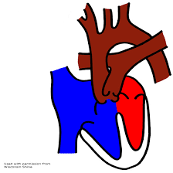
Double Outlet Right Ventricle
Dr Arun Jude Alphonse
DM Cardiology Resident
Govt TDMC Alappuzha

Slide 2
Definition
Embryology
Classification
Haemodynamics
Clinical presentation
Natural history
Investigations
Management

Slide 3
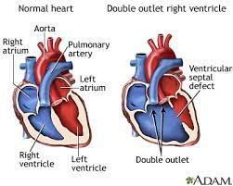
Definition
DOV- Double outlet ventricle:
origin of both great arteries from single ventricle
Double outlet right ventricle (DORV)
Double outlet left ventricle (DOLV)V)
DORV :“Type of ventriculoarterial connection in which both great vessels arise either entirely or predominantly from the right ventricle”
RV
VSD- only outlet from LV
Notes:
3
7/30/2014
DORV

Slide 4
Incidence
<1% of CHD
0.06 case per 1000 live birth
No sexual or racial predilection
No associated Genetic defect identified
Mostly sporadic, 22q11 deletion associated with some cases DORV

Slide 5
Embryology
Persistence of both subaortic and
sub pulmonary conus
AV valves not in continuity with semilunar valves
CONUS: A circular tube of muscle, upon which semilunar valve sits up.
The more conal muscle present beneath a semilunar valve, the more that valve is pushed superiorly and anteriorly.

Slide 6
Theory of conal inversion

Slide 7
One conus expands and takes the artery anterioly..One conus resolves and takes the artery posteriorly
Normal –sub pulmonary conus expands ,sub pulmonary resolves
Reversal of this –TGA
Both conus expands anteriorly –DORV
Both conus resolves - DOLV

Slide 8
Fibrous skeleton of heart

Slide 9
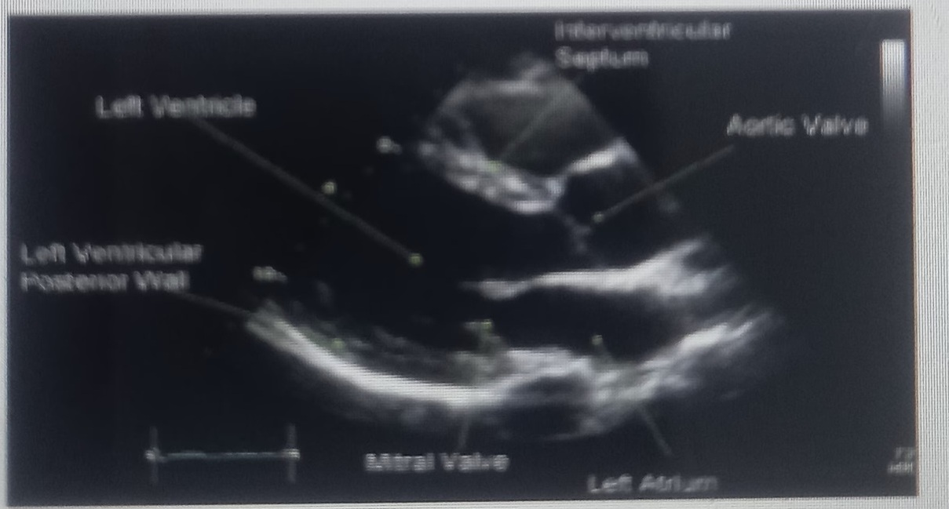
Aorto-mitral continuity

Slide 10
Tricuspid-pulmonary discontinuity

Slide 11
In DORV –
Aorto-pulmonary+Tricuspid-pulmonary discontuinity (Persistence of sub aortic and sub pulmonary conus)

Slide 12
Van Praagh classification of DORV
Type I DORV
- isolated conotruncal anomaly
Type II DORV
- conotruncal anomalies + associated malformations of the AV
valves and ventricles
Type III DORV
– heterotaxy (polysplenia, asplenia,,atrial isomerism)

Slide 13
PATHOLOGIC CLASSIFICATION
Based on
Location of VSD to great arteries
Great artery relationship

Slide 14
Ventricular septal defect
The only outflow tract of the left ventricle.
Mostly conoventricular.
Accordingly however DORV can be classified with respect to VSD location.
Subaortic
Subpulmonary
Doubly committed
Non committed.
Notes:
Conoventriccular: between the two limbs of TSM.
Sub aortic: TOF end: no sub aortic conus: superior margin of VSD is the Ao valve itself.
Sub pulmonary: TGA end: Progressive Subaortic conus; Ao Valve moves cephalad; and PV more intimately associated: Subpulmonary.
Non committed: VSD not in conal septum or Jn of conal and interventricular septum(subaortic) : remote from aorta: difficult to direct LV flow to aorta:: inlet type
Sub aortic VSD: VIF: posterior margin of VSD. Bundle away
Subaortic Perimembranous VSD near TV : Posterio division of TSM is deficient: Bundle lies in poesterior inferior margin of VSD.

Slide 15
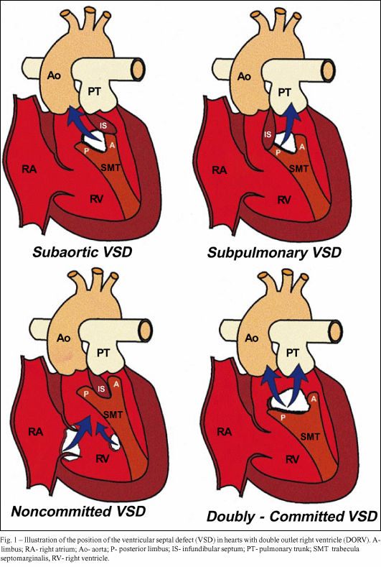
POSITION OF VSD
Sub-aortic type
Sub-pulmonary type
(Taussig Bing complex)
Doubly committed
Remote type

Slide 16
GREAT ARTERY RELATIONSHIPS AT THE LEVEL OF SEMILUNAR VALVES
Right posterior aorta :The aortic valve and trunk originate from the right ventricle at a location posterior and to the right of the pulmonary valve and its arterial trunk
Right lateral aorta (side-by-side relationship) : The aorta is to the right of the pulmonary artery, and the semilunar valves lie approximately in the same transverse and coronal plane. This is the classically described great artery relationship in DORV

Slide 17
Right anterior aorta (D-malposition)The aorta is to the right and anterior to the pulmonary artery.
Left anterior aorta (L-malposition)The aorta is to the left and anterior to the pulmonary artery.
This is least common great artery position.

Slide 18
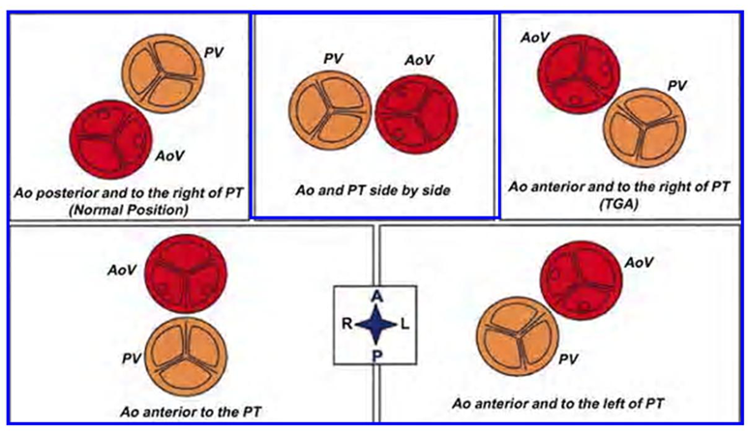
RELATIONSHIP OF GREAT ARTERIES AT SEMILUNAR VALVE LEVEL
Right posterior aorta
Right lateral aorta
(side by side relationship)
Right anterior aorta
Left anterior aorta.

Slide 20
PHYSIOLOGIC CLASSIFICATION
Depends on:
Presence or absence of associated pulmonary stenosis.
Relationship of VSD to great arteries.
DORV may simulate that of large VSD, TOF, TGA.

Slide 21
ASSOCIATED ANOMALIES
Subaortic stenosis – 3%;
Frequently co-exist with sub-pulmonary VSD type (50%).
Coarctation – 12%;
frequent in subpulmonary VSD type 50%.
Mitral valve anomalies – 10%; -
frequent in remote VSD
ASD – 10%
TAPVC – 2%
AV canal – 5%, Common in remote VSD.

Slide 22
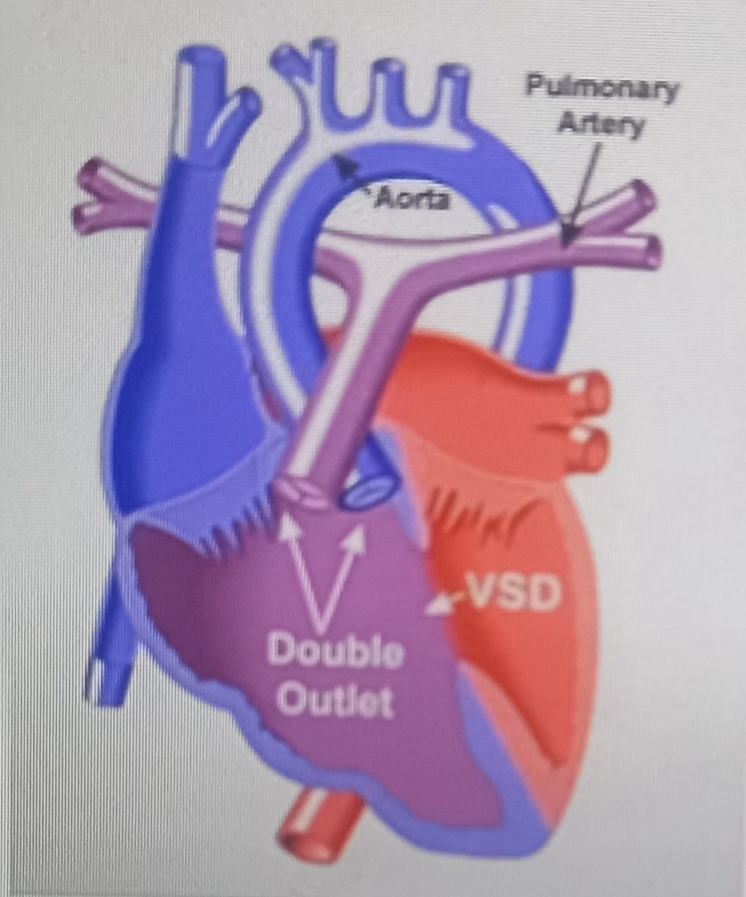
How it behaves
Function of
VSD
PS

Slide 23
MAJOR CLINICAL PATERNS
Group 1 - Sub aortic VSD with PS (resembles TOF)
Group 2-Sub pulmonary VSD, with or without PS
(resembles TGA).
Group 3- Sub aortic VSD, no PS, (resembles VSD)
Group4- Sub aortic VSD with PVOD (Resembles Eisenmenger– complex

Slide 24
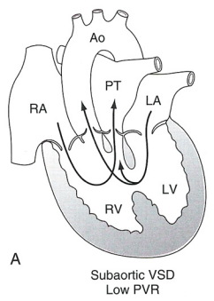
SUBAORTIC VSD WITH DECREASE PVR WITH NO PS
- Resembles VSD
LV—VSD---Ao/PA
RV—VSD---PA
- PBF increased
Resembles VSD with L-R shunt
-Aortic saturation is normal.

Slide 25
SUBAORTIC VSD – INCREASE PVR
-Increased blood to aorta
-Decreased flow to pulmonary trunk
-Aortic saturation falls

Slide 26
SUB AORTIC VSD WITH PS
50 % of DORV with subaortic VSD have PS
RV aorta
LV aorta
Aortic saturation decreased
PBF decreased
Resemble TOF

Slide 27
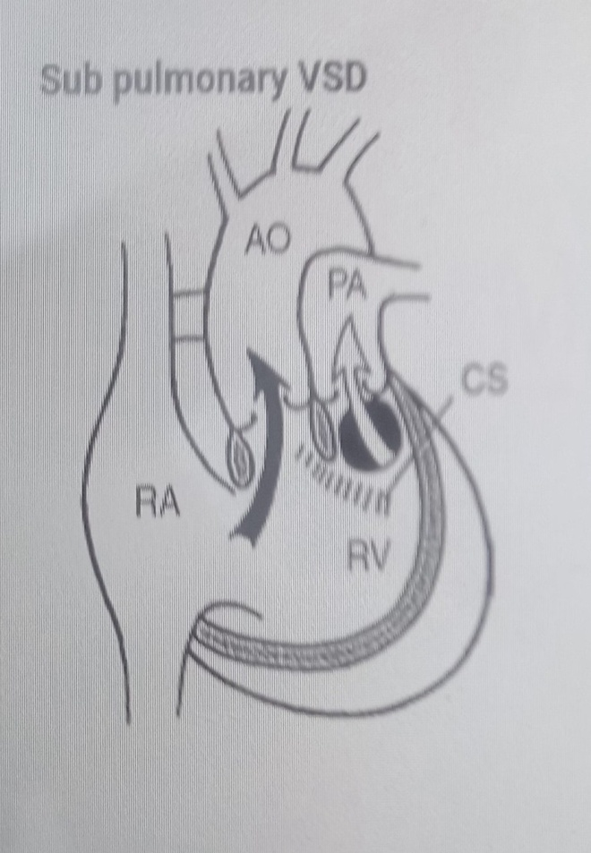
SUBPULMONARY VSD(Taussig Bing abnormality)
LV pulmonary trunk
RV aorta
Mimicks TGA
Pulmonary saturation > Aortic
If PVR decreased good aortic saturation;
LV volume overload
If PVR increases Blood from LV and RV Aorta Aortic saturation decreases.

Slide 28
DORV-Physiology & Clinical Manifestations
4 groups :
(a) Subaortic VSD + PS → TOF
(b) Subpulmonary VSD ± PS →TGA
(c) Subaortic VSD without PS → simple VSD with PAH
( non restrictive PM VSD)
(d) Subaortic VSD without PS + high PVR→ Eisenmenger syn.

Slide 29
1) DORV with subaortic VSD
Male : female 1.7 : 1
Murmur – from birth
Intensity of murmur increases
Increased pulmonary blood flow– LV volume overload– CHF
Poor growth and development
Cyanosis- mild or absent
Rise in PVR- curtails PBF

Slide 30
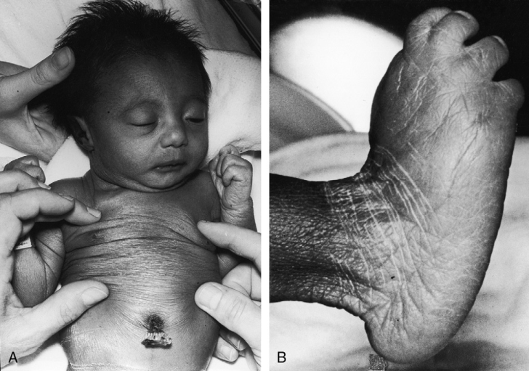
Physical appearance
Transient neonatal cyanosis- transient elevation in PVR
Catabolic appearance of congestive heart failure
Eisenmenger’s syndrome- cyanosis and clubbing
Trisomy 18- clinodactyly, rocker bottom feet and lax skin

Slide 31
Physical examination
Arterial pulse- brisk
Later rise in PVR- normalises pulse
CHF--JVP -A wave, V wave and mean pressure are elevated
Hyperactive precordium with Harrison’s grooves(chronic dyspnea)

Slide 32
Palpable P2(dilated hypertensive PA)
Thrill generated by VSD is maximal in the third and fourth intercostal spaces at the left sternal border
PVR rises- left ventricular impulse inconspicious
Right ventricular impulse, the palpable pulmonary trunk, and the palpable pulmonary closure sound persist

Slide 33
Auscultation
S1 soft ( PR interval prolonged)
S2- P2 loud, A2 loud
Inspiratory splitting preserved(until PVR<SVR)
Holosystolic murmur- 3rd, 4th ICS
Apical MDM

Slide 34
With elevated PVR
VSD murmur- softer and decrescendo but does not disappear
Eisenmenger syndrome- Pulmonary EC, loud single S2, Graham Steel murmur
DORV suspected- PBF remains increased in the presence of cyanosis and when a soft decrescendo systolic murmur persists at the left sternal edge

Slide 35
3) DORV with subaortic VSD and Pulmonary Stenosis
Pulmonary stenosis- mild to severe to atresia
May be present at birth or progressive increase in severity
Squatting episodes seen
Clinical features closely resemble TOF

Slide 36
Physical examination
JVP- A is normal
Arterial pulse is normal
Right ventricular impulse – 4th or 5th ICS and subxyphoid
Systolic thrill- 3rd left ICS

Slide 37
Auscultation
Acyanotic patients- mild PS – holosystolic murmur (VSD)- LLSB
Midsystolic murmur- (PS)- 2nd and 3rd left ICS
P2 delayed
Severe PS or atresia- TOF
Duration of PS murmur- varies inversely with the severity of stenosis
Pulmonary atresia- Aortic ejection sound, a soft midsystolic murmur into the dilated aorta, and a loud single S2 (aortic valve closure)

Slide 38
Long decrescendo systolic murmur at the left sternal border --obligatory flow from LV into aorta through a restrictive VSD--constitutes a zone of subaortic stenosis
LVS4 – LVH- subaortic stenosis
EDM of AR sometimes heard

Slide 39
When CoA elevates systemic systolic pressure -- diverts still more right ventricular blood into the pulmonary trunk- clinical course poor
A rise in PVR --regulates pulmonary blood flow and ameliorates CHF
Cyanosis increases but longevity improves- may reach 2nd 3rd or 4th decade

Slide 40
4)DORV with subpulmonary VSD
Cyanosis- birth or early infancy
RV blood- Aorta
LV blood preferentially enters the PT across the subpulmonary VSD
SpO2 is relatively high but at the price of increased PBF, left ventricular volume overload, and CHF

Slide 41
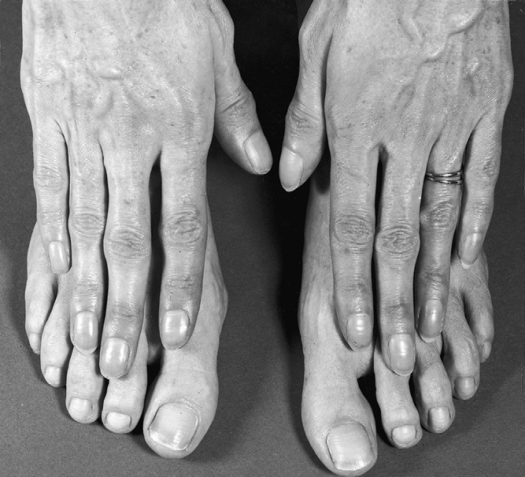
Increased PBF- poor growth and development
Suprasystemic PVR- reversed differential cyanosis- ductal flow is right to left

Slide 42
Reversed differential cyanosis
Toes are less cyanotic and less clubbed than the fingers
Oxygenated blood from the left ventricle flows through the subpulmonary ventricular septal defect into the PT and through the patent ductus into the descending aorta

Slide 43
Arterial pulse
UL and LL Pulses-- coarctation of the aorta
Femoral pulses may be preserved-- nonrestrictive PDA distal to the coarctation
JVP- In biventricular failure- A, V and mean pressure elevated
Elevated PVR- JVP normalises

Slide 44
Obligatory RV impulse
Palpable Dilated hypertensive PT
Palpable P2
Thrill in 2nd Lt ICS- Subpulmonary VSD
VSD murmur- 2nd lt ICS
Loud P2, S2 splitting preserved
Apical MDM
PVR elevates-
Murmur attenuated, MDM disapppears
Pulmonary EC, soft short systolic murmur, Graham Steel murmur
S2 loud and single

Slide 45
Natural History
1 )Infant without PS may develop severe CHF
-Later PVOD
-Spontaneous closure of VSD –fatal,rare
2 When PS present ,complications of CCHD
(Polycythemia,CVA)
3 -Taussig Bing –severe PVOD develop early
as in TGA
4 -Associated anomalies –COA
- LV hypoplasia
- poor prognosis

Slide 46
ECG
Basic ECG findings - RAD and RVH as right ventricle is systemic
Rest of findings will depend on pulmonary blood flow
PR interval prolonged (long course of common AV bundle)
DORV with Sub Aortic VSD without PS-LAD

Slide 47
In DORV, right ventricle is connected to the aorta and faces systemic pressure. Hence features of right ventricular hypertrophy is almost uniformly present in all types of DORV
Large VSD-LV Vol overload

Slide 48
Right atrial enlargement -patients with PS
left atrial enlargement may be observed in instances of increased pulmonary flow with intact atrial septum.
Patients with complete AV septal defect associated with DORV also typically have left axis deviation, combined ventricular hypertrophy, atrial enlargement, and first-degree AV conduction delay .

Slide 49
1. DORV. VSD. PAH
1st degree AV block. LAD. CC loop and RVH
2. DORV. VSD (Subpulmonic). PAH
BVH
3. DORV. VSD PS
RAE. RAD. RVH.
QRS axis may be more left ward.

Slide 50
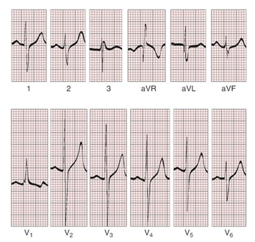
ECG showing deep S wave in V5-6 indicating right ventricular hypertrophy. Biventricular hypertrophy is manifested by large RS complexes in leads V3-6, in a case of DORV, subaortic VSD.

Slide 51
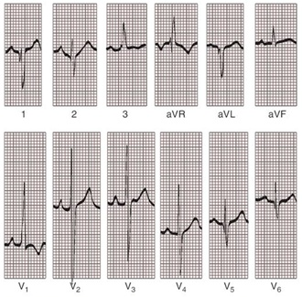
ECG showing peaked right atrial P waves in leads2 and V1. q waves appear in lead 1 and aVL despite right axis deviation. Right ventricular hypertrophy manifested by tall R waves in leads V1 and aVR. The qR pattern in leads V5-6 indicates that left ventricle is well developed, in a case of DORV with subaortic VSD and severe PS.

Slide 52
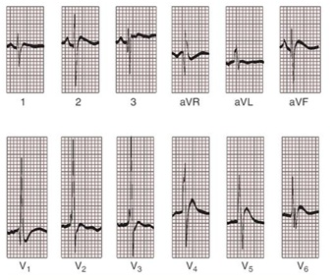
ECG showing peaked right atrial P waves in leads 2,3, aVF. The QRS axis is rightward. Right ventricular hypertrophy is reflected by tall R waves in leads V1-2 and in leads aVR and by prominent S waves in left precordial leads, in a case of DORV and subpulmonary VSD.

Slide 53
CHEST X RAY
In patients with PS,
Features may resemble TOF
Mild degree of cardiomegaly
Pulmonary vascularity is diminished
MPA segment is absent, which results in a concave upper left border of the heart

Slide 54
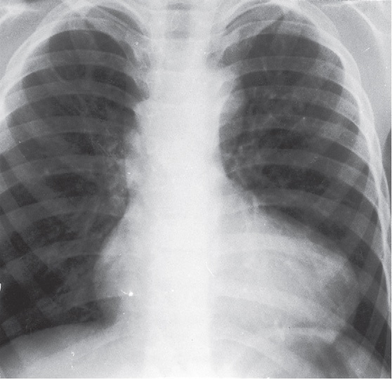
DORV subaortic VSD pulmonary atresia

Slide 55
In cases of subaortic VSD without PS -
Generalized cardiomegaly
Prominent main pulmonary artery segment
Increased pulmonary vascularity

Slide 56
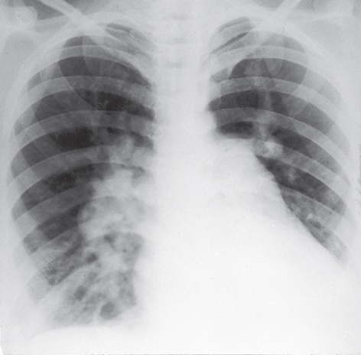
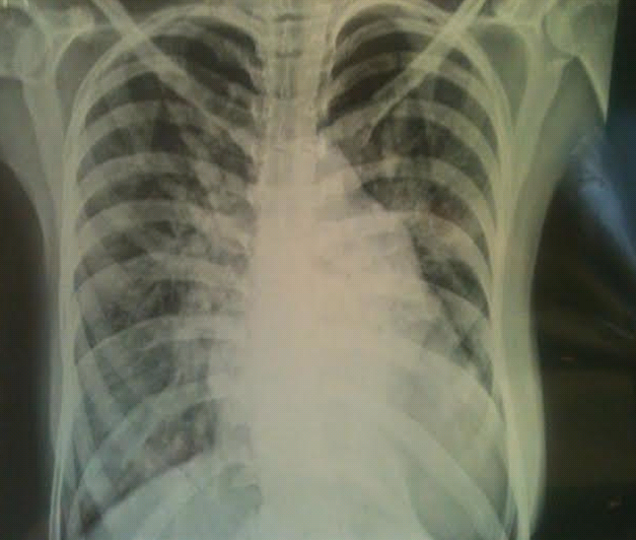
DORV with subaortic VSD

Slide 57
When PVR is high -
Prominent MPA
peripheral pruning

Slide 58
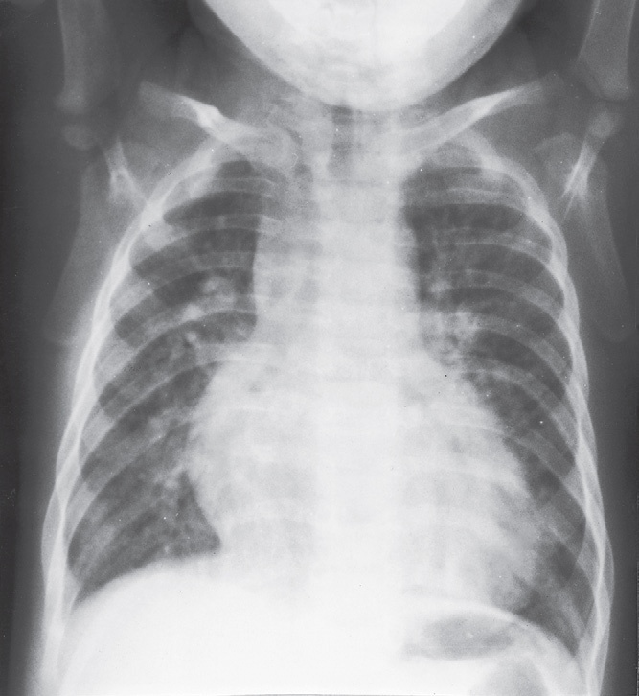
Taussig Bing anomaly

Slide 59
ECHO
4 OBSERVATIONS NOTED FOR DIAGNOSIS
Origin of one great vessel from the RV and overlie of at least 50% or more of the other great artery over the RV
Mitral- semilunar discontinuity with conus
Absence of LVOT other than VSD
Spatial relationship of great arteries determined by bifurcation of pulmonary artery and branching of aorta.

Slide 60
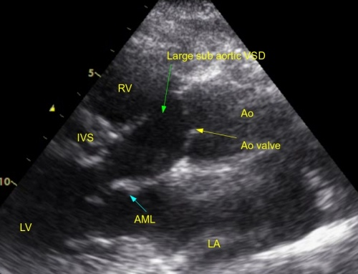
DORV: Aortic-mitral Discontinuity
Aortic - mitral discontinuity in DORV is best shown in the parasternal long-axial view.
RV
Ao
LV
LA

Slide 61
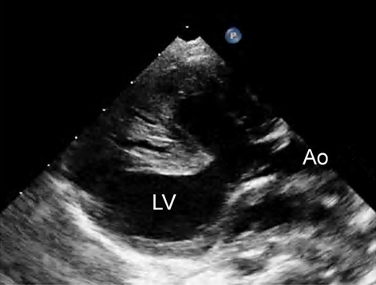
DORV with subaortic VSD

Slide 63
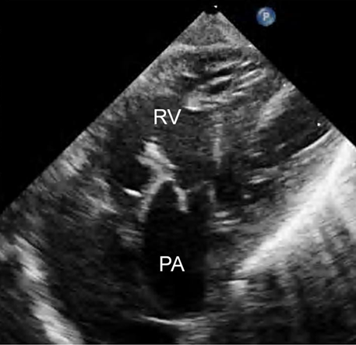
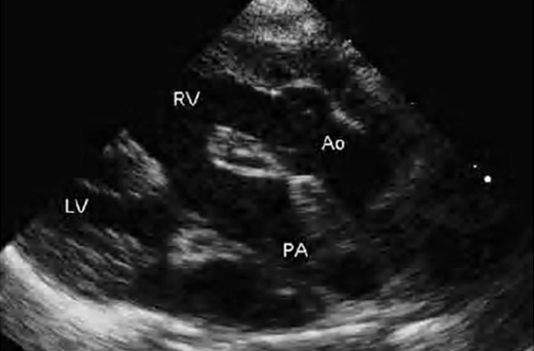
DORV with sub pulmonic VSD

Slide 64
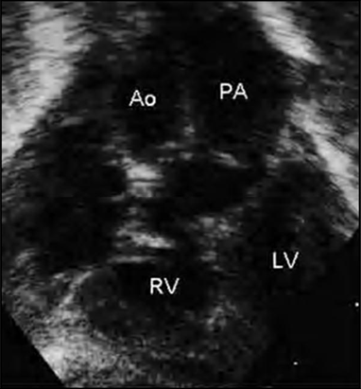
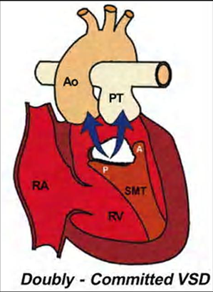
DORV with doubly committed VSD

Slide 65
DORV with remote VSD

Slide 66
Echo Evaluation of DORV: Role of Echocardiography in Planning Surgical Strategy:
The crucial question:
IS TWO VENTRICLE REPAIR FEASIBLE?
Two ventricle repair is preferred over the single ventricle (Fontan) option whenever feasible:
Better long term survival
Less arrhythmias
Better functional capacity

Slide 67
Role of Echocardiography in Planning Surgical Strategy: Criteria for Two Ventricle Repair
Two good-sized ventricles
No straddling of either of the AV valves
The VSD should be suitably located for intra-ventricular re-routing
No significant AV valve tissue in the way between VSD and the aorta

Slide 68
Echo Evaluation of DORV: Suitability for two-ventricle repair
Good separation between Pulm. and Tricusp. Valves:
Separation between Pulm. and Tricusp. Valves < Ao annulus
Minimum separation between Pulm. and Tricusp. Valves

Slide 69
CARDIAC CATHETERISATION
OBJECTIVES: to evaluate
Routability of VSD to aorta
Branch PA anatomy
Pulmonary vascular resistance
Coronary artery and aortic arch anatomy.

Slide 70
CORONARY ANOMALIES
Normal
Similar to TOF- LAD from RCA
Similar to TGA- RCA from the right posterior aortic cusp & LCA from the left posterior cusp
Anomalous origin of the left Cx from RCA,
single coronary ostium, origin of right Cx from LCA.

Slide 71
Management
Includes Medical care and surgical management
Optimize medical treatment before surgical intervention
Surgical – palliative or definitive
Thorough evaluation important before any plan is made

Slide 72
MEDICAL MANAGEMENT
Inadequate pulmonary blood flow – maintain ductal patency.
Prostaglandin E1(ie, alprostadil) is the standard of care until repair can take place.

Slide 73
MEDICAL MANAGEMENT
Clinical picture of congestive heart failure –
diuresis,
inotropic support

Slide 74
Surgical decision-making for DORV --most complicated in congenital heart surgery
Consider
Anatomic features
Age
Weight of the child
Clinical status
Repeated imaging with echo (TTE, TEE), angiography, CT, or MRI required --precise anatomy

Slide 75
Essential anatomic considerations for surgery
The position, size, and number of VSD and its relationship to the conduction system
The distance between the tricuspid valve and the pulmonary valve
Straddling or overriding of the AV valve
Relationship of the great arteries
Presence of pulmonary (RVOT) stenosis
Presence of aortic (LVOT) stenosis
Coronary artery anatomy

Slide 76
SURGERY
Palliative surgeries
1. PA banding- symptomatic infants - PBF- CHF
Occ multiple muscular VSD and remote VSD
2. Balloon atrial septostomy- Taussig Bing Anomaly- better mixing and decompressing LA
3. Infants- PS with PBF and cyanosis- systemic to PA shunt

Slide 77
DORV type | surgery strategy
VSD type | Close the VSD– physiologically eliminate L-R shunt
Transposition type | Ventricular outflow switched
Tetrology type | Routing blood form LV to Aorta- with enlargement of RV outflow

Slide 78
DORV surgery
DORV subtype | Initial procedure | Definitive surgery
Subaortic or Doubly commited VSD |  | VSD AO tunnel (1-6 mon)
Fallot type | ± BT shunt | 1.VSD- AO tunnel + Rastelli 2.REV procedure 3.Nikaidoh procedure
Taussig Bing | Ballon Atrial Septostomy | VSD -PA tunnel + ASO (3-4 mon) Less desirable- 1.VSD- PA tunnel + Senning 2.VSD- AO tunnel (± RVOT augmentation) 3.VSD- PA tunnel + DKS + RV -PA conduit
Multiple VSD or remote VSD | ±PA banding | VSD- AO tunnel (2-3 yr)
Hypoplastic RV or LV | BT shunt | Hemi Fontan - Fontan

Slide 79
Rastelli procedure TGA+VSD+PS DORV+SubPulmonary VSD+PS

Slide 80
Atrial switch

Slide 81
Arterial switch operation

Slide 82
REV procedure (Reparation a l’etage ventriculare)
Similar to ASO
Proximal ascending aorta and main PA- transected
Prox stump of PA oversewn
PA translocated anterior to Aorta (Lecompete maneuver) and AA reconnected
Distal PA- anastomed directly to infundibular incision

Slide 83
Infundibular resection to enlarge VSD
Intraventricular baffle ( LV to aorta)
Aortic transection- perform Lecompte manuever (RPA brought anterior to AA)
Direct RV to PA reconstruction by anterior patch

Slide 84
Infundibular resection to enlarge VSD
Intraventricular baffle ( LV to aorta)
Aortic transection- perform Lecompte manuever (RPA brought anterior to AA)
Direct RV to PA reconstruction by anterior patch

Slide 85
REV procedure

Slide 86
Complication with DORV in adults
Left ventricle outflow tract obstruction
Right ventricle outflow tract obstruction and pulmonary regurgitation
Failure of the right ventricle-to-pulmonary artery conduit (stenosis or regurgitation)
Aortic valve regurgitation (following arterial switch operation)
Coronary artery stenosis (following coronary transfer)
Right ventricle failure
Arrhythmia (atrial or ventricular) and sudden death
Endocarditis
Thromboembolic event

Slide 87
Pregnancy
Patients with biventricular repair without any residual defects or stenosis- low pregnancy risk
Close monitoring required
After Fontan surgery- successful pregnancies reported

Slide 88
. Q1) Classical echocardiographic features of DORV except?
a) Origin of both great arteries from the anterior RV
b) Mitral- semilunar valve discontinuity
c) Absence of left ventricular outflow other than the VSD
d) Ostium primum ASD- 90% cases

Slide 89
IE prophylaxis
Prosthetic cardiac valve or device
Previous endocarditis
First 6 months after intervention
Residual defect

Slide 90
Q2). False statement about DORV
Both great arteries & arterial trunks arise from RV
Neither semilunar valves is in fibrous continuity with either atrioventricular valves
VSD- only outlet from LV
Most common VSD – sub pulmonic

Slide 91
Q 3) Reversed Differential cyanosis seen in
1. Subaortic VSD with PS
2. Subaortic VSD without PS
3. Subpulmonary VSD
4. Non committed VSD

Slide 92
Q4) Taussig Bing anomaly is
1. DORV-subaortic VSD
2. DORV- subaortic VSD with PS
3. Subpulmonary VSD
4. Doubly committed VSD

Slide 93
Q5) Aortic arch Anomalies common in
1. Subaortic VSD with PS
2. Subaortic VSD without PS
3. Taussig Bing anomlies
4. Non committed VSD

Slide 94
Thank You

