Slide 1
DRUGS ACTING ON RAAS
Dr Arun Jude Alphonse
Dept of Cardiology
Govt Medical College, Alappuzha

Slide 2
SYNOPSIS
RAAS PATHOLOGY IN SHORT
DRUGS ACTING ON RAAS
ACEI
ARB
ARNI
AA
DRI

Slide 3
The Renin Angiotensin Aldosterone System (RAAS)
Most important neurohormonal system that maintains vascular tone and fluid-electrolyte balance in our body
Is involved in the pathophysiology of most cardiovascular diseases and hence its importance
Works through a negative feedback loop in our body

Slide 4
Pathophysiology of RAS

Slide 5
Factors stimulating renin release
Low arterial blood pressure
Decreased sodium concentration in the distal tubule
Decreased blood volume
Increased beta -1 sympathetic activity

Slide 6
Drugs influencing PRA
Increasing PRA
ACEI
ARBs
Vasodilators
Diuretics
Decreasing PRA
Adrenergic blockers
Renin inhibitors

Slide 8
RAAS INHIBITORS… WHICH ACTS WHERE..??

Slide 9
ACE Inhibitors

Slide 10
Historical aspects
ACE was initially discovered from the venom of pit viper and named bradykinin potentiating factor and later it was found that this kininase and ACE were the same.
Teprotide was the first ACEI to be synthezised
Later , captopril was developed as the first ACEI in 1977

Slide 11
ACEI
ACE inhibitors differ
in the chemical structure of their active metabolites,
in potency,
in bioavailability,
in plasma half-life,
in route of elimination,
in their distribution and affinity for tissue-bound ACE, and
in whether they are administered as prodrugs.

Slide 12
CLASSIFICATION
Class I : Containing a sulfhydryl group
-Captopril (proline derivative)
Class II : Containing a Dicarboxylate group
-Enalapril, Ramipril,Quinapril, Perindopril,Benezapril, Imidapril, Trandalopril
Class III : Water soluble
-Lisinopril ( Lysine derivative)
Class IV : Containing a Phosphonate group
-Fosinopril
Notes:
In vitro studies suggest that the presence of the sulfhydryl group may confer properties other than ACE inhibition to these drugs, such as free-radical scavenging but In vivo no much benefit has been found

Slide 13
ACEI – salient features
Captopril by itself is active and its metabolites are also active
Prodrugs by itself are not active and need to be converted to the active diacids in the liver and prodrugs have better bioavailability
Lisinopril is active and is not metabolised and excreted unchanged
All ACEI are excreted exclusively via renal system except fosinopril,spirapril and trandolapril which are excreted via the biliary system and feces.

Slide 15
ACEI - Pharmacokinetics

Slide 17
ACEI- hemodynamic effects
ACEI are beneficial in many ways
Prevents generation of angiotensin II
Useful in conditions in which the renin angiotensin system is dysregulated like essential hypertension and renovascular hypertension
Decreases the peripheral vascular resistance
Fall in systolic and diastolic BP
No effect on cardiac output

Slide 18
INDICATIONS OF ACEI
1. Heart failure
Chronic heart failure due to any cause HYHA FC 2-4
2. AMI
AMI with HFREF/TYPE2 DM with protienuria/HTN
3. Hypertension
4. Chronic Renal Disease
5. Diabetic nephropathy

Slide 19
Adverse effects

Slide 20
Adverse effects
First dose hypotension more in diuretic treated patients
Hyperkalemia more in patients with baseline impaired renal function and those taking potassium sparing diuretics / NSAIDs
Cough : Occurs in patients within 1-8 weeks
Subsides in 7-21 days after discontinuation
Not dose related
Bradykinin/Substance P mediated

Slide 21
Adverse effects
Angioedema: the pathogenesis is found to be similar to the cough
cough and angioedema found in higher incidence in those concomitantly using DPP IV inhibitors as DPP is also responsible for substance P breakdown
Rashes,urticaria: do not need drug stoppage
Dysguesia is a reversible alteration in the taste sensation – found in captopril treated patients and believed to be due to the sulfhydryl moiety

Slide 23
Adverse effects
Headache,dizziness ,nausea and bowel upset- in 1-4 %
ARF in bilateral RAS due to dilatation of efferent arterioles and fall in GFR and hence contraindicated
Fetopathic effects- 1st trimester produces cardiovascular malformations ( PDA ) and 2nd and 3rd trimester responsible for oligohydramnios, fetal calvarial hypoplasia, fetal pulmonary hypoplasia, fetal growth retardation, fetal death, neonatal anuria, and neonatal death and hence contraindicated in pregnancy.

Slide 24
Interactions
NSAIDs especially in elderly, taking diuretics and ACEI
Potassium sparing diuretics/ on K+ supplements
Antacids decrease absorption
Reduce Lithium clearance and predispose to toxicity in those taking lithium
Caution in
Impaired renal function, hypovolemia or dehydration

Slide 25
Contraindications
Bilateral RAS
Pregnancy
Hyperkalemia
Known allergy or hypersensitivity
Serum creatinine (>2 mg/dl ) arbitrary cut off in patients with heart failure

Slide 26
Pharmacogenomics
Found to be less effective in young and elderly blacks
because are found to have less PRA.
Adding drugs which increase PRA like diuretics have found to increase response to therapy
Angioedema more in whites.

Slide 28
ACEI in heart failure
Panel A- ACEI in HF with depressed EF in a post AMI metaanalysis
Panel B – ACEI in HF with depressed EF including postinfarction trials (metaanalysis)
Benefit from therapy is seen very early and persisted long term-more benefit for the more sick patient

Slide 29
Omapatrilat
Omapatrilat was a novel antihypertensive agent that inhibits both neutral endopeptidase (NEP) and angiotensin converting enzyme (ACE).
NEP inhibition results in elevated natriureticpeptide levels, promoting natriuresis, diuresis, vasodilation, and reductions in preload and ventricular remodeling.
This was being promoted for CHF but was not approved by the FDA due to angioedema safety concerns

Slide 30
Omapatrilat - trials
The OVERTURE (Omapatrilat Versus Enalapril Randomized Trial of Utility in Reducing Events) study:
Omapatrilat was as good as enalapril but not better
In the OCTAVE (Omapatrilat Cardiovascular Treatment Assessment Versus Enalapril) study 25,267 hypertensives were randomised to Omapatrilat or enalapril and a difference of approximately 3 mmHg in favour of Omapatrilat was seen.
Significantly more cases of angioedema were seen with Omapatrilat in both trials.

Slide 31
Angiotensin receptor blockers (ARBs)

Slide 32
How are they different from ACEI ?
Do not interfere with degradation of bradykinin and other ACE substrates
No rise in level or potentiation of bradykinin, substance P occurs. ACEI related cough is rare
More complete inhibition of AT1receptor
Responses to Ang II generated via alternative pathways and consequent AT1 receptor activation (which remain intact with ACEI) are also blocked.

Slide 33
What is the advantage of AT1 receptor specificity ?
AT2 receptor may be exposed to a higher concentration of Ang II
It increases the Ang II-induced AT2 receptor stimulation which may cause anti-cell proliferation and vasodilation

Slide 34
Other effects of ARBs
Inverse agonism of AT1 receptor
Anti platelet effects
Anti – inflammatory effects
Reduction in serum uric acid levels

Slide 35
Benefits of Inverse agonism
Sometimes AT1 receptors are mutated and have constitutive activity which means the receptors can get activated in the absence of its ligand
Constitutive has also been found in wild type receptors
Losartan,valsartan,olmesartan and candesartan have significant inverse agonism

Slide 36
Anti platelet effects
Losartan has some degree of antagonistic action on the thromboxane A2 receptor which is responsible for the platelet antiaggregatory effects

Slide 37
Anti inflammatory effects
Ang II induces inflammation in vasculature and vascular remodeling, and subsequently promotes atherosclerosis. Ang II stimulates monocyte chemoattractant protein-1 (MCP-1), interleukin (IL)-8, tumor necrosis factor-a and IL-6 production
Decrease in MCP-1 levels seen with irbesartan and losartan
Increase in adiponectin expression seen with irbesartan,losartan,candesartan and telmisartan

Slide 38
Anti inflammatory effects
PPAR gamma activation with telmisartan – may be one reason of preventing New Onset Diabetes(NOD), the other being increased adiponectin levels
Irbesartan and olmesartan act as antagonists of chemokine receptors
Actions are independent of actions on the AT1 and AT2 receptors and suggest a molecular level of action for the ARBs

Slide 39
Decrease in uric acid levels
Compared with other ARBs, losartan, telmisartan and irbesartan have been shown to reduce serum uric acid.
These effects are believed to be mediated at the molecular levels independent of action on the AT1 receptor

Slide 41
The concept of dual RAAS blockade with ACEI and ARB
Arose because of the phenomenon of escape phenomenon with ACEI
To achieve complete and more effective blockade of Angotensin action
It was combining ACEI and ARB would be of benefit but studies did not give promising results
Now dual ACEI and ARB therapy not recommended except in non- diabetic renal disease -(COOPERATE,2003 trial showed progression of non diabetic renal disease retarded to a greater extent than with monotherapy.

Slide 42
In a nut shell(Agents of choice)
Post MI- ACE>ARB..ACE-Class effect..ARB-V>L
HFrEF –ARNI>ACE>ARB..
(ACE-Class effect..ARB..C>V>L)
Hypertension –ARB (azil>olme>telmi) > ACE
Protienuria regression – ARB> ACE
LVH regression(sec to syst htn)- ARB> ACE
Longest duration of action - telmisartan
All ARBs need dose reduction in liver diseases

Slide 43
Adverse effects
Similar to ACEI except
Less incidence of first dose hypotension
Cough , angioedema , dysguesia incidence less

Slide 44
Interactions
Similar to that with ACEI

Slide 45
Angiotensin receptor/ neprilysin inhibitor(ARNI)

Slide 46
The ARB- MI paradox – a controversy unresolved
The major ARB trials in high-risk patients have thus far demonstrated almost a complete lack of reduction in MI and mortality despite significant reductions in blood pressure.
Paradoxically, rates of MI in some trials have actually increased with ARBs, which suggests that ARBs and ACEIs may exert distinctive effects on both the coronary circulation and atherosclerotic plaque stability
This unexpected relationship of ARBs with MI may be aptly described as the “ARB-MI paradox.”

Slide 47
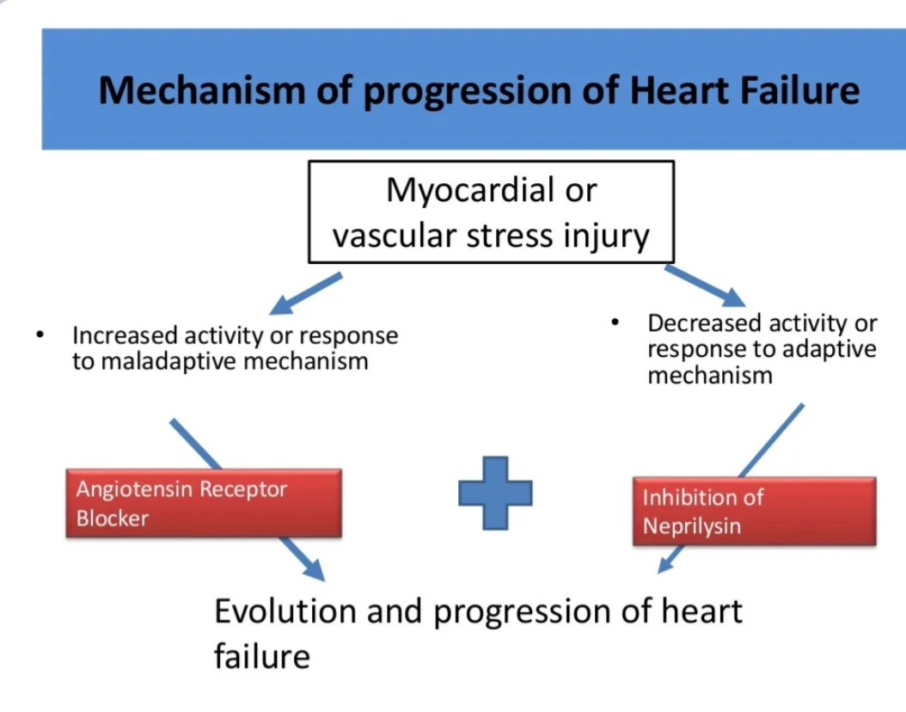

Slide 53
ACE to ARNI –stop ACE for 72hrs and then start ARNI

Slide 63
Aldosterone antagonists

Slide 64
Role of aldosterone in CV disease
Direct correlation of aldosterone levels and mortality in heart failure
Increase in myocardial fibrosis
Inhibition of the release of NO
Increased incidence of arrhythmias
Increased response to vasoconstrictor doses of angiotensin I
Critical mediator of early angiotensin II induced experimental myocardial injury

Slide 65
Deleterious effects of aldosterone

Slide 66
Aldosterone antagonists
Spironolactone
Eplerenone
Canrenone ( available only in europe)

Slide 67
What do they do?
Decrease extracellular markers of fibrosis
Decreases the release of cardiac norepinephrine
Vasodilator effects

Slide 68
Spironolactone- mechanism of action
It is a steroid chemically related to aldosterone
Competitive inhibition of the mineralocorticoid receptor from the interstitial side of the tubular cell
Inhibits formation of (Aldosterone induced proteins) AIPs

Slide 69
Spironolactone
Spironolactone acts as an antagonist and/or agonist at the following sites:
Antagonism
Mineralocorticoid receptor
Androgen receptor
Agonism
Progesterone receptor
Glucocorticoid receptor

Slide 70
Spironolactone bodies
Long-term administration of spironolactone gives the histologic characteristic of spironolactone bodies in the adrenal cortex. Spironolactone bodies are eosinophilic, round, concentrically laminated cytoplasmic inclusions surrounded by clear halos in preparations stained with hematoxylin and eosin

Slide 71
Contraindications
Hyperkalemic states
Pregnancy - high risk of feminisation of female fetuses

Slide 72
Pharmacokinetics
75% oral bioavailability
Highly bound to plasma proteins
Completely metabolised in the liver
Half life of spironolactone is 1-2 hours

Slide 73
Indications
To improve survival of stable patients with LV systolic dysfunction ( EF <35/40%(post MI))
Hypertension
Refractory edema in cirrhosis and renal disease – helps to breakdown resistance to thiazide diuretics due to secondary hyperaldosteronism
To counteract K+ loss due to thiazide and loop diuretics

Slide 74
Interactions
Dangerous hyperkalemia can occur if given with K+ supplements or drugs causing hyperkalemia ( ACEI or ARBs)
Aspirin blocks action of spironolactone by inhibiting tubular secretion of canrenone
Spironolactone increases plasma digoxin concentration

Slide 75
Adverse effects
Drowsiness , confusion and abdominal discomfort
Hirsutism,gynecomastia,impotence and menstrual irregularities
Hyperkalemia especially in renal disease
Risk of acidosis in cirrhotics

Slide 76
Eplerenone
More selective aldosterone antagonist
Less likely to cause hormonal disturbances like gynecomastia,impotence and menstrual irregularities

Slide 77
EPLERENONE
Starting dose 25 mg daily increased to 50 mg daily if serum potassium < 5.0 mEq/L
If serum K+ is > 5.5 mEq/L then the dose must be decreased or discontinued
Specific warning in T2DM with hypertension and microalbuminuria because of the risk of hyperkalemia
Dose for hypertension ; 50-100 mg once daily
Equally effective in white and black patients.

Slide 79
Trial data – aldosterone antagonists
Aldosterone antagonists (or mineralocorticoid receptor antagonists [MRAs]) are guideline-recommended therapy for patients with moderate to severe heart failure (HF) symptoms and reduced left ventricular ejection fraction (LVEF), and in postmyocardial infarction patients with HF.

Slide 80
Trial data
RALES,TOPCAT ( spironolactone)
EPHESUS ; EMPHASIS-HF ; 4E ( eplerenone)
AREA IN CHF ( canrenone )

Slide 81
The Eplerenone in Mild Patients Hospitalization and Survival Study in Heart Failure (EMPHASIS-HF)
Eplerenone reduced the risk of the primary endpoint of cardiovascular death or HF hospitalization (hazard ratio [HR] 0.63, 95% confidence interval [CI] 0.54-0.74, P < .001) and all-cause mortality (adjusted HR 0.76, 95% CI 0.62-0.93, P < .008) after a median of 21 months

Slide 82
The Randomized Aldactone Evaluation Study(RALES)
Eplerenone Post-Acute Myocardial Infarction Heart Failure Efficacy and Survival Study (EPHESUS) established that spironolactone and eplerenone, respectively, increased survival in patients with severe CHF symptoms from LV systolic dysfunction occurring with minimal exertion or at rest (New York Heart Association [NYHA] class III or IV) or CHF after an acute myocardial infarction

Slide 83
THE 4E STUDY
The 4E Study (Eplerenone,Enalapril, and Eplerenone/Enalapril Combination Therapy in Patients with Left Ventricular Hypertrophy) compared the effects of 9-month treatment with eplerenone 200 mg/d (n=64), enalapril 40 mg/d (n=71), or eplerenone 200 mg/d plus enalapril 10 mg/d (n= 67) on LV mass, systolic and diastolic blood pressures, and urinary albumin-creatinine ratio (UACR) in patients with mild-to-moderate hypertension and echocardiographic evidence of LVH.
Combination therapy with eplerenone and enalapril significantly reduced LV mass

Slide 84
TOPCAT study (Treatment of Preserved Cardiac
Function Heart Failure With an Aldosterone
Antagonist)

Slide 85
Direct renin inhibitors

Slide 86
Aliskiren
Aliskiren is the first synthetic non peptide direct renin inhibitor (DRI) to be approved
Aliskiren binds to the active site (S1/S3 hydrophobic binding pocket) of renin, preventing the conversion of angiotensinogen to angiotensin I

Slide 87
Aliskiren - pharmacokinetics
Direct renin inhibitor
50 – 80 % decrease plasma renin activity
Pharmacokinetics
Accumulation Half-life of ~ 24 hours
Oral bioavailability of 2.6%
7 – 8 days to achieve steady state levels
Elimination Half-life of ~ 48 hours
25 % excreted by kidneys
Metabolized by CYP 450-3A4
Does not induce or suppress CYP 450
No effect on QT interval

Slide 88
Aliskiren – pharmacokinetics
Pathway of elimination for aliskiren is via biliary excretion as unmetabolized drug.
Less than 1% of an orally administered dose is excreted in urine.
Not metabolized by, and does not induce or inhibit, cytochrome P450 enzymes and shows no clinically relevant pharmacokinetic interactions with warfarin, lovastatin, atenolol,celecoxib,cimetidine,amlodipine,valsartan,hydrochlorothiazide (HCTZ), or ramipril.
The pharmacokinetics of aliskiren remain unaffected by ethnicity, age, gender, hepatic impairment, renal impairment, and diabetes.

Slide 90
Thank you

