Slide 1
Assessment of LV Diastolic Function by ECHO
Dr Sanchna Dev S
Dept of Cardiology
TDMC

Slide 2
Overview
Introduction
Determinants of diastolic function.
Conventional echo parameters
Echo findings supporting the presence of diastolic dysfunction
New technologies for assessment
Algorithms
Assessment in specific groups

Slide 3
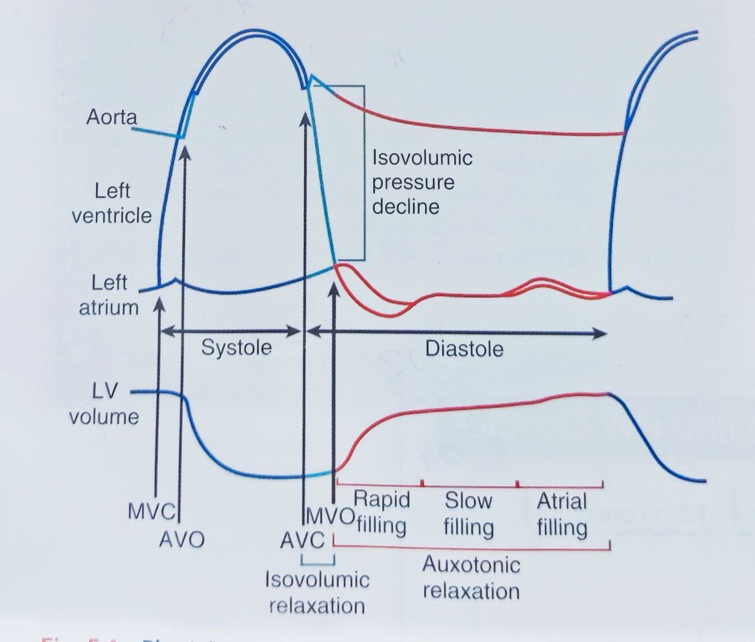
Introduction
Diastole –time interval between AV closure and MV closure.
Comprises 4 phases
ISOVOLUMIC RELAXATION
RAPID FILLING
SLOW FILLING (DIASTASIS)
ATRIAL CONTRACTION
NORMAL DIASTOLIC FUNCTION – ability of the LV to fill adequately to provide a normal stroke volume at normal LVFP both at rest and during excercise

Slide 4
Physiology
Key determinants of the driving pressures between LA and LV and of LV filling :
LV RELAXATION
LV COMPLIANCE
LA CONTRACTION
In young healthy individuals- most filling occurs in early diastole ( rapid filling phase)
With impaired relaxation and compliance , filling progressively shifts to late diastole —> atrial contraction to CO contribution increases ( 20 % to 40%)

Slide 5
Ventricular untwisting ( apical clockwise rotation) —mainly responsible for early diastolic filling- begins in late systole and extends into first third of diastole
Precedes diastolic lengthening and expansion of myocardial fibre
Responsible for early LV base to apex pressure gradients – diastolic suction —> fall in LV pressure —> rapid filling phase
LVDD –usually the result of abnormal LV relaxation with or without reduced restoring forces ( diastolic suction ) and inc LV chamber stiffness

Slide 6
Invasive evaluation of LV diastolic function
Cardiac catheterisation - gold standard - demonstrating abnormalities of LV relaxation , compliance and filling —by direct measurement of LV relaxation time constant, stiffness modulus and LVFP
“LV filling pressures” –indiscriminately used w.r.t. any of the following invasive measurements :
Mean PCWP >12mmHg
Mean LAP
LV pre-A pressure
Mean LV diastolic pressure
LV EDP >16 mmHg

Slide 9
Determination of LV Diastolic function
Ventricular relaxation and compliance-Haemodynamic load (afterload)
Synchrony
Cellular mechanisms
LA volume and function
Heart rate
Pericardium.
Derangement of any of the above will lead to abnormal filling pressures and diastolic dysfunction.

Slide 10
Echo Diagnosis Of Diastolic Function
Aptly described as non invasive “Swan ganz catheterization”
2D
M Mode.
Doppler- PW, CW and TDI
Newer modalities like Speckle tracking echocardiography

Slide 11
Conventional Echocardiographic parameters of diastolic function
Mitral inflow parameters
Pulmonary Venous flow parameters
Color M mode echo
Tissue Doppler echo

Slide 12
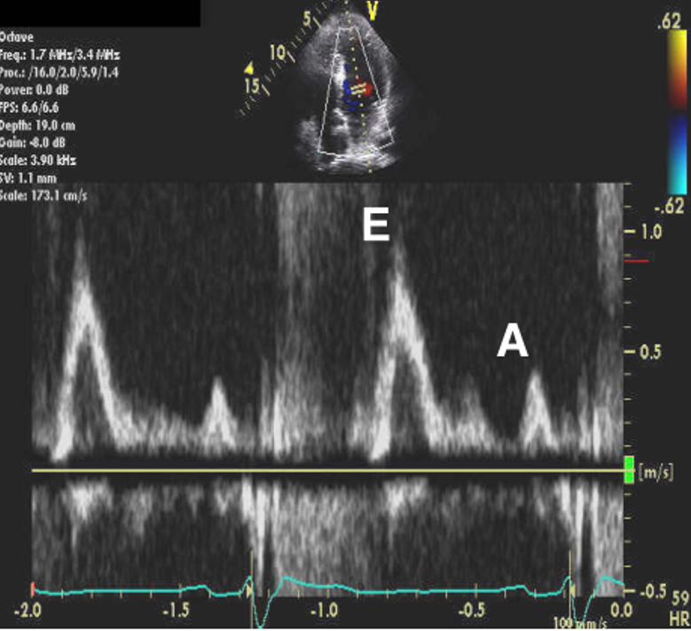
Mitral Inflow parameters
Acquisition –
Apical four-chamber with color flow imaging for optimal alignment of PW Doppler with bloodflow.
PW Doppler sample volume(1–3mm axial size)between mitral leaflet tips.
Parameters
MV peak E velocity
MV peak A velocity
MV E/A
MV E DT (msec) –time interval from peak E wave along the slope of LV filling extrapolated to baseline

Slide 13
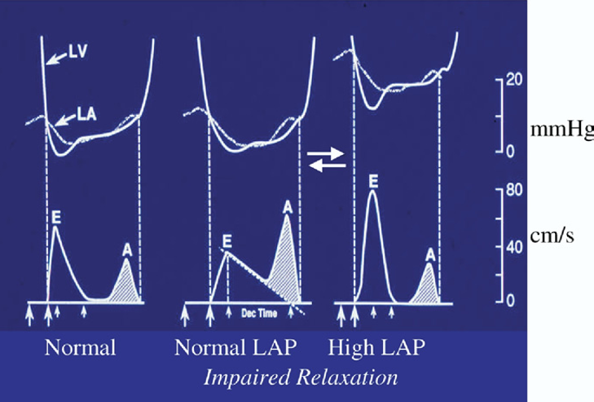
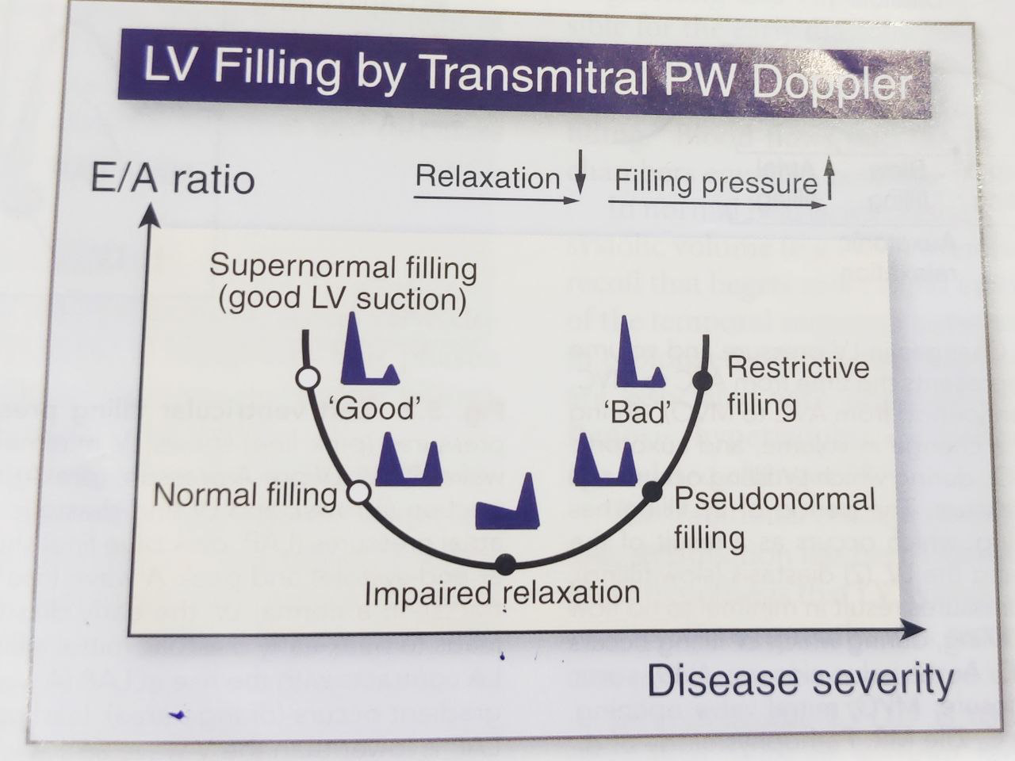

Slide 14
M E/A
MITRAL EDT
Advantages
Feasible & reproducible
DCM- filling patterns correlate better with LVFP , FC and prognosis than LVEF
Normal EF- restrictive filling +LA dilatation a/w poor prognosis
Disadvantages
U shaped relation – diff normal from abnormal
Not applicable in AF/ Atrial flutter
Age dependent (decreases with aging)
Advantages
Feasible & reproducible
Short EDT in reduced LVEF ~ increased LVFP with high accuracy in both SR and in AF
Disadvantages
EDT does not relate to LVEDP when LVEF is normal
Not applicable in atrial flutter
Age dependent ( increases with aging)

Slide 15
Loading conditions and aging are important factors that influence mitral inflow parameters
The load dependency of mitral inflow parameters can be overcome by performing Valsalva maneuver
A decrease in E/A ratio of ≥50% during valsalva is highly specific for increased LVFP
Mitral L velocity

Slide 18
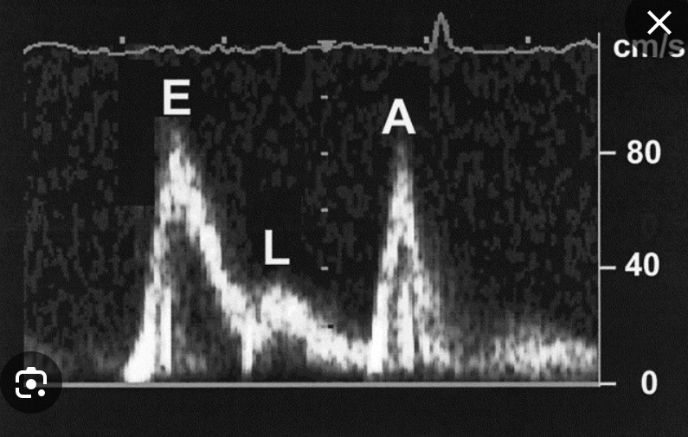

Slide 19
Pulmonary Venous Flow parameters
Acquisition –
Apical four-chamber with color flow imaging for optimal alignment of PW Doppler with bloodflow.
sample volume(1–3mm axial size) placed at 1-2 cm depth into right upper PV
Parameters
Normal PV flow has two forward waves S (systolic) and D (diastolic) and a reversal wave (Ar) –at the time of atrial contraction
In normal subjects the S/D is >1 and the Ar wave is usually small

Slide 22
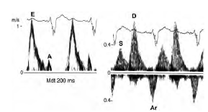
As LV compliance decreases and LAP increases – there’s blunting of S wave and a decrease in the systolic filling fraction.
(The systolic filling fraction = systolic VTI /Total forward flow VTI)
D wave becomes more prominent with shortened deceleration time
Ar duration and velocity increases
(Ar ≥ 35 cm/s suggest increased LVEDP)
Also influenced by loading conditions and ageing

Slide 23
Advantages
Disadvantages
Reduced S velocity,
S/D ratio <1 ,
systolic filling fraction < 40% —> INCREASED LAP in pts with reduced LVEF
D wave deceleration time (DDT) can be used to estimate LAP in AF
(DDT >220 msec has excellent accuracy in predicting normal PCWP in pts with AF)
Feasibility of recording PV inflow
The relationship between PV systolic fraction and LAP has limited accuracy in pts with normal EF, AF,MV disease or HCM

Slide 24
Ar -A duration
The PV Ar > mitral A duration by >30 msec indicates an increased LVEDP
Independent of age and EF
Accurate in pts with MR and HCM
Feasibility
Not applicable in pts with AF
Difficult to interpret in pts with sinus tachycardia or first degree AV block with E and A fusion

Slide 26
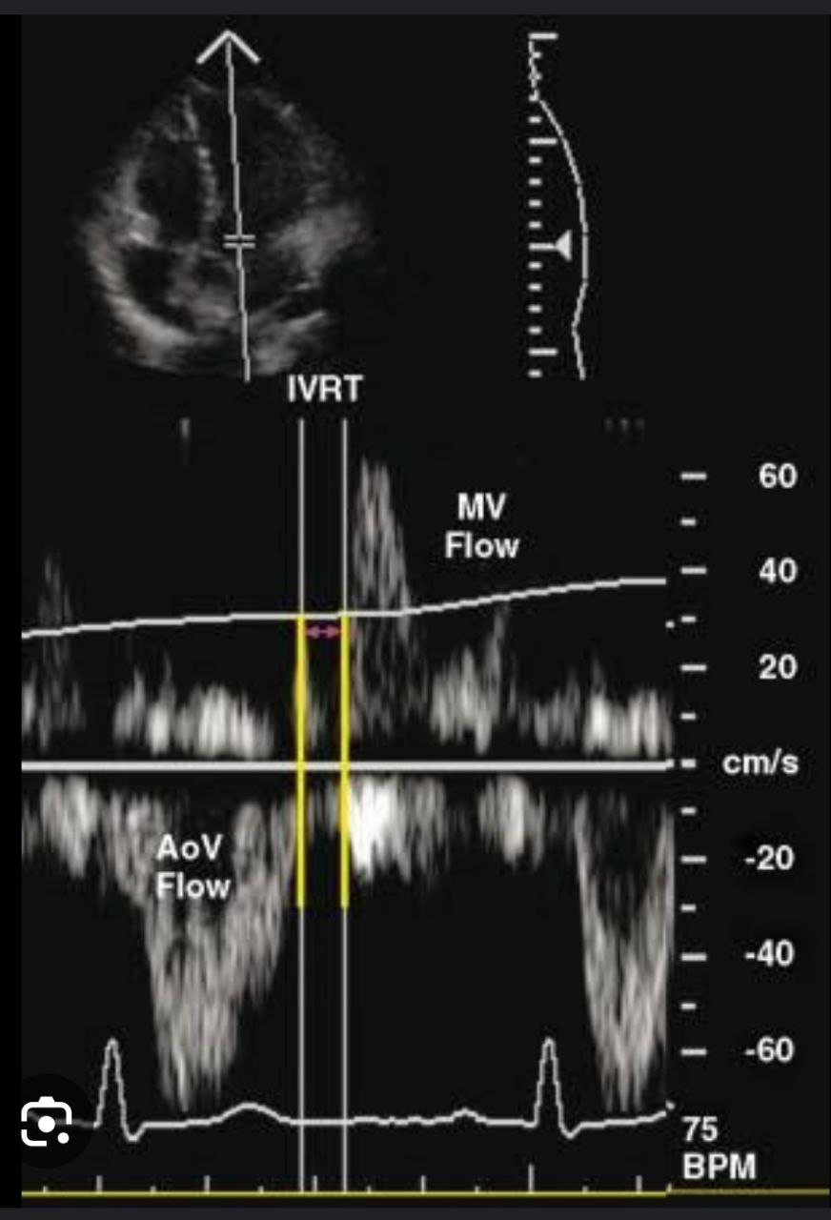
IVRT
Acquisition –
Anteriorly angulated A4C with 3–5-mm sample volume midway between aortic and mitral valves
Using CW doppler to simultaneously display end of aortic ejection and onset of mitral inflow
Normal IVRT is 90-100ms .
IVRT prolongation (>110ms) is an early manifestation of impaired LV relaxation
Short IVRT (<60 ms) indicates that mean LAP is elevated

Slide 27
Advantages
Disadvantages
Feasible, reproducible
Can be used in combination with other parameters viz. mitral inflow parameters in HFrEF
Combination with LVESP to estimate the time constant of LV relaxation
IVRT duration affected by heart rate and arterial pressure
More challenging to interpret in tachycardia
Results differ based on using CW or PW Doppler for acquisition

Slide 28
Colour M-Mode Echo
Acquisition –
A4C with color flow imaging for M mode cursor position
Normally pts in sinus rhythm have 2 waves of color flow in diastole –
The first E wave – from mitral annulus to apex ( represents early LV filling)
Second A wave – does not exceed middle portion of LV ( corresponds to atrial contraction)
2. Slope of inflow from MV plane into the LV chamber during early diastole at 4 cm distance
Flow propagation velocity (Vp) of the E wave
Vp >50 cm/s is considered normal.
Semi quantitative marker of LV diastolic dysfunction- progressively decreases with LVDD and does not undergo the phenomenon of pseudonormalisation

Slide 30
Advantages
Disadvantages
Vp is reliable in patients with depressed LVEF
E/Vp ≥2.5 predicts PCWP > 15 mm Hg with reasonable accuracy in patients with depressed LVEF
Prediction of LV filling pressures in patients with normal Ef’s should be with caution as they can have misleadingly normal Vp
Vp is not currently recommended as a first line parameter for LVDD
low reproducibility

Slide 31
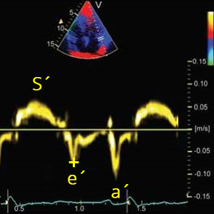
Tissue Doppler echo
PW tissue Doppler imaging (TDI) allows assessment of diastolic function by measuring the peak diastolic velocities of the mitral annulus
Acquisition - Apical 4C view
Primary measurements include systolic (S), early diastolic, and late diastolic velocities.
Early diastolic annular velocity has been expressed as Ea, Em, E´, or e´, and the late diastolic velocity as Aa, Am, A´, or a´.

Slide 32
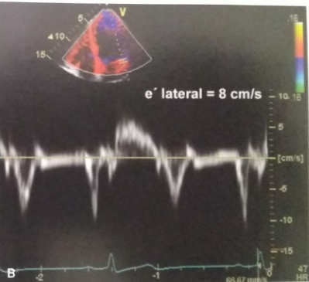

Slide 33
Parameters
e´ septal and e´ lateral diastolic velocities
Time interval between QRS complex- e´ onset time is prolonged in impaired LV relaxation.
[QRS-E]- [QRS-e’]=T_{E-e´} (Time interval between peak of R wave in QRS complex and onset of mitral E velocity is subtracted from time interval between QRS complex and onset of e’ velocity)
Annular e´/a´
Doppler E/e´ ratio is helpful in estimation of filling pressures and LV relaxation.

Slide 34
Septal e´ velocity < lateral e´ velocity & septal E/ e´ > lateral E/ e´ .
With age, e´ velocity decreases, whereas a´ velocity and the E/e´ ratio increase
Septal E/e´ <8 is usually associated with normal LV filling pressures.
Septal E/e´ >15 is associated with increased filling pressures.
IVRT/T_{E-e´} ratio <2 has reasonable accuracy in identifying patients with increased LV filling pressures
Limitations
Regional dysfunction in sampled segments
E´ may be decreased in annular calcification, surgical rings, mitral stenosis, and prosthetic mitral valves
Age dependent

Slide 36
Echo findings supporting the presence of diastolic dysfunction
Pathological LV hypertrophy
LA dilatation
Pulm HTN

Slide 37
LV Hypertrophy
Concentric hypertrophy or remodeling can be observed in Diastolic HF.
Eccentric LV hypertrophy in depressed Efs.
LV mass best measured by 3D echo but in 2D echo at least LV thickness should be measured.
LV wall thickness should be measured to arrive conclusions on LV diastolic function.
Relative wall thickness PW+IVS/LVID( diastole)
Relative wall thickness ≥0.42 used as threshold for pathologic LVH
LV mass index >95 g/m2 in females and > 115 g/m2 in males

Slide 38
LA Volume
Apical 4-chamber and 2-chamber views .
Signifies cumulative effect of increased filling pressures.
Normal- 16-34 ml/m²
LA volume index >34 mL/m² is an independent predictor of death, heart failure, atrial fibrillation, and ischemic stroke in diastolic dysfunction.
False results- Bradycardia, anemia and other high-output states, atrial flutter or fibrillation, and significant mitral valve disease.

Slide 39
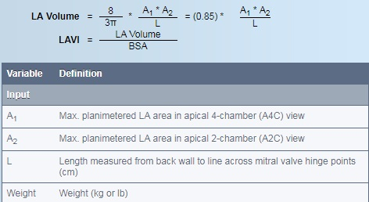
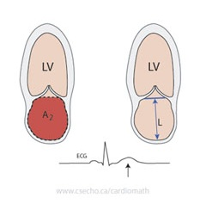

Slide 40
Pulmonary HTN
Symptomatic Diastolic dysfunction assoc Increased pulmonary artery (PA) pressures.
Peak velocity of the tricuspid regurgitation (TR) jet by continuous-wave (CW) Doppler together with systolic right atrial (RA) pressure are used to derive PA systolic pressure.
PASP = 4 X TR (V)² + RAP
PADP = 4 X PR (V)² + RAP
PA systolic pressure may be used as a surrogate for measuring LVFP
PA diastolic pressure may be used as a surrogate for measuring mean pulmonary wedge pressure.

Slide 42
New technologies
Diastolic stress test
LV strain
LA strain

Slide 43
DIASTOLIC STRESS TEST
Detect reduced LV systolic and/or diastolic reserve capacity in the setting of diastolic dysfunction.
Normal subjects :Increase stroke volume without significantly increasing filling pressures.
DD-Cardiac output achieved at the expense of increased LV filling pressures.
Indicated when resting echocardiography does not explain the symptoms of heart failure or dyspnoea, especially with exertion.
Most appropriate patient population for diastolic exercise testing is the group of patients with grade 1 diastolic dysfunction, which indicates delayed myocardial relaxation and normal LA mean pressure at rest.

Slide 44
Stress test is considered abnormal when all of the following conditions are met :
Averaged E/e’ >14
Septal E/e’ > 15
TR peak velocity >2.8 m/s
Septal e’ velocity < 7 cm/s

Slide 45
LV strain
Strain is most often expressed as a percentage or fractional strain.
Measured by 2D 3D or 4D speckle-tracking echocardiography
Values <16% -definitely abnormal
Global myocardial strain rate during the iso volumetric relaxation period (by speckle tracking) and mitral E velocity/global myocardial strain rate ratio predicted LV filling pressure in patients in whom the E/e´ ratio was inconclusive and was more accurate than E/e´.

Slide 46
LV global longitudinal diastolic strain rate measurements during the isovolumic relaxation period and during early diastole by STE have a significant association with the time constant of LV relaxation (t).
LV untwisting rate is another parameter that can be used as a surrogate of LV relaxation.
LA systolic strain can be combined with invasive and non invasive measurements of LAP to estimate LA stiffness.

Slide 47
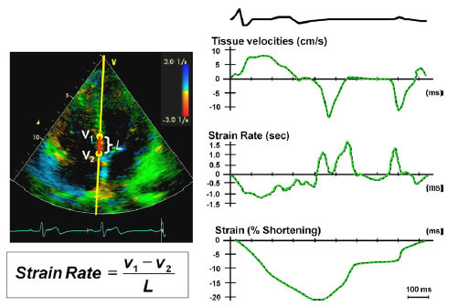

Slide 50
Approach to grade Diastolic Dysfunction

Slide 51
Grading of diastolic dysfunction

Slide 53
LV filling pressure in special population
HCM with severe MR- Ar‑A duration ≥30 ms and peak TR jet velocity 2.8 m/s.
AF- short DT (130 ms) , E/e’ and IVRT <65ms , PASP, E/Vp, PV DT <220 ms.
Av block and pacing- Peak velocity of TR >2.8 m/s, E/e’ not reliable.
Aortic stenosis and regurgitation -Average E/e’ ratio >14 ,Peak velocity of TR >2.8 m/s.
MS, MR and MAC- IVRT , IVRT/TE‑e’ ratio,E/e’ not reliable.
Post heart transplantation-peak velocity of TR is only helpful parameter in evaluating mean LAP provided pulmonary causes are excluded to detect graft rejection.

Slide 54
Conclusion
Diastole is a complex, energy-dependent process.
Echo indices of diastolic function include transmitral Doppler inflow, TD velocities, pulmonary venous Doppler study, and Color M-mode propagation velocity.
Diastolic dysfunction is a measurable, step-wise progression from normal to irreversible.
Ongoing research

Slide 56
MCQ’S

Slide 57
LAVI more than what value is an independent predictor of mortality in death in diastolic dysfn
24 mL/m²
34 mL/m²
44 mL/m²
54 mL/m²
Ans: 34 mL/m²

Slide 58
All of the following signifies grade IV Diastolic dysfunction all except
DT- 120 msec.
E/é -14
D>S and Ar-A=24
Vp< 45
Ans: D>S and Ar-A=24

Slide 59
All the following are true except
Diastolic stress test is done to detect reduced LV systolic and/or diastolic reserve capacity in the setting of diastolic dysfunction.
Normal Diastolic stress test response is increase stroke volume with increased filling pressures.
LV global longitudinal diastolic strain rate measurements during the isovolumic relaxation period in speckle tracking echocardiography.
LV untwisting rate is another parameter that can be used as a surrogate of LV relaxation.
Ans: Normal Diastolic stress test response is increase stroke volume with increased filling pressures.

Slide 60
E/e’ is not a useful parameter in all the following conditions to estimate filling pressures except
Mitral Regurgitation.
LBBB
Atrial fibrillation.
Post transplant.
Ans: LBBB

Slide 61
Diastolic dysfunction can be assessed by all of the following in AF except
MV EDT
E/e’
IVRT
PASP
E/Vp
PV DT
Ans :none

