Slide 1
DYNAMIC AUSCULTATION
Dr Arun Jude Alphonse
DM Cardiology Resident
Govt TDMC Alappuzha

Slide 2
What shall we discuss today ?

Slide 3
Dynamic – NOT just auscultation!
WHAT CAN BE DYNAMIC ? WHAT CAN MAKE IT DYNAMIC ?
Symptoms
Pulse
BP
JVP
Heart sounds
Additional sounds
Murmurs
Respiration
Position
Maneuvers
Pharmacologic
AF/Ectopics

Slide 5
THE BASIC CONCEPT …
Augment / attenuate the hemodynamic factors responsible for the genesis of sound

Slide 6
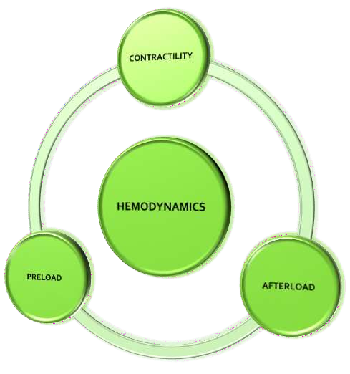
THE MAJOR DETERMINANTS

Slide 7
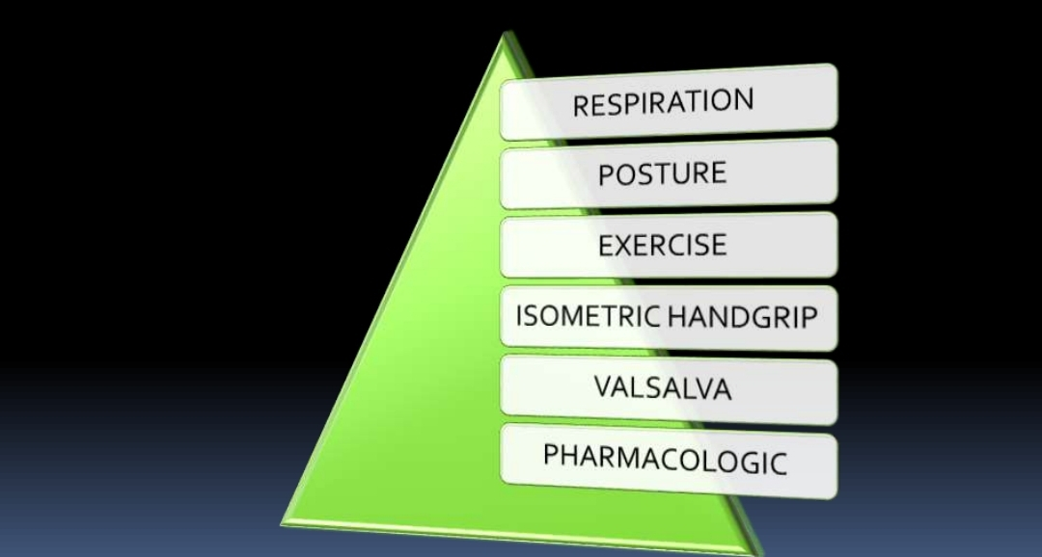
MODIFIERS OF THESE MAJOR DETERMINANTS

Slide 8
PRELOAD
Increased–
Lying down , Lower limb elevation, Squatting,
Inspiration(Right sided), Expiration(Left sided)
Reduced –
Upright posture ,
Inspiration(Left sided), Expiration(Right sided),
Valsalva(second phase)

Slide 9
AFTERLOAD
Increased by –
Squatting ,Isometric hand grip
Vasoactive agents- methoxamine ,phenylephrine
Decreased by -
Vasoactive agents-
Amyl nitrite(inhalation)

Slide 10
CONTRACTILITY
Increased by –
Long cycle length after PVC
or in long cycles of AF , walking

Slide 11
WHY DO IT AT ALL ?
Diagnose
Confirm clinical impression
Identify the origin
Differentiate
NEVER INTERPRET IN ISOLATION;
ALWAYS INTEGRATE WITH HISTORY,REST OF EXAMINATION

Slide 12
SPECIFIC ROLES
CORROBORATE
DIFFERENTIATE
VENOUS HUM
HOCM
MVP,MR
MS
HOCM VS AS
MVP-MR VS OTHER
MDM AT APEX
AS VS MR
MR VS TR
TOF VS PS
AR VS PR
PULMONARY EC VS
AORTIC

Slide 13
What is a ‘SIGNIFICANT’ augmentation ?
Increase in grade of murmur by atleast 1 grade
Development of a new thrill

Slide 14
When NOT to do it ?
Sick patient
HF
Very loud murmur
No additional information expected

Slide 15
ONE BY ONE

Slide 16
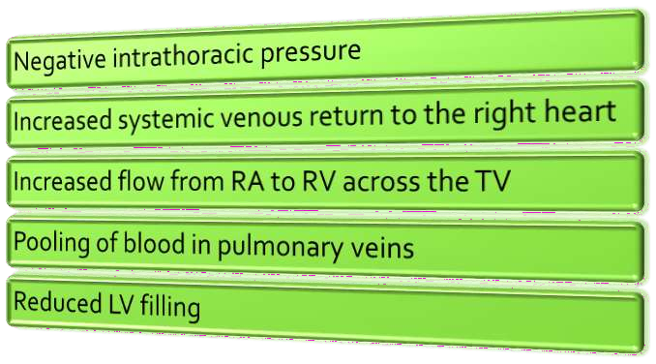
INSPIRATION

Slide 17
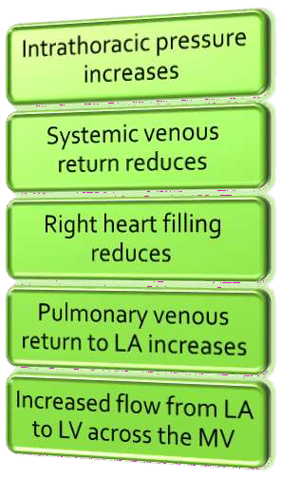
EXPIRATION

Slide 18
RESPIRATION
LOUDER ON INSPIRATION
RV S3, RVS4
TR
TS
PS
PR
LOUDER ON EXPIRATION
LV S3, LVS4
MR
MS
AS
AR

Slide 19
PULMONIC VALVE EJECTION CLICK : VALVULAR PS
EXCEPTION
typically softens or disappears with inspiration
PULMONARY STENOSIS
RVH→ ↓RV compliance→ RVEDP ↑
INSPIRATION
↑ Venous return to the RH →
More forceful RA contraction
→
↑ in RVEDP → RV late diastolic pressure exceeds the simultaneous PADP
Pulmonary valve cusps are pushed towards an open position during late diastole → Minimal further opening excursion of pulmonary valve cusps during systole
PV ejection click softens or disappears…………….

Slide 20
POSTURAL CHANGE
RAPID STANDING
Decrease in venous return, thus stroke volume

Slide 21
Width of the splitting become reduced
No change in patients with true fixed split
Decrease in intensity
RVS3 and RVS4
LVS3 and LVS4

Slide 22
Decrease in intensity
Semilunar valve stenosis
AV valve regurgitation murmurs
VSD
Most functional systolic murmurs

Slide 23
Since LV EDV is decreased
Increase in murmurs
HOCM(95% sensitivity, 84% specificity)
Early MSC and murmur of MVP

Slide 24
SQUATTING
Sudden change from standing to squatting position
Increase venous return and systemic resistance simultaneously
Squatting abruptly increases ventricular preload and afterload
Arterial pressure rise may cause transient reflex bradycardia

Slide 25
Elevation of arterial pressure
Increase in aortic reflux AR
Increase in MR volume
Increase in LT to RT shunt in VSD
Increase in blood flow through RVOT in TOF

Slide 26
Increase in stroke volume causes augmentation of
S3 and S4(of both ventricles)
Right sided murmurs
MS
AS

Slide 27
Lt Lateral Decubitus
LV impulse [apical sounds, murmurs better heard]
Sitting leaning forward
Accentuate AR and PR murmur (mechanical)

Slide 28
POSTURE - EFFECTS
LOUDER ON UPRIGHT
HOCM
MVP
LOUDER ON SQUATTING
AR
MR
VSD
PS
AS
TR
LVS3, LVS4

Slide 29
POSTURE - EFFECTS
SOFTER ON UPRIGHT
AS
PS
MS
TS
SOFTER ON SQUATTING
HOCM
MVP – murmur may increase or decrease, but begins later in sytole

Slide 30
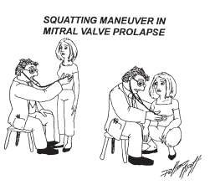
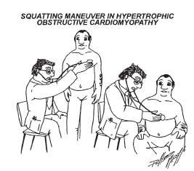
POSTURE-SQUATTING AND STANDING

Slide 31
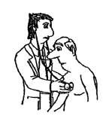
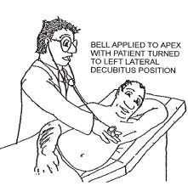
POSTURE
AR - EDM
MS – MDM AT APEX

Slide 32
ISOMETRIC EXERCISE
This can be carried out by using a calibrated handgrip device or a handball
Better to carryout bilaterally
Should be sustained for 20 to 30 secs
Valsalva maneuver during the handgrip must be avoided
Contraindicated in patients with myocardial ischemia and ventricular arrhythmias

Slide 33
Isometric exercise results in significant increase in
Systemic vascular resistance
Arterial pressure
Heart rate
COP
LV filling pressure
Heart size

Slide 34
Systolic murmur of AS diminished –reduction of pressure gradient across AV
Diastolic murmur of AR and systolic murmurs of rheumatic MR and VSD
increases
LVS3 and LVS4 accentuated
Diastolic murmur MS becomes louder –increase in flow across valve

Slide 35
Increase LV volume
Systolic murmur of HOCM decreased
Click and murmur of MVP delayed

Slide 36
ISOMETRIC HANDGRIP - EFFECTS
INCREASES
DECREASES
LVS3, LVS4
MR
AR
VSD
MS
HOCM
AS

Slide 37
VALSALVA MANEUVER
Forced expiration against a closed glottis
Standard test consists of asking the patient to blow against an aneroid manometer and maintain a pressure of 40mmhg for 30seconds

Slide 38
Relatively deep inspiration followed by forced exhalation against a closed glottis for 10 to 20 seconds
Physician has to keep flat of the hand on the abdomen to provide the patient a force to breathe against
Normal response has four phases

Slide 39
PHASE1
Intrathoracic pressure rises
Transient increase in LV output and SBP

Slide 40
PHASE II STRAINING PHASE
Systemic venous return decrease
Filling of right and then left side reduced
Stroke volume reduced
Mean arterial and pulse pressures falls
Reflex tachycardia

Slide 41
A2-P2 interval narrows
Attenuation of
S3 and S4
AS & PS
MR & TR
AR & PR
TS & MS

Slide 42
Since LV volume is reduced
Murmur of HOCM increased(65% sensitivity, 95% specificity)
Systolic click and murmur of MVP commence earlier

Slide 43
PHASEIII VALSALVA RELEASE
During first two cycles following release murmurs and sounds(S3 and S4) right side of heart return to normal
After six to eight cycles sounds and murmurs originating from left side of heart returns to normal
A2-P2 split increases
Decrease SBP

Slide 44
PHASE IV OVERSHOOT PHASE
Murmurs and heart sounds transiently augmented

Slide 45
Valsalva Maneuver
sudden return of peripherally pooled blood to the vaso-constricted arterial
system (2⁰ to the increased sympathetic tone)
initial pulm VR = SV
I/T Pr directly transmitted to aorta.
Sudden I/T Pr = BP
I/T Pr = VR = BP
sympathetic tone HR

Slide 47
POSTPREMATURE VENTRICULAR CONTRACTIONS
Followed by a significant pause
Increase in ventricular filling
Augmentation of cardiac contractility- post extra systolic potentiation

Slide 48
During postpremature beat – augmented are
ESM of AS and PS ^volume
^contractility
HOCM ^contractility-increase dynamic
LVOT obstruction
^volume-decrease LVOT obstruction
net increase gradient

Slide 49
PSM of MR and of VSD - not altered(relatively little further increase in mitral valve flow or change in the LV-LA gradient) (ventricle has has 2 openings aorta and LA in MR not in AS)
Systolic murmur of papillary muscle dysfunction diminish
Increase in LV size delays systolic click and murmur of MVP (depend mainly on volume)

Slide 50
IDENTIFY

Slide 51
Similar auscultatory changes follow prolonged diastolic pauses in AF

Slide 52
PHARMACOLOGICAL AGENTS
AMYL NITRITE INHALATION
Crush ampoule in towel
take 3-4 deep breaths over 10 – 15 secs
First 30 secs– Systemic art pressure decrease
30 to 60 secs– Reflex Tachycardia
> 60 secs -CO,HR and Velocity of BF
increase

Slide 53
S1 augmented
A2 diminished
OS mitral and tricuspid valve become louder
A2 OS interval shortens
RVS3 and LVS3 augmented –rapidity of ventricular filling
LVS3 associated with MR diminished(MR reduced)

Slide 54
Systolic murmurs accentuated are
HOCM
AS
PS
TR
Functional systolic murmurs
Increased ventricular contractility and SV

Slide 55
Due fall in systemic arterial pressure murmurs diminished are
PSM of MR
PSM of VSD
EDM of AR
Austin flint murmur
Continuous murmur of PDA
Continuous murmur of AVF

Slide 56
Reduction cardiac size leads to
Early appearance of click and murmur of MVP
Murmur intensity show variable response

Slide 57
Amyl nitrate response useful in distinguishing
Systolic murmur of AS(^)and MR(v)
Systolic murmur of TR(^) and MR(v)
Systolic murmur of PS(^) and TOF(v)
Systolic murmur of PS(^) and VSD(v)
Diastolic murmur of MS(^) and Austin flint(v)
EDM of PR(^) and AR(v)

Slide 58
METHOXAMINE AND PHENYL EPHRINE
Increase systemic arterial pressure
Reflex bradycardia and decreased contractility and COP
Contraindicated in CHF and HTN

Slide 59
Methoxamine 3-5 mg IV increase arterial pressure by 20-40 mm Hg for 10 to 20 min
Phenylephrine 0.5mg IV elevates systolic pressure around 30mm Hg for 3-5min
Phenylephrine preferred due to shorter duration action

Slide 60
S1 reduced
A2 becomes louder

Slide 61
Increase in arterial pressures cause following murmurs louder
EDM of AR
PSM of MR
VSD
TOF
Continuous murmurs of PDA and AVF

Slide 62
Systolic murmur of HOCM softens(^ LV size)
Click and murmur of MVP delayed(^ LV size)
Decrease in COP diminish
ESM of AS
Functional systolic murmurs
MDM of MS

Slide 63
TRANSIENT ARTERIAL OCCLUSION
Transient external compression of both brachial arteries
By bilateral cuff inflation to 20 mm Hg greater than peak systolic pressure
Augments the murmurs of MR, VSD, and AR

Slide 64
MS
Inspiration, Sudden standing
Dec pulmonary venous return, Reduces LAP
MDM reduced
OS softens
A2-OS gap widen
Three sequential sounds (A2, P2, and OS) may be audible
Exercise ,Squatting ,Amyl Nitrate
MDM accentuated

Slide 65
MR
Varies little with respiration
Decrease murmur
Sudden standing
Valsalva
Amyl Nitrate
Augments the murmur
Squatting
Isometric Exercise

Slide 66
TR MURMUR AND RIGHT HEART FILLING
INCREASED
INSPIRATION
HJR
LEG ELEVATION
SQUATTING
MUELLER’S MANEUVER
MILD EXERCISE
VOLUME OVERLOAD
VALSALVA-
RELEASE(IMMEDIATE)
DECREASED
EXPIRATION
STANDING
VALSALVA-STRAIN
NTG
DIURESIS
HYPOVOLEMIA

Slide 67
TS : Tricuspid MDM
INCREASED
INSPIRATION
MUELLER
RIGHT LATERAL
LEG RAISE
AMYL NITRITE
SQUATTING
ISOTONIC EXERCISE
DECREASED
EXPIRATION
VALSALVA STRAIN

Slide 68
AS
Murmur increases on
Post PVC beat
squatting
Reduces AS murmur
Valsalva
Standing
handgrip

Slide 69
AR
EDM increases on
sitting up and leaning forward
Squatting
Isometric exercise
Vasopressors
Decreases with
Amyl Nitrate
Valsalva

Slide 70
MVP
Murmur and click earlier(intensity decreases)
LV Volume decrease
Standing
Valsalva
Murmur and click later
LV Volume increase
Squatting
Post ectopic
Isometric Exercise (intensity increases)

Slide 72
HOCM
Increase murmur in
Valsalva
Standing
Post ectopic
Decrease murmur in
Sustained Handgrip
squatting
Methoxamine

Slide 73
HOCM: MURMUR AND GRADIENT
PVC,Isoproterenol,
Dobutamine,Exercise
INCREASED LV
CONTRACTILITY
REDUCED PRELOAD, DECREASED LV VOLUME/SIZE
REDUCED AFTERLOAD;REDUCED SVR/BP
Valsalva ,NTG,amyl nitrite, Dehydration,blood loss, heavy meal,alcohol
INCREASED VENTRICULAR
VOLUME/ARTERIAL PRESSURE-
Squatting,Isometric
handgrip,Phenylephrine
DECREASED MYOCARDIAL
CONTRACTILITY-Beta blockers

Slide 74
ASD : TRICUSPID VALVE FLOW MDM
‘ABSENCE OF SILENCE’
INCREASED BY INCREASED VENOUS RETURN TO THE RIGHT HEART
DEEP INSPIRATION
LEG ELEVATION

Slide 75
VSD – MITRAL VALVE FLOW MDM
Increased with : mild exercise (sit-ups,running)
Softer with: upright position

Slide 76
Dynamic auscultation helpful in
AS X HOCM squatting (^/v)
valsalva/standing (v/^)
AS x MR handgrip (v/^)
phenyl ephrine (v/^)
post pvc (^/v)
amyl nitrate (^/v)

Slide 78
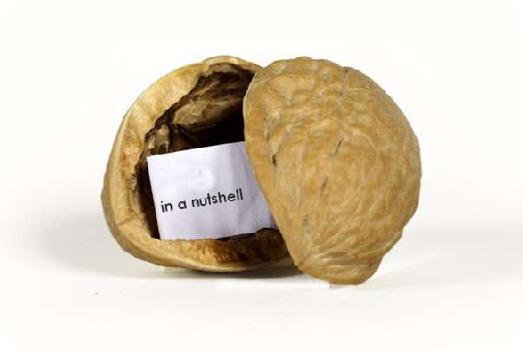
SUMMARY
HEART SOUNDS,
MURMURS
PHARMACOL OGIC
RESPIRATION
POSTURE
EXERCISE
HANDGRIP
VALSALVA

Slide 79
SUMMARY - HEMODYNAMICS
INSPIRATION
INCREASED RIGHT HEART FILLING
STANDING
DECREASED VENOUS RETURN
SQUATTING
INCREASED SVR,
INCREASED VENOUS RETURN
ISOMETRIC
HANDGRIP
INCREASED SVR,AFTERLOAD
VALSALVA STRAIN
DECREASED VENOUS RETURN
AMYL NITRITE
VASODILATATION,REDUCED SVR
PHENYLEPHRINE
VASOPRESSOR

Slide 80
SUMMARY - MANEUVERS
TR, RIGHT SIDED EVENTS
INSPIRATION
INCREASE
EC IN VALVULAR PS
INSPIRATION
DECREASE
MR,AR,VSD
ISOMETRIC
HANDGRIP
INCREASE
HOCM
ISOMETRIC
HANDGRIP
DECREASE

Slide 81
SUMMARY - HOCM AND MVP
HOCM
STANDING
INCREASE
MVP
STANDING
INCREASE
BOTH
SQUATTING
DECREASE
BOTH
VALSALVA
INCREASE

Slide 82
SUMMARY - POSITION
MS
MDM
LEFT LATERAL
AR
EDM
SIT UP,LEAN
FORWARD
LV S3/S4
LEFT LATERAL
PERICARDIAL
RUB
SIT UP,LEAN
FORWARD
VENOUS HUM
UPRIGHT

Slide 83
Previous Questions
1)Valsalva Maneuver(Aug 21,Sep 20,July 16)
2)Dynamic maneuvers and its effect on sounds and murmurs(Mar 14)
3)Haemodynamics of squatting(Mar 21)

Slide 84
REFERENCES
Abrams’ Essentials of Cardiac Physical Diagnosis
Bedside Cardiology – Jules Constant
Cardiac Auscultation: Rediscovering the Lost Art Michael A.
Chizner, MD, Curr Probl Cardiol 2008;33:326-408
Braunwald’s Heart Disease
Moss and Adams’ Heart Disease in Infants, Children and
Adolescents

Slide 85
THANK YOU

