Slide 1
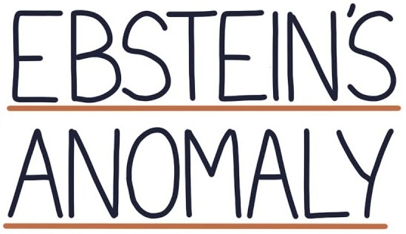
Dr Arun Jude Alphonse
DM Cardiology Resident
Govt TDMC Alappuzha

Slide 2
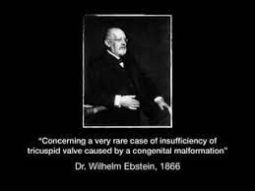

Slide 3
Original description
On 28 June 1864, Joseph Prescher, a 19-year-old laborer whose childhood dyspnea and palpitations had worsened with age.
The patient's attending physician, Hermann Kornfeld, described the patient's cachexia; severe cyanosis; jugular veins that throbbed in synchrony with the heart's rhythm; a systolic cardiac murmur; and an enlarged cardiac silhouette, detected during cardiac percussion

Slide 4
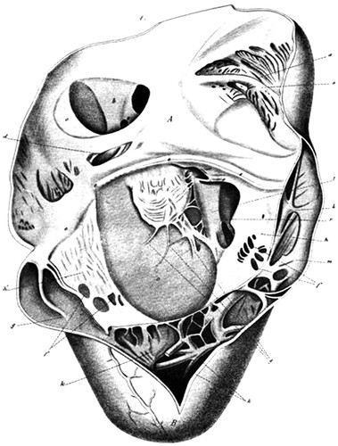
Eight days later the pateient died
At autopsy, Ebstein described an enlarged and fenestrated anterior leaflet of the tricuspid valve. The posterior and septal leaflets were hypoplastic, thickened, and adherent to the right ventricle.
There was also a thinned and dilated atrialized portion of the right ventricle, an enlarged right atrium, and a patent foramen ovale
By 1950, only 3 cases of this anomaly had been published

Slide 5
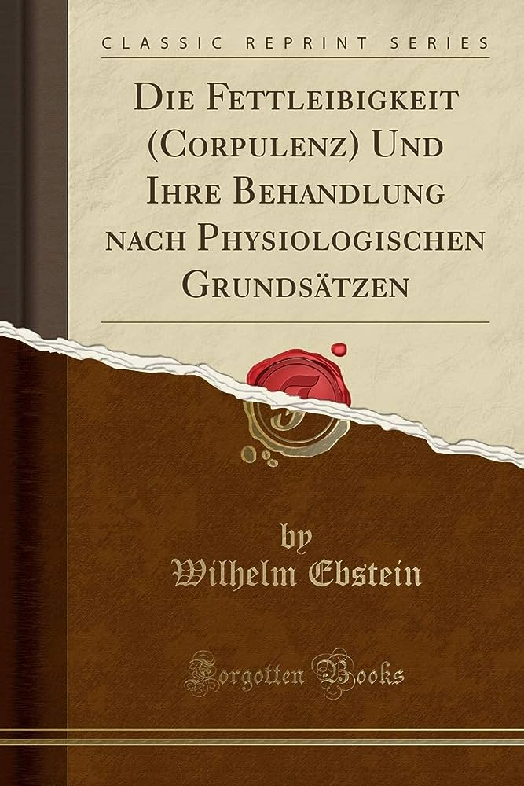
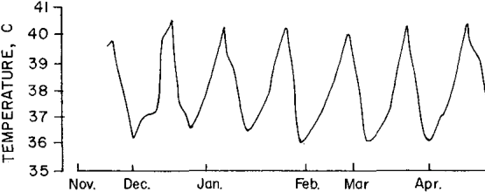

Slide 6
Tricuspid valve
Largest valve : 7-9cm2
Apparatus -5 components
(i.e –annulus,leaflets,commisures,chordae tendinae &papillary muscles)
Three leaflets – anterior,posterior,septal
Septophilic(septal leaflets attach to base of IVS) , Anterior leaflets from the AV junction
More apical than MV<10mm

Slide 7
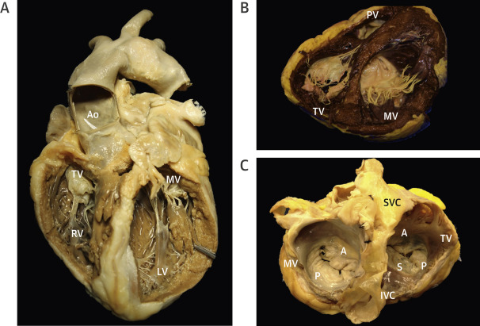
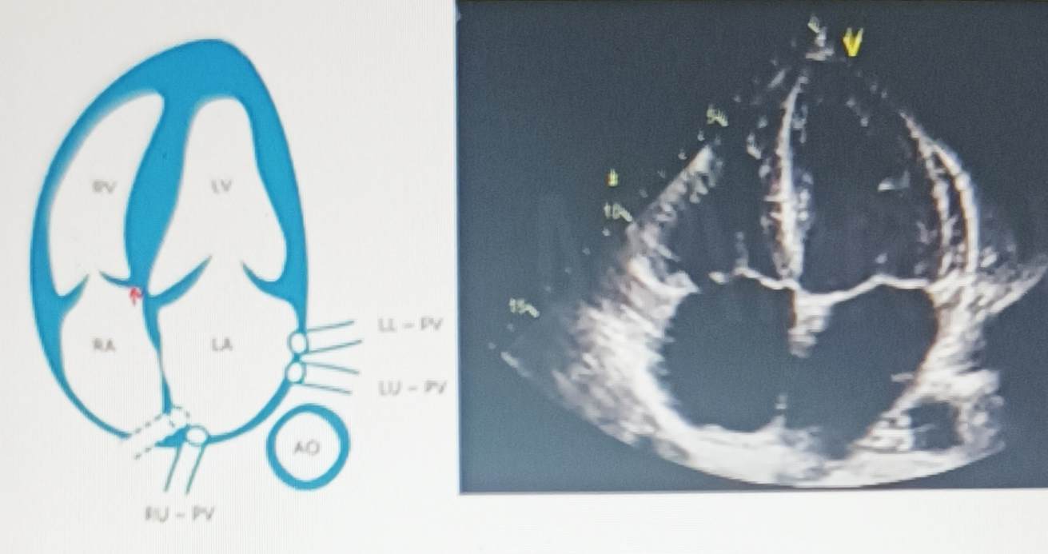

Slide 8
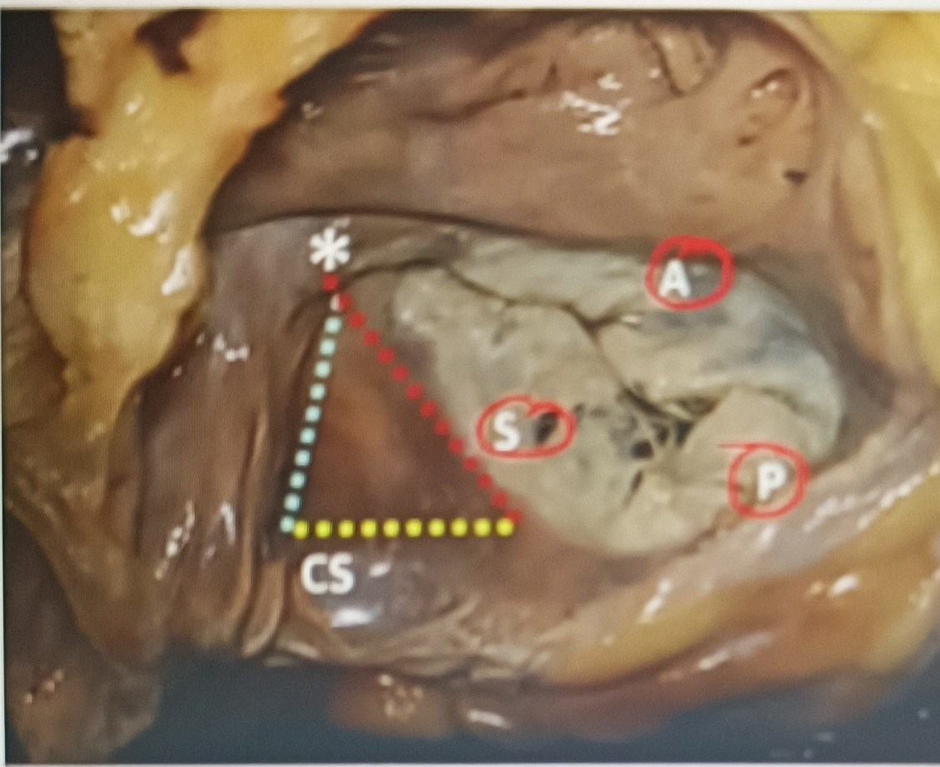
Triangle of Koch
Posteriorly bound by : ostium of coronary sinus
Anteriorly : tendon of torado
Base : septal wallet of tricuspid valve
Apex : AV node

Slide 9
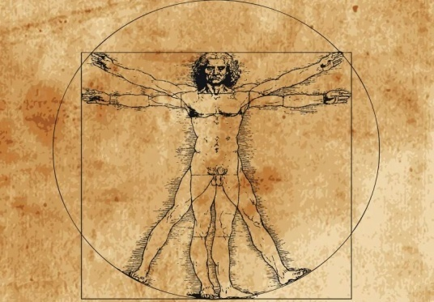
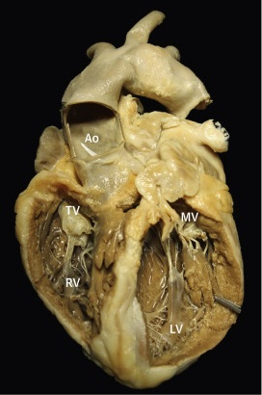
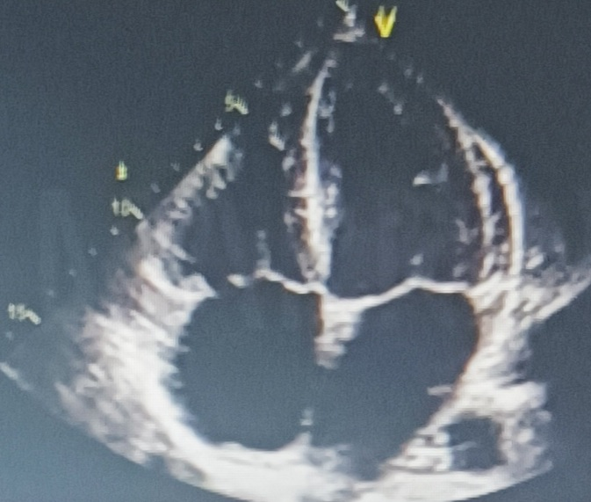
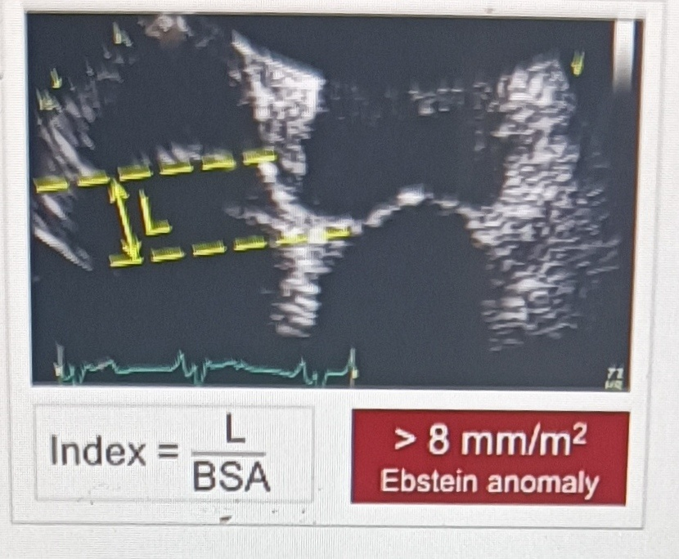
Ebsteins anomaly
Downward /apical shift of septal leaflet(100%) + posterior leaflet(mostly)

Slide 10
EMBRYOLOGY
Leaflets and tensile apparatus formed by a process of delamination of the inner layers of the inlet zone of the ventricles
Delamination begins at the tips of the leaflets and proceeds toward the AV junction
In EA - failure of this delamination occurs

Slide 11
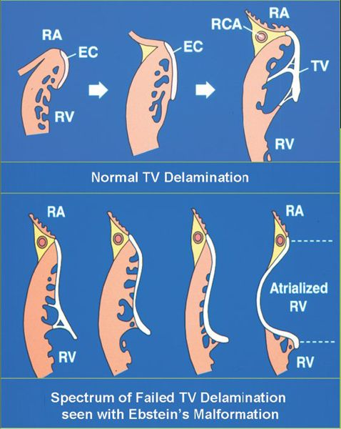
Delamination. Normal delamination process that gives rise to the tricuspid valve leaflets . During embryonic valve formation, the inner layer of endomyocardium separates (delaminates) from the underlying cardiac muscle and gradually loses its myocardial components. As development progresses (left to right), we begin to recognize the supportive chordal structures and leaflet of the mature valve.
When a failure of delamination occurs (bottom), it results in adherence of the “tricuspid valve” tissues to the right ventricular myocardium. This is the hallmark of Ebstein’s malformation.

Slide 12
Downward /apical shift of septal leaflet(100%) + posterior leaflet(mostly)
Anterior tricuspid leafltet originates normal, becomes bigger,goes and meets the displaced septal leaflet –SAIL like with multiple fenestrations in the substrate
Coaptation zone much lower and ineffective coaptation –Tricuspid regurgitation

Slide 13
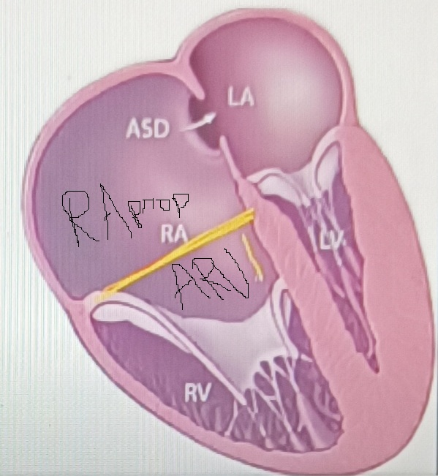
Huge RA –RA proper +ARV
(Torrential TR will further dialte RA)
Anterior leaflet large sail like
TR>>TS>.RVOTO
Three chambers
1)RA proper
2)ARV
3) RV

Slide 14
Infundibular portion of RV is sometimes obstructed by redundant anterior leaflet or its chordal attachments
Redundancy of tricuspid valve tissue may encroach RV outflow tract and cause sub pulmonary stenosis
Rarely, concomitant tricuspid stenosis or even atresia

Slide 15
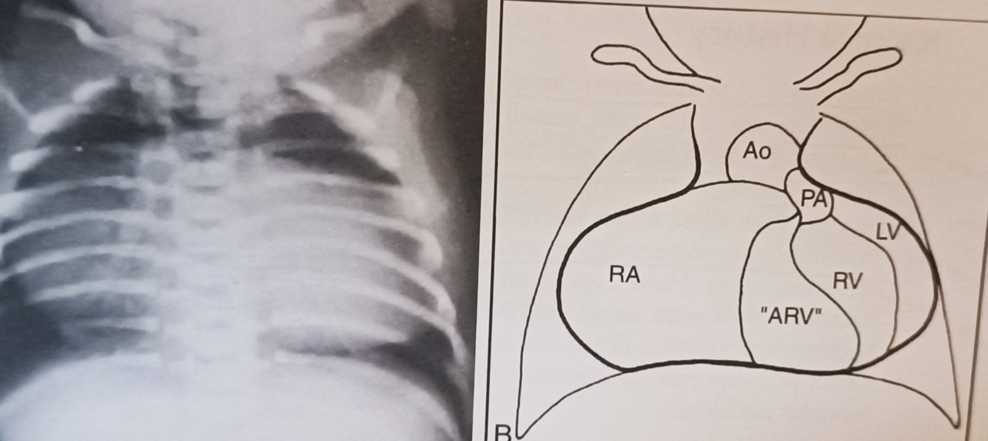
Right atrium (RA) –
dilated and hypertrophied - depends on
degree of displacement of TV leaflets
resultant tricuspid regurgitation
Responsible for the massive cardiomegaly

Slide 16
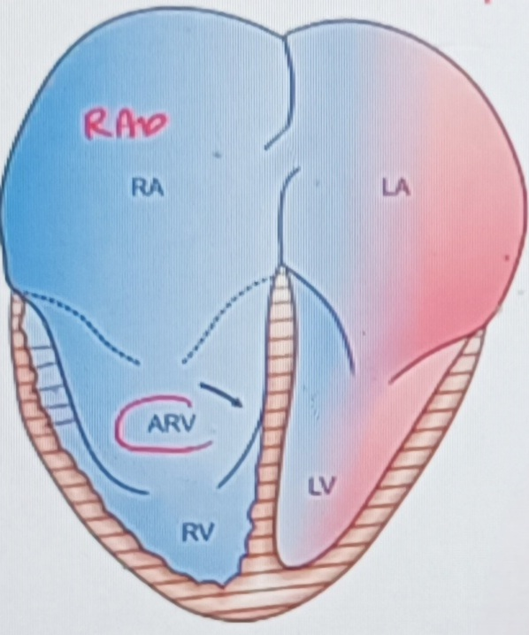
ARV – although part of RA anatomically, is electrically part of RV
RA contracts –ARV relaxes
Impediment to RA contraction
Electromechanical chaos-arrhythmic substrate

Slide 17
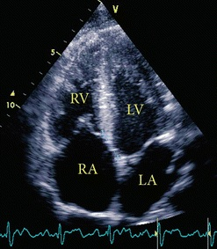
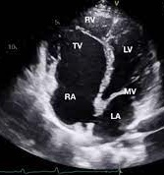
Right Ventricle -
In mild and moderate cases- normal with mild RV hypertrophy
severe cases- small with near normal thickness to very thin and dysplastic

Slide 18
In severe Ebsteins RV suffers miserably –Small size of RV+TR
LA/LV compressed by RA (LA/LV filling reduced)
RA enlarges at expense of all other three chambers

Slide 19
Conduction System
AV node is in triangle of Koch , is compressed and closer than usual to coronary sinus ostium
Area of triangle of koch much smaller in Ebsteins. Practical implication -during treatment of SVT with ablation at the base of Koch triangle may result in higher incidence of AV block
Downward displacement of septal tricuspid leaflet is accompanied by discontinuity between the central fibrous body and the septal atrioventricular ring –create substrate for preexcitation
Accessory pathway ,usually seen around the tricuspid annulus :wolff Parkinson white syndrome -5-25%
Anomalies of the right bundle branch reported -which may explain RBBB pattern seen in ECG

Slide 20
Conduction System
SVT association with Ebstein’s anomaly - related to accessory conduction pathways simulating Wolf-Parkinson-White (WPW) syndrome
Anomalies of the right bundle branch reported -which may explain RBBB pattern seen in ECG
area of triangle of Koch is much smaller in Ebsteins
While AV node and its extensions are normal in size, they are displaced towards the base of Koch triangle and his bundle penetrates well short of the apex of Koch triangle than normal
Practical implication -during treatment of SVT with ablation at the base of Koch triangle may result in higher incidence of AV block

Slide 21
Arrythmias in Ebstein
Hugely dilated RA –Atrial arrhythmias –AF/A flutter
Electromechanical chaos in ARV – Ventricular arrythmia
AVRT – Right sided/Type B accessory pathway -25%

Slide 22
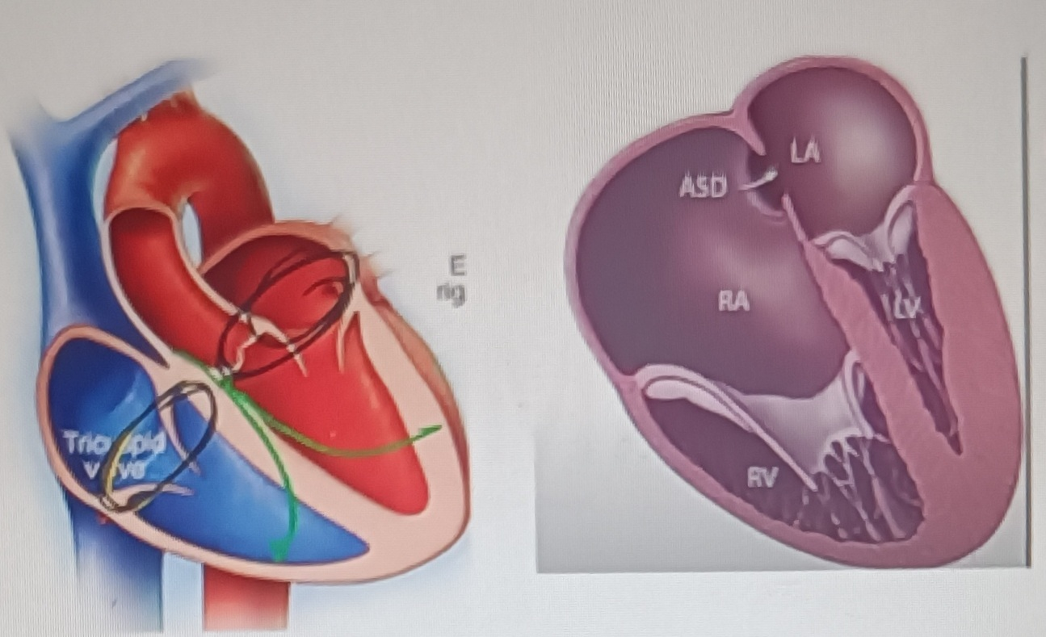
N – Fibrous ring seprates atrium from ventricle.Only was impulses can travel across is through the normal conduction system
Ebst- Displacement of septal leaflet – fibrous ring not developed properly at AV juntion – Acessory pathways(Rt/Type B upto 8)
AF in presence of accessory pathway(preexcited AF)-
can have 1:1 conduction –VF (SCD 3-10%)
Tachyarrythmias poorly tolerated in severe Ebsteins
(Small RV-with tachy RV filling further reduces)
Risk of arrhythmia in Ebsteins independent of severity of Ebsteins

Slide 23
Incidence
1 per 20,000 live births
As high as 2.4 per 10,000 live births reported
0.3 to 0.7 percent of all congenital heart defects
Equal male : female incidence
Majority of cases are sporadic
Represents 40% of congenital malformations of TV
Maternal lithium intake-28 fold increase risk
BZD intake
Sarcomere MYH7 mutation, NKX 2.5 gene

Slide 24
Associated abnormalities
ASD or PFO(90%)
Pulmonary stenosis/atresia(20-25%)
VSD,AVCD
Wolff-Parkinson white
Syndromes- Down , Marfan, Noonan, Cornelia de Lange
CCTGA with Ebsteins anomaly of lt AV valve -15-50%

Slide 25
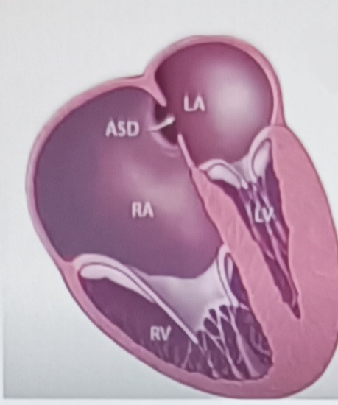
Cyanosis depends on ASD
Higher RA pressure – more the cyanosis
Balanced shunt - mild to no cyanosis
Lower RA pressure – left to right shunt –no cynosis
Intermittent cyanosis –right to left shunt may only be intermittent(during exercise or pregnancy)

Slide 26
CLINICAL PRESENTATION
Modes of presentation –depends on severity/size of functional RV
Can present at any age –foetus to elderly
Fetal –Hydrops,IUD
Neonate – death,HF,Transient neonatal cyanosis
Infant –CCF
Child –murmur
Teens & Adult –Palpitation
Rare –paradoxical embolism & brain abscess

Slide 27
Clinical Presentation
Wide spectrum of pathophysiology- differing presentations
Fetus :
present as cardiomegaly,tricuspid regurgitation, with RA enlargement on fetal echocardiography, arrhythmia or heart failure with hydrops.
high incidence of fetal loss
Neonates and Infants :
milder forms →asymptomatic
severe forms → symptomatic and have severe cardiomegaly : associated lung hypoplasia
no forward flow due to ineffective RV and inability to overcome the high PVR that exists in the early neonatal period
functional/physiological pulmonary atresia
pulmonary blood flow is dependent on ductal patency

Slide 28
Systemic venous return from RA needs PFO or ASD for egress
R → L shunt : significant cyanosis in newborn
If PFO is restrictive→ right atrial hypertension and systemic venous congestion occur
If ductus arteriosus is inadequate→ poor oxygenation from diminished blood flow and inadequate cardiac output due to poor pulmonary venous return coupled with small shunt via the PFO
leads to severe cyanosis and severe metabolic acidosis in the newborn
Cyanosis - approximately 50 percent newborn
Murmur -less common presenting featurs. Incidental finding of cardiomegaly in a chest X-ray performed for another purpose is another mode of presentation

Slide 29
Pathophysiology of intermittent cyanosis
main determinants - degree of displacement of TV and degree of TR
mild Ebstein –
tricuspid valve function is close to normal
moderate to severe forms-
with each atrial contraction→ blood is propelled into the atrialized RV
With ventricular contraction that follows- blood is forced back into the right atrium
more pronounced in children with significant TR
With the next atrial contraction, this blood is forced back into the atrialized RV

Slide 30
“ping-pong effect”
causes right atrial dilatation and increases right atrial pressure
right to left shunt across ASD/ PFO
arterial desaturation and pulmonary oligemia.

Slide 31
Newborn babies with severe Ebstein anomaly - cyanotic secondary to R→ L shunt across atrial septum
This is further accentuated by the usual high pulmonary vascular resistance that exists at this age
Significant TR causes severe RA enlargement in utero as well as after birth
inadequate RV myocardium to generate high enough pressure to achieve forward flow via the pulmonary valve
high PVR :inability of the pulmonary valve leaflets to open
‘functional’ pulmonary atresia

Slide 32
PVR DECREASE
pulmonary valve may open
R → L shunting at atrial septal level decrease→ cyanosis decreases
establishment of forward flow via the pulmonary valve
Cyanosis may return in later childhood or adolescence when tricuspid valve function deteriorates (causing regurgitation)
This clinical course is described as ‘transient’ or ‘intermittent’ cyanosis

Slide 33
Children, Adolescents and Adults
largely asymptomatic -may be detected by cardiac murmur or by echocardiogram performed for an unrelated problem
Infants with moderate to severe forms, who improved -may become symptomatic as the tricuspid valve and right ventricular function deteriorates
Easy fatigability, excertional dyspnea ,cyanosis or arrhythmia may be presenting symptoms

Slide 35
Arrhythmia
Supraventricular tachycardia (SVT) is common- secondary to accessory pathways or atrioventricular reentry.
Atrial arrhythmias such as atrial flutter or fibrillation may also be present
Accessory atrioventricular pathways are present in 20 % ; nearly all of them are right-sided pathways
Accessory pathways -located in the inferior portion of the tricuspid valve annulus—most commonly posteroseptal and posterolateral pathways
Due to slow conduction properties of the accessory pathways that are located in the atrialized portion of the RV, the conduction goes through AV node more often and therefore, most of these accessory pathways do manifest in sinus rhythm

Slide 36
Factors affecting prognosis in Ebsteins
RV function (Most important)
Size of functional RV
Degree to TV deformity
Malignant arrhythmias risk
Cardiomegaly(CT Ratio)
NYHA FC
Degree of Cyanosis
Age of presentation

Slide 37
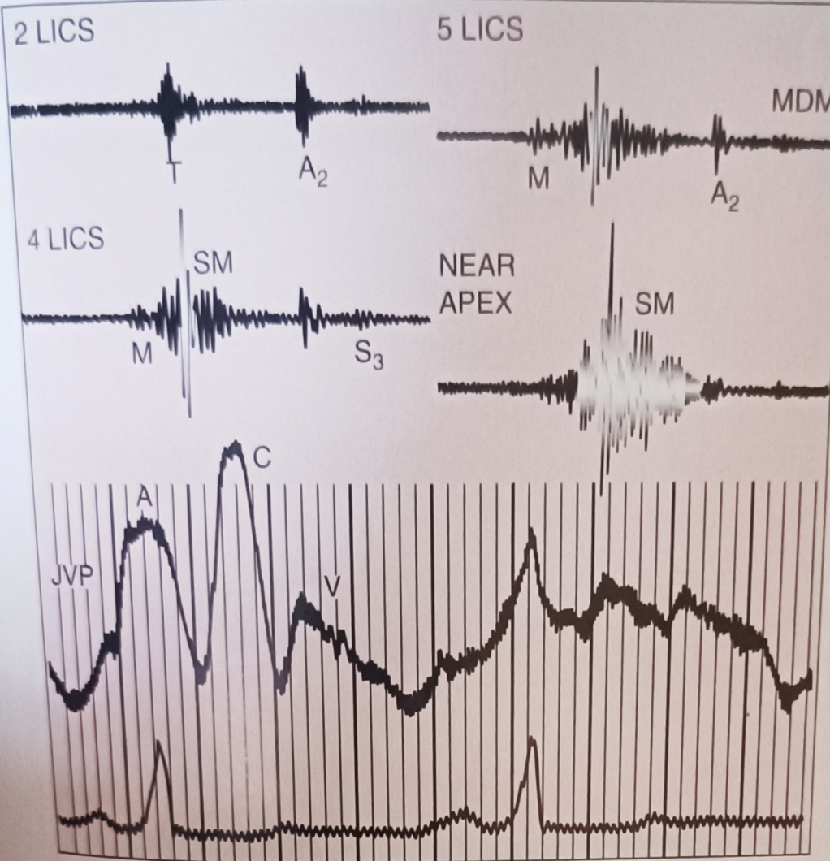
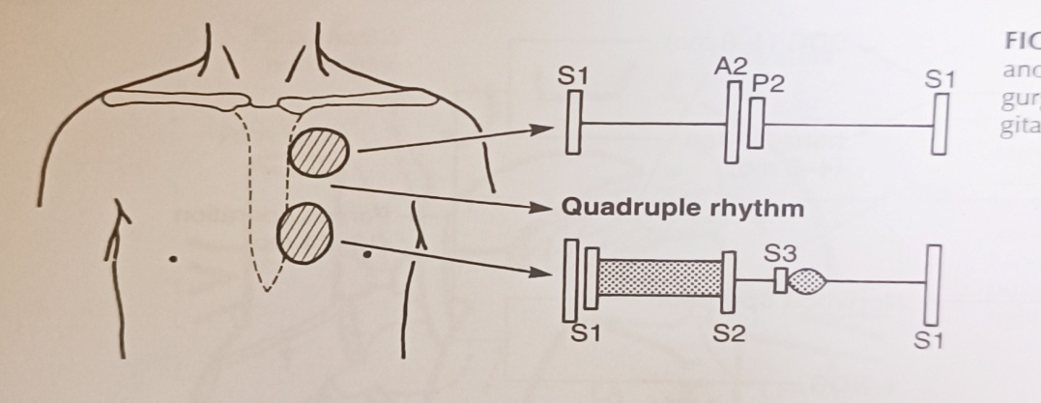
Signs
JVP –seldom elevated –usually normal – prominent c wave(large SAIL ATL)
Prominent RVOT pulsation(LPS 3rdICS), Absent RV body pulsations/LPH
S1 – widely split @TA M1T1 –loud T1 –SAIL sound
S2 -widely split(RBBB/RV dysfunction)
S3 ,S4, Quadruple rhythm
TR murmur –rub like early systolic/pan systolic murmur
Rub like MDM @TA
Cadence –like rhythmic chugging of a
locomotive engine as it gains speed

Slide 38
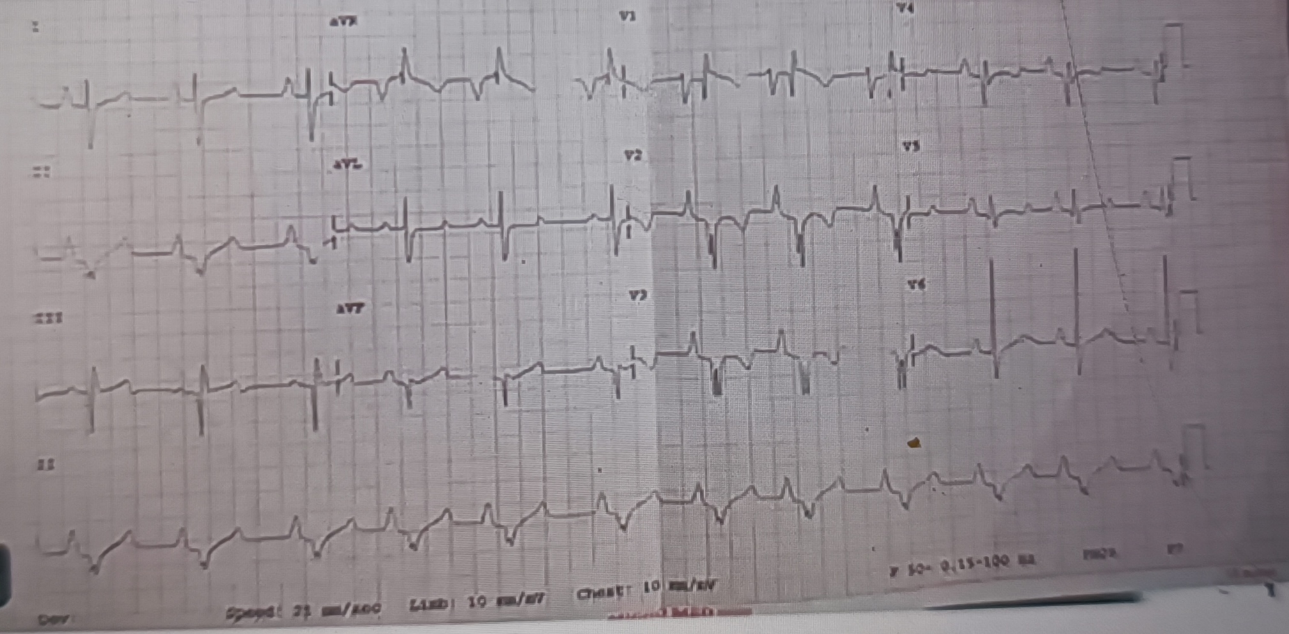

Slide 39
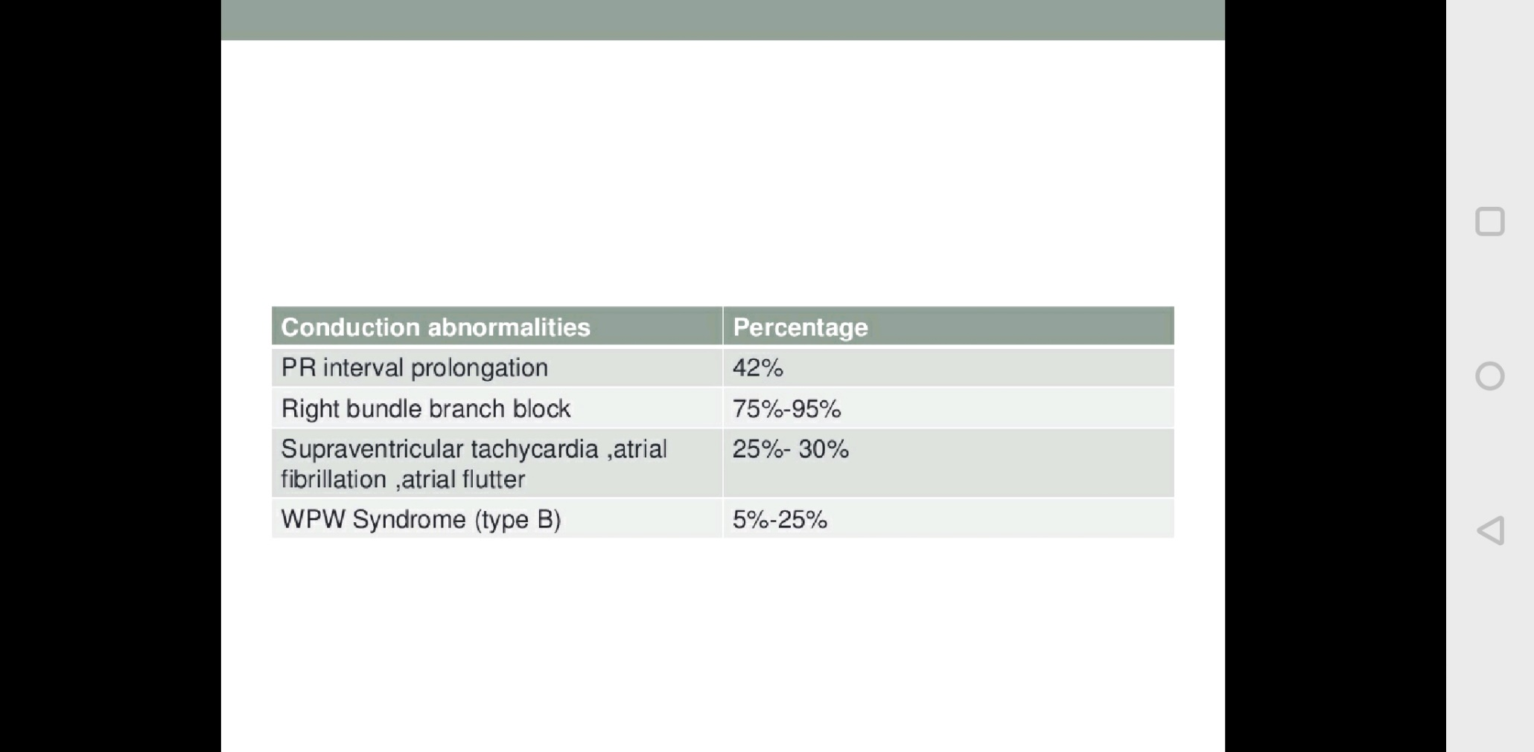
Investigations
ELECTROCARDIOGRAPHY
Right atrial enlargement – Himalayan P waves
Slurred fragmented QRS complexes in V2-V3(Impulse from RA to ARV)
low QRS voltages and right bundle branch block (RBBB) - typical findings in Ebstein anomaly
Right axis deviation is usual
Rarely, left axis deviation may be noted
Prolongation of PR interval -2/3RD (compress AV node)
Features of WPW syndrome with short PR interval are reported with higher frequency (30%) in Ebstein anomaly while a few (12%) have evidence of pre-excitation with normal PR interval

Slide 40
CHEST XRAY
Severe cardiomegaly (box like contour)-wall to wall heart
right atrial silhouette almost always enlargement
Lung fields are either normal or oligemic
Prominent RVOT
Inconspicous vascular pedicle
Infundibulum either straightens left cardiac border or forms a conspicuous convex shoulder
Cardiomegaly in milder cases is commensurate with the severity of tricuspid regurgitation.

Slide 41
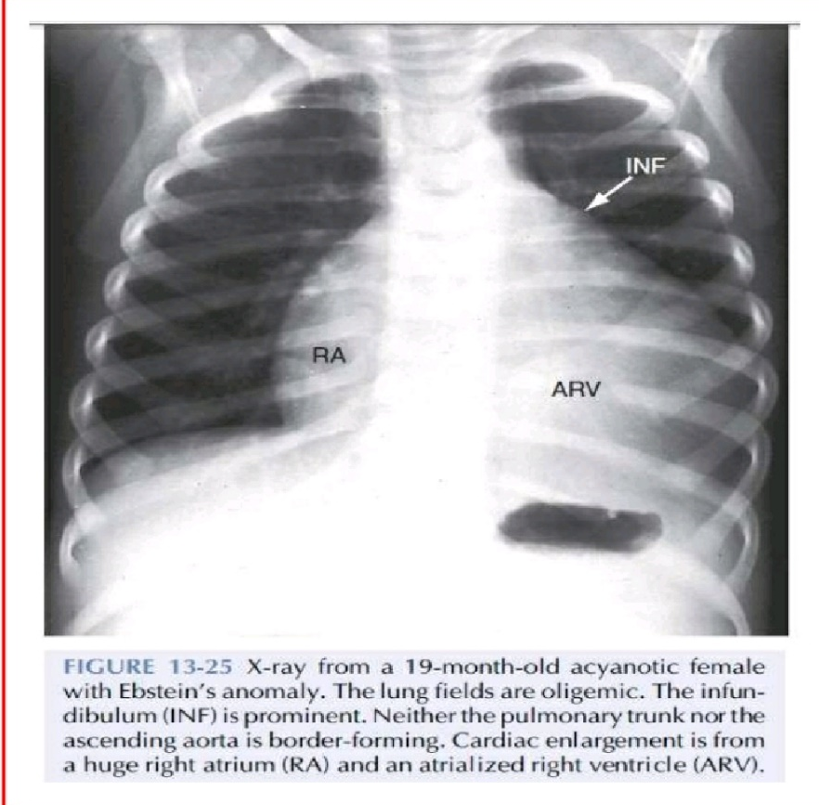
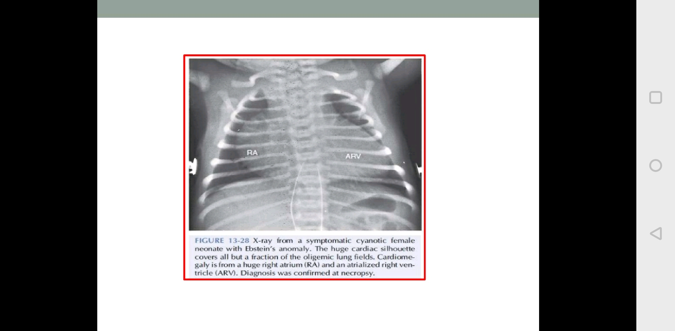

Slide 42
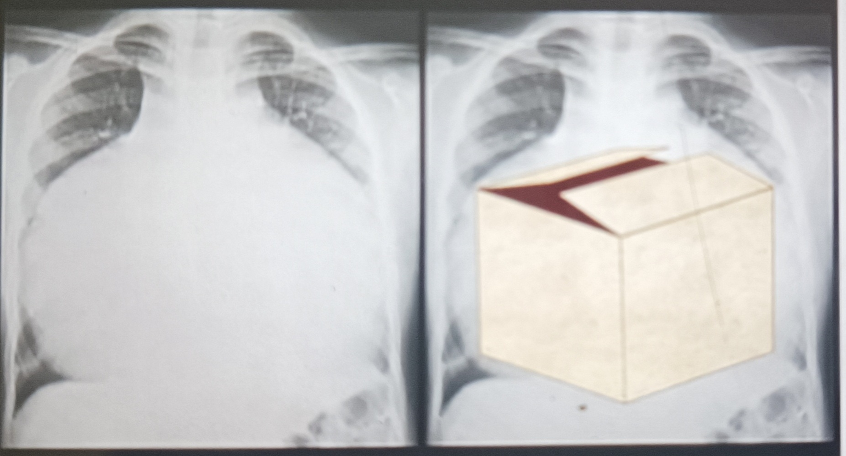
Box shaped heart

Slide 43
FETAL ECHO
Prenatal diagnosis can be made at 16 to 20 wks of gestation
Most fetus tolerate ebstein anomaly well as the LV function is normal in most cases but in rare cases , progress to fetal hydrops
Cardiac enlargement can compromise pulmonary development
Assessment of RV outflow tract is extremely important –functional PA –fetus require PGE1

Slide 44
FETAL ECHO
following are associated with death by 3 months of age—
severe RV outflow tract obstruction
tethered distal attachment of anterior leaflet
RV dysplasia
LV compression by RV dilatation
Celermajer index exceeding one

Slide 45
FETAL ECHO
Notes:
Scores of 0 to 10 are possible. There were no survivors when the score was greater than or equal to 5. Conversely, when the scores were less than or equal to 3, survival was 91 percent.

Slide 46
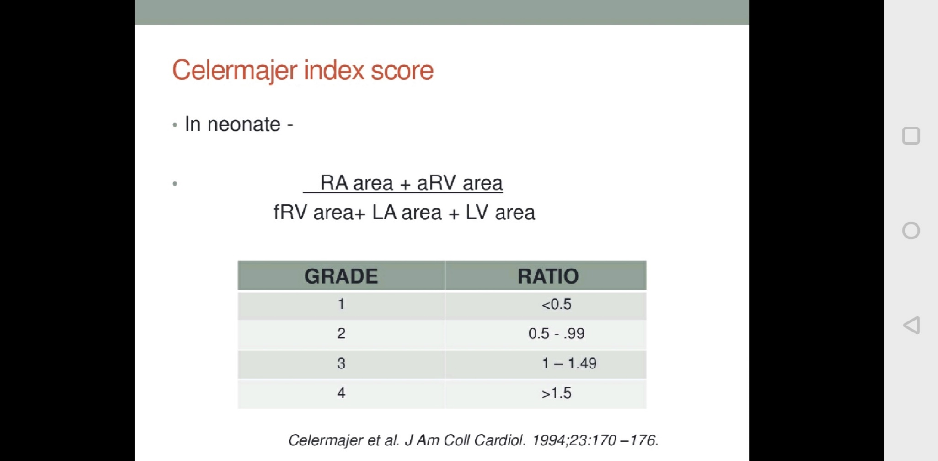

Slide 47
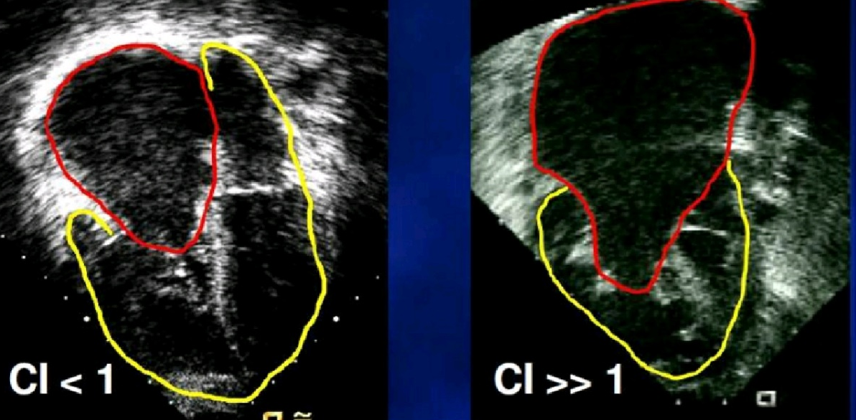

Slide 48
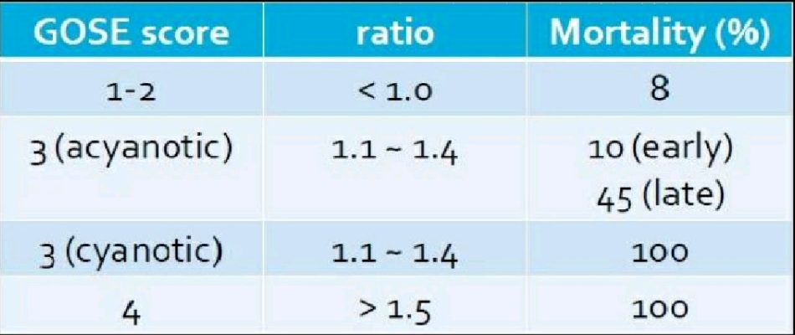
Great Ormond Street Echocardiography (GOSE) score

Slide 49
ECHOCARDIOGRAPHY
“Displacement Index” is measured in systole or diastole from the insertion point of the anterior mitral leaflet to the hinge point of the tricuspid septal leaflet
displacement index >8 mm/m2 -diagnosis of Ebstein anomaly
determination of forward flow through RVOT and across the pulmonary valve
difficult in the neonatal setting with elevated pulmonary vascular resistance
pulmonary regurgitation -differentiate anatomic atresia from the more common “functional” atresia of the pulmonary valve

Slide 50
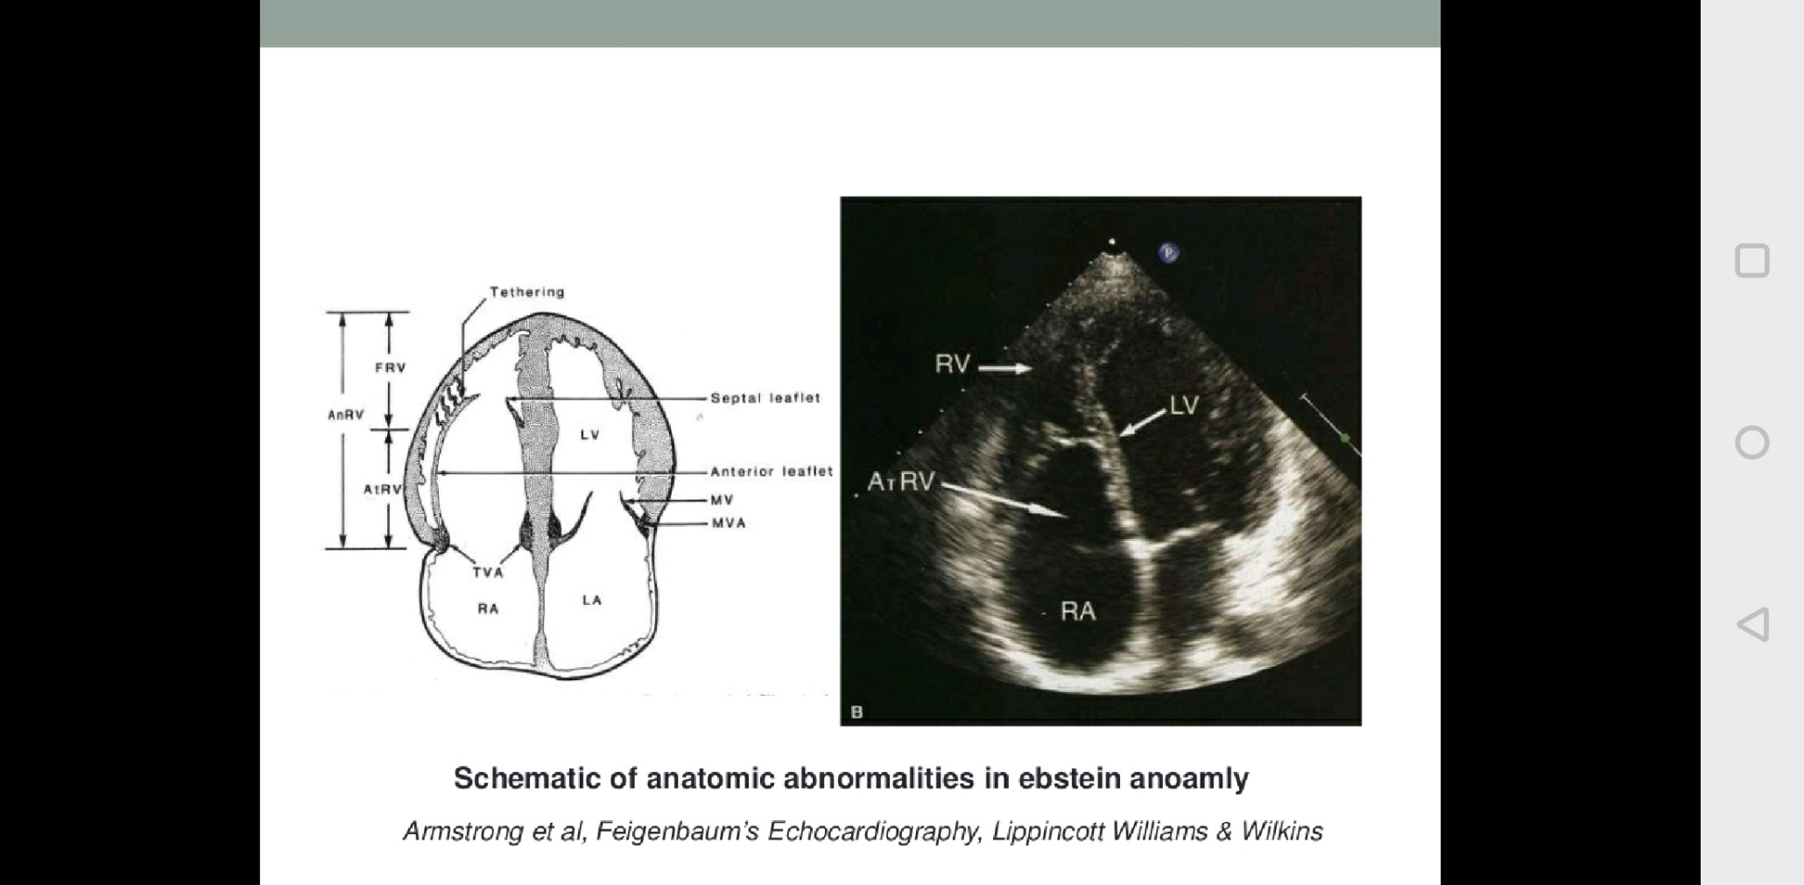

Slide 51
M mode
Paradoxical septal motion
Dilated right ventricle
Delayed closure of tricuspid valve leaflets more than 65 milliseconds after mitral valve closure
2D echo
Eccentric coaptation
Dilated RA
Dilated RV with decreased contractile performance
Eccentric leaflet coaptation
Asoociated cardiac abnirmalities –(ASD/PFO>VSD)

Slide 52
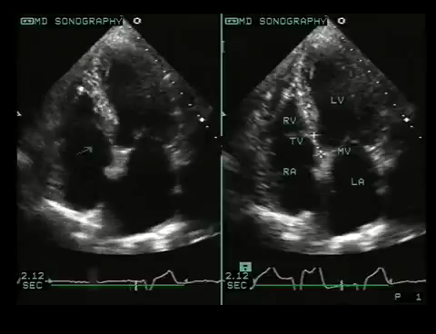

Slide 53
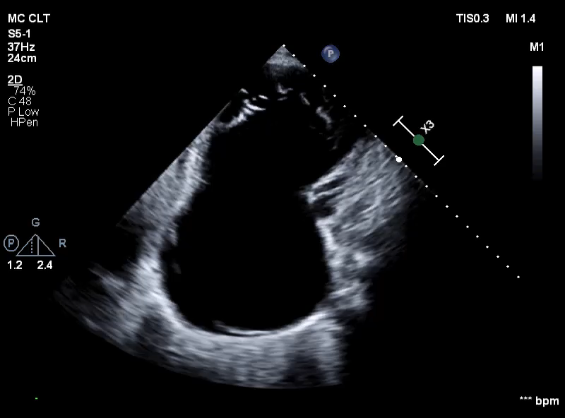
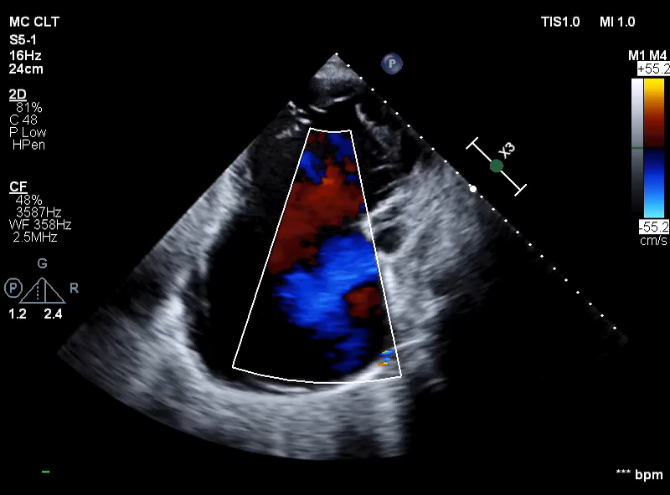

Slide 54
CT AND MRI
MRI – quantitative measurement of right atrial and RV size and systolic function
3D imaging for better delineation of disease severity

Slide 55
Cardiac Catheterization
not usually necessary :indicated for therapeutic purposes-associated, significant pulmonary stenosis
Catheterization :R → L shunting at atrial by oximetry. Left to right shunting is unusual unless there is VSD or PDA
Pressure traces —
RA pressure (mean) elevated; ‘a’ waves are more prominent than ‘v’ waves because of dissipation of tricuspid regurgitation in a large, compliant right atrium
Right ventricular pressure is low or normal
Low RV systolic pressure is a poor prognostic sign-indicative of inability of the RV to mount enough pressure to enable adequate forward flow via pulmonary valve
High RV systolic pressure is noted in the presence of VSD, PS or high PVR
RV enddiastolic pressure is usually elevated
Left sided pressures (left atrium, left ventricle and aorta) are normal
Tricuspid insufficiency during selective right ventricular angiography and right atrial angiography (not necessary) produces a trilobed heart representing, RA, atrialized portion of RV and RV

Slide 56
NATURAL HISTORY
extremely variable
The clinical course depends on issues related to the tricuspid valve apparatus, RV function and RV size and presence of an ASD
Intrauterine death or profound congestive heart failure in the neonatal period - one end of the spectrum
asymptomatic adults with only a mild degree of valve displacement and RV dysfunction –other end

Slide 57
MORTALITY
NEONATAL DEATH- severe hypoxemia , congestive heart failure or both
Younger patients- congestive heart failure
Older patients(20%) –with hemodynamically mild lesions –from atrial or ventricular arrhythmias
Brain abscess or paradoxical embolism and infective endocarditis-rare
Mortality in neonatal period is 20%-40% and less than 50% survive to 5 yrs
Mortality at all ages is 12.5%

Slide 58
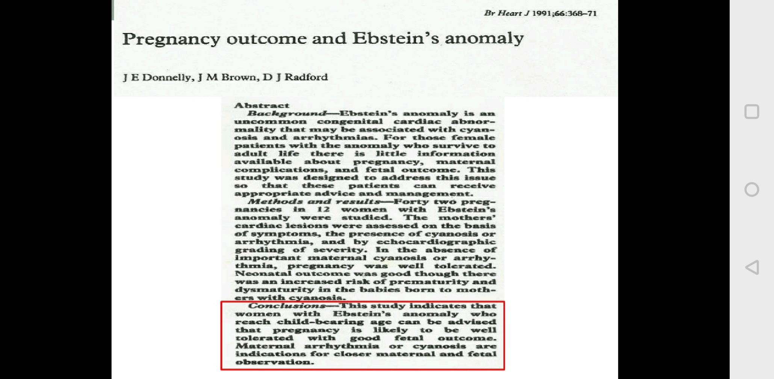
PREGNANCY
Increased incidence of prematurity and probably of spontaneous abortion
CHD incidence in offsprings- 6%

Slide 60
CLASSIFICATION
Echocardiographic assessment – visual
Carpentier classification
Celermajer classification
Classification by anatomical findings at surgery

Slide 61
Echocardiographic assessment
Classified as mild, moderate or severe-
Variables assessed :
Amount of leaflet displacement
Tethering
Degree of RV dilatation

Slide 63
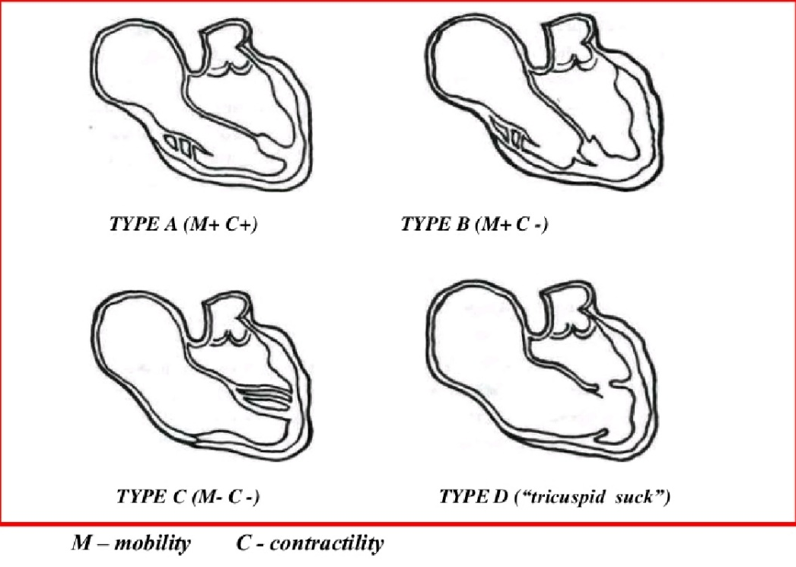
Carpentier classification

Slide 64
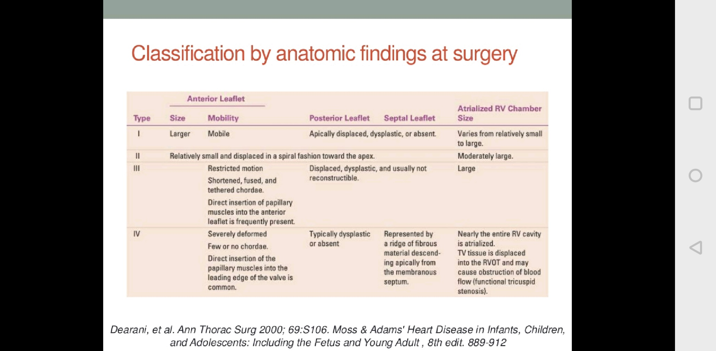

Slide 65
Management
Medical Management
Surgical Management

Slide 66
NEONATAL EBSTEIN
Poor prognosis
Reported survival only 68%
Indication for surgery
Heart failure
Profound cyanosis

Slide 67
NEWBORN
Asymptomatic cyanotic - no active treatment
cyanosis severe PG E1 infusion (0.05–0.1 mcg/kg/min) until PVR drops.(temporarily keeping the PDA open )
inhaled nitric oxide to reduce PVR
Intubation ,positive pressure ventilation ,Deep sedation and muscle relaxant
surgical systemic-pulmonary shunt to maintain adequate pulmonary blood flow
Furosemide and Digoxin- heart failure
Supraventricular tachycardia or atrial flutter -anti-arrhythmic medications
Restrictive PFO/ASD may require balloon atrial septostomy

Slide 68
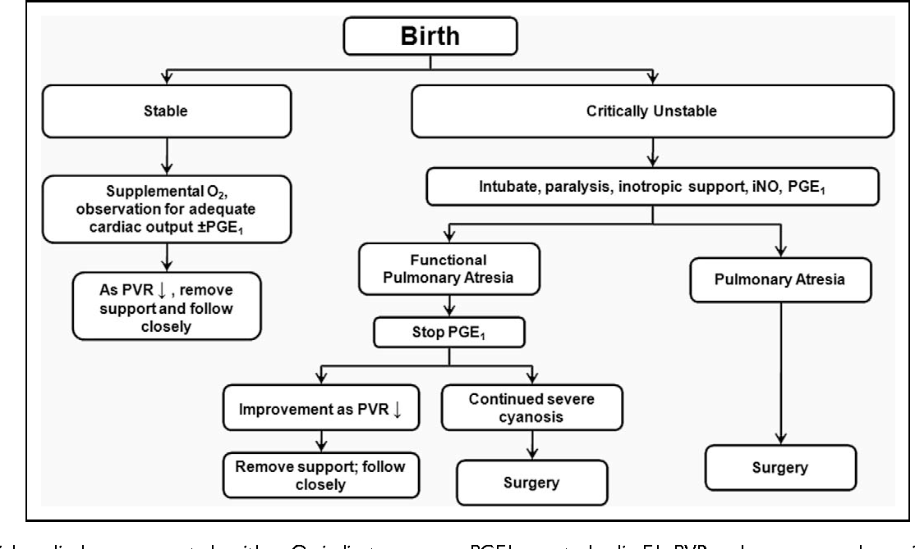

Slide 69
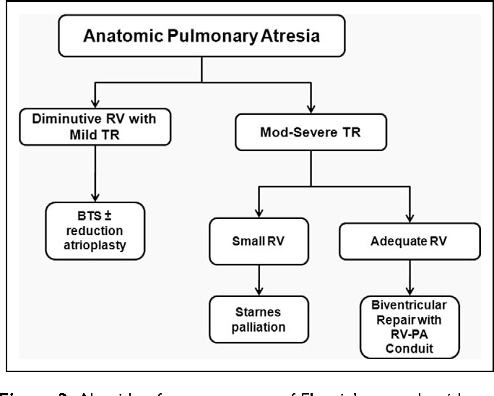

Slide 70
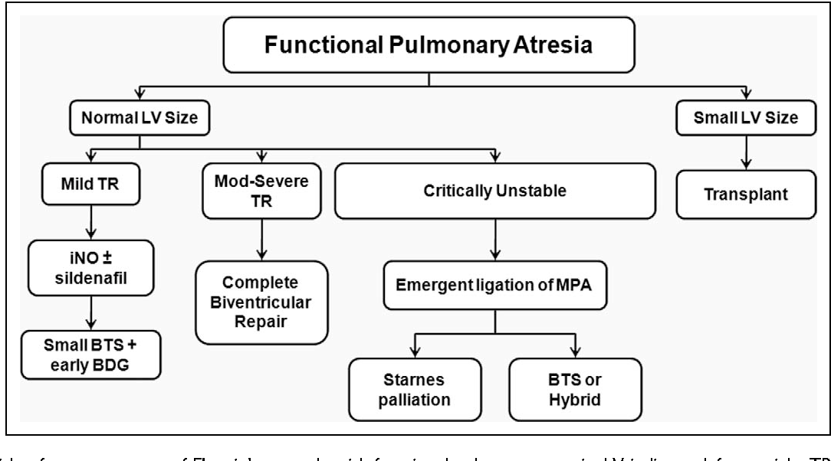

Slide 71
Indications for surgery
Decreased exercise tolerance
Cyanosis (80% or less; Hemoglobin 16 gm% or more)
Paradoxical embolization
Progressive right ventricular dilatation (Cardiothoracic ratio >60%)
Prior to significant right ventricular dysfunction
Onset or progression of atrial arrhythmias
Prior to left ventricular dysfunction , NYHA class III or IV or significant symptoms

Slide 72
Neonate – biventricular repair or a single ventricle repair
Infants beyond 3 months of age – 1.5 ventricle repair is prefered
For most children & adults with Ebstein anomaly – biventriclular repair is the procedure of chocie
TV repair >>> Replacement
TV repair not possible –TV repalcement-Biological valveP-orcine bioprosthetic valve replacement best option(bioprostheses preferred –lack of need of OAC)
Ablation of accessory pathway –Surgical interuruption/RFA

Slide 73
SURGICAL TECHNIQUES
A. Biventricular repair (Knott Craig approach)
B. Single ventricle pathway with right ventricular exclusion (starnes approach)
C. Cardiac transplant
PRINCIPLES OF SURGERY FOR Ebsteins anomaly
Closure of any intra cardiac communications
TV repair or replacement
Ablation of arrhythmias
Selective plication of the atrialized RV from apex to base
Reduction right atrioplasty
Repair of associated defects(eg. VSD closure)

Slide 74
Biventricular repair (Knott Craig approach)
TV is repaired and the atrial septum is partially closed
Repair typically a mono cusp type based on a satisfactory anterior leaflet
Right atrial reduction done to reduce the size of the markedly enlarged heart to allow room for the lungs
Although early mortality is high(25%) the intermediate outcome appears to be promising
Survival to hospital discharge was 74%

Slide 75
Single ventricle pathway with right ventricular exclusion (starnes approach)
Performed in anatomic RVOT obstruction
Objectives : exclude right ventricle and establish a reliable source of pulmonary blood flow
closing the tricuspid annular orifice using a pericardial patch, removing the entire septum primum and placing either a central aorto-pulmonary shunt or Blalock-Taussig shunt from innominate artery to right or left pulmonary artery
These neonates will subsequently need bidirectional Glenn procedure and eventually Fontan operation

Slide 76
Modified Starnes repair(total ventricular exclusion)
Sano et al. approach: total RV exclusion in which free wall of RV resected and closed primarily or with a poly tetrafluoroethylene patch
This simulates a large right ventricular plication which may improve filling and provide adequate decompression to the lungs and LV
Notes:
When tricuspid valve anatomy is
appropriate for repair, a biventricular approach is preferred. In patients with anatomic pulmonary valve atresia or
poor tricuspid leaflet anatomy, the single-ventricle strategy is favored.

Slide 77
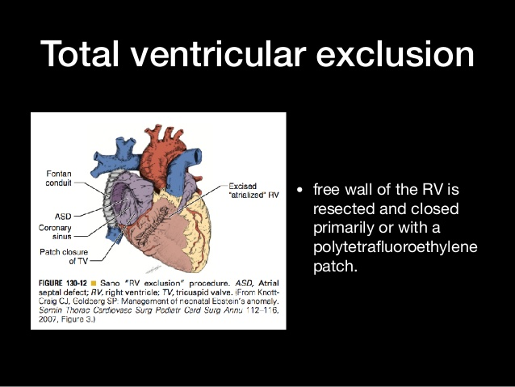

Slide 78
One and a half ventricle repair
Indications
severely enlarged right atrium, severe tricuspid regurgitation, bidirectional shunt across the PFO/ASD, very hypoplastic right ventricle with minimal functional right ventricle, depressed LV systolic function or a combination
Surgery
patch closure of ASD, repair of tricuspid valve with reduction of the atrialized portion of right ventricle and a bidirectional Glenn operation (i.e. end to side anastomosis of the superior vena cava to the right pulmonary artery)
accomplishes the following—
unloads the right atrial and right ventricular volume by approximately one third and still, right ventricle can contribute to the pulmonary circulation maintaining pulsatile flow and allowing for flexibility to cope with transient increases in pulmonary vascular resistance and allows for more aggressive repair of the tricuspid valve without concern for tricuspid stenosis due to overcorrection.

Slide 79
Repair of tricuspid valve
The goals of operation is:
To obtain a competent TV
Preserve right ventricular contractility
Decrease the risk of late rhythm disturbances

Slide 80
Carpentier Repair
anterior leaflet and the adjacent part of the inferior leaflet were detached followed by longitudinal plication of the atrialized RV and RA
The anterior and inferior leaflets were repositioned to cover the orifice area at the normal level
Remodeling and reinforcement of the tricuspid annulus was performed with a prosthetic ring
Unlike the CR, the anterior and inferior leaflets were not mobilized or rotated clockwise to meet the septal leaflet

Slide 81
THE BRAZIL EXPERIENCE (da silva approach)
Some septal leaflet should be present for this repair
Most anatomic- completion of the delamination process of the TV , providing 360 degrees of leaflet tissue around the AV junction with its hinge at the AV groove (true annulus)

Slide 82
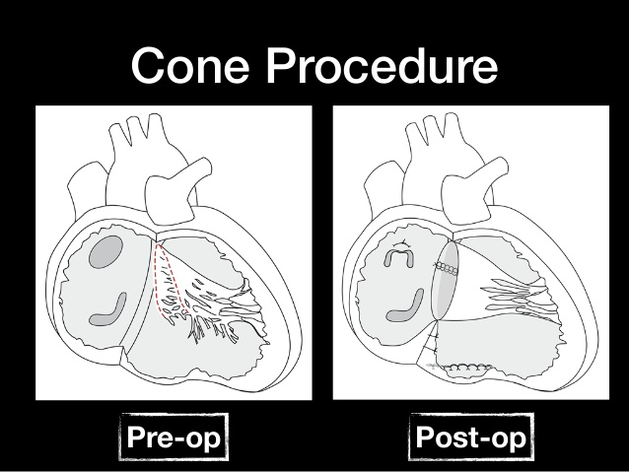
Notes:
Concept of the cone reconstruction in Ebstein malformation. A: Adherent segments of tricuspid
valve tissue being separated from the anatomic annulus and the underlying right ventricular myocardium. B:
Sheet of tricuspid of tissue after it has been released. This tissue is used to create a cone, often attaching the
anterior leaflet to the remnants of the septal leaflet (see suture line, C). Once the cone is created, the base is
attached to the atrioventricular junction, restoring the hinge points to a nondisplaced position (C). When dilated,
thin, or significantly dyskinetic, the atrialized right ventricle can be reduced in size by either elliptical resection or
plication (C). The annuloplasty reduces the size of the intraventricular junction to what is appropriate to the size
of the reconstructed cone

Slide 83
Relative contraindication to the reconstruction technique
(1) patient age >60 years
(2) moderate pulmonary hypertension
(3) severe LV dysfunction (EF <30%)
(4) absent septal leaflet
(5) heavy muscularization of the anterior leaflet
(6) severe tricuspid valve annular dilation with massive RV enlargement and systolic dysfunction (usually in older adults)
Notes:
Thus, tricuspid valve repair techniques continue to evolve, and there is no universally
correct technique because of the anatomic variation observed in patients with Ebstein anomaly.

Slide 84
TRICUSPID VALVE REPLACEMENT
Repair preferred than replacement
Porcine bioprosthetic valve replacement best option(bioprostheses preferred –lack of need of OAC)
During valve replacement , the suture line is deviated to the atrial side of the atrioventricular node and membranous septum to avoid the conduction tissue and right coronary artery injury -this results in an intra atrial position of the prosthesis

Slide 85
Atrial septal fenestration
In RV dysfunction , an alternative to the bidirectional canopulmonary shunt
Involve either subtotal closure of an ASD or leaving a patent foramen ovale open
Transient episodes of exacerbated RV dysfuntion result in right to left shunting that increases left sided preload that minimizes or avoids low cardiac output to systemic circulation
Helpful in the neonates undergoing biventricular repair when increased pulmonary vascular resistance may still be present or exacerbated by the pulmonary vasoconstive effects of intropic support

Slide 86
Arrhythmia management
Atrial fibrillation and flutter –MC
Most surgeons used successfully the right sided cut and sew lesions of
cox – maze III procedure in ebsteins anomaly
Radiofrequency ablation and cryoablation –procedure time for maze procedure is shortened significantly –Recurrence rate high(40%)..may be due to multiple accessory pathways
A biatrial maze procedure , performed particularly when there is chronic atrial fibrillation , left atrial dilation or con comiatriant mitral regurgitation

Slide 87
Pacing
Permanent pacing is required for 3.7% of patients with ebsteins anomaly , most commonly for atrioventricular block and rarely for sinus node dysfunction
In the presence of a tricuspid valve prosthesis the ventricular lead for permanent DDD pacing usually is placed epicardially or through the coronary sinus or cardiac vein

Slide 88
Cardiac Transplantation
rarely required for Ebstein anomaly
In the Mayo Clinic experience the indication for
transplantation - presence of severe biventricular dysfunction with an LV EF <25%
Other indications: severe LV dilation and dysfunction particularly when associated with mitral regurgitation

Slide 89
Outcomes
severity of the valve malformation and dysfunction of both ventricles will affect outcome
Early mortality in neonates has been linked to marked RV enlargement, severe tethering of all leaflets, LV dysfunction, and pulmonary atresia
severe cardiomegaly (CT ratio >0.6) may also have lung hypoplasia

Slide 93
Take home messages
Downward/apical displacement of septal&posterior leaflet of TV
Ant leaflet still reatins its normal attavhment
TR>>TS>>RVOTO
Variable presentation
ASD/PFO M/C associated abnormaility
Arrythmia poorly tolerated
Know the characteristic ECG features
The biggest hearts are found in Ebsteins and its all RA
Cone repair

Slide 94
MCQ 1
Which of the following is true regarding Ebsteins anomaly
1. downward displacement of insertion of anterior leaflets
2. It is due to delamination of the inner layers of the inlet zone of the ventricles
3. displacement index - < 8mm/m2
4. related to accessory conduction pathways simulating Wolf-Parkinson-White (WPW) syndrome in 25%

Slide 95
MCQ 2
Ebsteins anomaly is associated with LVNC –gene associated is
GATA4
NKX2.5
MYH7
none

Slide 96
MCQ 3
Major ECG abnormalities seen in Ebsteins are
PR interval prolongation
Type A Wolff-Parkinson-White preexcitation
Atrial fibrillation or flutter
Deep Q waves in leads V5,6

Slide 97
MCQ 4
Surgical procedure for infants include all except
A. Biventricular repair (Knott Craig approach)
B. starnes approach
C.total ventricular exclusion
D. Danielsons procedure

Slide 98
MCQ 5
Indication for surgery in adults with ebstein are all EXCEPT
Decreased exercise tolerance
Cyanosis (80% or less; Hemoglobin 16 gm% or more)
Paradoxical embolization
Progressive right ventricular dilatation (Cardiothoracic ratio >60%)
significant right ventricular dysfunction
None

Slide 99

Thank you

