Slide 1
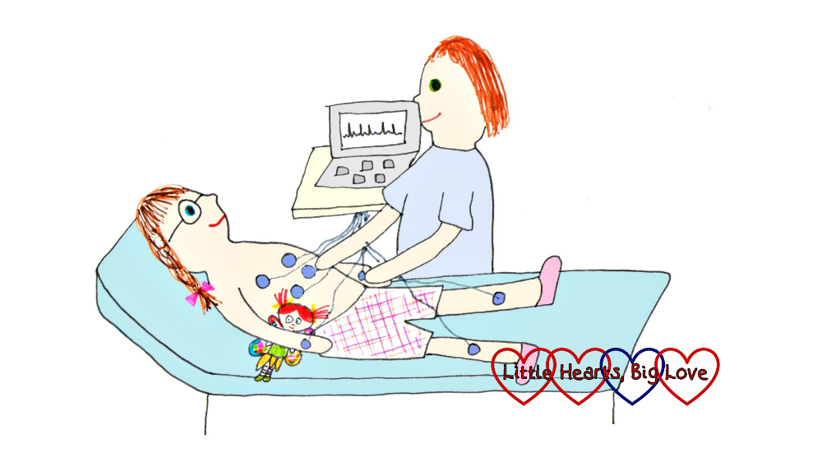
ECG in Congenital Heart Disease - A case based discussion
Dr Arun Jude Alphonse
DM Cardiology Resident
Govt TDMC Alappuzha

Slide 2
Paediatric ECG:Tips for recording
Limb leads may be placed more proximally - less movement artefacts
V3R,V4R to display RV potentials
Half gain(5mm/V) – if the complexes are large
Sedation/sleep
Notes:
Rv bulges to rt side

Slide 3
“BE A MASTER OF NORMAL FIRST BEFORE BECOMING A STUDENT OF ABNORMAL”

Slide 4
Normal Axis

Slide 5
P Wave
Amplitude : <3mm
Duration :
Infants: <70ms
Children: <90ms

Slide 6
PR interval
Birth: 80-160ms
1 yr: 70-150ms
5 yrs: 80-160ms
10yrs: 90-170ms

Slide 7
Q Wave
Normal
20-30ms
<0.5mV in left precordial leads & aVF
<0.8mV in lead III in children <3 years

Slide 8
QRS Duration
Upto 1 year: 50-70ms
1-3 years : 60-70ms
3-8 years : 70-80ms
8-16 years : 70-100ms

Slide 9
ST Segment
Normal
Limb lead ST deviation upto 1mm
Left precordial lead upto 2mm
Upsloping ST depression
BER:concave ST elevation with upright T

Slide 11
T Wave
First week: upright in all precordial leads
After 1st week: T↓V1-3 (until 8yrs)
Persistent juvenile pattern is possible till early adulthood

Slide 12
QTc
<6months : <490ms
>6months : <440ms

Slide 13
Normal findings in children
HR > 100/min
QRS axis > 90
Right precordial T inversion (juvenile T wave)
Dominant right precordial R waves
Inferior and lateral Q waves
Short PR (<120ms) and QRS (<80ms)
Slightly peaked P waves (<3mm)
Slightly long QTc (<490ms)
Respirophasic sinus arrhythmia
Shifting atrial pacemaker

Slide 14
Pediatric vs Adult ECG
RV dominance is the rule(till 3yrs)
RAD
Tall R in V1 and aVR
T↓ in V1-3 (juvenile T waves)
Upright T in V1 is abnormal after 3days

Slide 15
Short conduction intervals (small heart)
High resting HR
New born: 110-150/min
1 year: 100-130/min
5 years: 90-110/min
10 years: Adult HR

Slide 16
Chamber enlargement in newborn
RVH
S in lead I>12mm
R in aVR>8mm
V1:pure R>10mm, qR, upright T
RAD>180˚
LVH
LAD
Voltage criteria
Q in V5,V6>5mm with tall T

Slide 17
Pediatric LVH

Slide 18
Role of ECG in CHD
ECG can be supportive of clinical diagnosis, as in Tetralogy of Fallot
It can be affirmatory, as inostium secundum Atrial Septal Defect (ASD)
It can bemvirtually diagnostic, as in Ebstein anomaly or Tricuspid Atresia.

Slide 19
The standard format of reading a pediatric ECG
1. Rate per minute
2. Sinus rhythm or not
3. P wave and axis
4. PR interval
5. QRS morphology and width
6. QRS axis
7. QRS in V1 and V6 (R/S)
8. ST segment
9. T wave
10. Corrected QT interval, U wave

Slide 21
1. Rate 100 / minute
2. Normal sinus rhythm
3. Tall, peaked P wave - Right Atrial Enlargement(RAE)
4. PR interval 160 msec
5. QRS width normal; rSR in V1
6. QRS axis: Right Axis Deviation(RAD)
7. R/S in V6 16/10
8. ST segment normal
9. T inverted in V1-V3 (Normal)
10. QTc – Normal

Slide 22
Case study 1
A seven year old girl presents with asymptomatic murmur. She has a wide and fixed split S2. There is a grade 2/6 midsystolic murmur over pulmonary area.

Slide 24
Most likely, the diagnosis is ASD.
The ECG has a normal P wave and PR interval. RAD +. rSR is evident in V1. Has normal LV forces.
OS ASD Has
1) Normal P wave
2) RAD
3)rSR in V1 and V3R(90%)
4)The R’ never exceeds 15 mm unless PH
5)There can be a notch on R wave in II. III. andavF leads (Crochetage)

Slide 25
ATRIAL SEPTAL DEFECT (ASD)
ASDs can be ostium secundum (70%), ostium primum (20%) and sinus venosus(10%) types.
Ostium Secundum ASD
Sinus rhythm
P wave is peaked, but not tall.
PR interval is usually normal.
10-15% of OS ASD can have prolonged PR interval.

Slide 26
OSASD and 1st degree Atrio Ventricular Block can be present in
1) Familial OS ASD
2) Holt Oram syndrome
3) Adult with ASD
4) Associated rheumatic valvular disease

Slide 27
Sinus Venosus ASD (SV ASD)
1) rSR pattern is common to SV ASD
2) PR interval is normal.
3) P wave axis is abnormal(less than
+15 and P waves in II,III and aVF leads may be inverted)

Slide 28
Ostium Primum ASD
1)rSR pattern is common to OP ASD
2) PR interval can be prolonged
3)Left axis deviation (LAD) is standard feature

Slide 31
Case study 2
An abnormal looking baby of six months. She has a cyanotic heart disease. She is in CHF and has significant PAH.
Has wide split S2 with loud P2 and has both pan systolic murmur and mid diastolic murmur

Slide 33
• The ECG has
i. Tall peaked P wave (RAE)
ii. Left axis deviation
iii. rSR in V1. Tall R’ in VI.

Slide 34
Most likely diagnosis will be AVSD
AVSD will have
1. Right atrial enlargement
2. Prolonged PR interval
3. Left Axis Deviation
4. RVH or BVH + rSR’

Slide 35
ATRIOVENTRICULAR SEPTALDEFECT(AVSD
Ranges from partial – ostium primum ASD with cleft mitral valve to complete AVSD.
Two other varieties in between, transitional and intermediate

Slide 36
The triad of ECG findings in AVSD are
• Prolonged PR interval
• Left Axis Deviation
• rSR + LV hypertrophy
Right atrial, left atrial or biatrial enlargement is seen in 50% of AVSD.
Severe left AV valve regurgitation -LAE

Slide 37
Case study 3
A 10 month old baby has an acyanotic CHD and has heart failure (HF). The baby is waiting for surgery.
0/E -She has cardiomegaly, well split S2 with loud P2, pan systolic murmur and short mid diastolic murmur at apex

Slide 39
The ECG has
1)normal P wave and PR interval
2)right axis
3)mid precordial leads show tall R and deep S waves
4)q is prominent in V5-V6
5)deep q in II-III and aVF

Slide 40
Most likely the baby has VSD
VSD will have
1. Left atrial enlargement
2. Normal axis or RAD
3. Biventricular Hypertrophy
4. LV volume overload pattern

Slide 41
VENTRICULAR SEPTAL DEFECT (VSD)
ECG reflects the size, shunt and pulmonary vascular resistance (PVR) in VSD.
A. Small VSD
Usually normal. Occasional rSR in V1 may be noted
B. Moderate VSD
Normal sinus rhythm is the rule.
Axis of QRS could be either normal or right axis.
LV volume overload is present.

Slide 42
C. Large VSD
LAE is found in 50%.
QRS axis shifts to right.
Biventricular hypertrophy is found. (Katz-WachtelPhenomenon).
D. Eisenmenger VSD
Peaked P wave.
QRS axis –Right
. Monophasic R is found in V1 indicating RVH.

Slide 43
Left axis deviation in VSD is found in
1. Inlet VSD
2. Multiple muscular VSDs.
3. VSD with septal aneurysm
4. VSD as part of AVSD.
VSD with LV volume overload can be found in
1. Large – Moderate VSD
2. Small VSD with significant Aortic Regurgitation (AR)

Slide 44
Case study 4
A 12 month old boy. Has mild CHF and has no cyanosis. Has strong femorals and a continuous murmur over left upper sternal border

Slide 46
ECG shows
Normal QRS axis
Tall R in V4 – V6 (LV Vol overload)
Deep q in II III aVF
The most likely diagnosis is PDA
• PDA will have usually
1. Normal QRS axis
2. LAE
3. LV volume over load.

Slide 47
PATIENT DUCTUS ARTERIOSUS (PDA)
1. Small PDA
ECG is normal
2. Moderate PDA
LAE is found in 20-50%
LV volume over load
3. Large PDA
LAE is common
1Sst degree AV block can occur in 10-20%
RAD suggests severe PAH
Biventricular hypertrophy
4. Eisenmenger PDA
There is RAE, RAD and RVH
Prominent R can be found remaining in V5, V6

Slide 48
CASE STUDY 5
A 13 year old boy with asymptomatic basal murmur.Has an ejection click over aortic area and apex. There is a long, 4/6 mid systolic murmur over aortic area.

Slide 49
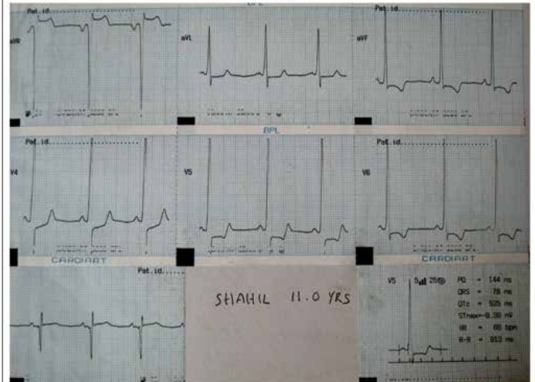

Slide 50
The ECG shows
Normal QRS axis
LAE (negative P in V1),
Deep S in V1 and tall R in V5 / V6
ST depression and T inversion is present in Lateral leads (LVH with strain)

Slide 51
The most likely diagnosis is Aortic Stenosis ( AS)
• Severe AS will have
1. Normal QRS axis
2. LVH + Strain
3. Possible LAE

Slide 52
AORTIC STENOSIS (AS)
Generally clinical severity in AS is reflected in ECG.
20% of severe AS in children can have normalECG

Slide 53
1. Infant
P wave normal.
QRS axis can be normal or RAD.
RV dominance is the rule below 1 month.
Older infants will have LVH in 75% of severe AS
LAE in infants –associated PDA or MR
RVH in AS
Below 1 month
Supravalvar AS with pulmonary Artery Branch Stenosis

Slide 54
2. Childhood
QRS axis is between +0+ to + 90.
LVH is found in 40% of moderate AS and 80% of severe AS.

Slide 55
LVH with ‘strain’ occurs as
Tall R in II. III aVF. V5-V6
No significant Q in lateral leads
ST depression and T inversion in V5-V6
LVH in children can occur in
1. Aortic stenosis
2. Hypertrophic cardiomyopathy
3. Coarctation of Aorta
4. Systemic hypertension
Mimickers - Pompe disease, Endocardial Fibro Elastosis (EFE)

Slide 56
CASE STUDY 6
A 6 year old boy has an asymptomatic basal murmur with ejection click. Both click and murmur are best heard at pulmonary area.

Slide 58
The ECG shows
RAE
RAD
Monophasic R in V1 and
Less of LV forces in V5 / V6

Slide 59
The most likely diagnosis is valvar PS
Severe valvar PS will have
1. Right atrial enlargement
2. RAD
3. RVH
4. RV Strain +

Slide 60
PULMONIC STENOSIS (PS)
ECG changes truly reflects the severity of PS unlike AS.

Slide 61
1. Mild PS
Can be normal.
RAD with tall R in V1or V3R
2. Moderate PS
Mostly abnormal.
RAD
RVH by voltage
3. Severe PS
Always abnormal.
RAE
QRS –RAD
QRS pattern could be – Rs, R and qR(V1)

Slide 62
qR pattern in V1 is found in 50% and indicates suprasystemic RV pressure. RVH with strain pattern can be found
In children between 2 yrs and 20 yrs,
RVSP= 5 x R in mm in V1 or V3R
PS gradient = RVSP – 10 mmHg
Example
3 year old. Severe PS
R in V1 = 22 mm
RVSP = 22 x 5 = 110 mmHg
PASP = 10 mm Hg
PS gradient = 110 – 10 = 100 mmHg

Slide 63
CASE STUDY 7
A 3 month old infant presents with poor femorals and CHF. There is an ejection click at apex and no significant murmur.

Slide 65
ECG shows
RAD
RVH(There is no LVH)
The likely diagnosis is severe Coarctation with bicuspid aortic valve

Slide 66
COARCTATION OF AORTA
Infant with Coarctation
ECG can be normal for age
May show RAE, RAD and RVH (not LVH)
If LVH -?AS, PDA
Child with Coarctation
Long standing Coarctation- LVH
LAD
Deep q in V4-V6 (AR due to bicuspid aortic valve)
RVH in childhood Coarctation -?PAH/VSD

Slide 68
CASE STUDY – 8
A 3 month old baby presents as dilated cardiomyopathy with significant LV dysfunction and grade 2/6 apical murmur.

Slide 70
The ECG shows
LAD
Deep q in l, aVL, V5-V6
absence of q in II, III,aVF
T inversion from V2 - V6
Likely diagnosis could be a remediable ‘DCM’ like ALCAPA

Slide 71
ALCAPA (Anomalous origin of Left Coronary Artery from Pulmonary Artery)
• ECG demonstrates.
1. q in I, aVL and V4-V6 leads.
2. Tall R in V4-V6
3. Left axis deviation. Axis can be normal.
4. Absence of q in II. III. aVF
5. ST elevation in precordial

Slide 73
Myocardial Infarction Pattern in ECG
Causes:Infants and Children
1. ALCAPA
2. Coronary AV Fistula
3. Viral Myocarditis
4. Kawasaki Disease
5. SLE
6. RSOV

Slide 74
CASE STUDY 9
A 10 month old baby has mild desaturation (Sat: 86%) and has a single S2 with a grade 3/6 mid systolic murmur at mid sternal border.

Slide 76
The ECG shows
RAD
Monophasic R in V1
Early transition (in V2)
The possible diagnosis is ToF

Slide 77
TETRALOGY OF FALLOT
ECG changes reflect the hemodynamics
The classic ‘tetrad’ in TOF are
No upright atrial enlargement
Right axis deviation
RVH
Early transition

Slide 78
1. TOF like clinical picture with LAD
a. Tricuspid Atresia
b. AVSD. PS
c. L-TGA. VSD. PS
d. SV. PS

Slide 79
2. TOF like clinical picture with10 AV block
a. L-TGA VSD PS
b. AVSD. PS
c. DORV. VSD. PS

Slide 80
3.TOF like clinical picture with CHB
a. L-TGA. VSD. PS
b. AVSD. PS
c. L-TGA VSD PS

Slide 81
CASE STUDY 10
A 6 days old baby has intense cyanosis and has a grade 1/6 murmur only. Saturation is 60%.

Slide 83
The ECG shows
RAE
RAD
RVH (R/S – 15/4) with upright T in V1-V2
The most likely diagnosis is d-TGA

Slide 84
The triad findings in TGA are
RAE
RAD
RVH

Slide 86
CASE STUDY 11
A four month old baby has deep cyanosis with grade 3/6 murmur. There is RAE in chest X-ray.

Slide 88
The ECG shows
RAE
LAD
Poor RV forces and good LV forces
The most likely diagnosis is Tricuspid Atresia (TA)

Slide 89
TRICUSPID ATRESIA (TA)
ECG findings
The Tetrad of features
1. RAE
2. LAD
3. Poor RV forces (r/s in V1)
4. Good LV forces

Slide 90
TA and QRS axis
1. TA. NRGA : LAD in 90% Normal in 10%
2. TA. TGA : LAD in 50% Normal in 50%.
There is paucity of RV forces and good LV force

Slide 91
CHD with Poor RV and good LV
1. Tricuspid Atresia
2. Pulmonary atresia with IVS
3. DILV (Single ventricle)

Slide 92
CASE STUDY 12
A 2 month old presents with CHF and tinge of cyanosis. Has both pansystolic and mid diastolic murmur with significant PAH.

Slide 94
The ECG shows
RAE
LAD
Monotonously similar r/S in V1-V6
Likely diagnosis could be Single Ventricle with PAH.

Slide 95
SINGLE VENTRICLE
In single ventricle, ECG depends on diversity of anatomy and physiology
The standard features are
1. LAD
2. No q in V5-V6
3. qR in V1 (less common)
4. r/S in V1 – V6

Slide 96
• SV. DILV. Non inverted ventricle
Normal PR interval. RAE. LAD or normal
LVH or stereotyped (r/S) QRS in V1-V6
• SV. DILV. Inverted ventricle.
Prolonged PR interval. CHB. RAE
RAD or normal. q in II, III ,Avf
• SV. DIRV.
RAD. RVH

Slide 97
CASE STUDY 13
A two month old baby presents with severe CHF and mild cyanosis. Has well split S2 with loud P2. Has multiple murmurs.

Slide 99
The ECG shows
RAE
RAD
RVH with RV strain (T ↓ in V1 – V6)
The likely possibility is TAPVC

Slide 100
TAPVC
ECG features
Sinus rhythm
RAE
RAD
RVH.
QRS pattern can be rSR, rR, qR or monophasic R

Slide 101
RVH with strain in new born can be due to
PPHN
Obstructed TAPVC
Critical Coarctation with PAH

Slide 102
CASE STUDY 14
A four year old child has mild cyanosis. Has a loud and single S2 and 3/6 murmur at left sternal border murmur

Slide 104
The ECG shows
LAD
q in V4R
Likely diagnosis is L-TGA

Slide 105
L TGA (Congenitally corrected TGA)
The standard ECG findings are
1. AV Block of varying degrees
2. LAD
3. q reversal in precordial leads.
4. WPW syndrome

Slide 106
qR in V1 can be found with
I. Suprasystemic RVSP
PPHN
Severe valvularar PS
Eisenmenger ASD
IPAH
II. RAE
RV EMF
Ebstein anomaly
III. Inverted ventricles
L-TGA

Slide 108
CASE STUDY 15
A one month baby has both CHF and cyanosis. Has severe PAH also

Slide 110
The ECG shows
RAE
RAD
Right ventricular hypertrophy

Slide 111
DORV
Basic ECG findings - RAD and RVH as rightventricle is systemic
Rest of findings will depend on pulmonary blood flow

Slide 112
1. DORV. VSD. PAH
1st degree AV block. LAD. CC loop and RVH
2. DORV. VSD (Subpulmonic). PAH
BVH
3. DORV. VSD PS
RAE. RAD. RVH.
QRS axis may be more left ward.

Slide 113
CASE STUDY 16
9 year old boy with mild dyspnea on exertion. Has saturation of 90%.
Has normal S1, wide split S2 and S3.
He has a pan systolic murmur also.

Slide 114
The ECG shows
RAE (very tall P)
RAD
Slightly prolonged PR
Wide and slurred QRS with M pattern in V1-V2
Likely possibility would be Ebstein anomaly

Slide 116
EBSTEIN anomaly
The abnormalities in Ebstein anomaly could be
1. Himalayan P wave
2. 1st degree AV block (50%)
3. RAD
4. RBBB pattern with splintered QRS
5. WPW (right sided) in 15%
6. Deep q in V1 V2
7. Various arrhythmias

Slide 117
Tall P Waves are found in
1. Ebstein
2. Tricuspid Atresia
3. Critical PS in new born
4. RV EMF

Slide 119
WPW and CHD
1. L-TGA (Left pathway)
2. Ebstein (Right pathway)
3. AVSD (Left pathway

Slide 120
CASE STUDY 17
An 18 year old girl, who had a ‘hole’ in the heart in infancy and improved later.
She was lost to follow up she has come back with dyspnea. Saturation is 90%

Slide 122
The ECG shows
RAE
RAD
Monophasic R in V1 (RVH)
Most likely diagnosis is Eisenmenger syndrome

Slide 123
EISENMENGER SYNDROME
Eisenmenger syndrome will have characteristically
RAE
RAD
RVH
qR in V1 can be found in ASD, Eisenmenger.

Slide 124
MALPOSITIONS
In cardiac malpositions, ECG changes depend on
1. Cardiac location
2. Situs
3. Intra cardiac anomalies
In dextrocardia, additional V4R, V5 R and V6 R are to be taken

Slide 125
I. P wave :
Analyze to assess situs
Situs solitus : P in I- aVF Positive,in aVR Negative
Situs inversus : P in 1- aVF Negative.P in aVR Positive
2. QRS
In dextrocardia
V6 R will face the right sided ventricle
V3 will face the left sided ventricle

Slide 126
Dextrocardia. Situs inversus. AV concordance
V5R, V6R will be facing morphological LV and will have q in them.

Slide 127
2. Dextrocardia .Situs inversus .AV discordance
V5 R and V6R face RV and will have no q.
V3 or V4 may have q.

Slide 128
3. Dextrocardia. Situs solitus.AV concordance
Right leads will face RV. V4 – V6 will face LV and can show q.

Slide 129
4. Dextrocardia Situs solitus. AV discordance
V5R, V6R will face LV and will have q.

Slide 130
Situs solitus, Levocardia

Slide 131
Situs inversus, dextrocardia

Slide 132
References
1. Electrocardiography in Science and Practice of Pediatric Cardiology
: A Garson Jr, JT Bricker, DJ Fisher
2. Demystifying the Pediatric ECG: MZ Ahamed
3. Chou’s Electrocardiography in Clinical Practice. Fifth Edition
4. Lipman - Massie Clinical Electrocardiography
5.Kerala Journal of Cardiology
6. Clinical Recognition of Congenital Heart Disease, Fifth edition 2003 J.K.Perloff, Saunders

Slide 133
THANK YOU

