Slide 1

Empagliflozin in Heart Failure with a
Preserved Ejection Fraction
EMPEROR-Preserved
Dr Arun Jude Alphonse
DM Cardiology Resident
Govt TDMC Alappuzha

Slide 2
INTRODUCTION
Heart failure is a complex clinical syndrome resulting from structural and functional impairment of ventricular filling or ejection of blood.
Acute heart failure is among the most common causes for hospitalization in patients older than 65 years of age in the developed world

Slide 3
OVERVIEW
What is HF-PEF ?
How Prevalent is it?
Who are these patients?
What is the pathophysiology?
How do you diagnose it?
What is the prognosis?
How to treat it?

Slide 4
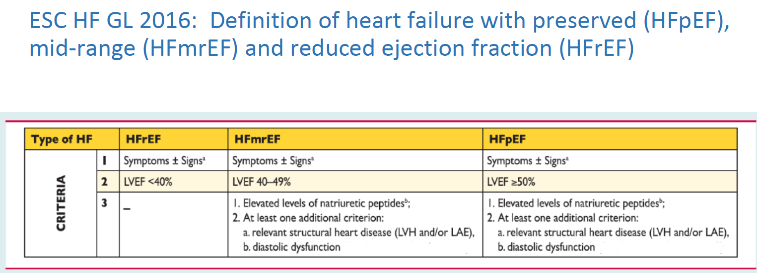
American College of Cardiology defines HFpEF as an LV ejection fraction >40%, with anything from 41% to 49% as borderline HFpEF

Slide 5
TERMINOLOGY
heart failure with a normal EF/ heart failure with normal systolic function/ diastolic heart failure / diastolic dysfunction

Slide 6
How Prevalent is it?
should hfpef be addressed

Slide 7

Prevalence of Heart Failure
USA
(CHS)
Finland
(Helsinki)
England
(Poole)
Sweden
(Vasteras)
Den.
(Copen.)
Spain
(Asturias)
Portugal
(EPICA)
Nether.
(Rotter.)
10
9
8.8
Proportion with reduced
LV ejection fraction
Proportion with preserved
LV ejection fraction
8.2
8
7.5
7
6.7
6.4
6
prevalence %
4.9
5
4.2
4
3
2.1
2
1
4.8
4.2
5.1
3.1
4.5
2.9
1.7
1.5
0
age range
mean age
66-103
78
75-86
-
70-84
76
75
75
> 50
-
> 40
60
>25
68
55-95
65

Slide 8
Ejection Fraction in Subjects with CHF
-the Cardiovascular Health Study
Men
Women
Normal (55%)
1
0
%
3
1
%
4
2
%
2
3
%
Mildly Reduced
(45% - 54%)
6
7
%
2
7
%
Moderately (30-44%) or severely reduced (< 30%)

Slide 9
NATURAL HISTORY
Mortality
  5-year survival rate less than 50%
  Remained static in HFpEF patients
  Annual mortality is about 5%
Mode of death
  >70 % are cardiovascular in nature (20% HF & 35% SCD)
  Incidence of non-cardiovascular deaths is significantly higher for HFpEF (30%)

Slide 10
What is the pathophysiology?

Slide 11
Determination of LV Diastolic function
Ventricular relaxation and compliance-Haemodynamic load (afterload)
Synchrony
Cellular mechanisms
LA volume and function
Heart rate
Pericardium
Derangement of any of the above will lead to abnormal filling pressures and diastolic dysfunction.

Slide 12
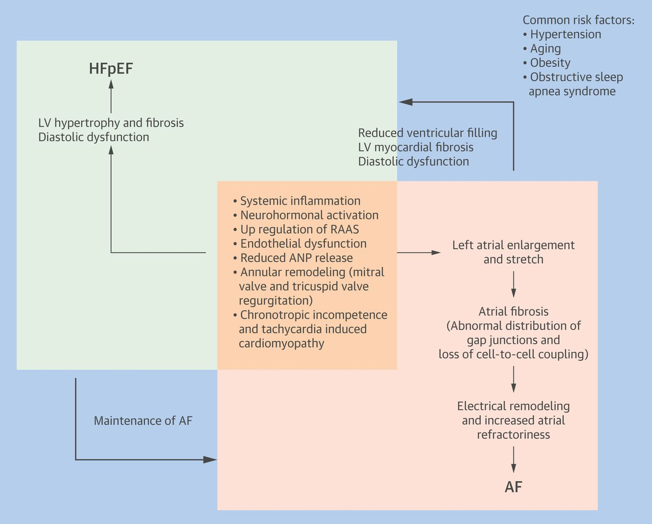

Slide 13
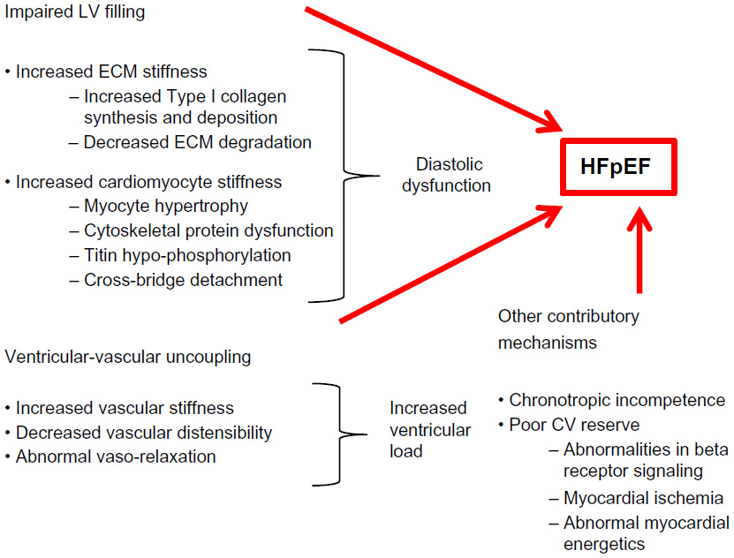

Slide 14
Who are these patients?

Slide 15
COMORBID CONDITIONS- heterogeneous clinical syndrome
AGE- decrement due to slower rates of LV relaxation, changes in the pattern of LV filling, and reduction in the early diastolic annular velocity that slowly progress with age
SEX-Females are at potent risk
HYPERTENSION - concentric remodeling or overt LV hypertrophy, increasing arterial and ventricular systolic stiffness -> impaired relaxation and increased diastolic stiffness

Slide 16
CAD - guidelines recommend revascularization in those patients with HFpEF in whom ischemia is felt to contribute to diastolic dysfunction
Atrial Fibrillation and Other Rhythm Disturbances:
Obesity
Diabetes mellitus - contributes to structural and functional coronary vascular and myocardial changes include metabolic disturbances, activation of proinflammatory and profibrotic mediators, cardiac autonomic neuropathy, and increases in advanced glycation end products (AGEs) -> promote increased collagen accumulation and stiffness

Slide 17
CKD
SLEEP APNOEA
PULMONARY ARTERY HYPERTENSION – prognostic implications and is associated with higher morbidity and mortality rates
OTHER RARE –infiltrative CM , valvular disease , constrictive pericarditis

Slide 18
PHENOTYPES

Slide 19
How do you diagnose it?
Diagnosis of HF-PEF – 5 STEP

Slide 22
How to treat it?
MANAGEMENT OF HFpEF

Slide 23
Pathophysiological Targets
1) Reduction and prevention of pulmonary and peripheral venous congestion
fluid and sodium restriction, judicious use of diuretics and nitrates, selective application of neurohormonal modulation, and appropriate remote monitoring–based tailored care
2) Treatment of antecedent and comorbid diseases
controlling blood pressure at rest and modifying blood pressure response to exercise, controlling glucose, treating and preventing ischemia, maintaining adequate renal function, and treating obesity
3)optimization of cardiac functional status
prevent excessive tachycardia or bradycardia

Slide 24
Randomized Clinical Trials

Slide 25
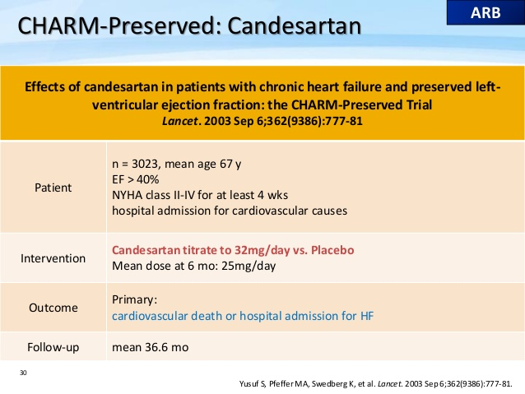

Slide 26
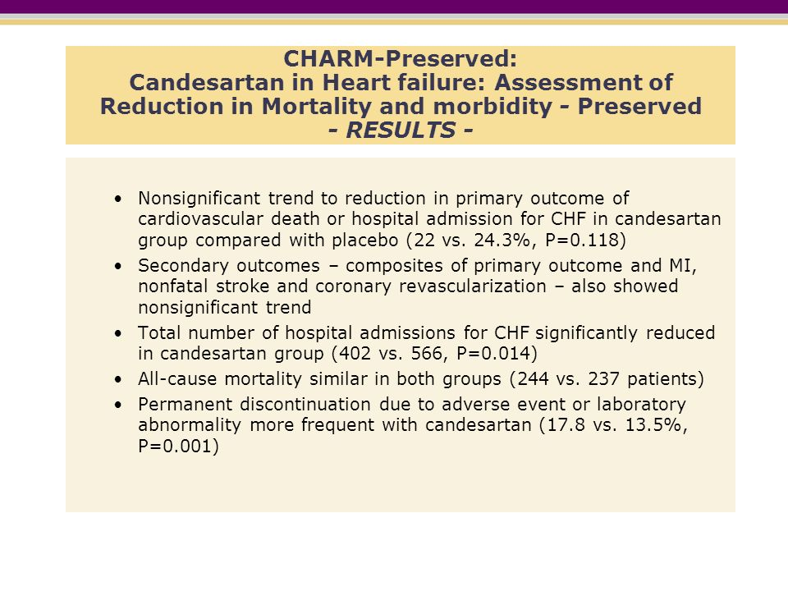
Notes:
reduced hospitalization

Slide 27
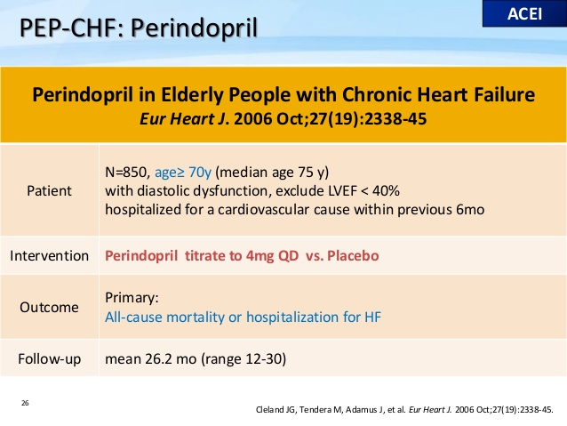

Slide 28
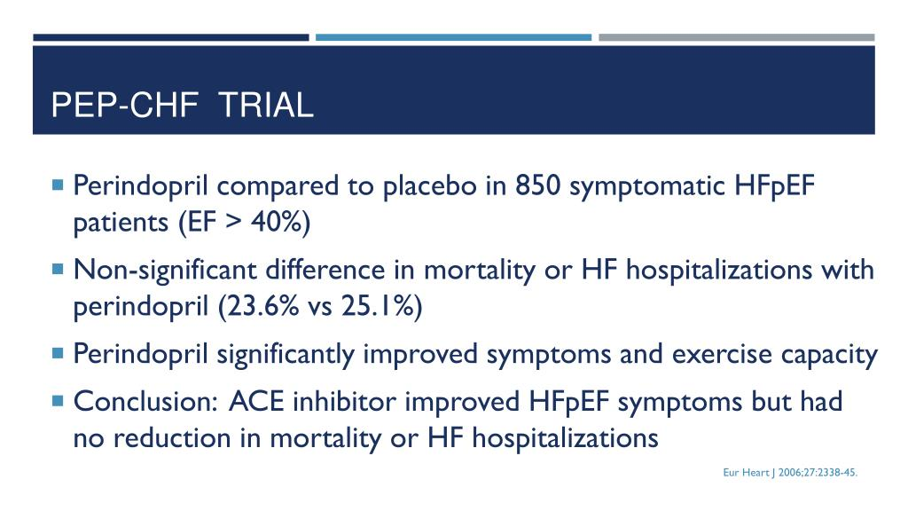

Slide 29
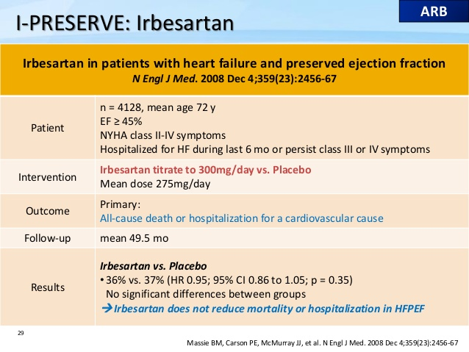

Slide 30
HEAT HFPEF
Background
Nitrates are commonly prescribed to enhance activity tolerance in patients with heart failure and a preserved ejection fraction. We compared the effect of isosorbide mononitrate or placebo on daily activity in such patients.
Methods
In this multicenter, double-blind, crossover study, 110 patients with heart failure and a preserved ejection fraction were randomly assigned to a 6-week dose-escalation regimen of isosorbide mononitrate (from 30 mg to 60 mg to 120 mg once daily) or placebo, with subsequent crossover to the other group for 6 weeks. The primary end point was the daily activity level, quantified as the average daily accelerometer units during the 120-mg phase, as assessed by patient-worn accelerometers. Secondary end points included hours of activity per day during the 120-mg phase, daily accelerometer units during all three dose regimens, quality-of-life scores, 6-minute walk distance, and levels of N-terminal pro–brain natriuretic peptide (NT-proBNP).
Results
In the group receiving the 120-mg dose of isosorbide mononitrate, as compared with the placebo group, there was a nonsignificant trend toward lower daily activity (−381 accelerometer units; 95% confidence interval [CI], −780 to 17; P=0.06) and a significant decrease in hours of activity per day (−0.30 hours; 95% CI, −0.55 to −0.05; P=0.02). During all dose regimens, activity in the isosorbide mononitrate group was lower than that in the placebo group (−439 accelerometer units; 95% CI, −792 to −86; P=0.02). Activity levels decreased progressively and significantly with increased doses of isosorbide mononitrate (but not placebo). There were no significant between-group differences in the 6-minute walk distance, quality-of-life scores, or NT-proBNP levels.
Conclusions
Patients with heart failure and a preserved ejection fraction who received isosorbide mononitrate were less active and did not have better quality of life or submaximal exercise capacity than did patients who received placebo. (Funded by the National Heart, Lung, and Blood Institute; ClinicalTrials.gov number, NCT02053493.)

Slide 31
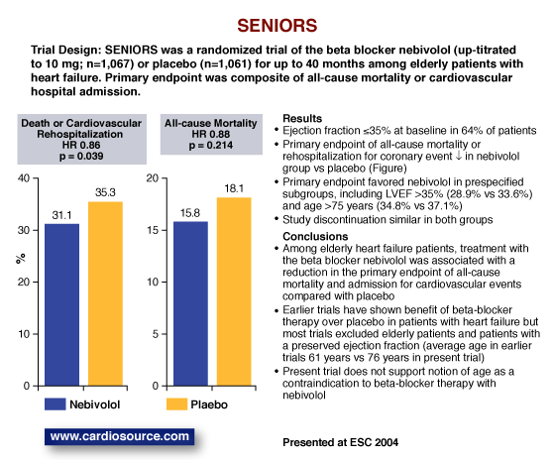
Notes:
very few patients with EF above 50% were included in the trial. Thus it is not possible to draw conclusions about the benefit of beta blockers in
HFpEF from this study

Slide 32
STATINS
Statins, as anti-inflammatory agents : first-line therapy in CAD and hyperlipidemia
CORONA (Controlled Rosuvastatin Multinational Trial in Heart Failure) trial : neutral regarding the efficacy of statins in patients with HFREF.
Fukuta et al: significant relative risk reduction in mortality in HFPEF (LVEF > 50%) pts with statin for 21months.
270 patients with HFPEF, follow-up for 5 years - improved survival compared to patients without statin therapy (HR= 0.65; 95%CI: 0.45-0.95, P = 0.029). - survival benefit was maintained after adjusting for differences in baseline characteristics, comorbidities, and other medications
Some small observational studies : seems to be associated with improved survival benefit in pts with HFPEF

Slide 33
PARAMOUNT HF trial
PARAMOUNT was a phase 2, randomised, parallel-group, double-blind multicentre trial in patients with NYHA class II-III heart failure, EF >=45% , and NT-proBNP > 400 pg/mL
Participants were randomly assigned (1:1) to LCZ696 titrated to 200 mg twice daily or valsartan titrated to 160 mg twice daily, and treated for 36 weeks

Slide 34
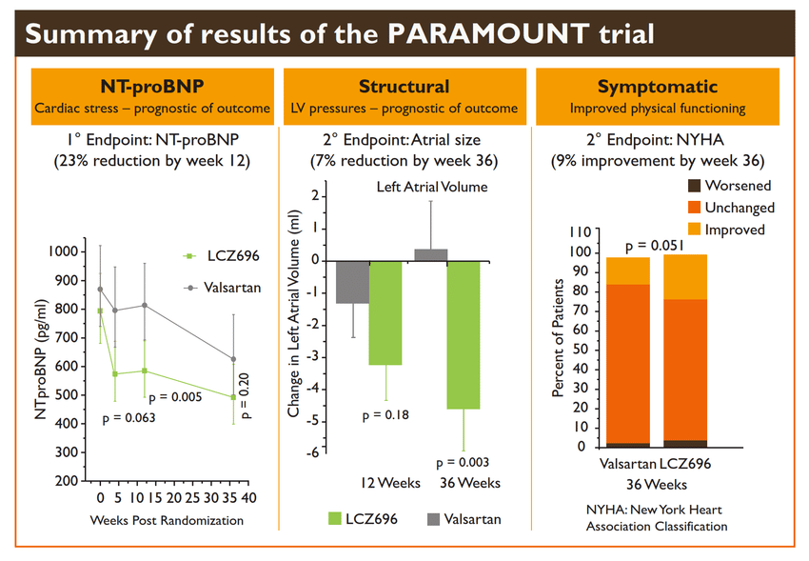

Slide 35
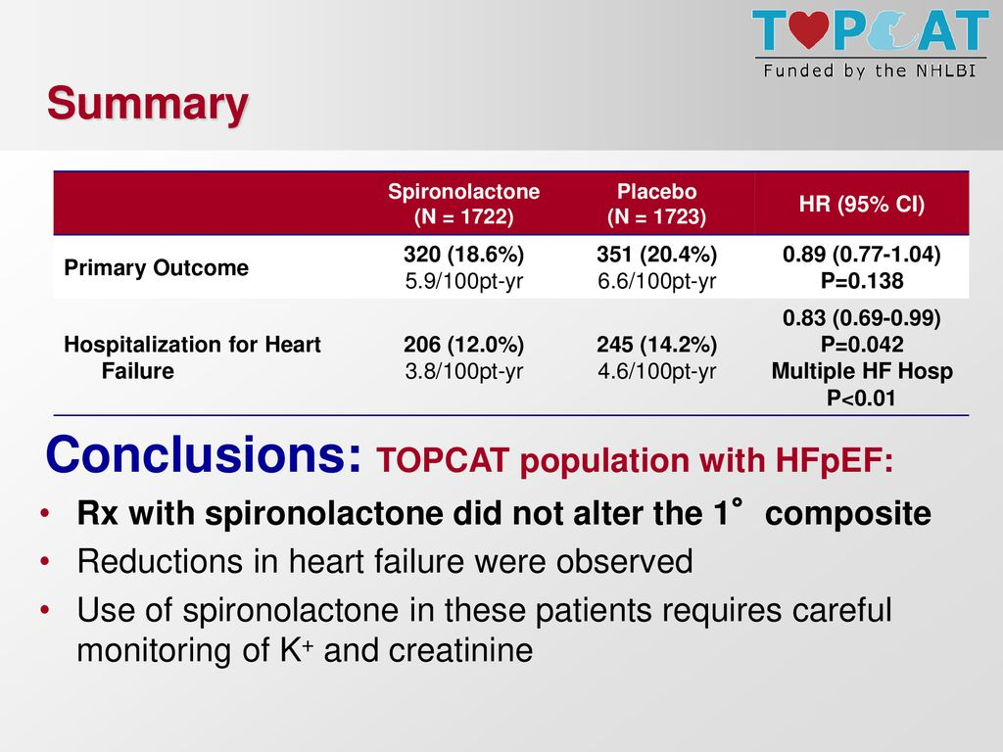

Slide 36
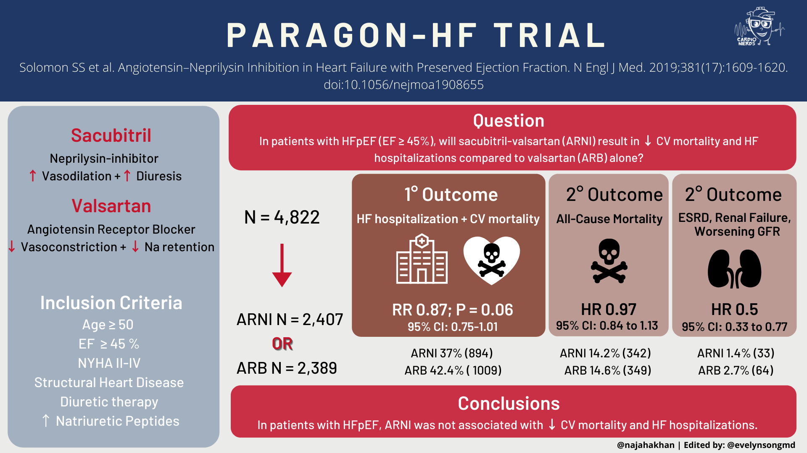

Slide 37
OTHER TRIALS IN HFpEF Patients
Digitalis Investigators Group (DIG) Trial included a separate cohort of 988 patients with ambulatory HFpEF (EF >45%) in normal sinus rhythm
Digoxin did not alter the primary endpoint of heart failure–related hospitalization or cardiovascular mortality but did reduce the number of such hospitalizations

Slide 38


Slide 39
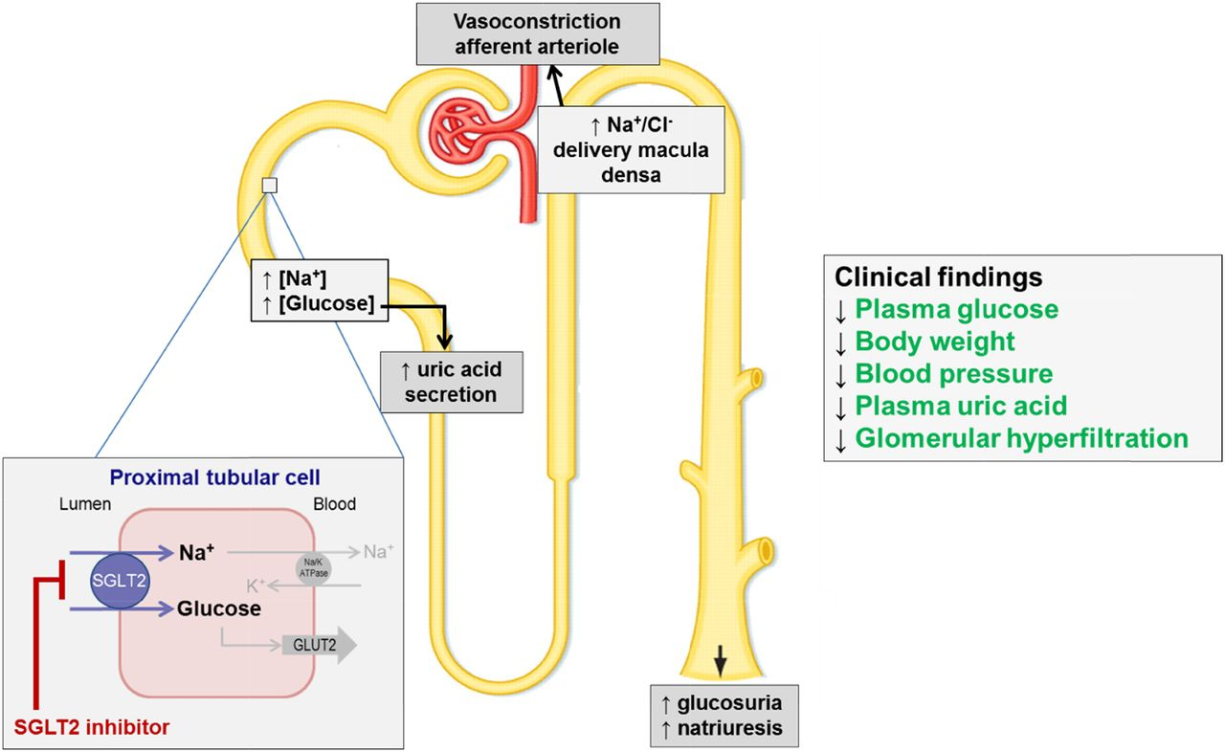
SGLT2 Inhibitirs
Mechanism of action
Glucosuria
Natiuresis
Osmotic diuresis
Uricosuria
Reduced oxidative stress and damage.
Reduced intraglomerular filteration pressures
Reduced albuminuria
Reduced BP
Reduced plasma volume
Reduced body weight.

Slide 40
Cardio-protective role
Blood pressure reduction and diuresis – SBP (5–6 mmHg) and DBP (1–2 mmHg).
Ketone body metabolism – Metabolic flexibility → more ATP is produced per molecule of oxygen consumed than with glucose or free fatty acids.
Ketone bodies (b-hydroxybutyrate) → intracellular signalling → endogenous inhibitor of histone deacetylases (HDACs) → gene expression.
  HDAC inhibition improves cardiac function, reducing chamber size, improving cardiac metabolism, and reducing inflammation.
  b-hydroxybutyrate is also reported to be a ligand for G proteincoupled receptor 41 (GPR41) → b-hydroxybutyrate reportedly suppresses sympathetic nervous system activity and heart rates .
Notes:
SGLT2 inhibitors improve myocardial fuel metabolism and cardiac efficiency by shifting fuel utilization away from lipids and glucose to ketone bodies …
Cardiac uptake of carbohydrate (glucose, lactate, and pyruvate) is decreased, whereas uptake of total ketone bodies and b-hydroxybutyrate are increased…… increases in the plasma ketone body concentration induced by SGLT2 inhibitors may protect failing hearts in diabetic patients….
These enzymes affect the acetylation status of histones and other important cellular proteins, thereby playing an important role in the regulation of gene expression……

Slide 41
4. Sodium-hydrogen exchanger
SGLT2 inhibitors may reduce intracellular Na+ load in failing cardiomyocytes by inhibiting the sarcolemmal Na+ /H+ exchanger (NHE) .
Elevated cytoplasmic Na+ → mitochondrial Ca2+ extrusion (cytosolic Na+ /Ca2+ exchanger ).
5. Elevation of hemoglobin and hematocrit levels (2-4%) and erythropoietin .
6. Suppression of sympathetic activity and HR.
7. Activation of endothelial nitric oxide synthase.
Notes:
This effect was independent of SGLT2 inhibition ….. NHE expression is increased in heart failure, which appears to increase conversion of pyruvate to lactate, leading to intracellular acidosis …………
Elevated cytoplasmic Na+ enhances mitochondrial Ca2+ extrusion, as mitochondrial Ca2+ is exported from mitochondria into the cytosol via the cytosolic Na+ /Ca2+ exchanger ….
s important not only for ATP production, but also for preserving mitochondrial anti-oxidative capacity…………..
Erythropoietin is produced by “neural crest-derived” fibroblasts residing near the proximal tubules in the kidney [46]. Selective proximal tubule injury induces transdifferentiation of erythropoietin-producing fibroblasts into myofibroblasts, resulting in a reduction in erythropoietin production …. .. SGLT2 inhibitors suppress Na+ reabsorption, reduce ATP consumption by Na+ /K+ ATPase, and improve relative hypoxic conditions in the proximal tubules. This may allow reversion of myofibroblasts to erythropoietin-producing fibroblasts, resulting in enhancement of hematopoiesis………..

Slide 42
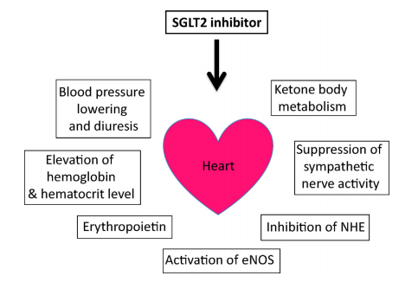
.
Notes:
This effect was independent of SGLT2 inhibition ….. NHE expression is increased in heart failure, which appears to increase conversion of pyruvate to lactate, leading to intracellular acidosis …………
Elevated cytoplasmic Na+ enhances mitochondrial Ca2+ extrusion, as mitochondrial Ca2+ is exported from mitochondria into the cytosol via the cytosolic Na+ /Ca2+ exchanger ….
s important not only for ATP production, but also for preserving mitochondrial anti-oxidative capacity…………..
Erythropoietin is produced by “neural crest-derived” fibroblasts residing near the proximal tubules in the kidney [46]. Selective proximal tubule injury induces transdifferentiation of erythropoietin-producing fibroblasts into myofibroblasts, resulting in a reduction in erythropoietin production …. .. SGLT2 inhibitors suppress Na+ reabsorption, reduce ATP consumption by Na+ /K+ ATPase, and improve relative hypoxic conditions in the proximal tubules. This may allow reversion of myofibroblasts to erythropoietin-producing fibroblasts, resulting in enhancement of hematopoiesis………..

Slide 43
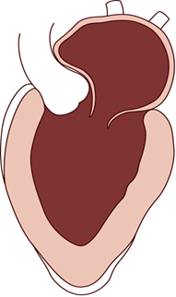
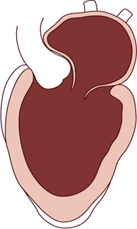
The Evolution of SGLT2i in HF Management
Diabetes Diabetes and No Diabetes
Window of opportunity for treatment
Pre-clinical (subclinical) stage of the disease
Clinical stage of the disease
Detectable cardiac involvement
0 years 10 years
18-20 years
DAPA-HF
CANVAS Program CREDENCE
DELIVER HFpEF
EMPEROR-Preserved
EMPEROR-Reduced SOLOIST-WHF
DAPA-CKD DECLARE-TIMI 58
EMPA-REG OUTCOME VERTIS CV
HF Prevention
Normal Ventricular Function
End-stage Heart Failure
HF Treatment
Acute HF?
Adapted from Bhatt DL, Verma S, Braunwald E. Cell Metabolism. 2019;30:847-849.

Slide 44
Methods
Trial design
Randomized
Double-blind
Parallel-group,Placebo-controlled
Event-driven trial
Final date of follow-up for data collection was April 26, 2021
The median duration of follow-up was 26.2 months

Slide 45
Inclusion criteria
Age ≥ 18 years at screening
Patients with chronic HF diagnosed for at least 3 months before Visit 1, and currently in NYHA class II-IV
Chronic HFpEF defined as LVEF > 40% and no prior measurement of LVEF ≤ 40% under stable conditions .The EF must have been obtained and documented at Visit 1 or within 6 months prior to Visit 1, and more than 90 days after any MI
Elevated NT-proBNP > 300 pg/ml for patients without AF, OR > 900 pg/ml for patients with AF

Slide 46
Patients must have at least one of the following evidence of HF
  Structural heart disease
  Documented HHF d within 12 months prior to Visit 1
Body Mass Index (BMI) < 45 kg/m2 at Visit 1
Consent to participate in the trial

Slide 47
Exclusion criteria
MI,CABG or other major cardiovascular surgery, stroke or TIA in past 90 days prior to Visit 1
ICD/CRT within 3 months prior to Visit 1
Cardiomyopathy based on infiltrative diseases
Any severe valvular heart disease expected to lead to surgery during the trial in the Investigator’s opinion
ADHF requiring i.v diuretics, i.v. inotropes or i.v. vasodilators, or LVAD within 1 week from discharge to Visit 1, and during screening period until Visit 2

Slide 48
Atrial fibrillation or atrial flutter with a resting heart rate > 110 bpm documented by ECG at Visit 2
Symptomatic hypotension and/or a SBP < 100 mmHg
Chronic pulmonary,liver,renal(eGFR <20 mL/min/1.73 m2) diseases
Anaemia, major surgery in prior 90 days
Alife expectancy of <1yr
Women who are pregnant, nursing, or who plan to become pregnant

Slide 49
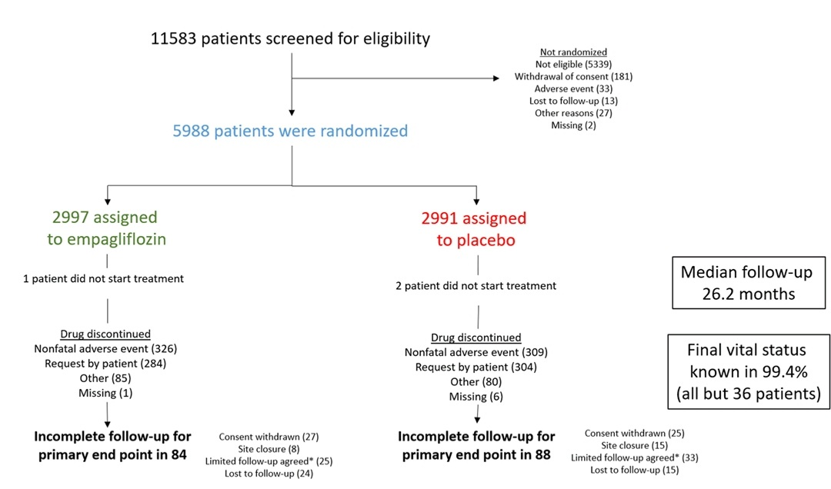

Slide 50
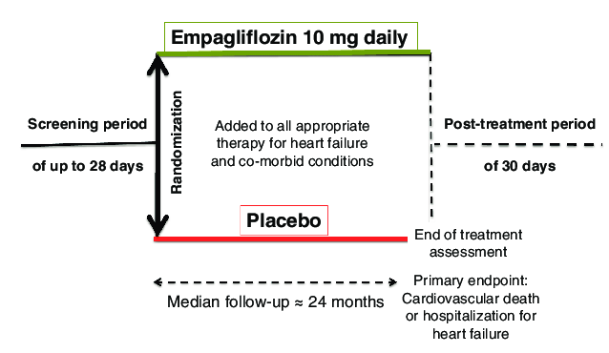
TRIAL VISITS AND FOLLOW-UP

Slide 51
TRIAL EFFICACY ENDPOINTS
Primary endpoint
The composite primary endpoint for this trial is the time to first event of CV death or adjudicated HHF in patients with
Secondary endpoint
The key secondary endpoints which are part of the testing strategy, are the following:
Occurrence of adjudicated HHF (first and recurrent)
eGFR (CKD-EPI) slope of change from baseline

Slide 52
Other secondary end points
Time to first adjudicated HHF
Time to adjudicated CV death
Time to all-cause mortality
Time to onset of DM
Time to first occurrence of sustained reduction of ≥40% eGFR
Occurrence of all-cause hospitalisation

Slide 53
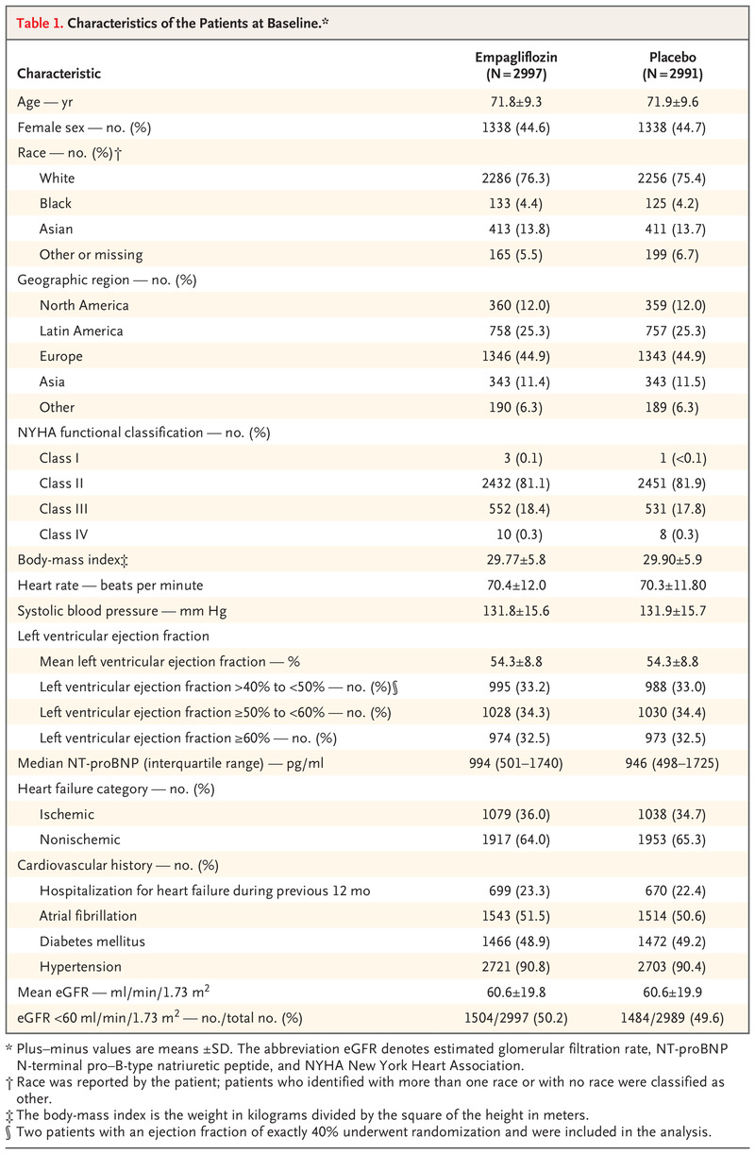

Slide 55
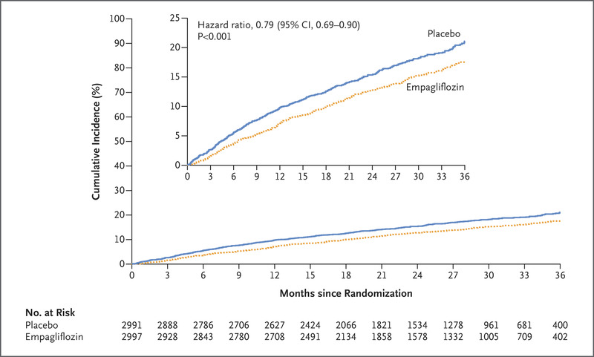
PRIMARY OUTCOME
A primary composite outcome event occurred in 415 patients (13.8%) in the empagliflozin group and in 511 patients (17.1%) in the placebo group (6.9 vs. 8.7 events per 100 patient-years; hazard ratio, 0.79; 95% CI, 0.69 to 0.90; P<0.001)

Slide 56
The total number of hospitalizations for heart failure was lower with empagliflozin than with placebo (hazard ratio, 0.73; 95% CI, 0.61 to 0.88; P<0.001)
The rate of decline in the eGFR was slower in the empagliflozin group than in the placebo group (–1.25 vs. –2.62 ml per minute per 1.73 m² per year; P<0.001)

Slide 57
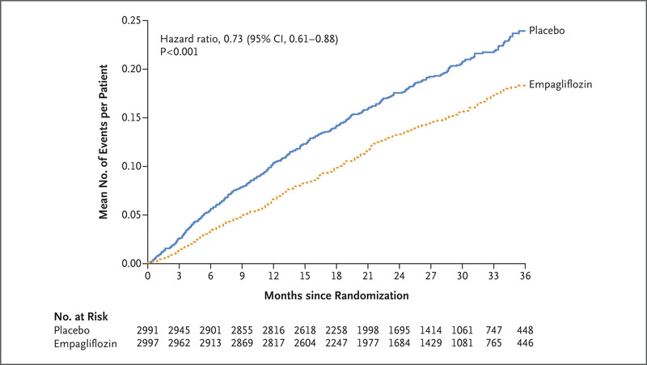

Slide 58
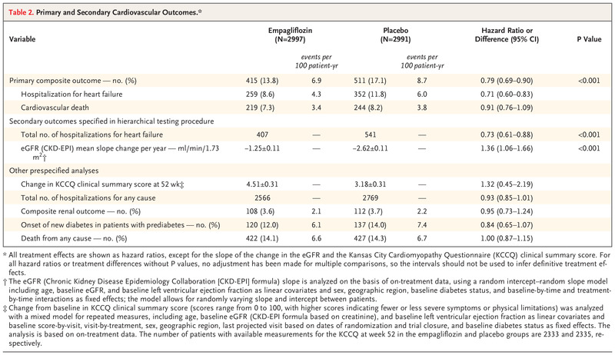

Slide 59
Discussion
In patients with heart failure and a preserved ejection fraction, empagliflozin led to a 21% lower relative risk in the composite of cardiovascular death 0r hospitalization for heart failure
Favorable effects were also seen in patients without diabetes.
Similar to that reported with empagliflozin in emperor-reduced.
Previous large-scale trials of drug interventions have failed to demonstrate unequivocal benefits
Lower incidence of hospitalization for heart failure

Slide 60
Conclusion
Empagliflozin reduced the risk of cardiovascular death or hospitalization for heart failure in patients with HFpEF. This benefit was consistent across prespecified ejection fraction subgroups and was seen in patients with or without diabetes.

Slide 61
CONCLUSION
Systolic and diastolic blood pressure should be controlled adequately→ I B
Diuretics should be used for relief of symptoms → I C
Coronary revascularization is reasonable in patients with CAD in whom symptoms (angina) or demonstrable myocardial ischemia is judged to be having an adverse effect on symptomatic HFpEF despite GDMT.→ IIa C

Slide 62
Management of AF according to published clinical practice guidelines in patients with HFpEF is reasonable to improve symptomatic HF.→ IIa C
The use of BB, ACE I, and ARBs in patients with hypertension is reasonable to control blood pressure in patients with HFpEF.→ IIa C
In appropriately selected patients with HFpEF (with EF >45%, elevated BNP levels or HF admission within 1 year, eGFR>30 mL/min, Cr<2.5mg L, k <5meq/l MRA to be considered → IIb B-R

Slide 63
THANK YOU

