Slide 1
Essential (Primary) Hypertension
Dr. Mayur A

Slide 2
Overview
Prevalence - About 80 million people in US and over 1 billion worldwide
Most common and reversible risk factor for myocardial infarction (MI), stroke, heart failure, atrial fibrillation, aortic dissection, peripheral arterial disease, and cognitive decline
The global burden of hypertension is rising due to escalating obesity and population aging

Slide 3
The prevalence of hypertension is increasing most rapidly in developing countries
Its due to poor hypertension treatment and control which contribute to the growing epidemic of cardiovascular disease
BP trends show a clear shift of the highest BPs from high-income to low-income regions, with an estimated 349 million with hypertension in HIC and 1.04 billion in LMICs

Slide 4
Definition & Prevalence
Hypertension is defined as a usual office BP of 140/90 mm Hg or higher
The prevalence of hypertension increases with age and rises exponentially after 30.
Before 50 years of age, women have a somewhat lower prevalence of hypertension than men but after menopause, the prevalence of hypertension increases rapidly in women.
According to U.S. data eventually, by age 78 almost 90% will have hypertension

Slide 5
Primary hypertension:
90% to 95% of hypertensive patients have no apparent single reversible cause of elevated BP
Secondary (identifiable) hypertension:
The remaining 5% to 10% cases demonstrate a more discrete mechanism.

Slide 6
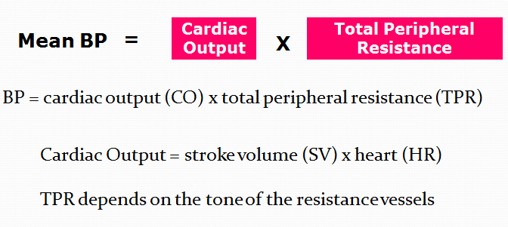
Blood pressure equation

Slide 7
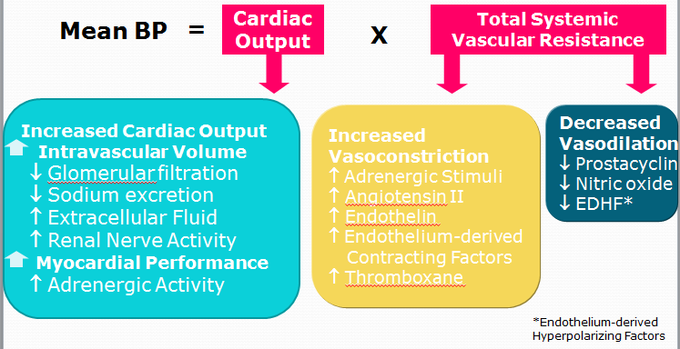
Causes of Hypertension

Slide 8
BP variability & Determinants
Behavioral Determinants
Smoking: transiently raises BP by 10 to 20 mm Hg
Alcohol: Moderate alcohol drinkers (one or two drinks per day) generally have less hypertension
Caffeine
Physical inactivity
Increases as BMI increases
Dietary Sodium intake: increases with increase sodium intake
Dietary potassium intake: decreases (Thiazide like diuretic action, it acutely decreases the activity of the thiazide-sensitive Na+/K+ cotransporter, thus lowering renal Na+ reabsorption)
Notes:
Dium intake

Slide 9
Genetic Determinants:
Incidance of BP is higher in families than in unrelated individuals, higher between monozygotic than dizygotic twins, and higher between biologic than adoptive siblings
Mutations in 20 salt-handling genes :rare monogenic forms causing hypotension (salt-wasting syndromes) and hypertension (all inherited as mendelian traits)
Mutations in some monogenic forms of severe hypertension which caused by renal or vascular mechanisms

Slide 10
Mechanisms of Primary (Essential) Hypertension
Hemodynamic Subtypes:
Systolic Hypertension in Teenagers and Young Adults:
Isolated systolic hypertension (ISH) is the main type in young adults (17 -25 yrs)
The key hemodynamic abnormalities:
Increased cardiac output and a stiff aorta because of overactive sympathetic nervous system
ISH in youth may predispose to diastolic hypertension in middle age

Slide 11
Diastolic Hypertension in Middle Age:
30 to 50 years
Isolated diastolic hypertension with normal systolic pressure or elevated systolic pressure (combined systolic-diastolic hypertension)
IDH is more common in men
Without treatment, IDH often progresses to combined systolic-diastolic hypertension

Slide 12
Hemodynamic fault: elevated SVR with normal cardiac output
Vasoconstriction of the resistance arterioles due to increased neurohormonal drive
Expanded plasma volume due to impairment in sodium excretion in the kidneys causes autoregulatory reaction of vascular smooth muscle

Slide 13
Isolated Systolic Hypertension in Older Adults:
After 55 yrs, ISH (SBP >140 mm Hg and DBP <90 mm Hg) predominates
Diastolic BP rises until about 55 years of age, then falls progressively
Hemodynamic fault: Stiffening of the central aorta and a more rapid return of reflected pulse waves from the periphery, increasing systolic aortic pressure
Accumulation of poorly distensible collagen affects its ratio to elastin in the aortic wall

Slide 14
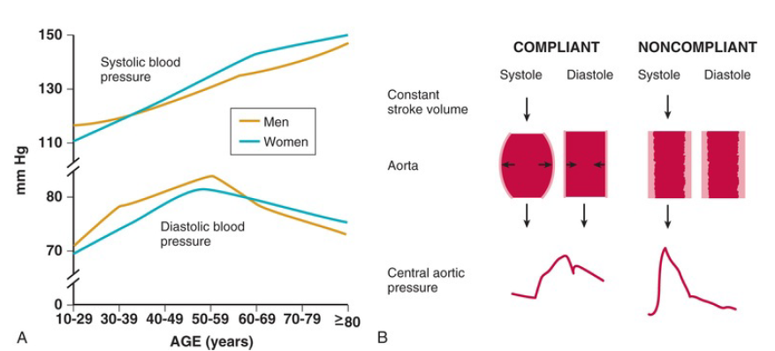
A, Age-dependent changes in systolic and diastolic blood pressure . B, Schematic representation of the relationship between aortic compliance and pulse pressure.

Slide 15
Neural Mechanisms
Two device-based interventional approaches to treat hypertension
Baroreflex activation therapy (BAT)
Renal denervation (RDN)

Slide 16
Baroreflex activation therapy (BAT)
Afferent neural signals:
Carotid BAT → carotid sinus nerve -→ brainstem →interprets as a rise in BP
Efferent neural signals: decreased efferent sympathetic nerve activity to
Heart →slows heart rate;
Peripheral circulation → lowers SVR; and
Kidney → reduces renin release and increases renal sodium excretion.

Slide 17
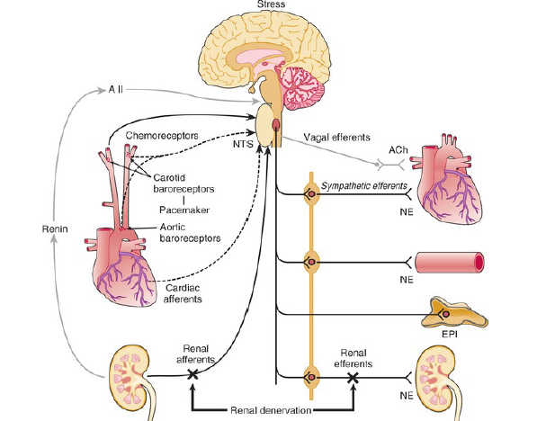
Sympathetic neural mechanisms of blood pressure regulation and treatment targets of carotid baroreceptor pacing and renal denervation

Slide 18
Renal Denervation (RDN)
Catheter is inserted into the renal arteries and radiofrequency or ultrasound is used to ablate the renal nerves, which are located on the adventitial surface of the renal arteries
Destroy both efferent and afferent renal nerves
Renal efferent nerves causes hypertension via:
Alpha1-adrenergic receptors: Renal vasoconstriction, vascular hypertrophy and enhance renal sodium and water reabsorption
Beta1-adrenergic receptors: stimulate renin release and

Slide 19
Renal afferent nerves contribute to hypertension:
By evoking reflex activation of central sympathetic outflow triggered to multiple tissues and vascular beds.

Slide 20
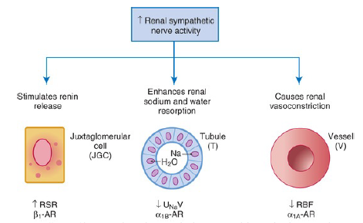
Effects of increased renal sympathetic nerve activity on the three renal neuroeffectors:
juxtaglomerular granular cells (JGC) with increased renin secretion rate (RSR) via stimulation of the β1- adrenoceptors (AR); renal tubular epithelial cells (T) with increased renal tubular sodium reabsorption and decreased urinary sodium excretion (UNaV) via stimulation of α1B AR; and the renal vasculature (V) with decreased renal blood flow (RBF) via stimulation of α1A AR.

Slide 21
Obesity-Related Hypertension
With weight gain, reflex sympathetic activation is an important compensation to burn fat
This sympathetic overactivity in target tissues such as vascular smooth muscle and kidney produces hypertension.
The sympathetic activation is associated with insulin resistance

Slide 22
OSA as a Cause of Neurogenic Hypertension
Can have elevated plasma and urine catecholamine levels, mimicking as in pts with pheochromocytoma
Repeated arterial desaturation during apneas → activation of carotid body chemoreceptors → triggers BP surges throughout the night and resets the chemoreceptor reflex
Daytime normoxia is misinterpreted as hypoxia, producing sustained reflex sympathetic activation and hypertension even during waking hours

Slide 23
Renal Mechanisms
A fundamental abnormality is an acquired or inherited defect in the kidneys' ability to excrete the excessive sodium load imposed by a modern high salt diet
Renal sodium retention expands the plasma volume, increases cardiac output and triggers autoregulatory responses that increase SVR
Salt retention also augments the smooth muscle contraction produced by endogenous vasoconstrictors

Slide 24
U.S. Department of Health and Human Services recommend a daily intake of NaCl
General population :less than 5.8 g (2300 mg of sodium)
Persons with hypertension or prehypertension : 3.7 g
Reducing dietary salt by 3 g per day likely would reduce the annual number of new cases of
Coronary heart disease by 60,000 to 120,000,
Stroke by 32,000 to 66,000, and of
MI by 54,000 to 99,000, and
Reduce the annual number of deaths from any cause by 44,000 to 92,000

Slide 25
Resetting of Pressure-Natriuresis
In normotensive individuals, BP elevation cases immediate increase in renal sodium excretion to reduce plasma volume and to return BP to normal
In hypertension, this pressure-natriuresis curve is shifted to the right
Resetting of pressure natriuresis prevents the return of BP to normal to maintain fluid balance but at the expense of high BP

Slide 26
Pressure-natriuresis causes profound nocturia in patients with pure autonomic failure who have supine nocturnal hypertension
So nocturia also may be an unrecognized symptom of uncontrolled primary hypertension.

Slide 27
Low Birth Weight
Because of low birth weight with reduced nephrogenesis it increases the risk for development of adult salt-dependent hypertension.
Hypertensive adults will have fewer glomeruli per kidney suggesting nephron dropout with decreased total filtration surface area
If low-birth-weight children consume a fast-food diet, they are susceptible to rapid postnatal weight gain, leading to adolescent obesity and hypertension

Slide 28
Genetic contribtion:
Studies have implicated an important genetic contribution to salt-sensitive hypertension
Sequence variations in the APOL1 gene associate strongly with African ancestry and causes a twofold to fourfold increased risk of end-stage renal disease (ESRD).

Slide 29
Vascular Mechanisms
Endothelial Cell Dysfunction:
Dysfunctional endothelium causes
Impaired release of endothelium-derived relaxing factors (e.g., nitric oxide, endothelium-derived hyperpolarizing factor) and
Enhanced release of endothelium-derived constricting, proinflammatory, prothrombotic, and growth factors3

Slide 30
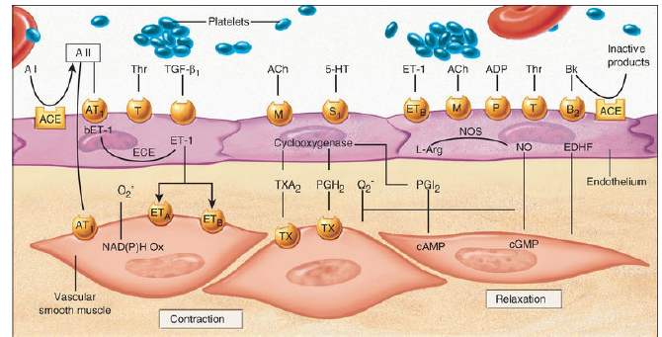
Endothelium-derived relaxing and constricting factors. Various blood- and platelet-derived substances can activate specific receptors (orange circles) on the endothelial membrane to release relaxing factors such as nitric oxide (NO), prostacyclin (PGI2), and an endothelium-derived hyperpolarizing factor (EDHF). Contracting factors also are released, such as endothelin (ET-1), angiotensin (A II), and thromboxane A2 (TXA2), as well as prostaglandin H2 (PGH2

Slide 31
Vascular Remodeling:
Prolong endothelial cell dysfunction, neurohormonal activation, and elevated BP cause remodeling of blood vessels, which further increases hypertension
An increase in the medial thickness relative to the lumen diameter (increased media-to-lumen ratio) is the hallmark of hypertensive remodeling in small and large arteries.

Slide 32
Inward eutrophic remodeling:
It’s a rearrangement of normal smooth muscle cells (SMCs) around a smaller lumen diameter
Vasoconstriction initiates small-artery remodeling
The media/lumen ratio increases, but the medial cross-sectional area remains unchanged.
So inward eutrophic remodeling increases SVR by decreasing lumen diameter in the peripheral circulation,

Slide 33
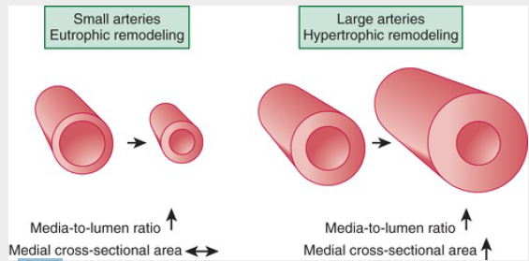
It is the hemodynamic hallmark of diastolic hypertension
Vascular remodeling of small and large arteries in hypertension. Diagrams represent arteries in cross section showing the tunica adventitia, tunica media, and tunica intima

Slide 34
Hormonal Mechanisms: Renin-Angiotensin-Aldosterone System
Activation of the RAAS contributes to endothelial cell dysfunction, vascular remodeling, and hypertension
Chymase, a serine protease in the heart and systemic arteries, provides an alternative pathway for conversion of A I to A II
The interaction of A II with G protein–coupled AT1 receptors contribute to hypertension and accelerate hypertensive end organ damage.
It causes vasoconstriction, ROS generation, vascular inflammation, vascular/cardiac remodeling, and production of aldosterone

Slide 35
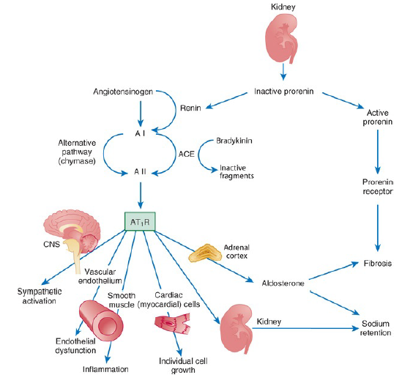
The renin-angiotensin-aldosterone system

Slide 36
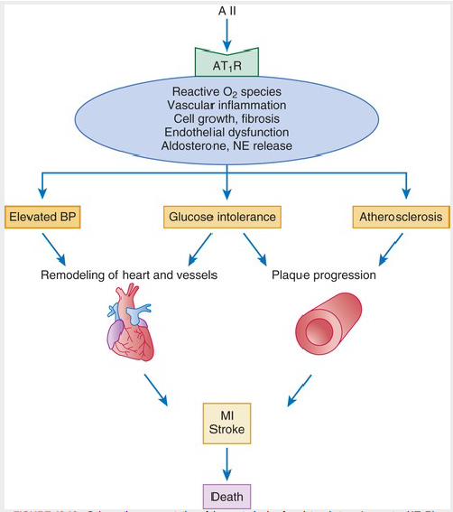
Schematic representation of the central role of angiotensin type 1 receptor (AT1R)–
mediated signaling in cardiovascular disease progression

Slide 37
Hypertension as an Immunologic Disorder
Hypertensive stimuli such as angiotensin II and sodium act in the central nervous system to increase renal sympathetic nerve activity.
The sympathetic activation causes hypertension by promoting inflammation and damage in the kidney and other organs (especially the systemic vasculature)
It involves accumulation of proteins oxidized by high reactive gamma ketoaldehydes termed isoketals in antigen-presenting dendritic cells (DC), which in turn promote T cell activation.

Slide 38
These activated T cells are homed by local expression of adhesion molecules (e.g., VCAM-1) to perinephric fat (and perivascular fat),
They produce proinflammatory cytokines (e.g., IL-17, TNF-α) and causes renal (and vascular) inflammation and damage.

Slide 39
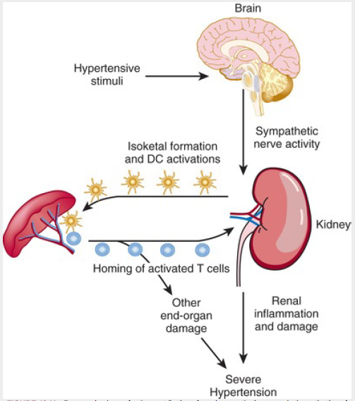

Slide 40
Thank you

