Slide 1
HYPERTROPHIC CARDIOMYOPATHY
Dr Arun Jude Alphonse
DM Cardiology Resident
Govt TDMC Alappuzha

Slide 2
TOPICS COVERED
Epidemiology and Etiology – Genetic basis
Current role of genetic testing
Gross Morphology and Histopathology
Pathophysiology – LVOTO , Diastolic dysfunction , microvascular dysfunction , MR .
Clinical features – symptoms /signs
ECG , ECHOCARDIOGRAPHY , CMRI , invasive studies
HCM risk stratification – ICD indications
Management – pharmacological + SRT
HCM phneocopies/mimics
Previous questions asked

Slide 3
Introduction
Thickened …… non-dilated left ventricle in the absence of another cardiac/ systemic or metabolic condition (e.g., AS, SHT physiologic athlete's heart) .—Inappropriate LVH, intrinsic muscle cause
LV end-diastolic wall thickness of ≥15 mm anywhere in the left ventricle.
Brock & Teare’s Syndrome
Frequency 1: 500→1:200 .
IHSS and HOCM → HCM with or without obstruction ( 1/3rd –nonobstructive)
Mutation in gene encoding the Sarcomere proteins .
Notes:
Most affected individuals remain unrecognized during their lifetime and usually do not have symptoms or suffer cardiovascular events.

Slide 4
Epidemiology
Frequency 1: 500→1:200 .
700,000 affected people in the United States .
Nearly 2 million affected people in India .
Supposed to be - equal frequency in men and women. (but MEN >> women)
Women- progression to advanced heart failure → HIGHER .

Slide 5
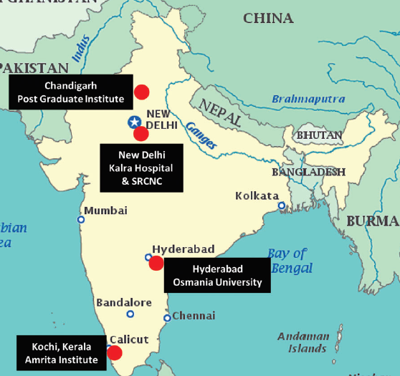
MULTI-DISCIPLINARY HCM CENTERS
Notes:
Progression to heart failure
Faster progression to heart failure due to higher incidence of outflow obstruction Slower than women …………..
The predominance of men with HCM reported in the literature probably reflects an underdiagnosis in women, who achieve clinical recognition less frequently and at older ages than men………..

Slide 6
GENETIC AND INHERITANCE
Autosomal dominant inheritance - variable penetrance can result in differences in onset and severity of clinical manifestations .
HCM is known to be caused by mutations in 11 or more genes encoding sarcomere proteins . (thick filament , thin filament , intermediate filament and Z disc)
β-myosin heavy chain (MYH7) and myosin-binding protein C (MYBPC3) – 70%
Troponin T (TNNT2), troponin I (TNNI3), and others -5%
1500 mutations (largely missense) – unique to a family .
Notes:
β-myosin heavy chain (MYH7) and myosin-binding protein C (MYBPC3)
are by far the most common, accounting for 70% of patients for whom genotyping has been successful.
heterogeneity of HCM is the recognition of over 1500 individual
mutations (largely missense), most of which are unique to individual families…………..

Slide 7
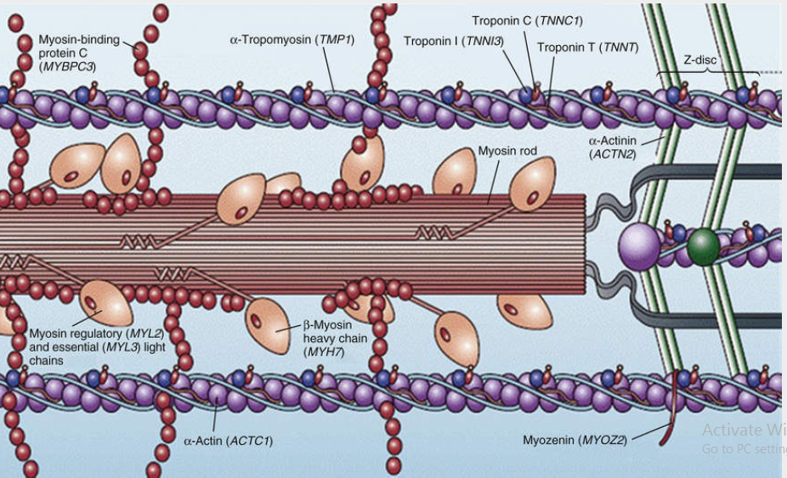
HIGH PATHOGENICITY
Thick filament
Thin filament
Intermediate filament
Z disc
LOW PATHOGENICITY
Calcium handling-CALSEQUESTRIN and JUNCTOPHILIN 2 .
Notes:
Mendelian trait
autosomal dominant inheritance

Slide 8
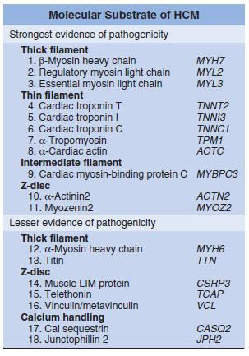
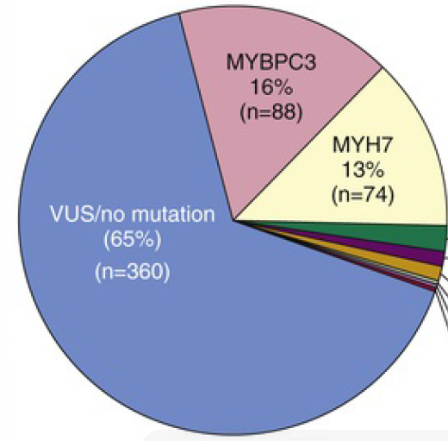
Pathogenicity of variants relies on a weight of collective evidence based on American College of Medical Genetics and Genomics criteria
Notes:
novel but ambiguous sequence - pathogenicity is unresolved (variants of unknown significance; VUSs)

Slide 9
Bottleneck in GENETIC TESTING
Identify/exclude an affected status in family members without LV hypertrophy .
BUT , this requires identification of a pathogenic mutation in a relative (proband) with clinically expressed HCM.
PROBLEM - genotype for a disease-causing mutation can be identified in only about 35% of families .
Notes:
a major obstacle to performing cascade screening of family members….
The importance of potential psychological, social, legal, ethical, and professional implications of having a genetic disease should be conveyed

Slide 10
Indications for genetic testing
In patients with HCM, genetic testing → elucidate the genetic basis to facilitate the identification of family members at risk for developing HCM (cascade testing).
In pts with atypical clinical presentation of HCM or when another genetic condition is suspected to be the cause. (HCM vs phenocopies )
PRKAG2 (glycogen storage disease), LAMP2 (Danon disease), GLA (Fabry disease), transthyretin amyloid CM , genes for RASopathies.
In first-degree relatives of patients with HCM, both clinical screening (ECG and 2D echocardiogram) and cascade genetic testing (when a pathogenic/likely pathogenic variant has been identified in the proband) should be offered .
No disease causing gene variant – no further clinical surveillance
G+P- needs clinical screening at regular intervals .
Notes:
2. genetic testing for HCM and other genetic causes of unexplained cardiac hypertrophy (“HCM phenocopies”) is recommended.
Genes associated with HCM phenocopies may be included in first-tier genetic testing if there is clinical suspicion based on phenotype evaluation of a systemic disorder, including PRKAG2 (glycogen storage disease), LAMP2 (Danon disease), GLA (Fabry disease),transthyretin amyloid cardiomyopathy, and disease genes related to RASopathies.
In patients with HCM who choose to undergo genetic testing, pre- and post-test genetic counseling by an expert in the genetics of cardiovascular disease is recommended so that risks, benefits, results, and their clinical significance can be reviewed and discussed with the patient in a shared decision-making process.

Slide 11
4. In families where a sudden unexplained death has occurred with a postmortem diagnosis of HCM, postmortem genetic testing is beneficial to facilitate cascade genetic testing and clinical screening in first-degree relatives.
5. In affected families with HCM, preconception and prenatal reproductive and genetic counseling should be offered.
Risk of transmission of disease,
Discussing potential reproductive options – IVF with preimplantation genetic diagnosis.
Prenatal genetic screening, and postnatal genetic testing.
Notes:
Pathogenicity of variants relies on a weight of collective evidence based on American College of Medical Genetics and Genomics criteria – can change over time …. fewer high-quality genetic data in a
non-White HCM population.
periodic reevaluation of variants every few years in case the variant has been reclassified (ie, either upgraded to likely pathogenic or
pathogenic), in which case family cascade genetic testing can be initiated, or downgraded to a VUS,
Several studies have reported that patients with HCM who carry pathogenic/likely pathogenic sarcomere variants have a
worse prognosis compared to sarcomere variant negative patients with HCM. This includes earlier onset of disease, higher incidence of SCD, higher incidence of AF and ventricular arrhythmias, HF, and overall mortality. However, there remains considerable heterogeneity within and between families with variants in the same gene that currently limits the application of genetic information for clinical decision-making, including risk stratification for SCD in the proband.

Slide 12
In patients with HCM, the usefulness of genetic testing in the assessment of risk of SCD is uncertain .
In patients with HCM who harbor a variant of uncertain significance – genetic testing of relatives not indicated .
HCM pts with no pathogenic variants – no need for family genetic testing .

Slide 13
Population-based association studies - demonstrated a more severe course in gene-positive patients than gene-negative patients , and
Thick-filament mutations (MYBPC3 and MYH7) >> thin-filament mutations (TNNT2 and TNNI3).
cTnI mutations- Greater predisposition of apical hypertrophy

Slide 14
Genotype-Positive, Phenotype-Negative
G+P- for HCM, serial clinical assessment, electrocardiography, and cardiac imaging are recommended at periodic intervals depending on age .
Participation in competitive athletics of any intensity is reasonable .
ICD is not recommended for primary prevention.
Notes:
Identification of a VUS in a proband is not a clinically actionable result. In select circumstances only, family mem ber testing may be offered at either a clinical or research level to further clarify the pathogenicity of the variant .

Slide 15
no family genetic screenign

Slide 16
GROSS MORPHOLOGY
MICROSCOPY
PATHOPHYSIOLOGY

Slide 17
GROSS MORPHOLOGY
Asymmetric hypertrophy with small left ventricular cavity .
Mc phenotype – ASH with/witout obstruction.
Diffuse hypertrophy of septum and anterolateral free wall(70-75%)
Basal septal hypertrophy(10-15%)
Apical hypertrophy(<5%)
Hypertrophy of lateral wall(1-2%)
Nearly 2/3rd have bulges into the LVOT causing LVOTO .
LVH associated with growth spurts in adolescence .
Notes:
20% LV mass may be normal because of a very small segment being hypertrophied.
HCM phenotype remains incomplete until adolescence, when accelerated growth and maturation are accompanied by spontaneous (often striking) increases in LV wall thickness and a more extensive distribution of hypertrophy.

Slide 18
HCM PHENOTYPIC VARIANTS
Reverse curvature septum HCM : shows a predominant mid-septal convexity toward the left ventricular (LV) cavity - crescent shape. A/w SAM+ and dynamic LVOTO+ .
Sigmoid septum HCM : shows a generally ovoid LV cavity with the septum being concave to the LV cavity and a prominent basal septal bulge . A/w SAM+ and dynamic LVOTO+ and a posteriorly directed jet of mitral regurgitation.
Neutral septum HCM : shows an overall straight septum that is neither predominantly convex nor concave toward the LV cavity. LVOTO is less common.
Apical HCM : shows a predominant apical distribution of hypertrophy .
Mid-ventricular HCM : predominant hypertrophy at the mid-ventricular level. Obstruction is at the level of the papillary muscles (MOHC) . No mitral SAM.
Notes:
Mid-ventricular HCM shows predominant hypertrophy at the mid-ventricular level. In this form a thinned and dyskinetic apical pouch is also present. Obstruction is at the level of the papillary muscles. No mitral SAM. Myocardial delayed enhancement may be seen in the dyskinetic apical pouch.

Slide 19
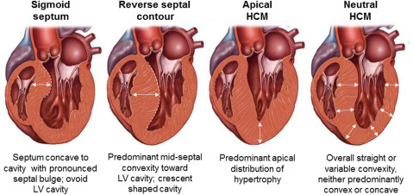
M.C Variant

Slide 20
MITRAL VALVE APPARATUS in HCM
The mitral valve may be more than 2 fold the normal size due to elongation of both leaflets.
Segmental enlargement of only anterior leaflet or mid portion of posteror leaflets.
HCM and SAM → the mitral leaflets coapt abnormally in the body (or central portion) of the leaflets rather than at the leaflet tips → leaving the distal residual anterior leaflet tip in the LV cavity during systole.
Sharp angulation of the distal anterior leaflet toward the septum in mid systole (SAM)- DRAG EFFECT
Notes:
Anterior mitral valve leaflet elongation in young preclinical HCM patients without other phenotypic expressions of HCM represents an independent and primary component of HCM disease expression.
The authors suggested that the presence of a distal residual anterior leaflet and abnormal leaflet coaptation are prerequisites for the genesis of SAM and LVOT obstruction .

Slide 21
Leaflet thickening due to repetitive septal contact
Mitral valve prolapse
Chordal abnormalities – absent chordae , elongation ,laxity and hypermobility.
Anomalous insertion of the papillary muscles .

Slide 22
HISTOPATHOLOGY
1) Cellular disarray of cardiomyocytes - bizarre shapes and are often arranged in a chaotic and disorganized architectural pattern.
95% of HCM pts . Both in Hypertrophied as well as non hypertrophied Ventricle.
2) Abnormal intramural coronary arterioles - thickened vessel walls caused by media smooth muscle hyperplasia.
narrowing of the vessel lumen - impaired vasodilator response and blunting of the coronary flow reserve .
“small-vessel” ischemia → myocyte death and a repair .
3) Replacement myocardial fibrosis - interstitial (matrix) collagen compartment is expanded greatly.
Notes:
ardiac muscle cells (myocytes) in both the ventricular septum and LV free wall
have bizarre shapes and are often arrged in a chaotic and disorganized architectural pattern

Slide 23
Pathophysiology
LVOT OBSTRUCTION
70% develop LVOTO (dynamic LVOT gradient >30mmHg- rest/provoked)
Produced by SAM of mitral valve and midsystolic ventricular septal contact.
Produces markedly increased intraventricular systolic pressures that over time increase the myocardial wall stress and oxygen demand.
Also a/w posterior directed MR jet .
Anterolateral papillary muscle insertion directly into the anterior leaflet (without interposition of chordae tendineae) can produce midcavity muscular obstruction.
Notes:
elongated leaflets bend sharply, contacting the ventricular septum in midsystole by
means of a drag effect, i.e., pushing force of flow directly on the leaflets,………….. producing markedly increased
intraventricular systolic pressures that over time increase the myocardial wall stress and oxygen demand

Slide 24
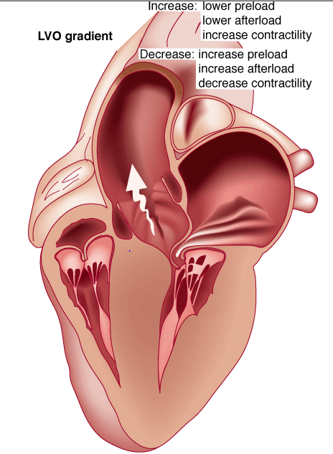
Obstruction is dynamic-varying with loading conditions and contractility of LV
Increase in contractility
VPC
Dobutamine,Isoproterenol
Exercise
Decrease in afterload/volume
Valsalva maneuver
Nitroglycerine/amylnitrite
Blood loss
dehydration

Slide 25
2. DIASTOLIC DYSFUNCTION
Nonobstructive HCM patients are almost five times less likely to develop NYHA class III or IV disease than are patients with obstruction.
Diastolic dysfunction is the likely cause of limiting symptoms in patients with nonobstructive disease

Slide 26
Evidence of impaired LV relaxation and filling, is present in most HCM patients→ symptoms of exertional dyspnea → although unrelated to the severity of LV hypertrophy .
Rapid filling phase is prolonged
Decreased rate and volume of filling
Compensatory increase in atrial filling
Reduced ventricular compliance in HCM- hypertrophy, replacement scarring, interstitial
fibrosis, abnormal microvascular blood flow, and disorganized cellular architecture.

Slide 27
3. MICROVASCULAR DYSFUNCTION
Myocardial ischemia is unrelated to epicardial coronary artery disease.
-supply demand mismatch due to hypertrophy.
-abnormally small and partially bliterated intramural coronary arteries
Myocardial scaring and replacement fibrosis -progressive heart failure and substrate for arrythmia
4. MITRAL REGURGITATION
Secondary to distortion of mitral valve apparatus from SAM.
Posterior directed jet

Slide 28
CLINICAL FEATURES - SYMPTOMS
Majority are asymptomatic
Dyspnoea - 90%( of symptomatic patients)
Syncope and presyncope in 20 and 50% respectively due to either hemodynamic or rhythm abnormality.
Angina -70-80%
small artery narrowing
intramural compression of small arteries
oxygen supply demand mismatch
abnormal coronary flow reserve
Palpitations
SCD
Notes:
Dyspnea due to high LV EDP d/t to non compliant hypertrophied LV
Syncope – LVOT or arrthmias

Slide 29
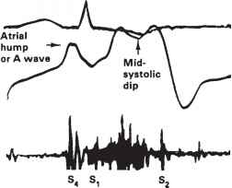
PHYSICAL EXAMINATION
Carotid pulse is brisk upstroke
Spike and dome pattern (in LVOTO)
Early spike – rapid ejection by hypercontractile LV
Presure dip and doming – reflect the dynamic outflow obstruction.
Carotid thrill or shudder can be heard .
JVP – mean JVP normal .
Prominent “a” wave is characteristic .
Typically palpable S4 +
Apex – early systolic dip/retraction TRIPPLE RIPPLE
- LATE SYSTOLIC HEAVE +
palpable in more than 1 ICS
Left Parasternal lift if present is due to ASH in thin pts .
Apical impulse: double or triple
Notes:
Brisk upstroke – early exaggerated systolic emptying of the LV ….. Pulse volume not increased .
Apical heave more pronounced in the left lateral position.

Slide 30
S1 – normal intensity or accentuated
S2 – NARROW SPLIT or with very severe LV-Ao gradient → PARADOXICAL SPLITTING
S3 - can be heard → D/t altered LV diastolic compliance and is a/w MR
S4 – loud and palpable (both obstructive and non obstructive)
Murmer: cresendo-decrescendo systolic at left sternal border.radiates to base as well as apex. Seldom radiates to carotid arteries .
louder and longer – with increase in gradient .
Dynamic auscultation: maneuvers that decrease preload or afterload or increase contraction will increase the dynamic gradient and increase intensity of murmer.
Eg: sudden standing from lying position
strain phase of valsalva
Notes:
S4 – dut to augmented LA contraction against a hypertrophied non compliant LV .

Slide 31
ECG in HCM
12 lead ECG is abnormal in 90% probands and 75% asymptomatic relatives.-NO CORRELATION WITH SEVERITY
Free Left Wall Hypertrophy
Classic presentation of LVH due to systolic overload
Deep S in V1-V2
Tall R in V5-V6 (V6>V5)
RAA +
Short PR interval
Shelf like angulation of ST segment in leads V5-V6 .
Wide QRS-T angle
ISOLATED SEPTAL HYPERTROPHY
Deep and narrow Q waves in inferior and left leads .
LAD of QRS axis
S in V1 and R in left precordial leads is of low amplitude
Abnormal “q” in the absence of left free wall hypertrophy in a young pt should raise suspicion of dominant septal hypertrophy.

Slide 32
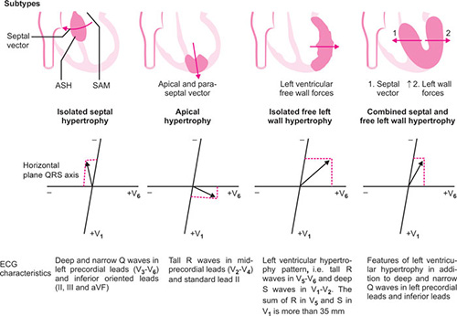
APICAL and paraseptal HYPERTROPHY
very tall R waves in mid precordial leads (V2-V4)
Tall R wave in lead II (mean QRS directed to lead II)
R V4 > RV5 > RV6
T waves in mid precordial leads deeply inverted .
Shelf like appearance of ST segment.
Other common ECG abnormalirties
Intraventricular conduction defects – LAHB/BBB
LAA/RAA
WPW pattern
SVT/VT arrhythmias

Slide 33
Isolated septal hypertrophy

Slide 34
Left free wall hypertrophy

Slide 35
Apical hypertrophy

Slide 36
HOLTER
For all pts
NSVT/AF/VF/SVT/SINUS NODE DYSFUNCTION/AV BLOCKS

Slide 37
Echocadiography in HCM
Confirming LV hypertrophy
Assessment of LVOT obstruction
Systolic anterior motion - SAM,
Assessment of systolic and diastolic LV function
Left atrial size

Slide 38
The clinical diagnosis of HCM depends on the accurate detection and quantitation of the site and extent of abnormal hypertrophy .
Unexplained maximal wall thickness >15 mm in any myocardial segment, or
Septal/posterior wall thickness ratio >1.3 in normotensive patients, or
Septal/posterior wall thickness ratio >1.5 in hypertensive patients.
Family members with Ecg changes > 1.2 cm is enough for diagnosis.
≥2 Standard Deviation greater than the Body-Surface-related normal values in pediatric patients

Slide 39
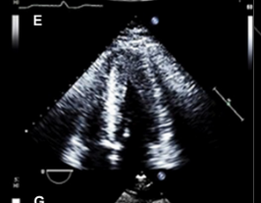

Slide 40
The routine use of myocardial contrast imaging is particularly important when echo image quality is suboptimal.
Define whether apical HCM is present,
Determine the true wall thickness and
Apical aneurysm .
Notes:
define the septal borders as well as the posterior wall thickness and particularly when lateral wall involvement predominates

Slide 42
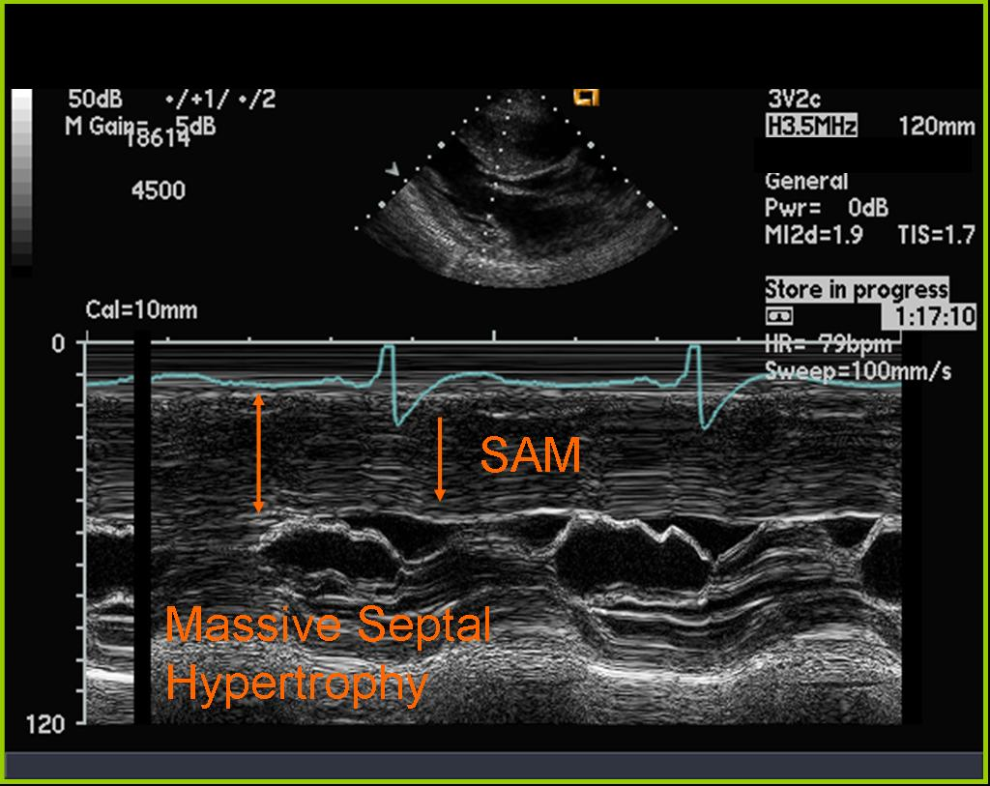
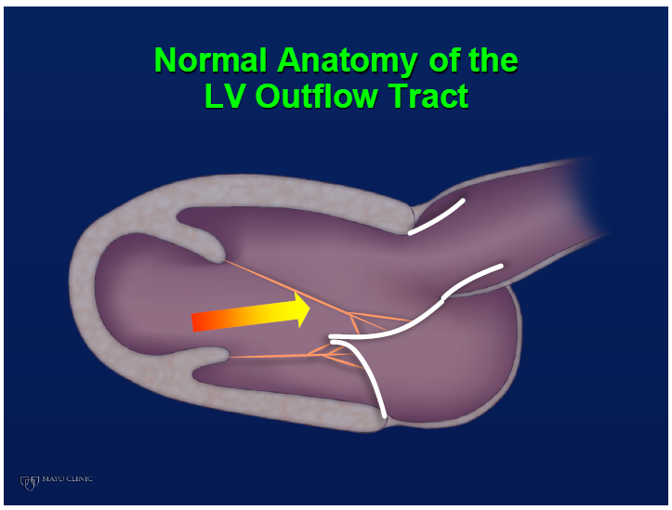
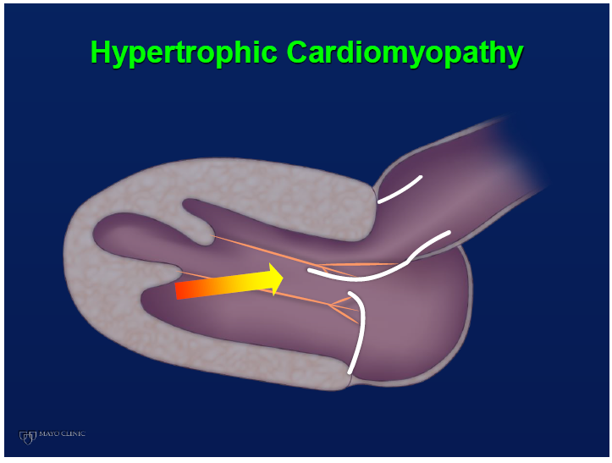
Systolic Anterior Motion (SAM)
Mitral leaflets coapt abnormally → distal residual anterior leaflet tip in the LV cavity during systole → Sharp angulation of the distal anterior leaflet toward the septum → DRAG EFFECT

Slide 43
M mode through aorta
midsystolic closure or notching

Slide 44
Mitral Regurgitation
Posteriorly directed due to the funnel created by the SAM and the malcoapting leaflets.
Other casues – MVP or torn chordae → central or anteriorly directed jet .
DOPPLER ECHOCARDIOGRAPHY
Dynamic LVOT obstruction- a high-velocity "dagger-shaped" signal .
In low outflow tract velocities(<3m/s) provocation with the Valsalva maneuver, inhalation of amyl nitrite or exercise to determine a labile or latent obstruction.
Notes:
Best 2D view for LVOT gradient-apical 3 chamber - 1.Doppler beam is parellel to LVOT,and can be directed away from lv inflow

Slide 45
Notes:
Dynamic LVOTO DDs –
Elderly patients with hypertension treated with vasodilators, diuretics or digoxin
Postoperative period intravascular volume depletion and inotropic use.
AS after AVR
Mitral valve prolapse after MVR
Acute anterior-apical MI
Some patients with apical ballooning

Slide 46
DIASTOLIC DYSFUNCTION
Average E/e‘ ratio greater than 14
LA volume index (>34 mL/m2)
Pulmonary vein atrial reversal velocity (Ar-A duration > 30 msec)
Peak velocity of TR jet by CW Doppler greater than 2.8 m/s .
Left atrial enlargement
Normal indexed LA volume = 22 ± 6 ml/m2.
LA volume index of >34 ml/m2
greater degree of LVH
severity of diastolic dysfunction, and
adverse cardiovascular outcomes.

Slide 47
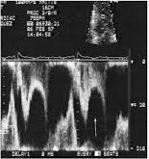
Assessment of systolic function
3% manifest the end stage- systolic dysfunction (ejection fraction <50%)
Progressive heart failure
Often associated with AF
Patterns of LV remodeling- Wall thinning and cavity dilation .
During midsystole when the dynamic gradient is maximal -there is a transient fall in LV ejection flow .
“lobster claw”
Notes:
Pulsed doppler at the entrance of LVOT-mid systolic drop in velocities “lobster claw”
most reliable risk marker for evolution to end-stage disease - family history of HCM with systolic dysfunction

Slide 48
CMRI
Diagnosis - accurate measurements of wall thickness, myocardial mass, morphologic features , EF and MR quantification ( if ECHO inconclusive)
Prognosis - through the detection of fibrosis and infarction (LGE and myocardial perfusion )
Distinguishing HCM from other similar-appearing disease entities.
In pts not identified as high risk - ? Decision for ICD remains uncertain after FH/Examination/ECG/ECHO …….. CMR is beneficial → extend of myocardial fibrosis with LGE .
Notes:
Cine imaging with bright blood prepared steady state free precession (SSFP) sequences provides intrinsically high definition of the blood pool-myocardium interface and forms the basis of morphological assessment.

Slide 49
A – Symmetrical Hypertrophy
B- - ASH
C - midventricular obstruction with apical aneurysm.
D - LGE MR image - thinned apical LV aneurysm .
E - Apical HCM
Notes:
C- demonstrates a
Bdumbbell^ configuration of the LV cavity with midventricular myocardial thickening (asterisks), marked muscular midcavity systolic constriction and a thin-walled apical aneurysm.
D - Four-chamber LGE MR image clearly depicts the enhanced thinned apical LV aneurysm (arrows) extending from the aneurysm rim into
the septum and free wall (arrowheads).

Slide 50
LATE GADOLINIUM ENHANCEMENT and t1 mapping
LGE is based on the kinetic behavior of gadolinium that washes out slower from diseased myocardium, due to fibrosis, infarction, or myocyte necrosis, compared with the healthy myocardium .
In HCM, the pattern of LGE is usually a focal area of midmyocardial fibrosis localized to the site of maximum wall thickness as well as at the RV insertion points.
Extensive LGE (ie, myocardial fibrosis) → life-threatening ventricular tachyarrhythmias and HF progression with systolic dysfunction.
LGE of ≥15% of the LV mass as represent→ 2-fold increase in SCD risk.
Notes:
including healthy myocardium, has a specific T1 relaxation time. Alteration of the healthy myocardium by extracellular deposition,
including fibrosis, alters its magnetic properties, leading to prolongation of the T1 relaxation time.
In HCM, native T1 has been proposed as a non contrast measure of fibrosis. Native T1 time is most prolonged in areas of LGE but is also abnormally prolonged to a lesser degree in areas free from DHE, making it a potential earlier marker of fibrosis.
For LGE imaging the patient is administered an intravenous injection of 0.2 mmol per kilogram of body weight gadolinium based contrast agent (Gadovist 1.0, Bayer Schering Pharma, Berlin-Wedding, Germany) at 1-2 mL/s. Ten minutes after injection time LGE images are acquired

Slide 51
T1 mapping : The degree to which T1 time is prolonged correlates with the degree of extracellular deposition.
Non contrast measure of fibrosis and potential earlier marker of fibrosis (prolonged even when there is no LGE)

Slide 52
CMR - Poor Prognostic factors
Extensive LGE (ie, myocardial fibrosis) → life-threatening ventricular tachyarrhythmias and HF progression with systolic dysfunction.
LGE of ≥15% of the LV mass as represent→ 2-fold increase in SCD risk.
Markedly elevated LV mass index (men > 91 g/m^{2,} women > 69 g/m²) .
Right ventricular (RV) hypertrophy
Myocardial edema by T2-weighted imaging
Notes:
Markedly elevated LV mass index (men >
91 g/m^{2,} women > 69 g/m²) - sensitive(100%)
Maximal wall thickness of more than 30 mm specific (91%) for cardiac deaths

Slide 53
Invasive Hemodynamics
Invasive testing with cardiac catheterization ;
Guide the treatment of hypertrophic cardiomyopathy .
Identifies patients who might benefit from septal reduction therapy, and
Assesses for other comorbidities that may be contributing to symptoms.

Slide 54
Right Heart Catheterisation
RA pressure , RV pressure , mPAP , PAWP , PVR .
Elucidation of obstructive physiology/ Location /Magnitude
A pigtail catheter is placed at the LV apex, and a second catheter is placed in the ascending aorta .
Any resting gradient – resting outflow tract or midcavity obstruction .
Gradients of greater than 30 mm Hg indicate obstructive disease, whereas those of greater than 50 mm Hg indicate candidacy for septal reduction therapy.
Provocative maneuvers - strain phase of the Valsalva maneuver , VPC to elicit the Brockenbrough-Braunwauld-Morrow sign .
Notes:
Two transducers are required to measure and compare pressures and calculate gradients .

Slide 55
Brockenbrough-Braunwauld-Morrow sign
Degree of obstruction will increase in the post-PVC beat.
LV pressure increases and the ascending aortic pressure decreases, with an increase in the LVOT gradient.
When gradient increases, and the spike and dome configuration becomes more evident.
It can be seen on routine physical examination as a decrease in the pulse pressure in the post-PVC beat in individuals with HCM.

Slide 56
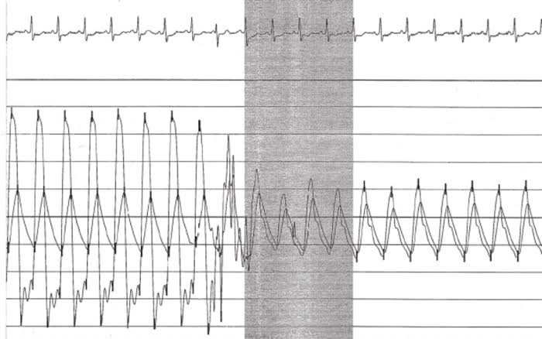
Pull back tracing (LV-Aorta)-HOCM vs AS

Slide 58
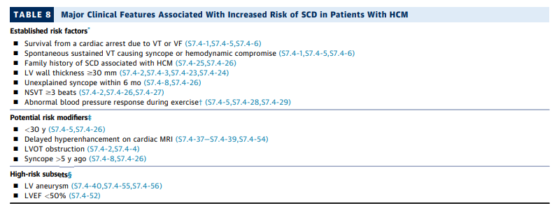
HCM guidelines for risk stratification and ICD

Slide 59
POTENTIAL ARBITRATORS FOR PRIMARY PREVENTION
Substantial LV outflow gradient at rest
Extensive or diffuse late gadolinium enhancement
Transmural scar associated with alcohol septal ablation
Multiple sarcomere mutations
Intense competitive sports
Atherosclerotic coronary artery disease

Slide 62
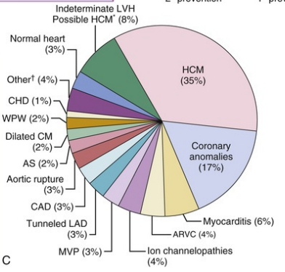
SCD → adolescents and young adults <30y.
Less common beyond 60y despite risk factors for SCD.
HCM is the most common cardiovascular cause of SD in competitive athletes.
ExtensiveE LGE on contrast- enhanced CMR (particularly when it is present in 15% or more of the LV mass) - independent predictor of SD, even in the absence of conventional risk factors .
Notes:
extensive LGE on contrast-
enhanced CMR (particularly when it is present in 15% or more of the LV mass) has been shown to be
associated with an increased SD risk; it is a new marker and independent predictor of SD, even in the
absence of conventional risk factors, and its presence would lead to consideration of a prophylactic ICD

Slide 63
SCD –Unrelated to pattern/location of hypertrophy/LVOT gradient
Directly related to LV thickening(>30mm)
LVOT gradient –directly related to risk of heart failure,not SCD

Slide 64
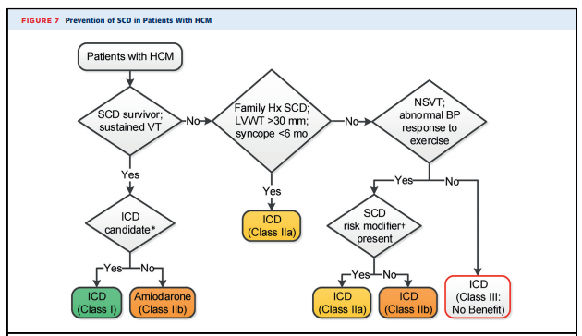
MANAGEMENT
PREVENTION OF SCD
Notes:
Beyond 60y not indicated …reduced risk for SCD
In young can consider S/C ICDs instead of transvenous ICDs
RFA ony in LV apical aneurysms – arrythmoc focus can be abolished.

Slide 65
MEDICAL THERAPY
Beta Blockers
Advantages of beta blockers include
1. Decreased heart rate response to exercise
2. Decreased outflow tract gradient with exercise
3.Relief of angina by a decrease in myocardial oxygen demand
4 Improvement in diastolic filling
.
Notes:
verapamil - sustained symptomatic improvement in <50% of patients
- resting heart rate of 60 beats/min and may require up to 480 mg/d.

Slide 66
Calcium Channel Blockers
Decrease inotropy and chronotropy
Improve abnormal diastolic relaxation by preventing calcium influx.
Verapamil -used most frequently due to its minimal effect on afterload.

Slide 67
Disopyramide
The negative inotropic effect - decrease the gradient and improve symptoms.
Concomitant betablockade to prevent rapid atrioventricular node conduction.
dosage 300 to 600 mg/d.
corrected QT interval to be monitored

Slide 69
EXPLORER HCM TRIAL
Notes:
Mevacampten was the first drug that targeted the underlying pathology og HCM.

Slide 72
Septal reduction therapy
Gold standard therapy for patients with obstruction and severe drug refractory symptoms.
ELIGIBLE PATIENTS :
Clinical:
Severe dyspnea or chest pain (NYHA classes III or IV) despite optimal medical therapy or exertional syncope or presyncope that interferes with everyday activity.
Hemodynamic
Dynamic LVOT gradient at rest or with physiologic provocation 50 mm Hg associated with septal hypertrophy and SAM of the mitral valve.
Anatomic
Targeted anterior septal thickness sufficient to perform the procedure safely and effectively (>15mm)
Notes:
In patients with HOCM and symptoms refractory to optimal medical therapy, septal reduction therapy
(SRT) with either alcohol septal ablation or surgical septal myectomy may be considered.
because of the potential for creating a ventricular septal defect, septal ablation should not be
performed if the target septal thickness is < 15 mm

Slide 73
Choice of SRT ?

Slide 74
SEPTAL ABLATION
Injection of 1 to 3ml of 95% alcohol in to major septal perforator
Creates necrosis and permanent transmural MI in prox septum
Scar -10% of LV wall,<30% septum.
Absence of significant coronary arterial disease
Adequately sized and accessible septal branches supplying the target myocardial segment.
Absence of important intrinsic abnormality of mitral valve and of other conditions for which cardiac surgery is indicated.
Relative contraindications to surgical myectomy(age,comorbidity)

Slide 75
Technique of septal ablation
Temporary pacemaker placement is required in patients without permanent devices .
The target territory is the basal septum at the point of systolic contact by the anterior leaflet of the mitral valve .
Proper vessel selection is determined by myocardial contrast echocardiography.
Notes:
This segment is usually but not always supplied by the first septal branch of the left anterior descending coronary artery.

Slide 76
4. Once the target vessel is selected, pure ethanol is slowly infused via the balloon catheter (with the balloon inflated).
In most cases, the total volume infused is 1 to 2 mL.
.
The LVOT gradient response is triphasic, with immediate reduction, early reappearance, and, by 3 months after the procedure, sustained fall.
Notes:
Myocardial stunning may be responsible in large part for the immediate reduction in gradient.
After recovery from stunning, ultimate gradient reduction is associated with remodeling of the
septum with an increase in LVOT area.

Slide 77
Complications
Complete heart block. 10 to 20% require permenent pacemaker implantation .
More likely to experience if LBBB was present prior.
Transmural scar – unstable electrical substrate-nidus for VT.
Coronary dissections
Large myocardial infarctions from "leakage" of the alcohol.
Ventricular septal defects
Myocardial perforations.
Notes:
Because atrioventricular block constitutes the major morbidity of septal ablation, temporary pace
maker placement is required in patients without permanent devices.

Slide 78
SEPTAL MYECTOMY (Morrow procedure)
Transaortic resection of 3 to 10gm muscle from the proximal to mid-septal region.
Enlarges the LVOT and significantly decreases or totally abolishes LVOT obstruction.
Mitral regurgitation secondary to SAM of the mitral valve also disappears.
Operative mortality has reduced to less than 1% at experienced HCM centers .
90-95%pts experience both permanent abolition of basal outflow gradient without compromise to LV function.
Relief of symptoms for more than 25yrs.

Slide 79
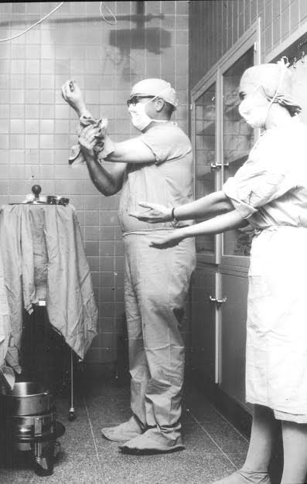
Identify?

Slide 81
Studies comparing ASA vs Myomectomy
SA does seem to show promise in treatment of HOCM owing to similar mortality rates as well as functional status compared with SM .
The caveat is increased conduction abnormalities (PPI) and a higher post-intervention LVOTG.
Notes:
The choice of treatment strategy should be made after a thorough discussion of the procedures with the individual patient.

Slide 83
Treatment of Atrial fibrillation
Mc arrhythmia , occurs in 20 to 25%
Requires anticoagulation therapy
CHA2DS2VASc- not validated for HCM
Amiodarone-most effective in reducing recurrences
Beta blockers and verapamil-to control heart rate
Catheter ablation for atrial fibrillation -who have drug refractory symptoms or are unable to take anti-arrhythmic drugs

Slide 84
HCM MIMICS Diagnostic Clues to Aid Early Identification of Phenocopies
Glycogen Storage Disorders – AR inheritance .
multisystemic involvement
Extreme LVH (histology – glycogen filled vacuoles)
early progression to DCM and
ECG - pre-excitation and conduction system defects.
Pompe Disease (Glycogen Storage Disease Type 2)
Alpha [α]-glucosidase) deficiency - multisystemic glycogen deposition.
Infantile form is one of the foremost causes of HCM in the paediatric population.
hypotonia, macroglossia, hepatomegaly, extreme LVH and heart failure, usually leading to death within two years.
Notes:
unique mechanism of disruption of the annulus fibrosus by glycogen-filled myocytes rather than the presence of histologically distinct accessory bypass tracts .

Slide 85
Pompe Disease (Glycogen Storage Disease Type 2)
Alpha [α]-glucosidase) deficiency - multisystemic glycogen deposition.
Infantile form is one of the foremost causes of HCM in the paediatric population.
hypotonia, macroglossia, hepatomegaly, extreme LVH and heart failure, usually leading to death within two years.
LVH in the infantile form may be asymmetric and associated with LV outflow tract obstruction..
ECG - short PR interval with pre-excitation or conduction block.
Skeletal muscle biopsy shows vacuolar deposition of glycogen and enzyme deficiency can be demonstrated in fibroblasts, lymphocytes and urine.
Rx - recombinant acid α-glucosidase .

Slide 86
Forbes Disease (Glycogen Storage Disease Type 3)
Mutation in the glycogen debranching enzyme (amylo-alpha-1, 6-glucosidase [AGL]) gene.
Muscle weakness, poor growth, hypoglycaemia and concentric LVH → DCM.

Slide 87
Danon Disease
Lysosomal storage disease d/t deficiency in lysosome-associated membrane protein-2 (LAMP2).
Defects in glycogen degradation pathways, leading to insidious glycogen accumulation.
Intracytoplasmic vacuoles within the cardiac muscle cells - disorganisation of ventricular myocardium and hypertrophy.
Triad of proximal muscle weakness (80 %), intellectual disability (100 % of men and 50 % of women) and hypertrophic cardiomyopathy (88 %) .
Rapid cardiac deterioration - Males have very poor prognosis, and in the absence of cardiac transplantation death typically occurs before 25 years of age due to heart failure or arrhythmias.
Notes:
Males have very poor prognosis, and in the absence of
cardiac transplantation death typically occurs before 25 years of age
due to heart failure or arrhythmias.

Slide 88
PRKAG2 Cardiomyopathy
mutations in the protein kinase, Adenosine monophosphate (AMP)-activated, gamma 2 non-catalytic subunit (PRKAG2) gene, which encodes the regulatory gamma (γ)-subunit of AMP-activated protein kinase (AMPK).
Adolescents and young adults with muscle weakness.
ECHO typically demonstrates LVH (variable severity and assymetric) with global hypokinesia.
Early progression to systolic dysfunction and dilated cardiomyopathy.
WPW syndrome and conduction system degeneration.
Rx – PPI for conduction disease or cardiac transplantation for heart failure.

Slide 89
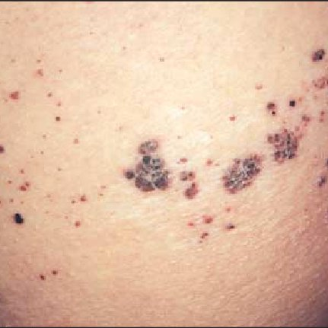
Anderson-Fabry Disease
Mutation in the α-galactosidase A (α-GAL A) gene and leads to multisystemic lysosomal accumulation of glycosphingolipids .
X-linked condition - heterozygous mothers have a 50 % chance of passing the defective gene on to all offspring.
Manifest in childhood (typically before 10 years of age)
Cutaneous angiokeratoma, hypohidrosis, acroparaesthesiae, gastrointestinal disturbances and corneal dystrophy .
3rd – 4th decade → 3 organ dysfunctions ;
renal (proteinuria, end-stage renal failure)
cardiac (angina due to microvascular ischaemia, arrhythmias, conduction disease, systolic and diastolic dysfunction .
Stroke
Notes:
Angiokeratoma corporum difussum .
Life-threatening multi-organ involvement such as
renal (proteinuria, end-stage renal failure), cardiac (angina due to
microvascular ischaemia, arrhythmias, conduction disease, systolic
and diastolic dysfunction) and cerebrovascular complications
(strokes) occured in the third and fourth decade.

Slide 90
Cardiac Amyloidosis
Extra-cellular deposits of amyloid in the myocardium.
Can occur with primary Amyloid Light-chain (AL) amyloidosis (in about 50 % patients) as well as transthyretin amyloidosis.
Symptoms - chest pain, symptoms of heart failure, arrhythmias and sudden death.
Multisystem involvement such as carpal tunnel syndrome, easy bruising, macroglossia, neuropathy and hepatomegaly.
ECG - low-voltage QRS complexes .
Echocardiography shows bi-ventricular hypertrophy (concentric HCM) with valve thickening, bi-atrial dilatation and diastolic dysfunction.
Strain ECHO – reduced GLS together with regional strain values reduced in all basal and mid LV with APICAL SPARING .

Slide 92
Mitochondrial Cytopathies
Maternally inherited mitochondrial genome and leads to dysfunctional energy production and multisystemic involvement.
Affectd the central nervous system, heart and skeletal system .
Symptoms any time from infancy to adulthood .
Non-obstructive cardiomyopathy with mild concentric hypertrophy.
Cardiac involvement significantly worsens prognosis - heart failure and about 70 % mortality before 30 years.
Rx – Cardiac transplantation .

Slide 93
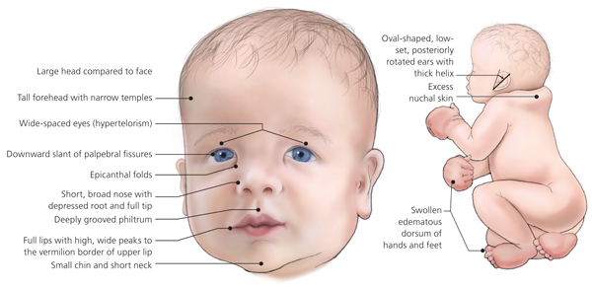
RASopathies (Malformation Syndromes)
Developmental syndromes caused by germline mutations in genes that alter the Ras subfamily .
2 most common malformation syndromes associated with HCM are Noonan syndrome and LEOPARD syndrome.
Noonan syndrome – AD inheritance , HCM seen in 25%. A/w PS , VSD , AVCD , CoA ,and arrhythmias.
Facial features , growth issues , musculoskeletal issues , eye abnormalities , bleeding , lymphedema,
Genito-urinary and skin problems.
Notes:
Eyes are wide-set and down-slanting with droopy lids. Irises are pale blue or green.
Ears are low-set and rotated backward.
Nose is depressed at the top, with a wide base and bulbous tip.
Mouth has a deep groove between the nose and the mouth and wide peaks in the upper lip. The crease that runs from the edge of the nose to the corner of the mouth becomes deeply grooved with age. Teeth may be crooked, the inside roof of the mouth (palate) may be highly arched and the lower jaw may be small.
Facial features may appear coarse, but appear sharper with age. The face may appear droopy and expressionless.
Head may appear large with a prominent forehead and a low hairline on the back of the head.
Skin may appear thin and transparent with age.
An unusually shaped chest often with a sunken sternum (pectus excavatum) or raised sternum (pectus carinatum)
Wide-set nipples
Short neck, often with extra folds of skin (webbed neck) or prominent neck muscles (trapezius)
Deformities of the spine
Problems with the eye muscles, such as cross-eye (strabismus)
Refractive problems, such as astigmatism, nearsightedness (myopia) or farsightedness (hyperopia)
Rapid movement of the eyeballs (nystagmus)
Cataracts
esticles. Undescended testicles (cryptorchidism) are common in males.
Puberty. Puberty may be delayed in both boys and girls.
Fertility. Most females develop normal fertility. In males, however, fertility may not develop normally, often because of undescended testicles.

Slide 94
LEOPARD syndrome is an allelic variant of Noonan syndrome.
Lentigines, Electrocardiographic abnormalities, Ocular hypertelorism, Pulmonic
stenosis, Abnormal male genitalia, Retardation of growth and Deafness.

Slide 95
Athlete's Heart Vs Hypertrophic Cardiomyopathy
HCM
Asymmetric
Wall thickness: > 15 mm
LA: > 40 mm
LVEDD :< 45 mm
Diastolic function: always abnormal
Athletic heart
Concentric & regresses
< 15 mm
< 40 mm
> 45 mm
Normal

Slide 97
Previous questions asked
1)Alcohol Septal ablation(Jan 18)
2)Mavcampten(Aug 22)
3)Septal myectomy vs alcohol septal ablation for obstructive hcm(Aug 22)

Slide 98
Take home messages
Patients with LVH and no systemic hypertension/AS –Think HCM
ESM in NAA/LLSB not radiating to carotid + PSM in apex-Think HCM
HCM with no LVOTO,may have LVOTO on exercsise
Majority-Reassure, betablocker,screen family
AF with HCM –don’t take lightly
Liberal use of holter

Slide 99
THANK YOU

