Slide 1
HEART SOUNDS
S1 S2 S3 S4
Dr Arun Jude Alphonse
DM Cardiology Resident
Govt TDMC Alappuzha

Slide 2
CLASSIFICATION
1. Valve closure sounds – S1, S2.
2. Valve opening sounds – Opening snap
3. Ventricular filling sounds – S3, S4.
4. Ejection sounds – aortic, pulmonary.
5. Other sounds – mediastinal crunch, tumor plop, pericardial knock,
prosthetic valve, pacing sounds, vascular sounds.

Slide 3
PHASES OF CARDIAC CYCLE
PHASE | DURATION
Atrial systole – 2nd rapid filling | 0.1sec
Isovolumic contraction | 0.05 sec
Maximal ejection | 0.11 sec.
Reduced ejection | 0.14 sec.
Protodiastole | 0.04sec
Isovolumetric relaxation | 0.06sec
Rapid filling phase | 0.11sec
Reduce filling phase,diastasis | 0.19sec

Slide 4
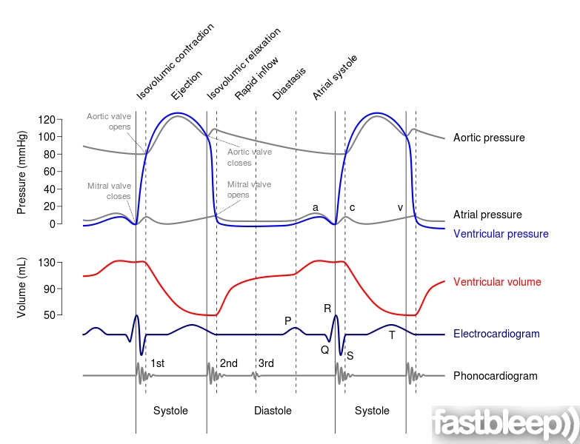

Slide 5
Heart Sounds - Basics
Human Ear Capacity 20- 20,000Hz
Best Acuity heard at 1000-5000Hz
Most Sounds and Murmurs 30- 1000Hz

Slide 6
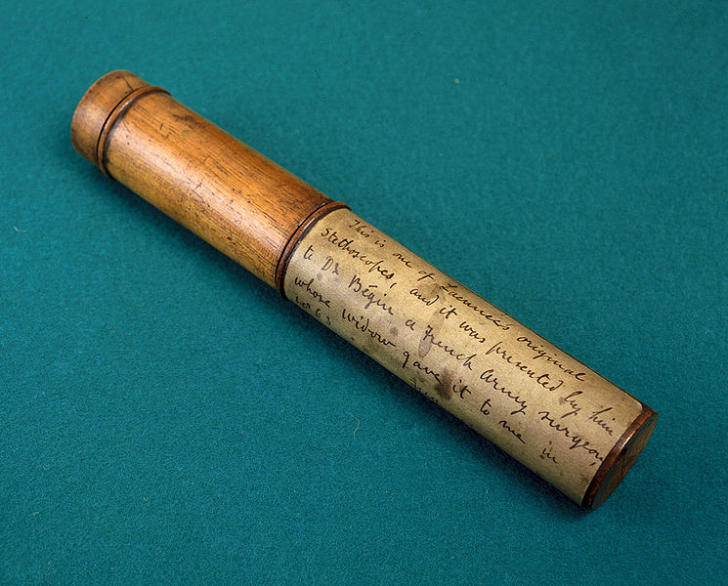
Stethoscope
Invented by Dr Rene Laennec in France in 1816
Monaural and wooden tube structure

Slide 7
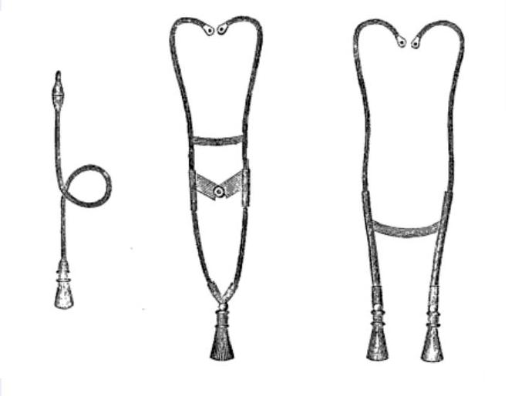
First Binaural Stethoscope was invented by Dr George Cammann in 1841 in New York

Slide 8
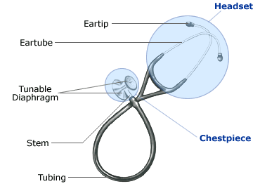
Conventional Stethoscope developed by 1960
Bell: Low frequency Sounds(30- 150HZ
Diaphragm: High Frequency >300HZ

Slide 9
GENESIS OF HEART SOUNDS

Slide 10
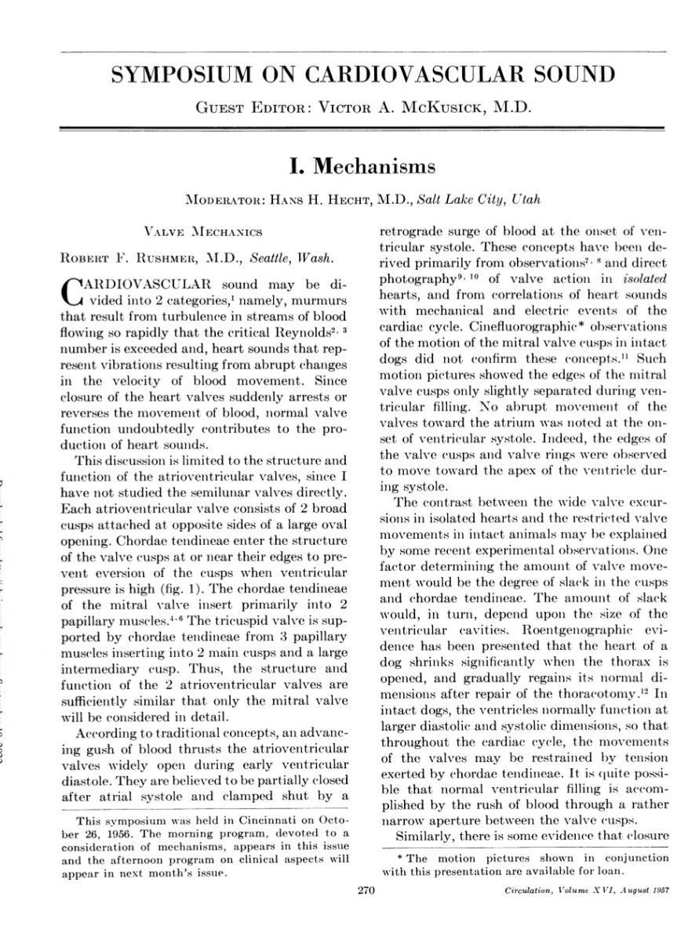
RUSHMER THEORY
Cardiac sounds represent the vibrations produced by the reverberations of the cardiac structures like ventricular mass, valvular apparatus and fibrous skeleton of the heart due to sudden accleration or deceleration of the blood mass during each cardiac cycle

Slide 11
More rapid the tensing due to blood mass and pressure crossover between two chambers ,higher is the frequency of the sound.
The low frequency sounds like S3 and S4 is not due to the sudden tensing rather than due to large amount of blood mass moving at low velocities

Slide 12
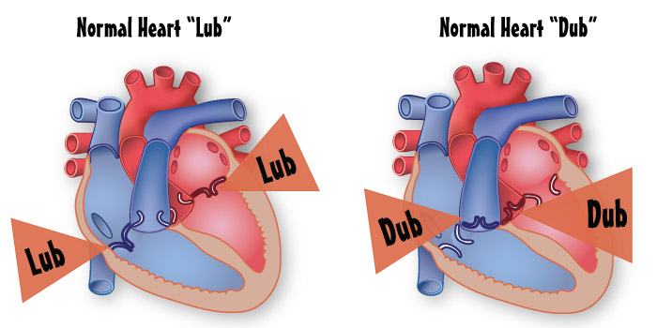
FIRST HEART SOUND

Slide 13
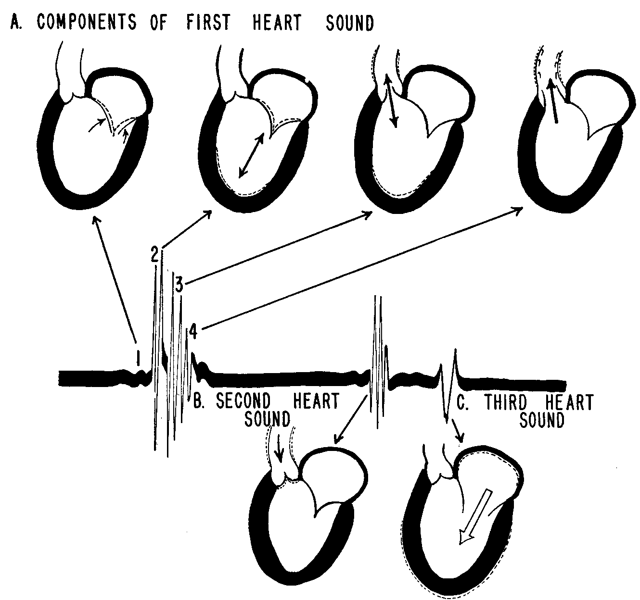
Produced mainly by MV closure[ M1T1]
In actuality there are 4 components of S1 but out of these, high frequency and audible are only 2 components.
Rushmer, R.F., Cardiovascular Dynamics
Obaidat M.S., J. Med. Eng. Tech., 1993
Notes:
S1 is assumed to have 4 major components: the initial vibrations occur when the first contraction of the ventricle move blood towards the atria, closing the AV-valves. The second component is caused by the abrupt tension of the closed AV-valves, decelerating the blood. The third component involves oscillation of blood between the root of the aorta and the ventricular walls, and the fourth component represents the vibrations caused by turbulence in the ejected blood flowing to the arteries

Slide 14
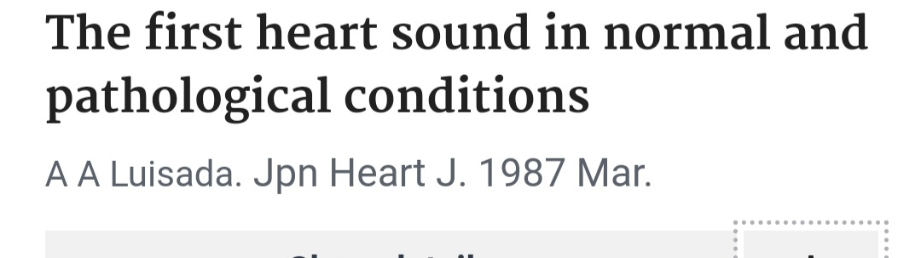
FIRST COMPONENT OF S1
LUISADA THEORY
States that MV cusps have nil or minimal role to play in the origin of this component and this component is due to the sudden tensing of LV walls , Septum and the MV apparatus at the onset of IVC.
He assumed that MV closure precedes the first high frequency component of S1.
He was against the terminology M1

Slide 15
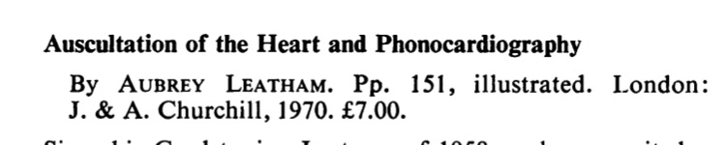
LEATHEM,CRAIGE AND OTHERS
They proposed that the first component is due to the maximal closing excursion of mitral cusps and M1 reflects the sudden tensing of the closed MV leaflets causing the vibration in the surrounding structures.
MV leaflets play a role in the production of M1 and Closure conincides with the M1

Slide 16
Second Component of S1
LUISADA AND SHAVER THEORY
Due to the vibrations caused by the ejection component occuring with the opening of Aortic Valve
CRAIGE AND LEATHAM THEORY
Due to closure of the tricuspid valve.

Slide 17
CHARACTERISTICS OF S1
Normally heard as fused single heart sound
Medium to High Frequency
Low Pitched
Best heard with diaphragm
M1 louder than T1
M1 best heard at apex
T1 best heard at Left LSB
Normal M1 is followed by T1 by 30msec
If the gap between is <20msec its sounds as a single sound

Slide 18
Loudness of M1 depends on
Rate of rise of pressure in LV (dP/dT)
LA pressure at the time of mitral valve closure

Slide 19
Other determinants of S1
Structural integrity of mitral valve
Mobility of the Valve
Physical Characteristics of the Vibrating Structures
PR interval
Transmission characteristics of the chest wall

Slide 20
Intensity of S1
LOUD S1:
Mitral stenosis
LA myxoma
Short PR
Holosystolic mitral valve prolapse
High output states, tachycardia
“Stiff” LV
SOFT S1:
Mitral regurgitation
Prolonged PR
Severe AR
LV dysfunction
LBBB
Extracardiac factors

Slide 21
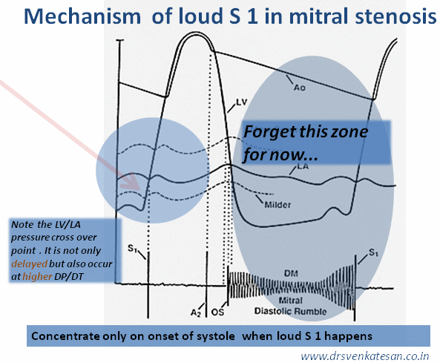
Loud M1 in MS
The M1 is loud due to the high dP/dT of the LV at the time of LA/LV pressure crossover
Other factors –
Wide closing excursion of leaflets
Quality of valve tissue

Slide 22
S1 and PR interval
Short PR
Higher LA pressure at the time of LA LV crossover
Loud S1
Conversely - Long PR gen. leads to soft S1
Steep dP/dT
Shallow dP/dT

Slide 23
M1 in Mitral Regurgitation
Generally expected to be soft
Loudness also depends on LV function, acuteness of MR
May be normal to loud in –
1. MVP
2. Tachycardia, short PR

Slide 24
M1 in AR
LVEDP is significantly raised due to AR
Hence, LV diastolic pressure can rise above LA pressure in the middle of diastole, prematurely closing the MV
This often leads to a soft S1

Slide 25
S1 in Ebstein Anomaly
T1 is delayed and loud, causing obvious splitting of S1
Delay – Due to RBBB
Loudness – Due to large sail-like ATL
Other causes of delayed T1:
RBBB, LV pacing, LV ectopics

Slide 26
Bedside Assessment of S1
Intensity (Loudness)
Any variation in Intensity
Audible splitting
Effect of respiration
Presence of Ejection click

Slide 27
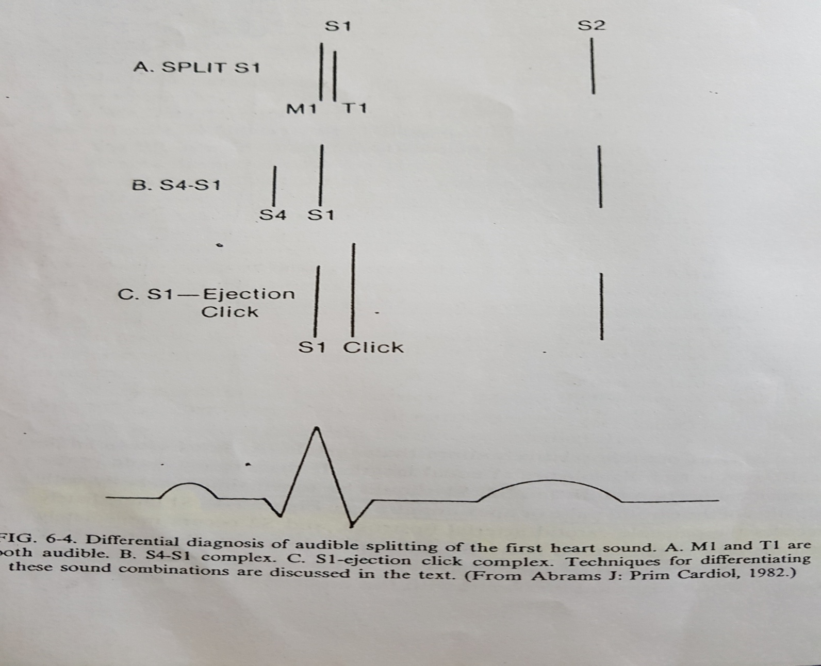
d/d of split s1

Slide 28
S4 - Low pitched generally,
with bell,
Often palpable
at apex
left lateral position,
varies with respiration
Ejection click – more intense
well heard at base
vary with respiration
associated RVH, LVH features
associated systolic thrills

Slide 29
Causes of varying intensity of S1
1. AV dissociation
2. Mobitz type I 2nd degree AV block
3. Atrial fibrillation
4. Pulsus alternans

Slide 30
Tic-Tac rhythm – embryocardia / foetal rhythm
a] shock
b] myocarditis
c] severe AR
Notes:
TIC-TAC RHYTHM – shortening of diastolic pause due to rapid heart rate and alteration of 1st heart sound, so that it is short sharp and resembles 2nd heart sound gives rise to a rhythm resembling the ticking of a clock. In severe AR increased volume prolongs systole relative to diastole

Slide 31
SECOND HEART SOUND

Slide 32
2 components Aortic and Pulmonary[ A2 P2]
Respiratory variations were described by Potaine in 1866.
As compared to S1 there are limited controversies over the exact genesis of S2 and the most accepted theory is by Shaver et al
It states that the highest frequency sound is heard due to the vibrations of the great vessels due to sudden tensing of the supporting structures of the semilunar valves at the time of pressure crossover between the ventricles and the great arteries due to the deceleration of the blood mass

Slide 33
GENESIS OF S2
LV End Systole
Flow into great vessels complete
Sudden deceleration of the blood mass towards the Semilunar
Valves (Ao-LV and PA-RV pressure crossover)
Cessation of Forward flow into great vessels
Coaptation of the Semilunar Valves
Abrupt tensing of the closed leaflets and vibration of LVOT
And RVOT and Great Vessels
A2 and P2

Slide 34
CHARACTERISTICS OF S2
High Frequency
Best Heard with Diaphragm
A2 louder than P2
Normally A2-P2 gap : 10-60msec
Average A2-P2 gap :40 msec best heard in Mid to late inspiration.
Narrow Splitting is gap < 30msec
Splitting can be heard if gap >20msec
With age the the A2-P2 gap reduces and its normal to find single S2 in both phases in aged>40yrs

Slide 35
A2: Can be heard at R/L 2nd ICS and apex
Best heard at apex
If palpable /Tambour A2(*) : Always pathology
P2: Best heard at Left 2-4th ICS
If heard at apex or if palpable: Pathological
S2 is louder and shorter than S1 due to
a] Elasticity- Elasticity of semilunar valves and arteries is much lower than AV valves and ventricular walls
b] Rate of oscillation - High Rate of oscillation in semilunar valves and arteries causes early and rapid damping out of sound
Notes:
Elasticity of semilunar valves and arteries is much lower than AV valves and ventricular walls
High Rate of oscillation in semilunar valves and arteries causes early and rapid damping out of sound

Slide 36
RESPIRATION AND S2
INSPIRATION
Decreased Intrathorasic Pressure
Increased Blood to RV and relatively less blood from PV to LA
Prolonged RV systole and LV systole either unchanged or decreased
RV ejection and Q-P2 increases and Q-A2 unchanged or decreased
Several beats later and during expiration this increased BV enters LV and Q-A2 increases, Q-P2 again decreases

Slide 37
Incisura - represents peak deceleration of blood mass and immediately is followed by a rebound of pressure[dicrotic notch].
Hangout interval[HI]- distance in time between ventricular systolic pressure and its great vessel at the level of incisura.

Slide 38
After the pressure cross over the valves should close but due to the inertia of the moving blood mass the valves remain open for a brief period and this period is hangout interval and it depends upon the vascular impedance of the great vessels.
Higher the resistance lower the H.I.
HI also defined as interval from crossover of pressures to the actual occurrence of sound

Slide 39
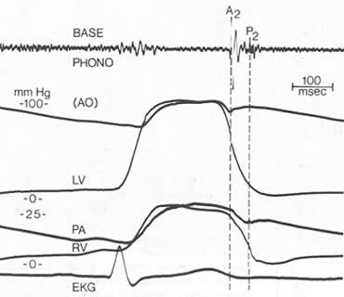
Notes:
HI – the arterial pressure curve faithfully accompanies chamber pressure curve along dome till it descends, where it dissociates from chamber pressure curve and hangsout for a certain millisec,this is called as hangout interval.

Slide 40
Importance of Hangout Interval
Aorta
Pulmonary Artery
High Resistance and Low Compliance
Lesser distensibility
Low Resistance & High Compliance
Recoil from the ejection of blood from
Aorta is brisk
Recoil is delayed
As there is higher distensiblity
Vibrations are relatively sooner
P2 and incisura come delayed after
RV ejection
A2 and incisura come immediately after
LV ejection
Smaller Hangout Interval
Longer Hangout Interval

Slide 41
Aortic HI is <15msec
Pulmonary Hangout Interval is 2-5 times higher than the Aortic Hangout Interval and can be 43-86msec.
PHI has more variation with respiration and is Inversely related to PVR
PHI is the most responsible for the widening of A2-P2 in inspiration.

Slide 42
Factors affecting Hangout Interval
Pressure beyond the valve
Dilation of the artery
Distensibility of the arterial system
Vascular impedance
e)Phase of respiration
Pulmonary HI has more respiratory variation and is inversely related to PVR
Pulmonary HI is more responsible for A2-P2 widening during inspiration

Slide 43
Normal audible split S2 in regular inspiration, why?
a] increase in RV systole – 28%
b] decrease in LV systole – 27%
c] hangout interval – 45%
Notes:
During inspiration, pulmonary vascular resistance decreases more than compared to that in aorta because pulmonary bed is more compliant to changes in negative intrathoracic pressure than aorta, so HI in pulmonary artery increases further and forward flow during systole into PA thus continues over a longer time than aorta, so incisura is delayed, so P2 is delayed.

Slide 44
Loudness of Second heart sound
Depends on –
Stroke volume, flow across the valve
Resistance in the respective circulation/Pressure in the great artery
Elasticity of the great vessel
Presence of stenosis/regurgitation
Loud A2:
A2 louder than S1 at sites other than the classical aortic area, especially at the apex
Loud P2:
P2 louder than A2 at a site away from the left second space
P2 heard at the apex

Slide 45
ABNORMALITIES OF SECOND HEART SOUND
Increased A2 - inc pressure in aorta in systemic htn, anxiety - aortic root dilatation in marfans, syphilis, aneurysm - thick mobile valve in rheumatic , atherosclerosis - TOGV | Increased P2 - mitral stenosis - PPH - PH 2° to ASD, VSD, PDA, recurrent pulm emboli - COPD, massive fibrosis * longstanding pulm HTN – RV failure – decrease P2. | Increased A2 and P2 - thin individual - lung disease - syst & pulm htn coexistence
Decreased A2 - valvular & supravalvular AS | Decreased P2 - valvular PS | Decreased A2 and P2 - thick chest wall - emphysematous chest - pericardial effusion

Slide 46
PAH AND LOUD P2
Normal Systolic PAP and MPG : P2<A2
Mild PAH
Systolic 30-50mmhg
Mean 30- 40mmhg P2>A2(localised)
Moderate PAH
Systolic 50-75mmhg
Mean 40-49mmhg P2>>A2
Severe PAH
Systolic >75mmhg
Mean >50mmhg Loud P2(also at apex)

Slide 47
Splitting of S2
Widening of split in inspiration is predominantly due to delay in P2 rather than A2 coming earlier
More prominent in younger people, may be absent beyond 60 y age
Should be evaluated in standing and supine positions
Best appreciated in left 2nd and third ICS

Slide 48
Determinants of splitting of S2
Relative pressures, compliance of pulmonary and systemic circulation
Ejection properties and onset of electrical activation of the RV and LV
Intactness of the interatrial septum
Ability of respiration to alter some of these characteristics
Possible variations –
No split
Wide split
Fixed or Variable
Narrow split
Paradoxical (Reversed) split

Slide 49
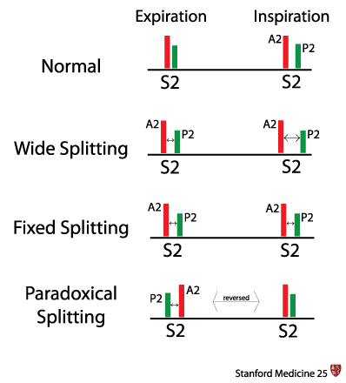

Slide 50
Normally, A2 will be heard at the apex and P2 will not be heard at apex even in inspiration.
Thus while assessing the split, base should be auscultated first and traced to the apex.

Slide 51
WIDE SPLIT
Delayed P2 - RBBB is m/c - LV pacing - PVC in LV - severe PS - pulm htn with RV failure - idiopathic dilatation of PA - pulmonic regurgitation - biventricular CCF - ASD | Early A2 - severe MR - VSD - pericardial tamponade - constrictive pericarditis - left atrial myxoma - severe pulm htn with embolus | Other - straight back syndrome - pectus excavatum - interventricular conduction delay - some normal children
Notes:
Idiopathic dilatation of PA – due to inc hangout interval
pericardial tamponade - reduction in LV stroke volume is greater than that in RV stroke volume as the latter is relatively fixed
constrictive pericarditis & left atrial myxoma – due to Decreased LV inflow and reduced LV systole
straight back syndrome assoc MVP causing MR decr LV systole
pectus excavatum [ restr and abstruc lung disease and assoc dec lv strike volume]

Slide 52
EXPIRATORY SPLIT
Presence of A2 and P2 at end Expiration
In supine position Pts may have expiratory split due to A2-P2 gap>30msec but it becomes single in upright position and hence basal areas should be auscultated in upright postions only.
Persistent expiratory split is pathological
All the causes of Wide Split will cause expiratory split also

Slide 53
FIXED SPLIT
When the RV or LV SV does not change with inspiration or changes equally with respiration the splitting heard is FIXED.
Diagnosis should be made only in both recumbent and upright position as it occasionally can be seen in supine position also

Slide 54
Equal change in LV / RV SV
1. Atrial Septal Defect
In cases of ASD with L-R shunt there is RV overload and RA, LA act
hemodynamically as a single reservoir.
In inspiration, increased flow to RV which causes decreased flow from LA to RA
and thus momentarily increased flow from LA to LV increasing LV inflow.
This leads to Increased Q-A2 and hence both RV and LV SV increase in
inspiration.

Slide 55
In cases of ASD without PAH, this fixed splitting is occasionally variable and respiratory variation can be heard in sitting position.
ASD with PAH: Always fixed splitting with loud P2
2. Ventricular Septal Defects
S2 is normally split in patients with VSD and normal PAP

Slide 56
VSD with PAH
Increased PVR, Decreased PA compliance and decreased PA hangout Interval.
Both chambers eject into high resistance vessels resulting in equal inspiratory delay on both sides accompanied by nil respiratory variation as both ventricles act as a common chamber
This leads to single S2 in both the phases of respiration

Slide 57
Failure to increase RV stroke volume with inspiration
1. RV failure
2. acute / chronic PTE
3. severe pulm htn
4. RBBB with Congestive Cardiac Failure: RV systole is substantially prolonged and
A2- P2 coupling will be both wide and fixed.

Slide 58
Paradoxical Split
Paradoxical Splitting
Type 1
(classical)
Type 2
Type 3
Incrased Q-A2 interval due to LV mechanical delay
During Expiration
Prolonged LV systole makes A2 follow P2 and is heard in expiration
During Inspiration
Q-P2 increases normally but Q-A2 remains unchanged and ear appreciates only single S2
Mild delay in Q-A2 and
Marked Q-P2 interval
During Inspiration
Normal split may be heard
During Expiration
S2 reverse split heard
Both Expiratory
And Inpiratory separation
Is <20msec and S2 is
Fused in both the phases

Slide 59
1. LBBB – most common
2. WPW syndrome with RV Pre excitation from Rt Bypass tract
May cause type 2 paradoxical splitting.
3. RV pacing and RV-PVC
4. Increased LV ejection time:
PDA
Severe AR
Severe LV dysfunction

Slide 60
5. LVOT Obstruction:
Valvular AS and HCM
In valvular AS ,not only its because of the prolonged ejection time but also due to
the post stenotic dilatation of the Aorta and thus increased Hangout interval.
Shortened RV systole : seen in TS and RA myxoma [ uncommon ]

Slide 61
PSEUDOPARADOXICAL SPLITTING
Deep Inspiration in these patients will cause artificial muffling Of P2 due to insulation of the PA by the expanded lungs and hence S2 appears single with inspiration and split in expiration
1.COPD:
2. Large chests:

Slide 62
SINGLE S2 / NARROW SPLIT S2
Heard when the A2-P2 gap is <30msec
1. Aging: Incidence of Auditary splitting with inspiration decrases with age.
50% subjects with age >60yrs have single S2.
Due to either age related increased LV ejection time
Or due to age related increase in PVR and subsequent decrease in PA hangout interval.

Slide 63
2. Artifactual Muffling of P2: Lung insulation of the P2 during inspiration in COPD and large A-P diameter chest individuals.
3. Pulmonary Hyertension: Pts with Severe PAH and Normal RV function narrow A2-P2 is a must and loud P2 can backwards mask A2 causing it to appear as single S2.
4. Pathological Absence of P2/A2:
Severe Pulmonic deformity with low or absent PBF and great vessel malposition causes single S2
ex: TOF
Pulmonary Atresia and stenosis
Tricuspid Atresia
Aortic stenosis

Slide 64
5. masking – by VSD,PDA,ASD
6. Eisenmenger VSD, Single Ventricle
Common ventricular chamber ejects into 2 vessels with equal
compliance,resistance and hangout interval, the systole lengths will be equal
and S2 will be fused in all phases.

Slide 65
How to Assess S2 – A summary
The Art and Science of Cardiac physical Examination
N Ranganathan et al. 2006. Humana Press

Slide 66
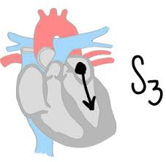
Third Heart Sound

Slide 67
Third Heart Sound
Ventricular gallop or protodiastolic gallop or S3 gallop
It follows the second heart sound during rapid ventricular filling
Low frequency, low amplitude diastolic sound
Heard after A2 (120-140 msec after)
Timing like the “-ky” in “Ken-tuc-ky.”
Heard at cardiac apex ( LVS3) and Left LSB (RVS3)
Can be heard normally in children and young adults (<40 years)

Slide 68
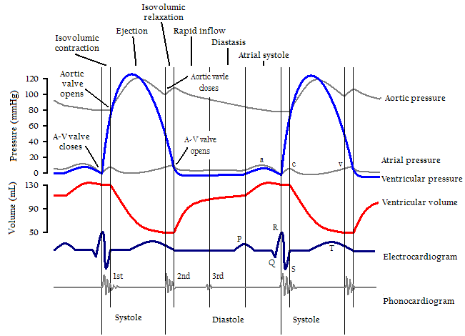
Third Heart Sound
Physiology of origin
Occurs at the end of the rapid filling phase, when the incoming column of blood abruptly decelerates
Increased momentum of incoming column + Decreased compliance of ventricle =
Abrupt relaxation
Occurs when the active ventricular relaxation ends and passive distension begins

Slide 69
Theories for S3:
Pontain :
Suggested the origin of S3 to be a ventricular sound due to sudden cessation of ventricular distension in early diastole
Shaver Reddy et al:
Nature of coupling of the LV with inner chest wall
A prominent ventricular gallop (VG) is recorded 0.16 second after the second heart sound

Slide 70
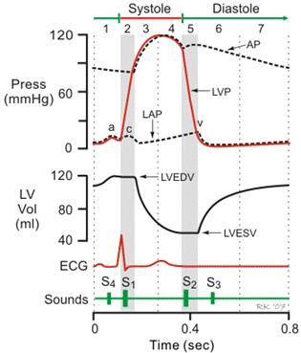

Slide 71
Factors affecting genesis of S3
Transmitral blood flow velocity or volume
LV relaxation properties
LV end diastolic volume
Blood viscosity
Coupling of LV with chest wall
Character of the chest
Causes of S3
Physiological:
Children & young adults
Pregnancy
Hyperkinetic states

Slide 72
Why is it heard normally in Children and Young Subjects
1. Young have rapid diastolic filling secondary to higher Cardiac
Output as compared to elderly
2. Altered LV compliance physiology with age
3. Altered sound transmission in adults
4.Decrease in LV-chest wall coupling in adults

Slide 73
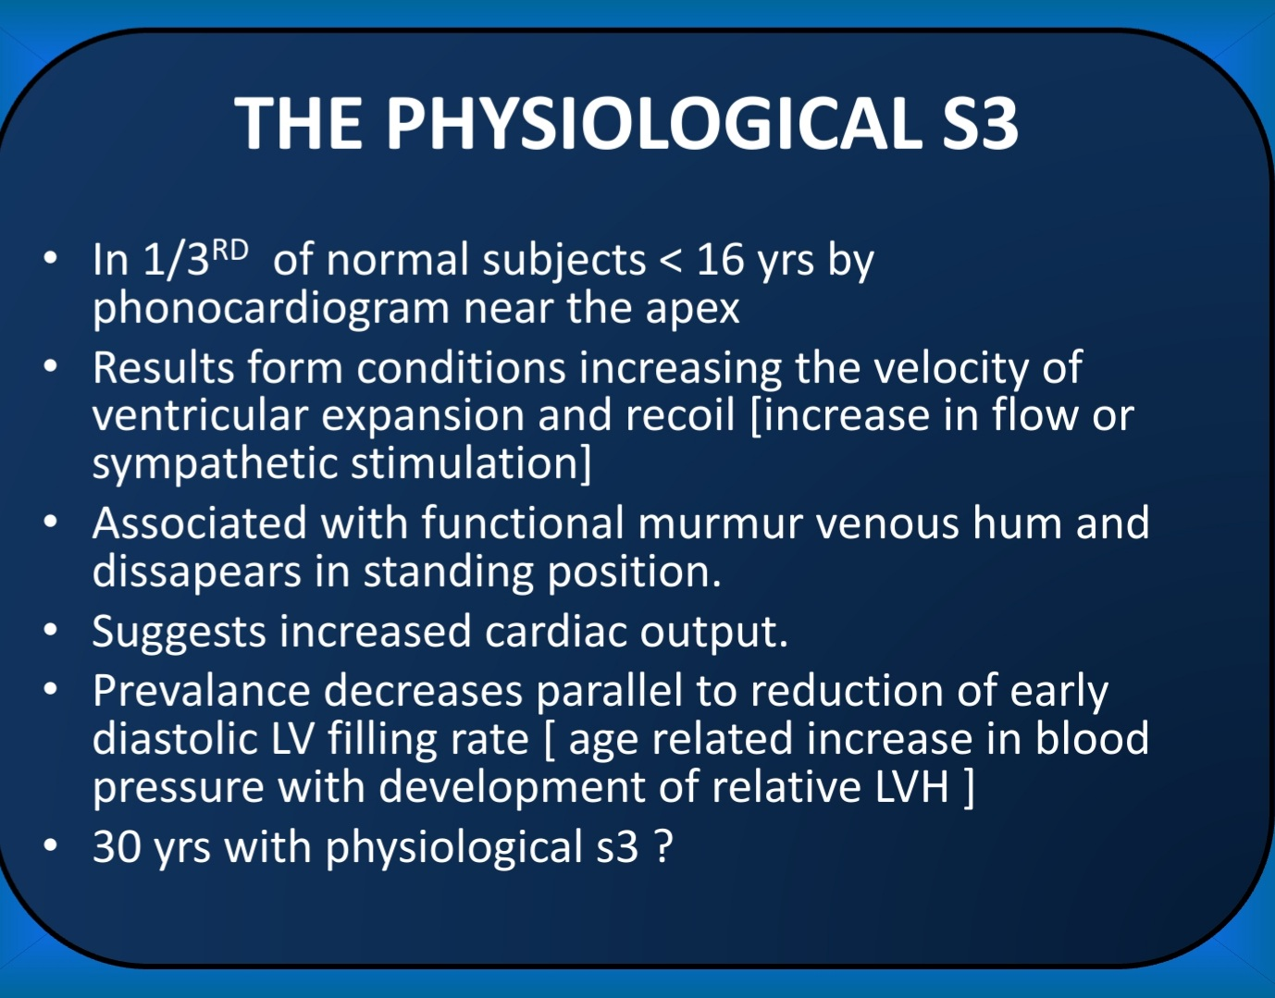

Slide 74
Pathological S3
Ventricular systolic dysfunction:
Due to decreased compliance as well as rise in the height of the atrial a wave consequent to increased ventricular diastolic pressure
Ventricular volume overload
AV valve regurgitation
Semilunar valve regurgitation
Left to right shunts with increased flow across AV valves
Systemic AV fistula

Slide 75
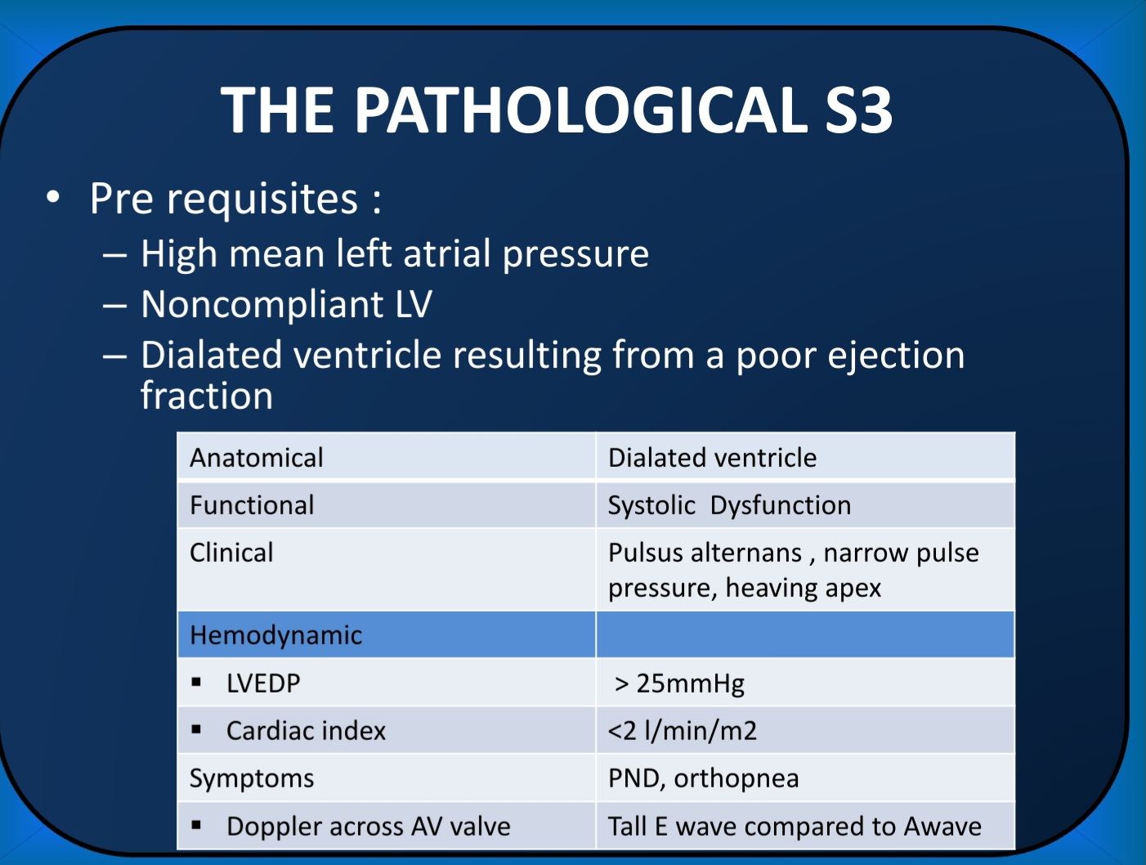

Slide 76
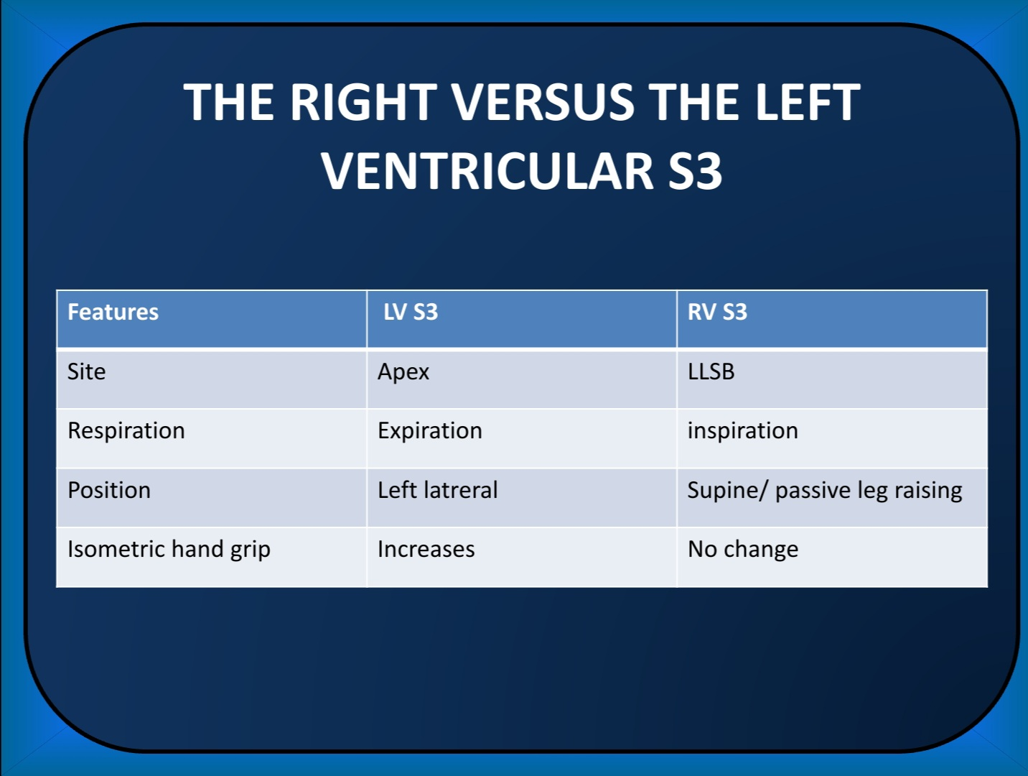

Slide 77
CLINICAL SIGNIFICANCE OF S3
a] normal hearts –
children and young adults, hyperkinetic states
hemodynamics – rapid rate of LV diastole with normal cardiac
output and LA pressures.
b] diastolic overload states –
MR, VSD, PDA, TR, ASD
hemodynamics – peak diastolic filling rates with inc LA pressures
and normal cardiac output.

Slide 78
Development of significant PAH after severe MR will soften the S3 but if it causes RV failure S3 may appear again.
Usually RV S3 is uncommon in cases of high flow situations like TR and ASD on the right side unless there is high RV volume overload or RV failure.
This is seen because RV compliance is much more than the LV compliance.

Slide 79
c] LV dysfunction –
Significant myocardial disease of any etiology like CAD, DCM, LV
aneurysm, markedly dec LVEF
hemodynamics – dec cardiac output, EF
inc LAP, PCWP, EDP, EDV
inc cavity / wall thickness
Persistent S3 – a poor prognosis and may be associated with narrow
pulse pressure, pulsus alternans, signs of CCF.

Slide 80
Differentials of S3
Sound | Best heard | Interval after A2(sec) | Pitch | Miscellaneous
Opening snap | Lower Lt. sternal border or apex | 0.06 to 0.12 | Medium to high pitch | Split varies with respiration
MVP | Lower lt. sternal border | 0.06 to 0.08 | Medium to high pitch | A/W click and or murmur
Pericardial knock | Apex | 0.09 to 0.12 | Medium to high pitch | Usually loud and palpable A/W JVP finding
Tumor plop | Apex | Depend on RR interval | Low | Often louder than S1 and S2

Slide 81
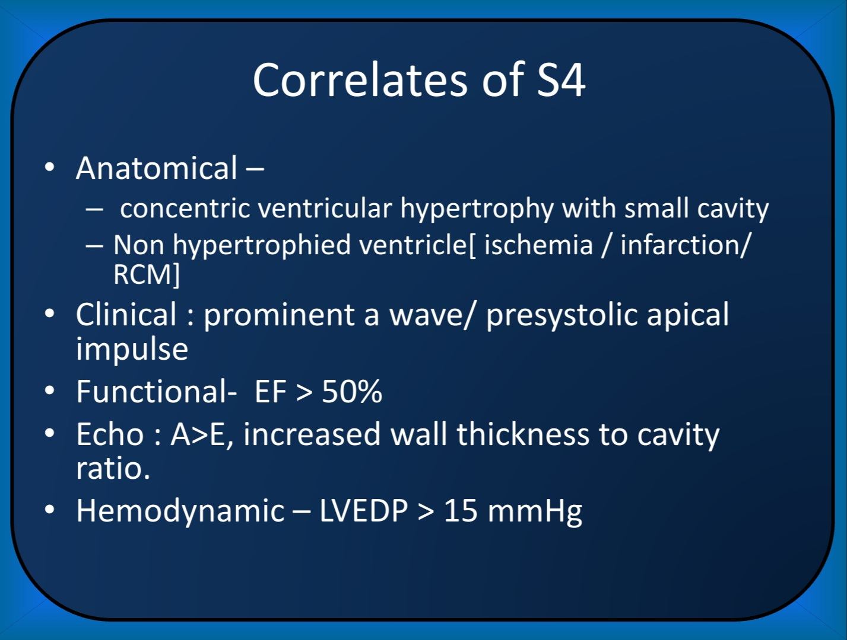

Slide 82
Pathological S3- PND/Sever Dyspnea/Soft S1/Sustained Apex/Persist on standing
Physiological S3- Young/Assymptomatic/S1 preserved/Normal apex/Dissappear on standing

Slide 83
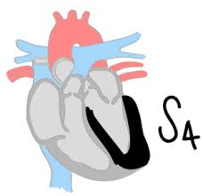
FOURTH HEART SOUND

Slide 84
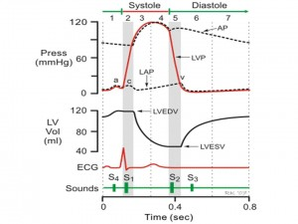
Fourth Heart Sound (S4)
Atrial or presystolic gallop
Low frequency (20-40 Hz) sound occurring after atrial systole
Ventricular origin
Follows P wave by 140-200 msec
Precedes S1
Like “Ten-” in “Ten-nes-see,”
Bell of stethoscope ,best heard at apex
May be better palpated

Slide 85
Actual contraction of atria doesn’t produce any sound and the sound is due to the sudden tensing of cardiohemic system [LV, MV, and blood within ventricles]
Hemodynamics – hypertrophied LV with normal diameter
dec cavity / wall thickness ratio
LV-EDP 》15mm hg
Low compliance ventricle
Impaired early diastolic filling
Normal cardiac output.
Notes:
Hemodynamics – normally 70-80% diastolic volume received in early to mid diastole and 20% by atrial systole but in hypertrophy atrial systole becomes greater proportion, so S4 is heard. But as lv dysfunction progresses early diast pressure increases and LA systole produces relatively small further inc in pressure once LV cavity is enlarged[ LV failure].at this stage s4 becomes inaudible.
When atrial contraction forces are reduced by fibrosis,ischemia,dilatation in chronic MR,arrhythmias, s4 becomes inaudible.

Slide 86
Genesis of S4
Decreased ventricular compliance
More vigorous atrial contraction
Increased atrial a wave pressure peak
Accelerated ventricular inflow at the end of diastole
Rapid deceleration of flow due to reduced ventricular compliance
Occurrence of S4 requires:
Reduced ventricular compliance
Healthy atrium
Normal sinus rhythm
Non-obstructed AV valves

Slide 87
Assessment of S4
Site: LVS4 at apex, RV S4 near xiphoid area/lower sternum
Low pitched. Heard with the bell, softens with firm pressure
Often palpable
Diminishes on standing
Associated with prominent a wave in the JVP (Gen. RVS4)

Slide 89
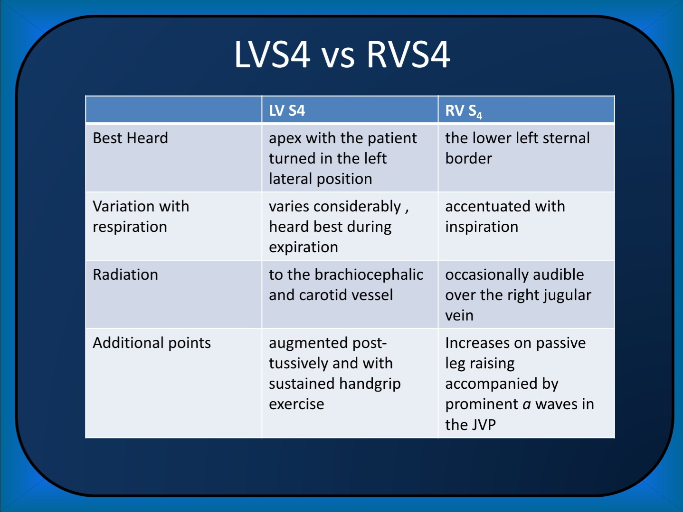

Slide 90
Cause of S4
Age more than 50 yrs.
All cause of LVH
Systemic hypertension
Moderate to severe AS
HCM
Restrictive cardiomyopathy
All cause of RVH
Moderate to severe PS
Moderate to severe PAH
Restrictive cardiomyopathy
Coronary Artery disease
Ischemia
Infraction
Acute mitral regurgitation

Slide 91
CLINICAL CORREALTES
Common denominator of all the causes in all the conditions causing S4 is LVH with restricted early diastolic filing due to stiff ventricle
Sensitivity
Ventricular compliance: S4>>S3
Cardiac decompensation: S3>>S4
S4 has a benign prognosis compared to S3.

Slide 92
CLINICAL SIGNIFICANCE OF S4
a] normal hearts –
old age due to dec compliance
hyperkinetic states
b] abnormal hearts –
HOCM AS syst HTN
CAD PS acute MR
pulm HTN

Slide 93
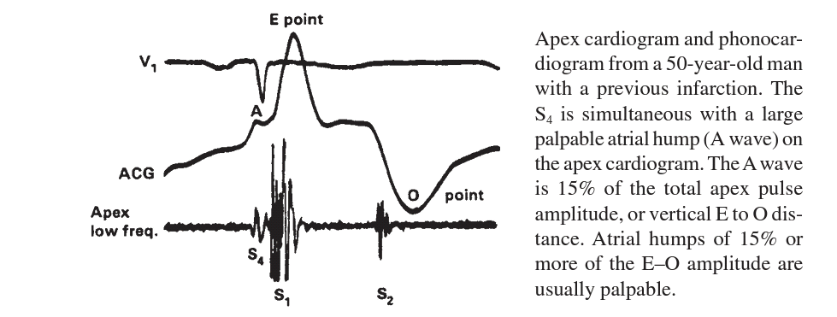
S4 in CAD and Acute MR
Coronary artery disease
S4 is hallmark
Reduced LV compliance d/t prior MI produces S4
Acute MI causes S4 in 80-90% cases which manifest 24-48 hours after onset of infarction
S4 persisting after MI portends poorer prognosis for subsequent cardiac events
May appear with angina and disappear with NTG
Patients with LV aneurysm may have palpable S4
Acute MR
Causes large regurgitant volume to be pushed forcibly into a normal sized LV resulting in S4
Chronic MR leads to decreased LA contraction d/t enlarged LA leading to loss of S4

Slide 94
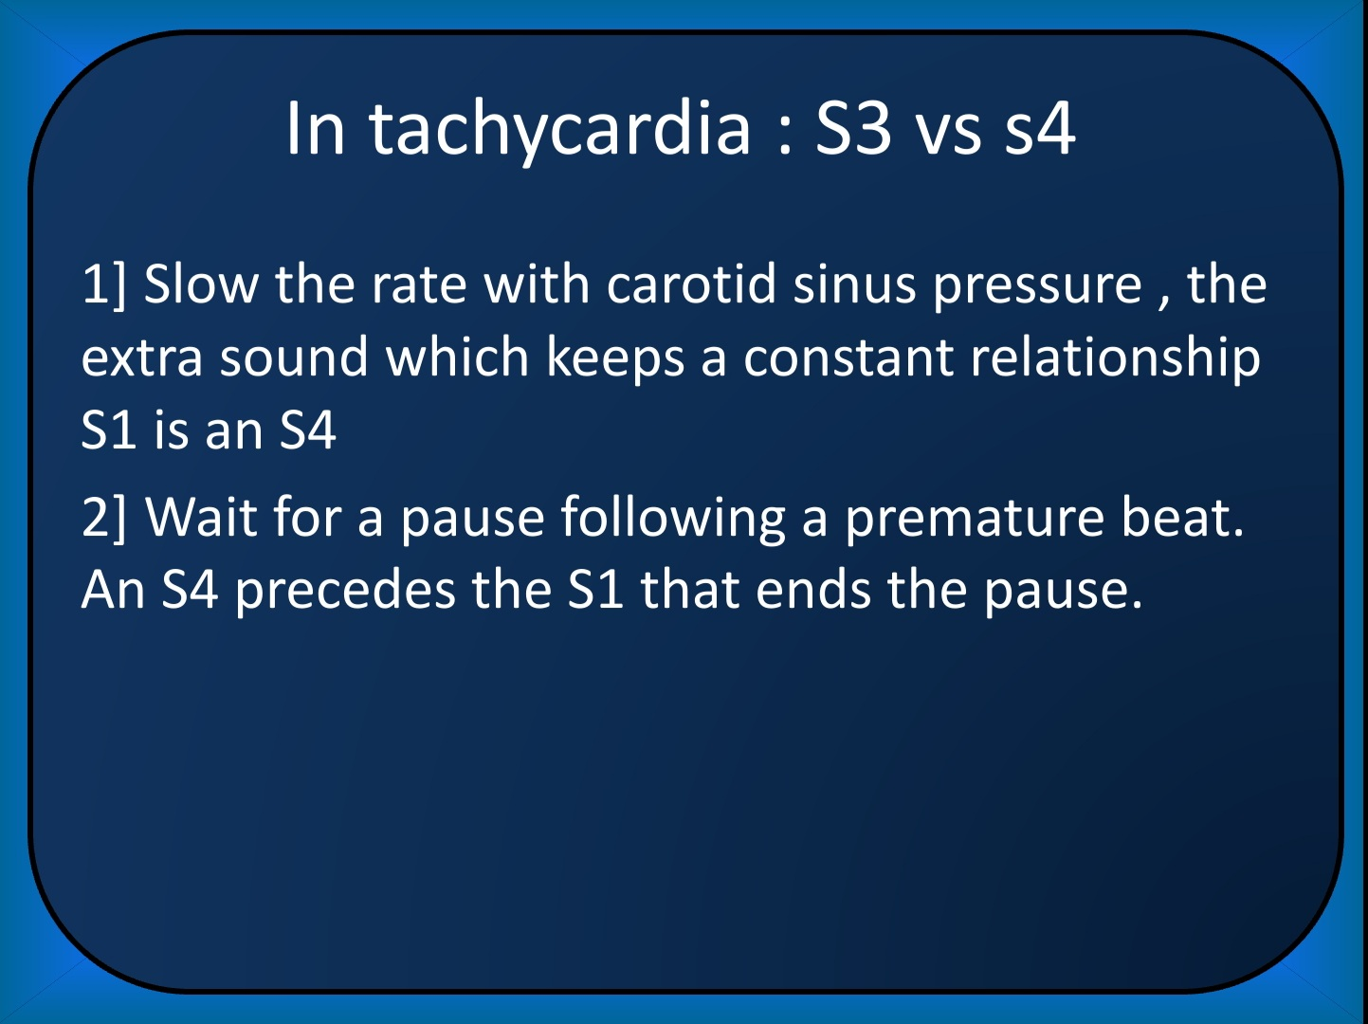

Slide 95
Pathological S4-Better audible/palpable/Increased S4-S1 gap
Physiological S4- Less audible/palpable/Reduced S4-S1 gap

Slide 96
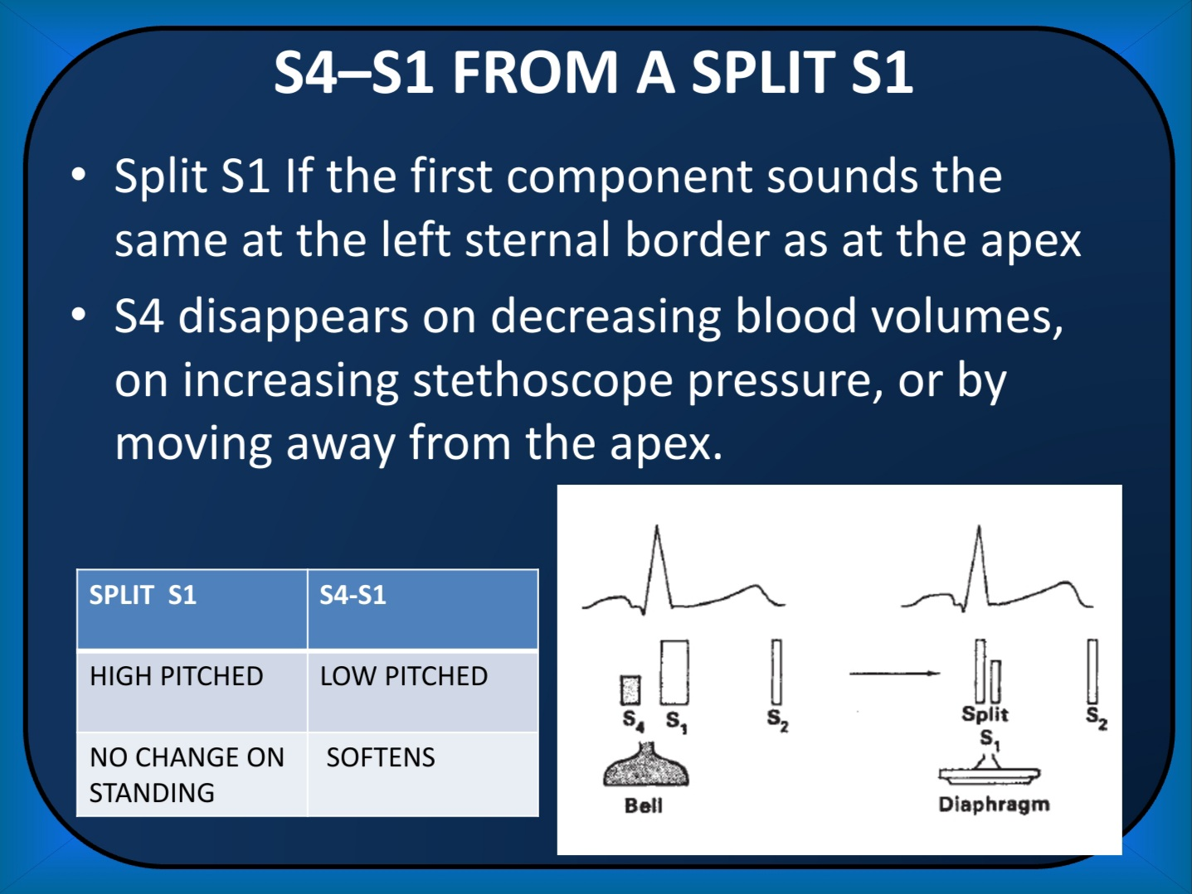

Slide 97
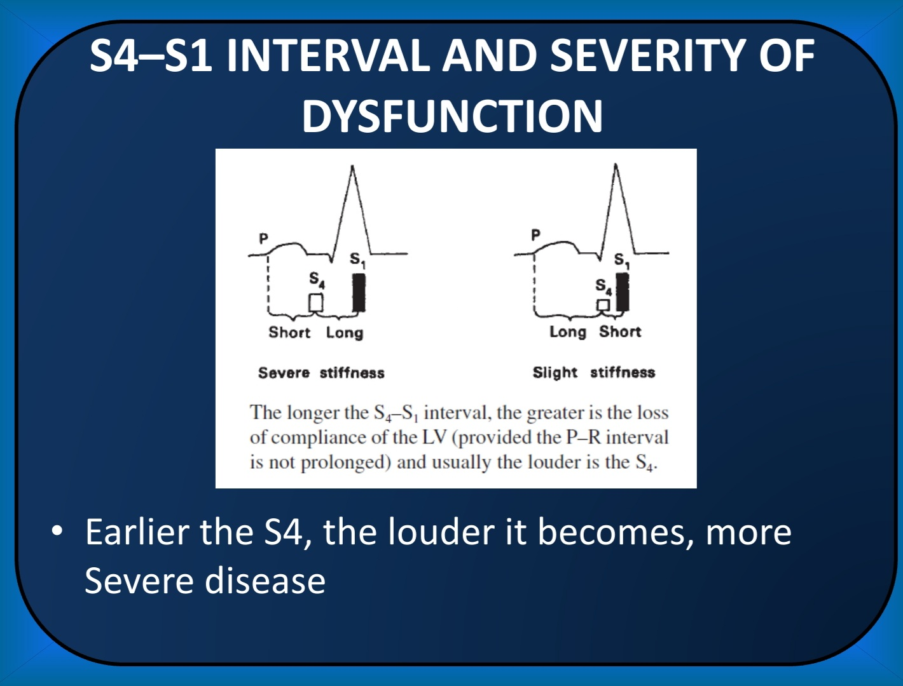

Slide 98
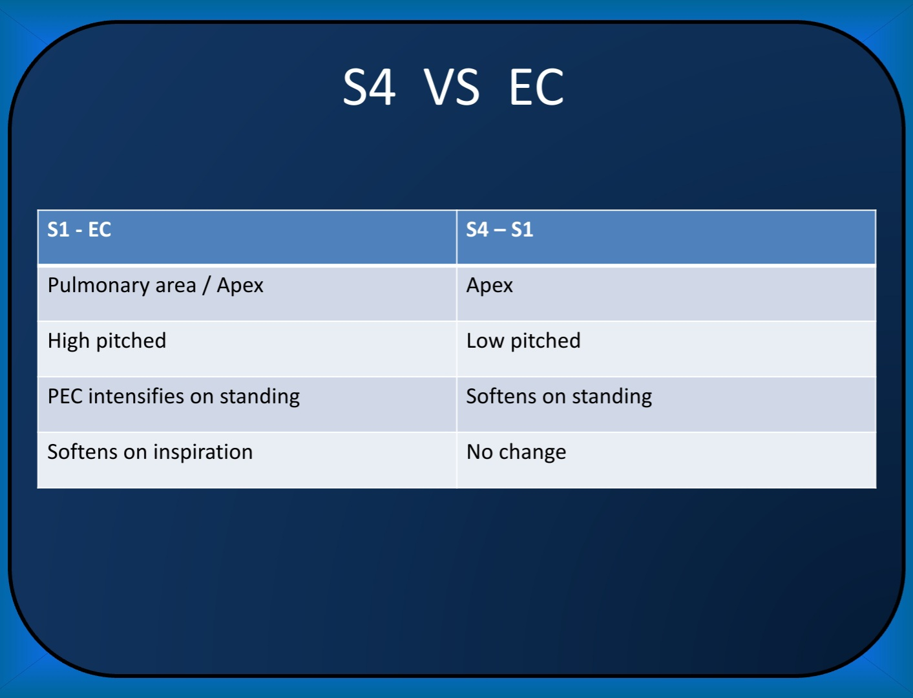

Slide 99
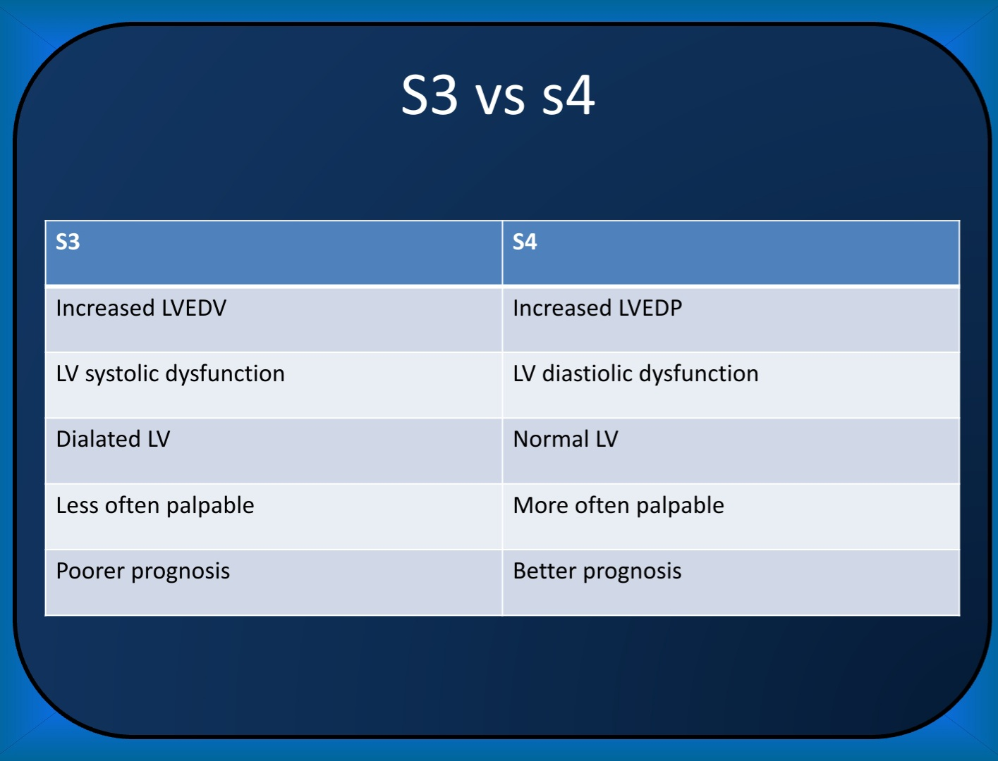

Slide 100
SUMMATION GALLOP/QUADRUPLE RHYTHM
Summation gallop – S3 + S4 as a single loud sound.
Seen in tachycardias.
When HR is high, atrial contraction will move into rapid filling phase of diastole and thus S3 and S4 will occur together leading to a very loud summation gallop.
CSM and rate control can separate the two components.
Quadruple rhythm – S1 , S2 , S3 , S4.
LV aneurysm, cardiomyopathy, or severe LV failure from any cause
When S3 and S4 both are heard, the term quadruple gallop is used.

Slide 101
Reference
Essentials of Cardiac physical diagnosis- Jonathan Abrams
Art and Science of Cardiac Physical Examination – Narasimhan Ranganathan
Kerala Journal of Cardiology
Clinical Methods in Cardiology – B Somaraju
Braunwald’s Heart Disease – Textbook of Cardiovascular Medicine
Hurst’s The Heart

Slide 102
THANK YOU

