Slide 1

Dr Arun Jude Alphonse
DM Cardiology Resident
Govt TDMC Alappuzha

Slide 2

70 /F Mrs Y
Progressive DOE for 1-2 yrs (NYHA CLASS III)
h/o HTN,DM
Physical examination:
Obese
  BP:160/90
  JVP not elevated
  No cardiomegaly
  LV S4+
  Chest clear
  LAB:S. cr-1.7 , Hb:9.9

Slide 3
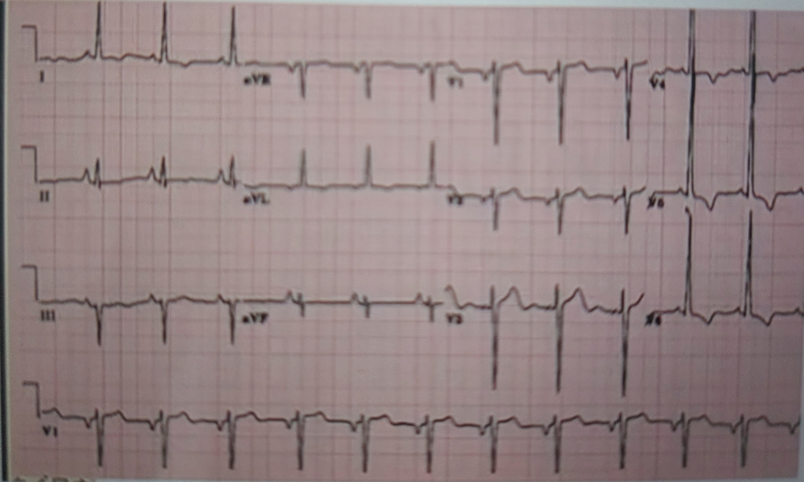

Slide 4
Lab: NT probnp 627
Screening Echo –LVH, LAA, EF-76%
Normal LV dimensions
  LAVI:36%
  DT – 140ms , e’ =4 cm/s: E/e’ = 16
CAG: Normal coronaries
DIAGNOSIS ?

Slide 5
OVERVIEW
What is HF-PEF ?
How Prevalent is it?
Who are these patients?
How do they present clinically?
What is the pathophysiology?
How do you diagnose it?
What is the prognosis?
How to treat it?
Previous questions asked ?

Slide 6
ACC/AHA -2013- Heart failure
Complex clinical syndrome that results from
any structural or functional impairment
of ventricular filling(diastole) or ejection of blood(systole)

Slide 7


Slide 8
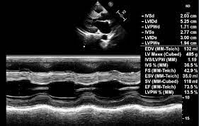

Slide 9
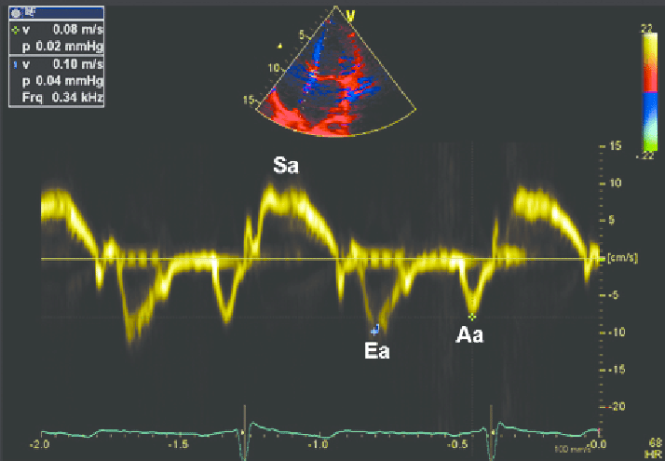
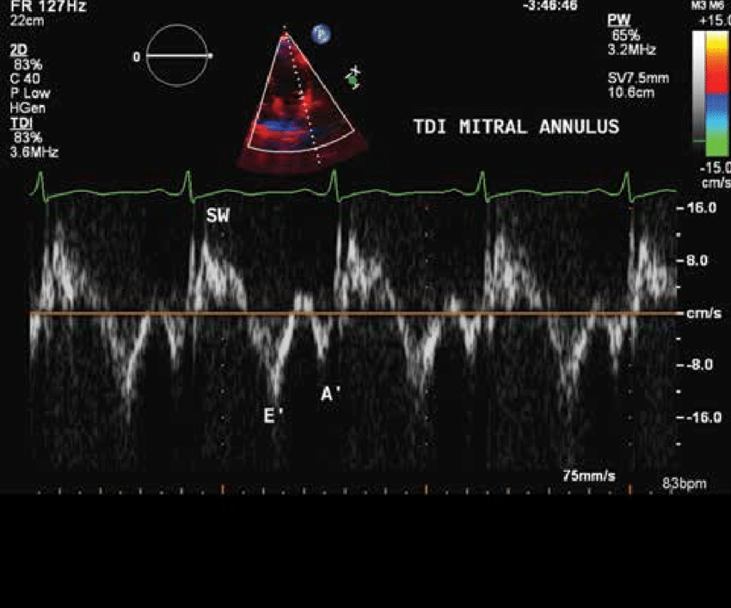

Slide 10
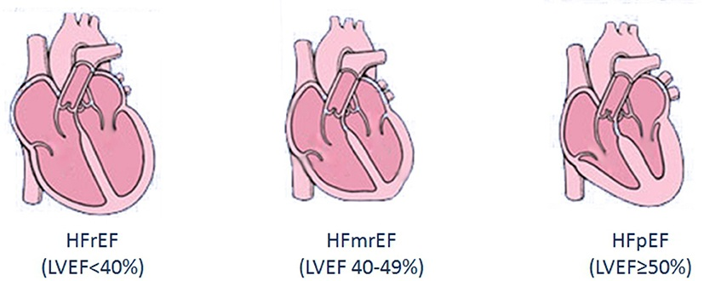
Classification of Heart failure by EF
Heart failure with preserved ejection fraction(not always normal EF)

Slide 11
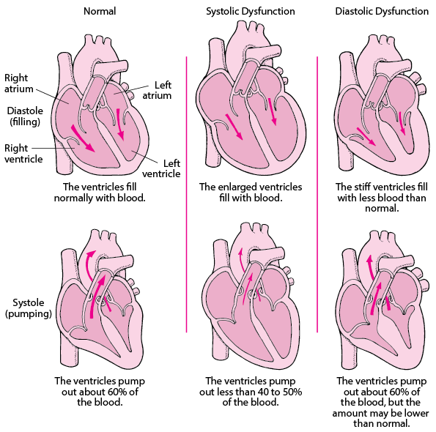

Slide 12
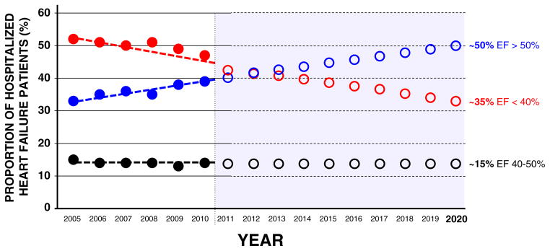
HFpEF is not “benign”
Similar functional decline, hospital readmission rates, economic costs
as HFrEF
Prevelance increasing

Slide 13
HFpEF is not an inferior form of heart failure
Responsible for 50-55% of all heart failure cases
50% readmission at 6 months, 60% 5 year mortailty ,

Slide 14
Who are these patients?
Most important risk factor- Advancing age
Hypertension in majority of (80% to 90)
Obesity is seen in 30% to 50%
Diabetes in 20% to 30%
Atrial fibrillation (AF) in up to 20% to 30%, and a history of AF in about 50% of patients
high prevalence of renal disease
CAD is 20% to 40%
Females at higher potent risk

Slide 15
ADHERE Registry
Preserved ejection fraction (n=26,322)
Age 74
Women % 62
Hypertension % 77
CAD % 50
MI hx % 24
SBP>140 % 61
SBP (mmHg) 152
A Fib % 21
COPD/Asthma % 31
Reduced ejection fraction (n=25,865)
Age 70
Women % 40
Hypertension% 69
CAD% 59
MI hx % 36
SBP>140 % 44
SBP (mmHg) 139
A Fib% 17
COPD/Asthma 27
JACC 2006

Slide 16

How do they present CLASSIC PROTOTYPE
Elderly , female , multiple comorbidities, DOE

Slide 17
M/C presentation -Dyspnea on excertion
Exercise poorly tolerated

Slide 18
2 different pictures – but same presentation-DOE
Why?

Slide 19
Looking at HF beyond EF
LVEDP=LAP=PCWP(If no MV/PV obstruction
Blood flows from area of higher to lower pressure)

Slide 20
Altered physiology - PVH
Poorly contractile heart : Increased EDV –Increased LVEDP
Diastolic dysfunction : thick non complaint ventricle(muscle expands at cost of its cavity)-cavity can only fill at expense of increased filling pressure(LVEDP)
LVEDP increased either by increase in EDV or increase in filing pressure
Increased LAP – Increased FoC of LA(Increased LA contribution to LV filling)
Atrial dilation – higher risk of AF
Increased PCWP – PVH – Exudation – Interstial edema – Pul Edema

Slide 21
Poorly tolerate exercise/ unaccustomed physical activity
Increase HR – Decrease in daistolic filling time –LAP rises-PCWP rises(In a normal heart this is compensated by increased untwisting –increased suction effect from LA to LV)
Increased preload-poorly tolerated
At every corresponding EDV – EDP is higher

Slide 22
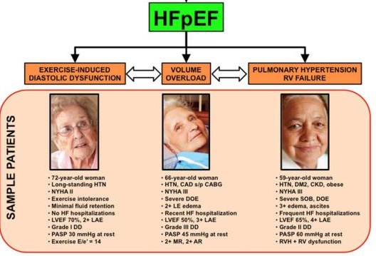

Slide 23
2/3 rd of all HFpEF patients develop AF at some point
AF may precepitate decompensation
Increase HR(decrease DFT), Loss of atrial contribution to CO

Slide 24
Signs
Tachypnea, Tachychardia , Use of accessory muscles of respiration
Dependant edema , Elevated JVP
LVS4>S3
B/L Fine end inspiratory crepitations

Slide 25
Causes of mortality –
CVS causes-50-70%
20% resulting from heart failure, 35% from SCD
Noncardiovascular deaths is significantly higher for HFpEF(30-40%)
than HFrEF(15%)
1)Comorbidities 2)Lack of treatment target

Slide 26
What is the pathophysiology?

Slide 27
Determination of LV Diastolic function
Ventricular relaxation and compliance-Haemodynamic load (afterload)
Synchrony
Cellular mechanisms
LA volume and function
Heart rate
Pericardium
Derangement of any of the above will lead to abnormal filling pressures and diastolic dysfunction.

Slide 28
Myocardial determinants
Two of the determinants
presence of LV and cardiomyocyte concentric remodeling and hypertrophy
changes in the material properties of myocardial muscle itself (i.e., myocardial stiffness)

Slide 29
Heterogenous syndrome
Diastolic dysfunction is not equal to HFpEF
Pathophysiology of HFpEF is complex
Designed and driven by comorbidities

Slide 30
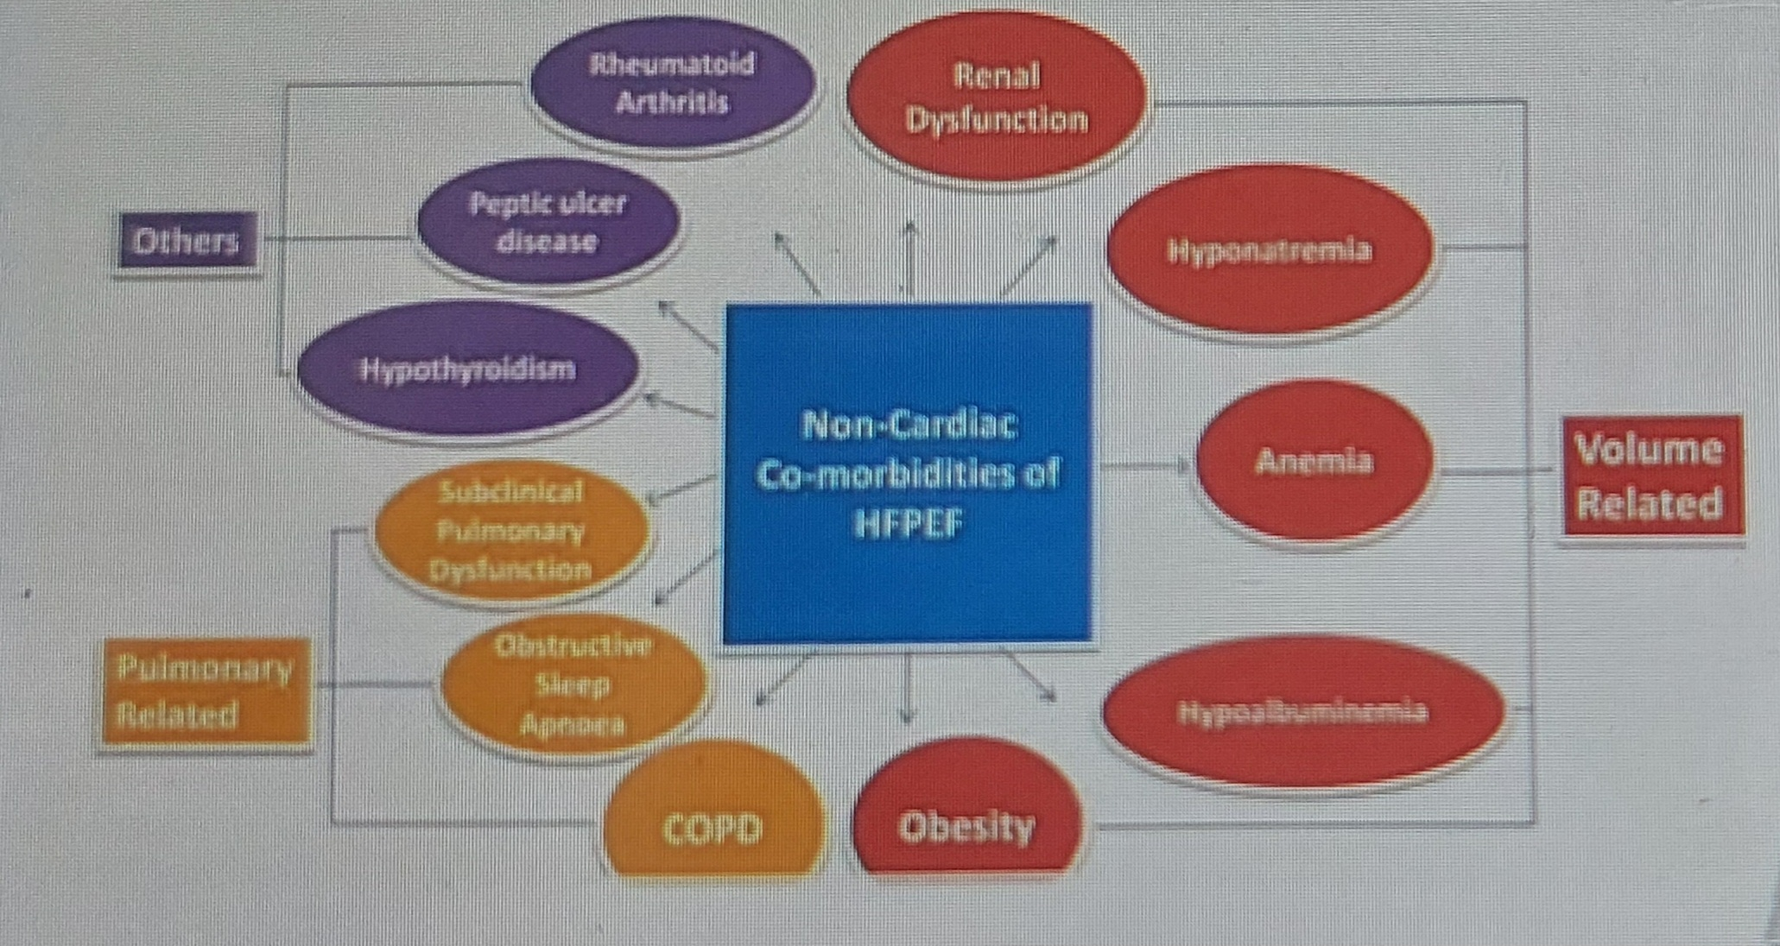
A disease defined by co-morbidities-Avg 4

Slide 31
A disease driven by comorbidites-
Comorbidity driven microvascular inflammation
Notes:
Proinflammatory and profibrotic signaling effects recruitment of circulating hematopoietic progenitor cells, alters endothelial function, and increases reactive oxygen species, all of which in turn alters extracellular matrix (ECM) homeostasis that favors fibrosis and cardiomyocyte mechanisms including calcium and energetic regulation, myofilament
structure and function, and intracellular signaling. In aggregate these changes in the ECM and cardiomyocyte result in abnormal diastolic function and promote the development of HFpEF

Slide 33
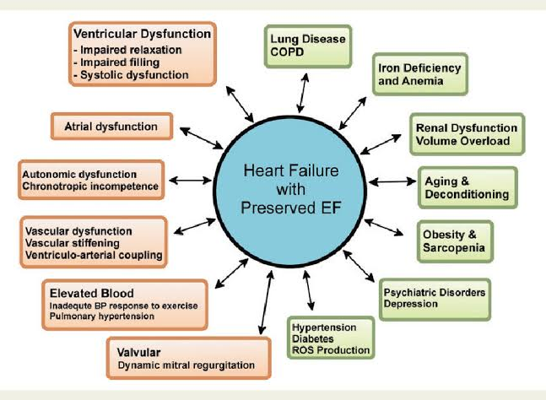

Slide 34
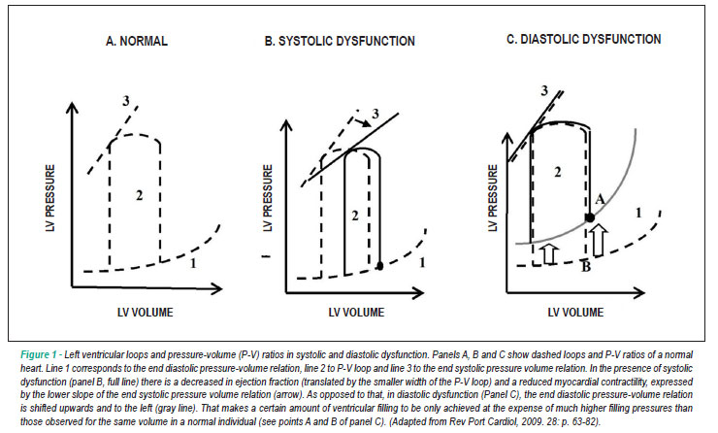

Slide 35
In heart failure with reduced ejection fraction, administration of arterial vasodilators results in minimal drop in blood pressure and substantial improvement in stroke volume
In contrast, the steeper end-systolic pressure–volume relationship in heart failure with preserved ejection fraction results in more exaggerated drops in blood pressure with vasodilator therapy, with potential reduction in stroke volume

Slide 36
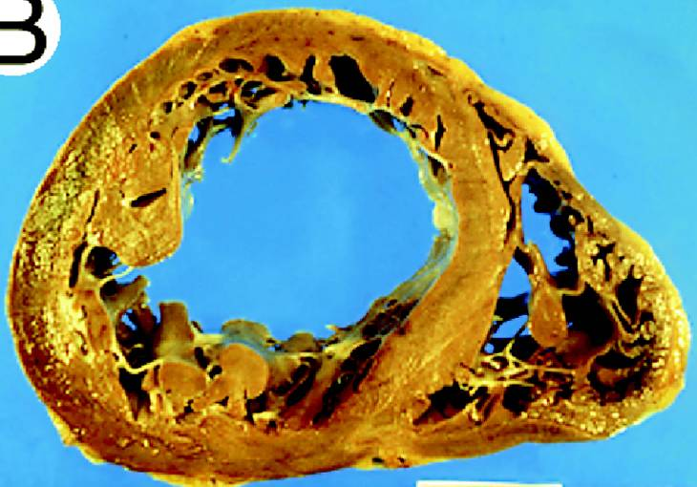
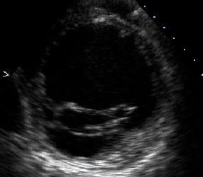
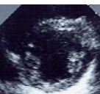
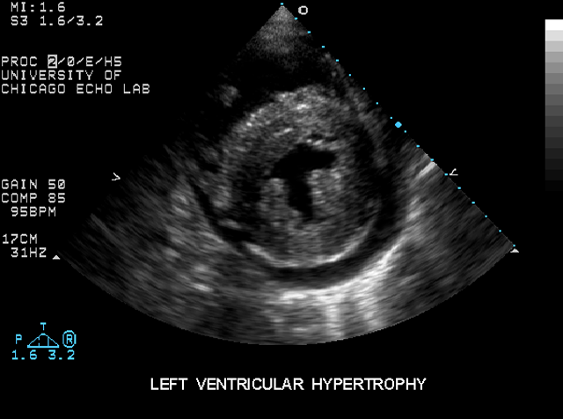
Systolic
Heart Failure
Normal
Diastolic
Heart Failure
Aurigemma, Zile, Gaasch
Circulation 2005

Slide 37
Diagnosing HFpEF-diligence &hypervigilence
STEP 1
Signs and symptoms of heart failure
Reduced exercise tolerance, dyspnea on exertion, orthopnea, paroxysmal nocturnal dyspnea, peripheral edema
LV S4/S3 , Basal fine crepitations
no clinical features (symptoms, signs, or chest radiograph findings) can be used to reliably

Slide 38
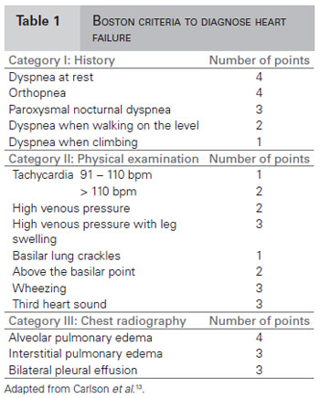
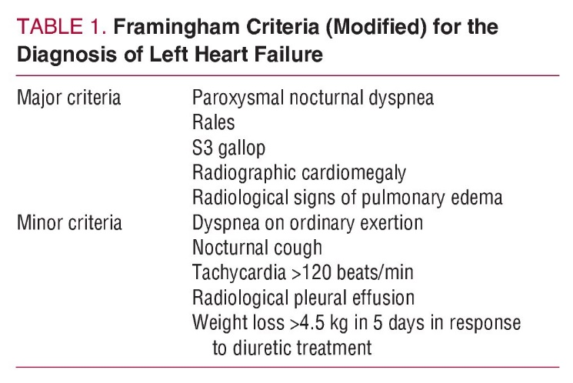

Slide 39
STEP 2
Preserved EF of >50%, LVEDV<97ml/m2

Slide 40
STEP 3 – Increase in biomarkers
BNP and NT-proBNP
lower than in patients with HFrEF-smaller LV cavity and thicker LV walls - end diastolic wall stress is less
increased BNP is directly related to LV diastolic filling pressure and end diastolic wall stress
lower in obese patients and higher in women, older persons, and patients with concomitant pulmonary disease (chronic obstructive disease, pulmonary hypertension, pulmonary embolus) and renal dysfunction
Consider higher cutoff in setting of AF
BNP of 100 pg/mL and for NT-proBNP of 400 pg/mL (Acute setting)
BNP of 35pg/mL and for NT-proBNP of 125 pg/ml (Chronic setting)
New FDA–approved biomarkers (e.g. soluble ST2, galectin 3), as well as others still under development (e.g., TIMP-1)

Slide 41
Heart as an endocrine organ
ANP – secreted by ventricle in response to stress
BNP/NT-ProBNP – secreted by ventricle in repsonse to increase in wall stress (First derived from porcine brain)
Prehormonal BNP cleaved to form BNP & NT Pro BNP
NT Pro BNP – no biological function (half life 90-120mins)
BNP – Vasodilation,natriuresis, inhibits RAAS/SNS(half life-20mins)

Slide 42
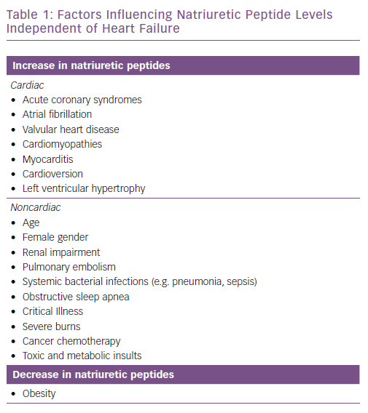

Slide 43
BNP/NT ProBNP excellent negative predictive value
USED TO RULE OUT HEART FAILURE & NOT TO RULE IN HEART FAILURE
Non elevated levels rules out heart failure
Eleavted levels don’t diagnose heart failure on its own
Higher levels correlate with hugher mortality
Serial levels of more importance than single value –assess therapeutic response

Slide 44
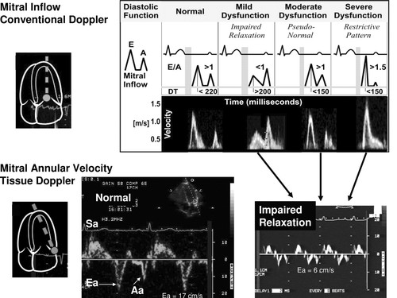
STEP 4 : Structural or filling abnormality by echocardiography
Identifying filling abnormality

Slide 45
Classification of diastolic dysfunction
(Myocardial inflow doppler & Tissue doppler)
Grade 1 : ( Mild) Impaired relaxation with normal filling pressure.
Grade 2 : (Moderate) Pseudo normalized mitral flow pattern.
Grade 3 : (Severe Reversible) Reversible restrictive with high filling pressure.
Grade 4 : (severe Irreversible) Irreversible restrictive with high filling pressure.

Slide 46
Grade 1: ( Mild)Impaired relaxation with normal filling pressure
Earliest abnormality is impaired relaxation
Mild diastolic dysfunction with slow LV relaxation
Haemodynamically causes delay in the LV pressure curve during iso volumetric relaxation
Prolongs IVRT
Rate of deceleration of early mitral flow decreases thereby DT is prolonged
Mitral flow during atrial systole increased
Filling pressures are normal

Slide 47
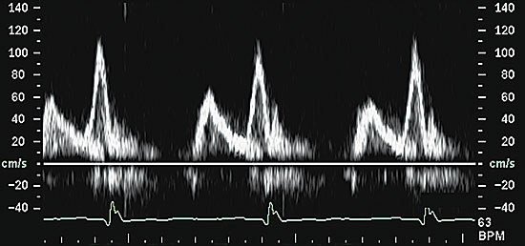

Slide 48
Grade 2 : (Moderate)Pseudo normalized mitral flow pattern
increase in LA pressure and there is restoration of the early diastolic pressure gradient despite increased early diastolic LV pressures
E wave to return to normal range (pseudonormal mitral inflow pattern)
Displacement of the left ventricle onto a steeper
portion of the pressure-volume curve results in a shortening of the DT.
slower relaxation, the e′ is delayed, occurring after the E
Pulmonary venous flow shows diastolic predominance

Slide 49
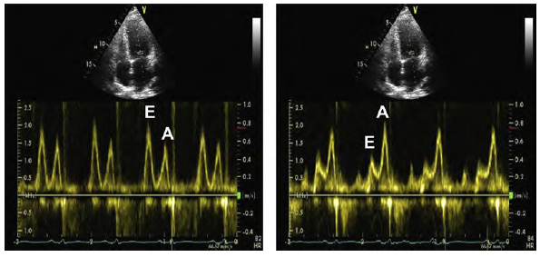

Slide 50
Grade 3 : (Severe Reversible) Reversible restrictive with high filling pressure.
markedly slowed relaxation and elevated LA pressure
E increases further, DT becomes very short, and e′ is further reduced and delayed resulting in a marked elevation of E/e
In severe diastolic dysfunction, the late diastolic annular velocity (a′) also may be reduced
Pulmonary venous flow shows diastolic predominance with prominent flow reversal.
Ar-A is prolonged (>30).
Reversibility.

Slide 51
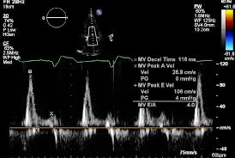

Slide 52
Grade IV
Irreversibly restrictive.
Preload manipulation no longer leads to improvement in filling pattern.
Maintaining precarious balance between volume overload and hypoperfusion can be difficult.

Slide 53
E/e′
most frequently used parameter to estimate LA pressure
LAP = (E/e´ x 1.25) + 1.9
found to correlate with pulmonary capillary wedge pressures (PCWPs)
>15 has been found clearly to indicate elevated PCWP
E/e′ less than 8 is associated with normal LA pressure
The cutoff value for E/e′ of 15 to recognize elevated LA pressure was obtained using e′ velocity from the medial mitral annulus
An average of the medial and lateral annular velocities has been recommended

Slide 54
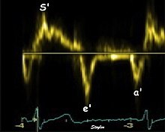
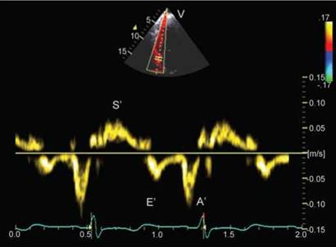
Tissue doppler – myocardial velocity

Slide 55
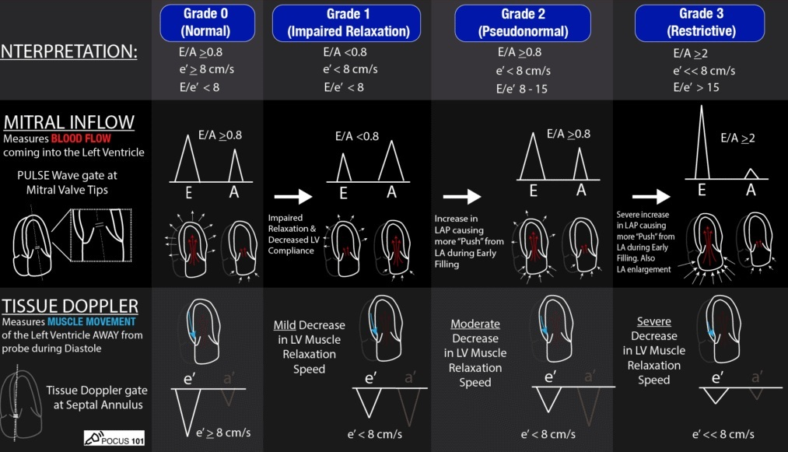

Slide 56
Identifying structural abnormality
LA Volume Index
Feasible and reliable
Bi Plane method
Apical 4-chamber and 2-chamber views -circunfernece in both views
Signifies cumulative effect of increased filling pressures –LA marker for diastolic dyfunction
Normal- 16-34 ml/m²
LA volume index >34 mL/m² is an independent predictor of death, heart failure, atrial fibrillation, and ischemic stroke in diastolic dysfunction
False results- Bradycardia, anemia and other high-output states, atrial flutter or fibrillation, and significant mitral valve disease.

Slide 57
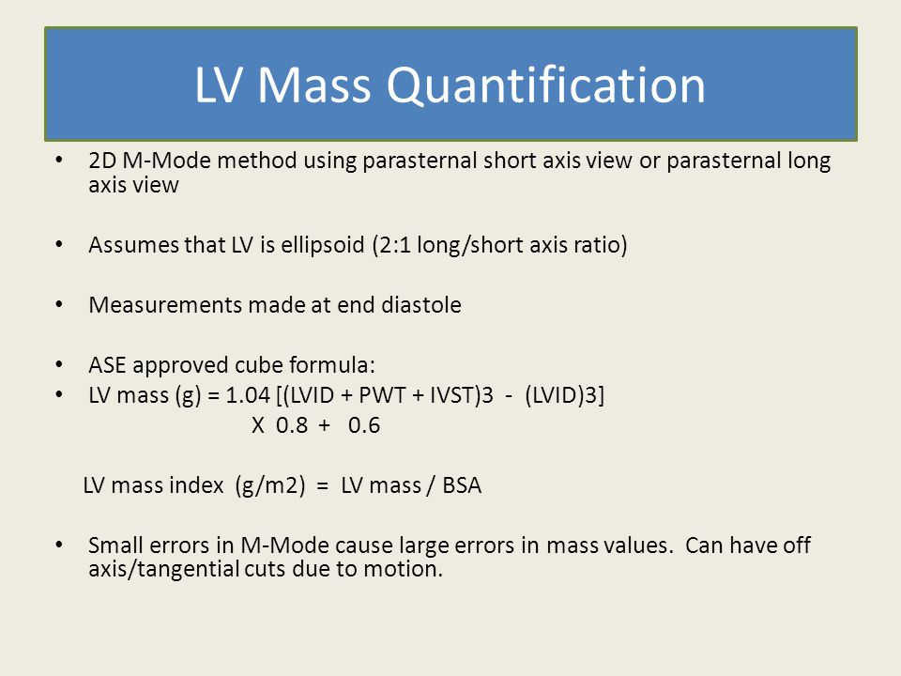
LVMI

Slide 58
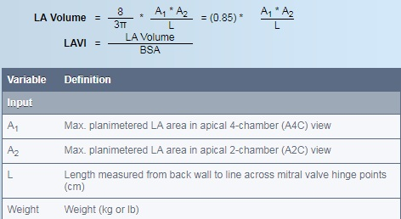
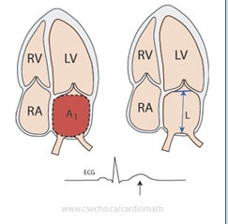
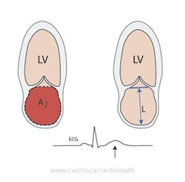

Slide 59
Surrogate Measurements Of LV stiffness
Transmitral flow propagation velocity (Vp)
Colour M-Mode Vp-
Measured during the early rapid filling phase of the left ventricle and is used to assess the active diastolic relaxation of the left ventricle.
M-Mode scan line is placed through the center of the LV inflow blood column from the mitral valve to the LV apex
Flow propagation velocity is measured as the slope of the first aliasing velocity during early filling, and is measured from the mitral valve plane to 4 cm distally into the LV cavity. Vp >50 cm/second is considered normal

Slide 60
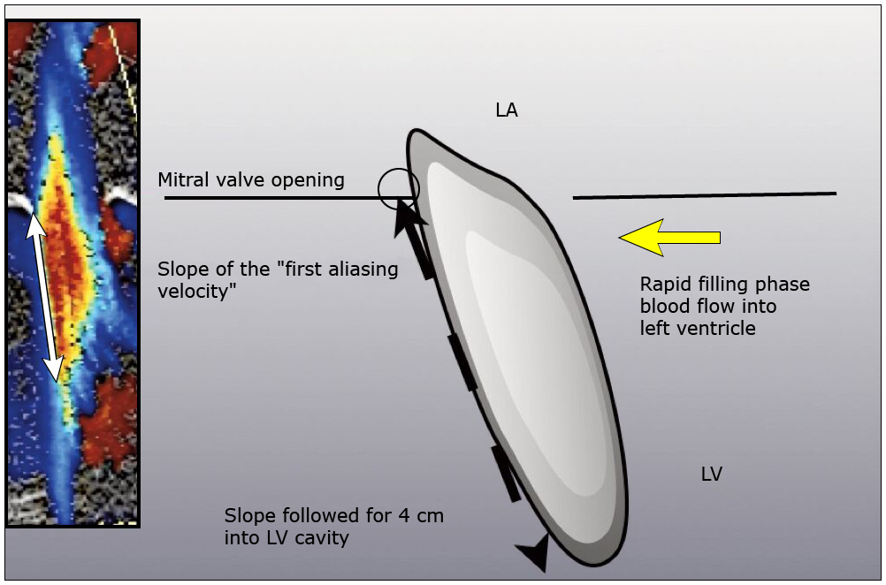

Slide 61
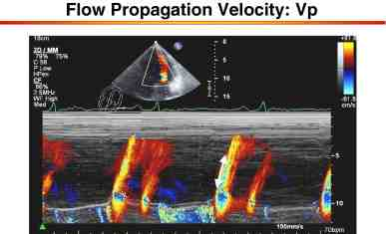
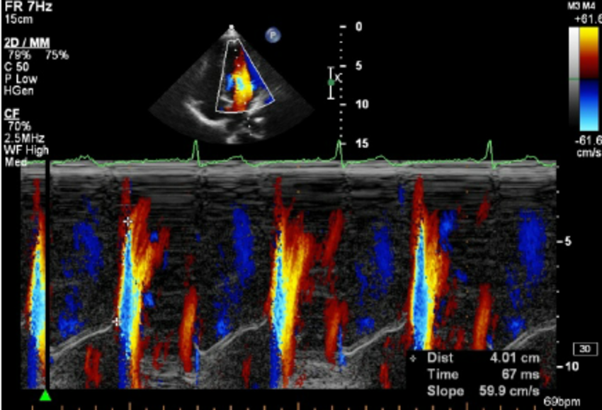

Slide 62
Step 5-If diagnosis in doubt
Diastolic stress test
Invasive pressure measurment-LVEDP >16 or PCWP>15

Slide 63
DIASTOLIC STRESS TEST
Detect reduced LV systolic and/or diastolic reserve capacity in the setting of diastolic dysfunction
Normal subjects: Increase stroke volume without significantly increasing filling pressures
HFpEF: Cannot augment myocardial relaxation with exercise compared with normal subjects.
Cardiac output achieved at the expense of increased LV filling pressures
Indicated when resting echocardiography does not explain the symptoms of heart failure or dyspnoea, especially with exertion
Most appropriate patient population for diastolic exercise testing is the group of patients with grade 1 diastolic dysfunction, which indicates delayed myocardial relaxation and normal LA mean pressure at rest.
TO FIND OUT CAUSE OF EXCERTIONAL DYSPNEA YOU SHOULD EXCERT THE PATIENT

Slide 64
DIASTOLIC STRESS ECHO

Slide 65
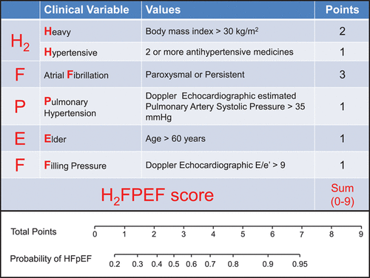
H2PEF diagnostic score
Score >5 likely , <1 unlikely , 2-4 uncertain

Slide 66
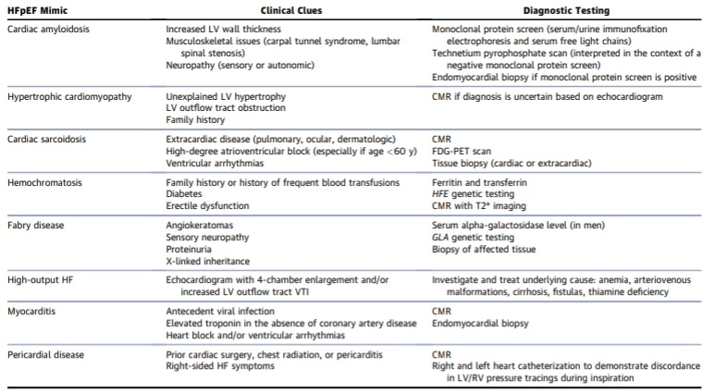
Mimickers – pathologic mechanisms distinctly different/ treatment targets+

Slide 67
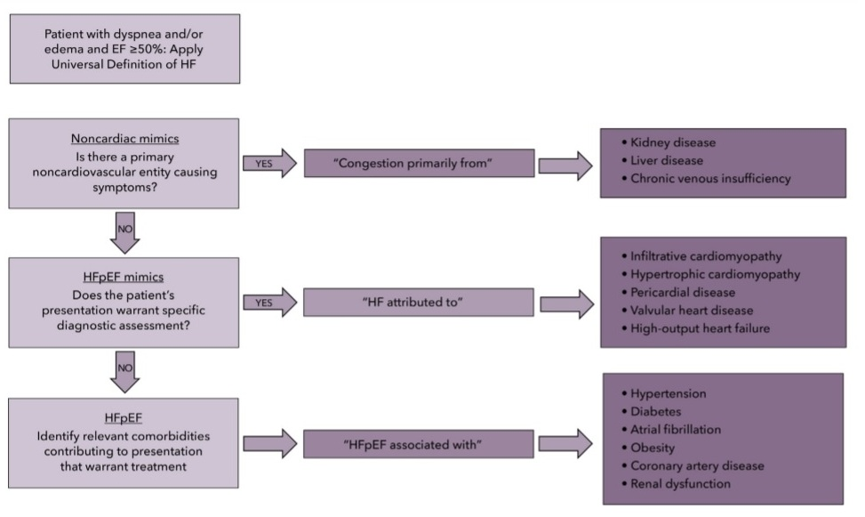
A careful approach

Slide 68
How to treat it?
MANAGEMENT OF HFpEF
1)Most important step –control syst htn <130/80(intensive control)
Haemodynamics of HFpEF poorly tolerant of increased afterload

Slide 69
2)Treatment/correction of associated comorbidity
A diseases initiated and driven by comorbidities
If CAD- revascularize
Target heart rate of 65-70 pereferably
AF patients should receive anticoagulation

Slide 70
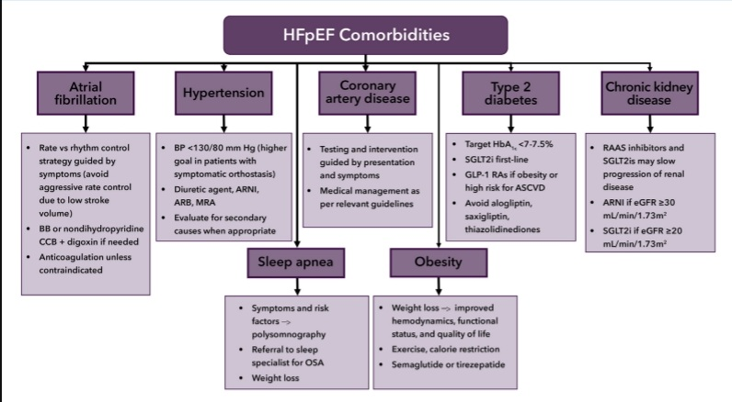

Slide 71
3) Superivsed exercise training
Only intervention shown to consistently improve exercise capacity and quality of life in HFpEF

Slide 72
4)Ensure correct volume status
Small amount of fluid loss – hypotension
Small amount of fluid increase – worsening dyspnea/pul edema
If requiring diuretics taper and adjust accordingly
THICK NON COMPLIANT VENTRICLE & REDUCED VENTRICULAR CAVITY SIZE

Slide 73
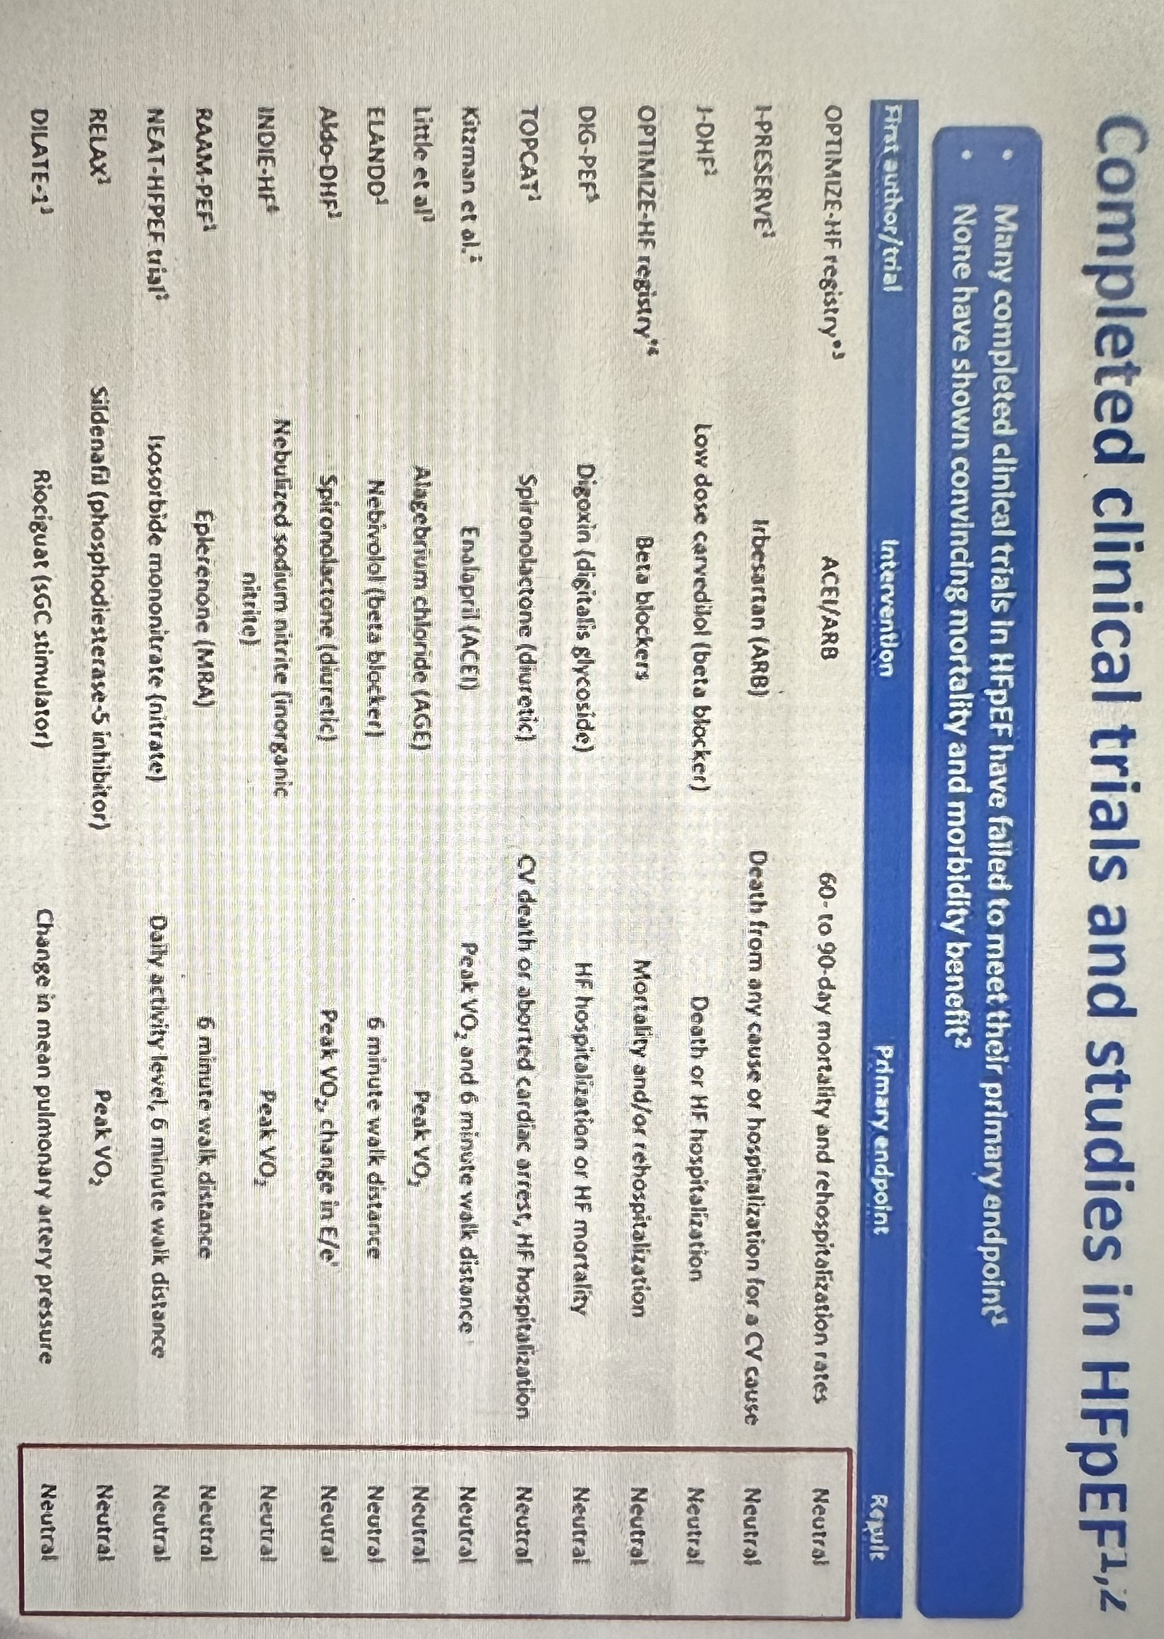
5)Specific pharmacotherapy

Slide 74
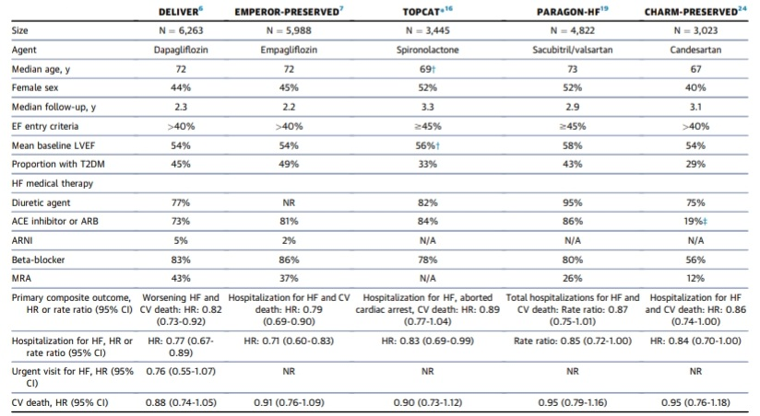

Slide 75
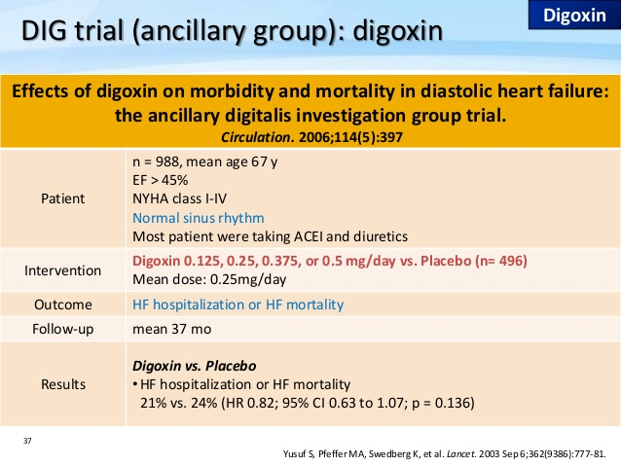
Notes:
digoxin did not alter the primary endpoint of HF-related hospitalization or CV mortality but did reduce the number of such hospitalizations.

Slide 76
Heart failure hospitalization or heart failure mortality
0
.
5
2-year
HR 0.71
95% CI 0.52-0.98
P=0.034
0
.
4
0
.
3
% Events
0
.
2
Placebo
Overall
HR 0.82
95% CI 0.63-1.07
P=0.136
0
.
1
Digoxin
0
.
0
0
1
2
2
4
3
6
4
8
Months
CV Hospitalization or Mortality NO DIFFERENT
↑ in Unstable Angina
Ahmed A et al, Circ, 2006

Slide 77
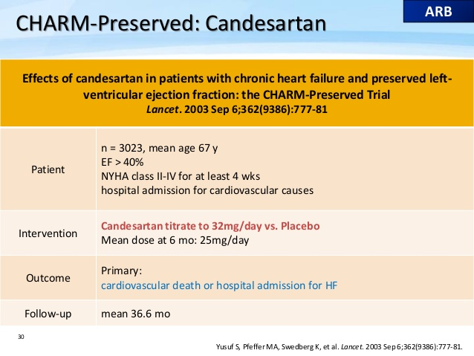

Slide 78
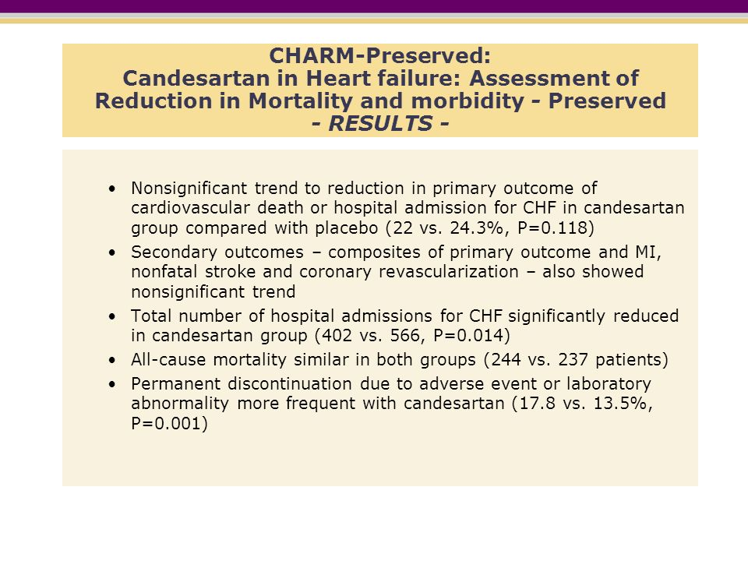
Notes:
reduced hospitalization

Slide 79
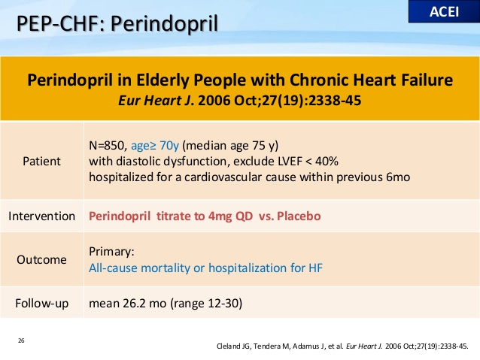

Slide 80
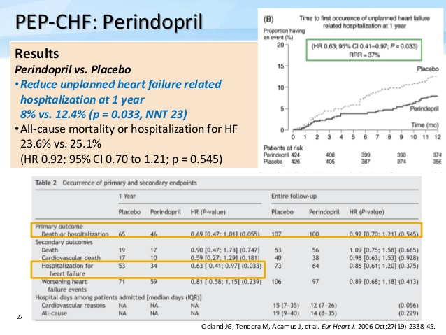

Slide 81
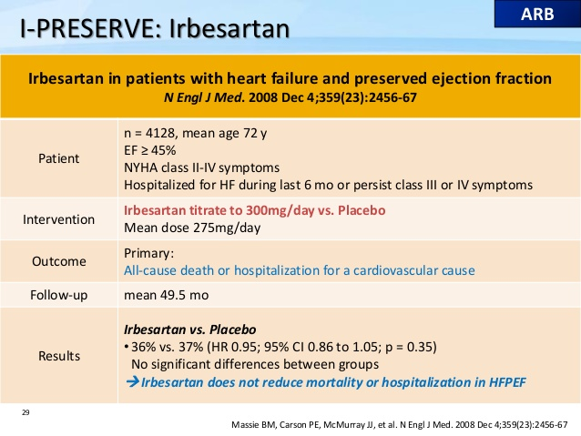

Slide 82
HEAT HFPEF
Background
Nitrates are commonly prescribed to enhance activity tolerance in patients with heart failure and a preserved ejection fraction. We compared the effect of isosorbide mononitrate or placebo on daily activity in such patients.
Methods
In this multicenter, double-blind, crossover study, 110 patients with heart failure and a preserved ejection fraction were randomly assigned to a 6-week dose-escalation regimen of isosorbide mononitrate (from 30 mg to 60 mg to 120 mg once daily) or placebo, with subsequent crossover to the other group for 6 weeks. The primary end point was the daily activity level, quantified as the average daily accelerometer units during the 120-mg phase, as assessed by patient-worn accelerometers. Secondary end points included hours of activity per day during the 120-mg phase, daily accelerometer units during all three dose regimens, quality-of-life scores, 6-minute walk distance, and levels of N-terminal pro–brain natriuretic peptide (NT-proBNP).
Results
In the group receiving the 120-mg dose of isosorbide mononitrate, as compared with the placebo group, there was a nonsignificant trend toward lower daily activity (−381 accelerometer units; 95% confidence interval [CI], −780 to 17; P=0.06) and a significant decrease in hours of activity per day (−0.30 hours; 95% CI, −0.55 to −0.05; P=0.02). During all dose regimens, activity in the isosorbide mononitrate group was lower than that in the placebo group (−439 accelerometer units; 95% CI, −792 to −86; P=0.02). Activity levels decreased progressively and significantly with increased doses of isosorbide mononitrate (but not placebo). There were no significant between-group differences in the 6-minute walk distance, quality-of-life scores, or NT-proBNP levels.
Conclusions
(Patients with heart failure and a preserved ejection fraction who received isosorbide mononitrate were less active and did not have better quality of life or submaximal exercise capacity than did patients who received placebo.

Slide 83
STATINS
Statins, as anti-inflammatory agents : first-line therapy in CAD and hyperlipidemia
CORONA (Controlled Rosuvastatin Multinational Trial in Heart Failure) trial : neutral regarding the efficacy of statins in patients with HFREF.
Fukuta et al: significant relative risk reduction in mortality in HFPEF (LVEF > 50%) pts with statin for 21months.
270 patients with HFPEF, follow-up for 5 years - improved survival compared to patients without statin therapy (HR= 0.65; 95%CI: 0.45-0.95, P = 0.029). - survival benefit was maintained after adjusting for differences in baseline characteristics, comorbidities, and other medications
Some small observational studies : seems to be associated with improved survival benefit in pts with HFPEF

Slide 84
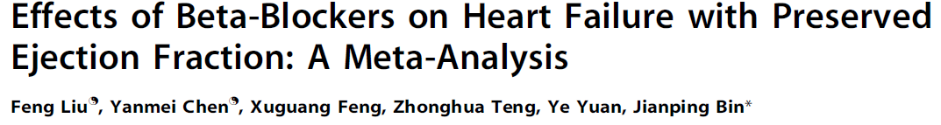
12 clinical studies
21,206 paients with HFpEF
9% reduction in relative risk for all-cause mortality in patients with HFpEF (95% CI: 0.87 – 0.95; P , 0.001)
all-cause hospitalization, HF hospitalization and composite outcomes (mortality and hospitalization) were not affected by this treatment (P = 0.26, P = 0.97, and P = 0.88 respectively)

Slide 85
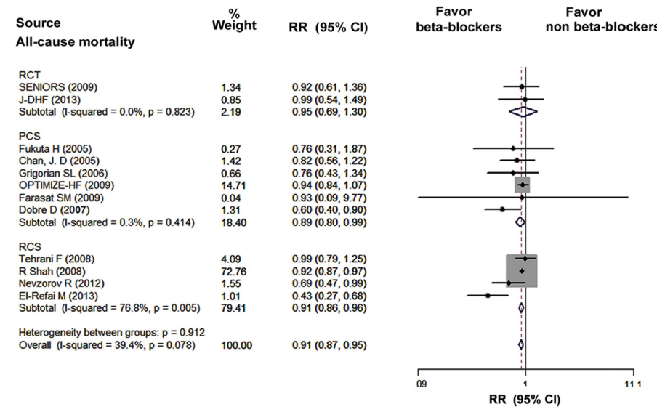

Slide 86
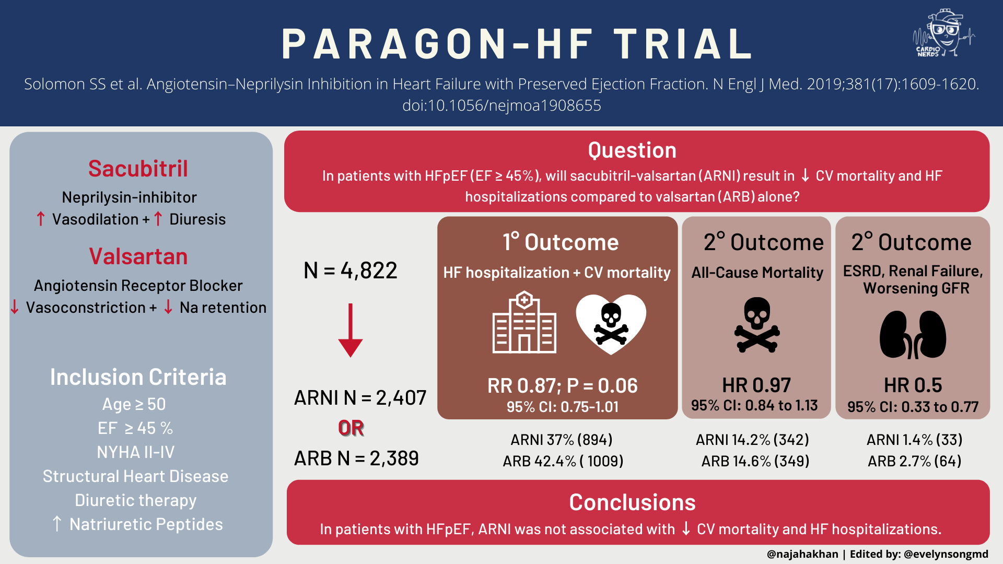

Slide 87
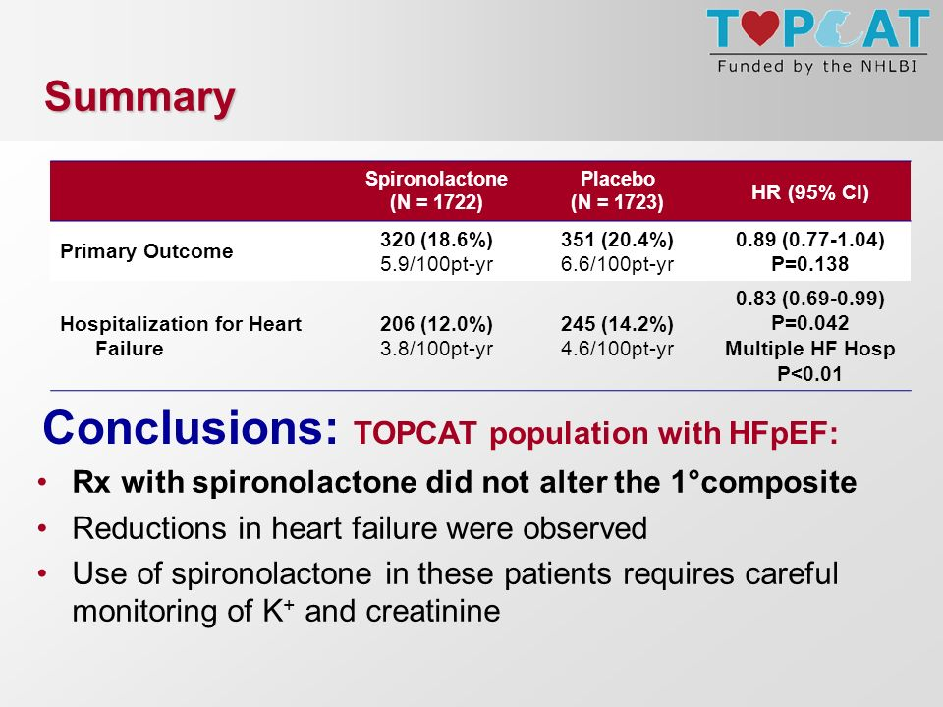

Slide 88
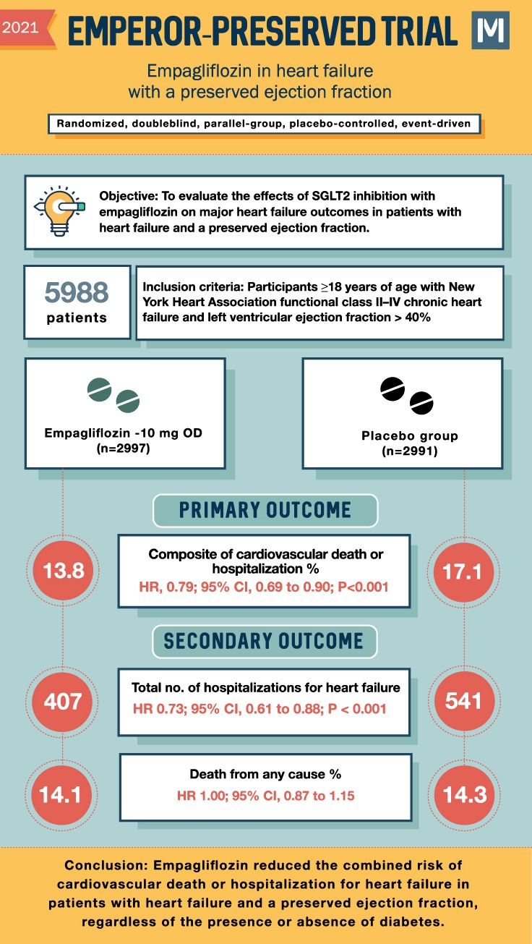

Slide 89
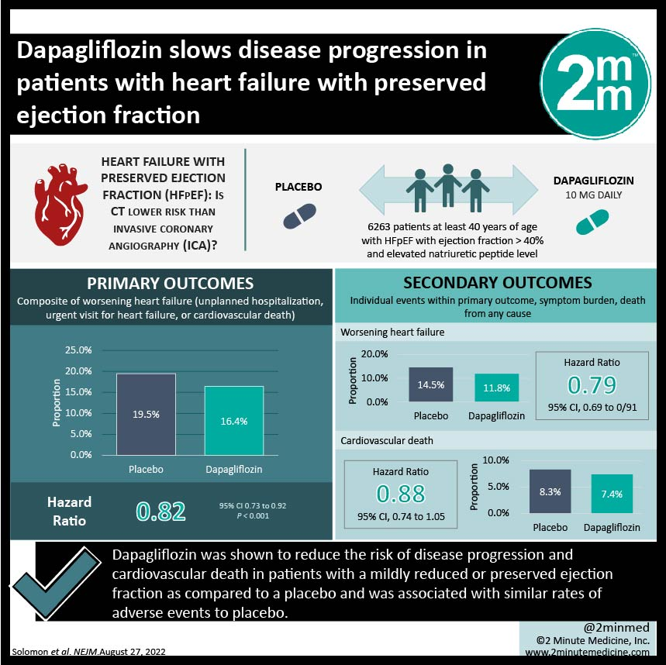
DELIVER Trial

Slide 90

Notes:
active treatment arm demonstrated a 152% decrease in pulmonary artery diastolic and systolic pressures and a 52% decrease in HF-related events (both P < 0.0001 and control) and a decrease in CV mortality rate

Slide 91



Slide 92
Common causes of precipitants of ADHF in HFpEF
1)Exercise
2)AF
3)Increase in afterload/preload
4)CAD

Slide 93
Take home messages
HFpEF is a complex heterogenous disease
HFpEF is not an inferior form of HF
HFpEF patients tolerate increase in volume and pressure poorly
Avoid therapeuatic inertia- balanced rx
Aggressive control of HTN
LA dilation in absence of MV disease think diastolic dysfunction
Unexplained TR think diastolic dysfunction
Insist of E/e’ in every echo

Slide 94
Previous questions asked
1)Echo assessment of LV diastolic dysfunction (Sep 20)
2)Pathophysiology of duastolic heart failure (July 15)

Slide 95

THANK YOU

