Slide 1
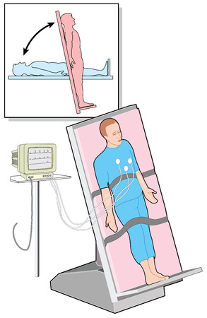
Head-up tilt test
Dr Arun Jude Alphonse
Dept of Cardiology
Govt Medical College, Alappuzha

Slide 2
Discussion
Introduction – Syncope and how to go about it
HUTT –
1)Pathophysiology
2)Indications
3)Prerequisite
4)Procedure
5)Interpretation of a positive test
6)Complications

Slide 3
Syncope is a transient LOC due to transient global cerebral hypoperfusion characterized by
rapid onset, short duration, and spontaneous complete recovery

Slide 5
How to go about in a scenario of TLOC

Slide 6
Pathophysiology
Reproduction of a neurally mediated reflex in laboratory setting
Redistribution of up to 1000 ml of blood from the central cardiovascular compartment to the capacitance vessels of the lower limbs
This leads to a progressive fall in venous return, which may be excessive in patients predisposed to vasovagal syncope

Slide 7
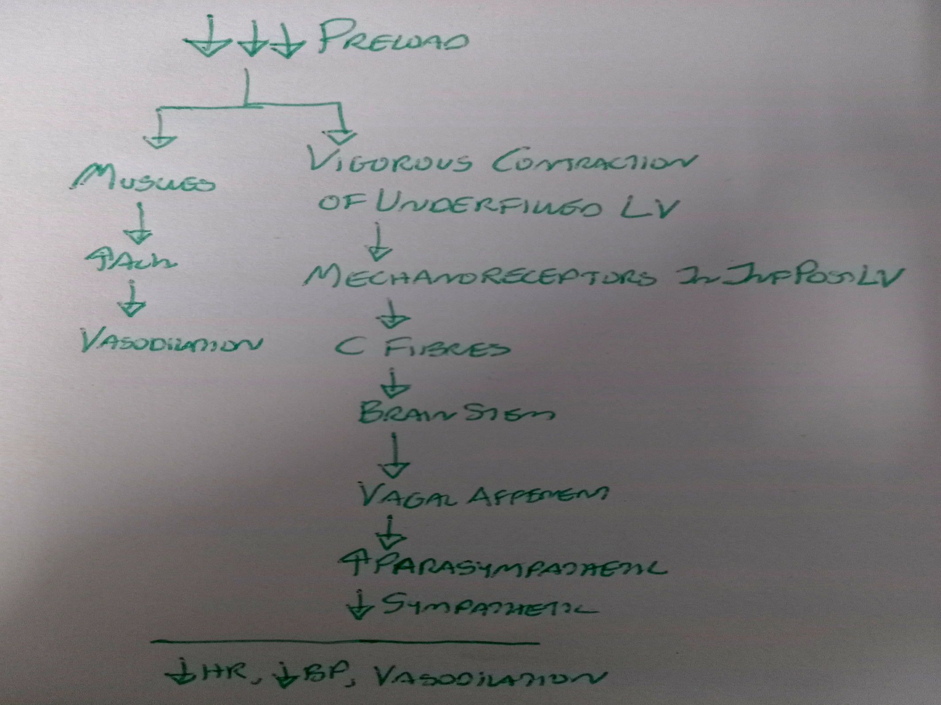

Slide 8
Redistribution of blood is directly related to the sine of the angle of tilt,which rises in an approximately linear fashion between 30° and 60° but changes very little at angles beyond 60°
There is a “plateauing” of haemodynamic effects at 60°Positive in various types of reflex syncope due to prolonged standing
May also be positive in
Sick sinus syndrome
Other classes of reflex syncope

Slide 9
Indications
Unexplained syncopal episode in the absence of organic heart disease after cardiac causes have been ruled out
To demonstrate susceptibility of reflex syncope to the patient
Class II indications
Reflex vs OH
Syncope with jerky movements vs Epilepsy
Recurrent unexplained falls
In psychiatric diseases

Slide 10
Not recommended for assessment of treament

Slide 11
Pre requisites
3 hours fasting
Quiet and with dim lights
Tilt table should be able to achieve the upright position smoothly and rapidly and to reset to the supine position quickly (<10 s)
Foot-board support
Experienced nurse or medical technician in person
a physician is in proximity and immediately available if needed

Slide 13
Procedure
Various protocols are available
First developed by Kenny et al in 1986
Supine pre tilt phase of atleast 5mins, 20 mins if venous cannulation
Tilt angle between 60-70 degrees (ESC 2001 & 2009) or 70degrees (AHA 2017)
Pre drug Tilt duration of 20 – 45 mins
45 mins did not increase sensitivity and specificity compared to 20 mins

Slide 14
Use of ether intravenous isoprenaline or sublingual nitroglycerin for drug provocation if passive phase has been negative
Isoprenaline to increase heart rate 20-25%from baseline
Nitroglycerin (a fixed dose of 400 mcg sublingual spray) sublingually administered in the upright position
Isoprenaline and NTG did not differ much in responses but adverse effects were more with isoprenaline

Slide 15
Other agents that has been used
Iv NTG
Isosorbide dinitrate
Adenosine
Post drug tilt duration of 20 mins
Terminated with induction of syncope/ presyncope or completion of the planned duration of tilt including drug provocation

Slide 16
Ideally requires continuous beat-to beat finger arterial BP measurement
Manual intermittent measures using a sphygmomanometer are acceptable and should be performed within short intervals
A carotid sinus massage may be done during the passive tilt ..increased sensitivity in persons aged > 40yrs

Slide 17
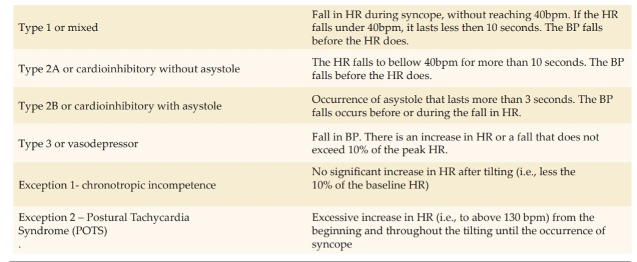
Positive response to heald tilt- How to classify?

Slide 19
In persons with psychogenic syncope symptoms will occur in the absence of fall in BP and HR
VVS with convulsive fainting can aslo be diagnosed in which instead of syncope patients have prodrome followed by seizures

Slide 20
Complications
A very safe procedure if done after exculsion of cardiac causes of syncope
One reported VT with isoprenaline (h/o MI, CAG 99% LCx lesion)
One reported case of AF in british study (n=1900)
One reported case of asystole of 72 seconds resuscitated successfully

Slide 21
Asystole during the tilt is easily reversible with reversal to supine position or trendelenberg position

Slide 22
THANK YOU

