Slide 1
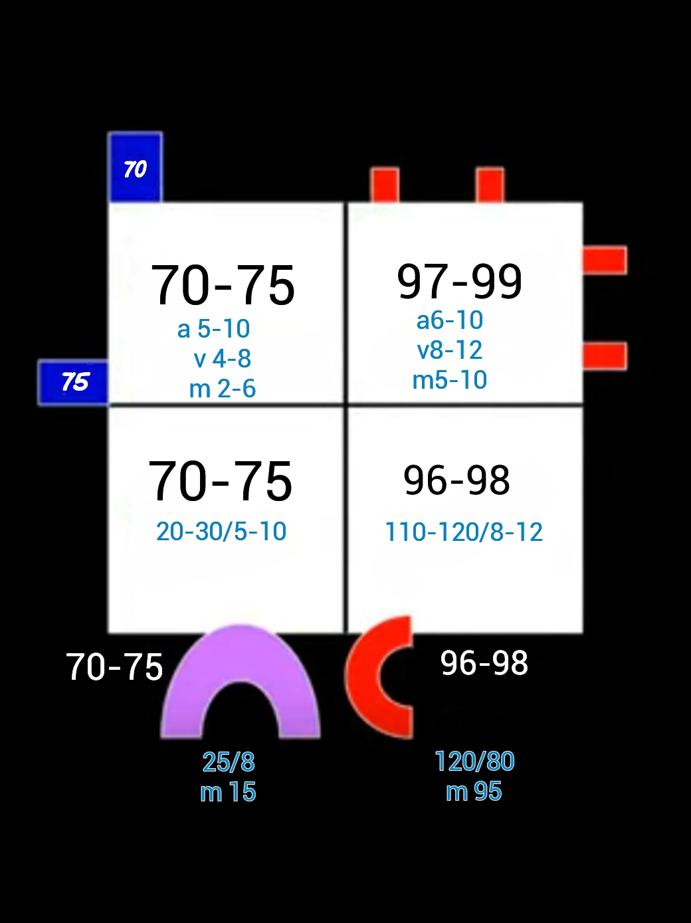
Hemodynamics – Basic principles & Interpretation of oximetry and pressure data Part 1
Dr Arun Jude Alphonse
DM Cardiology Resident
Govt TDMC Alappuzha

Slide 2
Cardiac cycle
Electromechanical delay

Slide 4
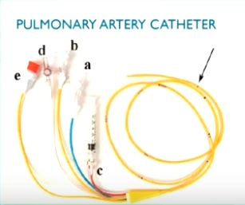
Methods
End hole catheters(Swan Ganz(100-110cm long , 3-4 lumens..balloon floatation catheter/CO2) or side hole close to tip catheters(Goodale-lubin(endhole+sidehole)/
NIH catheter(side hole close to tip)
Under flouroscopic control
Confirmed by pressure trace

Slide 5
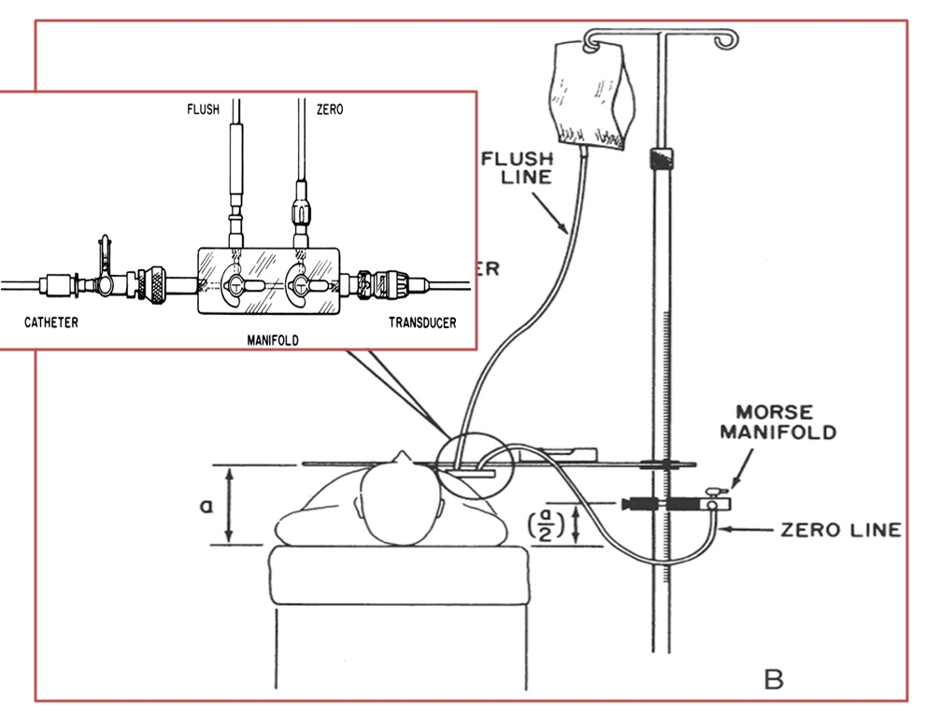
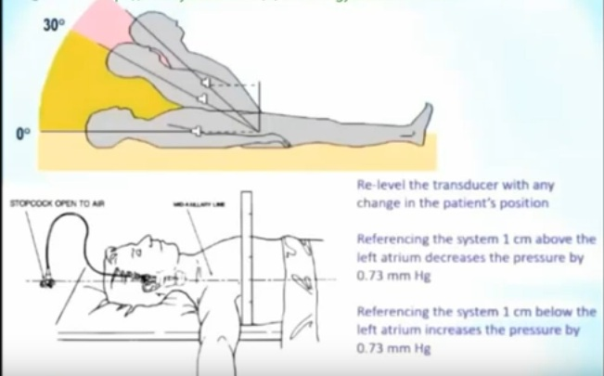

Slide 6
2ml samples from each site sequentially
Steady state
Entire data in less than 7mins
Withdrawal values better than ingoing
Repeated samples better than single sample

Slide 8
Normal haemodynamics
IVC(above renal)>SVC/IVC(below renal)>Coronary sinus(26%)

Slide 10
02 consumption(emperical formula) -3.5ml/min x kg /125 X BSA
Total uptake or release of a substance by an organ is the product of the blood flow through that organ and the arteriovenous concentration difference of the substance.

Slide 12
Definitions

Slide 13
Understand with TGA

Slide 18
Oximetry run

Slide 19
PV to LA >2% drop significant
LA(bronchial veins draining) LV(thesbian veins draining)
Left side >2% drop with spo2 <92% significant

Slide 20
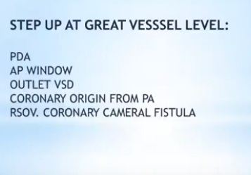

Slide 21
Step down

Slide 23
Polyphasic deflections(low pressure) in a single cardiac cycle –atrial/venous wave form

Slide 24
LA wave form

Slide 25
Why is the left atrial “v” wave taller than right atrial “v”wave ?
V waves are passive atrial filling waves and are timed during ventricular systole .Left atrium is relatively thick stiff , less compliant chamber
Apart from relative thinness,right atrial volume is more , hence it can accommodate more volume without raising its pressure .
The left atrium is decompressed by relatively stiff pulmonary veins with a mean pressure of 8 mmhg , can not adequately dampen the refluxing tides of v waves , while the low pressure vena cava of RA dampen the right atrial v waves with ease .
Further ,the adjoining systemic left ventricle , adds up to the stiffness of left atrial filling .
Thickness of RA -2mm, LA -3mm

Slide 26
RV vs LV curve

Slide 27
RV vs LV curve
RV pressure curve is triangular in shape,
Upstroke is not rapid , (Low dp/dt)
There is no sustained peak ,
There is an early fall and
The pressure falls to zero which never happens in LV
RV crossover points slightly later than LV
The shapes of RV curve will change in pathological states.Example in TOF, large VSD there will be left ventricularisation of RV pressure wave forms. Also in pulmonary hypertension RV pressure may mimic a LV curve.

Slide 29
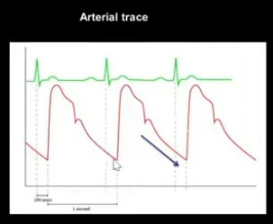
Ventricular vs arterial curve

Slide 30
Ventricular vs arterial curve
End diastolic pressure vs diastolic blood pressure
Pressure rises in diastole vs pressure falls in diastole
Pressure wave rises slighlty later in arterial curve(after IVC phase)

Slide 31
Pull back tracing

Slide 32
Pressure tracings

Slide 33
Vent diastole

Slide 34
Abnormal pressure gradients
Across TV – more than 1mm hg
Across MV- more than 2 mm hg
Across PV – more than 5 mm hg
Across AV - more than 10 mm hg

Slide 37
Whenever faced with an haemodynamic analysis always draw this(keep it in mind)
Whenever faced with an hemodynamic analysis
always draw this(keep this diag in mind) and analyse

Slide 38
Look at SVC saturation first -?normal or low.
.if low?HF/systemic deaturation
PA and Aorta saturation
(PA>N..L-R shunt, AO<N..R-L shunt,
PA>>A0-Transposition ,PA=AO-Admixture)
Step up or step down at any level—proximal to distal
RA pressures..?sinus rhythm or not
Diastolic pressure gradient across TV/PV/MV
Systolic gradient across RV/PA, LV/AO
Compare pressures in each chamber with proximal, distal and adjacent chamber
SYSTEMATIC ANALYSIS STEPWISE MORE IMPORTANT
THAN AN ABSOLUTE DIAGNOSIS

Slide 40
Questions

Slide 41
Look at saturation first
Significant step up at RA –
ASD,Single atria ,TAPVC,PAPVC,Gerbode VSD,
RSOV to RA,Coronary Fistula to RA,VSD with TR
?PS – unlikely ,higher mPAP, likely due to increase volume overload in RA/RV(RV –PA gradient upto
40mm hg difference can be present with L-R shunt)
With clinical scenario likely –PAPVC with intact septum

Slide 42
Q2)Identify the tracing List the hemodynamic information gathered Propable diagnosis

Slide 43
Simultaneous tracing of LV and Ao
Elevated Lv peak systolic pressure
Significant LV-Ao systolic pressure gradient(peak to peak and peak instantaneous)
Delay in peak aortic pressure-slow rising low intensity aortic pressure curve-pulsus parvus et tardus
Elevated LVEDP/Prominent a wave
LV dp/dt maintained-fair LV systolic function
Severe Aortic stenosis with preseved LV systolic function

Slide 44
Q3)Diagnosis?

Slide 45
Significant step up at RV –
VSD(Restrictive/Non restrictive),low ASD,
RSOV to RV,Coronary fistula to RV,PDA with PR
Size decides the pressure
Likely restrictive VSD with L-R shunt
?Qp/Qs - 99-65/99-76=1.4

Slide 46
Q4)Diagnosis and why?

Slide 47
Intraventricular gradient with no valvular gradient with spike and dome pattern in aortic pressure tracing
HOCM

Slide 49
Q5)Diagnosis?

Slide 50
VSD with L-R shunt
Mild-moderate PAH
Qp/Qs -2.2
LV failure or Eissenmenger more likely?

Slide 51
Q6)Identify the sign and diagnosis

Slide 52
Brockenbrough-Braunwald-Morrow sign – failure of pulse pressure to rise following an ectopic beat
normally pulse pressure rises following ectopic beat – DBP falls due to longer diastolic runoff time,Lv peak systolic pressure same(contractility increases not LVESP)
Aortic pressure tracing shows spike and dome pattern
HOCM

Slide 53
Q7)Diagnosis?

Slide 54
LARGE VSD with bidirectional shunt
Why was values taken aften 02?
Qp/Qs -1.4 to 4.5
PVR - 6.6 to 2.5
Still operable

Slide 55
Q8)Normal or abnormal response?

Slide 56
Normal post ectopic response –LV peak systolic pressure same(high resistance circuit) ,RV peak systolic pressure rises(low resistance circuit)

Slide 59
Q10)Diagnosis?

Slide 60
Moderately restrictive VSD with RVOTO
(gradient more than 40 and lower mPAP)
?TOF –unlikely no RV/LV pressure equalization

Slide 61
Q11)Identify the propable clinical findings from thid hemodynamic tracing and appropriate diagnosis?

Slide 62
Loud S1 (MV closes at higher dp)
Low pitch Decrescendo crescendo diastolic murmur(shape of murmur goes along with shape of pressure gradient..pan diastolic gradient between LV and LA-Max in rapid filling phase then comes down slowly again rises up in atrial systole..LA empties slowly and LV fills slowly in diastole)
Opening snap,Short A2-0S interval
If TS –slow y descent (JVP)
Severe Mitral Stenosis

Slide 63
Q12)Diagnosis?

Slide 64
Step up at RV with reduced Aortic DBP
Restrictive VSD with AR
?RSOV to RV

Slide 65
Q13)Identify hemodynamic findings and propable diagnosis?

Slide 66
Elevated LV peak systolic pressure and LVEDP –
Eleavted Aortic SBP and low DBP with wide pulse pressure
Chronic Severe AR (A/C AR SBP wont be high)

Slide 67
Q14)Identify hemodynamic findings and propable diagnosis?

Slide 68
Normal LV peak systolic pressure , rapid rise and plateuing of LVEDP
Normal Aortic SBP(equal to LV peak systolic pressure) ,low DBP and equalization of DBP to LVEDP (Aortic valve remains open till end of systole)
LVEDP-LA gradient
Acute Severe AR with diastolic MR with heart failure (MV may close in diastole itself..soft S1)

Slide 69
Q15)Diagnosis?

Slide 70
Significant step up at mid & low RA with PAH-
Gerbode VSD ,
Coronary AV fistula to RA,RSOV to RA,Non resitrictive ASD

Slide 71
Q16)Diagnosis?

Slide 72
Step up at PA
Moderate size PDA with L-R shunt Qp/Qs -2:1
?Coronary fistula to PA, RSOV to PA,
Outlet VSD

Slide 73
Q17) Identify hemodynamic findings ,auscultatory findings and propable diagnosis?

Slide 74
Elevated v wave upto IVR with elevated LVEDP with preserved LV systolic function
Acute severe MR with preserved LV systolic function with heart failure

Slide 75
ESM-PSM-ESM High pitch blowing LV S3

Slide 76
Q18)Diagnosis?

Slide 77
Admixture physiology at RA
Higher SVC saturation
RAP=LAP with no PAH
Supracardiac nonobstructive TAPVC
(If gradient between LA & RA or at PV-Obstructive)

Slide 78
Q19)Diagnosis?

Slide 79
Systolic gradient between RV and MPA
Valvular PS

Slide 80
Q20)Diagnosis?

Slide 81
Pulmonary artery-artery systolic gradient with elevated pulmonary artery sytolic pressure and normal paedp with wide pulse pressure
Pulmonary artery stenosis

Slide 82
Q21)Diagnosis?

Slide 83
Systemic desaturation starting at PV
Pulmonary AV Malformation/Fistula
?Parenchymal/ILD

Slide 84
Q22)Auscultatory finding?

Slide 85
Continous murmur

Slide 86
Q23)Diagnosis?

Slide 87
Systemic desaturation starting at LA
Systemic venous drainage to LA
?Unroofing of croonary sinus to LA

Slide 88
Q24)Diagnosis

Slide 89
CCP-prominent y descent

Slide 91
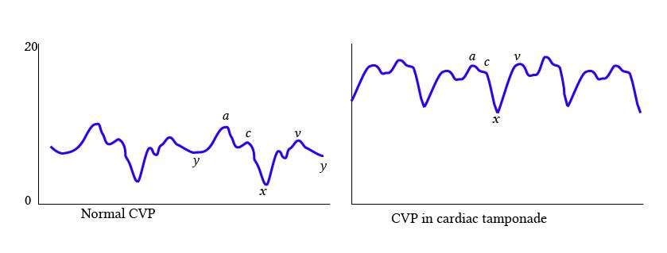

Slide 92
Q25)Diagnosis?

Slide 93
Step up at RV + step down at LV
RVOTO
Non restrictive VSD with pulmonary stenosis

Slide 94
Q26)Identify the finding and what will you do next?

Slide 95
Ventricularized pressure –flat diastole with prominent a wave(propable LMCA disease)
Pull back the catheter-disengage from LMCA

Slide 96
Q27)Diagnosis?

Slide 97
Step up at RA
Increased RAP/Lower Aortic DBP
RSOV to RA

Slide 98
Q28)Identify the marked 2 waves and identify the clinical scenario?

Slide 99
Low arterial systole with balloon assisted diastole

Slide 100
Q29)Interpret the tracing and propable diagnosis

Slide 101
LV-Ao systolic gradient
With JR – SR gradient reduces(Atrial filling-LV cavity size increases-obstruction reduces)
Aortic pressure curve rapid rise and plateau
HOCM

Slide 112
DD – Ebstein,s

Slide 116
PDA Eissenmenger

Slide 117
Q36) Diagnosis?

Slide 118
Normal tracing

Slide 119
Cath study 9 month old with cyanosis-Interpret?

Slide 120
THANK YOU

