Slide 1
Heparin-Induced Thrombocytopenia
Dr Aswin Narendran

Slide 2
Heparin-induced thrombocytopenia (HIT) is characterized by a decrease in the platelet count of more than 50% from the highest platelet count value after the start of heparin, an onset 5 to 10 days after the start of heparin, hypercoagulability, and the presence of heparin-dependent, platelet-activating IgG antibodies.

Slide 3
In contrast to other conditions caused by enhance consumption, impaired production, or destruction of platelets, which lead to bleeding complications, immune-mediated heparin-induced thrombocytopenia (HIT) does not induce bleeding but rather results in a paradoxical prothrombotic state.
HIT occurs in approximately 1 in 5000 hospitalized patients. Patients who receive unfractionated heparin for 7 to10 days are at the highest risk; incidence rates of 1 to 3% have been reported after cardiac surgery.

Slide 4
Thromboembolic complications develop in approximately 50% of patients with confirmed HIT. Venous thrombosis of the large vessels of the lower limbs and pulmonary embolism are the most frequent complications, followed by peripheral arterial thrombosis and then stroke; myocardial infarction is uncommon.
Thrombotic complications may also affect other vessels, including the cerebral sinus or splanchnic veins.

Slide 5
These patients can present with thrombosis up to 3 weeks after the start of heparin exposure.
Note that in some cases, a single heparin bolus is sufficient to induce the syndrome, so the start of heparin is the only fixed time point.
A rare but often catastrophic form of HIT is spontaneous, or autoimmune HIT, which develops in the absence of heparin exposure, most often after major surgery (especially knee replacement) or recent infection.
In contrast to typical HIT, in which the platelet count increases within 2 to 5 days after the start of an alternative anticoagulant, autoimmune HIT may persist for weeks.

Slide 6
The onset of HIT –5 and 10 days after heparin is started
Both in patients who receive heparin for the first time and in patients with reexposure.
Exceptions are there
1.Major surgery resets the clock (i.e., the window of 5 to 10 days restarts), even if the patient has recently received heparin (e.g., HIT can develop 5 to 10 days after surgery in patients who have been undergoing hemodialysis for a long time).
2. In persons who have received heparin within the previous 90 days (especially, ≤30 days), there may be persistent circulating anti–platelet factor 4 (PF4)–heparin antibodies, and HIT can start abruptly on reexposure to heparin (rapid-onset HIT);
In this case, HIT is complicated by an anaphylactoid reaction within 30 minutes after a heparin bolus.

Slide 7
Normally, HIT occurs, once the typically transient antibodies have disappeared (median, 50 to 85 days), POST exposure to heparin, since the regeneration of antibodies requires at least 5 days.
In some patients, HIT develops or worsens after heparin has been discontinued (delayed-onset HIT).
The platelet count starts to rise within 2–3 days and usually returns to normal within 4–10 days after cessation of heparin treatment, and it takes another 2–3 months for antibodies to disappear.

Slide 8
TYPES
Type I
associated with an early (within 4 days) and usually mild decrease in platelet count (rarely <100 x 10⁹/L)
typically recovers within 3 days despite continued use of heparin
nonimmunologic mechanisms (mild direct platelet activation by heparin)
not associated with any major clinical sequelae
occurs primarily with high dose iv heparin

Slide 9
Type II
substantial fall in platelet count (> 50%)
count in the 50,000 - 150,000 /mm range
typical onset of 4-14 days
occurs with any dose by any route
induced by immunologic mechanisms
rarely causes bleeding (think of alternative Dx)
potential for development of life-threatening thromboembolic complications

Slide 10
It has recently been proposed that the term “HIT type I” be changed to “non‐immune heparin associated thrombocytopenia” and that the term “HIT type II” be changed to “HIT” to avoid confusion between the two syndromes

Slide 11
Pathogenesis
HIT is induced by IgG antibodies recognizing neoepitopes on the positively charged chemokine PF4 within PF4–polyanion complexes
The resulting immune complexes cross-link Fcγ receptors on platelets (Fcγ RIIa) and monocytes (Fcγ RI), thus activating them.
Further enhanced by the alteration of endothelial cells, the activation of platelets and monocytes increases thrombin generation. Increased thrombin, not thrombocytopenia, causes the clinical problems.
In addition to binding heparin, PF4 binds other polyanions, such as nucleic acids and lipopolysaccharides on bacteria. This phenomenon may explain cases of spontaneous HIT after major surgery (causing DNA, RNA, or glycosaminoglycan release) or bacterial infection.

Slide 12
Anti-PF4–heparin antibodies are produced by B cells (probably marginal-zone B cells),which can mediate a transient antibody response.

Slide 13
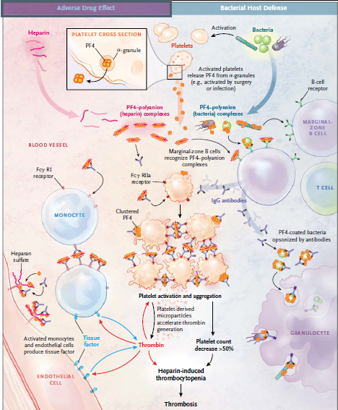

Slide 14
Risk of HIT
The risk of HIT depends on the type of heparin and the patient population.
The incidence is up to 10 times as high among patients receiving unfractionated heparin as it is among those receiving low-molecular-weight heparin
HIT occurs more frequently among patients who have had major surgery than among those who have had minor surgery or are receiving medical therapy.
HIT is rare in obstetrical patients, although in contexts other than pregnancy, women are at slightly higher risk than men.

Slide 15
COMPLICATIONS
HIT is strongly associated with thromboembolic complications which can be venous, arterial, or both, and include deep venous thrombosis, pulmonary embolism, myocardial infarction, thrombotic stroke, and occlusion of limb artery requiring amputation.
Deep vein thrombosis and pulmonary embolism occur more frequently in postoperative patients.
The presence of a central venous catheter is associated with increased upper‐extremity venous thrombosis.
Thrombosis of the cerebral venous sinuses and disseminated intravascular coagulation has also been reported.
In contrast, arterial thrombosis occurs more frequently than venous thrombosis in HIT patients receiving heparin for cardiovascular diseases.

Slide 16
Other complications of HIT include necrotising skin lesions at the injection site in 10–20% of patients
Acute systemic reactions, characterised by fever, chills, hypertension, tachycardia, chest pain and dyspnoea, in up to 25% of patients with circulating HIT antibodies.
Thrombosis in HIT is associated with a mortality of approximately 20–30%, with an equal percentage of patients becoming permanently disabled by amputation, stroke or other causes.

Slide 17
Diagnosis
The diagnosis of HIT is based on a decrease in the platelet count of more than 50% or thrombosis beginning 5 to 10 days after the start of heparin, in association with the appearance of platelet-activating HIT antibodies, as shown by means of a functional assay or inferred by means of a strong positive immunoassay.
The fall in platelet count in HIT occurs rapidly (over a period of 1 to 3 days) and is assessed relative to the highest platelet count after the start of heparin.
The typical nadir is 40,000 to 80,000 platelets per cubic millimeter,
But the count may remain in the normal range (e.g., a decline from 500,000 to 200,000 per cubic millimeter).

Slide 18
In less than 10% of patients, the decrease in platelet count is less pronounced (30 to 50% of the highest preceding value).
Rarely, the platelet count may fall below 20,000 per cubic millimeter, especially when HIT is associated with other causes of thrombocytopenia, such as consumptive coagulopathy.

Slide 19
Monitoring of platelet counts facilitates the recognition of HIT.
Monitoring should be considered when the risk of HIT is relatively high (>1%), such as among patients who have undergone cardiac surgery and those receiving unfractionated heparin after major surgery
After major surgery, patients typically have a reactive platelet count increase that exceeds the baseline value (i.e., the value before the receipt of heparin) after the first postoperative week.
Given the typical time window of HIT, platelet count monitoring on days 5, 7, and 9 allows for the early recognition of HIT in the majority of patients.
Even with platelet count monitoring, however, the first thrombotic complication may not be preventable, because in approximately 20% of patients it occurs shortly before, or concomitant with,the platelet count decrease

Slide 20
Scoring systems can be helpful in estimating the probability of HIT.
Scoring system used is the 4T score,which evaluates four indicators:
the relative platelet count fall,
The timing of the onset of the platelet count fall,
The presence or absence of thrombosis
the likelihood of another cause,
A total score of less than 4 points has a very high negative predictive value (97 to 99%)
whereas the positive predictive value is low (10 to 20% for an intermediate score [4or 5 points] and 40 to 80% for a high score [6 to 8 points].
A falsely low score may result from missing platelet count values or coexisting conditions that may also underlie thrombocytopenia.
For patients with missing values or coexisting conditions and for those whose score is intermediate or high, laboratory tests are needed to rule out HIT.

Slide 21
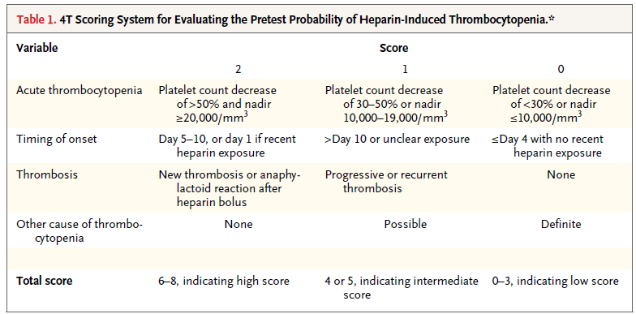

Slide 22
Additional Laboratory Testing
Anti–PF4–heparin enzyme immunoassays have an excellent negative predictive value (98 to 99%) but a low positive predictive value, owing to the detection of clinically insignificant anti–PF4–heparin antibodies.
In systematic serosurveillance studies, clinically evident HIT developed in only a minority (2 to 15%) of heparin-treated patients who had anti–PF4–heparin antibodies detected by means of enzyme immunoassay.
In patients with thrombocytopenia who have a negative test, repeat testing is generally not indicated in the absence of a new decrease in the platelet count or a thrombotic event.
Anti–PF4–heparin antibodies are always present before the platelet count begins to decline, so seroconversion after an initially negative test for anti–PF4–heparin antibodies nearly always detects coincidental, clinically irrelevant antibodies.

Slide 23
Over diagnosis and associated overtreatment of HIT are probably more common than under recognition, given the high frequency of thrombocytopenia among early postoperative and critically ill patients
Several strategies can be used to increase the specificity of PF4–heparin enzyme immunoassays.
1. One strategy is the restriction of the assay to IgG antibodies, because only IgG activates platelets and monocytes by means of Fcγ receptors, yet some commercial assays detect combined IgG, IgA, and IgM.
2. The magnitude of anti–PF4–heparin reactivity on enzyme immunoassay should be considered, because greater reactivity correlates with a greater likelihood of HIT.
3. Inhibition of the enzyme immunoassay by high concentrations of heparin also increases specificity, but the most relevant, very strongly reacting antibodies may not be inhibited.
Diagnostic accuracy for HIT is improved with the use of both an anti–PF4–heparin enzyme immunoassay and a functional test (e.g.,a platelet-activation assay).

Slide 24
FUNCTIONAL ASSAYS exploits the ability of HIT antibodies to activate normal platelets
platelet aggregation assay (PAA)
serotonin release assay (SRA)
heparin induced platelet activation (HIPA)

Slide 25
In particular platelet activation assays with the use of washed platelets (e.g., serotonin-release assay and heparin induced platelet-activation test, both with the use of high heparin inhibition) are much more specific .
A negative functional assay essentially rules out HIT.
HIT assays should not be used to screen asymptomatic patients and should be interpreted only in the context of the pretest probability of HIT.
A low or intermediate 4T score together with a negative antigen test rules out HIT, whereas an intermediate or high score together with a positive functional assay makes HIT very likely.

Slide 26
In a subgroup of patients, anti–PF4–heparin antibodies show very high optical densities (>2.0) and strongly activate platelets even in the absence of heparin.
First recognized in delayed onset HIT, these autoreactive antibodies mediate spontaneous HIT.
In patients with strongly suspected or confirmed HIT, duplex ultrasonography can rule out subclinical deep-vein thrombosis, which may affect the duration of treatment.
In patients with HIT who have abdominal pain or hypotension, bilateral adrenal hemorrhage associated with adrenal-vein thrombosis should be considered; severe headache should prompt the consideration of cavernous sinus thrombosis.

Slide 27
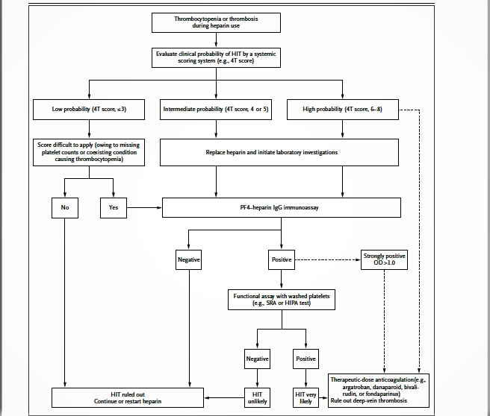

Slide 28
Treatment
Key interventions in patients with highly suspected or confirmed acute HIT are the prompt cessation of heparin (if still being administered and the initiation of an alternative anticoagulant at a therapeutic dose.
Prophylactic-dose anticoagulation is insufficient to compensate for massive thrombin generation, even if the patient has no apparent thrombosis.

Slide 29
Vitamin K antagonists (e.g., warfarin) should not be given until HIT has abated (e.g., the platelet count has increased to >150,000 per cubic millimeter at a stable plateau for 2 consecutive days),
Because they increase the risk of venous limb gangrene and limb loss by decreasing the level of protein C. When vitamin K antagonists are initiated, overlap with an alternative anticoagulant is needed.

Slide 30
Two drugs are approved for the treatment of HIT —
The direct thrombin inhibitor argatroban and the antithrombin-dependent factor Xa inhibitor danaparoid .
Ananalysis of prospective cohorts showed a reduced risk of the composite outcome of new thrombosis, death due to thrombosis, or amputation related to thrombosis in patients treated with argatroban, as compared with historical controls.
An analysis of outcomes with danaparoid that was provided on a compassionate use basis showed a rate of treatment success (platelet count recovery without new thrombosis and absence of major adverse events requiring drug cessation) that was higher than 90%.

Slide 31
In a small, open-label, randomized trial comparing danaparoid with dextran 70 for the treatment of HIT with thrombosis, the rates of recovery from thromboembolism were significantly higher with danaparoid.
Fondaparinux and bivalirudin are also used in this context, although they have not been approved by the Food and Drug Administration for this indication. Case series have shown good outcomes in patients with HIT treated with fondaparinux or bivalirudin.

Slide 32
Argatroban is frequently used in critically ill patients. It has a relatively short half-life, which is independent of renal function, but it requires intravenous administration
An underrecognized issue is that the activated partial-thromboplastin time may be falsely high when argatroban is given to patients who have additional coagulopathies (e.g., consumptive coagulopathy or impaired liver function) or to patients who have received pretreatment with warfarin.
This situation may lead to underdosing of argatroban, with the risk of progressive microvascular thrombosis and ischemic limb loss. This limitation may be overcome by the use of an ecarin-based clotting assay(which has limited availability) or the plasma diluted thrombin time assay (for which an inhouse standard for argatroban is required).

Slide 33
Danaparoid can be administered intravenously or subcutaneously, whereas fondaparinux is given only subcutaneously.
These two drugs can be reliably monitored by anti–factor Xa assays, but they have long half-lives and in patients with renal insufficiency, a dose adjustment will be necessary.
Subcutaneous injection makes these drugs easier than argatroban to use outside the intensive care unit.
In addition, danaparoid interferes with the immune mechanism of HIT by disrupting PF4–heparin complexes.

Slide 34
Exacerbations of HIT have been reported infrequently with the use of either danaparoid or fondaparinux.
Although most cases of exacerbations are attributable to autoimmune HIT antibodies and are independent of these drugs, a small percentage of patients have true in vivo and in vitro crossreactivity.
If manifestations of HIT worsen despite sufficient levels of anti–factor Xa activity in patients taking danaparoid or fondaparinux, treatment should be switched (e.g., to argatroban).
Prophylactic platelet transfusions should be avoided in patients with HIT. The risk of bleeding is very low, and such transfusions can increase the risk of thrombosis.

Slide 35
Data suggest that dabigatran, rivaroxaban, and apixaban might also be used to treat patients with HIT, more data are needed before these drugs can be recommended in the context of acute HIT.
A concern is whether trough levels are sufficient to prevent thrombin generation by strongly reactive anti–PF4–heparin antibodies.
Patients who have HIT with thrombosis require therapeutic dose anticoagulation for at least 3 months. However, in patients who have HIT without thrombosis, the duration of therapeutic dose anticoagulation after the platelet count has reached a stable plateau (ideally >150,000 per cubic millimeter) is unresolved.

Slide 36
High-dose intravenous immune globulin G(e.g., at a dose of 2 g per kilogram of body weight over a 2-day period) interferes with HIT by blocking platelet Fcγ receptors.
Limited data suggest that this drug may be an option (along with anticoagulation) in patients at high risk for thrombosis and bleeding (e.g., those who are pregnant or have sinus-vein thrombosis complicating
HIT) or in patients who have autoimmune HIT.

Slide 37
In patients with a history of HIT who require cardiac surgery, postponing surgery until platelet-activating anti–PF4–heparin antibodies disappear and then using heparin intraoperatively is a safe approach.
Another option in urgent situations is the removal of platelet-activating anti–PF4–heparin antibodies by plasmapheresis.
Otherwise, bivalirudin is a compatible anticoagulant for cardiac surgery if platelet-activating anti–PF4 heparin antibodies are present.

Slide 38
Guidelines
The guidelines of the American College of Chest Physicians (ACCP) and national European guideines address HIT. In the absence of data from randomized trials, most recommendations are supported by low-grade evidence.
All these guidelines recommend the use of a scoring system to determine the probability of HIT before testing is performed and note the need for therapeutic-dose anticoagulation in cases of acute HIT.
The ACCP guidelines recommend assessing patients at high risk (>1%) for HIT every 2 to 3 days between day 4 and day 14.

Slide 39
A 64-year-old woman who is hospitalized with endocarditis and whose condition is
clinically stable while she is receiving intravenous antibiotic agents has had a de-crease in platelet count from 161,000 per cubic millimeter on day 7 of hospitalizationto 60,000 per cubic millimeter on day 9. She has been receiving low-molecular-weight heparin at a dose of 40 mg per day since admission. How should her case be further evaluated and treated?

Slide 40
The patient had a marked decrease in the platelet count after several days of therapy with low-molecular-weight heparin, which raises concern about HIT.
Calculation of the 4T score is recommended to determine her risk of HIT.
Her score of 5 points (decrease in platelet count, 2; timing, 2; thrombosis, 0; and likelihood of other reasons, 1, since her endocarditis is stable and the platelet count is too high for antibiotic-induced immune thrombocytopenia) places her at intermediate risk.
Although routine screening for PF4–heparin antibodies is strongly discouraged, patients at intermediate or high risk should undergo this testing.

Slide 41
A positive anti–PF4heparin IgG enzyme immunoassay is necessary for the diagnosis of HIT but is nonspecific.
A strongly positive platelet-activation assay would strongly support the diagnosis of HIT. Treatment involves the prompt cessation of heparin and the initiation of an alternative anticoagulant (argatroban or danaparoid, both of which are approved for this indication, or fondaparinux or bivalirudin, withuse of these agents supported by case series).

Slide 42
Prevention
The incidence of HIT can be reduced by:
Limiting courses of heparin to <5 days, if possible.
Using LMWH in place of heparin for thromboprophylaxis in high‐risk postoperative patients.
Porcine UFH is associated with lower incidence of HIT then bovine UFH.

Slide 43
In general, monitoring the platelet count at least every other day between days 4 and 14 of heparin exposure or until heparin is discontinued.
Taking care not to automatically initiate heparin if a patient is re‐admitted for a thrombotic event; the medical record must be thoroughly reviewed for use of heparin on a previous admission (within the past 100 days). Unfortunately, in some cases, the previous heparin exposure may not be recorded in the medical record (for example, heparin flushes).

Slide 44
SUMMARY
• Heparin-induced thrombocytopenia (HIT) is characterized by a decrease in the platelet count of more than 50% from the highest platelet count value after the start of heparin, an onset 5 to 10 days after the start of heparin, hypercoagulability, and the presence of heparin-dependent, platelet-activating IgG antibodies.
• Use of a scoring system that takes into account the timing and magnitude of the platelet count fall, new thrombosis, and the likelihood of other reasons for thrombocytopenia is helpful in assessing the pretest probability of HIT.

Slide 45
• Delayed-onset HIT develops after the cessation of heparin, and spontaneous or autoimmune HIT
develops in the absence of heparin exposure.
• Platelet factor 4–heparin antibody tests should be ordered only if clinical features reasonably suggest HIT. These tests have a high negative predictive value but a low positive predictive value.
• Treatment of acute HIT requires the cessation of heparin and the initiation of therapeutic-dose anti-
coagulation with an alternative agent (argatroban, danaparoid, fondaparinux, or bivalirudin).
• Warfarin should be avoided in patients with acute HIT.

Slide 46
MCQS

Slide 47
The percentage reduction in platelet count to make a diagnosis of HIT
>40%
>50%
>60%
>30%

Slide 48
B

Slide 49
4T Scoring system 4T score include all of the following except;
the absolute platelet count fall,
The timing of the onset of the platelet count fall,
The presence or absence of thrombosis
the likelihood of another cause,

Slide 50
A

Slide 51
Anti PF4-HEPARIN IgG immune complexes bind to which platelet receptor
FcyRIIa
FcyRI
TLR
GpIb

Slide 52
A

Slide 53
A patient after starting UFH as post surgical prophylaxis developed acute thrombocytopenia with platelet count falling from 2L TO 90,000, at day 6 after starting heparin, with no e/o thrombosis, with no e/o sepsis or other causes of thrombocytopenia
What is the 4T score for this patient
7
5
6
8

Slide 54
A

Slide 55
THANKYOU

