Slide 2
CONTENT
BACKGROUND
MECHANISM OF ACTION
PHARMACOKINETICS
THE ORION TRIALS

Slide 3
BACKGROUND
Proprotein convertase subtilisin/kexin type 9 (PCSK9) has emerged as an important regulator of cholesterol metabolism
PCSK9 journey began in 2003 and is still actively ongoing
PCSK9 gene is located on chromosome 1p32.3
Abifadel et al discovered that a gain of function mutation of gene encoding PCSK9 led to FH in a French family
In 2005, the Dallas Heart Study in Afro-Americans showed that loss of function mutation in the gene for PCSK9 was associated with low serum LDL-C levels and a reduced incidence of CVD

Slide 4
Further animal studies in mice and primates using RNA inhibitors and monoclonal antibodies confirmed the relationship of PCSK9 inhibition and lipid lowering
led to the development of several strategies to inhibit the PCSK9 protein or RNA using monoclonal antibodies or RNA interference drug
Trials were conducted for 3 monoclonal antibodies
evolocumab and alirocumab are now available for clinical use
bococizumab -stopped because of immunogenicity issues and attenuation of its LDL-C lowering effect with time

Slide 5
Mechanism of action

Slide 6
RNA THERAPEUTICS

Slide 7
Inclisiran harnesses a natural catalytic process
Synthetic double strand 21-23 oligonucleotide
5’
3’
GalNAc
GalNAc
GalNAc
3x GalNAc at sense 3’ end enables hepatic-specific uptake via ASGP receptor
Chemically modified to prevent RNAse degradation
Dicer separates antisense strand – and incorporates it into RISC
RISC - RNA induced silencing complex
RISC degrades PCSK9 mRNA catalytically to halt PCSK9 protein synthesis in the liver

Slide 8
Si RNA =small interfering RNA

Slide 9
PHARMACOKINETICS
Absorption
Peak plasma time: 4 hr
Peak plasma concentration: 509 ng/mL
Distribution
Protein bound: 87%
Vd: 500 L (healthy adults)
Metabolism
Primarily metabolized by nucleases to shorter nucleotides of varying length
Not a substrate for CYP450 or transporters
Elimination
Half-life: 9 hr
Renally cleared: ~16% of drug

Slide 10
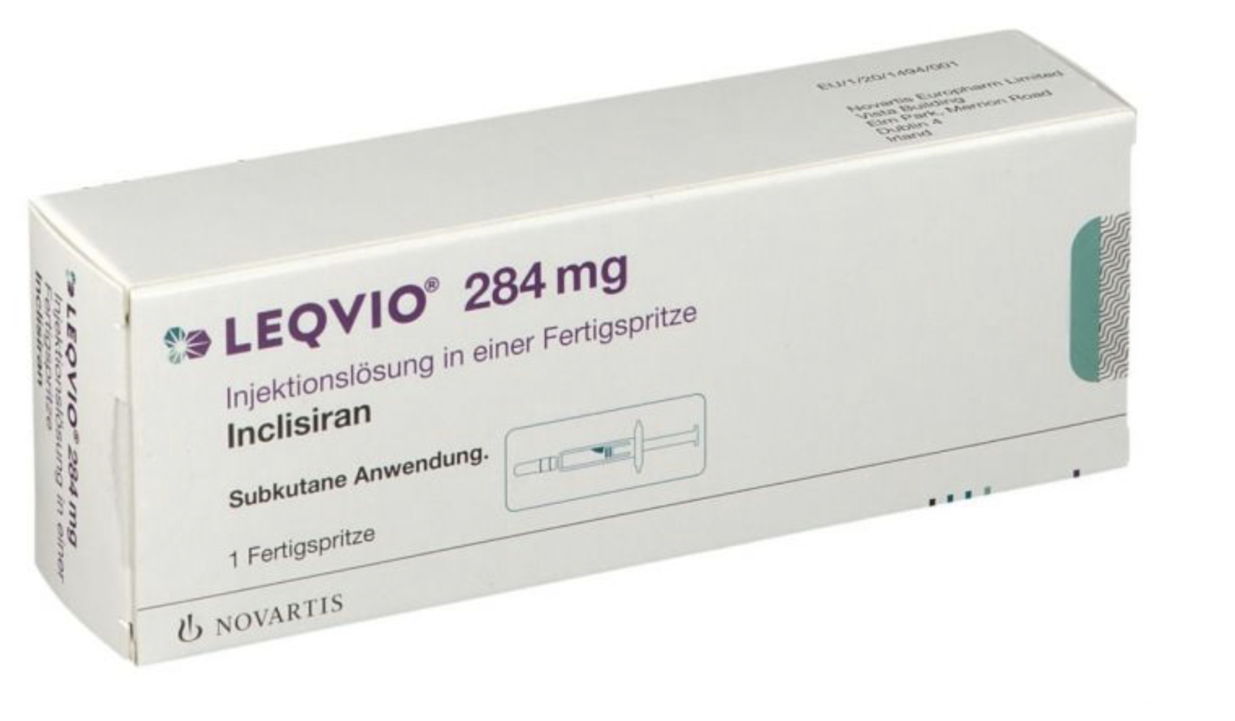
DOSAGE
injectable SC solution
284mg/1.5mL (prefilled syringe)
284 mg SC x 1 dose initially
Repeat in 3 months and then every 6 months thereafter
Dosage Modifications
Renal impairment
Mild, moderate, or severe: No dosage adjustment necessary
Hepatic impairment
Mild or moderate: No dosage adjustment necessary
Severe: Not studied

Slide 11
Missed dose
<3 months: administer inclisiran and maintain dosing according to original schedule
>3 months: Restart with new dosing schedule; administer inclisiran initially, again at 3 months, and then q6months
Storage
Store at 20-25ºC ; excursions allowed to 15-30ºC

Slide 12
Adverse Effects
1-10%
Injection site reaction (8.2%)
Arthralgia (5%)
Urinary tract infection (4.4%)
Bronchitis (4.3%)
Diarrhea (3.9%)
Pain in extremity (3.3%)
Dyspnea (3.2%)
NO CONTRAINDICATION
PREGNANCY/ LACTATION –no data

Slide 13
ORION TRIALS

Slide 14
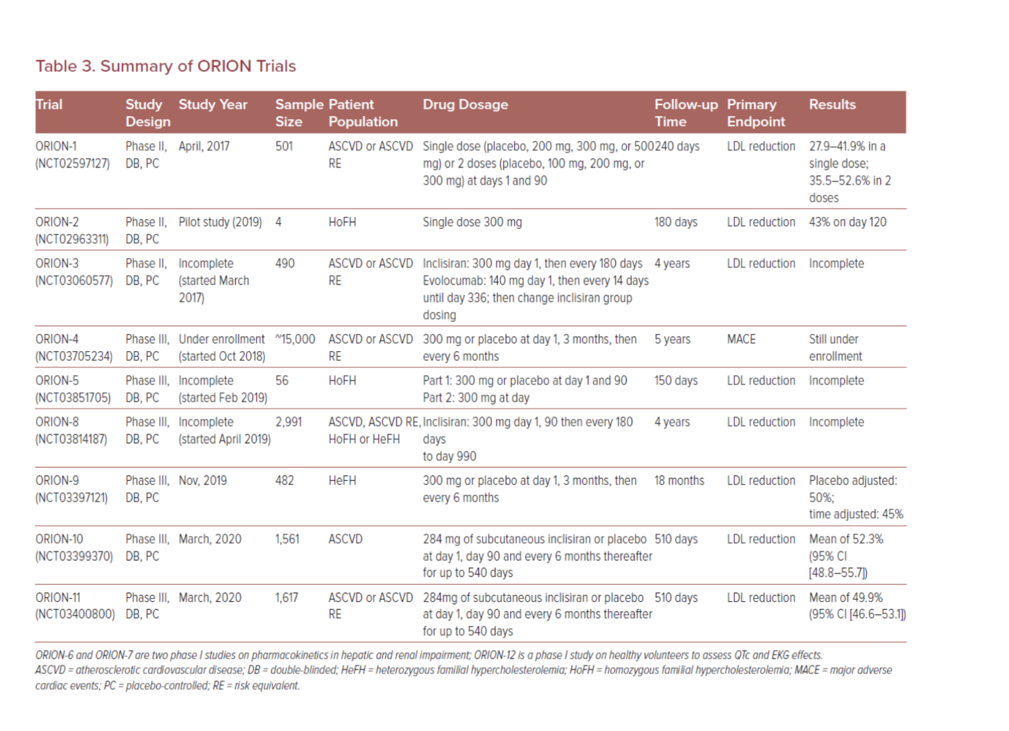
PHASE I TRIALS -6,7 ( HEPATIC AND RENAL IMPAIRMENT) 12 ( ASSESS QTc AND ECG EFFECTS
PHASE II TRIALS -1,2,3
PHASE III TRIALS -4,8,5,9,10,11

Slide 15
PUBLISHED IN FEB 2023

Slide 17
ORION 1 & 3 TRIALS

Slide 18
Patient population High cardiovascular risk and elevated LDL-C
Inclusion criteria
Age ≥18 years
With ASCVD - LDL-C >70 mg/dL
High risk primary prevention LDL-C >100
TG <400 mg/dL
eGFR ≥30 mL/min
Maximally tolerated statin
Stable lipid Rx for ≥30 days
Exclusion criteria
Significant comorbidity
HbA1c ≥10%
NYHA Class II-IV HF
MACE <6 months
Uncontrolled BP
Active liver disease
Pregnancy or risk | nursing
Cognitive impairment

Slide 19
Study design and statistics ORION 1 Dose finding - placebo controlled
Day of study
Dose (N) | 1 | 14 | 30 | 60 | 90 | 104 | 120 | 150 | 180 | 210
Assessment | ■ | ■ | ■ | ■ | ■ | ■ | ■ | ■ | ■ | ■
One dose |  |  |  |  | Interim analysis |  |  |  |  | Final analysis
Placebo (65) 200 mg (60) 300 mg (62) 500 mg (66)
Two doses
Placebo (62) 100 mg (62) 200 mg (63) 300 mg (61)
Follow-up as of 25 Oct 2016 | 501 |  |  |  | 497 |  |  |  | 189
Patients were randomly assigned to receive a single dose of placebo or 200, 300, or 500 mg of inclisiran or two doses (at days 1 and 90) of placebo or 100, 200, or 300 mg of inclisiran
The primary end point was the change from baseline in LDL cholesterol level at 180 days

Slide 20
ORION 1 VS ORION 3

Slide 21
OUTCOMES
ORION 1
ORION 3
Primary endpoint
Percent change in LDL-C levels from baseline at day 180
Secondary endpoint
LDL-C levels at day 90 and other lipid parameters
LDL-C and PCSK9 levels over time
Safety and tolerability
Primary endpoint –
The percentage change in LDL cholesterol from baseline of ORION-1 to day 210 in this study for the inclisiran-only arm—ie, an observation period of approximately 570 days from first inclisiran injection.
Secondary endpoints
included percentage and absolute change from baseline of ORION-1 in LDL cholesterol and PCSK9 over time

Slide 22
Safety of inclisiran to day 90 Liver and muscle TEAE¹
Total=497 |  |  |  | Inclisiran
Day 1-90 | Placebo |  |  | Pooled |  | 100 mg |  | 200 mg |  | 300 mg |  | 500 mg
 | N=127 |  |  | N=370 |  | N=61 |  | N=122 |  | N=122 |  | N=65
ALT >3x ULN | 0 |  |  | 1 | (0.3%) | 0 |  | 0 |  | 1 | (0.8%) | 0
AST >3x ULN | 0 |  |  | 1 | (0.3%) | 0 |  | 0 |  | 1 | (0.8%) | 0
ALP >2x ULN | 0 |  |  | 3 | (0.8%) | 1 | (1.6%) | 0 |  | 2 | (1.6%)² | 0
Bilirubin >2x ULN³ | 0 |  |  | 0 |  | 0 |  | 0 |  | 0 |  | 0
CK >5x ULN | 0 |  |  | 2 | (0.6%) | 0 |  | 1 | (0.8%)⁴ | 1 | (0.8%) | 0
Myalgia | 6 | (4.7%) |  | 21 | (5.7%) | 5 | (8.2%) | 7 | (5.7%) | 8 | (6.6%) | 1 | (1.5%)
1: Crossing above threshold for significance at any time after randomization regardless of baseline
2: One patient above ULN at baseline
3: No patient met the criteria for Hy’s law
4: Patient >3x ULN at baseline

Slide 23
Safety of inclisiran to day 90 First injection TEAE^{1,2}
Total=497 |  |  |  | Inclisiran
 | Placebo |  |  | Pooled |  | 100 mg |  | 200 mg |  | 300 mg |  | 500 mg
AE terms | N=127 |  |  | N=370 |  | N=61 |  | N=122 |  | N=122 |  | N=65
Injection site erythema | 0 |  |  | 4 | (1.1%) | 0 |  | 2 | (1.6%) | 1 | (0.8%) | 1 | (1.5%)
Injection site pruritus | 0 |  |  | 1 | (0.3%) | 0 |  | 0 |  | 1 | (0.8%) | 0
Injection site rash | 0 |  |  | 0 |  | 0 |  | 0 |  | 0 |  | 0
Injection site reaction | 0 |  |  | 7 | (1.9%) | 1 | (1.6%) | 1 | (0.8%) | 3 | (2.5%) | 2 | (3.1%)
Total (observed any time) | 0 |  |  | 12 | (3.2%) | 1 | (1.6%) | 3 | (2.5%) | 5 | (4.1%) | 3 | (4.6%)
Total (observed >4 hours) | 0 |  |  | 9 | (2.4%) | 1 | (1.6%) | 3 | (2.5%) | 4 | (3.3%) | 1 | (1.5%)
1: Number of patients with adverse event classified by preferred term – each patient is counted only once
2: Pre-defined histaminic/allergic type adverse events

Slide 24
Efficacy of one dose of inclisiran up to day 90 Significant, durable PCSK9 and LDL-C lowering
PCSK9
LDL-C
p-value for all comparisons to placebo <0.0001
p-value for all comparisons to placebo <0.0001

Slide 25
Efficacy of one dose of inclisiran up to day 90 Other lipid parameters - change from baseline
Total=494¹ |  |  |  | Inclisiran
Day 90 |  | Placebo |  | 100 mg |  | 200 mg |  | 300 mg |  | 500 mg
 |  | N=124 |  | N=61 |  | N=122 |  | N=122 |  | N=65
Total cholesterol | mean (SD) | -1% | (16) | -22% | (12) | -26% | (14) | -28% | (15) | -30% | (11)
Triglyceride | median | 3% |  | 1% |  | -11% |  | -10% |  | 0%
HDL-C | mean (SD) | -2% | (14) | 5% | (11) | 8% | (12) | 9% | (16) | 8% | (15)
Non-HDL-C | mean (SD) | 0% | (20) | -30% | (13) | -37% | (18) | -40% | (19) | -42% | (15)
Apo-B | mean (SD) | -2% | (16) | -28% | (12) | -34% | (15) | -37% | (16) | -40% | (13)
Lp(a) | median | -1% |  | -18% |  | -21% |  | -23% |  | -22%
1: Includes patients with baseline and day-90 measurement for all parameters

Slide 26
Individual patient response at day 180 Absolute change in LDL-C from baseline
Placebo
Two doses
(N=23)
Mean -3.1 Median 2 mg/dL
Change in LDL-C (mg/dL)
300 mg
Two doses
(N=28)
Mean -64.9 Median -64 mg/dL
Available data as of 25 Oct 2016

Slide 27
RESULTS
ORION 1
One dose of 300 mg achieved mean 51% LDL-C reduction
Two doses of 300 mg achieved mean 57% LDL-C reduction

Slide 28
RESULTS –ORION 3

Slide 29
RESULTS –ORION 3
Irrespective of the timing of the switch from evolocumab to inclisiran (staged or concurrent), LDL cholesterol concentrations and PCSK9 reductions on inclisiran were generally similar over years 2–4 and similar to the inclisiran-only arm
During years 2–4, changes in other lipids and lipoproteins in the switching arm resembled changes observed with the inclisiran-only arm
The proportion of patients achieving >50% lowering of LDL cholesterol varied in the switching arm and was higher during evolocumab treatment

Slide 30
ORION 9,10,11 ( PHASE III TRIALS)
POOLED ANALYSIS

Slide 47
Labelled Indication
HeFH – adjunct to diet and max tolerated statin who require additional LDL lowering
Secondary prevention of cardiovascular events -adjunct to diet and max tolerated statin who require additional LDL lowering

Slide 49
Q. Which of the following is not a phase III trial
ORION 1
ORION 3
ORION 10
ORION 11
BOTH A and B

Slide 50
Q. Inclisiran made of :
Single stranded RNA
Ds RNA 100-120 nucleotides
Ds RNA 20-25 nucleotides
Ss DNA

Slide 51
Which of the following trial assesses cardiovascular outcome ?
ORION 3
ORION 4
ORION 5
VICTORION 2 PREVENT TRIAL
BOTH B AND D

