Slide 1
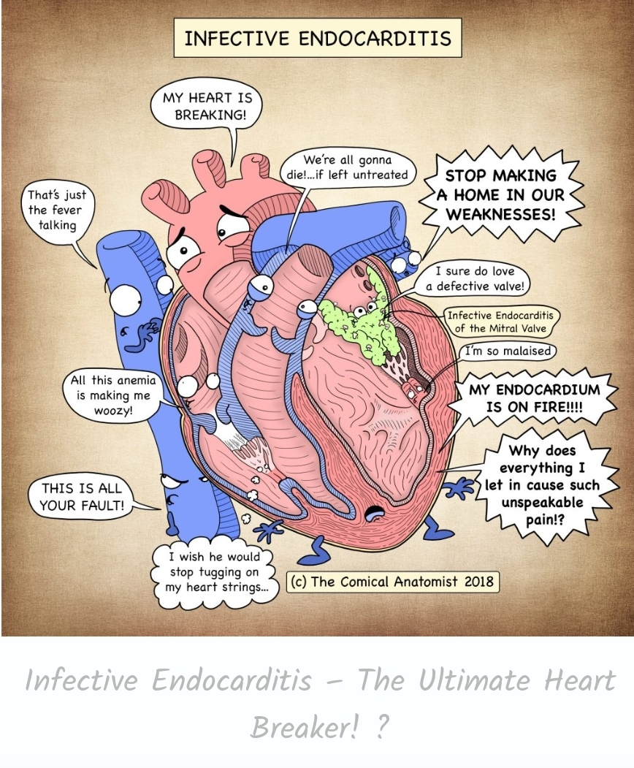
INFECTIVE ENDOCARDITIS
Dr Arun Jude Alphonse
DM Cardiology Resident
Govt TDMC Alappuzha

Slide 2
DISCUSSION
> HISTORY
>DEFINITION
>CLASSIFICATION
> MICROBIOLOGY
>PATHOGENESIS
>PREDISPOSING CONDITIONS
>CLINICAL FEATURES
> DIAGNOSIS
>MANAGEMENT
>COMPLICATIONS
>PROPHYLLAXIS
>CLINICAL TRIALS
>QUESTIONS

Slide 3
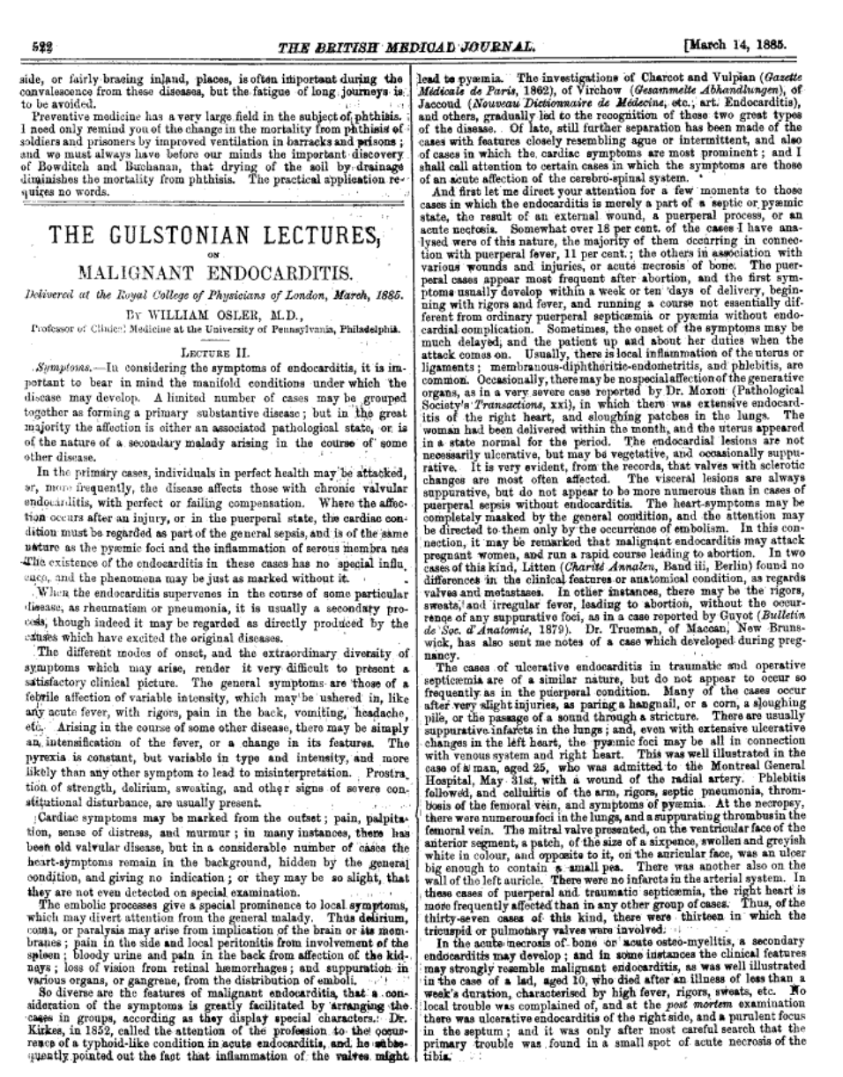
GULSTONIAN LECTURES OF 1885

Slide 4
Sir William Osler--Gulstonian lectures of 1885
Primary “mycotic” process
First formal description of two clinical variants of the disease—the acute and fulminating form versus the chronic and insidious form.

Slide 5
Definition
Infective endocarditis (IE ) is characterized by colonization or invasion of the heart valves or endocardium by a microbe, leading to the formation of vegetations
MICROBE + VEGETATION

Slide 6
Epidemiology
Incidence – 3.6 to 7.0 cases per 100,000 patient-yrs
More frequent in men ( M: F - 2 : 1)
< 50 yrs - 5 cases per 100,000 person-years
> 50 yrs- 15 to 30 cases per 100,000 person-years

Slide 7
Classification
•
Classified into four groups: Native Valve IE Prosthetic Valve IE
Intravenous drug abuse (IVDA) IE Health care associated IE
•
Acute
Affects normal valves
Rapidly destructive
Commonly Staph.
Metastatic complications
Subacute
Often affects damaged heart valves
Indolent nature
Less virulant organism
•

Slide 8
Various patient groups
Adults
MVP accounts for 7% to 30% of NVE not related to drug abuse or nosocomial infection.
Increased risk in MVP is confined to pts with thickened valve leaflets (>5 mm) and MR
In pts with RHD , endocarditis occurs most frequently on mitral valve followed by aortic valve.

Slide 9
Children
Commonlyinvolves tricuspid valve in neonates
Associated CHD in 75% to 90% of cases
Can occur at site of surgical repair after complex reconstructive surgery.

Slide 10
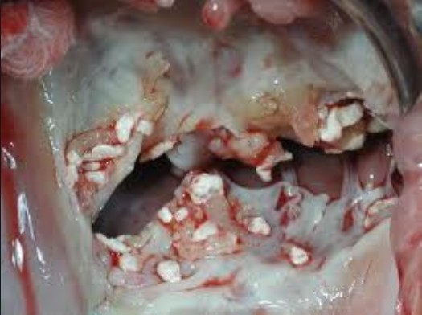
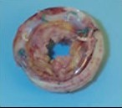
Intravenous Drug Abusers
7 fold greater risk than pts with RHD or prosthetic valves.
Located on tricuspid valve in majority
Risk factor for recurrent NVE.
Prosthetic Valve Endocarditis (PVE )
Constitutes 10% to 30% of IE in developed countries
Incidence ranges from 1.4% to 3.1% at 12 months & 3.0% to 5.7% at 5 years.

Slide 11
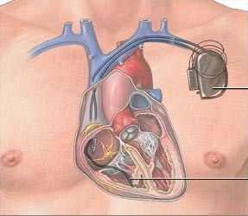
Cardiac Device–Related Infective Endocarditis (CDRIE)
Caused by Staphylococcal species in more than 70%
Infection with coagulase-negative staphylococci is difficult to eradicate.
Majority of cardiac device infections are likely due to pocket site contamination at the time of device placements.

Slide 12
MICROBIOLOGY
Overall most common organism – Staph Aureus
Community acquired IE – Strep Viridans> Staph Aureus
Health care associated – Staph Aureus
IV Drug use – Staph Aureus
Prosthetic valve IE – Early <2 months – Staph Aureus
Late >2months- CONS>Staph Aureus

Slide 13
Staphylococcus aureus-
Most common overall
Drug resistance common
If for any evaluation Blood C/S positive for staph aureus –Do Echocardiogram-25% change of vegetationb

Slide 14
Strep Viridans
M/C cause of Community acquired IE
Alpha hemolytic streptococci
Oral flora
Indolent infection
SABE in RHD
Sensitive to pencillin
Beta hemolytic streptococci
A/C IE
Susceptible to pencillin

Slide 15
Staph Gallolyticus/Bovis
Flora of GI tract
If blood C/S positive-colonoscopy to r/o CA Colon
CONS
Normal skin commensal
M/C –Staph epidermis
Staph lugdunensis more virulent
3 or more blood c/s positive needed
Drug resistance common

Slide 16
Pneumococci/Strept pneummonia
A/C IE
Metastatic infection-meningitis
Pencillin sensitive
Aerobic gram negative
E Coli/Kleb/Enterobacter/Pseudomonas
Rare
A/C IE

Slide 17
HACEK (Haemophilus,Aggregatibacter,Cardiobacterium hominis, Eikenella,Kingela)
Orapharynx/URT
Slow growing/indolent/min symptoms/large veg
Embolism common/large veg
Ceftriaxone-DOC

Slide 18
Fungal
Extremely rare
M/C Candida
Prosthetic valve
IV Antifungal+Surgical repair needed
Lifelong antifungals

Slide 19
Pathogenesis
Both patient and microbial factors contribute.
Endothelial injury – trauma , turbulance , inflammation
Formation of platelet fibrin nidus
Bacterial adhesion and invasion
Microbial growth and secondary accumulation of more platelets and fibrin

Slide 20
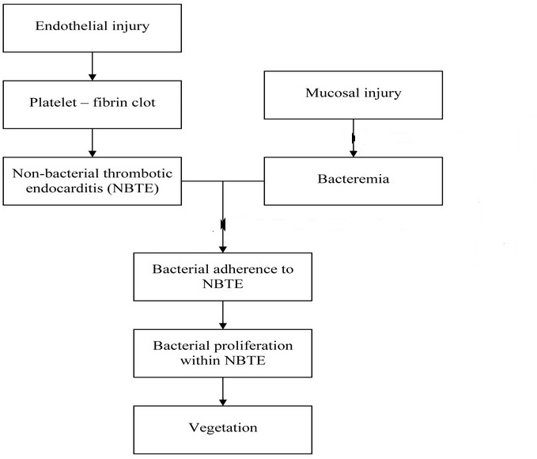
IE pathogenesis

Slide 21
Location of vegetations
LOW PRESSURE SIDE OF A HIGH PRESSURE JET(debris deposition)
Atrial surface of incompetent AV valves
Ventricular surface of incompetent semilunar valves
In VSD - on RV side of the defect and on tricuspid and pulmonic valves
In AR - chordae tendineae of anterior leaflet of mitral valve
In MR- atrial wall where jet strikes

Slide 22
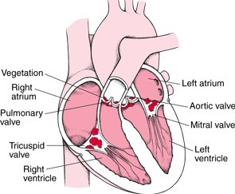
Location of vegetations

Slide 23
TYPES OF VEGETATIONS

Slide 24
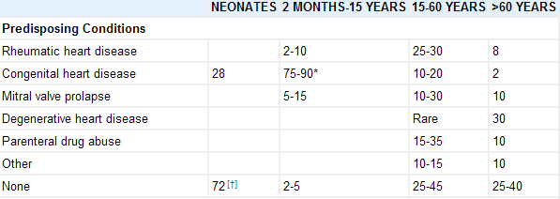
Predisposing Conditions in native valve

Slide 25
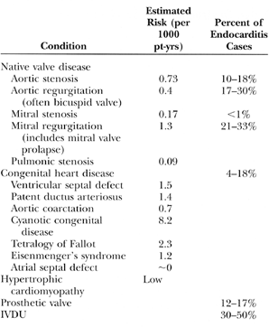
Predisposing Conditions

Slide 26
Clinical Features
Interval b/w bacteremia and onset of symptoms -
< 2 wks in 80% of pts with NVE
May be prolonged in candidemia causing IE or perioperative infection of prosthetic valves
Fever is universal symptom ( absent in CHF, severe debility or CRF )
(FEVER+Antibiotics-Subsides in less than 4 days-Not IE,
4-7 days-Typical IE
>7 days-?Complicated
Dyspnea (20-40%) –LHF(Acute MR or AcuteAR)
Stroke(20%)- SABE stroke as presenation

Slide 27
Symptoms
Fever is universal symptom ( absent in CHF, severe debility or CRF )
FEVER+Antibiotics- If it subsides in
Less than 4 days-Not IE 4-7 days-Typical IE
>7 days-?Complicated)
Dyspnea (20-40%) –LHF(Acute MR or AcuteAR)
Stroke(20%)- SABE stroke as presenation
Anorexia,weight loss, malaise,myalgia

Slide 28
SIGNS
MURMUR –CHANGING CHARACTER /NEW ONSET
PETICHAE
SPLENOMEGALY
OSLERS NODES
SPLINTER HAEMORHHAGES
JANEWAY LESIONS
RETINAL HAEMORRHAGE/ROTH SPOTS
CLUBBING
NEUROLOGICAL ABNORMALITIES

Slide 29
CLINICAL FEATURES OF INFECTIVE ENDOCARDITIS
SYMPTOMS | PERCENT | SIGNS | PERCENT
Fever | 80–85 | Fever | 80–90
Chills | 42–75 | Murmur | 80–85
Sweats | 25 | Changing/new murmur | 10–40
Anorexia | 25–55 | Neurological abnormalities† | 30–40
Weight loss | 25–35 | Embolic event | 20–40
Malaise | 25–40 | Splenomegaly | 15–50
Dyspnea | 20–40 | Clubbing | 10–20
Cough | 25 | Peripheral manifestation
Stroke | 13–20 | Osler's nodes | 7–10
Headache | 15–40 | Splinter hemorrhage | 5–15
Nausea/vomiting | 15–20 | Petechiae | 10–40
Myalgia/arthralgia | 15–30 | Janeway's lesion | 6–10
Chest pain* | 8–35 | Retinal lesion/Roth's spots | 4–10
Abdominal pain | 5–15
Back pain | 7–10
Confusion | 10–20
*More common in intravenous drug abusers.
†Central nervous system.

Slide 30
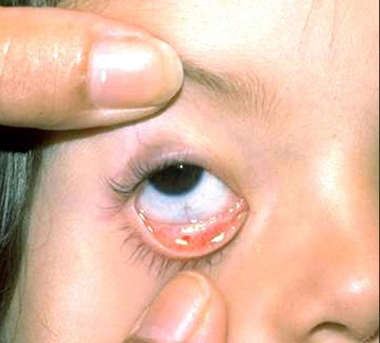
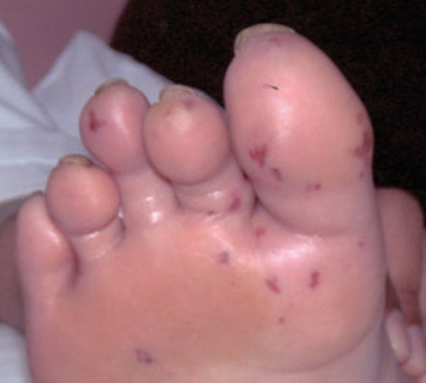
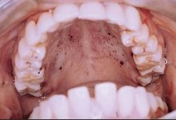
Peripheral manifestations
•
Petechiae : ( most common ) are found on palpebral conjunctiva, buccal and palatal mucosa, extremities

Slide 31
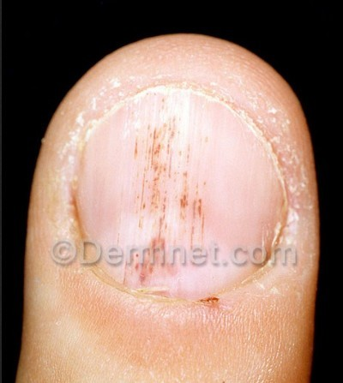
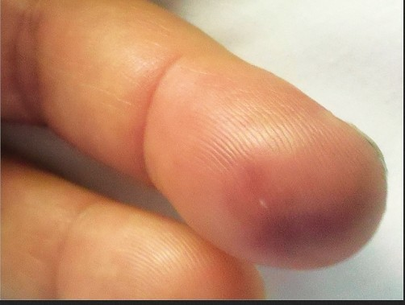
Splinter or subungual hemorrhages are dark red, linear or flame-shaped streaks in proximal nailbed.
•
•
Osler nodes are small, tender s/c nodules in the pulp of digits or more proximal, that persist for hours to several days.

Slide 32
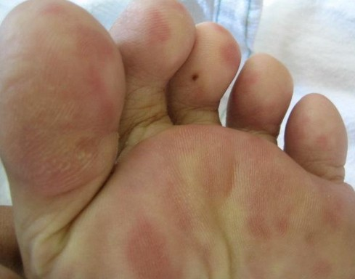
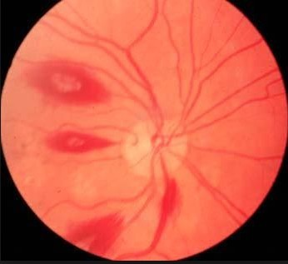
•
Janeway lesions :small erythematous or hemorrhagic macular nontender lesions on palms and soles and
are consequence of septic embolic events
•
Roth spots : oval retinal hemorrhages with pale centers
less frequent finding in IE
Roth spots ,osler nodes , petechial hge are not pathognomonic of IE

Slide 33
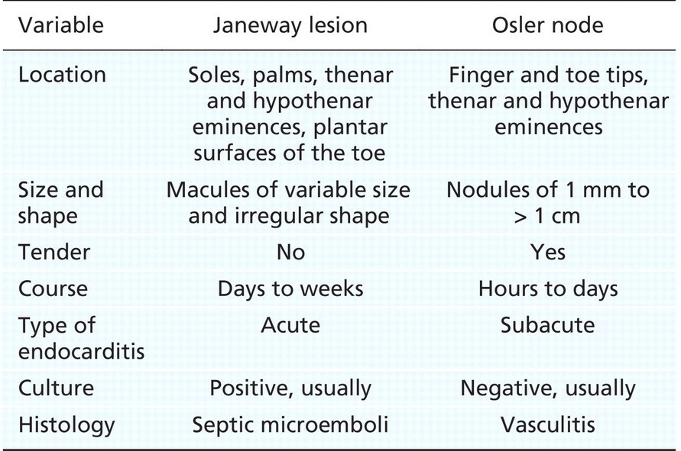

Slide 34
DIAGNOSIS OF INFECTIVE ENDOCARDITIS
Clinical suspicion in a patient with identifiable risk factors
Microbiologic data blood cultures demonstrating continuous bacteremia or cultures of vegetative emboli removed surgically
Echocardiographic imaging

Slide 35
CLINICAL CRITERIA
1994-- Durack and collageus-- Duke criteria.
Revised in 2000 to increase the sensitivity for -- Staphylococcus aureus bacteremia & culture-negative IE.
Three separate sets of blood cultures obtained from different venipuncture sites over 24 hours (RA/LA/RL/LL-0/6/12/18)
ESC 2015 –Added modality of SPECT/PET/CT in specific scenarios

Slide 36
Definition of Terms Used in Modified Duke Criteria
Major criteria
Blood culture positive for IE
Typical microorganisms consistent with IE from 2 separate blood cultures (Strep. viridans, Strep. bovis, HACEK group,Staph. aureus or Community- acquired enterococci ) or
Microorganisms consistent with IE from persistently positive blood cultures, defined as
* At least 2 positive cultures of blood samples drawn more than 12 h apart
or
*All of 3 or a majority of greater than 4 separate cultures of blood (with first and last sample drawn at least 1 h apart)
*Single positive blood culture for Coxiella brunetti or anti-phase 1 IgG antibody titer greater than 1:800

Slide 37
2. Evidence of endocardial involvement Echocardiogram positive for IE defined as
Oscillating intracardiac mass on valve or supporting structures, in the path of regurgitant jets or on implanted material in the absence of alternative anatomic explanation or
Abscess or
New partial dehiscence of prosthetic valve.
New valvular regurgitation .

Slide 38
Minor criteria
•
Predisposing heart condition or IV drug abuse
Fever : temperature > 100.4°F (38°C)
Vascular phenomena : major arterial emboli, septic pulmonary infarcts, mycotic aneurysm, intracranial hemorrhage, conjunctival hemorrhages & Janeway lesions.
Immunologic phenomena: Glomerulonephritis, Osler nodes, Roth spots and Rheumatoid factor .
Microbiologic evidence: positive blood culture but does not meet a major criterion or serologic evidence of active infection with organism consistent with IE.

Slide 40
Rejected
Firm alternate diagnosis or
Resolution of manifestations with antibiotic therapy
< 4 days or
No pathologic evidence of infective endocarditis at surgery or autopsy, with antibiotic therapy < 4 days or
Does not meet criteria for possible IE

Slide 41
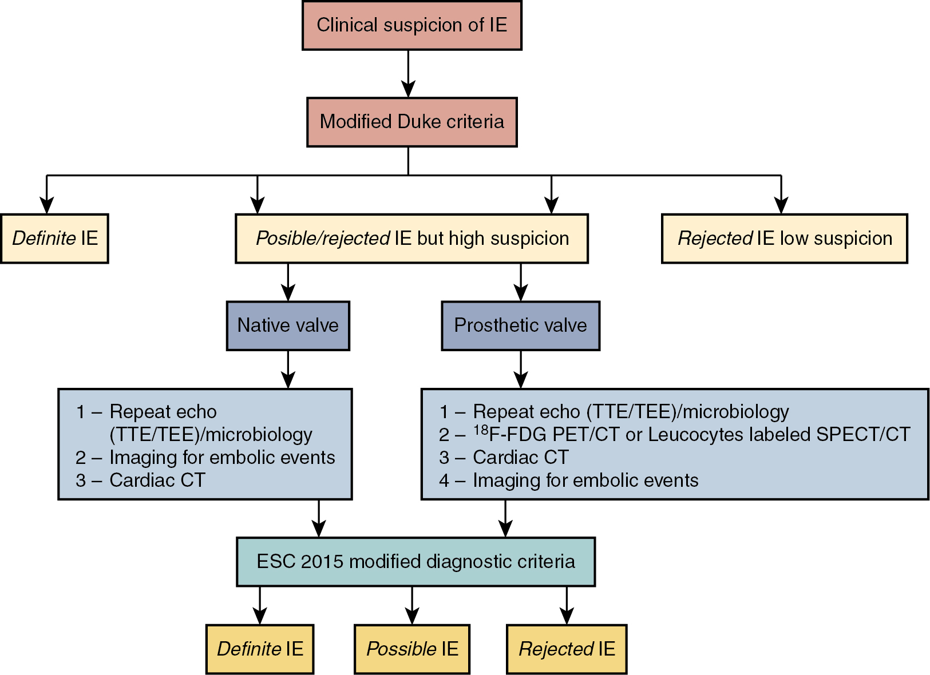

Slide 42
ENDOCARDITIS TEAM
ALL CRITERIA ARE USEFUL BUT DO NOT REPLACE CLINICAL JUDGEMENT OF ENDOCARDITIS TEAM-VETO POWER
COMPLICATED PTS-Managed by IE Team
NON COMPLICATED PTS- Managed by consultation from IE team

Slide 43
Blood Culture Specimens in IE
•
3 separate sets of blood cultures, each from a separate venipuncture, obtained during 24 hours are recommended.
•
Each set should include a bottle containing aerobic medium & anaerobic medium.
•
Serologic tests can be used if suspected organisms are Brucella , Legionella , Bartonella , C. burnetii, Aspergillus or Chlamydia

Slide 44
Blood C/S can be repeated every 3 days til negative to evaluate effectiveness of therapy

Slide 45
Culture Negative IE
•
•
Blood cultures are negative in up to 20% pts with IE May be due to
Antimicrobial therapy before blood culture acquisition Inadequate culture technique
Fastidious organism or Nonbacterial pathogen

Slide 46
Echocardiography in Infective Endocarditis
•
All pts with suspected IE should undergo echocardiographic assessment.
TTE is done first except in prosthetic valve
•
 | SENSITIVITY(%) | SPECIFICITY(%)
TTE | 60 – 65 | 98
TEE | 85 -95 | 85 -98

Slide 47
Indications for TEE in IE
To assess severity of valvular lesions in symptomatic pts with IE if TTE is non diagnostic
To diagnose IE in pts with valvular heart disease and positive blood cultures, if TTE nondiagnostic
To diagnose complications of IE with potential impact on prognosis & management ( abscesses, perforation and shunts)
₁st
line diagnostic study in PVE and assess for complications
Preoperative evaluation and intraoperative assessment.

Slide 48
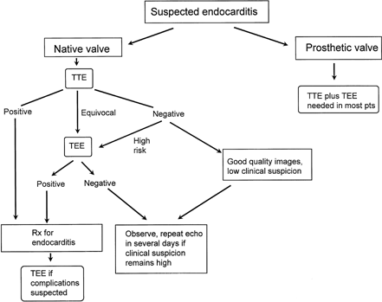

Slide 49
Other laboratory Tests
Anemia (normochromic normocytic ) in 70% to 90% of pts.
may be absent in acute IE
WBC count increased in acute IE , may be normal in subacute
Thrombocytopenia is rare.
ESR is elevated in almost all patients except those with CHF, renal failure or DIC .
C-reactive protein is elevated.
Rheumatoid factor is increased in 50% .
Proteinuria and microscopic hematuria are noted in 50% even when renal function remains normal.

Slide 50
ECG- AV block(Mainly in AV-IE)
ST Elevation –Vegetation embolizing and occluding coronar artery

Slide 51
Treatment
Rapid institution of appropriate antibiotic therapy is the single most imp initial intervention in the treatment of IE
HIT HARD/HIT FAST/HIT PROLONGED

Slide 52
Timing of initiation of Antimicrobial Therapy
•
Initiate antimicrobial therapy for acute IE immediately after blood culture specimens are obtained.
•
In subacute endocarditis antibiotic therapy may be delayed till initial cultures are available.
•
This delay provides opportunity to perform additional blood cultures without confounding effect of empiric treatment

Slide 53
Empirical regimen should cover S. aureus and many species of streptococci that can cause IE
Combination of β lactamase resistant penicillin or vancomycin for penicillin-allergic pts and gentamicin is used.
Oral rifampin is added in patients with prosthetic materials .
DURTION OF ANTIBIOTIC THERAPY STARTS FROM THE DAY C/S BECOMES NEGATIVE(NOT WHEN STARTED RX)

Slide 54
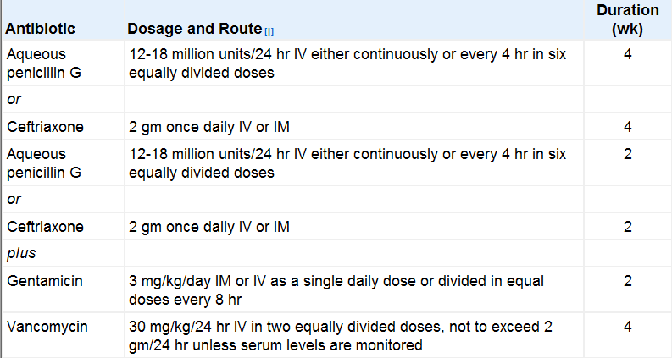
Streptococci (bovis &viridans gp)sensitive to Pencillin

Slide 55
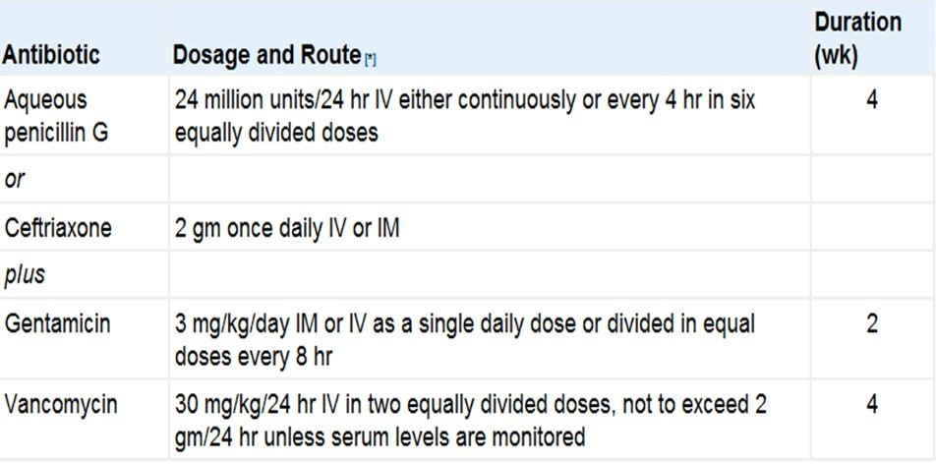
Streptococci (bovis &viridans gp)with relative resistance

Slide 56
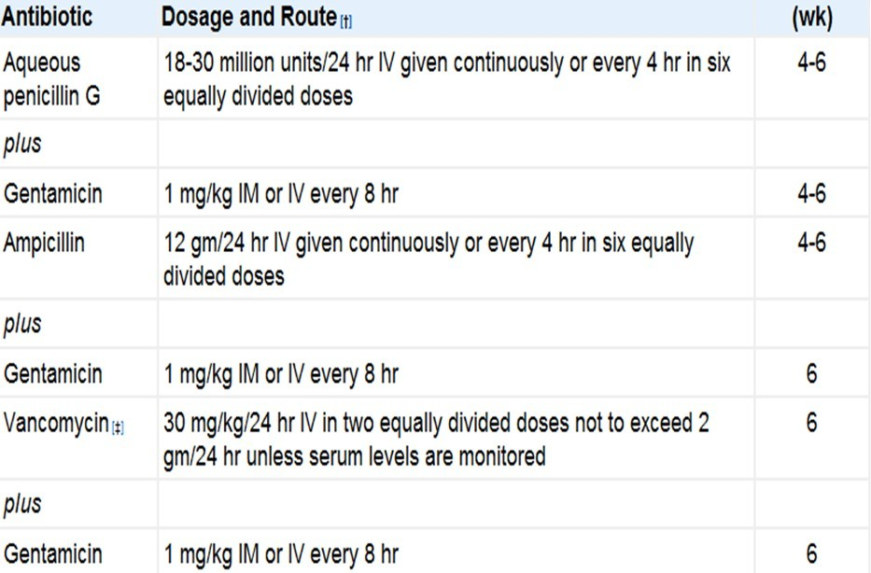
Enterococcal IE

Slide 57
Enterococcal Endocarditis Caused by Strains Resistant to Penicillin, Aminoglycoside & Vancomycin
Regimen E faecium Linezolid
Dose Duration
1200 mg /24 h in 2 ≥ 8 wk doses
2g /24 h in 4 doses ≥ 8 wk
E faecalis Imipenum/ cilastin
+
Ampicillin
or
ceftriaxone
12g /24 h in 6 divided doses
4g /24 h 2 divided doses
≥ 8 wk
≥ 8 wk

Slide 58
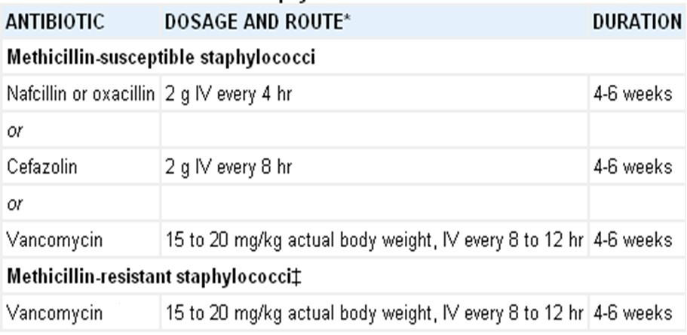
Staphylococcal Endocarditis in the Absence of Prosthetic Material

Slide 59
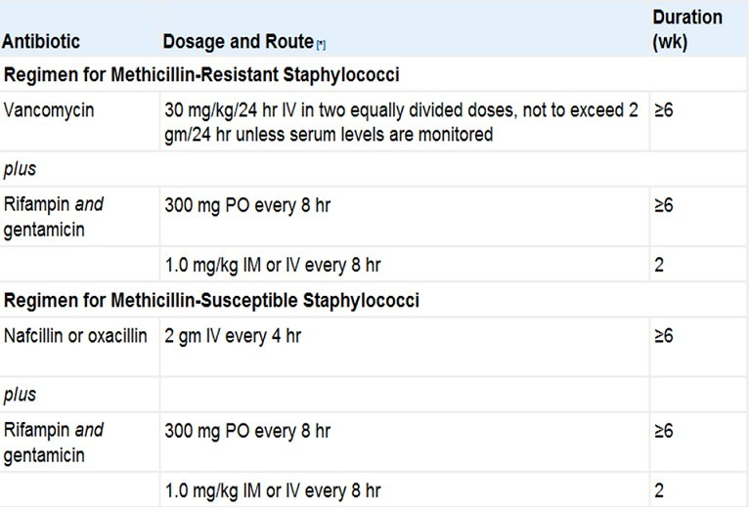
Staphylococcal IE in Presence of Prosthetic Valve /material

Slide 60
IE by HACEK group

Slide 61
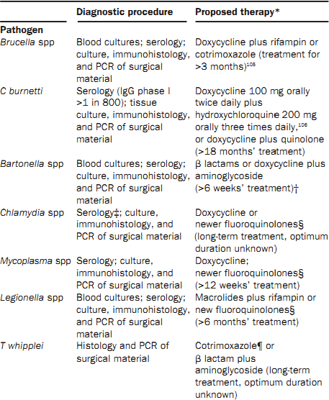
IE by rare organisms

Slide 62
Surgical Intervention in NVE indications
Class I
Acute valve stenosis or regurgitation with heart failure (B)
Acute AR or MR with evidence of elevated filling pressures (B)
Fungal endocarditis or IE caused by other highly resistant organisms (B)
IE complicated by heart block , annular or aortic abscess or destructive penetrating lesions. (B)
Class IIa
Recurrent emboli and persistent vegetations despite appropriate antibiotic therapy (C)
Class IIb
Mobile vegetations >10 mm (C)

Slide 63
Surgical Intervention in PVE indications
Class I
IE of a prosthetic valve resulting in heart failure (B)
IE of a prosthetic valve with evidence of dehiscence by cine fluoroscopy or echocardiography (B)
IE of a prosthetic valve with evidence of increasing obstruction or worsening regurgitation (C)
IE of a prosthetic valve with complications such as abscess formation (C)

Slide 64
Surgical Intervention in PVE indications
Class IIa
IE of a prosthetic valve with evidence of persistent bacteremia or recurrent emboli despite appropriate antibiotic treatment (C)
IE of a prosthetic valve with relapsing infection(C)
Class III
Routine surgery is not indicated for patients with uncomplicated IE of a prosthetic valve caused by first infection with a sensitive organism (C)

Slide 65
Response to Therapy
70% pts with NVE or PVE are afebrile by end of 1st week and 90% end of 2nd wk
Fever persists longer in pts with S. aureus, P. aeruginosa or culture-negative IE and those with microvascular phenomena and major embolic complications
Should be evaluated for intracardiac complications, focal extracardiac septic complications, intercurrent nosocomial infections, recurrent pulmonary emboli (in right-sided IE), drug-associated fever and additional underlying illnesses.

Slide 66
COMPLICATIONS
Part and parcel of IE(30-60%)
Local
Heart failure(L>R –A/C AR/MR)
Abscess
Fistula formation
Perforation of valve
Mycotic pseudo aneurysm

Slide 67
Systemic
Sepsis
Systemic embolization
Mycotic aneurysm
Renal dysfunction
Neurologic manifestations

Slide 68
Heart Failure
Most frequent major complication of IE
Occur in 32% of patients
It is an indication for surgical intervention in most instances.
Results from a/c severe valvular dysfunction due to leaflet destruction or interference with normal coaptation ,rupture of infected mitral chordae, obstruction due to bulky vegetations, development of intracardiac shunts or prosthetic valve dehiscence

Slide 69
Systemic emboli
•
•
•
Usually precede or coincide with diagnosis of IE . Are infrequent after 1 wk of therapy.
Risks increases with mitral vegetations, S. aureus IE, large vegetations (>10 mm) .
Embolic stroke syndromes predominantly involve MCA territory.
Clinically Occur in 13% to 35% of pts with NVE & PVE.
Careful routine imaging detect similar additional frequency of asymptomatic embolic infarcts.
•
•
•

Slide 70
Mycotic Aneurysms
Extremely dangerous subset of embolic complications
Occur most frequently in middle cerebral artery and its branches
Result from embolization to arterial vasa-vasorum, with subsequent spread of infection and weakening of the vessel wall
Mortality rate is 60% to 80%
Symptoms vary from localized headache to dense neurologic deficits.

Slide 71
Periannular Extension of Infection
Persistent fever and bacteremia despite antibiotic therapy, heart failure or new conduction block should raise suspicion for this complication
More common in PVE than NVE(10% to 40% vs >50%)
It may progress to abscess formation, perforation, fistula development .
.

Slide 72
Renal Dysfunction
May be due to immune complex disease, drug-induced nephrotoxicity.
Focal glomerulonephritis and embolic renal infarcts cause hematuria

Slide 73
CHEMOPROPHYLLAXIS
NO HUMAN STUDY HAS DEFINITELY DEMONSTRATED THAT PROPHYLLACTIC ANTIBIOTICS PREVENT ENDOCARDITIS AFTER AN INVASIVE PROCEDURE
WHO NEEDS IT -HIGHEST RISK PATIENT + HIGHEST RISK PROCEDURE

Slide 74
HIGHEST RISK PATIENT
Prosthetic cardiac valve or prosthetic material used for cardiac valve repair.
Previous IE.
Congenital heart disease (CHD)
Unrepaired cyanotic CHD, including palliative shunts & conduits
Completely repaired CHD with prosthetic material or device for 6 months after the procedure
Repaired CHD with residual defects at the site or adjacent to the site of prosthetic patch or device.
Cardiac transplantation recipients who develop cardiac valvulopathy.

Slide 75
HIGHEST RISK PROCEDURE
•
Dental procedures that involve manipulation of gingival tissue or periapical region of teeth or perforation of the oral mucosa. Class IIa
Invasive procedure of respiratory tract that involves incision or biopsy of respiratory mucosa, such as tonsillectomy and adenoidectomy. Class II a
•

Slide 76
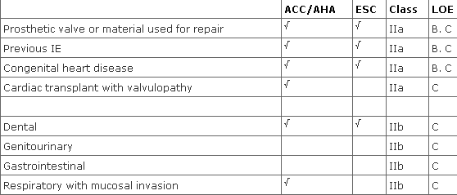
Comparison of ACC/AHA and ESC Recommendations for IE Prevention

Slide 77
Regimens for IE prophylaxis
If pt can take oral medication Amoxycillin 2gm
Allergic to penicillins
Oral Cephalexin 2g OR Clindamycin 600 mg OR
Azithromycin or clarithromycin 500 mg
If pt cannot take oral medication Ampicillin : 2g IM or IV OR Cefazolin or ceftriaxone 1g IM or IV
Allergic to penicillins
Clindamycin 600 mg IM or IV
Single Dose 30 to 60 min before Procedure

Slide 78
CLINICAL TRIALS
Early Surgery Versus Conventional Treatment in Infective Endocarditis (EASE)
As compared with conventional treatment, early surgery in patients with infective endocarditis and large vegetations significantly reduced the composite end point of death from any cause and embolic events by effectively decreasing the risk of systemic embolism

Slide 79
Partial Oral versus Intravenous Antibiotic Treatment of Endocarditis(POET)
In patients with endocarditis on the left side of the heart who were in stable condition, changing to oral antibiotic treatment was noninferior to continued intravenous antibiotic treatment

Slide 80
ONGOING TRIALS
Accelerated treatment of endocarditis-The POET II trial
Short-course antibiotic regimen compared to conventional antibiotic treatment for gram-positive cocci infective endocarditis- SATIE trial
Antibiotics vs Antibiotics and Surgical ThERapy for Infective Endocarditis – ASTERIx study

Slide 81
Recent Questions
Post prothetic implantation endocarditis (Jan 17,Sep20)
Culture Negative Endocarditis (July 19)
Indications of surgery in Infective Endocarditis(Jan 19)
Management of Infective Endocarditis(March 21)
Evaluation, Indication,Timing of Surgery in InectiveEndocarditis(Aug 22)

Slide 82
References
Braunwald's Heart Disease: A Textbook of Cardiovascular Medicine 12thedition
Hurst’s the Heart 15th edition
Prevention of Infective Endocarditis : Guidelines From the American HeartAssociationCirculation.
2015 ESC Guidelines for the management of infective endocarditis
Infective endocarditis : Philippe Moreillon, Yok-Ai Que THE LANCET
Clinical Presentation, Etiology and Outcome of Infective Endocarditis in the 21st Century: The International Collaboration on Endocarditis-Prospective
Infective Endocarditis – An Indian Perspective :SS Kothari, S Ramakrishnan:Indian Heart J

Slide 83
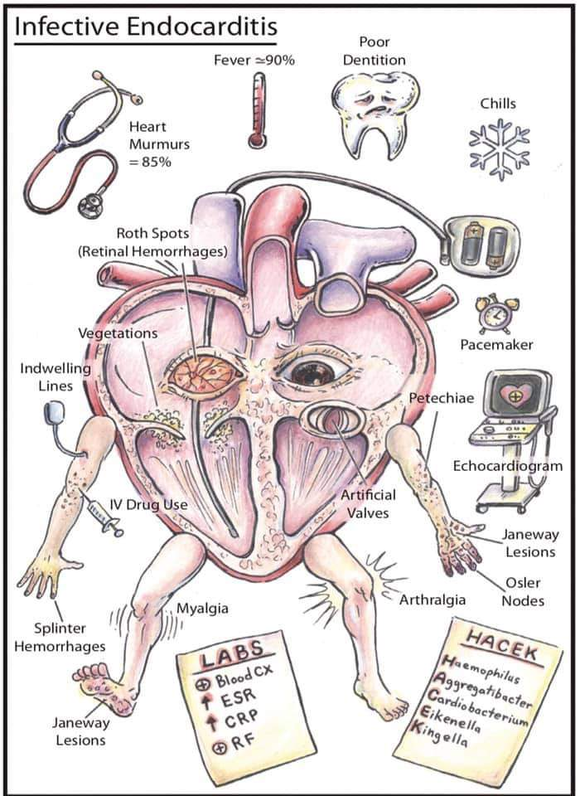
THANK YOU

