Slide 1
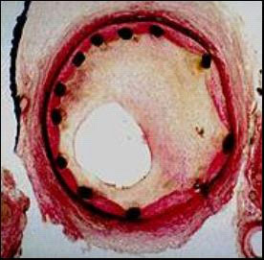
IN-STENT RESTENOSIS

Slide 2
DEFINITION
ISR is due as the gradual re-narrowing of a stented coronary artery lesion due to arterial damage with subsequent neointimal tissue proliferation.
ISR has classically been defined as a luminal narrowing with >50% diameter stenosis of a stented coronary segment or within 5 mm of a stent edge

Slide 3
Incidence of DES-ISR
National Cardiovascular Data Registry database, ≈10% of PCIs in the US were for the treatment of ISR
In general, rates of ISR range from 3% to 20% with drug-eluting stents and 16% and 44% with BMS
Mostly between 3 to 20 mo after stent placement

Slide 4
The incidence of ISR depends on the definition, stent type, location, patient comorbidities and lesion complexity (i.e., lesion length, vessel size, and bifurcation lesions).

Slide 6
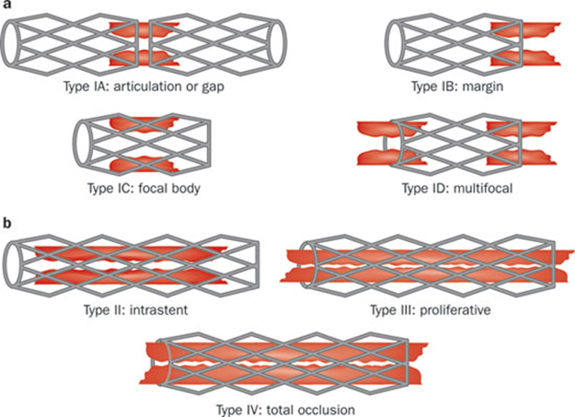
ANGIOGRAPHIC RESTENOSIS & CLASSIFICATION
Diameter stenosis > 50%
Type I focal <10 mm in length
IA articulation or gap
IB margin
IC focal body
ID multifocal
Type 2 diffuse >10 mm intrastent
Type 3 proliferative >10 mm extending beyond stent margins
Type 4 total occlusion: restenotic lesions with TIMI flow grade of 0

Slide 7
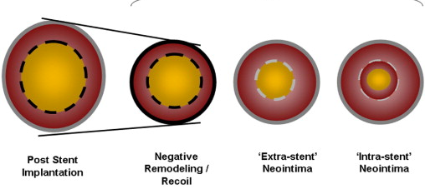
Pathogenesis
Three major pathogenic mechanisms
Early elastic return (recoil)
Vascular remodeling
Neointimal hyperplasia

Slide 8
ISR, which happens early within days of stent deployment, is due to elastic recoil and relocation of axially transmitted plaque.
The causes of late (weeks to months) ISR commonly are reorganization of thrombus, neointima formation and remodeling.
Neoatherosclerosis yet is another contributing factor to ISR.
The stimulation of neointima formation happens due to injury to the vessel during the PCI and stent deployment

Slide 9
ER and vascular remodeling
IEL/EEL of human epicardial coronary arteries contain elastin fibres that may cause ER after balloon overstretch
ER can result in up to 40% loss of luminal areas.
These mechanisms have been almost cancelled with the advent of stents

Slide 10
Neointimal hyperplasia
Vascular smooth muscle cell (VSMC) proliferation or migration and activation caused by mechanical stretch, IEL rupture, and medial dissection
ISR is primarily a non-specific inflammatory response to vessel wall injury due to the persistent “insult”

Slide 11
Chronic wall stress stimulates inflammatory processes and the migration of smooth muscle cells from tunica media and myofibroblasts from tunica adventitia to tunica intima.
A cascade of events are triggered by the intimal and medial damage, leading to proliferation and migration of vascular smooth muscle cells, extracellular matrix formation which ultimately activates the coagulation-fibrinolysis system. •

Slide 12
The local inflammation can lead to the development of neoatherosclerosis characterized by accumulation of lipid-laden foamy macrophages within the neointima with or without a necrotic core formation and calcification, which can occur years after stent placement.
This is associated with a higher proportion of in-stent atherosclerotic plaque

Slide 13
Nakazawa et al. have individuated some independent predictors for its occurrence: younger age, longer stent age (≥48 months), SES,PES, active smoking, chronic kidney disease and angiotensin-converting enzyme inhibitors or angiotensin receptor blocker, or LDL-cholesterol levels above 70 mg/dL

Slide 15
PREDICTORS OF IN-STENT RESTENOSIS
Patient characteristics
Lesion characteristics
Procedural characteristics

Slide 16
Patient characteristics
Metal allergy.
Local hypersensitivity reactions with immunologic and inflammatory response to the drug or the polymer.
Age & female gender.
Diabetes mellitus.
Chronic kidney disease (including hemodialysis).
Multivessel coronary artery disease

Slide 17
Lesion characteristics
Lesion length.
Smaller reference artery diameter.
Ostial lesion.
Initial plaque burden and residual plaque after implantation.
In contrast with BMS, DES tends to have a more focal pattern of ISR, except in diabetics, where the ISR tends to be more confined to the stent edges.

Slide 18
Focal ISR (Mehran pattern Ⅰ) has been associated with a lower rate of ISR recurrence than nonfocal (Mehran pattern > Ⅰ) ISR

Slide 19
Procedure related
Stent undersizing.
Incomplete lesion coverage.
Stent under expansion, and malapposition.

Slide 20
Mechanical properties of stents that may lead to recoil because of
Loss of radial force.
Stent fractures, and altering increase in shear stress are all associated with higher rates of ISR.
For every 10 mm of excess stent length beyond lesion has been independently associated with increased post-procedural percent diameter stenosis by 4% and increased TLR at 9 mo. .

Slide 21
Malapposition
Incomplete stent apposition (ISA),
The absence of contact between stent struts and the vessel wall not overlying a side branch.
Malapposition seems to be related to procedural technique due to under-sizing the stent,
low deployment pressures
severely calcified lesions.
Oversized stents can also lead to extensive trauma to the vessel wall and increased proliferative reaction.

Slide 22
Inadequate stent expansion
IVUS & OCT allows a more detailed analysis of a correct implantation
The MUSIC criteria were developed: a stent expansion is defined excellent if minimum lumen area inside the stent is ≥90% of the average reference lumen area

Slide 23
Stent length
Important determinant for ISR
Choi et al in a study with median follow-up of 36.9 months observed how patients treated with stent length ≥32 mm had a greater risk of ISR than those treated with a stent <32 mm
HORIZONS-AMI study- ISR rate increases significantly when the vascular caliber is ≤3 mm

Slide 25
Biological Factors
Resistance to antiproliferative drugs.
Mutations of the gene polymorphism that encode mTOR - resistance to sirolimus (rapamycin). ➢
Hypersensitivity reactions to the polymer.
Inflammatory response associated with sirolimus eluting stents (SES) /everolimus-eluting stent (EES).
Hypersensitivity reactions to the metallic stent platform.

Slide 26
Arterial factors
High-shear stress areas like carina of the bifurcation can potentially limit progression of atherosclerosis.
Low-shear stress areas like ostium of a bifurcation may lead to promotion of atherosclerosis or enhancement of neointimal proliferation.
Positive vessel remodeling may be also a contributable factor for development of DES-ISR.

Slide 27
Stent Factors
Stent underexpansion ( major risk-factor for ISR).
Stent malapposition
Stent fracture.
Type of DES (type of drug and polymer release kinetics).

Slide 28
modernized classification system specific to DES-ISR
Waksman Classification for DES-ISR

Slide 30
CLINICAL PRESENTATION
Majority of ISR presents as progressive recurrent angina.
The time for symptoms to develop due to DES-ISR is 3 to 12 mo after stent placement.
BMS stent develop ISR symptoms sooner with average period of 6 mo post-PCI.
BMS-ISR presented as MI in 3.5%-20% of patients.
DES-ISR is similar to that of BMS with approximately 16%-66% of patients presenting with unstable angina and 1%-20% with MI.

Slide 31
Imaging strategies
Intracoronary Imaging--> IVUS/OCT
Imaging can differentiate between a mechanical mechanism and a biological cause

Slide 32
IVUS
IVUS does help detect the presence of neointimal hyperplasia obstructing the stent, stent underexpansion, stent fracture, or edge restenosis.
In addition, it can provide insights into optimal vessel sizing for choosing the appropriate stent size .
However, IVUS has limited axial resolution (150 μm), which makes neointimal interface hard to define.

Slide 33
Optical Coherence Tomography
OCT provides better axial resolution (15 μm), allowing better resolution of the vessel lumen, neointimal tissue, and stent struts distribution.
The morphology of ISR can be identified using OCT which could show macrophage infiltration, necrotic core, in-stent calcification and neoatherosclerotic plaque rupture.
The weakness of the OCT resides in the poor tissue penetration, which cause poor visualization of the residual plaque that is beyond the stent.

Slide 35
A, OCT cross-section demonstrating 2 layers of stent struts with characteristic shadowing behind stent struts (arrow). B, OCT cross-section with in-stent restenosis at a site with overlapping stents. The asterisk (*) indicates a region with 3 distinct layers of stent struts.

Slide 36
STENT THROMBOSIS
Angiographic confirmation of stent thrombosis
Thrombus in stent or in segment 5 mm proximal or distal to stent and at least 1 of the following within a 48-hrs
Acute onset of ischemic symptoms at rest
New ischemic ECG changes that suggest acute ischemia
Typical rise and fall in cardiac biomarkers
Pathologic confirmation of stent thrombosis
Evidence of recent thrombus within stent- autopsy or examination of tissue from thrombectomy

Slide 37
STENT THROMBOSIS ISR
Frequently presents as MI
Time frame from original implantation - shorter
IVUS
Intraprocedural findings- Thrombus is soft
Presents as MI rarely
Longer time
Neointimal hyperplasia-reliably seen and measured
Neointimal tissue is hard and associated with balloon slippage

Slide 39
TREATMENT OPTIONS
Optimal treatment for DES restenosis remains undefined
Conventional balloon angioplasty
Cutting or scoring balloon
Drug-eluting balloon
BMS
Same DES
Different DES
Vascular brachytherapy [VBT]- uniform avoidance
Bypass surgery

Slide 40
Balloon angioplasty
Original stent underexpansion
Larger high-pressure balloon
Technical problem - slippage during inflation
Cutting or scoring balloon
Avoid slippage during inflation
Difficult to deliver in distal areas through stented segments

Slide 41
Same DES or different DES
Drug resistance
DES eluting a different drug might be more effective

Slide 42
ISAR-DESIRE trial
RCT, 450 patients with SES ISR
Treatment with same (homo-DES) or different DES (hetero- DES [PES])
Mean lesion lengths -12.7 and 12.5 mm respectively
Focal pattern of restenosis (65% and 61%) respectively
No significant differences in
in-stent late lumen loss at 8 months
1-year clinical end points of TLR(17% vs 15%)
Death/MI (6.1% vs. 5.8%)
Stent thrombosis (0.4% in both groups).
Focal ISR might not be due to drug resistance
Diffuse ISR has a greater chance to be due to drug resistance
Alternate DES should focus solely on diffuse ISR pattern

Slide 43
VBT
High rates of late restenosis and logistic issues
Use of VBT has declined

Slide 44
DEB
Novel modality to treat DES ISR
Advantage of DEB over DES
Delivery of an antirestenotic agent without adding a second layer of metal
DEB effective in treatment of BMS ISR
PEPCAD-DES - currently investigating efficacy of paclitaxel-eluting balloon for treatment of DES ISR

Slide 45
CABG
Multivessel DES with multivessel ISR
Diffuse or even single-vessel ISR at very critical lesion location
Patient treated with a new DES for ISR should continue on dual antiplatelet therapy unless a complication emerges
Any complication or noncompliance issues -favor CABG

Slide 46
Guidelines
Current European guidelines recommend either DESs or DCBs with consideration for intracoronary imaging to treat ISR

Slide 47
Future Directions
Several randomized trials investigating treatment strategies for DES ISR are currently ongoing
GISE-CROSS (DES Crossover for In-Stent Restenosis) trial is evaluating same versus different DES as alternate therapies for DES restenosis
DES-ISR trial is evaluating relative efficacy of PES and SES for diffuse DES ISR
FOCUS (Focal In-Stent Restenosis After Drug-Eluting Stent) trial compares cutting balloon angioplasty with SES for focal DES ISR

Slide 48
References
Topol interventional cardiology 6th edition
Dangas et al.In-Stent Restenosis in the DES Era JACC Vol. 56, No. 23, 2010 November 30, 2010:1897–907

