Slide 1
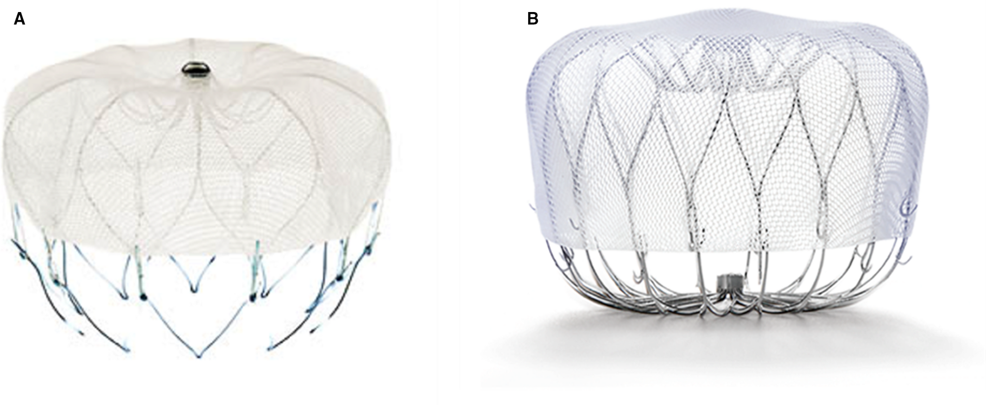
LAA CLOSURE
Dr Sanchna Dev S
Dept of Cardiology
TDMC

Slide 2
CONTENTS
INTRODUCTION
HISTORY OF LAA CLOSURE
MORPHOLOGY AND FUNCTION OF LAA
SURGICAL LAA LIGATION /OCCLUSION
PERCUTANEOUS LAAO DEVICES
PERCUTANEOUS LAAO DEVICE TRIALS
COMPLICATIONS OF LAAO

Slide 3
INTRODUCTION
Left atrial appendage —> “most lethal human attachment”
responsible for >90% of embolic strokes
AF –associated with a 4- to 5- fold increased risk of ischemic stroke
Historically, the mainstay of treatment for stroke prevention in AF
—>oral anticoagulation (OAC).
Large, randomized, controlled clinical studies of vitamin K antagonists (VKA), direct thrombin inhibitors, and factor- Xa inhibitors have established OACs as the standard of care for stroke prevention in AF

Slide 4
VKA – dietary restriction and routine blood monitoring —>poor compliance and freq measurements outside the therapeutic window
DOACS- without blood level monitoring —> significant bleeding , high medication costs, patient non compliance
Elderly – unfavourable risk profile for anticoagulation (HASBLED)
These challenges led to a quest for alternative non pharmacologic strategies particularly for high- risk patients who are intolerant to standard therapy

Slide 5
HISTORY OF LAA CLOSURE
the earliest documented LAA excision procedures were in patients with rheumatic mitral stenosis undergoing cardiac surgery.
In 1949, Madden described 2 patients who underwent LAA excision as prophylaxis for recurring atrial thrombi
A meta-analysis of 23 studies noted
57% of patients with valvular AF had thrombi localized in the LAA and extended into LA cavity
91% of patients with non valvular AF had thrombi localised in LAA only (P<0.0001) —> occlusion or exclusion of the LAA for the prevention of embolic stroke

Slide 6
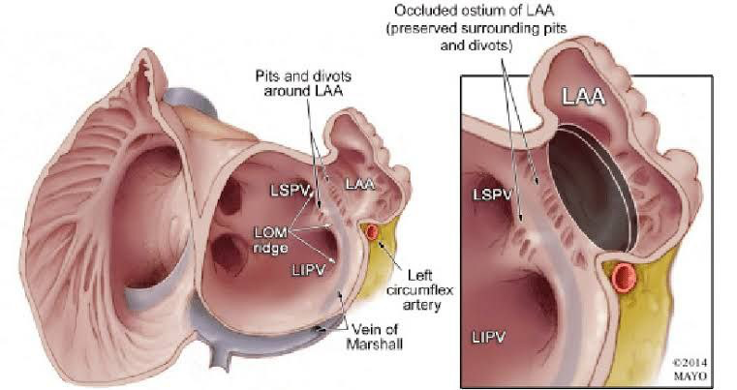
MORPHOLOGY OF LAA
LAA —> finger- like projection contiguous with the main body of LA
vestigial remnant of the primordial LA
Most cases —> extends between the anterior and lateral walls with its tip pointed anterosuperiorly.
In a small percentage of hearts, the LAA is directed laterally and posteriorly or sits in the transverse pericardial sinus
postmortem study —> 54% of hearts had 2 lobes, 23% had 3 lobes, 20% had 1 lobe, and only 3% had 4 lobes.
strong association with the number of lobes and the presence of LAA thrombus
most patients with LAA thrombus had ≥3 lobes
In contrast, thrombus was only seen in 0.7% with 1 or 2 lobes

Slide 7
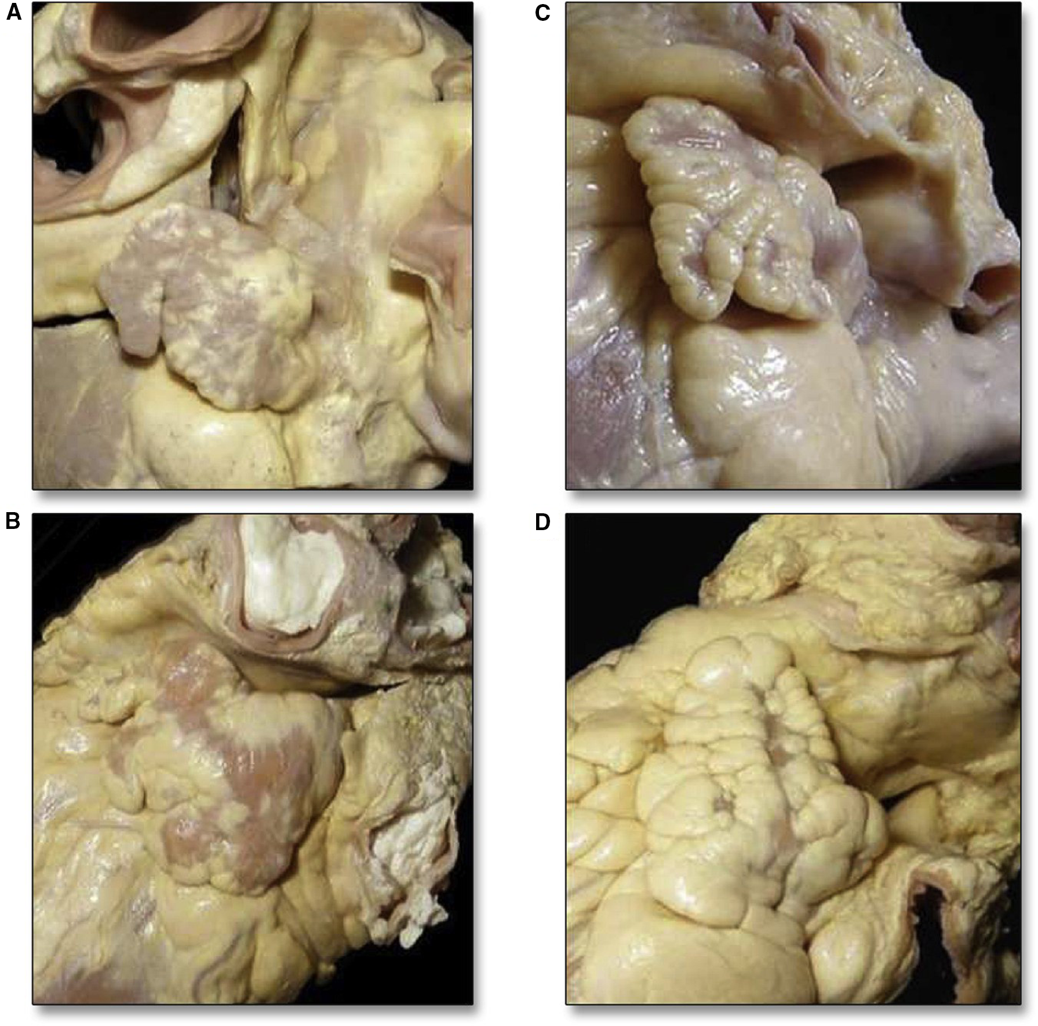
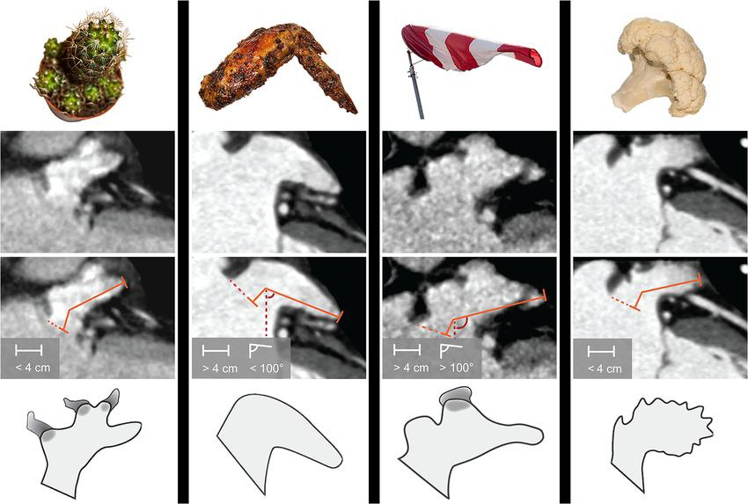
LAA SHAPE
4 shapes

Slide 8
LAA FUNCTION
neurohormonal and reservoir function
contains specialized endothelial cells —> ANP and BNP —> regulate fluid balance (surgical removal of LAA- fluid retention in immediate post op period) ~ MAZE procedure
Compared with the LA, the LAA is more distensible
LAA –IDEAL DECOMPRESSION CHAMBER when LA pressure increases
Mechanical activity of LAA has no apparent effect on cardiac output —> excision has no haemodynamic consequence

Slide 9
When LA undergoes remodeling in patients with chronic AF, the LAA becomes a static pouch
During AF, Doppler flow velocity is reduced and propensity for thrombus formation increases.
Endocardial damage – atrial dilatation,endocardial denudation, fibroelastic inflitration of the extracellular matrix
Hypercoagulable state -Hemostatic and platelet activation
Stasis in LAA esp during AF
VIRCHOWS TRIAD

Slide 10
SURGICAL LAA LIGATION & OCCLUSION

Slide 11
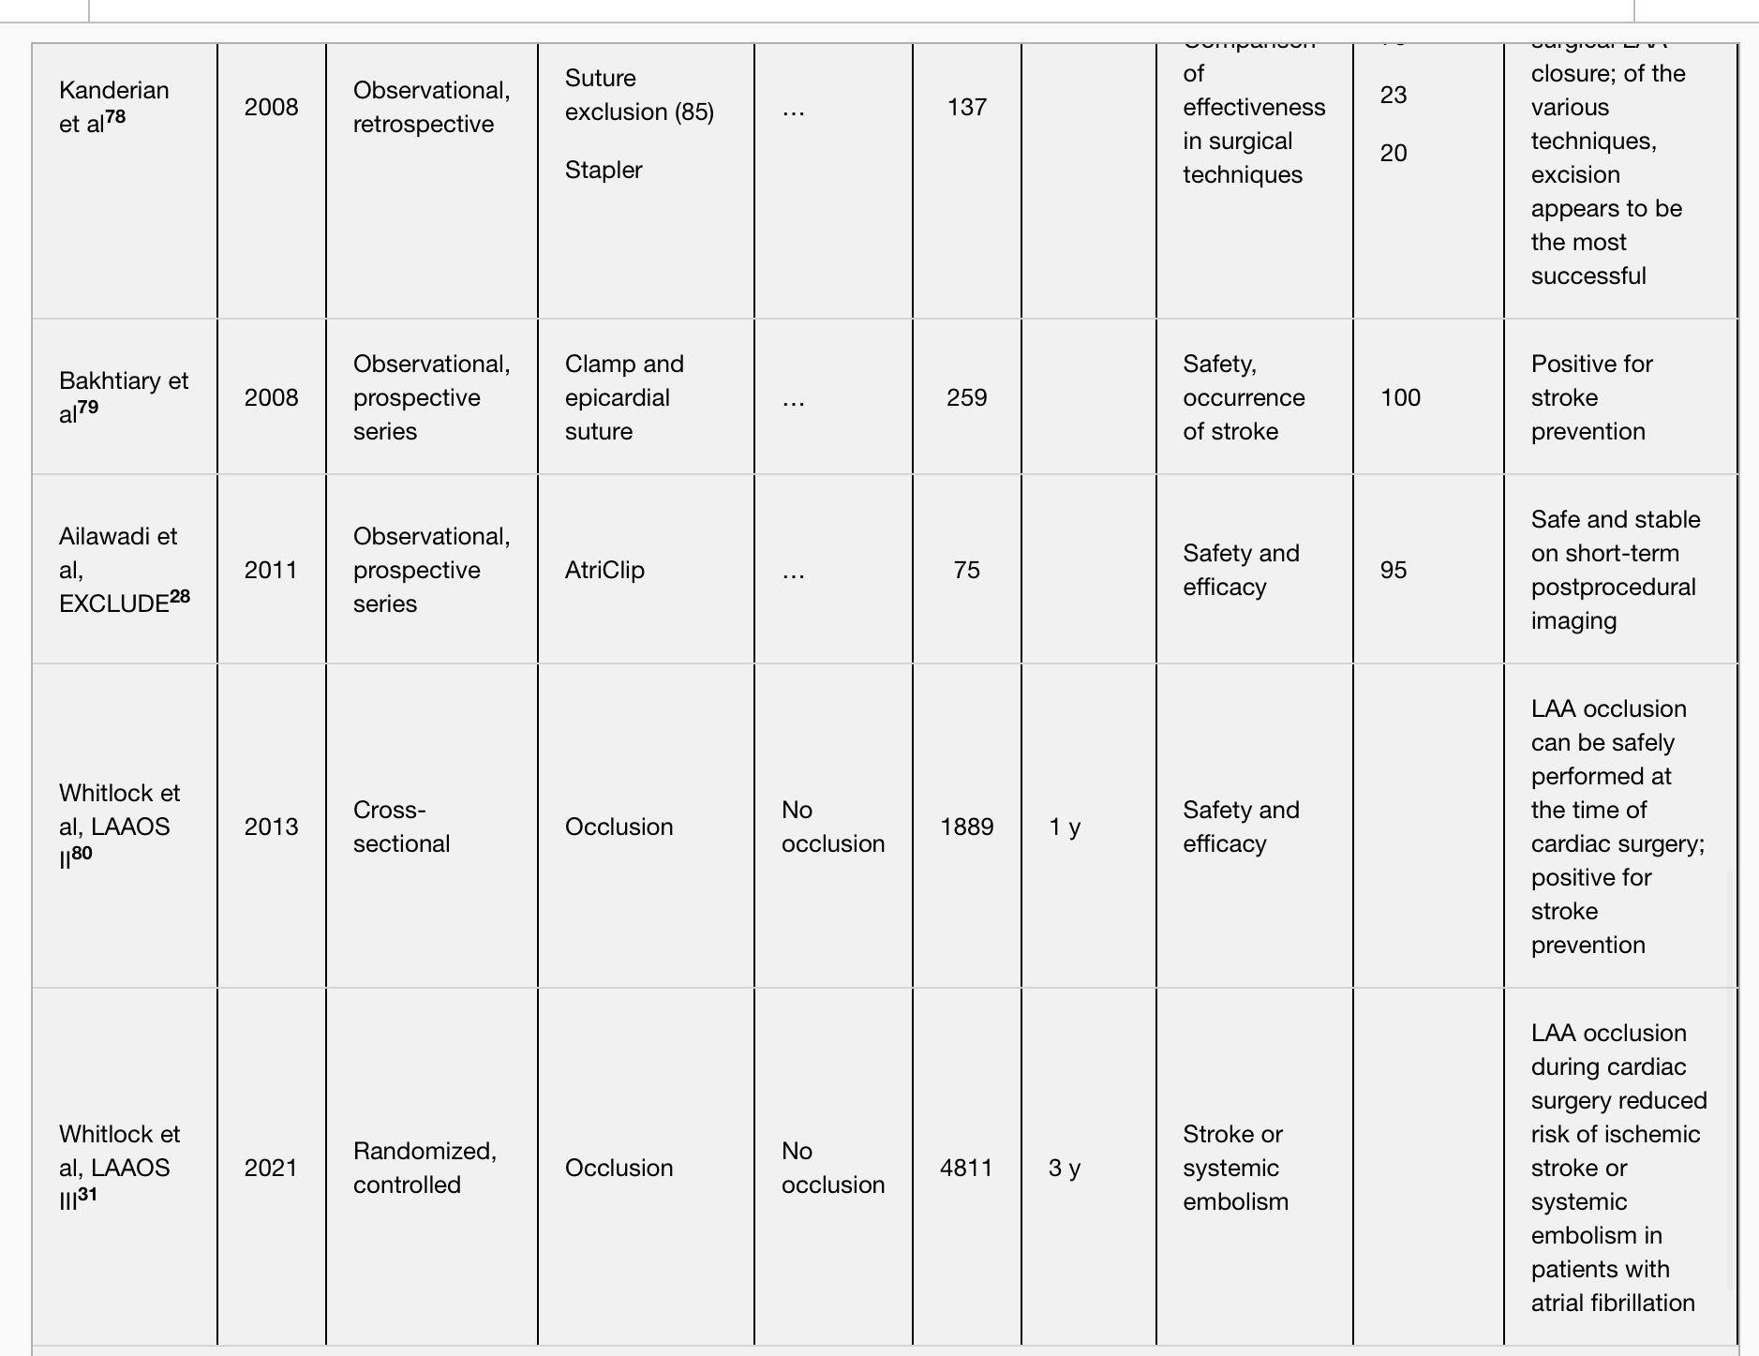

Slide 12
Current surgical techniques – resection, epicardial stapling, clip application or endoatrial double layer longitudinal suture closure
LAAOS –pilot study (2005) → randomly assigned 77 patients- undergoing CABG at increased risk for stroke to LAA exclusion using epicardial suture ligation or stapler (n=52) versus control (no LAA exclusion; n=25)
TEE was performed after 14 months.
Success in the LAA exclusion arm was defined as no residual Doppler flow into the appendage or residual “neck” of <1 cm
stroke rate in both exclusion groups (suture or stapler) was lower than the control group (2.7% versus 5.6%) —> benefit despite the differences in technique

Slide 13
Conclusions derived from LAAOS pilot study
successful closure immediately post operation compares well to long‐term observations, suggesting that failure is most likely derived from surgical technique rather than gradual suture/staple dehiscence
Incomplete occlusion carries a higher risk than no occlusion in relation to long‐term thromboembolic events
newer surgical devices have been developed –AtriClip device holds the strongest evidence available

Slide 15
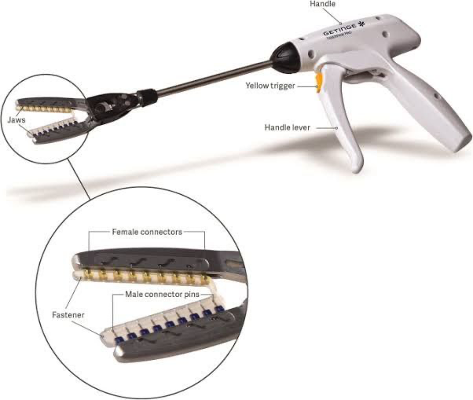
Other surgical LAAO technologies such as the Cardioblate Closure Device and Sierra Ligation System are currently investigational.
The Tiger Paw System was recalled in 2015 after reports of LAA tears leading to adverse events and death

Slide 16
2017 Society of Thoracic Surgeons gave a Class II a recommendation (Level of Evidence C) for the excision or exclusion of the LAA in concomitant cardiac operations in patients with AF for the prevention of thromboembolism

Slide 17
Percutaneous LAAO Devices

Slide 18
Several percutaneous devices for LAAO are being developed and tested in clinical trials
LARIAT device (SentreHeart, Redwood City, CA)
Amulet device (St. Jude Medical, St. Paul, MN)
WaveCrest device (Biosense Webster, Diamond Bar, CA).
The redesigned next‐generation Watchman FLX 2.5 (Boston Scientific, Marlborough, MA), which has been recently approved, is currently available for commercial use

Slide 19
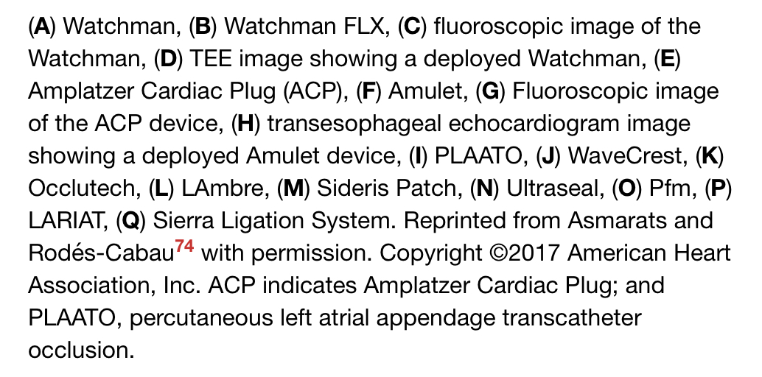

Slide 20
PLAATO (Percutaneous Left Atrial Appendage Transcatheter Occlusion)
first percutaneous LAAO device implanted in humans
device consisted of a self‐expanding nitinol cage enclosed by polytetrafluoroethylene membrane
European PLAATO study evaluated the safety and efficacy of the device in 180 patients with non valvular AF and contraindication to warfarin therapy
primary end point -LAA closure as determined by TEE after 2 months post procedure and stroke rate at 150 patient‐years. LAA occlusion was successful in 90% of the patients

Slide 21
trial was inundated with complications, including 2 deaths within 24 hours, 6 cardiac tamponades, and 1 device embolization.
The follow‐up phase was halted, and the trial was prematurely discontinued because of financial issues
The PLAATO device is no longer commercially available

Slide 22
Watchman and Watchman FLX 2.5
only US FDA approved devices for LAAO in the United States

Slide 23
Watchman device
The first‐in‐man Watchman device implantation was performed on August 12, 2002, in Europe
Self‐expanding nitinol 10‐strut frame with a 160‐μm polyethylene terephthalate fabric mesh cap
polyethylene terephthalate membrane covers 50% of the proximal outer nitinol frame —> designed to prevent thrombus embolization from the LAA and to promote endothelialization.
The selected device should be larger than the diameter of the LAA ostium to ensure device stability and sufficient compression (8%–20%) against the LAA wall.

Slide 24
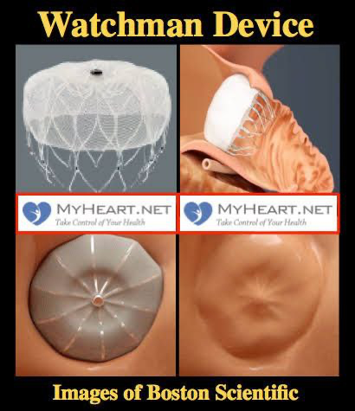
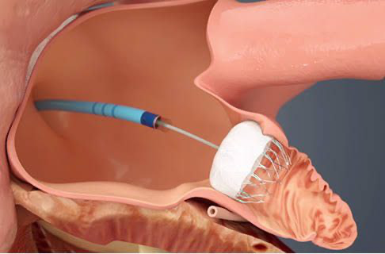
The length of the device is approximately equal to its width.
Fixation anchors, located distal to the distal end of the polyester fabric cap, secure the device within the LAA trabeculae.

Slide 25
Watchman FLX device
next‐generation Watchman device
fully recapturable and repositionable
shorter device length, 18 struts (versus 10 struts)
Atraumatic closed distal end (versus open end)
broader size range (20–35 mm) compared with its predecessor (21–33 mm) → provide a wider range to accommodate different LAA anatomies
The closed distal end design compared with the open‐ended design of the first Watchman device should theoretically lessen the likelihood of perforation, pericardial effusion, and tamponade
A significant redesign —>dual row anchors to reduce the risk of embolization

Slide 26
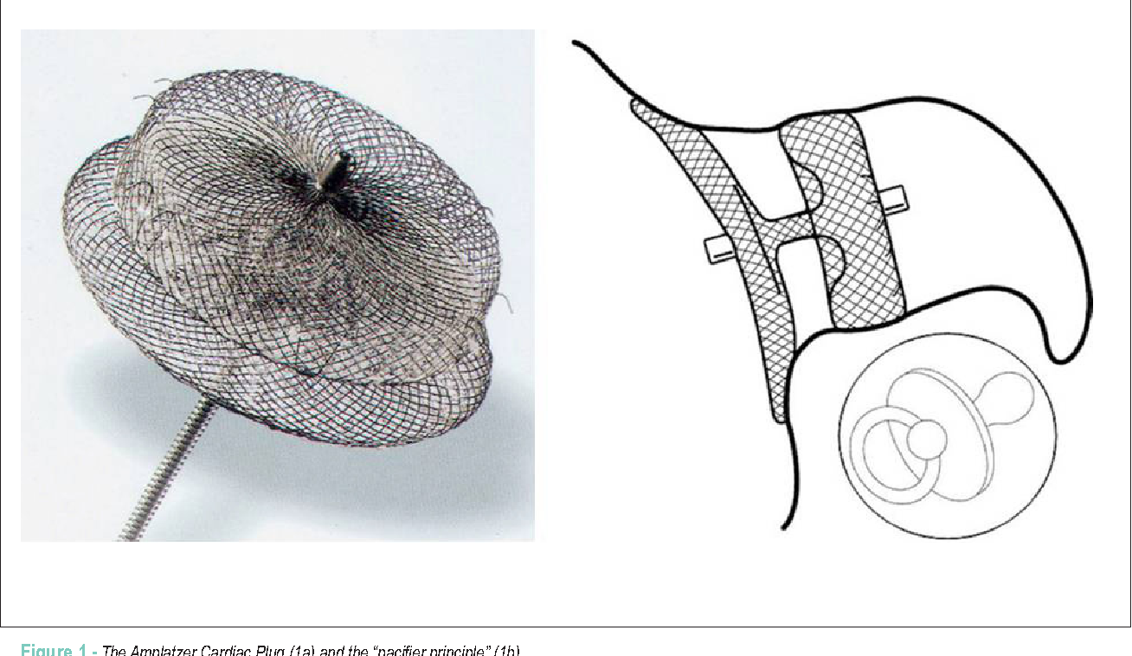
Amplatzer Cardiac Plug
Amplatzer Cardiac Plug (ACP; Abbott Vascular, Santa Clara, CA) —> self‐expanding, double‐disc device consisting of a nitinol mesh with polyester fabric
The length of the device is shorter than the diameter, thereby allowing its use in cases of shorter LAA anatomy.
Device size ranges from 16 mm to 30 mm, allowing broader options for different LAA sizes

Slide 27
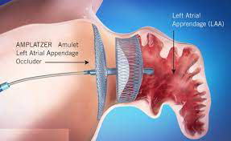
Amplatzer Amulet Device
latest generation of the ACP
based on a design similar to the ACP while incorporating some modifications to allow for easier implantation and reduce periprocedural complications
The ACP and Amulet devices received Conformité Européene mark approval in 2008 and 2013, respectively. At this time, the device is for investigational use only in the United States

Slide 28
The AMULET Investigational Device Exemption (IDE) trial
prospective, randomized, multinational trial that is currently ongoing.
designed to evaluate the safety and effectiveness of the Amplatzer Amulet device in comparison with the Watchman device for stroke prevention in patients with nonvalvular AF
This trial is the first head‐to‐head trial comparing 2 different LAAO devices
A total of 1878 patients will be randomly assigned 1:1 between the Amulet and the Watchman LAAO devices

Slide 29
The AMULET Investigational Device Exemption (IDE) trial
The 3 primary end points of the trial are the following:
composite of procedure‐related complications, or all‐cause death, or major bleeding through 12 months
a composite of ischemic stroke or systemic embolism through 18 months;
Effective device LAAO, defined as residual jet around the device ≤5 mm at the 45‐day visit.
initial data from the roll‐in phase appear promising with a low rate of complications and a high procedural success rate.

Slide 30
LARIAT
LAAO ligation system that uses a unique technique of combining epicardial and endocardial approaches
After obtaining percutaneous pericardial access, a magnet‐tipped wire is inserted into the pericardial space
Transseptal access is then performed and 20‐mm compliant occlusion balloon catheter with a second magnet‐tipped wire is introduced into the LAA.
After the 2 magnets are connected, the LARIAT snare delivery system is advanced over the LAA.
This maneuver is guided by the endocardial balloon catheter inside the LAA.
The snare is closed and the suture is tightened to ligate the LAA.

Slide 32
The US FDA approved the LARIAT in June 2006 for soft tissue approximation but not specifically for prevention of thromboembolism by occluding the LAA
unique to other LAAO devices because there is no device left in the endocardial surface of the LAA.
theoretically, anticoagulation is not required post procedure
In large (>40 mm) LAA, which may be prohibitive for both the Watchman or ACP devices, the placement of the LARIAT system may be considered as long as it is anatomically suitable for the device (up to 45 mm [width], 20 mm [height], 70 mm [length]).

Slide 33
the major limitation of the LARIAT device is the need for epicardial access.
Most of the complications are related to the pericardial puncture including pericardial effusion, cardiac perforation, and severe pericarditis.
Reports of death and major complications including complete LAA detachment and cardiac perforation prompted the US FDA to issue a safety communication in July 2015
Currently, the LARIAT system is generally considered for patients who have LAA anatomy that precludes endovascular LAAO or with absolute contraindications to anticoagulation

Slide 34
aMAZE (LAA Ligation Adjunctive to PVI for Persistent or Longstanding Persistent Atrial Fibrillation)
ongoing prospective, multicenter, randomized study.
evaluates the safety and effectiveness of the LARIAT system to ligate the LAA as an adjunct to planned pulmonary vein isolation for the treatment of AF
It is hypothesized that the combination of pulmonary vein isolation and LAA ligation can safely and effectively reduce the incidence of recurrent AF compared with pulmonary vein isolation alone
It is a unique trial because it combines 2 percutaneous procedures with different indications

Slide 35
Percutaneous LAAO device trials
Two prospective, randomized clinical trials evaluating the safety and efficacy of LAAO using the Watchman device were conducted in 2014
PROTECT AF (Watchman Left Atrial Appendage System for Embolic Protection in Patients With Atrial Fibrillation)
PREVAIL (Evaluation of the Watchman LAA Closure Device in Patients With Atrial Fibrillation Versus Long‐Term Warfarin Therapy) trial
In both trials, patients were randomized 2:1 to either LAAO using the Watchman device or warfarin.

Slide 36
Patients in the LAAO arm used aspirin (81 mg) and warfarin for 45 days, then dual antiplatelet therapy (DAPT) with clopidogrel 75 mg until 6 months, then indefinite aspirin therapy (325 mg)
The results of PROTECT AF were ultimately in favor of LAAO, demonstrating both noninferiority and superiority compared with warfarin in the primary end point of stroke, systemic embolism, or cardiovascular mortality.
However, the PROTECT AF trial identified a periprocedural safety hazard particularly cardiac tamponade, pericardial effusion, and procedure‐related strokes.
The PREVAIL trial was conducted specifically to further evaluate the safety end point of the Watchman device.

Slide 37
This trial mandated at least 25% of new operators be included to further assess the effect of procedural performance.
Interestingly, there was an unusually low ischemic stroke rate in the warfarin arm (0.73%) in the PREVAIL trial.
The PROTECT AF trial had a median follow‐up of about 4 years;the PREVAIL trial ~ 10 months
Meta‐analysis of patients in both trials followed for 5 years showed that the composite end‐point between groups was similar.
Despite ischemic stroke/systemic embolization being numerically higher in LAAO, the difference was not statistically significant (P=0.87).
Of note, hemorrhagic stroke, disabling stroke, postprocedure bleeding, and even all‐cause death favored LAAO

Slide 38
Preprocedural imaging
The presence of LAA or LA thrombus, determination of LAA dimensions and morphology, and feasibility of LAAO implant are the primary objectives of preprocedural imaging
TEE has remained the gold standard in LAAO preprocedural assessment
The LAA is evaluated by using different TEE omni plane angles (0°, 45°, 90°, and 135°). Based on these views, the maximal and minimal diameters of the ostium, depth of the LAA, and perimeter are noted.

Slide 39
CT is also widely used
less invasive than TEE with less interoperator variability
A standard CT analysis includes an assessment of the LAA anatomy in the sagittal, axial, and coronal planes
The perimeter, maximal, and minimal diameters of the LAA ostium and landing zone are standard measurements in cardiac CT analysis of the LAA

Slide 40
Intraprocedural imaging
TEE traditionally has been the gold standard for imaging guidance during LAAO
The TEE probe is reusable ; defrays the cost of the procedure
major disadvantage of using TEE is the requirement for general anesthesia (GA).
ICE -simplicity, single‐operator use, and avoidance of GA ( steep learning curve)

Slide 41
Complications of LAAO
general, complications from LAAO are related to (1) vascular access, (2) device implantation, (3) and antithrombotic therapy
Pericardial effusion
Procedure related stroke
Device embolization
Device related thrombus -Low ejection fraction, history of thromboembolism, deep implantation of the LAAO device, and large occluders were noted to increase the rates of DRT

Slide 43
Conclusion
The majority of embolic strokes in patients with nonvalvular AF are caused by thrombi in the LAA
Systemic anticoagulation has been known to be highly effective in reducing stroke risk in patients with AF
bleeding complications and nonadherence are barriers to effective anticoagulation therapy.
Surgical and percutaneous left atrial appendage occlusion devices - nonpharmacologic strategies to mitigate the challenges of drug therapy

Slide 45
Q. Most commonly associated with embolism events
Chicken wing type
Cauliflower type
Cactus type
Wind sock type

Slide 46
Trials involving watchman devices are all except:
PROTECT AF
PREVAIL
PREVENT AF
NONE

Slide 47
IDENTIFY
ACP

Slide 48
IDENTIFY
AtriClip

