Slide 1
LODESTAR (Low-Density Lipoprotein Cholesterol-Targeting Statin Therapy Versus Intensity-Based Statin Therapy in Patients With Coronary Artery Disease) Trial
Presenter
Dr Vishnu S
Senior Resident DM Cardiology
TDMCH

Slide 2
Statins:
Atorvastatin, fluvastatin, lovastatin, pitavastatin, pravastatin, rosuvastatin, simvastatin
Mechanism of action:
Inhibition of HMG-CoA reductase

Slide 3
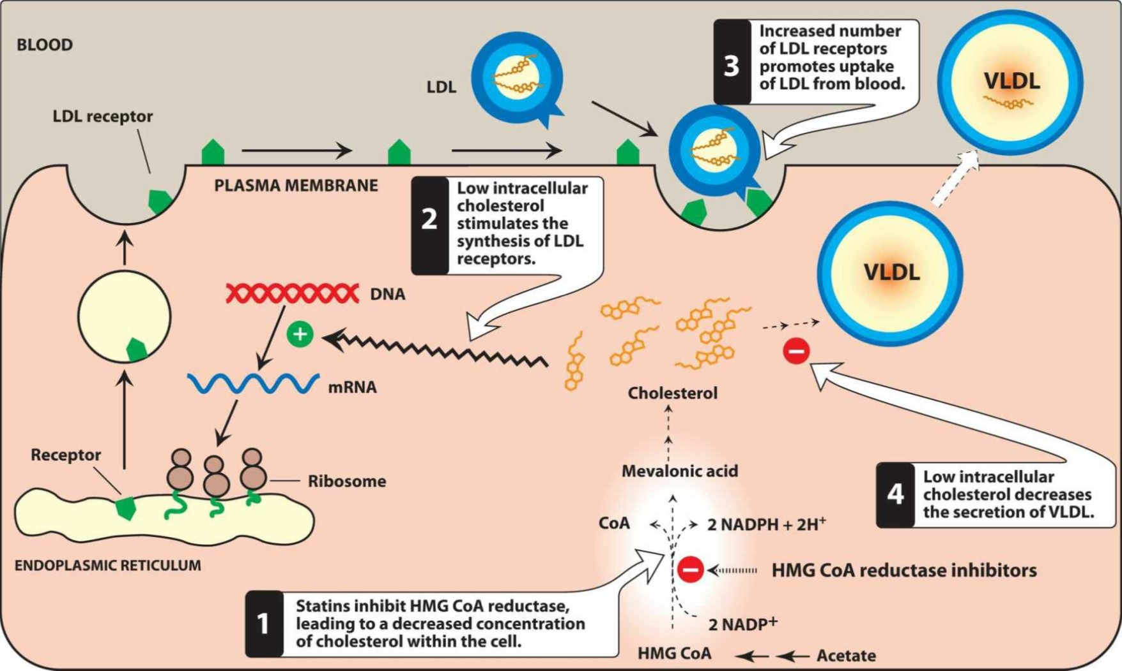

Slide 4
Uses: Atherosclerotic vascular disease- primary and secondary prevention, Coronary artery disease
Adverse effects: Liver failure, myopathy, contraindicated in pregnancy

Slide 5
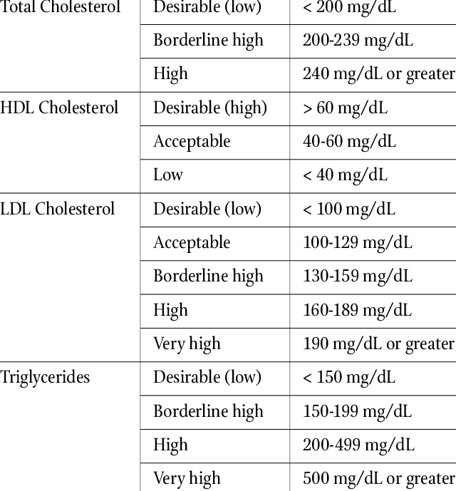

Slide 7
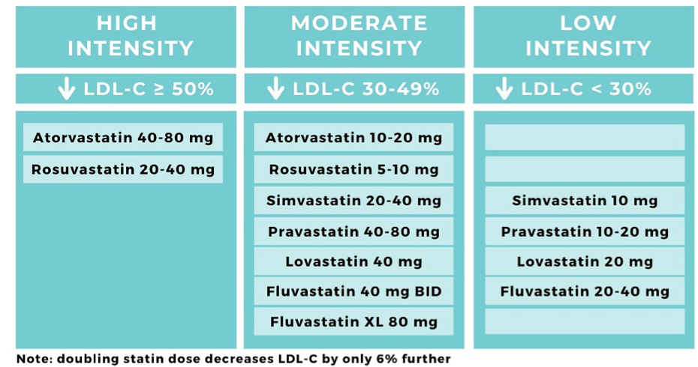

Slide 8
Statin therapy: cornerstone of the management of patients with both DM and CAD, who are considered as the highest risk population among patients with atherosclerotic cardiovascular disease
High-intensity statin therapy is strongly recommended in most patients with both DM and CAD

Slide 9
Concerns regarding the side-effects of high-intensity statin treatment : new-onset DM or worsening of DM
Identifying the optimal statin therapy and dose titration strategy to improve drug adherence and to achieve a sufficient reduction in LDL-C level is crucial

Slide 10
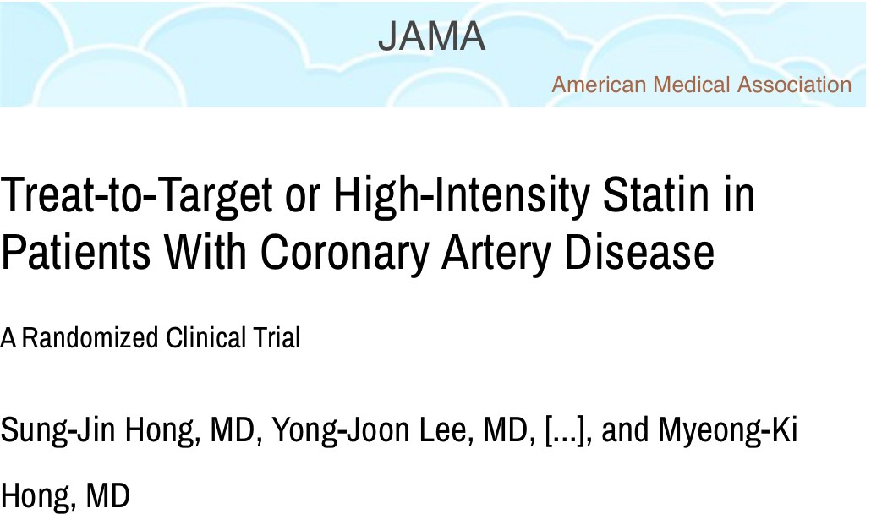
Compares “Treat to target strategy” (LDL 50-70 mg/dl) with “High-Intensity statins therapy” in patients with CAD

Slide 11
Conclusion of LODESTAR trial
Among patients with coronary artery disease, a treat-to-target LDL-C strategy of 50 to 70 mg/dL as the goal was noninferior to a high-intensity statin therapy for the 3-year composite of death, myocardial infarction, stroke, or coronary revascularization.

Slide 12
Trial Sponsor: Yonsei University, Seoul, Korea
Date Presented: 25/08/2023
Date Published: 18/10/2023

Slide 13
Objective: To compare the long term efficacy and safety of rosuvastatin with atorvastatin treatment in adults with coronary artery disease.
Study Design:
Randomization
Multicentre trial
Open label
Setting: 12 hospitals in South Korea, September 2016 to November 2019.

Slide 14
Patients with coronary artery disease were randomized to rosuvastatin (n = 2,204) vs. atorvastatin (n = 2,196).
Total number of enrollees: 4,400
Duration of follow-up: 3 years
Mean patient age: 65 years
Percentage female: 27%
Percentage with diabetes: 33%

Slide 15
Inclusion criteria:
Patients at least 19 years of age with coronary artery disease
Exclusion criteria:
Pregnancy
Intolerance to statin or use of a medication that interacts with statin metabolism
Risk for myopathy
Limited life expectancy

Slide 16
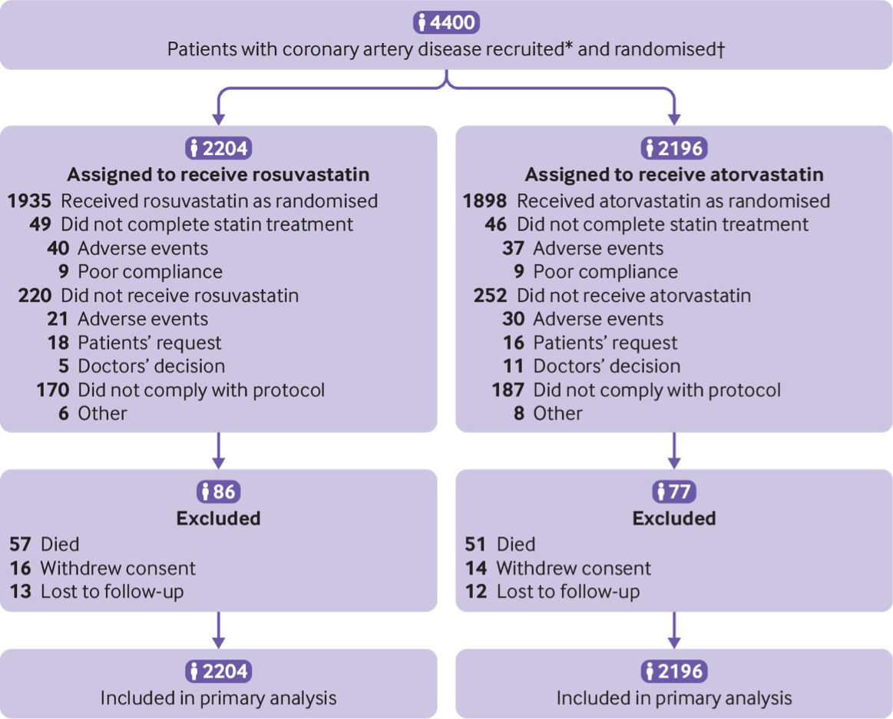
Randomisation

Slide 17
Rosuvastatin 10 mg/Atorvastatin 20 mg: moderate-intensity statin therapy
Rosuvastatin 20 mg/Atorvastatin 40 mg: high-intensity statin therapy
Treat-to-Target group, the target LDL-C level was set at < 70 mg/dL
Statin-naïve patients: started moderate-intensity statin therapy
Already on statin therapy: based on their baseline LDL-C levels(≥50 mg/dL and <70 mg/dL)

Slide 18
High-Intensity statin group: High-Intensity statin Therapy
Non-statin agents like ezetimibe: not recommended to avoid confounding effects
Follow-up visits:
6 weeks and 3, 6, 12, 24, and 36 months: General checkup
6 weeks and 12, 24, and 36 months: FLP, AST/AST, CK, Creatinine
12, 24, and 36 months: RBS, HbA1C

Slide 19
Occurence of primary outcome in study group

Slide 21
Principal Findings: The primary outcome, death, stroke, myocardial infarction, or any coronary revascularization at 3 years, was 8.7% in the rosuvastatin group vs. 8.2% in the atorvastatin group (p = 0.58).

Slide 22
Occurrence of the secondary outcome in study group

Slide 23
Secondary outcomes:
High-intensity statin therapy dosing was achieved in 70.9% of the rosuvastatin group vs. 74.0% of the atorvastatin group (p = 0.022)
LDL-C level <70 mg/dL at 3 years: 62.5% of the rosuvastatin group vs. 55.2% of the atorvastatin group (p < 0.001)

Slide 24
Death at 3 years: 2.6% in the rosuvastatin group vs. 2.3% in the atorvastatin group (p = 0.57)
Myocardial infarction at 3 years: 1.5% in the rosuvastatin group vs. 1.2% in the atorvastatin group (p = 0.37)
Initiation of diabetic medication: 7.2% in the rosuvastatin group vs. 5.3% in the atorvastatin group (p = 0.031)
Cataract operation: 2.5% in the rosuvastatin group vs. 1.5% in the atorvastatin group (p = 0.022)

Slide 25
Interpretation:
The 3-year composite of all-cause death, MI, stroke, or any coronary revascularization did not differ between the rosuvastatin and atorvastatin treatment.
Rosuvastatin treatment was associated with lower LDL cholesterol levels, but it also carried a higher risk of new-onset diabetes mellitus requiring anti- diabetic medication and cataract operation, compared with atorvastatin treatment.
Based on this study, high-intensity atorvastatin therapy may be preferential to rosuvastatin.

Slide 26
URANUS STUDY

Slide 27
Methods: After a 6-week dietary run-in, patients aged > or = 18 years with type 2 diabetes and LDL-C > or = 3.3 mmol/L were randomised to double-blind treatment with rosuvastatin 10 mg (n = 232) or atorvastatin 10 mg (n = 233) for 4 weeks. Doses were then titrated up to a maximum of rosuvastatin 40 mg or atorvastatin 80 mg over 12 weeks to achieve the 1998 European LDL-C goal (<3.0 mmol/L).

Slide 28
Conclusion: At the start dose and following dose titration, rosuvastatin was significantly more effective than atorvastatin at reducing LDL-C and achieving European LDL-C goals in patients with type 2 diabetes.

Slide 29
MCQs
1. Statin with longest halflife
a) Atorvastatin
b) Rosuvastatin
c) Simvastatin
d) Fluvastatin

Slide 30
2. Ratelimiting step in cholesterol synthesis
a) HMG CoA synthase
b) Mevalonate kinase
c) Squalene synthase
d) HMG CoA reductase

Slide 31
3. Target of LDL- C in CAD
a) 30-50 mg/dl
b) 40-60 mg/dl
c) 50-70 mg/dl
d) 80-100 mg/dl

Slide 32
THANK YOU…

