Slide 1
Leadless pacemakers
Dr Pranay Jambhulkar
DM Cardiology

Slide 2
Annually, ≈1 million new pacemakers are implanted worldwide.
Since first pacemaker implants almost 6 decades ago, conventional transvenous pacemaker therapy has evolved tremendously.
Still associated with significant complications, mostly related to the transvenous lead and the subcutaneous generator pocket.
Leadless pacemaker systems conceptualized in the 1970 and have been gradually developed.
In 2012, a new single-chamber right ventricular leadless cardiac pacemaker was introduced

Slide 3
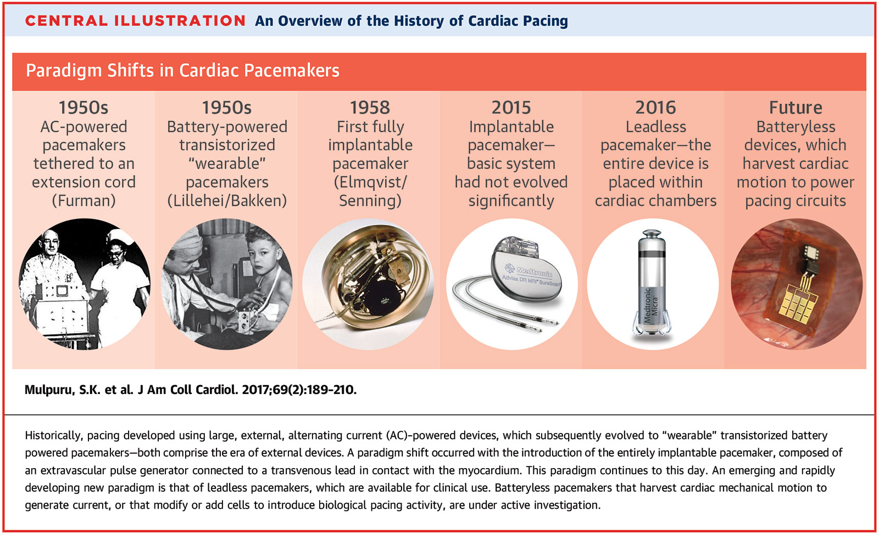

Slide 4
Short-term complication
Rates as high as 8% to 12%.
Pneumothorax, cardiac tamponade, pocket hematoma, and lead dislodgement.
Transvenous leads can cause complications such as
  venous obstruction,
  Tricuspid regurgitation
  Endocarditis.
  Transvenous lead– related endocarditis (mortality risk as high as 12% to 31)

Slide 5
Long term complication
Leads are also prone to insulation breaks and conductor fracture, requiring reintervention
0.7% to 2.4% of patients encounter serious complications related to the subcutaneously placed pulse generator:
  Skin erosion
  Pocket infection
  Septicemia.

Slide 6
Development of miniaturized devices enabled by:
(1) Improvements in battery technology to allow adequate pacemaker longevity despite its low profile and overall size
(2) Advances in component design including miniaturization and low power utilization
(3) Communication protocols to minimize power utilization
(4) Practical catheter-based delivery tools to negotiate the vasculature and cardiac anatomy and permit safe affixation to the myocardial wall.

Slide 7
ADVANTAGE
• Less invasive
• Less implantation time (25 to 40mins vs 60 mins)
• Less recovery time & Less radiation
• Eliminates complications related to the transvenous leads
  Venous obstruction
  Insulation breaks
  Lead dislodgement
  Electrical malfunction
  Lead fractures
  Infection.

Slide 8
ADVANTAGE
• No visible lump or scar
• Shoulder mobility is maintained(6 out of 10 patients experience reduced mobility in the shoulder)
• No Pocket hematoma/infection ( Vs 0.5-1.5% incidence)
• No Hemothorax/pneumothorax
• Better quality of life.

Slide 9
automatic power-generating system (AGS)
The AGS converts kinetic energy to electric energy similar to what is seen in quartz watches.
The AGS system is implanted in the right ventricle, and it transfers kinetic energy to the rest of the device.
AGS could generate 13 micro-Joules per heartbeat, suggesting that it supplied sufficient energy to power an LCP.
The investigators successfully paced a mongrel dog’s heart at 140 beats/min for 60 min with a fully charged AGS system

Slide 10
2006, Echt et al. used ultrasound as a power source.
Ultrasound energy, which was emitted from a receiver on the chest wall, would reach an electrode placed in contact with the myocardium.
The electrode would then convert ultrasound energy to electrical energy and thus cause pacing.
Pacing was achieved in more than 30 different sites in right atrium and ventricle with ultrasound energy.

Slide 11
Wieneke et al. brought yet another power source based on induction using a subcutaneous transmitter unit and an endocardial receiver unit at the apex of the right ventricle
Currently, in most LCPs, these power sources are not being used as they need to be further investigated.
LCPs available now are mainly powered by lithium batteries
It will continue to be that way until a better source of power can be established

Slide 12
Nanostim-TM device
Made by St. Jude Medical (St.Paul, MN, USA).
Smaller than an AAA battery
can be completely placed within the heart.
Most of the LCP consists of a battery.
Dimension : 4-cm long, 6-mm wide, and just 2 g in weight
LCP is delivered by an 18F catheter attached to a docking button on the end of the device, which introduces it into the body via the femoral vein and subsequently into the right ventricle
Nanostim-TM LCP is fixed mainly by the helix.

Slide 13
A tether mode is used to tug on the device after implantation to ensure that it is fixed to the heart wall.
The LCP can be unscrewed during the operation
  If positioning needs to be changed
  If it has not been completely fixed.
Since it uses electrical impulses to communicate rather than the standard antenna and coil system.
It has a long battery life of 9–10 years, which is particularly useful as fewer replacements will be needed
After the LEADLESS trial, this particular LCP was given the CE mark

Slide 14
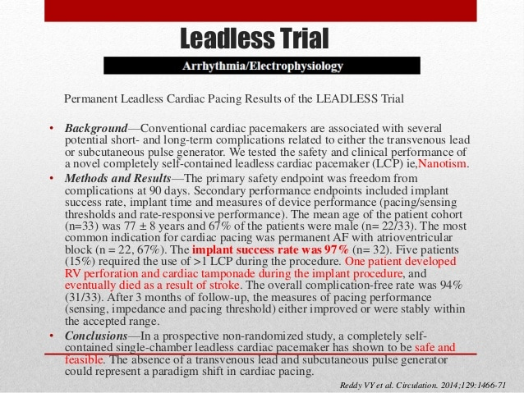

Slide 15
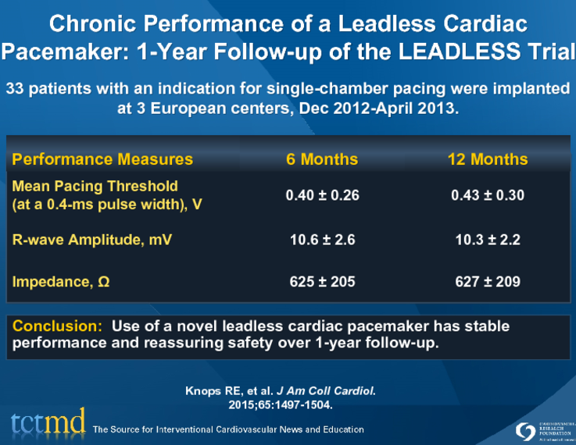

Slide 16
Leadless II Trial
Prospective, multicenter, non-randomized, FDA IDE study
Objective: – To evaluate the clinical safety and efficacy of nonsurgical implantation of the leadless cardiac pacemaker in patients indicated for a VVI(R) pacemaker
Primary Cohort: 1st 300 patients followed for 6mo (June 2015)
Total Cohort: All patients enrolled by June 2015 (n=526)
Mean age 75±8 years, 62% male
mean procedure time was 28.6±17.8 minutes
70% of the patients did not require device repositioning.

Slide 17
Primary Endpoints (by ITT):
– Safety: Freedom from Serious Adverse Device Effects at 6 months
– Efficacy: Acceptable pacing capture threshold (2.0 V at 0.4 msec) and a therapeutically acceptable sensing amplitude (R wave 5.0 mV, or a value equal to or greater than the value at implantation) through 6 mo.
56 Centers in the US, Canada and Australia – 100 Operators (only one had prior experience with leadless pacing)

Slide 18
RESULT
Device was successfully implanted in ~96% of patients
Primary Safety Endpoint (Intent-to-Treat Analysis) –280 of the 300 patients achieved endpoint (93.3%; 95% CI = 89.9 to 95.9) – This exceeded the performance goal of 86% (P<0.001)
Primary Efficacy Endpoint (Intent-to-Treat Analysis) – 270 of the 300 patients achieved endpoint (90.0%; 95% CI = 86.0 to 93.2) – This exceeded the performance goal of 85% (P = 0.007)
Efficacy (Successful implants) – 289 patients with successful device implant – 270 of the 289 patients achieved endpoint (93.4%; 95% CI = 89.9 to 96.0)– This exceeded the performance goal of 85% (P <0.001)

Slide 19
RetrievabiliTY
The Nanostim LCP is retrieved using a dedicated single-loop retrieval catheter (18F).
First, the LCP is captured by maneuvering the single snare of the retrieval catheter around the docking button of the LCP.
Then, the LCP is docked to the retrieval catheter and rotated counterclockwise to disengage the screw-in helix from the myocardial tissue.
Subsequently the protective sleeve is advanced over the LCP and the LCP is removed.

Slide 20
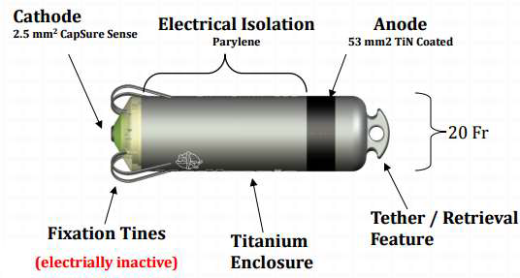
Micra Transcatheter Pacing System (TPS)
Made by Medtronic Inc. (Dublin, Ireland)
Claimed to be the ‘world’s smallest pacemaker’
Dimensions : 7 mm in width, 26 mm long, and weighing 2 gm
TPS is delivered to the right ventricle via a 23 F catheter through femoral vein, can be repositioned as necessary.
Estimated battery life of 7–15 years
TPS is attached by small self expanding nitinol tines.

Slide 21
TPS is not intended to be removed when its battery is nearing depletion.
Instead, another TPS is added into the right ventricle.
This is possible due to the small size of the device.
In younger patients, this might cause problems down the line due to a large amount of TPS systems being placed within the ventricle
Medtronic Micra is approved for full body MRI scans.

Slide 22
Micra-TPS Trial
Global, multicenter prospective study to evaluate device safety and efficacy
N = 725 patients (mean age 75.9±10.9 years, 58.8% male)
In 99.2% of the patients, the implantation of the TPS was successful (n=719/725), with a mean procedure duration of 23.0±15.3 minutes
Major device-related complications occurred in 25 (3.4%) of the 725 patients, including cardiac perforations in 1.5%, vascular complications in 0.7%, venous thromboembolism in 0.3%, and increased pacing thresholds in 0.3% of patients
No device dislodgements were observed

Slide 23
The Micra TPS is removed using a grandmother mother- child technique used to direct the snare at the proximal retrieval feature.
The snare is tightened around the waist of the retrieval feature and the TPS is removed from the myocardial tissue by pulling back the device while exerting moderate counter pressure using the sheaths

Slide 24
Wireless Cardiac Stimulation system (WiCS-LV)
Developed by EBR Systems (Sunnyvale, CA, USA).
The system utilizes ultrasound emitted from a transmitter implanted subcutaneously in the left chest and a receiver implanted in the ventricle which converts ultrasound energy to electrical energy that can be used to pace the heart.
WiCS-LV system has been used in CRT when used with conventional RV pacers.
Hence both ventricles will contract almost simultaneously which allows resynchronization

Slide 26
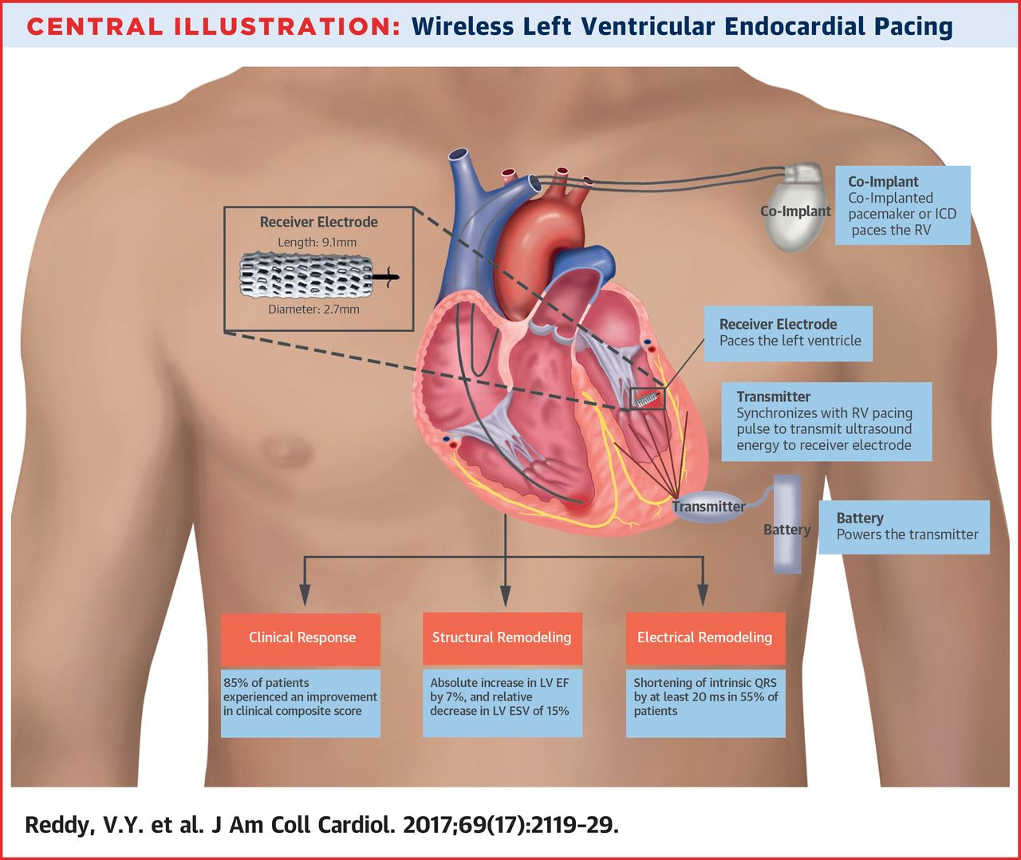

Slide 27
Added advantage of the WiCS-LV system is its capability of endocardial pacing which runs contrary to epicardial pacing seen with conventional CRT devices.
Endocardial pacing may be more physiological and theoretically could improve patients clinical response to CRT therapy.

Slide 28
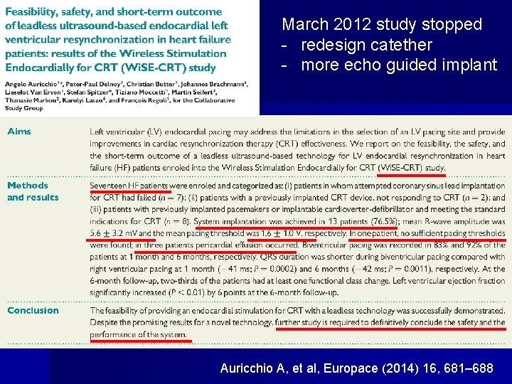

Slide 29
AIM :
Totally leadless CRT can be delivered with a combination of Micra and WiSE-CRT systems.
Describe the technical feasibility and first insights into the safety and efficacy of this combination in European experience.
Patients enrolled had indication for both Micra and WiSE-CRT systems
  Heart failure related to high burden of pacing by a Micra necessitating system upgrade
  Inability to implant a conventional CRT system because of infectious or anatomical conditions.

Slide 30
The endpoints of the study
  Technical success of WiSE-CRT implantation with RV-synchonized CRT delivery
  Acute QRS duration reduction
  Freedom from procedure-related major adverse events.
All eight WiSE-CRT devices were able to detect the Micra pacing output and to be trained to deliver synchronous LV endocardial pacing.

Slide 32
RESULT

Slide 33
CONCLUSION
The Micra and the WiSE-CRT systems can successfully operate together to deliver total leadless CRT to a patient.
WiSE-CRT system provides the only means to upgrade the large population of Micra patients to CRT capability without replacing the Micra.
This combination could broaden in the future with the upcoming developments of leadless cardiac pacing.

Slide 34
CRT With Wireless Left Ventricular Endocardial Pacing: SELECT-LV Study
Prospective ,multicenter ,non-randomized trial .
Assess: the safety and performance of the WiSE-CRT system.
A total of 35 patients indicated for CRT who"failed" conventional CRT underwent implantation of an LV endocardial pacing electrode and a subcutaneous pulse generator.
System performance, clinical efficacy, and safety events were assessed at 6 months post-implant.

Slide 35
The procedure was successful in 97.1% (n = 34) of attempted implants.
The most common indications for endocardial LV pacing were
  Difficult CS anatomy (n =12)
  Failure to respond to conventional CRT (n = 10)
  High CS pacing threshold or phrenic nerve capture (n = 5).
Primary performance endpoint- biventricular pacing on the 12-lead ECG at 1 month, was achieved in 33 of 34 patients.

Slide 36
A total of 28 patients (84.8%) had improvement in the clinical composite score at 6 months
21 (66%) demonstrated a positive echocardiographic CRT response (≥5% absolute increase in LV ejection fraction).
There were no pericardial effusions, but serious procedure/device-related events occurred in 3 patients (8.6%) within 24 h, and 8 patients (22.9%) between 24 h and 1 month
The SELECT-LV study demonstrates the clinical feasibility for the WiSE-CRT system, and provided clinical benefits to a majority of patients within an otherwise "failed" CRT population

Slide 38
FUTURE

Slide 39
SUMMARY
The first 2 leadless pacemaker systems have demonstrated similar performance and initial promise of efficacy and safety.
A significant implanter learning curve has been appreciated.
No long-term performance data of the leadless systems are yet available to determine technological robustness.
As leadless pacing matures, both in device technology and physician experience, procedure-related complications are likely to decrease.
Randomized controlled trials comparing leadless and conventional devices are necessary to fully appreciate any differences between these technologies in clinical practice.

Slide 40
THANK YOU

