Slide 1
MAnagement of high bleeding risk patients post bioresorbable polymer coated STEnt implantation with an abbReviated versus prolonged DAPT regimen
MASTER DAPT
Dr.AJU AJAY

Slide 2
Introduction
High bleeding risk(HBR) population represents a significant proportion of CAD patients undergoing coronary stent implantation.
Decisions regarding the duration of DAPT are difficult, especially after implantation of newer generation DES due to conflicting results from recent trials.
The appropriate duration of DAPT in patients at high risk for bleeding after the implantation of a DES remains unclear.
RCTs have established the superiority of DES over BMS in patients at high bleeding risk.

Slide 3
Studies of 1 month DAPT after the implantation of a DES have suggested that this regimen may mitigate bleeding risk without compromising safety
But studies were non randomised /did not select patients with high bleeding risk etc.

Slide 4
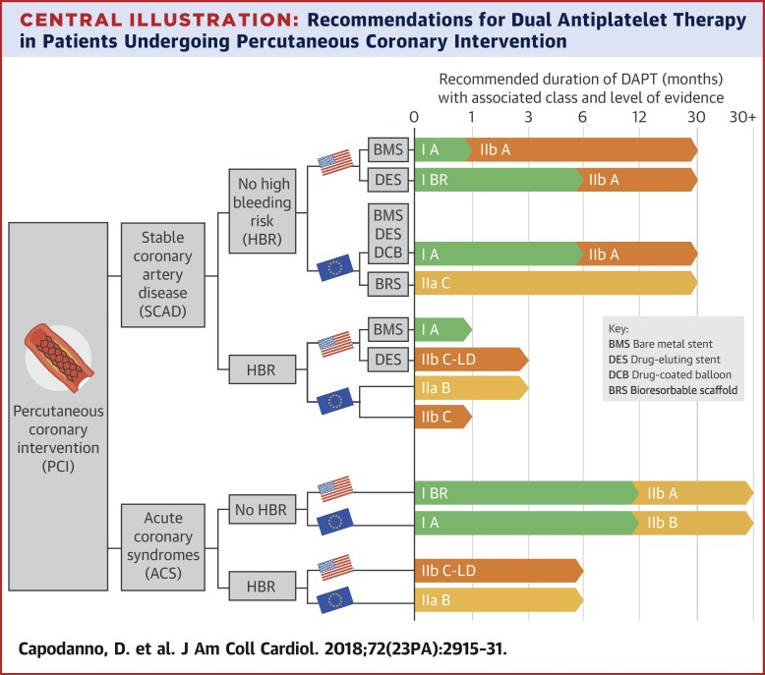

Slide 5
Study Design
Investigator-initiated, multi-center, randomized clinical trial.
Index PCI -The index procedure is either single procedure or the last sitting in planned staged procedure.

Slide 6
Inclusion criteria after index PCI
After index PCI, patients aged 18 years or more are eligible for inclusion into the study
  At least one among the HBR criteria is met.
  All lesions are successfully treated with Ultimaster stent, i.e. post-procedural angiographic diameter stenosis <20% by visual estimation
  Free from any flow-limiting angiographic complications which require prolonged DAPT duration based on operator’s opinion.
  All stages of PCI are complete and no further PCI is planned.

Slide 7
Inclusion criteria at one-month randomization visit
Fulfilment of at least one HBR criterion or post-PCI actionable non-access site related bleeding episode
Uneventful 30-day clinical course, i.e. free from spontaneous MI, symptomatic restenosis, stent thrombosis, stroke and any revascularization requiring prolonged DAPT

Slide 8
Cnt.
If not on OAC,
  Patient is on a DAPT regimen of aspirin and a P2Y12 inhibitor
  Patient with one type of P2Y12 inhibitor for at least 7 days
If on OAC
  Patient is on the same type of OAC for at least 7 days
  Patient is on clopidogrel for at least 7 days

Slide 9
Ultimaster stent
The Ultimaster stent is the only sirolimus-eluting stent having received CE mark labeling for 1-month DAPT duration in HBR population
The Ultimaster coronary stent system consists of a cobalt-chromium (Co-Cr) bare metal stent scaffold with thin struts (80 µm)
The stent is mounted on a rapid-exchange catheter with a high-pressure, semi-compliant balloon
sirolimus (3.9 µg/mm stent length) in a matrix with bioresorbable, Poly (DL-lactide-cocaprolactone) polymer

Slide 10
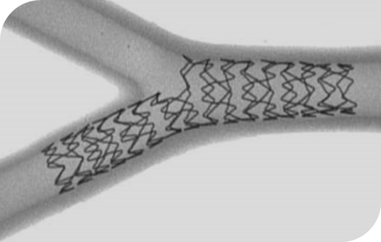
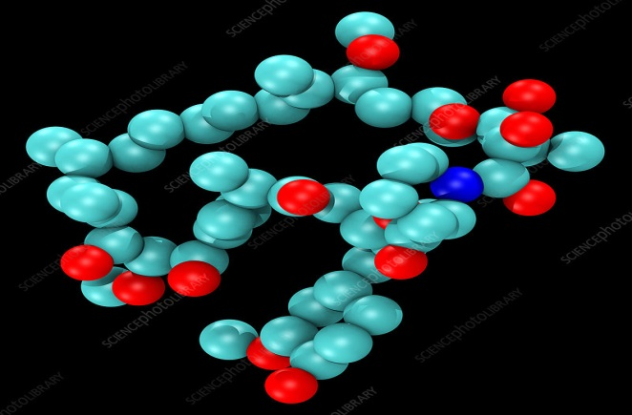

Ultimaster Stent
Stent Platform
Drug
Polymer Coating
CE Marks
Open Cell 2-link Design
CoCr L-605 Alloy
Strut thickness:
80 μm
Abluminal, PDLLA-PCL
gradient coating
Simultaneous polymer
resorption and drug release
in 3-4 months
Sirolimus
3.9 μg/mm stent length
Diabetes
Long lesions
Women/men
Small vessels
2-link
Elderly
Ostial lesions
1-mo DAPT
Patients
Anatomy
MVD
16
CE marked
indications
NSTEMI
Conditions
Procedures
Radial/femoral
STEMI
Bifurcation
ACS
ISR
Left main
CTO

Slide 11
High Bleeding Risk Definition
Clinical indication to oral anticoagulants (OAC) for at least 12 months
Recent (<12 months) non-access site bleeding episode(s), which required medical attention
Previous bleeding episode(s) which required hospitalization if the underlying cause has not been definitively treated (i.e. surgical removal of the bleeding source)
Age ≥75 years
Systemic conditions associated with an increased bleeding risk
Documented anemia (Hb<11 g/dL) or transfusion within 4 weeks before randomization
Need for chronic treatment with steroids or non-steroidal anti-inflammatory drugs
Diagnosed malignancy (other than skin) considered at high bleeding risk
Stroke at any time or transient ischemic attack (TIA) in the previous 6 months
PRECISE DAPT score ≥25

Slide 12
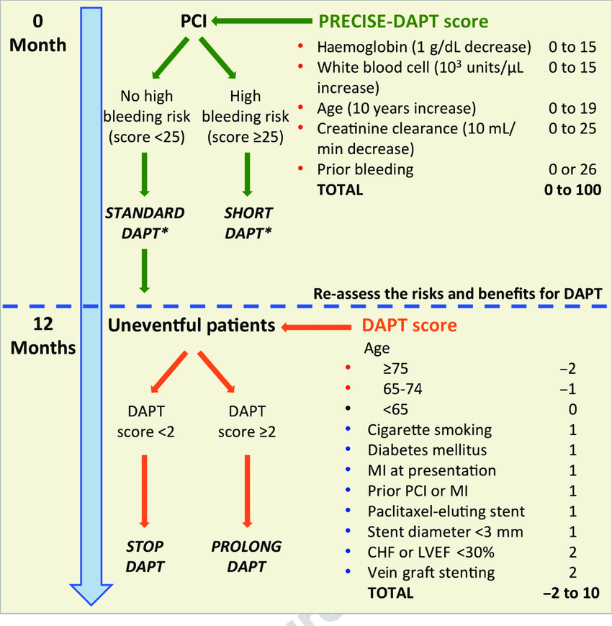

Slide 13
Exclusion criteria
Treated with stents other than Ultimaster stent within 6 months prior to index procedure
Treated for in-stent restenosis or stent thrombosis at index PCI or within 6 months before
Treated with a bioresorbable scaffold at any time prior to index procedure
Cannot provide written informed consent
Unable to comply with study protocol
Active bleeding requiring medical attention (BARC≥2) on randomization visit

Slide 14
Cnt.
Life expectancy less than one year
Known hypersensitivity or allergy for aspirin, clopidogrel, ticagrelor, prasugrel, cobalt chromium or sirolimus
Any planned and anticipated PCI
Participation in another trial
Pregnant or breast feeding women

Slide 15

MASTER DAPT Trial
30 (+14) Days after PCI
Free from cardiac and cerebral ischemic events
and active bleeding
No further revascularization planned
Sx: Site
Need for oral anticoagulation
Prior MI within 12 months
Abbreviated DAPT
Immediate DAPT discontinuation
Standard DAPT
DAPT for ≥ 2 or 5 months in pts with
or without OAC indication, respectively
followed by SAPT for 11 months
or 5 months if OAC is indicated
followed by SAPT up to 11 months
HBR: high bleeding risk; DAPT: dual antiplatelet therapy; SAPT: single antiplatelet therapy; MI myocardial infarction: OAC: oral anticoagulation

Slide 16
Abbreviated DAPT regimen
Patients not on OAC
DAPT is discontinued and a single anti-platelet agent (SAPT) is continued until at least 11 months post randomization (i.e.12 months after index PCI).
Patients on OAC
DAPT is discontinued and either aspirin or clopidogrel is continued until 5 months post randomization (i.e. 6 months after index PCI). OAC is continued until at least 11 months post randomization (i.e.12 months after index PCI).

Slide 17
Prolonged DAPT regimen
Patients not on OAC
Aspirin is continued until at least 11 months post randomization (i.e.12 months after index PCI). The P2Y12 inhibitor being taken at the time of randomization is continued for at least 5 months and up to 11 months post randomization (i.e.12 months after index PCI).
Patients on OAC
Aspirin and clopidogrel are continued for at least 2 months (i.e. 3 months after index PCI) and up to 11 months post randomization
OAC is continued until at least 11 months post randomization

Slide 18
Treatment and Follow-up
Clinical follow-up is performed 2, 5, 11 and 14 months after randomization.

Slide 19
Study Endpoints
The study has 3 primary endpoints to be tested in an hierarchical order:
Net adverse clinical events (NACE): the composite of all-cause death, MI, stroke, and major bleeding defined as BARC type 3 or 5
Major adverse cardiac and cerebral events (MACCE): the composite of
all-cause death, MI, and stroke
Major or clinically relevant non-major bleeding (MCB): the composite of BARC type 2, 3 and 5 bleeding

Slide 20
BARC (Bleeding Academic Research Consortium) definitions, Mehran et al, Circulation 2011;123:2736-2747
Type 0: no evidence of bleeding
Type 1: bleeding that is not actionable, without need for hospitalization or treatment (e.g. bruising, hematoma, nosebleeds, etc.)
Type 2: any clinically overt sign of hemorrhage that is actionable but does not meet criteria for type 3, 4 or 5. Must meet at least 1 of following criteria:
  Requires intervention
  Leads to hospitalization
  Prompts evaluation

Slide 21
BARC (Bleeding Academic Research Consortium) definitions, Mehran et al, Circulation 2011;123:2736-2747
Type 3: clinical, laboratory, and/or imaging evidence of bleeding, with healthcare provider responses:
  BARC type 3a:
    any transfusion with overt bleeding
    overt bleeding plus hemoglobin drop ≥3 to <5 g/dL
  BARC type 3b:
    overt bleeding plus hemoglobin drop >5 g/dL
    Cardiac tamponade
    Bleeding requiring surgical intervention for control
    (excluding dental/nasal/skin/hemorrhoid)
    Bleeding requiring intravenous vasoactive drugs
  BARC type 3c:
    Intracranial hemorrhage, subcategories confirmed by autopsy, imaging or lumbar puncture
    Intraocular bleed compromising vision

Slide 22
BARC (Bleeding Academic Research Consortium) definitions, Mehran et al, Circulation 2011;123:2736-2747
Type 4: Coronary Artery Bypass Graft–related bleeding
  Perioperative intracranial bleeding within 48 hours
  Reoperation after closure of sternotomy for the purpose
  of controlling bleeding
  Transfusion of ≥5 U whole blood or packed red blood cells within a 48-hour period
  Chest tube output 2 L within a 24-hour period
  .
Type 5: Fatal bleeding

Slide 23
Patient Disposition
4520 Consented at Index PCI*
267 Excluded
5 not eligible
27 died
33 did not attend M1
202 withdrew consent
684 Consented at M1*
4937 Assessed for Eligibility at M1*
358 Excluded
304 not eligible
54 Medical reasons
4579 Randomized
2295 Abbreviated DAPT
2204 (96%) per-protocol pop †
2284 Standard DAPT
2230 (98%) per-protocol pop †
2 LTFUP
13 withdrew consent
8 LTFUP
9 withdrew consent
Outcome data at 1 year
2280 (99%)
Outcome data at 1 year
2267 (99%)
*: From February 28, 2017 through December 5, 2019
† : Per-protocol population: met eligibility criteria and implemented study Tx within 14 days after Rx

Slide 24
Major Secondary endpoints
1) The individual components of each composite primary endpoints
2) The composite of cardiovascular death, MI, and stroke
3) The composite of cardiovascular death, MI, and any revascularization
4) Death from cardiovascular causes
5) The composite of definite or probable stent thrombosis
6) Myocardial infarction
7) Any target vessel revascularization

Slide 25
 | Abbreviated DAPT (N=2295) | Standard DAPT (N=2284)
Age | 76.1±8.7 | 76.0±8.8
Male sex — no. (%) | 1590 (69.3) | 1581 (69.2)
Diabetes mellitus — no. (%) | 754 (32.9) | 784 (34.3)
Prior MI— no. (%) | 434 (18.9) | 430 (18.8)
Prior PCI— no. (%) | 594 (25.9) | 594 (26.0)
Prior CVA— no. (%) | 268 (11.7) | 302 (13.2)
Chronic kidney disease— no. (%) | 418 (18.2) | 458 (20.1)
Atrial fibrillation — no. (%) | 770 (33.6) | 720 (31.5)
Oral anticoagulant — no. (%) | 849 (37.0) | 820 (35.9)
Non–ST-elevation ACS– no. (%) | 855 (37.2) | 818 (35.8)
ST-elevation MI– no. (%) | 273 (11.9) | 265 (11.6)
Killip II, III or IV | 252 (11.0) | 254 (11.1)

Slide 26
 | Abbreviated DAPT (N=2295) | Standard DAPT (N=2284)
Arterial access site
Femoral | 360 (15.7) | 293 (12.8)
Radial | 1930 (84.1) | 1984 (86.9)
Multivessel Intervention — no. (%) | 579 (25.2) | 635 (27.8)
Treated vessel(s)— no. (%)
Left main | 126 (5.5) | 134 (5.9)
Left arterial descending artery | 1240 (54.0) | 1271 (55.6)
Left circumflex artery | 652 (28.4) | 689 (30.2)
Right coronary artery | 854 (37.2) | 806 (35.3)
Bypass graft | 38 (1.7) | 38 (1.7)
Number of stents per patient | 1.74±1.13 | 1.76±1.11
Total stent length per patient | 39.3±29.2 | 39.7±28.4
Overlapping stenting — no. (%) | 488 (21.3) | 450 (19.7)
Bifurcation/trifurcation stenting — no. (%) | 83 (3.6) | 101 (4.4)

Slide 27
Net adverse clinical events (NACE)
Per protocol population
In the Study, net adverse clinical events occurred in 165 patients (7.5%) in the abbreviated-therapy group and in 172 (7.7%) in the standard-therapy group (hazard ratio, 0.97; 95% confidence interval [CI], 0.78 to 1.20), for a difference in risk of −0.23 percentage points (95% CI, −1.80 to 1.33; P<0.001 for noninferiority)
7.7%
7.5%
Non-inferiority margin: 3.6%
%
NACE: All-cause death, MI, stroke, and major bleeding events defined as BARC 3 or 5

Slide 28
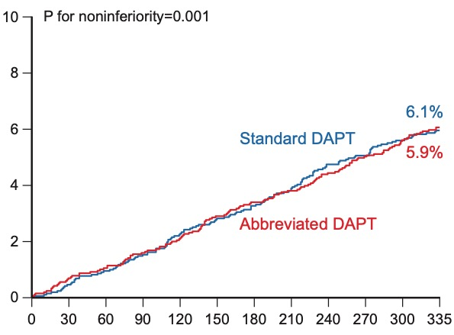

Major adverse cardiac and cerebral events (MACCE)
133 patients (6.1%) in the abbreviated-therapy group and 132 patients (5.9%) in the standard-therapy group had a major adverse cardiac and cerebral event (hazard ratio, 1.02; 95% CI, 0.80 to 1.30), for a difference in risk of 0.11 percentage points (95% CI, −1.29 to 1.51; P=0.001 for noninferiority)
6.1%
5.9%
%
MACCE: All-cause death, MI, stroke

Slide 29
Major or clinically relevant nonmajor bleeding
Intention to treat population
In the intention-to-treat population, the incidence of major or clinically relevant nonmajor bleeding was lower among patients in the abbreviated-therapy group than among those in the standard-therapy group (148 patients [6.5%] vs. 211 [9.4%]; hazard ratio, 0.68; 95% CI, 0.55 to 0.84), for a difference in risk of −2.82 percentage points (95% CI, −4.40 to –1.24; P<0.001 for superiority)
Difference in cumulative incidence, -2.82
%
NNTB: 35
MCB: BARC 2, 3 or 5

Slide 30
Secondary Endpoints
0.66
(0.51-0.84)
%
6.8
0.92
(0.67-1.26)
4.5
3.6
1.30
(0.88-1.91)
3.3
0.89
(0.61-1.29)
0.84
(0.54-1.31)
2.7
0.52
(0.28-0.95)
2.5
2.0
2.2
2.3
0.50
(0.24-1.04)
1.6
1.4
1.85
(0.69-5.01)
1.0
0.25
(0.05-1.17)
0.8
0.5
0.5
0.3
0.3
0.1
Per protocol population
Intention to treat population

Slide 31
Discussion
Among patients at high risk for bleeding , the discontinuation of dual antiplatelet therapy at a median of 34 days after PCI was noninferior to the continuation of dual antiplatelet therapy for a median duration of 193 days.
Clopidogrel was the most frequently used P2Y₁₂ inhibitor

Slide 32
Two trials have compared 1 month of DAPT with at least 12 months of DAPT after PCI with drug-eluting stents
GLOBAL LEADERS
1 month of DAPT followed by ticagrelor monotherapy for an additional 23 months was not associated with lower all-cause mortality or with a lower incidence of new Q-wave MI than 12 months of DAPT followed by aspirin monotherapy for an additional 12 months.
STOPDAPT-2
1 month of dual antiplatelet therapy followed by clopidogrel monotherapy was associated with a lower risk of a composite of cardiovascular and bleeding events than 12 months of dual antiplatelet therapy

Slide 33
Study Limitations
Open label study
DAPT duration was heterogenous in the standard DAPT group, which reflects current clinical practice
DAPT duration in both arms was longer than what is currently recommended for OAC patients
This study was not designed to assess the role of type of SAPT after DAPT discontinuation
Non-inferiority margins were relatively wide and the observed event rates were lower than expected for NACE and MACE
Our results may not apply to patients not treated with biodegradable-polymer sirolimus eluting stents

Slide 34
Conclusions
In patients at HBR who had undergone implantation of a biodegradable-polymer ULTIMASTER sirolimus-eluting stent, the discontinuation of DAPT at a median of 34 days compared with continuation of treatment for a median of 193 days after PCI was:
noninferior for the incidence of net adverse clinical events
noninferior for the incidence of major adverse cardiac or cerebral events
associated with a lower incidence of major or clinically relevant nonmajor bleeding

