Slide 1
MITRAL ANNULAR DISJUNCTION
Dr Shreyas Samaga
Dept of Cardiology
Govt TD Medical College, Alappuzha

Slide 2
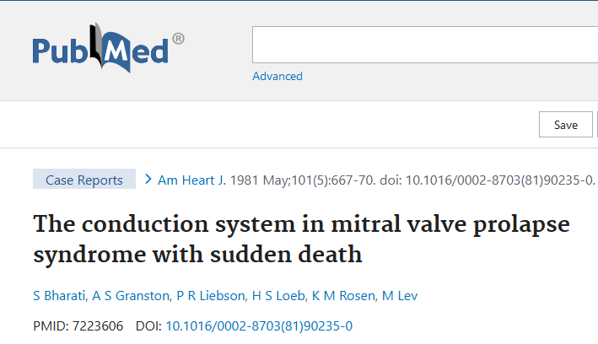
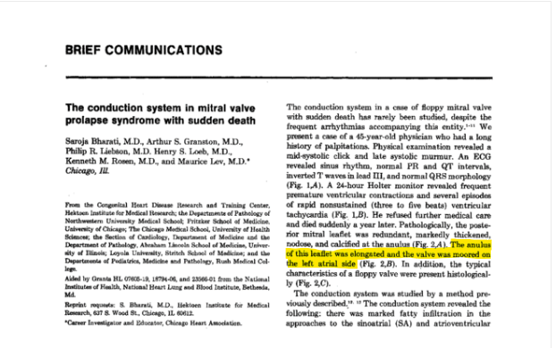
MAD
Abnormal displacement of the mitral valve leaflet onto the left atrial wall
commonly found in patients with mitral valve prolapse (MVP).
The actual mitral valve insertion point, instead of totally on annulus, is partially (sometimes totally) displaced towards the atrium.
? Distinct anatomic / clinical syndrome?- unclear
First described by a pathologist- Dr Bharathi-30y ago- autopsy finding

Slide 3
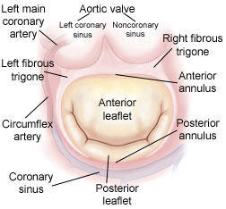
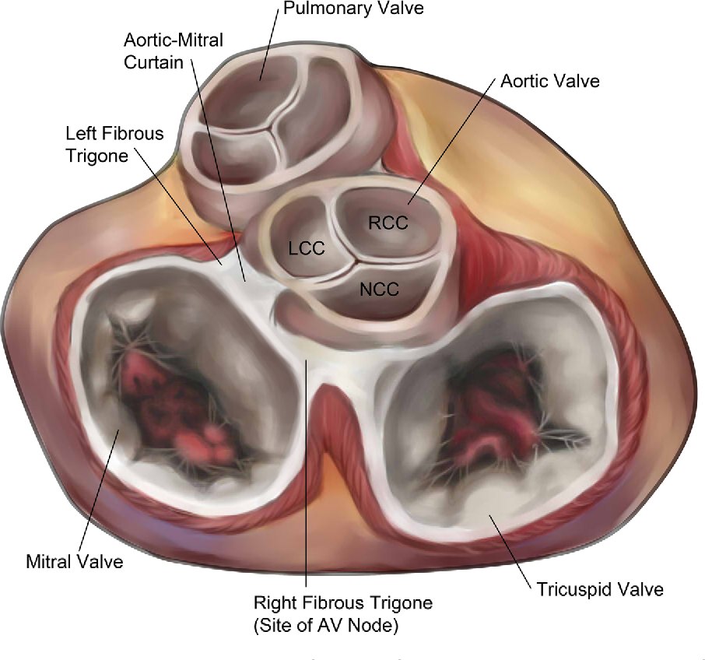
ANATOMY

Slide 4
The mitral annulus is a complex D-shaped structure with an anterior straight component and a posterior curved component.
The posterior mitral annulus is composed of the left atrial wall, the leaflet hinge line, the LV free wall and epicardial adipose tissue, held together by a fibrous cord.
The anterior annulus is composed
of the anterior mitral leaflet which
inserts onto a band of connective tissue
called the mitral-aortic curtain.

Slide 5
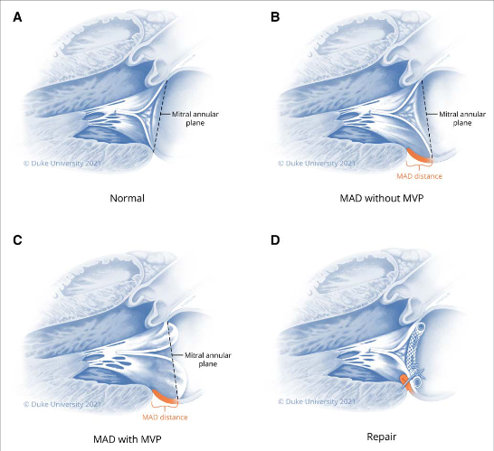

Slide 6
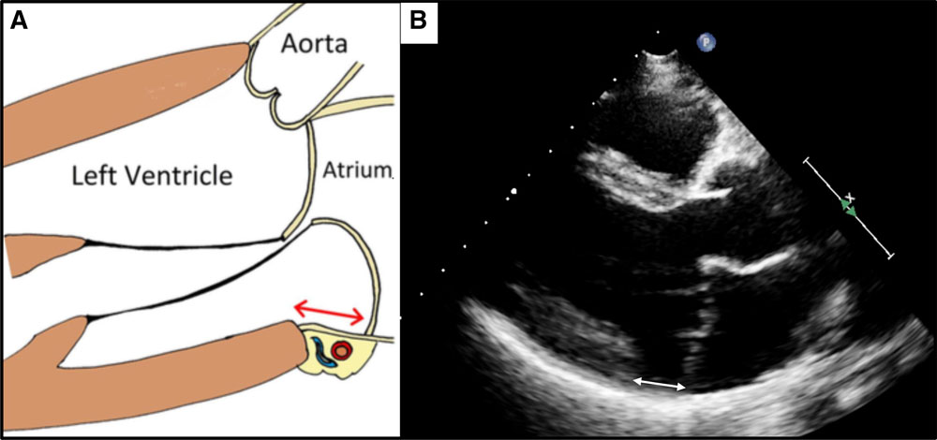
The posterior mitral leaflet hinges to the junction of the atrial and ventricular myocardium.
In MAD
the hinge line of the posterior leaflet is dislocated superiorly toward the left atrial wall and away from the left ventricular (LV) myocardium, leaving a separation between the atrial-valve junction and LV wall.

Slide 7
Normal mitral annulus motion is coupled to LV deformation and the annulus contracts and deepens its saddle shape during ventricular systole
The disjunctive mitral annulus follows the motion of the left atrial wall instead and displays paradoxical systolic expansion and increase in mitral annulus diameter, which may have important functional implications.

Slide 8
UNCLEAR!
MAD
Precedes &
Causes MVP
Independent of MVP
Is a byproduct of MVP

Slide 9
Diagnosis and multimodality imaging
TEE
CMR
CARDIAC CT
TTE
The diagnosis of MAD

Slide 10
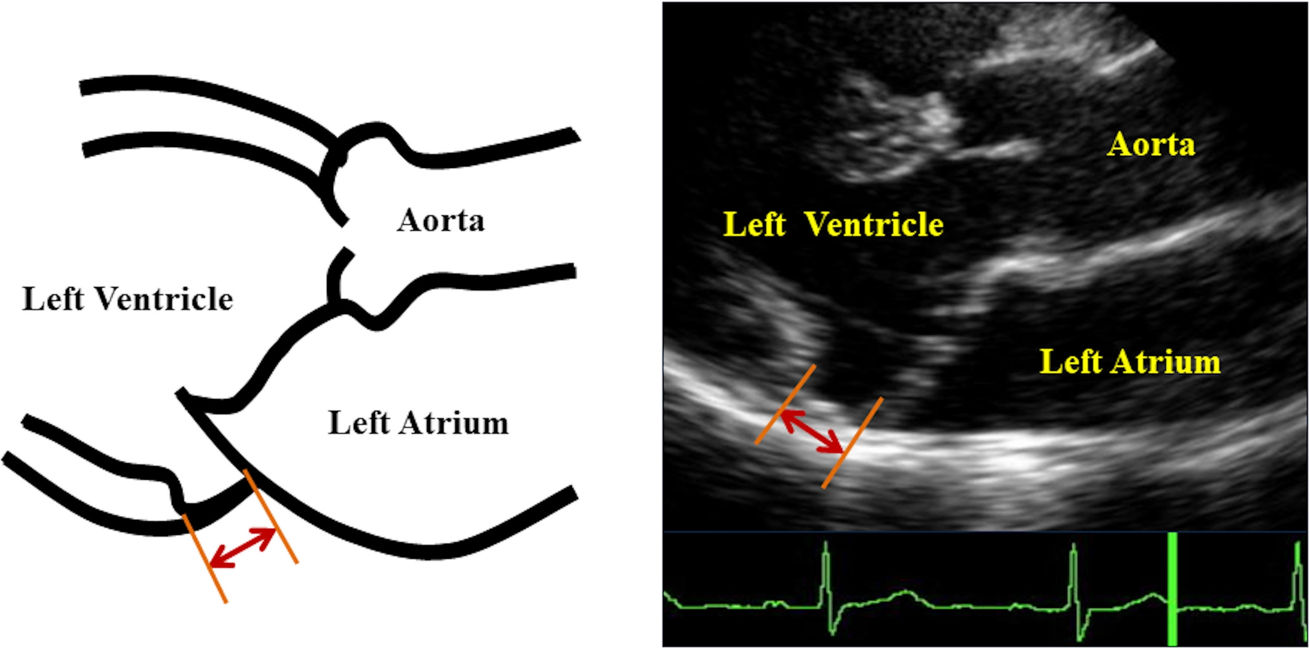
On imaging studies, MAD is best identified in late systole and is often difficult to recognize in diastole alone.
The distance between the insertion point of the posterior MV leaflet and the LA-LV junction is defined as the MAD length or distance.
MAD distance is most accurately measured by tracking the movement of the valve throughout systole and pausing for measurement at the point where all necessary structures are clearly visualized.
Faletra et al recently observed that what seems to be MAD is sometimes the bowed posterior leaflet in MVP contacting the atrial wall and giving the false appearance of an abnormal insertion point.
When using TTE, MAD tends to be most apparent in the parasternal long-axis view and occasionally in the apical views.

Slide 14
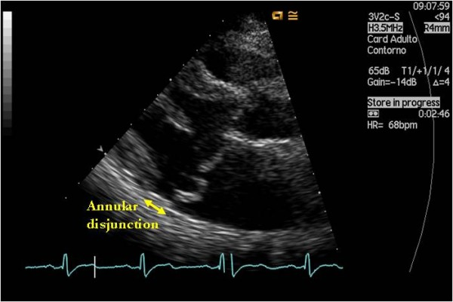
Carmo et al. described the recognition of MAD by TTE using the length of the annular disjunction during end-systole on parasternal long axis view, which was defined as the measurement from the junction of the left atrial wall and MV posterior leaflet to the top of the LV posterior wall.
MAD has also been described based upon intraoperative TEE, and was defined as a separation between the P2 insertion into the left atrial wall and the atrial/ventricular attachment performed in a 4-chamber mid-esophageal view
Although MAD can be detected by TTE and TEE, it is only visualized during ventricular systole and may be missed and underreported especially in the absence of concomitant mitral valve disease.

Slide 15
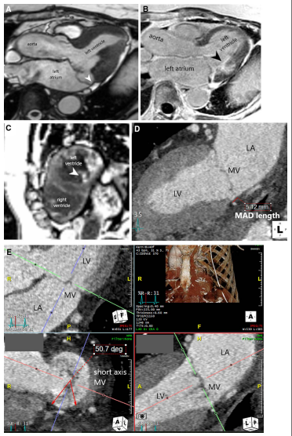

Slide 16
131 patients with MVP & MR
TTE & CMR
(106 pts also had TEE)

Slide 17
In total, available studies suggest that the prevalence of MAD is between 16% and 55% in patients with MVP and/or severe MR.

Slide 18
BIOMECHANICS AND PATHOPHYSIOLOGY
While mitral annular dysfunction is present in all advanced degenerative MVD, abnormal mitral annular and papillary muscle dynamics are especially pronounced with MAD.
The fibrous mitral annulus itself cannot contract, but rather undergoes conformational change in systole because of attachment to the ventricular myocardium.
anteroposterior contraction and
increased annular height leading to a more saddle-shaped annulus

Slide 19
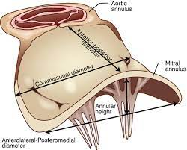
The interruption of the left ventricular to mitral annular connection that occurs in MAD involves primarily the posterior aspect of the mitral annulus and impairs this conformational change.
Lee et al –
In patients with MAD (distance ≥5 mm), the mitral annulus paradoxically expanded and flattened, becoming less saddle-shaped during ventricular systole
Carmo et al
found that the mitral annular diameter was larger in systole than in diastole for patients with MAD

Slide 20
Disjunction of the mitral annulus increases the distance between the mitral valve leaflets and papillary muscles.
This may accelerate valve degeneration with annular dilation and promote myocardial fibrosis and ventricular arrhythmias

Slide 21
CLINICAL SIGNIFICANCE
The clinical significance of MAD in the absence of mitral valve disease is unknown.
Prevalence of ventricular arrhythmias in MAD with concomitant MVP and isolated MAD -significantly different, which suggests the arrhythmogenicity of MAD alone.
Predictors of arrhythmias in MAD:
Younger age,
higher burden of VE,
longer longitudinal distance of MAD, and
evidence of papillary muscle fibrosis on CMR
Dejgaard LA, Skjølsvik ET, Lie ØH, Ribe M, Stokke MK, Hegbom F, et al.. The mitral annulus disjunction arrhythmic syndrome. J Am Coll Cardiol. (2018) 72:1600–9. 10.1016/j.jacc.2018.07.070

Slide 22
The presence of MAD has been shown to be associated with
more severe mitral leaflet and chordae tendineae deformity
LV enlargement,
MR severity correlates with the degree of MAD.
MAD may contribute to the progression of MR
the presence of MAD may predispose future prolapse in patients without concomitant MV disease

Slide 23
VENTRICULAR ARRHYTHMIAS AND SUDDEN CARDIAC DEATH
Mechanism- not fully understood
This scarring may serve as a substrate for anatomic or functional reentrant ventricular arrhythmias.
Mechanical stretch by the prolapsing leaflets
Fibrotic changes in basal IL LV & papillary muscles

Slide 24
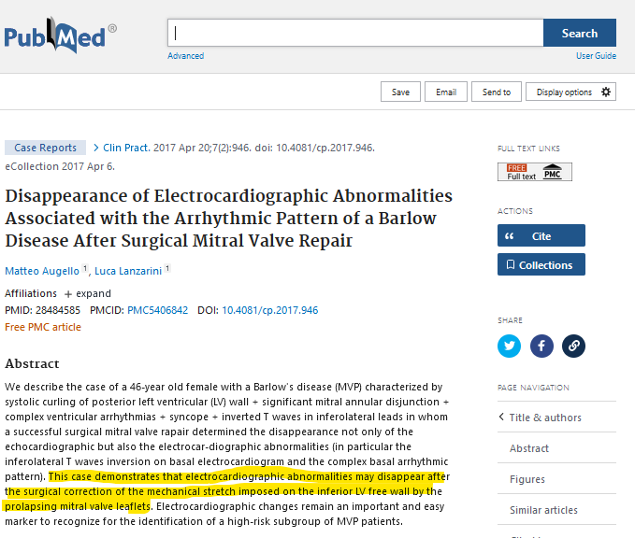
Post-operatively, the patient had subsequent resolution of T wave inversions, a decrease in ventricular ectopy, and normalization of LV function.
While myocardial fibrosis is not likely to resolve following MV surgery, postoperative regional remodeling would be expected to alter the dispersion of ventricular repolarization, a significant factor in functional reentry.

Slide 25
Abnormal mechanical motions
Disappear after surgical repair with annuloplasty
papillary muscle traction
Systolic mitral annular expansion
These mechanical abnormalities are likely exacerbated by the abnormal geometry created by MAD, which can create 2 additional distinct arrhythmic phenomena:
Stretch-activated early after depolarizations
a “source-sink” mismatch

Slide 26
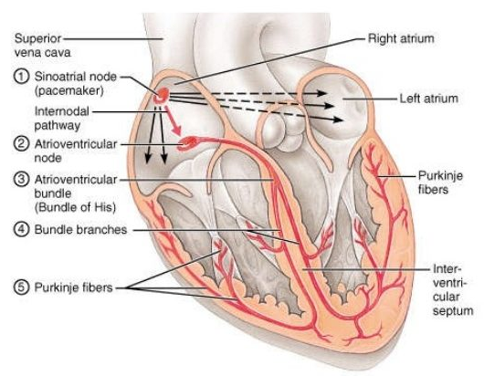
The distal Purkinje fibers that run through the papillary muscles are susceptible to abnormal automaticity and early after depolarizations.
These triggered PVCs may utilize the adjacent Purkinje network and functional block created by a source-sink mismatch to form functional reentry.
Ventricular arrhythmias in patients with MVP or MAD are often polymorphic, as opposed to the monomorphic VT expected with scar-mediated reentrant arrhythmias.

Slide 27
Genetic cause?
novel mutations in the filamin C
LMNA genes

Slide 28
RISK PREDICTORS FOR VEMTRICULAR ARRHYTHMIAS
mid-systolic click,
biphasic or inverted T waves,
ST-segment depressions,
QT prolongation, and
PVCs with a right bundle branch block pattern
MAD distance >8.5 mm,
mitral leaflet thickness ≥5 mm on M-mode echocardiography,
bileaflet prolapse,
mitral annular dilation,
lower global longitudinal strain,
paradoxical systolic increase in mitral annular diameter, and
papillary muscle or LV fibrosis

Slide 29
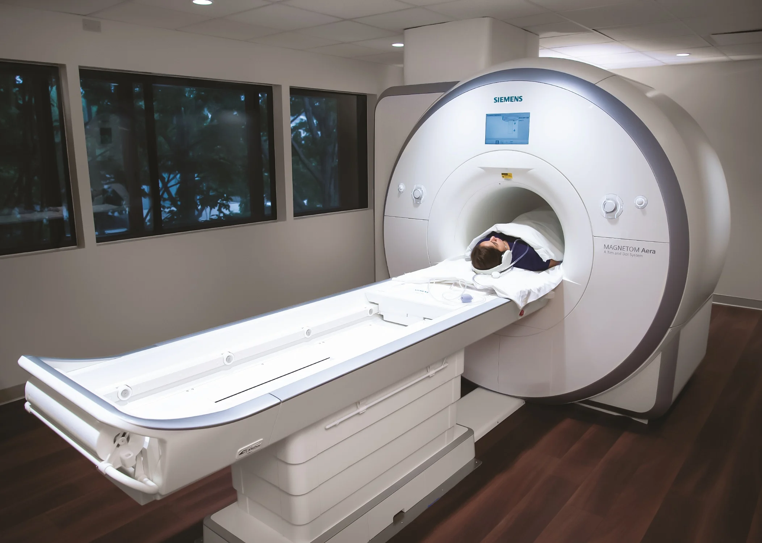
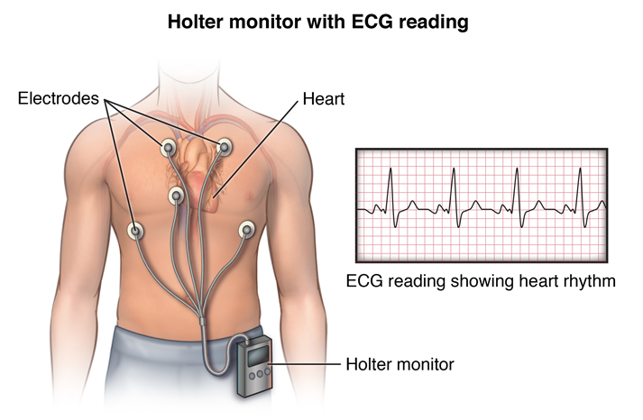
RISK STRATIFICATION
EP
study
CMR
Rhythm monitoring

Slide 30
In addition to assessing for the presence of non-sustained VT, studies have shown that VE originating from the papillary muscles is associated with ventricular fibrillation.
CMR is an important method for evaluating cardiac and valvular structure and function as well as for assessing for the presence and extent of myocardial fibrosis. LGE is more commonly found in patients with MVP, most often seen in the papillary muscles or basal inferior wall, and is associated with an increased risk of arrhythmias.
Patients with arrhythmic MVP may also have more diffuse fibrosis, identified on CMR by increased extracellular volume

Slide 31
treatment
Valvular disease, heart failure or arrhythmias
Treat according to standard AHA/ACC guidelines
?Catheter
ablation
No guidelines
can be performed in patients with symptomatic, drug refractory ventricular arrhythmias
ICD
The role of primary prevention ICD is unclear.
Secondary prevention ICD is generally indicated in patients experiencing out-of-hospital cardiac arrest after reversible causes are excluded

Slide 33
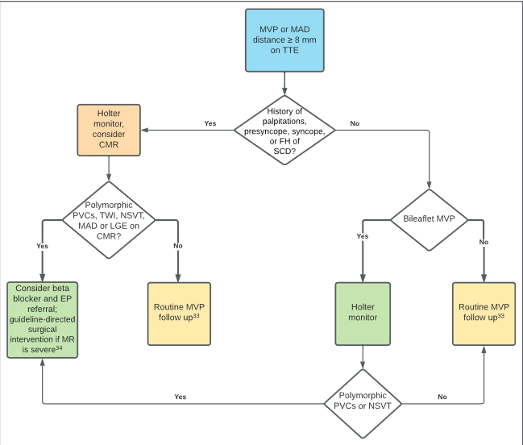

Slide 34
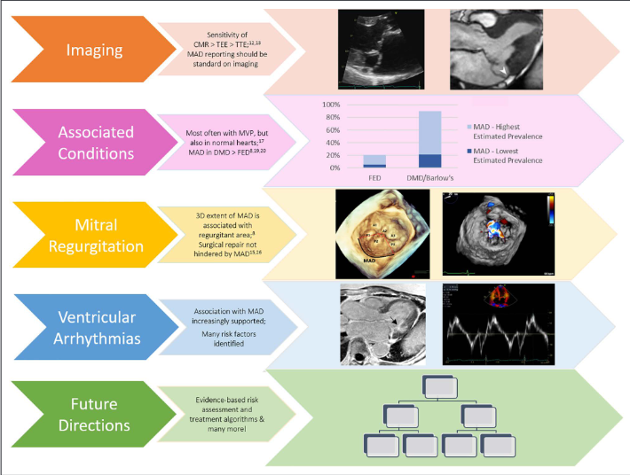
RECAPITULATE…

Slide 35
references
Wu S, Siegel RJ. Mitral annular disjunction: A case series and review of the literature. Front Cardiovasc Med. 2022 Aug 12;9:976066. doi: 10.3389/fcvm.2022.976066. PMID: 36035903; PMCID: PMC9411994.
Drescher et al Mitral Annular Disjunction Circ Cardiovasc Imaging. 2022;15:e014243. DOI: 10.1161/CIRCIMAGING.122.014243 September 2022 676
Augello M, Lanzarini L. Disappearance of Electrocardiographic Abnormalities Associated with the Arrhythmic Pattern of a Barlow Disease After Surgical Mitral Valve Repair. Clin Pract. 2017 Apr 20;7(2):946.

Slide 36
thankyou

