Slide 1
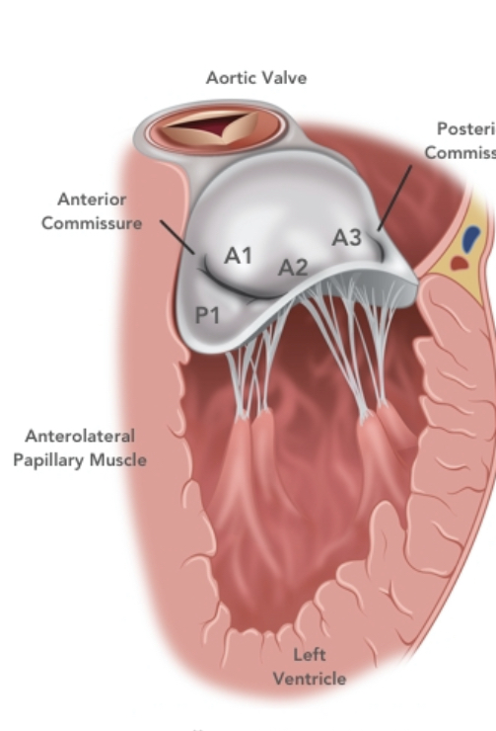
MITRAL VALVE APPARATUS
DR SANCHNA DEV S
DEPT OF CARDIOLOGY
TDMC

Slide 2
Contents
INTRODUCTION
EMBRYOLOGY
COMPONENTS
CONGENITAL ANOMALIES

Slide 3
INTRODUCTION
Dynamic 3D system
Regulates blood flow in 2 ways:
Forward towards left ventricle (LV) in diastole
Prevents backflow towards left atrium (LA) in systole
Helps regulate size, geometry and function of the LV

Slide 4
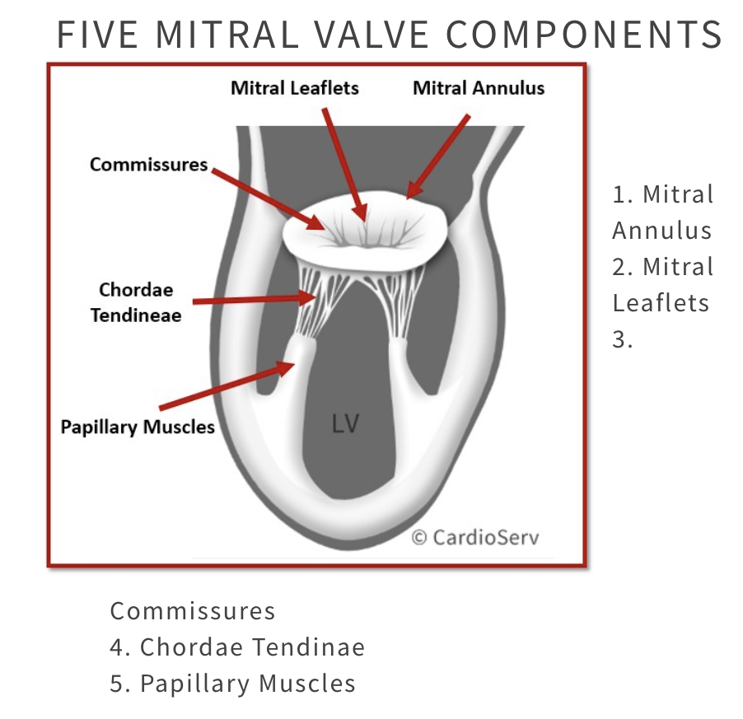
FIVE MITRAL VALVE COMPONENTS
Mitral Annulus
Mitral Leaflets
Commissures
Chordae tendinae
LV wall with its attached papillary muscles

Slide 5
EMBRYOLOGY
Mitral valve formation begins during the fourth week of gestation
During the sixth week, fusion of the endocardial cushions divides the atrioventricular canal into right and left atrioventricular junctions
Four endocardial cushions (superior, inferior, right lateral, left lateral) and the dextrodorsal conus cushion.
anterior mitral leaflet forms from the superior cushion and the left half of the inferior cushion.
posterior mitral leaflet arises from the left lateral endocardial cushion

Slide 7
At the eighth week, the shape of the orifice looks like a crescent, the two ends of which are connected to compacting columns in the trabecular muscle of the left ventricle.
These columns form a muscular ridge, the anterior and posterior parts of which become the papillary muscles.
The transformation of the ridge into papillary muscles implies a gradual loosening of muscle, called delamination
The chordae - individualized between the 11th and 13th week - by the appearance of defects in the cushion tissue at the place where the tips of the papillary muscles are attached to the leaflets

Slide 9
leaflets and chordae <—cushion tissue
Papillary muscles <—ventricular myocardium

Slide 10
MVA - COMPONENTS

Slide 11
1. MITRAL ANNULUS
The annulus is surgically defined as the level of visible transition between the left atrial myocardium and the whitish leaflet
anatomical definition -fibrous hingeline of the valvar leaflets
En face, the MA resembles a kidney bean
3 D -nonplanar saddle shape
The mitral annulus changes shape during the cardiac cycle from circular in diastole to eliptical during systole.
The annular circumference and area also decrease by approximately 15% and 25%, respectively, during ventricular systole

Slide 14
The MA area can significantly increase in patients with dilated LVs

Slide 15
2. MV LEAFLETS
The normal mitral valve has two leaflets
posterior leaflet -quadrangular shape -attached to approximately two-thirds of the annular circumference
posterior leaflet typically has two well defined indentations which divide the leaflet into three individual scallops identified as P1, P2, and P3
The P1 scallop corresponds to the external, anterolateral portion of the posterior leaflet, close to the anterior commissure and the left atrium (LA) appendage

Slide 17
The anterior leaflet -semi-circular shape and is in continuity with the non-coronary cusp of the aortic valve, referred to as the intervalvular fibrosa
The free edge of the anterior leaflet is usually continuous, without indentations
It is artificially divided into three portions A1, A2, and A3, corresponding to the posterior scallops P1, P2, and P3
Coaptation of MV leaflets – not restricted to tips
- but overlap of several millimetres of
tissue – ZONA COAPTA

Slide 19
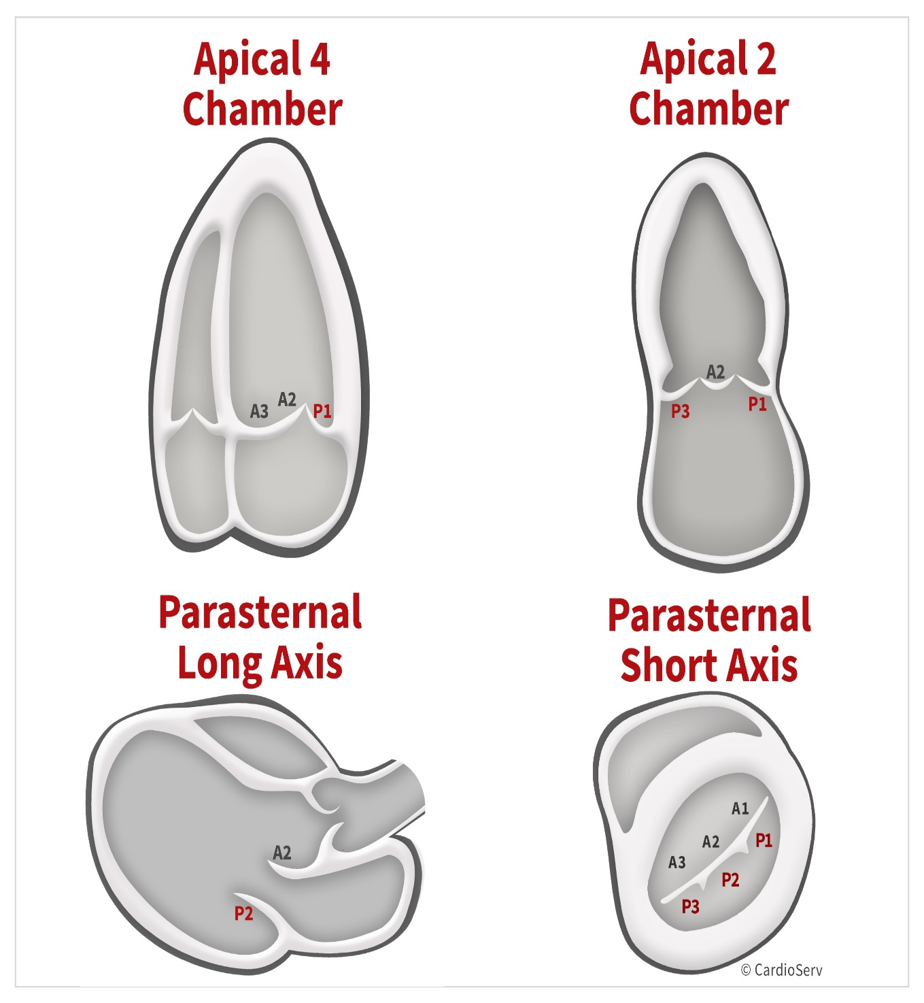
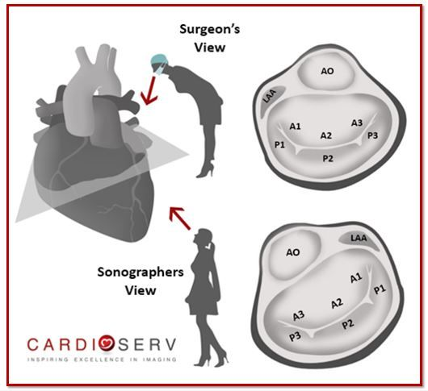

Slide 20
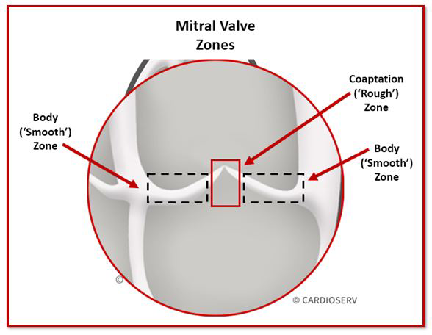
Redundant leaflet tissue is critically important for leaflet apposition and tight leaflet coaptation
In normal and dilated LVs, a leaflet-to-MA area ratio of 1.5 to 2.0 has been found sufficient to prevent significant mitral regurgitation.
The atrial surface of the leaflets is smooth and the leaflet body translucent
A hydrophilic protein-rich zone, termed rough zone, starts approximately 1 cm from the distal leaflet edge.
When the leaflets coapt, the irregular surface of this zone helps to maintain and ensure a seal

Slide 23
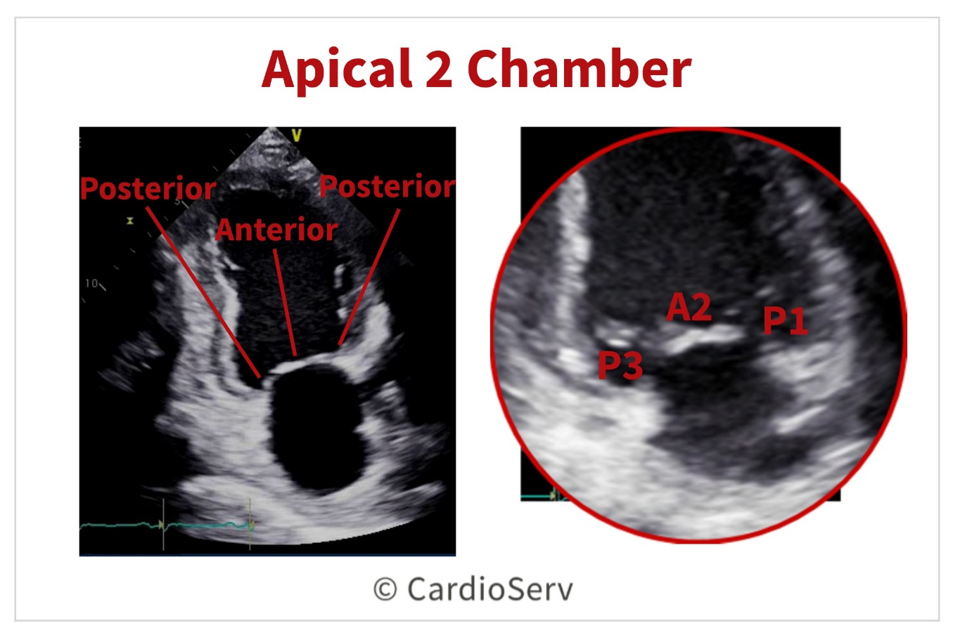

Slide 24
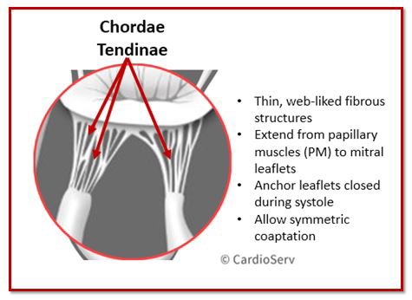
3. Chordae tendinae
Fibrous strings that attach specific portions of mitral leaflets to papillary muscle tips
Normal average length is around 20mm
Normal average thickness is 1-2mm

Slide 25
Types
Marginal chordae (primary) are inserted on the free margin of the leaflets
Function to maintain coaptation of leaflets
Failure of primary leads to rupture or elongated chordae
Cause development of prolapse or flail leaflet
2. Intermediate chordae (secondary) insert on the ventricular surface of the leaflets and relieve valvular tissue of excess tension
3.Basal chordae (tertiary) are limited to the posterior leaflet and connect the leaflet base and mitral annulus to the papillary muscle

Slide 26
Rupture, calcification, fusion, or redundancy of the chordae can lead to regurgitation

Slide 27
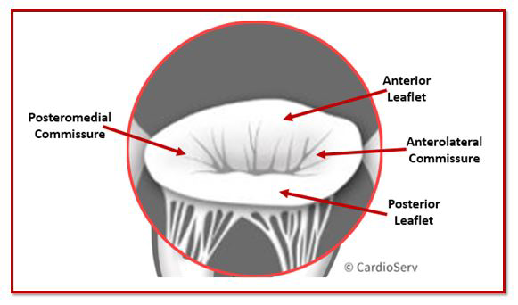
4. COMMISURES
2 specific sites where the leaflets insert and join into mitral annulus
Anterolateral Commissure
Posteromedial Commissure

Slide 28
5. PAPILLARY MUSCLES
Large trabeculae muscles that branch from 1/3rd of LV, connecting chordae to mitral leaflets
2 papillary muscles:
Anterolateral (APM):
Dual blood supply (LAD & Cx)
Posteromedial (PPM):
Single blood supply (Either RCA or LCX)
Prone to injury from MI due to single blood supply

Slide 29
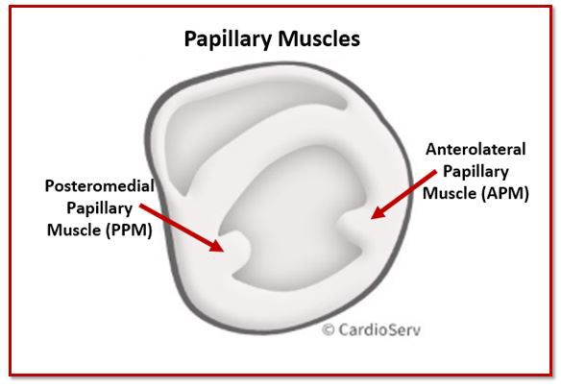

Slide 30
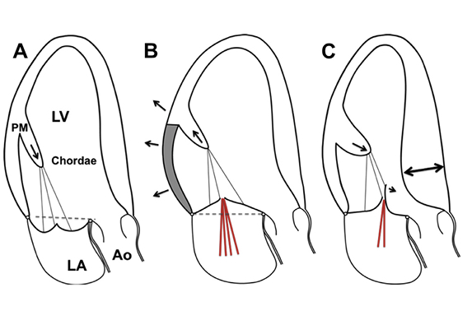

Slide 31
Anomalies of the leaflet

Slide 32
1. Mitral valve prolapse
MVP occurs when the leaflets extend above the plane of the mitral annulus during ventricular systole.
most common cardiac valvular anomaly in developed countries.
Myxomatous degeneration is the main aetiology of prolapsing valvar leaflets
MVA –saddle shaped —> MVP overestimated
the normal leaflets can falsely appear to prolapse in certain echocardiographic views, especially in the apical two- and four-chamber views

Slide 33
echographical MVP has been defined as a single or bileaflet prolapse located at least 2 mm beyond the long-axis annular plane, with or without a thickening of leaflets
A classic prolapse is defined as a leaflet thickening exceeding 5 mm, whereas a prolapse with a lesser degree of leaflet thickening is referred to as non-classic

Slide 35
2. Isolated cleft
Isolated cleft of the anterior mitral valve leaflet is a rare but well-known finding
division of one of the leaflets (usually the anterior leaflet) of the mitral valve
On transthoracic echocardiography, it looks like a slit-like hole in the anterior mitral leaflet
Mitral valve repair of isolated cleft associated with mitral regurgitation is preferred to mitral valve replacement and usually consists of a direct suture of the cleft

Slide 36
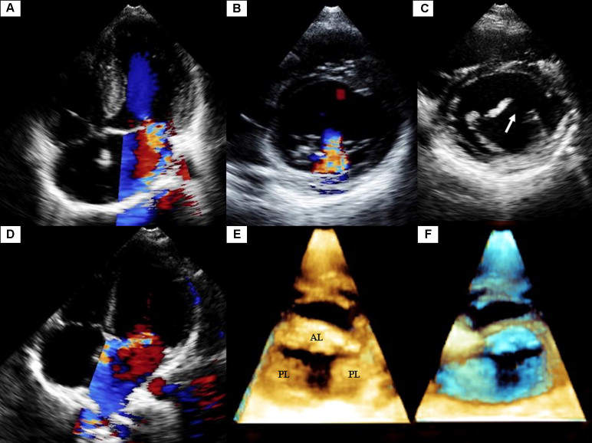

Slide 37
3. Double orifice mitral valve
DOMV -rarely isolated but usually an ancillary finding in the setting of a more complex congenital cardiac anomaly
found in association with AVSD (52%), obstructive left-sided lesions (41%) and cyanotic heart disease
DOMV is defined as a single fibrous annulus with two orifices opening into the left ventricle
duplicate mitral valve - two mitral valve annuli and valves, each with its own set of leaflets, commissures, chordae and papillary muscles

Slide 38
DOMV is usually classified into three types
‘incomplete bridge type’ - small strand of tissue connecting the anterior and posterior leaflets at the leaflet edge level
‘complete bridge type’- a fibrous bridge divides the atrioventricular orifice completely from the leaflet edge all the way through the valve annulus
‘hole type’ (eccentric) -a secondary orifice with subvalvular apparatus occurs in the lateral commissure of the mitral valve

Slide 40
Transthoracic echocardiography is efficient for diagnosing and evaluating DOMV
The two distinct orifices are clearly recognized in parasternal short-axis views
Rather than the ellipsoid shape of a normal mitral valve, DOMV opens as two circles in diastole
the visualization of two anterograde flows through the mitral valve in color Doppler is key

Slide 41
4. Mitral ring
Mitral ring, also called supravalvar mitral ring or supramitral ring, is one of the components described by Shone et al. in Shone's syndrome (association of coarctation of the aorta, subaortic stenosis, PMV and supramitral ring)
Exceptionally isolated (mainly ventricular septal defects and left-sided obstructive lesions )

Slide 42
According to the relation with the mitral annulus -two types of mitral rings
The supramitral ring is a fibrous membrane originating just above the mitral annulus, beneath the orifice of the left atrial appendage, within the muscular atrial vestibule, not adhering to the leaflets and associated with a normal subvalvular apparatus.
The intramitral ring is a thin membrane located within the funnel created by the leaflets of the mitral valve, closely adherent to the valve leaflets always combined with abnormal subvalvular apparatus

Slide 44
4.Ebstein's malformation of the mitral valve
The malformation exclusively affects the posterior valve leaflet, which is plastered into the left ventricle wall, thus displacing the mitral valve orifice downward into the left ventricle.
Unlike Ebstein's malformation of the tricuspid valve, the atrialized inlet portion is usually not thinned
This exceedingly rare anatomical condition causes mitral insufficiency

Slide 45
Anomalies of the tensor apparatus

Slide 46
Arcade or hammock valve
Anomalous mitral arcade was first described as a direct connection of the papillary muscles to the mitral leaflets, either directly or through the interposition of unusually short chordae
sometimes called hammock valve because it mimics a hammock when the valve is observed from an atrial aspect (as seen by a surgeon)
The tendinous cords are thickened and extremely short, thus reducing the intercordal spaces and leading to an abnormal excursion of the leaflets that may cause both stenosis and insufficiency

Slide 47
When the space between the abnormal chordae is completely obliterated, a fibrous (muscular) bridge (band) joins the two papillary muscles
In the most severe form, with no chordae tendinae at all, the papillary muscles are directly fused with the free edge of the leaflet

Slide 49
Straddling mitral valve
SMV is defined by an abnormal attachment of the mitral chordae to both ventricles
SMV is consequently always associated with a ventricular septal defect.
The mitral valve always straddles through a conoventricular (misalignment) type of ventricular septal defect
SMV is almost always associated with conotruncal anomalies, such as double outlet right ventricle or transposition of the great arteries

Slide 51
Anomalies of papillary muscle

Slide 52
Parachute mitral valve
Among the causes of congenital mitral stenosis, PMV is frequently encountered
True PMV is characterized by unifocal attachment of the mitral valve chordae to a single (or fused) papillary muscle.
This single papillary muscle is usually centrally placed and receives all chordae from both mitral valve leaflets

Slide 53
In PLAMV, chordae are distributed unequally between two identifiable papillary muscles, with most or all of the chordae converging on a dominant papillary muscle
The dominant papillary muscle, classically posteromedial , is of normal size, whereas the other is elongated and displaced higher in the ventricle with its tip reaching to the annulus.
In both PMV and PLAMV, the chordae are short and thickened, thus restricting the motion of the leaflets

Slide 54
Echocardiography establishes the diagnosis in most patients with PMV
In the parasternal short-axis view, a single papillary muscle is confirmed at the mid-level of the left ventricle.
The pathognomonic ‘pear’ shape of the mitral valve is seen in the four-chamber view, with the left atrium forming the larger base of the pear and the mitral leaflets the apex. In this view, the valve has a typical ‘domed’ appearance in diastole

Slide 56
Which among the following is not derived from endocardial cushions?
AML
PML
PAPILLARY MUSCLE
CHORDAE TENDINAE

Slide 57
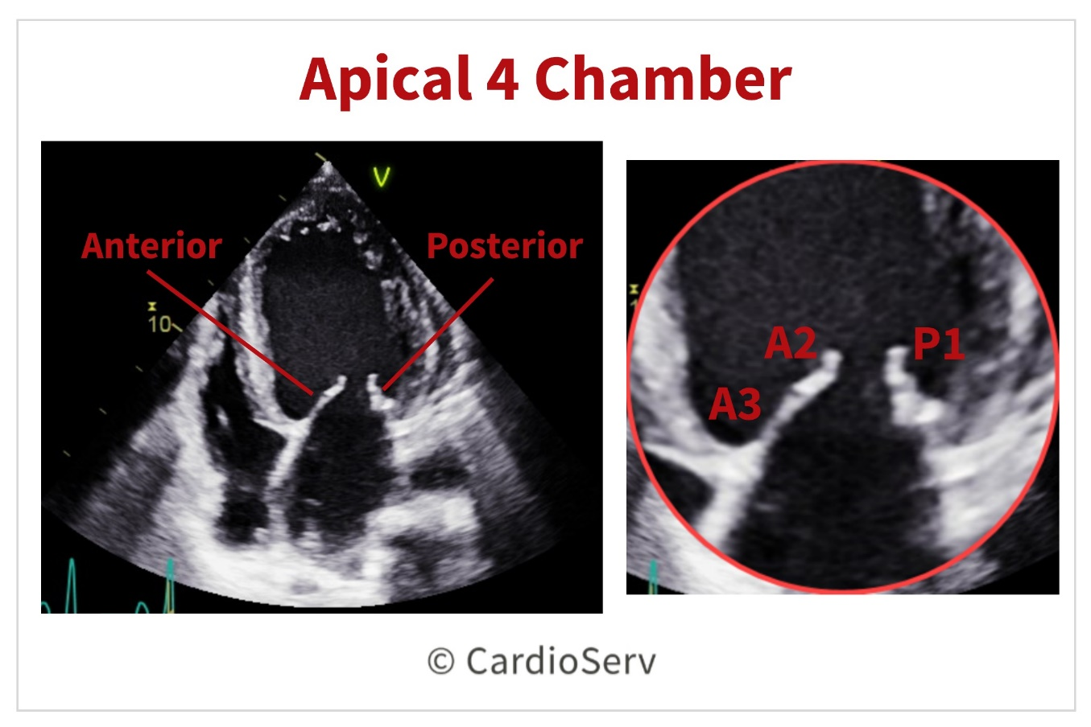
APICAL 4C VIEW - MV VISUALISED INCLUDES
P1 A2 A3
P1 P2 A3
P1 A2 P3
P1 P2 P3

Slide 58
IDENTIFY
HAMMOCK VALVE
PARACHUTE MV
PLAMV
STRADDLING MV

Slide 59
SHONES COMPLEX INCLUDES ALL EXCEPT
coarctation of the aorta
subaortic stenosis
Parachute MV
Intramitral ring

Slide 60
Thank you

