Slide 1
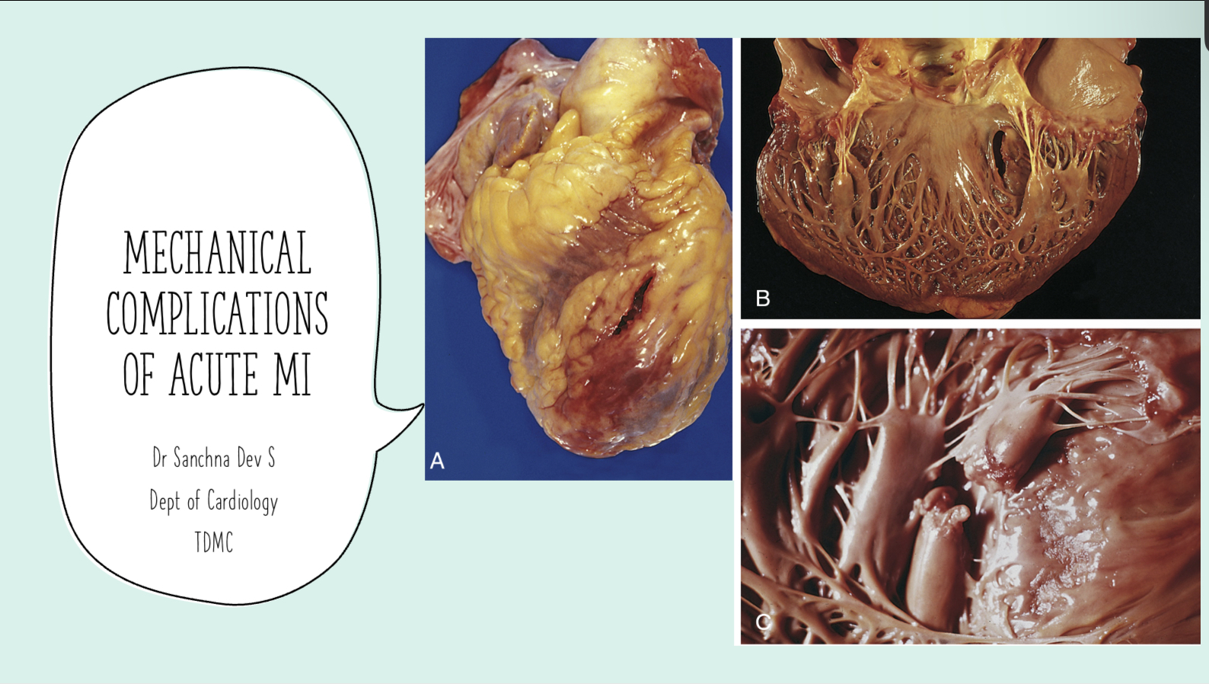

Slide 2
Contents
INTRODUCTION
PAPILLARY MUSCLE RUPTURE
VENTRICULAR SEPTAL RUPTURE
FREE WALL RUPTURE
PSEUDOANEURYSM OF LV
DD

Slide 3
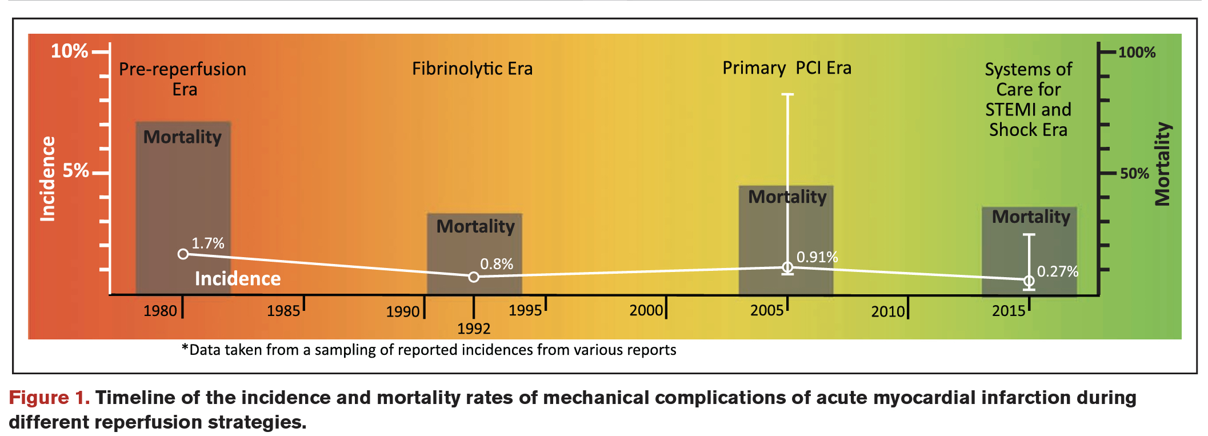
INTRODUCTION
Over the past 30 years, improvements in timely reperfusion with advancement in optimal medical therapies —> reduced mortality rates of AMI
Despite improvements in revascularization strategies , the incidence of mechanical complications has remained relatively unchanged over time.
RISK FACTORS —older, female, history of heart failure, chronic kidney disease, first MI, single vessel disease with no collaterals, large infarction, late hospital presentation, lack of tissue level reperfusion

Slide 5
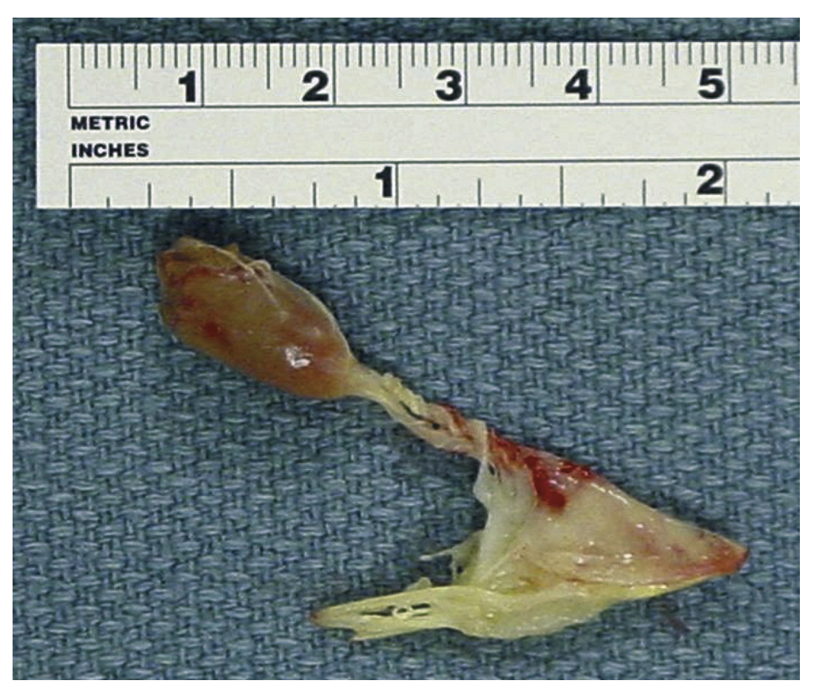
Papillary muscle rupture

Slide 6
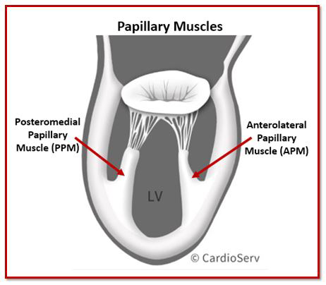
1.Papillary Muscle Rupture
Incidence - declined in the reperfusion era (0.05-0.26%)
hospital mortality rate remains high between 10% and 40%.
Complete transection of an LV papillary muscle- incompatible with life — sudden massive MR
Rupture of a portion of a papillary muscle (partial), usually the tip or head —> severe MR, - more frequent - not immediately fatal
IW or LW MI —> Posteromedial PM (singular blood supply)
AWMI —> Anterolateral PM (dual blood supply)
Occurs with a relatively small infarction in approx half of cases
Rupture – RV papillary muscle is unusual -cause massive TR and RV failure

Slide 7
Time course -Bimodal peak
within 24 hr and 3–5 days; range: 1–14 days
median time of presentation -13 hrs (SHOCK TRIAL REGISTRY)
Clinical manifestations –
abrupt onset of shortness of breath -pulmonary edema; hypotension
exertion/prolongued angina before symptom onset
Physical findings -soft murmur in some cases, no thrill, variable signs of RV overload, severe pulmonary edema, cardiogenic shock
Echo findings -Hypercontractile LV, mobile mass in LV prolapsing into LA , prolapsing or flail leaflet , eccentric or board jet of severe MR , V shaped MR signal ( rather than typical rounded pattern) in spectral Doppler tracing
Right heart catheterisation -No increase in oxygen saturation from the RA to RV, large v waves - very high PCWP

Slide 9
Management
Initial medical care and resuscitation -vasoactive drugs and respiratory support
norepinephrine or dopamine is a good initial vasoactive agent but after the hemodynamic stabilization is achieved, the addition of an inotropic agent is suggested for patients with pump failure
positive-pressure ventilation can improve gas exchange and cardiovascular hemodynamics by reducing LV preload and afterload and MR, augmenting cardiac output
In hemodynamically stable patients- IV nitroglycerin or nitroprusside — reduce LV afterload
Patients who do not initially present with cardiogenic shock commonly experience rapid hemodynamic deterioration

Slide 10
The proportion of patients who required mechanical circulatory support before mitral valve surgery was in excess of 70%
In the APEX-AMI trial (Assessment of Pexelizumab in Acute Myocardial Infarction), patients who underwent surgical repair had a markedly improved survival rate at 90 days, in comparison with those who were treated medically (surgical treatment, 69% versus medical treatment, 33%)
IABP-Shock II trial (Intraaortic Balloon Pump in Cardiogenic Shock II) did not show a mortality benefit from the use of an IABP in patients with AMI complicated by cardiogenic shock ( the study excluded patients with mechanical complications)
IABP placement is still recommended by guidelines as a bridge to therapy because of its presumed ability to reduce afterload
MCS – percutaneous VAD , ECMO —> bridge to decision or definitive surgical or percutaneous therapies ( data limited to case series )

Slide 11
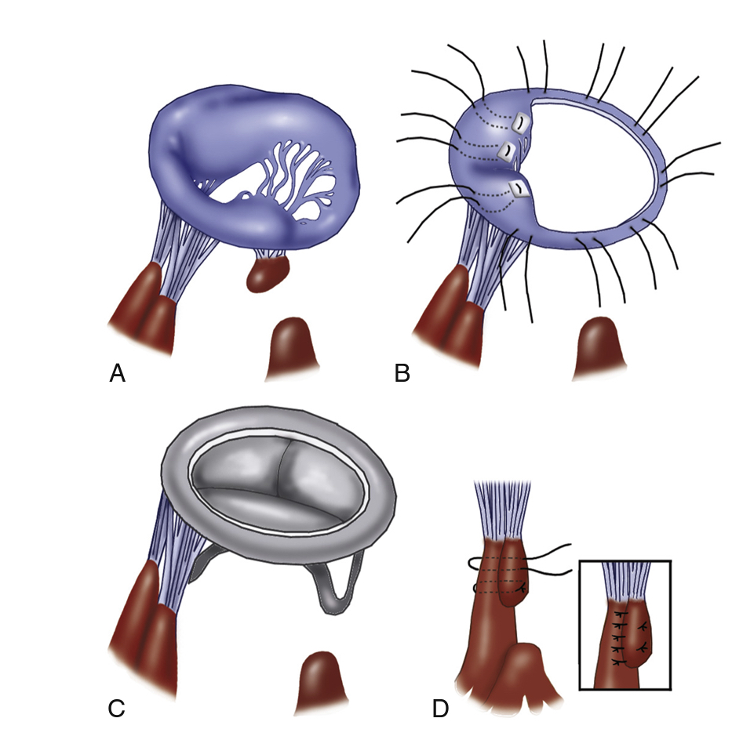
1. Cardiac surgery
MV replacement vs repair
Emergency mitral valve replacement ( generally chordal sparing ) is the treatment of choice
MV repair - typically for patients with partial PMR and stable hemodynamics, by surgeons with technical expertise in MV repair
Surgical expertise, the patient's general condition, urgency and the general need to decrease further ischaemic myocardial injury by minimising cross-clamp times —> influences the choice between valve repair and replacement
Mechanical vs bioprosthetic valve
mechanical valve- long-term symptom-free survival, particularly, in younger patients
BV - need for mechanical circulatory support or advanced heart failure therapies wherein the risk of mechanical valve thrombosis may be much higher

Slide 12
Concomitant CABG surgery — to achieve optimal revascularisation
weigh the risks of prolonging the operation versus the benefit of revascularization with CABG
Some surgical series have reported improved outcomes with concomitant CABG
In a large series from the Society of Thoracic Surgeons Database, similar operative mortality was observed in patients who received mitral valve surgery with concomitant CABG versus those who received valve surgery alone (20.1% versus 19.8%, P=0.91).
many patients may have multivessel coronary disease that will require surgical revascularization.
high-quality studies are lacking, but, if severe multivessel disease is not treated at the time of mitral valve replacement, weaning from cardiopulmonary bypass may be less feasible

Slide 13
2. Transcatheter edge-to-edge MV repair
In select patients with PMR complicated by cardiogenic shock and pump failure with prohibitively high surgical risk, percutaneous mitral valve edge-to-edge repair may be a therapeutic option (bail out)
Other therapeutic options in pts CI for surgery :
medical management as a bridge to candidacy for mitral valve replacement can be considered in patients with severe MR complicated by cardiogenic shock
temporary mechanical support as a bridge to long-term ventricular assist device or heart transplantation

Slide 14
Ventricular septal rupture

Slide 15
2.Ventricular Septal Rupture
Incidence – around 0.2 % in the current era of P PCI
High mortality rate — 80% at 30 days in uncorrected defects, 40% at 30 days following repair
The culprit vessels are the LAD and the PDA of RCA
Anterior and apical VSR —> infarcts in the LAD territory
Posterior VSR —> caused by inferior (PDA) infarcts (often accompanied by MR commonly secondary to ischemic tethering)
The locations of VSD as reported in a study —> more frequently in the anterior than inferior/lateral wall infarction (70% versus 29%), but inferior infarcts are associated with “complex VSDs, those with multiple, irregular, and/or variable interventricular connections” —> worse prognosis!!

Slide 16
Time course -Bimodal peak
within 24 hr and 3–5 days; range: 1–14 days
median time to VSR -16 hrs (SHOCK TRIAL REGISTRY) and 1 day ( GUSTO-I TRIAL)
Clinical manifestations –
Female sex; older age; CKD; absence of hypertension, diabetes, smoking or history of MI (lack of collaterals) — increase the risk for VSR
Fibrinolytic therapy > primary PCI
Delayed PCI > Primary PCI
Chest pain , dyspnoea , hypotension (pulmonary edema less common)
Physical findings – harsh pansystolic murmur at the left lower sternal border, thrill + , S3 , accentuated S2, RV and LV failure, cardiogenic shock

Slide 17
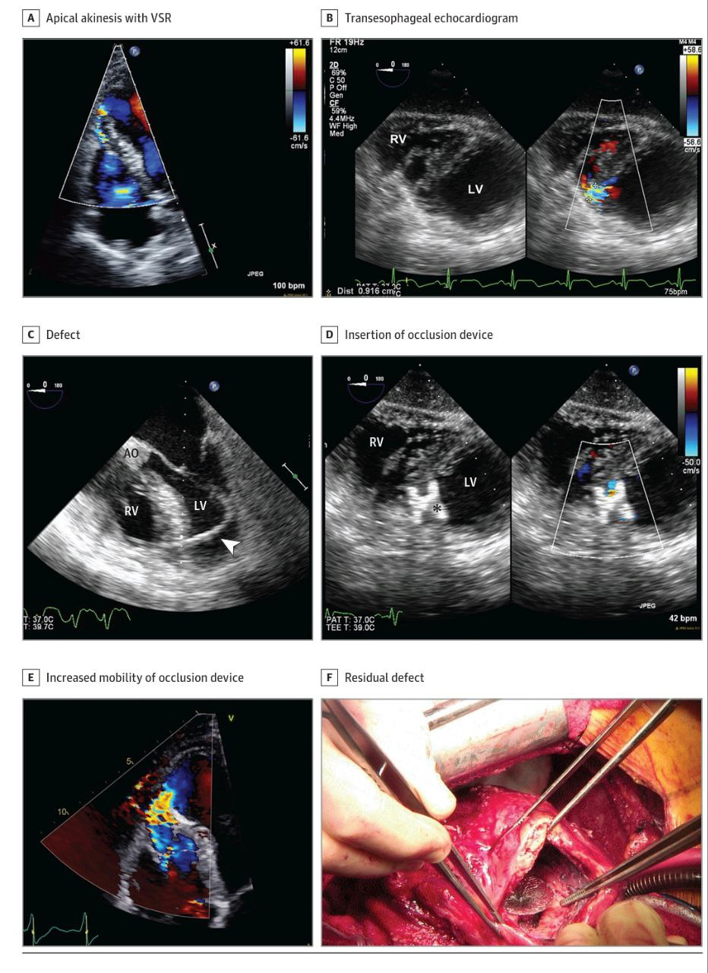
Echo findings – ventricular septal rupture with left to right shunt on color flow doppler, evidence of chamber enlargement with dysfunction. TEE/ ventriculography
Right heart catheterisation –step-up oxygen saturation from the RA to RV,elevated pulmonary-to-systemic flow ratio (up to 8:1 depending on the defect size), large v waves - very high PCWP

Slide 18
Management
Immediate afterload reduction- mainstay of treatment (to decrease the left-to-right shunt is essential): IABPs with pharmacotherapy are used in >80% of emergency and 65% of urgent repairs.
In the SHOCK Trial Registry, IABPs were used in up to 75% of postinfarct VSDs. Within 30 minutes of the initiation of IABP, the median systolic blood pressure was increased from 81 mm Hg to 102 mm Hg.
When a patient presents with multiorgan failure, potential support with ECMO (percutaneous /surgical LV vents) may be considered to allow for improvements in end-organ failure as a bridge to surgical candidacy.
In patients without clinical symptoms of end-organ failure, a delayed treatment may allow for connective tissue or scar formation around the defect, resulting in a better anchor for suture material and a lower potential for patch dehiscence. (avoid bleeding from antiplatelet medications)

Slide 19
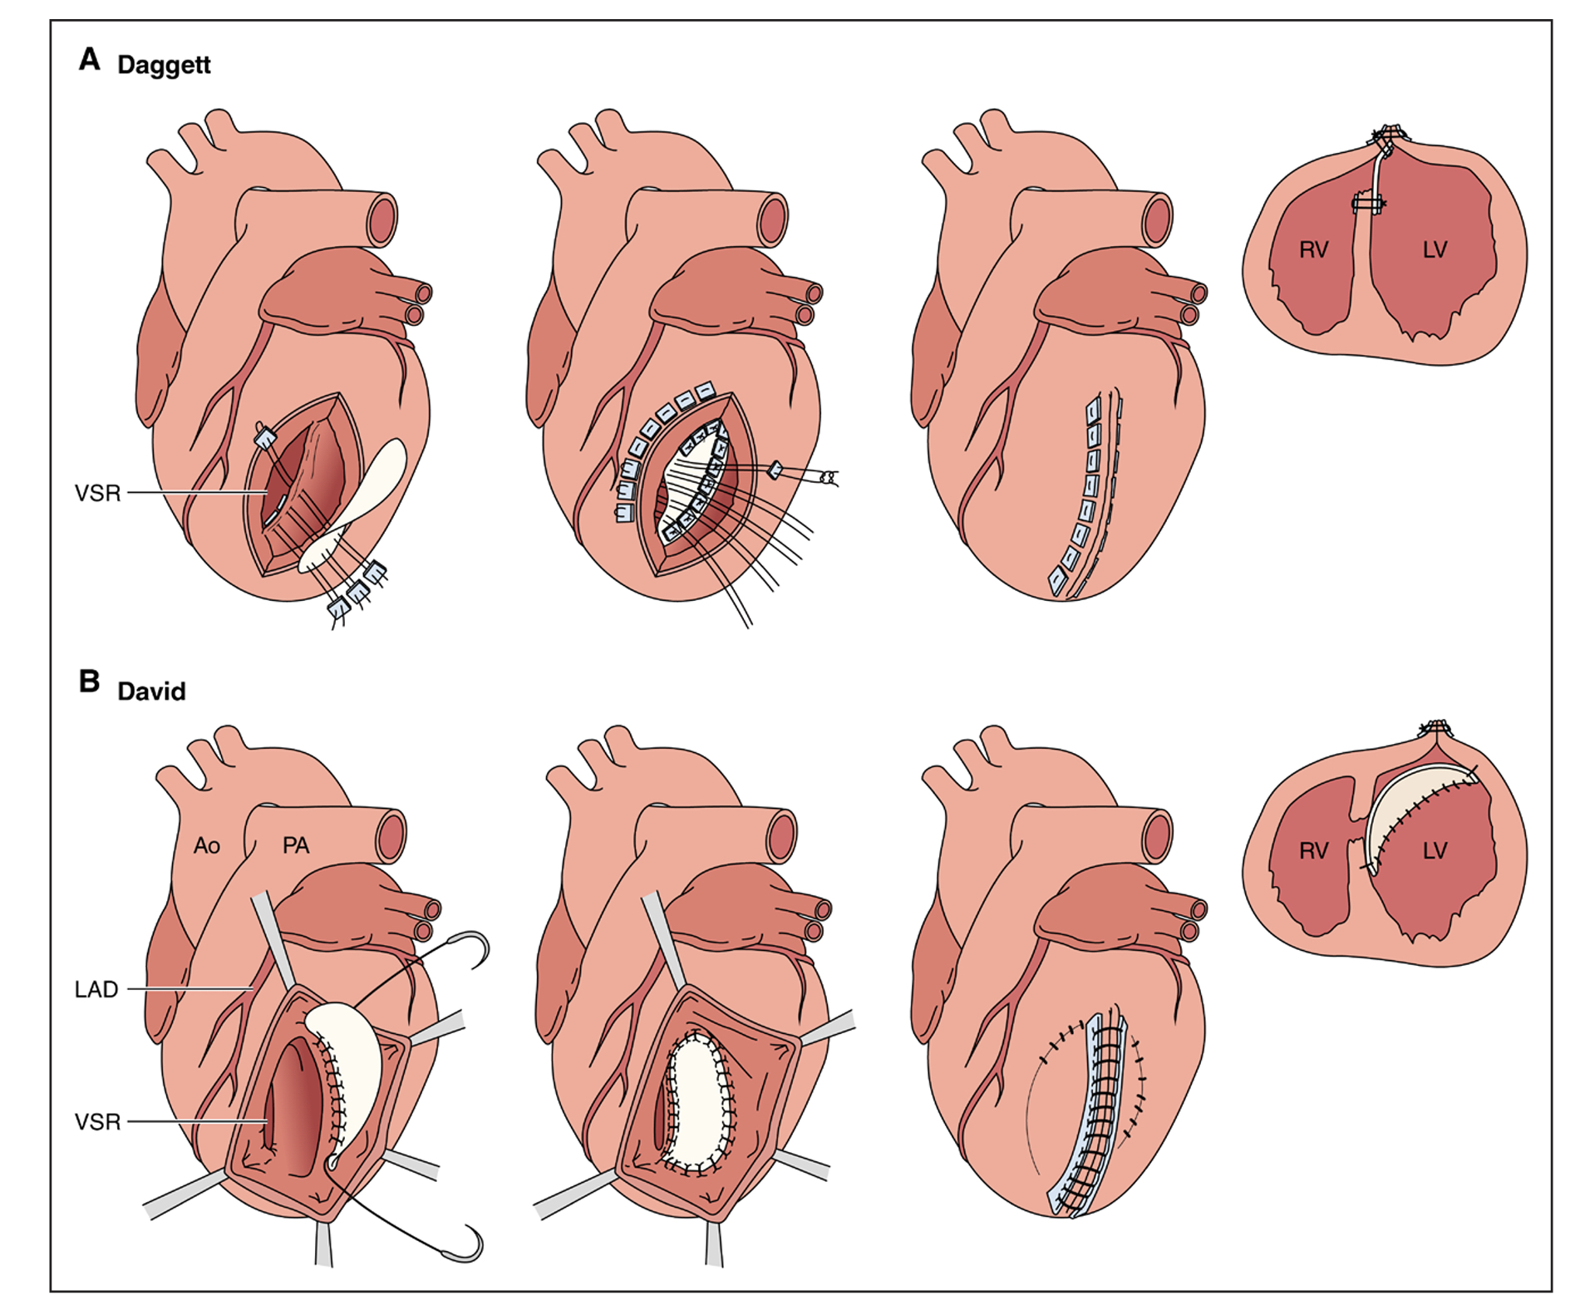
1. Cardiac surgery
Urgent postinfarct VSD surgical repair in patients with cardiogenic shock and respiratory failure is associated with 40% mortality
Delayed surgery –risks extension of the VSR and subsequent associated mortality.
Optimal timing of surgical treatment is IMPORTANT !!
During surgical repair of VSD, coronary bypasses are performed first, commonly with saphenous veins, to facilitate myocardial protection and minimize handling of the heart after VSD repair.
Surgical techniques –
primary repair (Dagett) - defect is suture closed – patch if defect is large
Infarct exclusion (David) – patch larger than the infarcted area is sewn over the defect and the infarcted myocardium directly unto healthy myocardium
Double patch technique

Slide 20
For anterior VSDs, the infarcted surface of the anterolateral LV is incised parallel to the LAD
True apical VSDs can be repaired and closed primarily by amputating the apex
Posterior VSDs are approached through a ventriculotomy in the infarcted posterior LV wall parallel to the posterior descending coronary artery
preoperative prognostic factors associated with in-hospital mortality -poor ventricular function, deteriorating cardiovascular status, cardiogenic shock, inferior AMI, inotropic support, and total occlusion of the infarct-related artery.
Factors that determine long-term survival -right ventricular dysfunction, residual LV function after surgical closure and NYHA functional class at the time of presentation

Slide 21
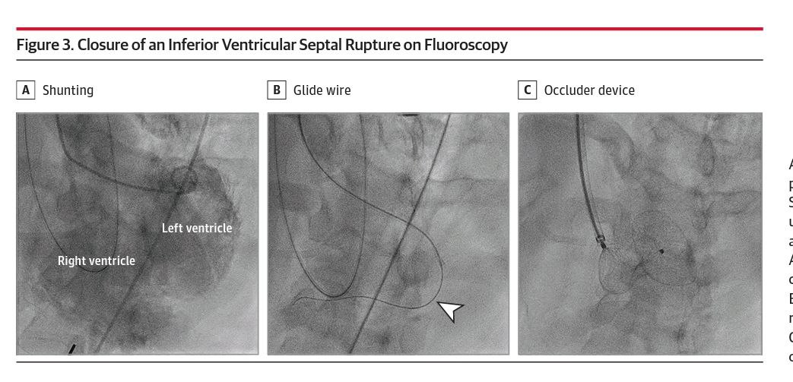
2. Transcatheter repair of VSR
In patients with prohibitive surgical risk —> percutaneous closure can be considered
The procedure is usually performed under GA with TEE guidance for device sizing
Most often, the VSD is crossed by using a hydrophilic wire from the left to the right ventricle into the pulmonary trunk. The wire is snared and exteriorized through the venous access (femoral or jugular)
Over this arteriovenous rail, a shuttle sheath is advanced into the interventricular septum and an occluder is deployed
If difficulties crossing the VSD are encountered, right to left wiring and exteriorization can be performed

Slide 22
Although procedural success approaches 89% (range, 80%–100%) in centers of excellence, hospital mortality remains excessively high and procedural complications are common
Complications —>device embolization, arrhythmia, hemolysis, and failure of complete occlusion of the VSD requiring surgical repair
Predictors of adverse outcomes -delayed diagnosis, high MELD score, increased pulmonary to systemic flow ratio at time of closure, and residual defect.
In patients with severe refractory shock and biventricular failure prohibiting surgical or transcatheter repair, evaluation for durable mechanical circulatory support or heart transplantation or total artificial heart may be considered.

Slide 23
Free wall rupture

Slide 24
3. Free Wall Rupture
Incidence – around 0.3-1 % .
Fribrinolysis does not reduce risk vs PCI –reduces risk—> initial trials of fibrinolysis versus placebo showed an early increased risk of FWR after 24 hours with fibrinolytic therapy that supports a higher risk of rupture with delayed reperfusion therapy
attributed to intramyocardial hemorrhage, myocardial dissection, and subsequent rupture
worst prognosis among the mechanical complications of AMI. In-hospital mortality is around 60% according to the SHOCK Trial registry data
more common in the LV (specifically, the anterior or lateral wall) than in the right ventricle and seldom occurs in the atria

Slide 25
The tear is usually preceded by a large infarct with subsequent expansion, sometimes with a dissecting hematoma —> occurs near the junction of the infarct and normal muscle
3 morphologies of FWR were originally described by Becker:
TYPE 1 — abrupt tear usually within the first 24 hours of MI
TYPE 2 — slower tear with localised myocardial erosion
TYPE 3 — thin walled aneurysm perforation –usually occurs > 7 days after MI
Time course -Bimodal peak
within 24 hr and 3–5 days; range: 1–14 days
Mean time for diagnosis – 2.6 days (2018 series)

Slide 26
Clinical presentation :
catastrophic - acute tear leading to tamponade and immediate death
Subacute -nausea, hypotension, and pericardial discomfort
Physical findings :
classically shows jugular venous distension (29%)
pulsus-paradoxus (47%)
frank electromechanical disassociation ( without preceding overt failure – specific for FWR)
muffled heart sounds in the setting of cardiovascular collapse
ECG may show new ST-segment elevation because contact with blood irritates the pericardium

Slide 27
Echo findings – >5 mm pericardial effusion not visualized in all cases; layered, high- acoustic echoes within the pericardium (blood clot); direct visualization of tear; signs of tamponade
Right heart catheterisation –Ventriculography insensitive, classic signs of tamponade not always present
From a surgical viewpoint, two distinct groups of FWR exist:
the 'oozing type', without an obvious bleeding source and blood slowly accumulating in the pericardial sac
the 'blow-out type' with a macroscopic defect and high-volume bleeding causing abrupt pericardial tamponade.
Clinical presentation reflects this variability

Slide 28
Management
Immediate surgical referral is vital
Percutaneous relief with pericardiocentesis can be life-saving in manifest tamponade and circulatory collapse —> clot might be expected in the pericardial cavity
As sutures easily tear through in the extremely fragile, necrotic myocardial wall, attempts for direct closure should be avoided
The two most commonly applied techniques are
classical infarctectomy and patch reconstruction of the LV wall on cardiopulmonary bypass –primary patch repair
coverage of the affected region with an oversized pericardial patch reinforced by glue, with or without suture anchoring or collagen sponge patch

Slide 29
Mechanical circulatory support using ventricular assist devices may be considered to help wean patients from cardiopulmonary bypass after surgical closure of the LV free wall rupture and to provide LV decompression
percutaneous approach using intrapericardial fibrin-glue injection has also been described

Slide 30
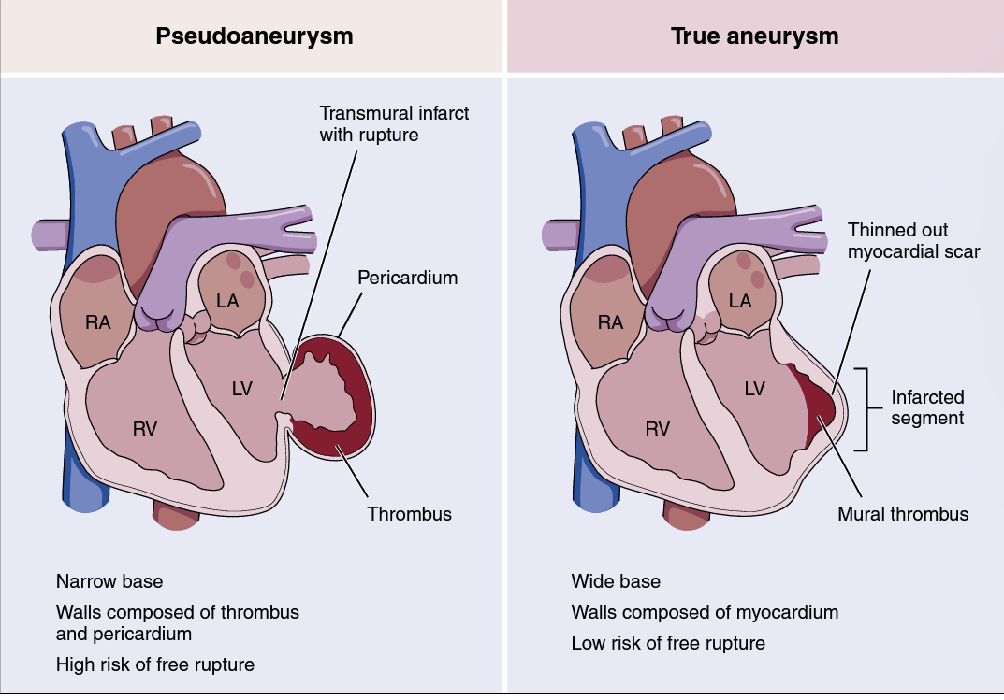
Pseudoaneurysm & True LV aneurysm

Slide 31
4. Pseudoaneurysm
Pseudoaneurysms of the LV develop when cardiac rupture is contained by pericardial adhesions.
Incomplete rupture of the heart may occur when organizing thrombus and hematoma, together with pericardium, seal a rupture of the left ventricle and thus prevent the development of hemopericardium
With time, this area of organized thrombus and pericardium can become a pseudoaneurysm (false aneurysm) that maintains communication with the cavity of the left ventricle
In contrast to true aneurysms, which always contain some myocardial elements in their walls, the walls of pseudoaneurysms are composed of organized hematoma and pericardium and lack any elements of the original myocardial wall.

Slide 32
Pseudoaneurysms can become quite large, even equaling the true ventricular cavity in size, and they communicate with the LV cavity through a narrow neck.
Frequently, pseudoaneurysms contain old and recent thrombi, the superficial portions of which can cause arterial emboli.
can drain off a portion of each ventricular stroke volume, exactly as do true aneurysms.
Diagnosis - echo, contrast- enhanced angiography, CMR, or CT
Differentiation between a true aneurysm and a pseudoaneurysm can sometimes be difficult with any imaging technique
Clinical presentation : may present with a myriad of signs or symptoms — asymptomatic/CCF/chest pain/dyspnoea —none of which can be considered pathognomonic for the condition /FWR

Slide 33
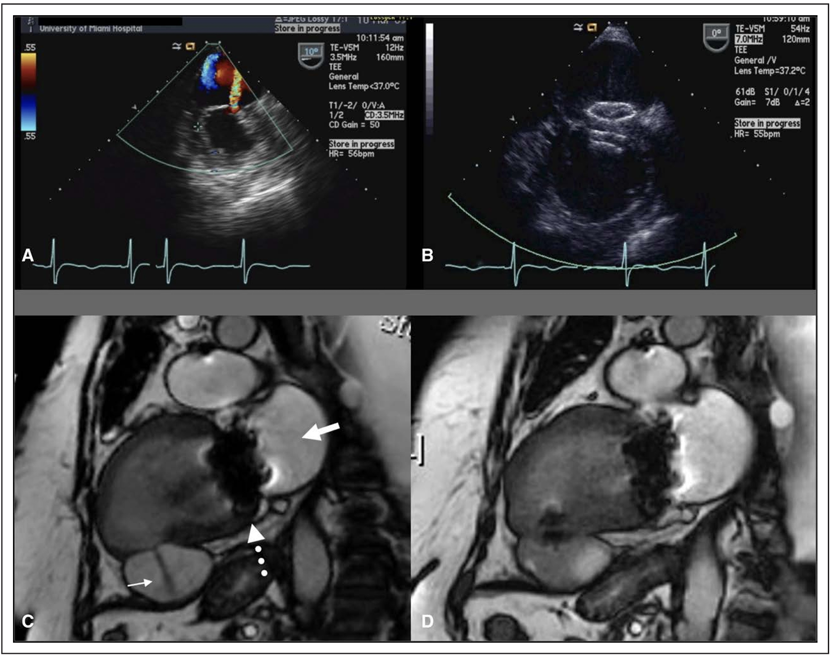
Management
In patients with critically compromised hemodynamics, establishment of the diagnosis should be followed immediately by surgical resection of the necrotic and ruptured myocardium with primary reconstruction
When the rupture is subacute and a pseudoaneurysm is suspected or present, prompt elective surgery is indicated because the risk of rupture approaches 50% in untreated cases
The feasibility and efficacy of transcatheter closure of LV pseudoaneurysms were demonstrated in selected patients at high risk for conventional surgery.

Slide 34
Recomendations – LV aneurysm
2004 American College of Cardiology/AHA guidelines on STEMI gave a class IIa recommendation (Level of Evidence: B) to consider aneurysmectomy during CABG when intractable ventricular arrhythmia and heart failure were unresponsive to conventional therapies.
These recommendations were also endorsed by the ESC
Surgical techniques aiming at restoring the LV physiological geometry - plication, excision with linear repair, and ventricular reconstruction with endoventricular patches.
The 2013 American College of Cardiology Foundation/AHA guidelines did not specify any level of recommendation for surgical repair, but the document suggested surgery for LV aneurysm in patients with refractory heart failure, ventricular arrhythmia not amenable to drugs or radiofrequency ablation, or recurrent thromboembolisms despite anticoagulation therapy.

Slide 35
Differentials ??

Slide 41
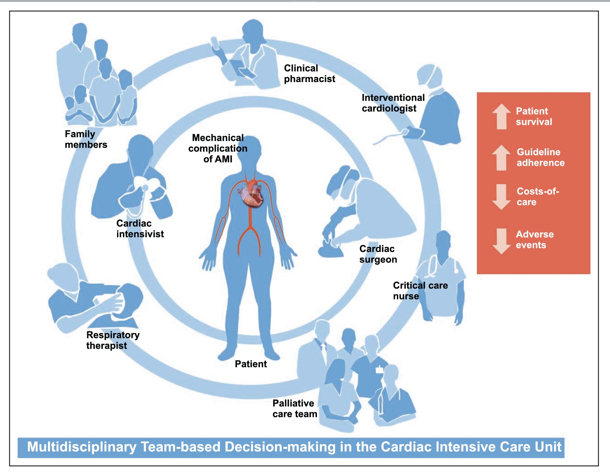

Slide 42
MCQ
Which of the following is false regarding PMR ?
Occurs with a relatively small infarction in approx half of cases
Posteromedial papillary muscle is most affected
soft murmur , no thrill
Emergency mitral valve repair is the treatment of choice

Slide 43
2. Which of the following is FALSE regarding VSR?
harsh pansystolic murmur at the left lower sternal border, thrill +
more frequently seen in anterior than inferior/lateral wall infarction
Inferiors infarcts cause simple VSDs carries better prognosis
Infarct exclusion repair proposed by David

Slide 44
3. FWR – most specific physical finding?
jugular venous distension
pulsus-paradoxus
frank electromechanical disassociation without overt failure
muffled heart sounds

Slide 45
4. Which of the following is false w.r.t LV pseudoaneurysm ?
maintains communication with the cavity of the left ventricle
aneurysmectomy when intractable ventricular arrhythmia and heart failure presents
Maybe asymptomatic
Asymptomatic cases do not require surgery

Slide 46
5. Identify Becker morphological type 3 FWR?

Slide 47
Thank you !

