Slide 1
Modes of Pacemaker
Dr. Mayur A

Slide 2
In order to standardize and facilitate the use and understanding of pacemakers, the
North American Society for Pacing and Electrophysiology (NASPE) and
British Pacing and Electrophysiology Group (NASPE/BPEG) groups
devised the standard pacemaker codes, the NBG coding system. The most recent iteration of the NBG code was revised in 2002

Slide 3
In the context of the NBG code, “sensing” refers to the detection, by the pulse generator, of spontaneous cardiac depolarizations.
The effect of a “sensed” event is either a “triggered” pacing stimulus or an “inhibited” pacing stimulus

Slide 4
Pacing modes describe which chambers are sensed and paced and are characterized by a four-letter code
The first letter indicates the chamber paced:
A for atrium, V for ventricle, and D for dual—both atrium and ventricle.
The second letter denotes the chamber sensed.

Slide 5
The third letter describes pacemaker function: I for inhibition, T for triggered, and D for dual- Atrial tracking and Ventricular inhibition, “O” indicates absence of any of these functions.
The fourth letter is R, for rate-adaptive pacing.
Timing cycles are the rules that define a pacemaker's beat-by-beat response to sensed and paced beats

Slide 13
VVI MODE
Basic single-chamber ventricular mode.
Pacing occurs when the VR slows below the programmed lower rate limit
The interval corresponding to the lower rate limit is the ventricular pacing interval
There is no atrial sensing, so AV synchrony is not preserved.
Indicated in patients with permanent AF

Slide 14
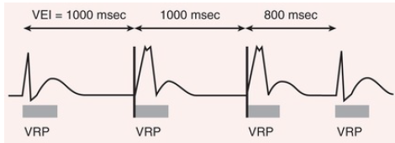
The VVI timing cycle consists of a defined lower rate limit and a ventricular refractory period.
When the ventricular escape interval (VEI) from the ventricular sensed event of 1000 milliseconds is completed, a paced event occurs.
Because no ventricular sensed event occurs within 1000 milliseconds after the paced event, a second ventricular paced event occurs.
A VRP begins with any sensed or paced ventricular activity

Slide 15
AAI Mode
Single-chamber atrial pacing mode
It is appropriate for patients with sinus node dysfunction and intact AV conduction.
Because it does not provide ventricular pacing, AAI mode should not be used in patients who are at risk for AV block

Slide 16
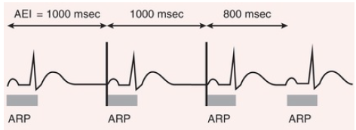
The AAI timing cycle consists of a defined lower rate limit and an atrial refractory period (ARP, represented by rectangles).
When the atrial escape interval (AEI) from the atrial sensed event of 1000 milliseconds is completed, a paced event occurs..
Because an atrial sensed event occurs 800 milliseconds later, an atrial paced event does not occur.
An ARP begins with any sensed or paced atrial activity.

Slide 21
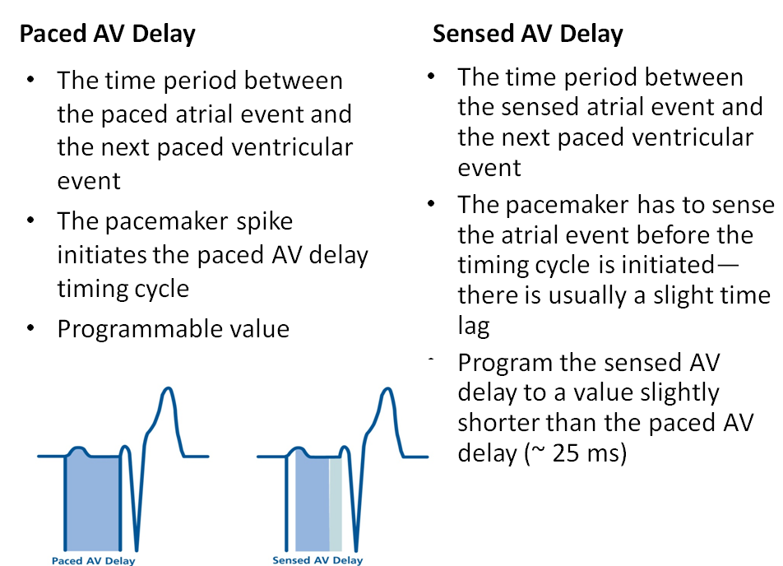

Slide 27
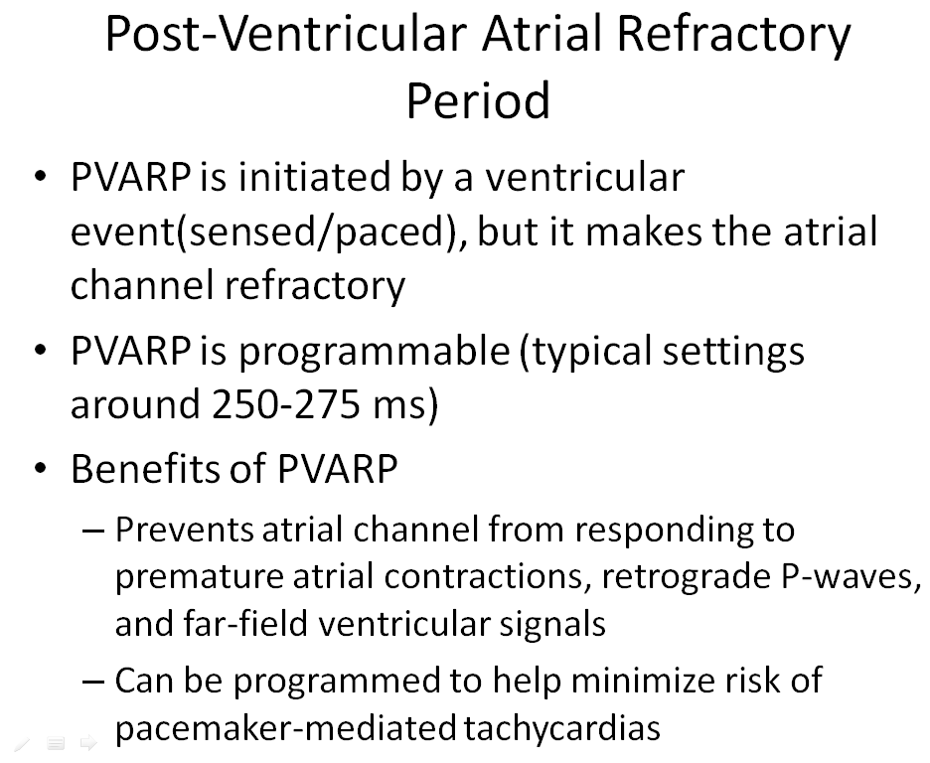

Slide 29
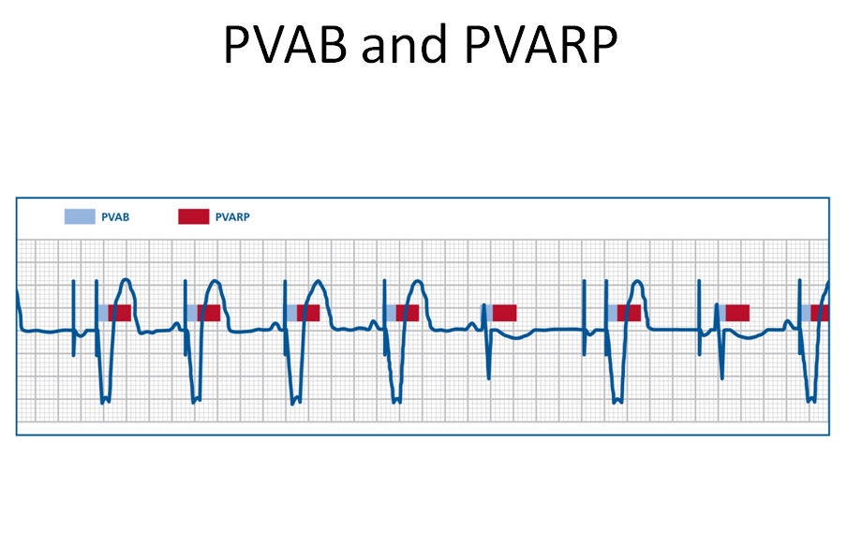

Slide 32
DDD Mode
Preserves AV synchrony.
The atrial rate cannot go lower than the programmed lower rate.
The AV delay is the maximum permitted time from an atrial event to a ventricular event.
If a spontaneous ventricular event does not occur by the time the AV delay elapses, a ventricular paced event occurs.
In the setting of AV block, all ventricular events are paced.

Slide 33
The special characteristic of the DDD pacing mode is the ability to “track” intrinsic atrial activity so that a ventricular beat follows each P wave in order to maintain AV synchrony.
The upper rate limit is the maximum rate at which intrinsic atrial activity will be tracked, and it is selected to exceed the patient's maximum sinus rate.
The upper rate limit prevents rapid ventricular tracking of atrial activity in AF and other atrial tachyarrhythmias.

Slide 34
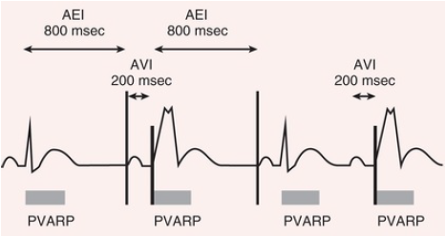
The timing cycle in DDD consists of a lower rate limit, an AV interval, a ventricular refractory period, a postventricular atrial refractory period (PVARP), and an upper rate limit. Because an intrinsic atrial event occurs and is followed by an intrinsic ventricular event within the AV interval, no ventricular pacing occurs in the first beat.
In ventricular-based timing, the time from a ventricular paced or sensed event to the next atrial paced event is called the atrial escape interval (AEI), which is the lower rate limit interval minus the AV interval.
The fourth beat begins with an intrinsic atrial event that is not followed by an intrinsic ventricular event within the AV interval. Hence the intrinsic atrial event is “tracked” and followed by a paced ventricular event

Slide 35
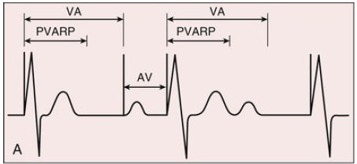
The DDI and VDD pacing modes comprise complementary subsets of DDD functionality
The DDI mode lacks atrial tracking and is suitable for patients with sinus bradycardia, with or without intact AV conduction
Because AV synchrony is lost, the DDI mode is rarely programmed unless atrial sensing problems prevent reliable mode switching in DDD mode.

Slide 36
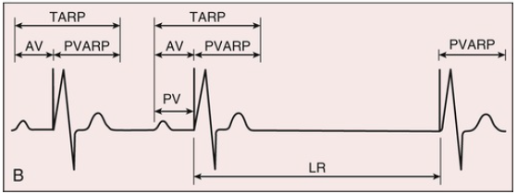
The VDD mode lacks atrial pacing and is suitable for patients with normal sinus node function and AV block.
It can be achieved using a single lead with additional atrial sensing electrodes, permitting ventricular tracking of atrial activity to achieve AV synchrony.
The VDD mode should not be used in patients with sinus bradycardia, since ventricular pacing without AV synchrony will occur at the lower rate limit, equivalent to the VVI mode.

Slide 37
Automatic Mode Switching
The DDD and VDD pacing modes need a method to prevent rapid ventricular pacing as a result of ventricular tracking of atrial EGMs during paroxysmal AF, other atrial tachyarrhythmias.
Automatic mode switching initiates a temporary mode change to a nontracking mode (usually DDI or DDIR) in response to an atrial sensed rate above a specified value.
When the atrial rhythm slows sufficiently, the mode switches back to an atrial tracking mode

Slide 38
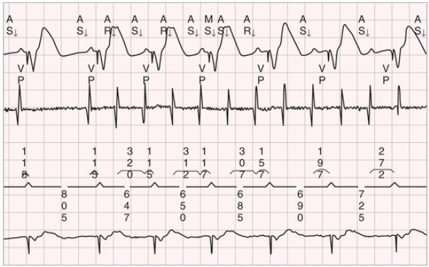
Mode switch from the DDDR to the DDIR mode during transient atrial tachycardia (AT).
The top channel is the surface electrocardiogram (ECG) with markers. The second channel is the atrial electrogram (EGM). The third channel displays atrial intervals above the line and ventricular intervals below the line. The bottom channel is the ventricular EGM. The first two atrial events (AS) are sinus beats tracked with the programmed interval for atrial synchronous pacing.
The AT begins with the third atrial event. Mode switch (MS) occurs after the fourth rapid atrial event interval. In the DDI mode, P waves are not tracked, so the AV interval varies. AS, Atrial sense; AR, event in atrial refractory period; VP, ventricular pace.

Slide 39
Programming to Avoid Unnecessary Right Ventricular Pacing
Facilitating AV conduction in patients without permanent AV block.
The first approach was to prolong the AV interval or extend it periodically
The primary limitation is that it may result in extremely long AV delays
No consensus about the max acceptable PR interval, but 350 to 400 ms is typically used.

Slide 40
Secondly in AAIR pacing with backup ventricular pacing.
Sometimes AAIR pacing mode is used when AV block is not present but can switch automatically to a DDDR mode when AV block is detected.
Can be tolerant in c/o occasional single beats of AV block without resorting to consistent RV pacing

Slide 41
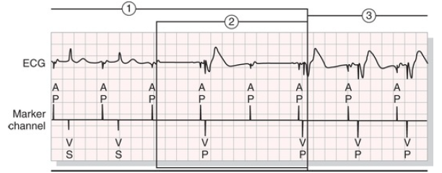
AAIR pacing is seen (1); if an atrial pace event occurs without a ventricular sensed event, a ventricular backup output occurs (2), and the pacemaker then switches to the DDDR mode (3)

Slide 42
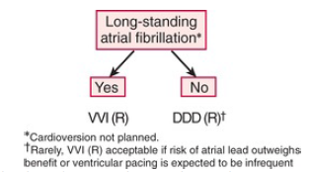
Single- versus Dual-Chamber Pacing Mode and Pacemaker Selection

Slide 43
Sinus Node Disease:
In SA node diseases RCTs demonstrate that DDD pacing reduces AF and pacemaker syndrome in comparison with VVI pacing
Rate-adaptive pacing is recommended for patients with significant, symptomatic chronotropic incompetence, the inability to increase heart rate for metabolic needs of exertion
In AV blocks and Bi or Trifascicular blocks, Dual chamber pacing is preferred over single-chamber ventricular pacing provided sinus rhythm is present.

