Slide 1
PATHOPHYSIOLOGY OF HEART FAILURE
Dr.AJU AJAY

Slide 2
Definition
Definition (2022 AHA/ACC/HFSA Guideline)
  Complex clinical syndrome with symptoms and signs that result from any structural or functional impairment of ventricular filling or ejection of blood
Asymptomatic stages with structural heart disease not covered in the definition
At-risk for HF (stage A) or pre-HF (stage B)

Slide 3
Epidemiology
Worldwide almost 23 million people.
In the United States 5.7 million
By 2030 the prevalence will increase 25% from current estimates
European population ranges from 0.4% to 2% same as US
The prevalence of HF rises exponentially with age and affects 4% to 8% of people older than 65

Slide 4
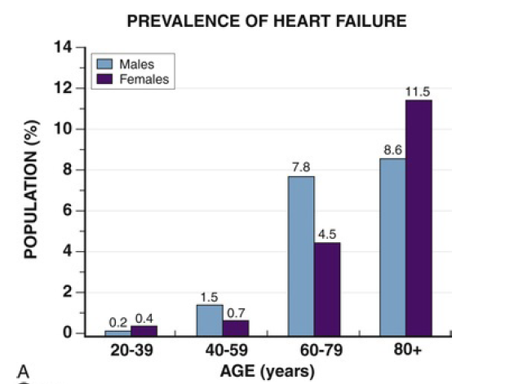
Blacks > Hispanic > white > Chinese Americans

Slide 5
Risk Factors
Ischemic heart disease
Myocarditis
Valvular heart disease
Tachycardia
Diabetes mellitus
Structural heart disease related to congenital heart disease
sleep apnea
Excessive drug or alcohol use
Obesity

Slide 6
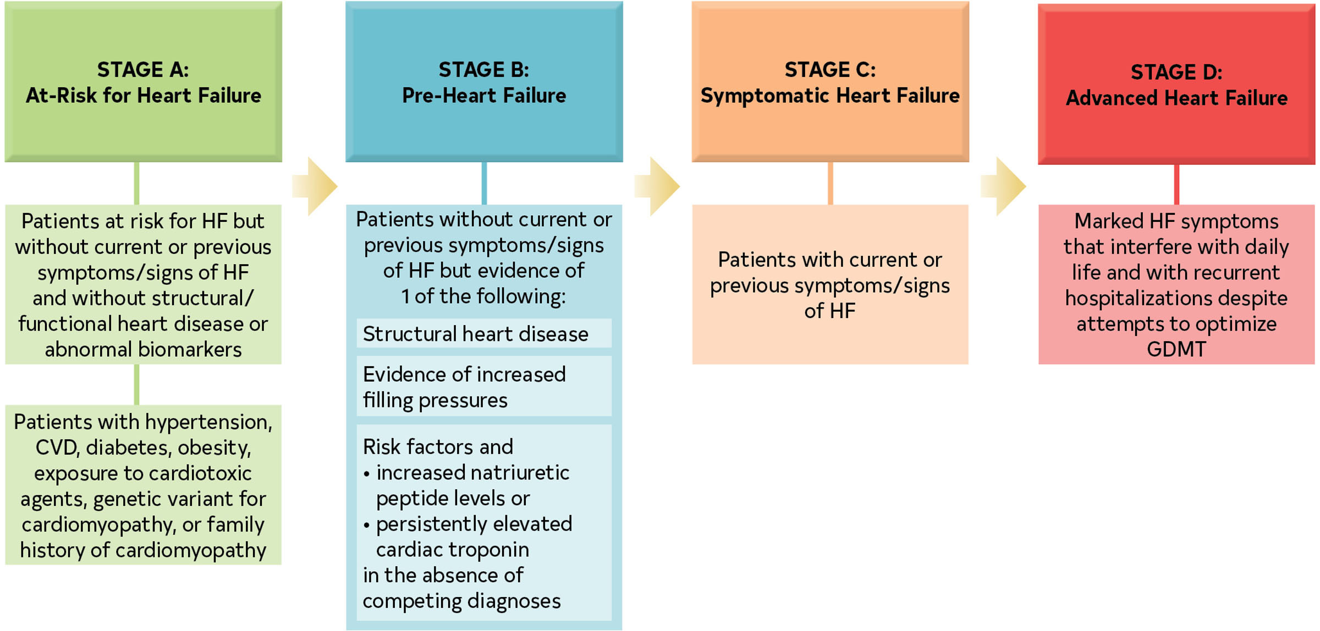
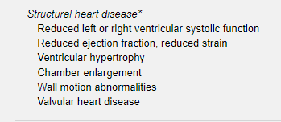
ACC/AHA Stages of HF

Slide 7
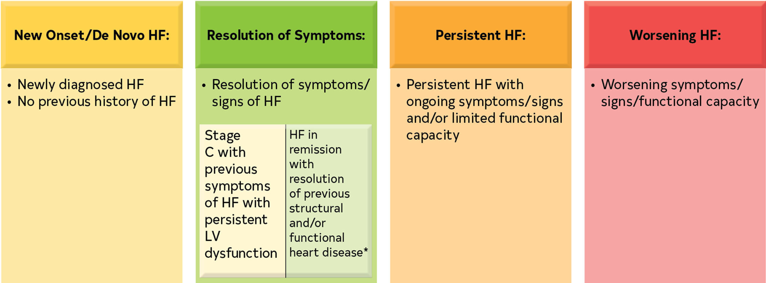
Trajectory of Stage C HF

Slide 8
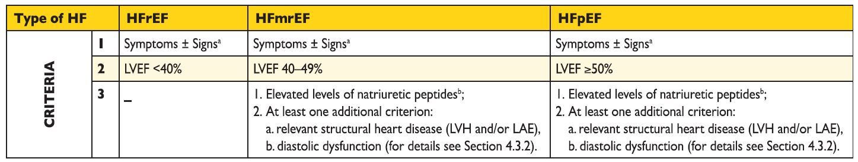
Classification of HF
Heart failure with reduced EF
Heart failure with mid range EF
Heart failure with preserved EF
ªSigns may not be present in the early stages of HF (especially in HFpEF) and in patients treated with diuretics. ^{b}BNP>35 pg/ml and/or NT-proBNP>125 pg/mL.

Slide 9
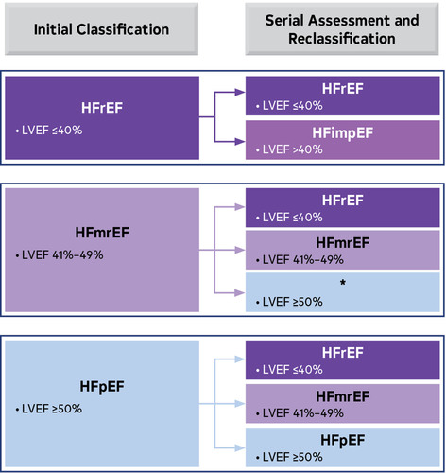

Slide 10
Pathophysiologic models of heart failure
HEMODYNAMIC MODEL
NEUROHORMONAL MODEL
CELLULAR MODEL

Slide 11
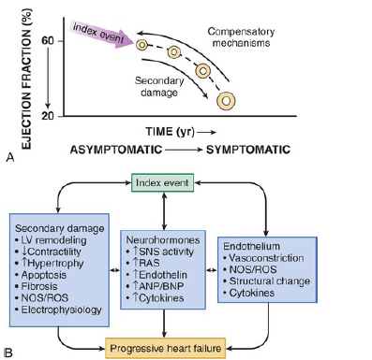

Slide 12
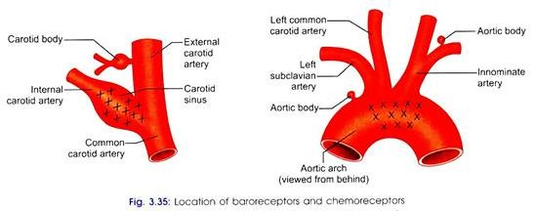

Slide 13
Activation of Sympathetic Nervous System
Compensatory adaptations to maintain cardiovascular homeostasis.
Activation of the sympathetic nervous system (SNS), which occurs early in the course of HF
Concomitant withdrawal of parasympathetic tone
Excitatory reflexes also may participate in the autonomic imbalance that occurs in HF

Slide 14
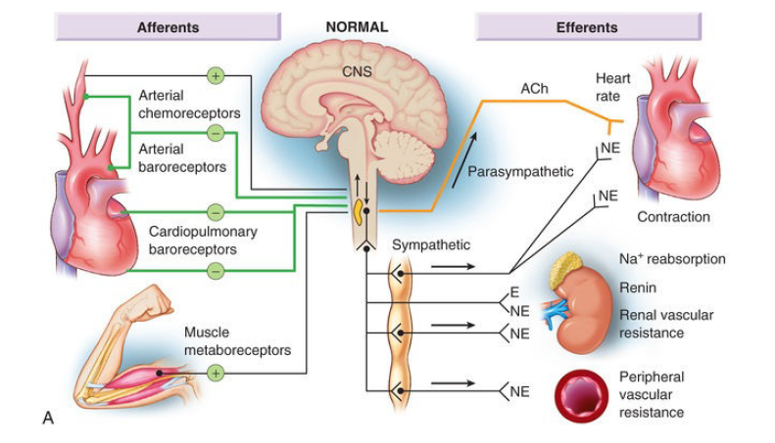
Normal ANS

Slide 15
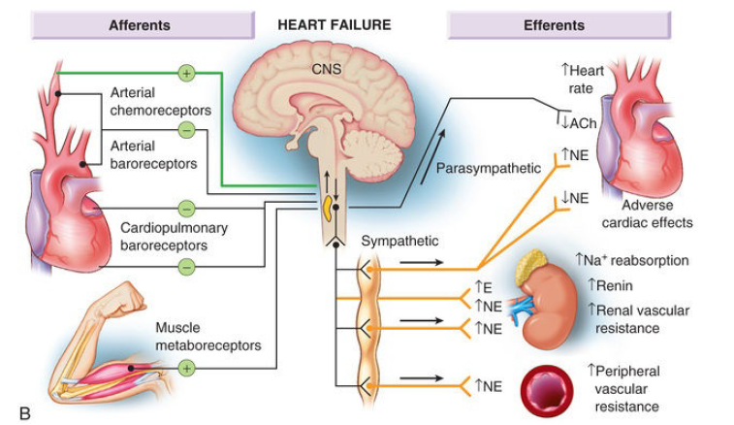
Disordered ANS results in HF

Slide 16
In patients with HF, inhibitory input from baroreceptors and mechanoreceptors decreases and excitatory input increases
Generalized increase in sympathetic nerve traffic and blunted parasympathetic nerve traffic
Loss of heart rate variability and increased peripheral vascular resistance

Slide 17
Circulating levels of NE in resting patients are two to three times those found in normal persons
Significant decrease in the myocardial concentration of NE.
“exhaustion” phenomenon resulting from the prolonged adrenergic activation of the cardiac adrenergic nerves in HF

Slide 18
Myocardial alpha1- adrenergic receptors, which elicits a modest positive inotropic effect, as well as peripheral arterial Vasoconstriction
Myocardial energy requirements are augmented, which can intensify ischemia when myocardial oxygen (O2) delivery is restricted
Augmented adrenergic outflow from the CNS also may trigger ventricular tachycardia or even sudden cardiac death, particularly in the presence of myocardial ischemia

Slide 19
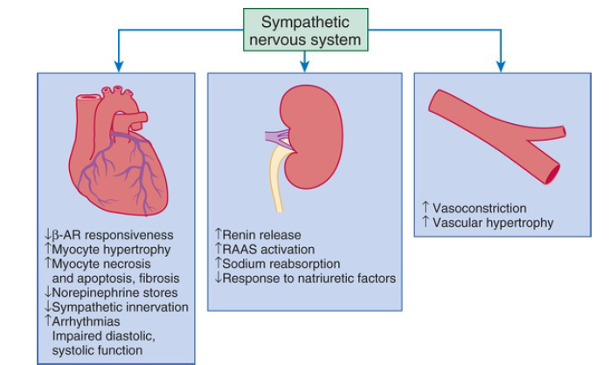
Activation of the sympathetic nervous system.
Increased sympathetic nervous system (SNS) activity may contribute to the pathophysiology of congestive heart failure by multiple mechanisms involving cardiac, renal, and vascular function.

Slide 20
RAAS activation
Components of the RAS are activated comparatively later in HF
Renal hypoperfusion
Decreased filtered Na reaching the macula densa in the distal tubule
Increased sympathetic stimulation of the kidney
leads to increased renin release from juxtaglomerular apparatus.

Slide 21
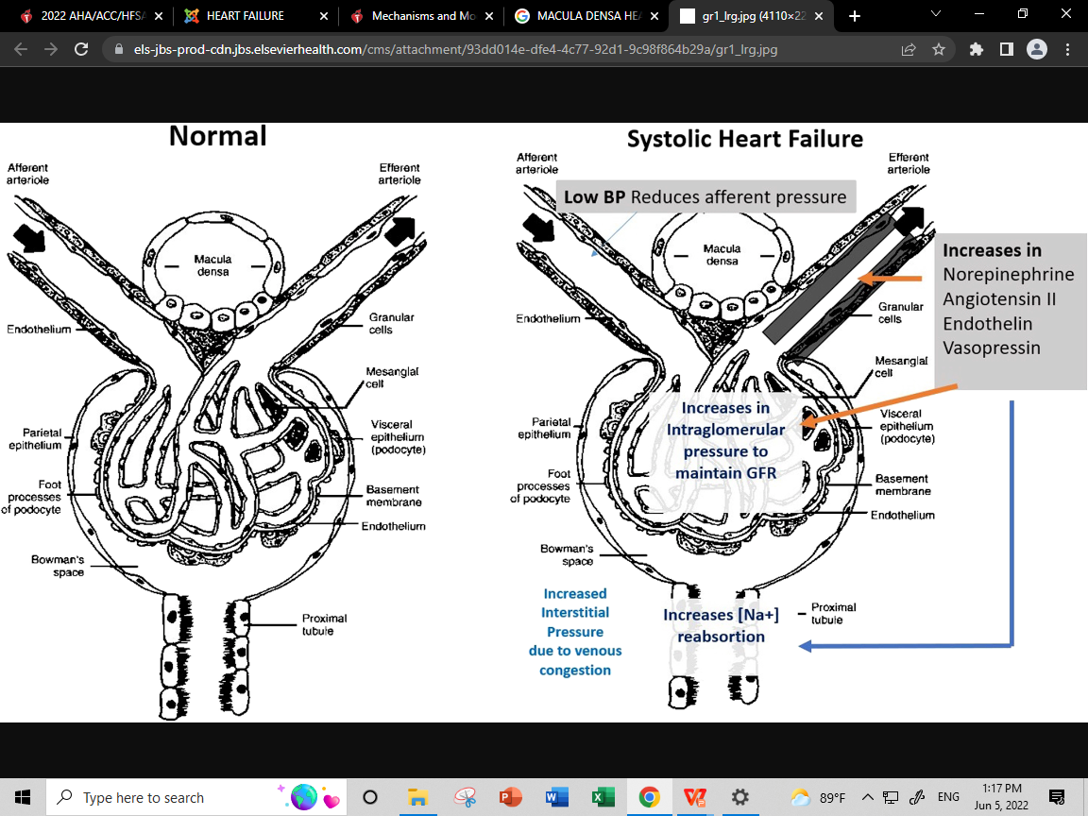

Slide 22
Sustained expression of angiotensin II is maladaptive, leading to fibrosis of the heart, kidneys, and other organs.
Angiotensin II can also lead to worsening neurohormonal activation by enhancing the release of NE from sympathetic nerve endings, as well as stimulating aldosterone production.

Slide 23
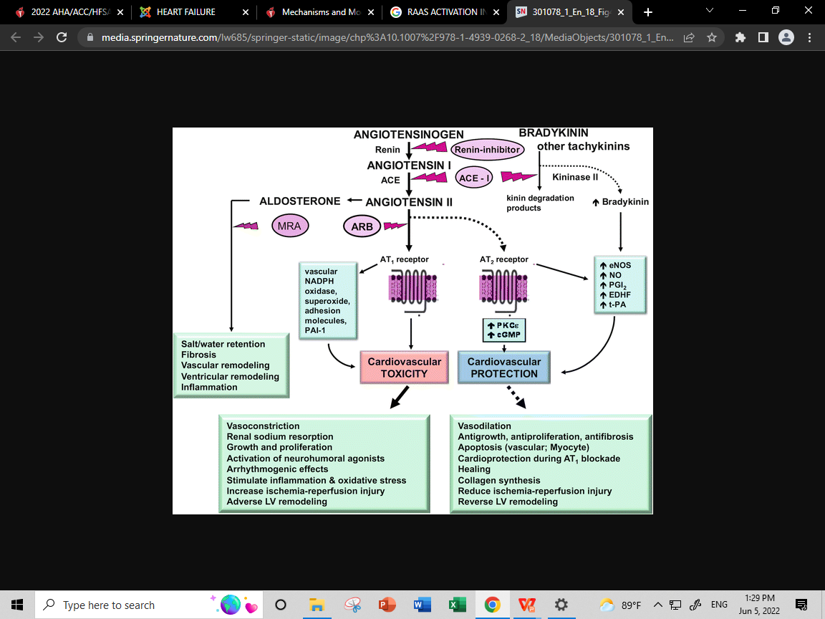

Slide 24
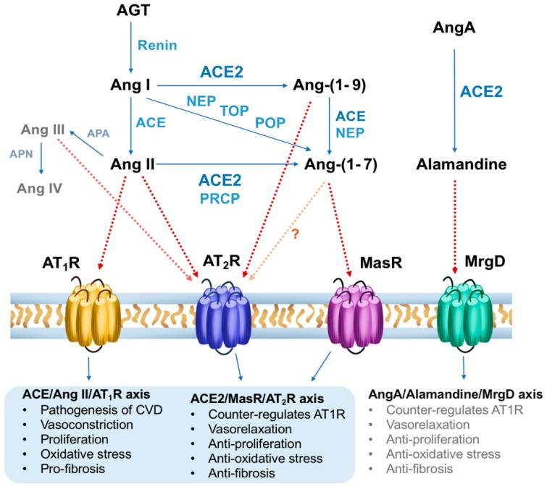
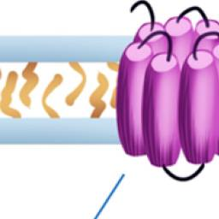

Slide 25
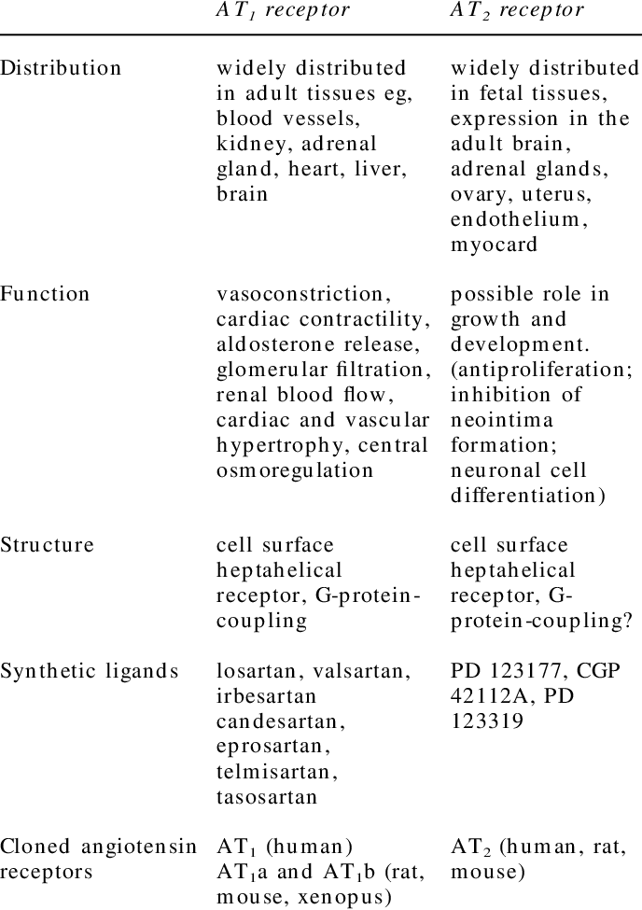

Slide 26
Neurohormonal Alterations in the Peripheral Vasculature
Complex interactions between the autonomic nervous system and local autoregulatory mechanisms tend to preserve circulation to the brain and heart
The most powerful stimulus for peripheral vasoconstriction is sympathetic activation - releases NE.
Other vasoconstrictors - include angiotensin II, ET, neuropeptide Y, urotensin II, thromboxane A2, and AVP
Maintains arterial pressure
They activate counterregulatory vasodilators, namely natriuretic peptides, NO, bradykinin, adrenomedullin, apelin, and vasodilating PGI2 and PGE2

Slide 27
NITRIC OXIDE
Free radical NO is produced by three isoforms
  NOS1 (neuronal NOS [nNOS])
  NOS2 (inducible NOS [iNOS])
  NOS3 ( endothelial-constitutive NOS [eNOS])
NOS1 localizesd near SR in proximity to the RyR and sarcoendoplasmic reticulum calcium–adenosine triphosphatase (SR Ca2+-ATPase, SERCA2a)
NOS3 is found in sarcolemmal caveolae compartmentalized with cell surface receptors and the L-type Ca2+ channel
NOS2 is calcium independent
LV remodeling was ameliorated and survival improved after MI in transgenic mice deficient in NOS2

Slide 28
Cntd.
“Nitroso-redox imbalance”
Emerging evidence indicates an imbalance between increasing free radical production and decreased NO generation in HF
NOS uncoupling secondary to a deficiency of tetrahydrobiopterin

Slide 29
Vasoconstricting Peptides in Heart Failure
Endothelin
The three endothelin (ET) peptides—ET-1, ET-2, and ET-3—all are potent vasoconstrictors.
Released primarily by endothelial cells
ET also can be synthesized and released by a variety of other cell types, such as cardiac myocytes

Slide 30
Neuropeptide Y
Vasoconstricting peptide that is released together with NE from sympathetic nerve endings.
NPY is released from sympathetic nerves in the heart and influences coronary artery constriction and myocardial contraction.
Urotensin II
Mammalian urotensin II is the most potent endogenous cardiostimulatory peptide identified
Urotensin II mediates vascular tone and increased contractile force in human atrium and ventricle

Slide 31
Neurohormonal Alterations of Renal Function
Increased salt and water retention by the kidneys- “forward” failure/backward failure
Supplanted by decreased “effective arterial blood volume”
Inadequate cardiac output sensed by baroreceptors.
BeAT-HF (Barostim Therapy for Heart Failure) trial role of baroreceptor activation therapy
Non osmotic release of AVP
ACTIVATION OF THE COUNTER REGULATORY HORMONES

Slide 32
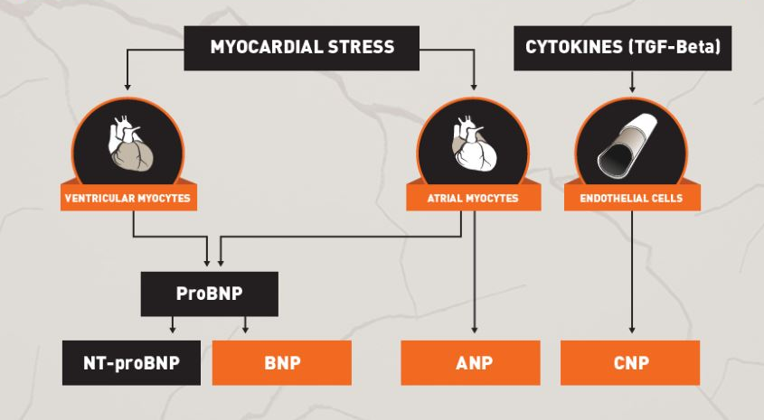
NATRIURETIC PEPTIDE SYSTEM

Slide 33
Five structurally similar peptides:ANP, urodilatin (an isoform of ANP), BNP, C-type natriuretic peptide (CNP), and dendroaspis natriuretic peptide (DNP)
ANP is secreted in short bursts
BNP is regulated in response to chronic increases in atrial/ventricular pressure.
ANP/BNP--(corin/furin)-->NT fragments-->ANP/BNP
t-half ANP 3min,BNP 20min

Slide 34
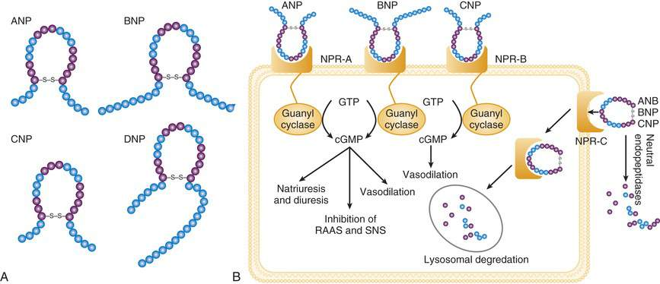

Slide 35
Beneficial effects of ANP'S
Decreases sympathetic outflow
Inhibits RAAS
Decreases maladaptive cardiac remodelling
Arteriolar and venular dilatation
Natriuresis
Inhibition of fibrosis
Increased lusitropy

Slide 36
Non cardiac cause of elevated BNP
Pulmonary
Cirrhosis
Renal failure
Anaemia
Sepsis,burns
Stroke
Hyperaldosternoism
Snakebite

Slide 37
Increase with age
Higher in women than men
Lower in obese individuals.
In normal subjects, the plasma concentrations of BNP and NT-proBNP are similar (approximately 10 pmol/L).
In LV dysfunction, plasma NT-proBNP rises more than BNP, with NT-proBNP concentrations approximately four-fold higher

Slide 38
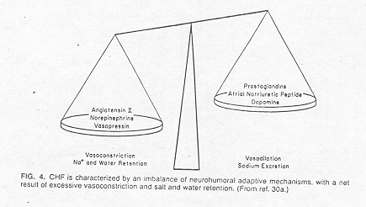
Nitric oxyde
Bradykinin

Slide 39
Cardiac Remodelling
Neurohormonal models fail to completely explain the basis for this progression.
Alteration in the structure (dimensions, mass, shape) of the heart in response to hemodynamic load or cardiac injury
"Phenotypic plasticity"
Adaptive or maladaptive
3 types

Slide 40
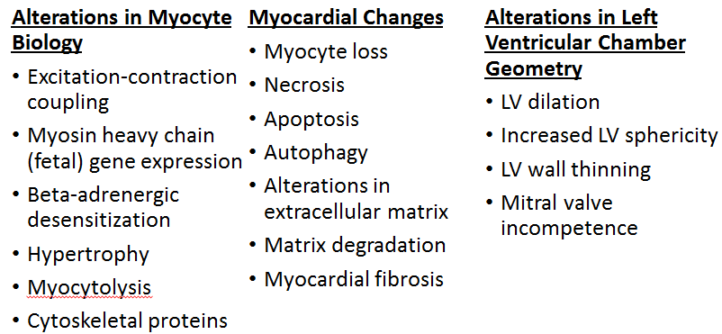
Left Ventricular Remodeling

Slide 41
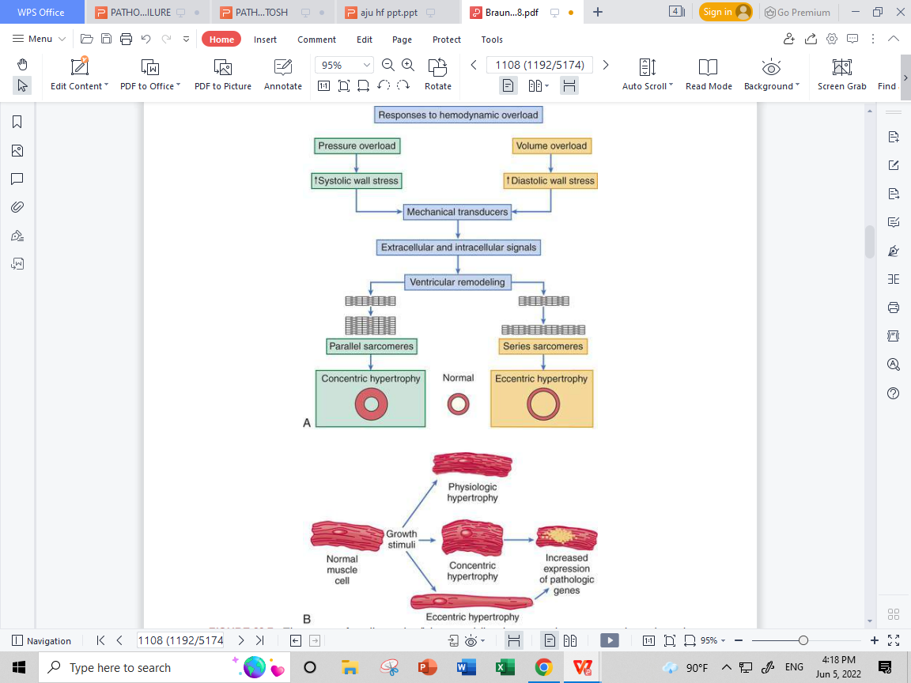
Alterations in Biology of Cardiac Myocyte
Cardiac Myocyte Hypertrophy
Ca2+/calmodulin-dependent protein kinase II
Protein kinase B (Akt) activation

Slide 42
Alterations in Excitation-Contraction Coupling
Normally-->higher contraction frequency --> better cardiac contraction--> frequency-dependent augmentation of intracellular Ca2+ influx.
Impaired contraction and relaxation of the failing heart is most prominent at high heart rates
  (1) increased Ca2+ leak through ryanodine receptors (RyRs)
  (2) impaired sarcoplasmic reticulum Ca2+ uptake from reduced SERCA2a protein levels and function
  (3) increased expression and function of the sarcolemmal Na+/Ca2+ exchanger

Slide 43
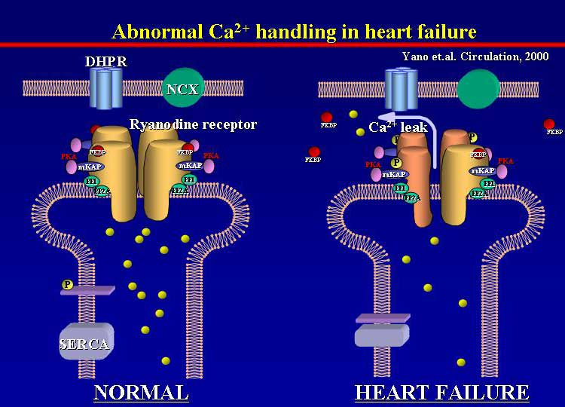
In normal conditions, the ryanoid channel in SR is stabilized, but in heart
failure abnormal calcium leak is induced. In heart failure, channel gating is
hypersensitized to calcium: at a lower concentration of calcium, the channel
is more activated.

Slide 44
Prolongation of the action potential duration
Transient outward potassium current (Ito) and the inward rectifier potassium current (Ik1) both are reduced in heart failure
Persistent activity of the sodium channel (late sodium current)&increased inward Na+ current through the NCX--> prolongs action potential
Abnormalities in Cytoskeletal Proteins

Slide 45
Beta-Adrenergic Desensitization
Reduction in beta-adrenergic receptor density
Isoproterenol-mediated adenyl cyclase stimulation
The contractile response to beta-adrenergic agonists
Increased βARK (GRK2) activity contribute to the desensitization of both beta1 and beta2 receptors
Desensitization both beneficial and deleterious in HF
By reducing LV contractility, desensitization may be deleterious.
By reducing energy expenditure of myocardium and protecting the myocyte from the deleterious effects of sustained adrenergic stimulation-Beneficial

Slide 46
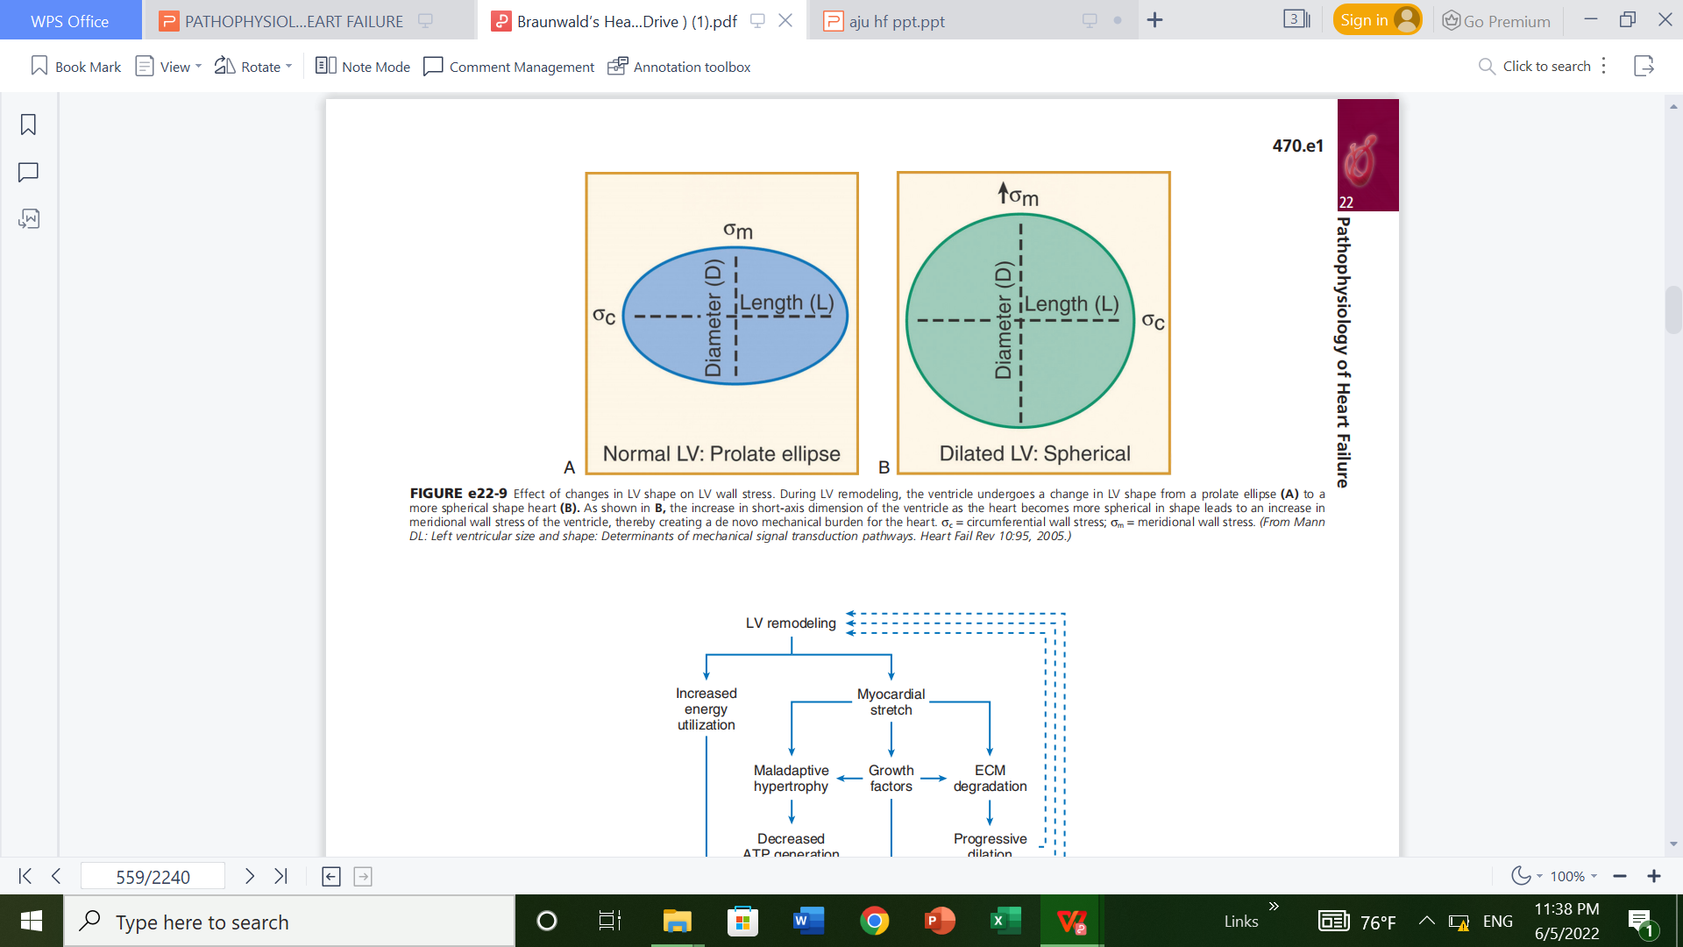
Alterations in Left Ventricular Structure
Changes in the biology of the failing myocyte, largely responsible for the progressive LV dilation and LV dysfunction that occur during cardiac remodeling

Slide 47
Left ventricular function is dependent on myocardial contractility, preload and afterload
Cardiac output (CO) = heart rate (HR) x stroke vol.(SV)
Control of HR:
  autonomic nervous system
  humoral control
Control of SV:
  Preload, contractility, afterload, number and size of myocytes,heart architecture, synchronisation of function of the atrias and ventricles

Slide 48
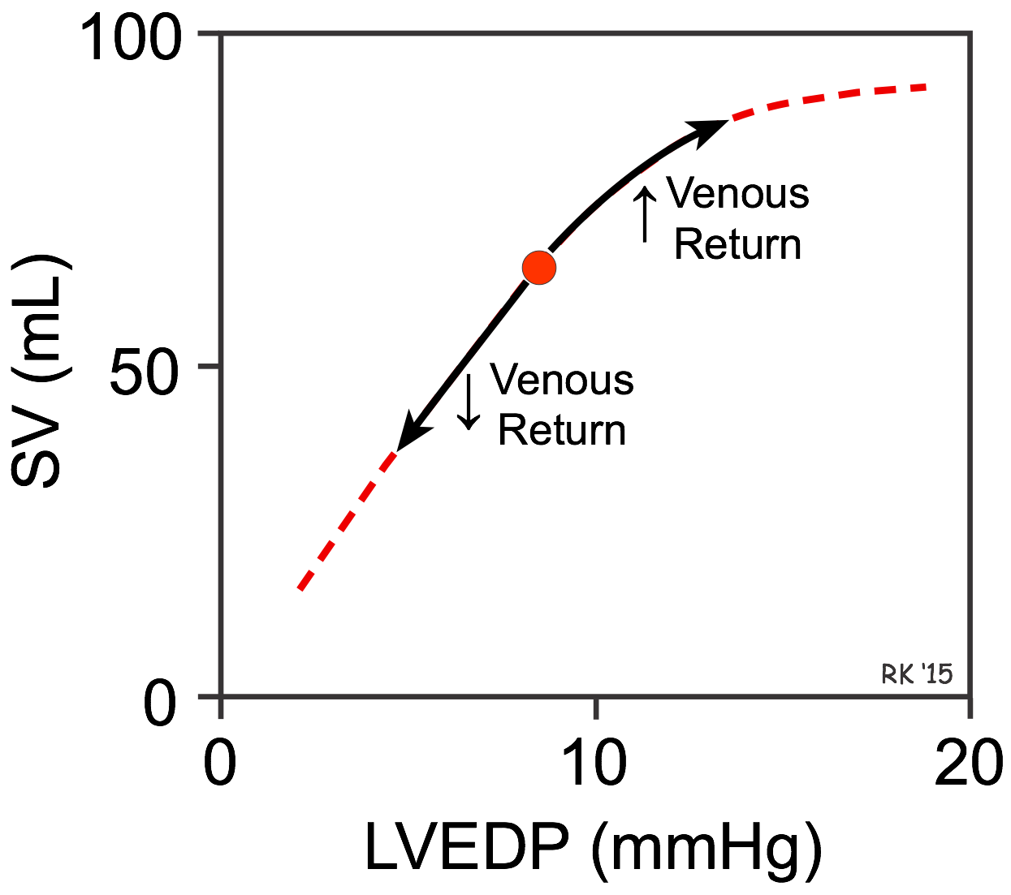
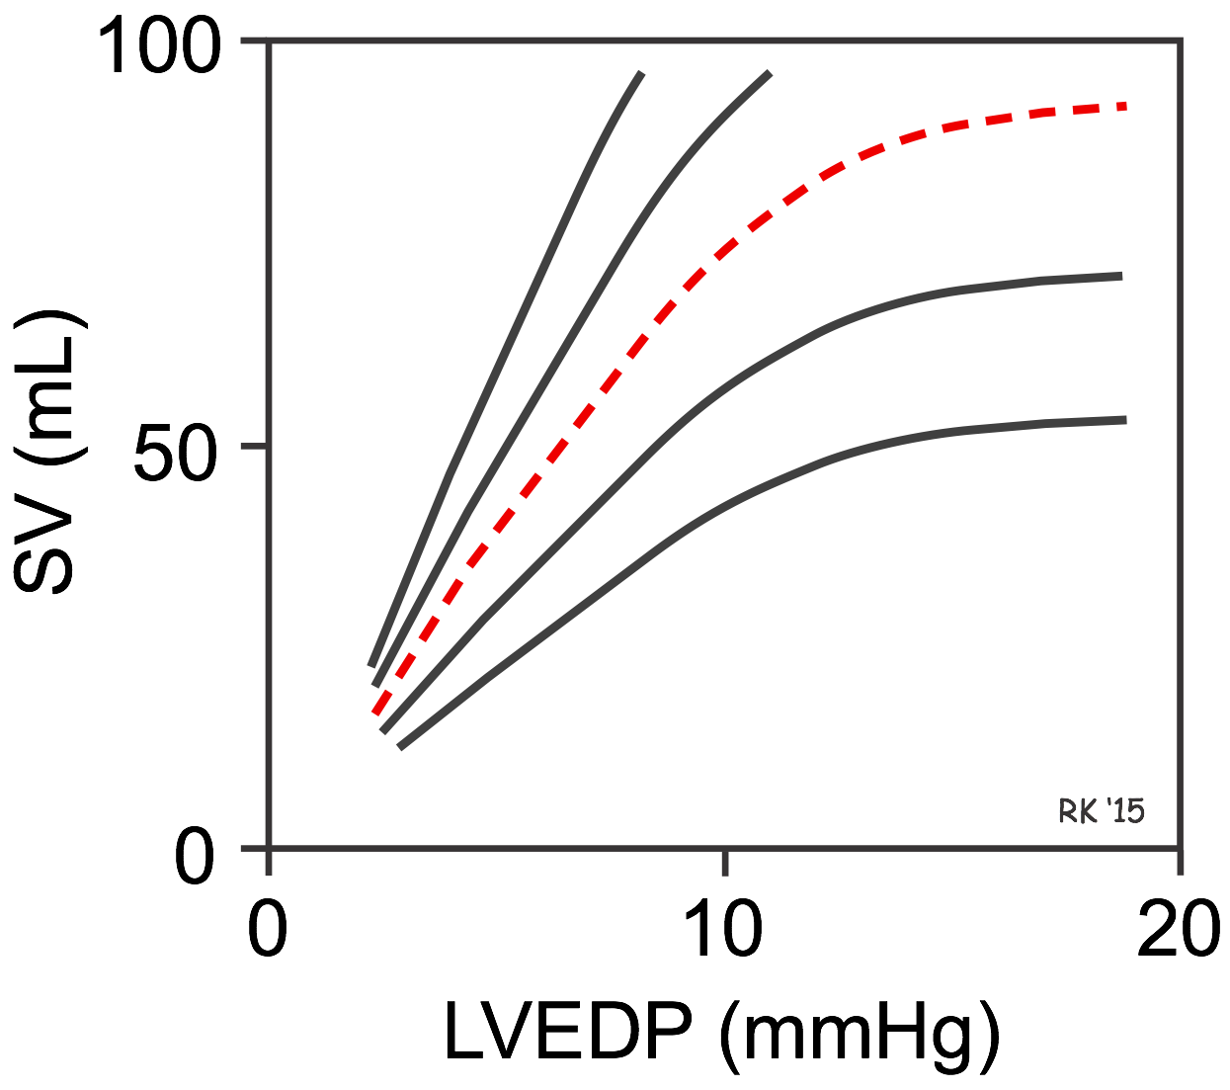
Adaptive mechanisms of the heart to increased load
Frank - Starling mechanism is the ability of the heart to change its contractile force and thus increase stroke volume due to elevated preload.
There is no single Frank-Starling curve on which the ventricle operates.
Instead, there is a family of curves, each of which is defined by the afterload and inotropic state of the heart.

Slide 49
Preload
Stretching the myocardial fibers during diastole by increasing end-diastolic volume → ↑force of contraction during systole = Starling´s law
Venous return to the heart is important → Influences end-diastolic
volume
Stretching of the sarcomere maximises the number
of actin-myosin bridges (older concept)
Length-tension and Force-velocity
Optimal sarcomere length ∼ 2.2 μm

Slide 50
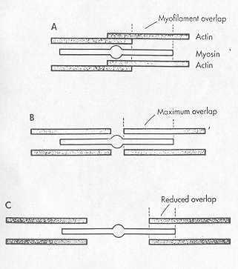
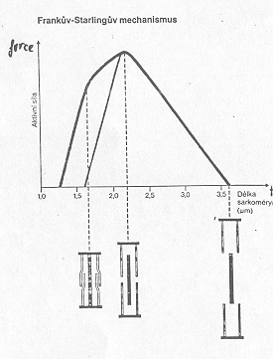

Slide 51
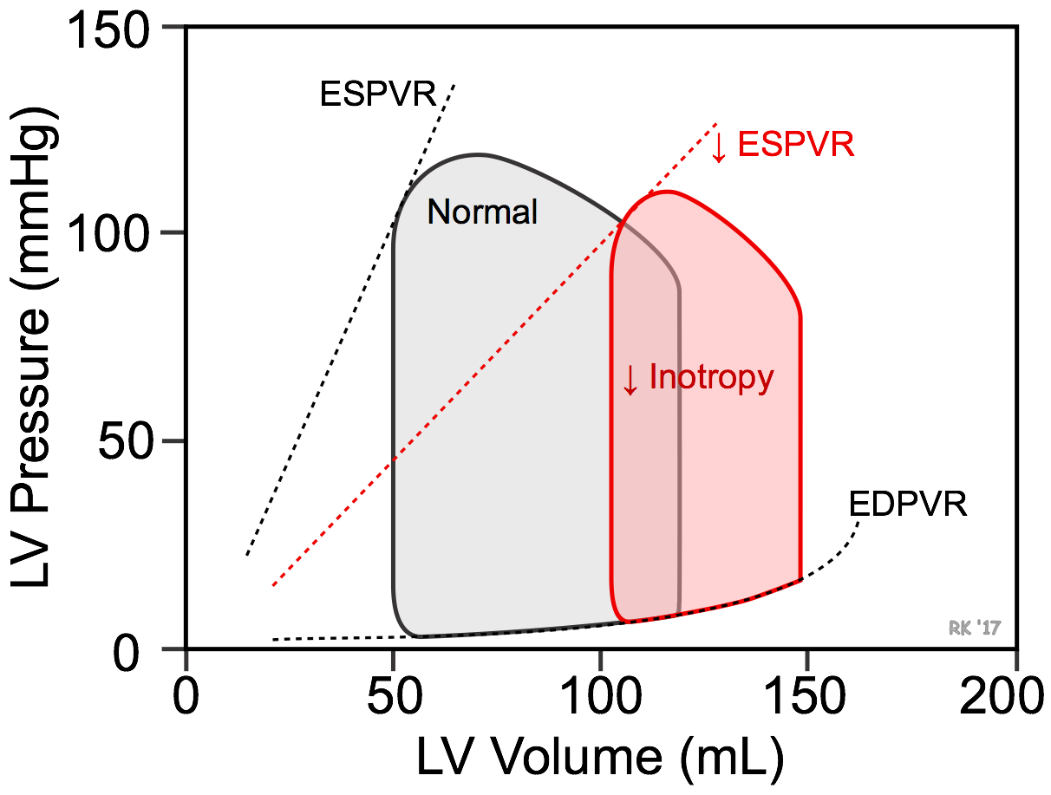
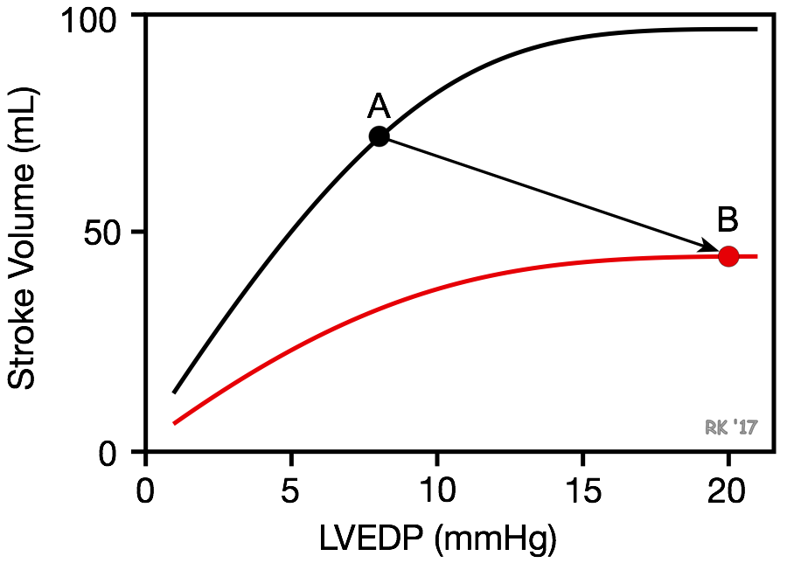
The loss of cardiac inotropy causes a downward shift in the Frank-Starling curve.
Results in a decrease in stroke volume and a compensatory rise in preload.
The rise in preload is a compensatory response that activates the Frank-Starling mechanism to help maintain stroke volume despite the loss of inotropy.
Ventricular remodeling occurs in chronic failure leading to anatomic dilation of the ventricle.

Slide 52
Afterload
It is expressed as tension which must be developed in the wall of ventricles during systole to open the semilunar valves and eject blood to aorta/pulmunary artery
Laplace law:
intraventricular pressure x radius of ventricle
Wall tension = --------------------------------------------------------
2 x ventricular wall thickness
↑ afterload: due to - elevation of arterial resistance
    - ↑ ventricular size
↓ afterload: due to - ↓ arterial resistance
- myocardial hypertrophy
- ↓ ventricular size

Slide 53
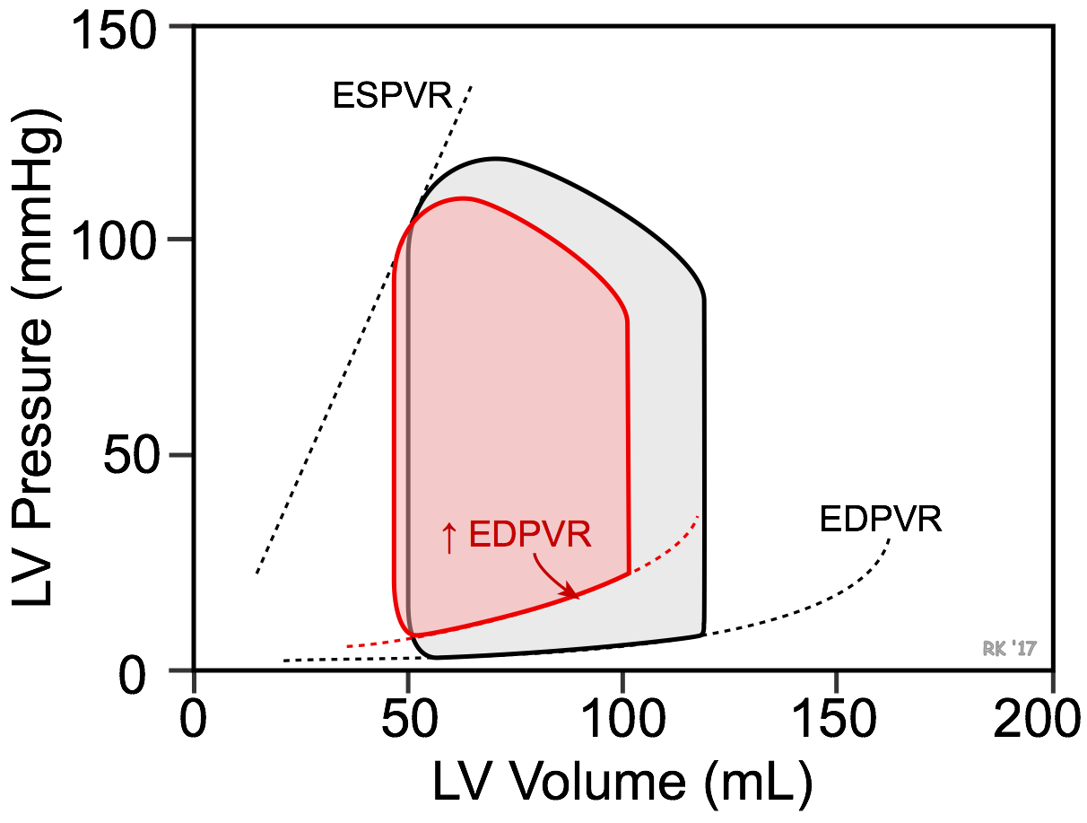
Pathophysiology of diastolic heart failure
Ventricular function is highly dependent upon preload
Ventricular filling depends on the venous return and compliance of the ventricle during diastole
A reduction in ventricular compliance, increases the slope of the ventricular EDPVR and results in less ventricular filling and a greater end-diastolic pressure

Slide 54
A second mechanism that is non-anatomical, can also contribute to diastolic dysfunction: impaired ventricular relaxation (reduced lusitropy)
Leading to deleterious consequence of diastolic dysfunction is the rise in end-diastolic pressure

Slide 55
Mechanical Disadvantages Created by Left Ventricular Remodeling
Increased wall stress (afterload)
Afterload mismatch
Episodic subendocardial hypoperfusion
Increased oxygen utilization
Functional mitral regurgitation
Worsening hemodynamic overloading
A stretch-induced activation of maladaptive signal transduction pathways
Stretch-induced activation of maladaptive gene programs

Slide 56
Thank you.

