Slide 1
PULMONARY
VENOUS
ANOMALIES
DR SHREYAS SAMAGA
DEPT OF CARDIOLOGY

Slide 2
Anomalies
Embryology
Genetics & epidemiology
Classification
Role of foramen ovale & ductus
Clinical features
Investigations
Management
PAPVC
Scimitar syndrome
Atresia of CPV
Cortriatriatum

Slide 3
Anomalies
Anomalous connections vs Anomalous Drainage
Anomalies:
Anomalous connections (TAPVC, PAPVC)
Anomalous drainage with normal connections (TAPVD, PAPVD)
Stenotic connections (Stenosis of one or more pulmonary veins, Cor triatriatum)
Abnormal number of pulmonary veins
  Single pulmonary vein on either left or right side- 24%(L>R).
  Third pulmonary vein- 1.6-2%
  Single common pulmonary vein: exclusively in cases of visceral heterotaxy with asplenia
Healy JE Jr. An anatomic survey of anomalous pulmonary veins: Their clinical significance. J Thorac Cardiovasc Surg 1952
Notes:
It is also possible, however, to have normal pulmonary venous connections( connected to back wall of atria between the right and left horns of sinus venosus) with abnormal drainage. Eg: Common Atrium and malposition of septum primum

Slide 4
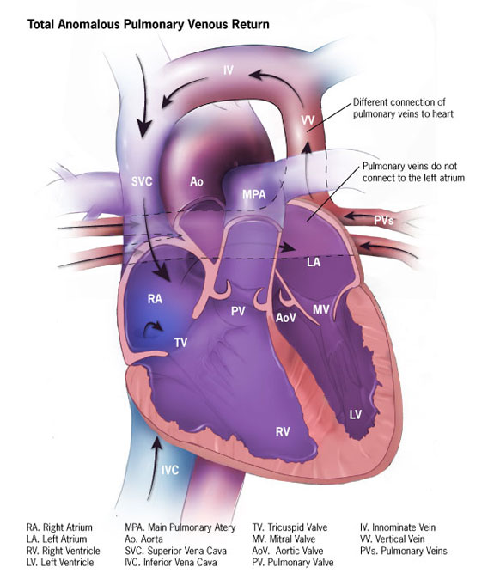
A pulmonary vein is connected anomalously-
only when it is attached to a site other than the morphologically left atrium.
Notes:
There are typically four pulmonary veins:
right superior - drains right upper and middle lobes
right inferior - drains right lower lobe
left superior - drains left upper lobe
left inferior - drains left lower lobe
The superior pulmonary veins takes an oblique inferomedial course whereas the inferior pulmonary veins run horizontally peripherally before taking a more vertical course. They pass through the lung hilum, antero-inferiorly to the pulmonary arteries, forming a short intrapericardial segment, to drain into the left atrium. The ostia of the inferior pulmonary veins are more posteromedial and the left pulmonary veins being more superior.

Slide 5
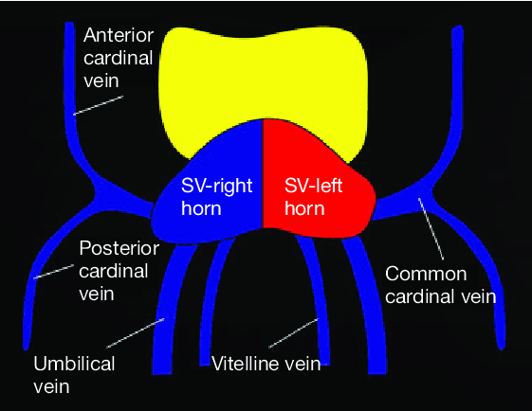
Embryology
VENOUS SYSTEM OF THE EMBRYO
VITELLINE VEINS (OMPHALOMESENTERIC VEINS)-
These veins carry blood from the yolk sac to the sinus venosus.
UMBILICAL VEINS-
Carrying oxygenated blood from chorionic villi to the embryo.
CARDINAL VEINS-
These veins drain the body of the embryo proper.

Slide 6
Embryology cont.
VENOUS SYSTEM OF THE EMBRYO
The right cardinal venous system develops into the right SVC whereas the left cardinal venous system mostly disappears and may potentially develop into left SVC (<1% of individuals).
The umbilicovitelline veins develop into the IVC, the portal venous system and ductus venosus.

Slide 7
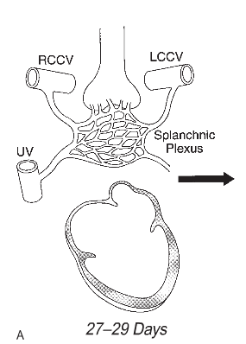
Embryology cont.
In early stage of embryo, the lung buds are enmeshed by the vascular plexus of the foregut (splanchnic plexus).
A small evagination arises in the posterior wall of the left atrium to the left of the developing septum secundum. It forms the common pulmonary vein
Dorsal mesocardium- atrium to mediastinum
Notes:
In the embryo, the primordia of the lungs, larynx and tracheobronchial tree are derived from a division of the foregut. So, during early stage of development, lungs are enmeshed by the vascular plexus of the foregut (splanchnic plexus).
At this stage, lungs has no direct connection with the heart. There are multiple connections with the splanchnic plexus i.e, umbilicovitelline and cardinal venous systems.

Slide 8
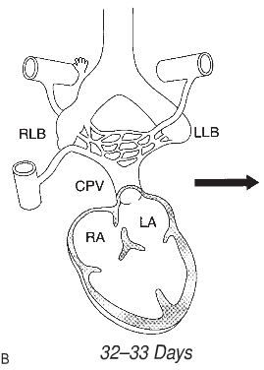
Embryology cont.
By the end of the 1st month of gestation, common pulmonary vein establishes connection between the pulmonary venous plexus and the sinoatrial portion of the heart.
  Via Dorsal mesocardium
Connection b/w pulmonary venous plexus and the splanchnic venous plexus are still patent.

Slide 9
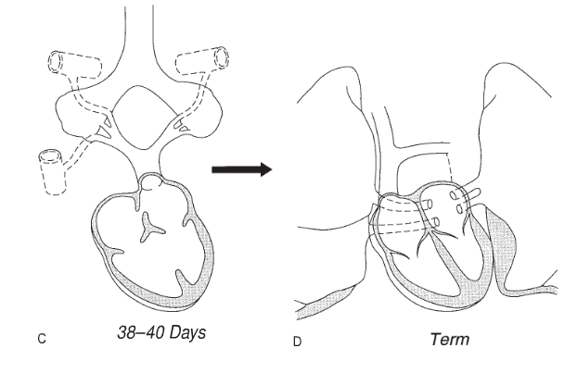
Embryology cont
The connection between pulmonary venous plexus and splanchnic venous plexus involutes.
Common pulmonary vein incorporates into the left atrium so that individual pulmonary veins connect separately and directly to the left atrium.

Slide 10
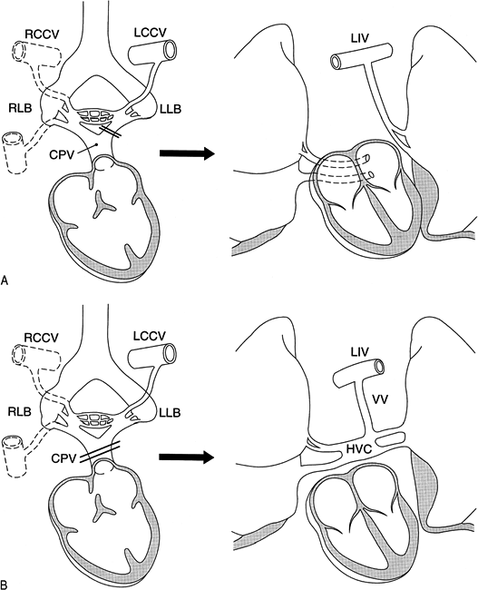
Early Atresia of the Common Pulmonary Vein while Pulmonary-Systemic Venous Connections Are Still Present
PAPVC: Failure to establish a normal connection between one or more of the pulmonary veins with the common pulmonary vein (CPV) before the connections with the splanchnic venous system have regressed.
TAPVC: Failure to establish a normal connection between the pulmonary venous plexus and the common pulmonary vein before the connections with splanchnic venous system have regressed.
TAPVC is the consequence of failure of canalization of pulmonary venous
Channel in the mediastinum.

Slide 11
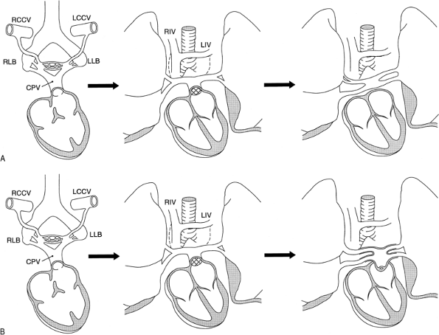
Late Atresia of the Common Pulmonary Vein after Pulmonary-Systemic Connections Are Obliterated
Normal connection between the left atrium and common pulmonary vein fails – Atresia of common pulmonary vein.
Connection between left atrium and CPV stenotic and the CPV dilates – Cor triatriatum.

Slide 12
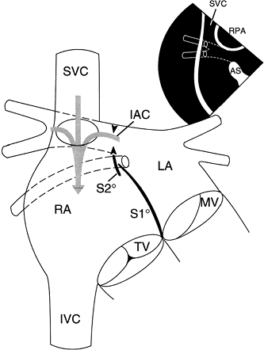
Normal Absorption of the Common Pulmonary Vein with Partially or Totally Abnormal Pulmonary Venous Drainage and Normal Connection of the Pulmonary Veins
Sinus Venosus Defects: The true defect is the deficiency of the common wall between the right SVC and the right upper pulmonary vein or the wall between the right atrium and the right upper and lower pulmonary veins.
  Unroofing of right upper pulmonary vein and its branches into right SVC (Sinus venosus defect of SVC type)
  Unroofing of right upper and lower pulmonary veins into right atrium (Sinus venosus defect of right atrial type)
Malposition of septum primum:
  When S2° absent, S1° displaced towards the anatomic LA
  Incorporation of half or all of the pulmonary veins into morphological RA

Slide 13
EMBRYOLOGIC CLASSIFICATION OF PULMONARY VENOUS ANOMALIES
I) Normal absorption of CPV with defects resulting in abnormal pulmonary venous drainage
  Sinus venous defects
  Malposition of septum primum
II) Early atresia of CPV when pulmonary to systemic venous connections are still present
  PAPVC
  TAPVC – with or without obstruction
III) Late atresia of CPV after pulmonary to systemic venous connections are obliterated
  Atresia of CPV
IV) Stenosis of CPV
  Cor triatriatum
V) Abnormal absorption of CPV into left atrium
  Stenosis of individual pulmonary veins
  Abnormal number of pulmonary veins

Slide 14
TAPVC
Total (totally) anomalous pulmonary venous connection (TAPVC) is a cardiac malformation in which there is no direct connection between pulmonary vein and the left atrium; rather, all the pulmonary veins connect to the right atrium or one of its tributaries.

Slide 15
First described by Wilson in 1798 ‘monstrous formation of the heart in which the superior caval vein was joined by a trunk formed by two large veins coming out of the lungs’.
Muller- 1956- First successful open repair.
Incidence: 4 to 6 per 1,00,000 live births. Account for 2% of deaths due to CHD in first year of life.
  Baltimore Washington infant study 1.5% of all CHDs
  India: Vellore(1970) 2.08%, AIIMS(1976) 0.74%
Male preponderance in infradiaphragmatic TAPVC (3.6:1)
Equal in other varieties.
  However in New England Regional Infant Cardiac Program: 2/3rds of supracardiac and cardiac connections were males whereas infradiaphragmatic variety no preponderance.

Slide 16
Genetics and epidemiology
Mechanism of transmission unclear – monogenic pattern of inheritance suggested.
Baltimore Washington infant study- possible association with exposure to lead, paints and pesticides.
Associated syndromes:
  Holt Oram syndrome
  Klippel Feil syndrome
  Schachermann syndrome
  Asplenia, polysplenia
  Cat’s eye syndrome
  Phocomelia

Slide 17
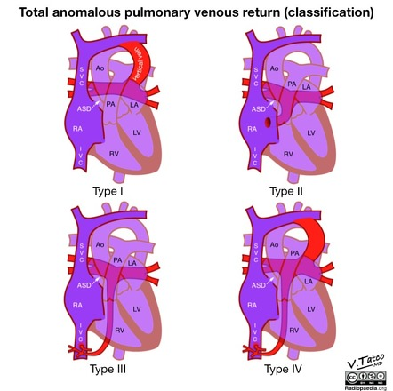
Classification
Darling et al.1957:
  Type I: anomalous connection at the supracardiac level. 45%.
  Type II: anomalous connection at the cardiac level (to the coronary sinus).25%.
  Type III: anomalous connection at the infracardiac level.21%.
  Type IV: anomalous connection at two or more of the above levels. <10%.
Darling RC et.al. Lab Invest.1957;6:44-64
Karamlou T et.al. Circulation 2007;115:1591-1598

Slide 18
Classification cont.
Neill classification (1956)-embryologic basis (not commonly used)
Connections to the right atrium or right common cardinal system(SVC and the azygous veins)
Connections to the left common cardinal system (left innominate vein, left SVC or the coronary sinus)
Connections to the umbilicovitelline system (portal vein,ductus venosus or hepatic veins)
Smith et al. classification:
  Supradiaphragmatic (without pulmonary venous obstruction).
  Infradiaphragmatic (with pulmonary venous obstruction).

Slide 19
Anomalous connections
Connection to the Right Superior Vena Cava or the Right Azygos Vein
Connection to the Left Innominate Vein: most common site of connection.
Connection to the Coronary Sinus: Entire anamolous pathway is within the pericardium.
Connection to the Umbilicovitelline System. ( Portal vein > ductus venosus > to one of the hepatic veins, or to the IVC). Most often associated with pulmonary venous obstruction.
Notes:
the portal vein at the confluence of the splenic and superior mesenteric veins

Slide 20
Site of connection or drainage | Burroughs and Edwards (N=113) % | Lucas et al (N=71) % | Delisle et al (N=93) %
Left innominate vein | 36 | 37 | 26
Coronary sinus | 16 | 16 | 1
Right atrium | 15 | 2 | 8
Right SVC | 11 | 12 | 15
Portal system | 13 | 23 | 24
Multiple sites | 7 | 10 | 5
Unknown or other | 2 | 0 | 4

Slide 21
Anatomic Sites of Obstruction
Obstruction at the Interatrial Septum: Longevity in TAPVC depends on size of ASD. Restrictive ASDs associated with increased mortality.
Obstruction in the Anomalous Venous Channel: Causes:
  Intrinsic narrowing in the walls of anomalous channel.
  Extrinsic pressure. Examples:
    Vertical vein in TAPVC to left innominate vein passes between left MPA and left main bronchus- “hemodynamic vise”.
    In infradiaphragmatic TAPVC, constriction occurs as it traversus the esophageal hiatus.
  Ductus venosus undergoes constriction.
  When the anomalous connection is to the portal vein or one of its tributaries, the hepatic sinusoids are interposed in the pulmonary venous channel.
Infracardiac type is usually obstructive while supracardiac and cardiac are often nonobstructive.

Slide 22
Associated Cardiac Anomalies
  Usually associated with PFO or OS ASD.
  PDA 20%
  VSD with TGA or DORV
  Single ventricle 11%
  Single atrium
  Coarctation of aorta 2%
  Pulmonary valvar stenosis 1%
TAPVD to right atrium associated with visceral heterotaxy and polysplenia.

Slide 23
Physiology
Survival of the child is dependent on the presence of a right to left intracardiac shunt either PFO or ASD (obligatory shunt).
Prognosis in TAPVC depends on:
Size of interatrial communication
Presence of obstruction to pulmonary venous drainage.
Whether or not the pulmonary veins enter below the diaphragm.
Notes:
All venous blood enters the right atrium.
Size of ASD most imp factor. Good sized ASDs are usually present in patients who survive infancy.

Slide 24
Fetal circulation
Development of pulmonary circulation:
  Pulmonary flow in fetus is low. Obstruction should be severe to produce pulmonary venous hypertension.
  Left atrium and left ventricle are small.
  When lungs expand at birth, an obligatory left to right shunt is established causing mixing of pulmonary and systemic venous return at the right atrium.
Notes:
Hemodynamics of unobstructed TAPVC is similar to ASD
Hemodynamics of obstructed type is similar to Mitral Stenosis

Slide 25
Without venous obstruction (non restrictive ASD)
DIRECTION OF FLOW IS A FUNCTION OF DISTENSIBILITY CHARACTERISTICS OF RIGHT VENTRICLE
RV receives most blood from RA
Ejects large volume of blood to PA
Mild cyanosis
Pulmonary blood flow reduces
Cyanosis increases
INITIALLY LOW PVR AND COMPLIANT RV
INCREASED PULMONARY VASCULAR RESISTANCE
LESS COMPLIANT RV

Slide 26
With venous obstruction
PULMONARY CONGESTION
PULMONARY HYPERTENSION
Intra and extrapulmonary veins
exhibit intimal proliferation,
thick walls and reduction in size
DECREASED PULMONARY BLOOD FLOW
INCREASED CYANOSIS
PULMONARY HYPERTENSION – DILATION OF PUL TRUNK
COMPRESSES VERTICAL VENOUS CHANNEL FURTHER
VICIOUS CYCLE CONTINUES

Slide 27
Role of foramen ovale
Systemic blood flow has to be maintained by right to left flow through PFO
In the absence of venous return to the left atrium, RA pressure > LA pressure -----------→right to left flow through PFO.
Infants with venous obstruction, PFO is usually large to provide adequate systemic flow.
Restriction of foramen ovale is more often seen in infants with no or moderate venous obstruction.

Slide 28
Role of ductus arteriosus
Severe venous obstruction facilitates pulmonary hypertension.
As PVR is high, blood shunts from PA to aorta through DA.
Pulmonary venous flow is reduced, pulmonary venous pressure is lowered
and pulmonary edema is less likely to develop.
Decrease in pulmonary blood flow will restrict oxygen uptake in the lungs
and systemic arterial oxygen saturation will be decreased.
If DA closes, right to left flow is reduced, Increased pulmonary venous pressure aggravating pulmonary edema. As pulmonary flow is increased, oxygen saturation improves.
Notes:
Because pulmonary vascular resistance is high, blood shunts from the pulmonary artery to the aorta through the ductus arteriosus; therefore,
while the ductus is widely patent, pressure in the pulmonary artery cannot be raised above that in the systemic circulation. The diversion of blood
through the ductus reduces flow through the pulmonary circulation. Pulmonary venous flow is reduced, pulmonary venous pressure is lowered,
and thus less pulmonary edema is likely to develop. However, the decrease in pulmonary blood flow will restrict oxygen uptake in the lungs and, with
the lower pulmonary to systemic blood flow ratio, systemic arterial oxygen saturation will be greatly decreased. This hypoxemia may result in a fall in
systemic vascular resistance, which would further facilitate right-to-left shunting through the ductus

Slide 29
Role of ductus venosus
While the ductus venosus is patent, pulmonary venous blood returning to the portal vein can pass through it directly to the IVC, thus bypassing the hepatic circulation.
Pulmonary venous hypertension and pulmonary edema would not develop.
Closure or inadequate growth of the ductus venosus would necessitate that pulmonary venous blood pass through the hepatic microcirculation
Elevation of portal and pulmonary venous pressures and pulmonary edema may develop

Slide 30
Effect of feeding:
  Feeding increases gastrointestinal and portal blood flows ---- increases pulmonary venous pressures ---- aggravates pulmonary edema.
Effect of O2 administration:
  Improves saturation, worsens pulmonary edema.
    O2 causes pulmonary vasodilation, increasing pulmonary blood flow.
    O2 may cause vasoconstriction of ductus arteriosus
Effect of PGE1 infusion: Depends on whether response is more in DA or pulmonary vasculature.
  Dilating the ductus - ↑ R→L shunt , ↑ cyanosis
  Pulm vasodilatation, ↑ pulm blood flow, ↑ pulm edema, improve cyanosis
Infradiaphragmatic TAPVC- beneficial by causing relaxation of ductus venosus.

Slide 31
Clinical Features
TAPVC without pulmonary venous obstruction:
Asymptomatic at birth.
Tachypnea and feeding difficulties- usually in first few weeks.
Followed by frequent respiratory tract infections and failure to thrive.
Cyanosis is mild because of adequate mixing of blood.
Gradually they develop right heart failure and pulmonary arterial hypertension.
Cardiac failure in most patients prior to 6 months of age. (Hepatomegaly is always present and peripheral edema is present in about half of the cases).

Slide 32
Clinical features cont.
TAPVC with pulmonary venous obstruction:
Tachypnea, tachycardia and cyanosis within few days of life.
Usually not within first 12 hours of birth (differentiate from patients with respiratory distress syndrome).
Dyspnea is severe because of marked pulmonary venous congestion and cyanosis is marked because of reduced pulmonary flow.
If left untreated, death may occur from pulmonary edema and RV failure within few days or weeks of life.
Infradiaphragmatic TAPVC- cyanosis and dyspnea accentuated by straining and swallowing.
  Interference of pulmonary venous outflow by increased intra-abdominal pressure
  Impingement of the esophagus on the common pulmonary vein as it exits through the esophageal hiatus

Slide 33
Northern Great Plains Registry of Congenital Heart Disease
74 patients of TAPVC without PV obstruction.
  56% symptoms in first month, remainder in first year.
43 patients of TAPVC with obstruction.
  72% symptoms in first month, remainder early in first year.
Those who survive their first year almost always have supradiaphragmatic connections, low pulmonary vascular resistance and a nonrestrictive atrial septal defect.

Slide 34
Examination
Physical appearance:
  Mild cyanosis with features of congestive cardiac failure ( TAPVC without obstruction)
Arterial pulse and JVP:
  Small volume pulse – decreased LV stroke volume.
  JVP: In nonrestrictive interatrial communication, resembles that of isolated OS ASD.
  In restrictive interatrial communication with pulmonary hypertension-Large ‘a’ waves.

Slide 35
Examination
Inspection and Palpation:
  LV impulse impalpable.
  Left parasternal heave – hyperdynamic RV impulse. (Not a feature of TAPVC with obstruction).

Slide 36
Auscultation
TAPVC without obstruction
S1 loud (loud T1)
Wide fixed splitting of S2.
S3- RVF, S4- increased atrial contraction
Pulmonary ESM
Tricuspid flow MDM
Pulmonary hypertension:
  Pulmonary ejection sound
  Attenuation of pulmonary systolic murmur
  Loss of tricuspid diastolic murmur
  Inspiratory splitting of second heart sound
  Graham Steell murmur
TAPVC with obstruction
Clinical condition is grave with minimal cardiac findings.
Signs of PAH present.
Apex impulse is of RV type.
S1 normal, S2 closely split, P2 loud.
Frequently murmurless. Occasionally loud continuous murmur over the site of venous narrowing.
High frequency holosystolic murmur of TR accompanies pulmonary hypertensive RV failure.

Slide 37
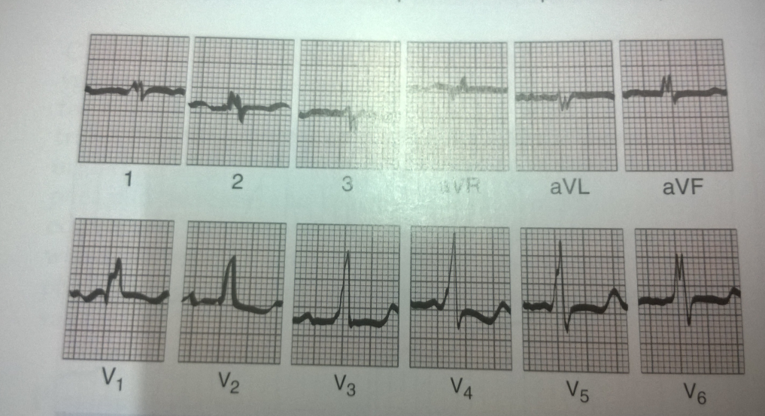
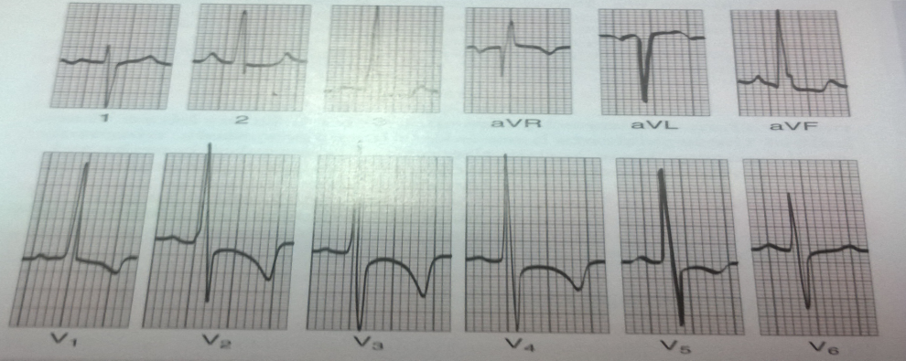
ECG
Incomplete RBBB.
PR interval prolonged.
In presence of pulmonary hypertension:
  P Pulmonale
  RAD
  Tall right precordial R waves
  Deep left precordial S waves

Slide 38
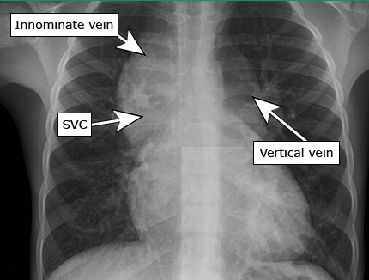
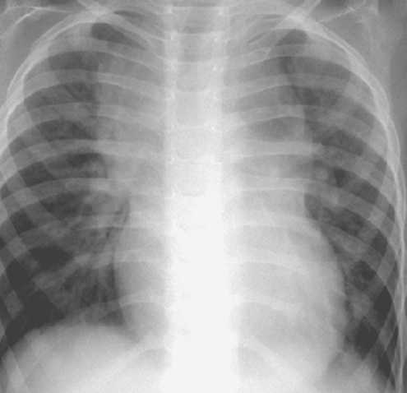

CXR- supracardiac
Figure of 8 or ‘snowman’ appearance.
Composed of the anomalous vertical vein on the left, the left innominate vein superiorly, and the SVC on the right.
Not usually present in the first few months of life
Notes:
The lung fields reflect increased pulmonary blood flow. The right atrium and right ventricle are enlarged, and the pulmonary artery segment is prominent. The left-sided chambers are not enlarged.

Slide 39
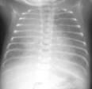
CXR- obstructive TAPVC
Ground-glass appearance
Diffuse reticular pattern
Cardiac size is normal
Kerley B lines may be present
This pattern also seen in other causes of pulmonary venous obstruction.
Notes:
Pulmonary edema is striking.
Pulmonary veins and lymphatics are distended.
Lung fields exhibit a reticular nodular ground glass appearance and stand out in contrast to the comparatively unimpressive cardiac silhouette.

Slide 40
Echocardiography
2D echo with colour Doppler is the definitive non-invasive method for diagnosis of TAPVC.
A sensitivity of 100% and specificity of 85% is claimed for detection of obstruction by 2D echo with colour doppler.
J Am Coll Cardiol 1991;18:1746-1751

Slide 41
Echocardiography
Goals of echocardiography-
Size of pulmonary veins
Connection of all 4 major pulmonary veins to confluence and any additional pulmonary veins.
Size of pulmonary venous confluence & its relation with LA.
Course of pulmonary venous channel and whether there is obstruction to its flow.
To evaluate interatrial communication for obstruction.
Any additional cardiac anomaly.

Slide 42
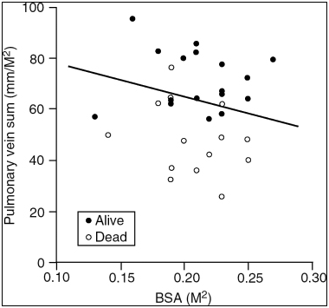
Echocardiography
Features common to all forms of TAPVC are-
Signs of right ventricular volume overload.
Inability to image the pulmonary veins entering the LA.
Size of the individual pulmonary vein at the time of diagnosis is a strong, independent predictor of survival.
Smaller pulmonary veins were associated with poorer prognosis and higher surgical mortality after repair of TAPVC.
Jenkins KJ et al. JACC 1993;22:201-206
Notes:
Size and orientation (horizontal or vertical) of the pulmonary venous confluence and its relation with the left atrium are important for surgical planning.
Generally,the venous channel in supracardiac TAPVC is best imaged from the precordial windows,and the venous channel in infradiaphragmatic TAPVC is best evaluated from the subcostal view.

Slide 43
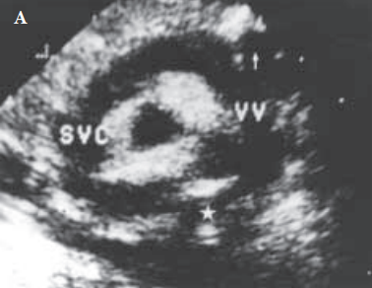
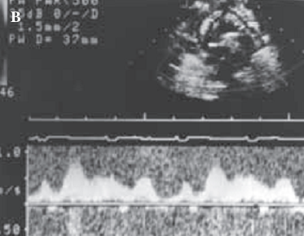
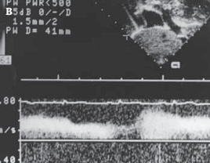
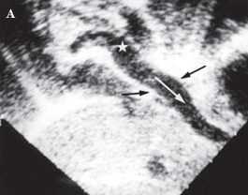
Suprasternal long axis view showing VV, left innominate and right SVC.
Phasic pulmonary venous flow in VV and innominate implying absence of pulmonary venous obstruction.
Subcostal view showing pulmonary venous confluence (star) traced to descending vein (arrow) that drains into portal vein.
Continuous, turbulent and non phasic pulmonary venous flow indicating pulmonary venous obstruction.

Slide 44


Slide 45
CT and MRI
CT excellently depicts vascular structures peripheral to heart. Disadvantage of CT is that it requires ionizing radiations and IV iodinated contrast material.
MRI is the preferred imaging technique for evaluation of pulmonary venous structures after echocardiography. Lack of ionizing radiation and need for single IV bolus gadolinium contrast are advantages of MRI.

Slide 46
Cardiac catheterization
Cardiac cath.is reserved for precise examination of pulmonary veins and their obstruction.
The pathognomonic finding is oxygen saturation in all chambers and great vessels are nearly identical(80-95%).
When TAPVC is to left innominate vein or right SVC, SVC blood preferentially flows into tricuspid orifice and IVC blood preferentially shunts into the left atrium, resulting in a pulmonary artery O2 saturation that may be higher than that in the systemic artery.
Notes:
RA is the common mixing chamber. This situation is reflected in the frequent finding
of close similarity of oxygen content and saturations from the
right atrium, left atrium, pulmonary artery, and systemic
artery. There is considerable deviation from this pattern,
however, because of streaming of systemic venous return in
the right atrium, directing inferior vena caval blood through
the foramen ovale to the mitral valve, and superior vena caval
blood through the tricuspid valve. Thus, in infracardiac
TAPVC, systemic arterial saturation is typically higher than
pulmonary artery saturation.

Slide 47
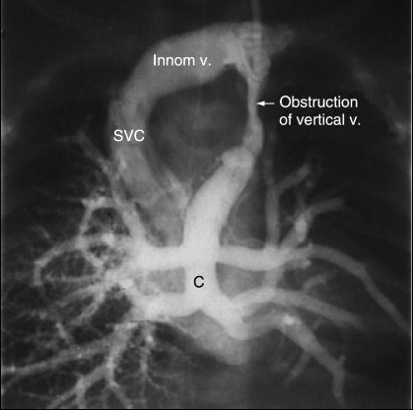
Cardiac catheterization
In obstructive type, RV and PA pressures are increased and may be equal or more than systemic pressure.
Selective pulmonary arteriography-
  If pulmonary veins cannot be entered directly then selective RIGHT pulmonary artery angiography is done.
  Pulmonary arteriography in levophase shows the anomalous venous connections.

Slide 48
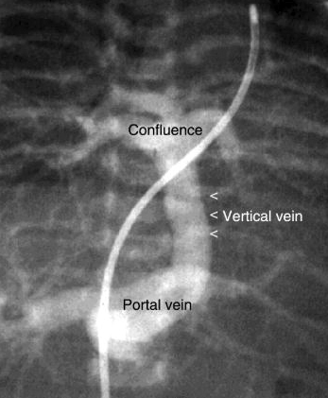
Cardiac catheterization
In infracardiac type, anomalous connection of pulmonary veins via descending vertical vein to portal vein is characteristic and it is termed as TREE IN WINTER.
In neonates, umbilical vein catheterization allows direct injection of contrast in anomalous connection in the infradiaphragmatic type of TAPVC.
Tynan M.Br Heart J.1974;36:115

Slide 49
Natural History
10 -20% survive first year of life, 50% survive beyond 3 months.
Those who survive first year ( have large ASDs) without surgical treatment have a stable course till 10-20 years.
In the 2nd decade, pulmonary vascular disease --→ increasing cyanosis.
Notes:
Survival past the critical first
few weeks and months does not portend a favorable prognosis,
because only about half the patients surviving to
age 3 months survive to 1 year.

Slide 50
Emergency Therapy
  Immediate endotracheal intubation and hyperventilation with 100% oxygen to a PaCO2 of ˂ 30 mm Hg and correction of pH.
  Metabolic acidosis should be treated with NaHCO3 infusion.
  Cardiac failure: inotropes and diuretics.
  Isoproterenol has special merit for inotropic support in obstructed TAPVC because it has pulmonary vasodilatory properties (0.1 microgm/kg/min for 24-48 hrs).
  PGE1 infusion given to maintain patency of ductus venosus to decompress the pulmonary veins in obstructed TAPVC.
  ECMO in infants with refractory heart failure.
  Balloon or blade atrial septostomy: palliative procedure no longer recommended.
    Delays definitive procedure
    No role in pulmonary venous obstruction
Notes:
Induced respiratory alkalosis decreases pulmonary vascular resistance and improves oxygenation.

Slide 51
Surgery
The goal of the surgery is to create an unobstructed egress of blood from pulmonary veins into the left atrium.
Various approaches for surgery-
Posterior approach
Right atrial approach
Superior approach

Slide 52
Indications for operation
Once the diagnosis is made, operation should be undertaken immediately in any neonate or infant.
Surgical intervention during the first few days or week of life, usually within 6 months of life.
Diagnosis between 6 to 12 months: Immediate surgery.
Diagnosis in childhood or early adult life: Depends on PVR measured at preoperative Cardiac catherization after 100% oxygen and inhaled NO.
If PVR < 8 U.m2-----------→ Operation
If PVR > 8 U.m2-----------→ chronic pulmonary vasodilatory therapy may be considered to increase operability.
Notes:
Rarely, individuals survive into childhood or early adult
life with TAPVC and are first seen for surgical consideration
at that time.
When pulmonary vascular disease is suspected clinically,
measurement of pulmonary vascular resistance is required at
preoperative cardiac catheterization. Using the Fick principle,
the patient’s response to 100% oxygen and to inhaled nitric
oxide is determined. If pulmonary vascular resistance is less
than 8 U · m2 using these maneuvers, operation is undertaken.
If resistance is higher than 8 U · m2, chronic pulmonary
vasodilatory therapy, both pre- and postoperatively, can
be considered in an attempt to increase operability

Slide 53
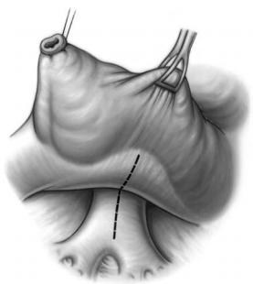
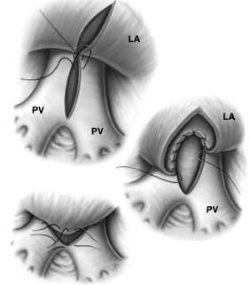
Posterior approach
Notes:
The pulmonary venous confluence is seen in the posterior pericardium by retracting the heart anteriorly and to the right.
Because of lack of pulmonary vein attachment to the left atrium,the heart is unusually mobile and pulmonary venous confluence can be easily exposed.
A longitudinal incision is made in the venous confluence to match a corresponding incision in the posterior left atrium

Slide 54
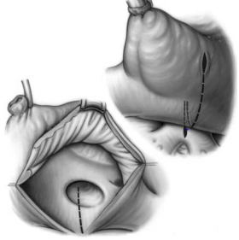
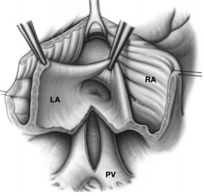
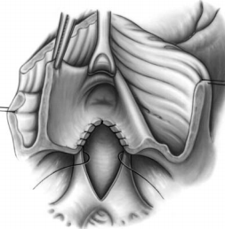
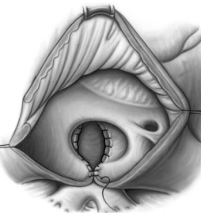
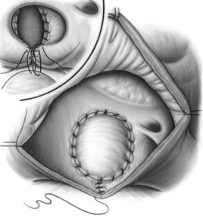
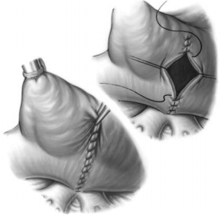
Right atrial approach
Notes:
A atriotomy incision extended across the right atrium and then across the atrial septum.
It allows incision of the posterior wall of the left atrium precisely over the pulmonary venous confluence.
In patients with small left atria and rightward pulmonary venous confluence,this approach allows patch augmentation of the left atrium when reconstructing the atrial septum and right atrial incision.

Slide 55
Repair of total anomalous pulmonary venous connection to coronary sinus, Van Praagh method
Notes:
Repair of total anomalous pulmonary venous connection to coronary sinus, Van Praagh method.V1 A, After usual preparations,
right atrium is opened obliquely and exposure arranged. Foramen ovale is enlarged cephalad and at times caudad to attain adequate
visibility within left atrium. B, An opening is made in the common wall between coronary sinus and left atrium after wall has been tented
with right-angle forceps. This opening is enlarged downward and to the left; care must be taken not to go outside the heart in the process.
(If this occurs, the opening must be closed at this point from within the heart by a few sutures, because the area is difficult to expose from
outside the heart.) The incision is carried anteriorly and to the right to within a few millimeters of the ostium of the coronary sinus.
C, Foramen ovale and ostium of coronary sinus are closed, usually individually, with interrupted or continuous suture.
Suture line should start inferiorly just below the last tiny coronary vein entering the sinus and, as it proceeds superiorly, should be made
with shallow bites and preferably kept within the coronary sinus ostium to avoid the atrioventricular (AV) node. D, Arrow indicates path of
blood flow through the coronary sinus to the right atrium before repair. After repair, blood flow from the coronary sinus is to the left atrium
above the mitral valve through the unroofed coronary sinus.

Slide 56
Surgical outcomes
Surgical mortality has decreased from 50% in 1970s to 2-20% in recent studies.
Modes of death after repair:
  Cardiac failure
  Hypertensive pulmonary artery crisis
Complications:
EARLY-
Pulmonary edema, Pulmonary hypertensive crisis, Phrenic nerve damage, Rhythm disorders
LATE-
Pulmonary venous obstruction, Anastomotic stricture, Pulmonary venous stenosis
Notes:
Holter monitoring after repair demonstrates that asymptomatic ectopic atrial pacemaker
activity and other abnormalities are present in most patients.

Slide 57
Postoperative complications
Pulmonary edema- due to noncompliant left heart and increased left atrial pressure . Diuretics are useful for treatment.
Pulmonary hypertensive crisis-hyperventilation with 100% oxygen and inhaled nitric oxide is the treatment of choice. Infusion of prostacyclin may also be useful.
Rhythm disorders- junctional rhythms and various types of heart blocks are common in cardiac type TAPVC repair

Slide 58
Pulmonary venous obstruction
2 causes: Severe anastomotic stricture and pulmonary vein stenosis.
Risk factors:
  Original diagnosis of infracardiac or mixed TAPVC
  Obstructed TAPVC.
Anastomotic Stenosis:
  10% of patients.
  Within few months of repair
  No relationship between suturing technique and stricture formation.
Pulmonary Vein Stenosis:
  Less common (5%), appears later
  Due to diffuse thickening and fibrosis of vein wall.
  Usually lethal despite reoperation.
Notes:
Despite theoretical considerations favoring use of interrupted
sutures, there is no correlation between stricture formation
and method of suturing.

Slide 59
PAPVC
One or more of the pulmonary veins is connected to the morphologically left atrium, while the rest are connected to a systemic vein or the right atrium.
Sex ratio is equal
Associations
Asplenia and polysplenia
Turner and Noonan syndrome.
ASD - Present in 9 % of ASDs.
TOF - 0.6%
Tricuspid atresia
Single ventricle

Slide 60
Pathophysiology
PAPVC with intact IAS
Pulmonary venous obstruction is rarely present.
Haemodynamic effects are almost always the result of an obligatory left-to-right shunt through the anomalously connected segments of lung.
Factors that determine the amount of blood draining anomalously:
  Number of veins connected anomalously
  Relative resistance of the vascular beds normally and anomalously connected
  Compliance of the respective atria into which the normally and anomalously connected veins empty
When there is complete anomalous connection of one lung, the left-to-right shunt is usually greater than 50%.
The lobe or lobes drained by the anomalously connecting pulmonary vein also affect the magnitude of the left-to-right shunt
Notes:
More blood flows through the anomalously connected lung than would be the case if it were normally connected (systemic veins have lesser mean pressure than the left atrium).
The lobe or lobes drained by the anomalously connecting pulmonary vein also affect the magnitude of the left-to-right shunt. In the upright position at rest, pulmonary blood flow is distributed preferentially to the middle and lower lobes. In supine position and during exercise, pulmonary blood flow is redistributed to the upper lobes.
Magnitude of the left-to-right shunt in a patient with PAPVC from one of the upper lobes may vary according to body position and level of activity

Slide 61
PAPVC with ASD
Small ASD: Resembles that of PAPVC with IAS.
Large ASD: Left to right shunt will be large.
  Due to anomalous drainage of most of the blood from the anomalously connected lung as well as anomalous drainage of more than half the blood from the normally connected lung via the ASD.

Slide 62
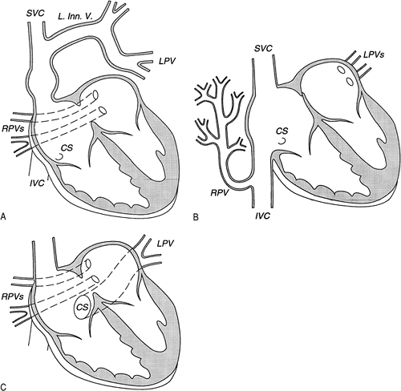
Abnormal connections
RPVs to SVC
RPVs to IVC: Normal pulmonary venous pattern of the right lung is altered -fir tree configuration. 2nd commonest(Fig B)
LPVs to IVC
LPVs to left innominate vein: commonest variety (Fig A)
Uncommon sites of PAPVC of LPVs to coronary sinus (Fig C), Rt SVC, Lt subclavian , azygos vein
Notes:
the cases previously considered PAPVC to the right SVC and to the right atrium (now considered under sinus venosus defect and malposition of the septum primum), commonest variety

Slide 63
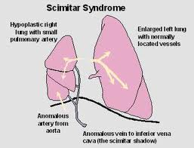
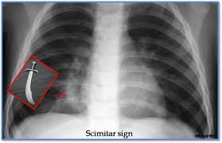
Scimitar syndrome
Pulmonary venolobar syndrome or hypogenetic lung syndrome or Halasz’s syndrome.
Described by Chassinat in 1836.
Connection of all of the RPVs into the IVC with hypoplasia of the ipsilateral lung and pulmonary artery.
Associated anomalies: Anomalies of the bronchial system, horseshoe lung, dextroposition of heart, anomalous arterial connection to the right lung from the aorta, and pulmonary sequestration.
Rarely involves the left lung.
“Scimitar”- refers to radiologic shadow resembles the shape of Turkish sword.
Notes:
In this lesion, the lower lobe of the right lung
is hypoplastic, and is supplied with arterial blood from the
descending aorta. Its pulmonary venous return is connect-­
ed to the inferior caval vein. There are marked variations
in the combination of abnormal connections, including
sequestration of the abnormal lobe of the lung.
Scimitar= descending pulmonary vein

Slide 64
Clinical features
Asymptomatic- one vein connects anomalously.
Mimics TAPVC - in subtotal PAPVC.
When one lung drains anomalously:
  Cyanosis unusual in childhood, appears in 3rd to 4th decades due to PHT.

Slide 65
Investigations
Electrocardiogram:
  In supracardiac connections or those associated with ASD: rsr¹ or rsR¹, or rarely QR in V1.
  Partial return to inferior caval vein: terminal s or S in V1.
  Peaked P waves, RVH --- after development of PHTN.
Echocardiogram:
  Attempt must be made to identify pulmonary venous connections from all portions of the lung into the heart.
  Increased flow in the superior or inferior caval veins should alert to the possibility of PAPVC.
PAPVC - “Achilles heel of echocardiographer”
  Even if all 4 pulmonary veins are normally connected, they may not be imaged.
  Some patients have more than 4 pulmonary veins.
  Great clue to diagnosis of TAPVC, “the pulmonary confluence” is invariably missing

Slide 66
Management
Medical:
  Diuretics and other treatment to manage heart failure
Surgical: Definitive treatment
Indications for surgery-
  Uncomplicated PAPVC: Qp/Qs more than 1.8:1
  Scimitar syndrome with severe hypoplasia of right lung ( even when Qp:Qs <1.8:1 because of complications of bronchopulmonary sequestration).
Optimal timing: 1 to 2 years.
Notes:
An exception is patients with scimitar syndrome who
have severe hypoplasia of the right lung and a Q p/Q s of less than 1.8; operation, usually lobectomy or pneumonectomy
with ligation of the anomalous arterial supply, may be required
in these patients because of complications of bronchopulmonary
sequestration.

Slide 67
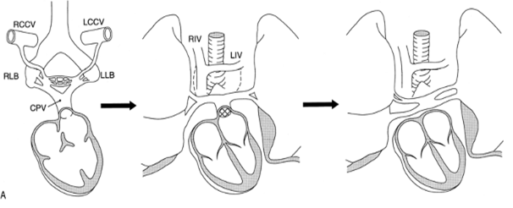
Atresia of CPV
No direct route for blood to enter either the left atrium or the systemic veins.
Instances of patients surviving up until 1 month of life.
Suggested routes:
  Bronchopulmonary venous anastomosis to the hilar bronchial veins--→ into azygos, hemiazygos and brachiocephalic veins.
  Reflux from pulmonary capillaries to arteries---→ bronchopulmonary arterial anastomosis into systemic circuit
Management: early surgical repair
Notes:
How oxygen reaches
the systemic arteries is uncertain. One suggested route is
via bronchopulmonary venous anastomoses to the pleuro-­
hilar bronchial veins, which drain into the azygos, hemia-­
zygos and brachiocephalic veins. Alternatively, blood could
reflux from pulmonary capillaries into pulmonary arteries,
and thence pass through bronchopulmonary arterial anas-­
tomoses and bronchial arteries into the systemic circuit

Slide 68
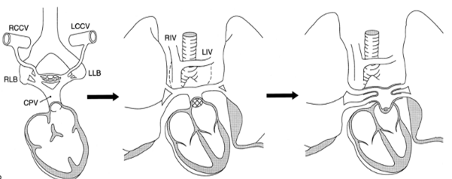
Cor triatriatum
Recognized first by Andral in 1829, detailed description by Church 4 decades later.
0.1% of all CHDs.
Usually involves left atrium (Cor triatriatum sinister) and rarely the right atrium ( Cor triatriatum dexter).
Characterised by a fibromuscular membrane that partitions the left atrium into a proximal accessory chamber that receives pulmonary veins and a distal true chamber that contains left atrial appendage and fossa ovalis.
3 anatomic varieties: diaphragmatic, hourglass and tubular.
Pressure is elevated in proximal accessory chamber and is normal in distal true chamber.
Blood flow across obstructing partition is continuous.

Slide 69
Associated lesions
Associated with other anomalies in 80% of cases:
  Atrial septal defect
  Anomalous pulmonary venous return
  Tetralogy of Fallot
  Bicuspid aortic valve
  Double outlet right ventricule
  Coarctation of the aorta
  Persistant left superior vena cava with unroofed coronary sinus
  Ventricular septal defect
  Common atrio-ventricular canal
  Hypoplastic mitral valve
  Bicuspid right atrio-ventricular valve
COMMONEST
RARE

Slide 70
Classification
Loeffler (1949)
Based on the number and size of fenestrations in the fibromuscular membrane.
3 groups:
  Absence of communication between the 2 chambers. Accesory chamber may connect to right atrium or some of the pulmonary veins may drain anomalously.
  One or few small openings in the intra- atrial membrane.
  Single large opening between accessory chamber and true atrium.

Slide 71
Clinical presentation
Physiologic consequences of CTS are directly related to the size of the orifice between the accessory and the true atrial chamber.
Appearance of symptoms occurs secondary to fibrosis and calcification of the accessory membrane orifice.
Anomaly is sometimes revealed by atrial arrhythmias or cerebral and systemic embolic events (thrombosis in dilated propximal chamber)
Notes:
In infants and newborns, the manifestations of the disease are secondary to a relatively
narrow opening with a subsequent rise in proximal left atrial pressure and pulmonary
congestion. Dyspnoea ranges from mild forms to more severe presentations such as neonatal
respiratory distress with an increased mortality risk

Slide 72
Diagnosis
ECG: Usually normal. RVH and RAD associated with PAH. Atrial arrhythmias like atrial tachycardia or atrial fibrillation may be seen.
Cardiac catheterization: Reference diagnostic technique in pre echocardiographic era. Normal left ventricular hemodynamic profile with a transatrial gradient.
Echocardiogram:
  Thin undulating intra atrial membrane characterized by diastolic movement towards the mitral funnel and systolic movement away.
  Left atrial appendage seen in distal compartment (distinguishing from supravalvular mitral ring).
  Mitral valve normal (deformed in supravalvular mitral ring).

Slide 73
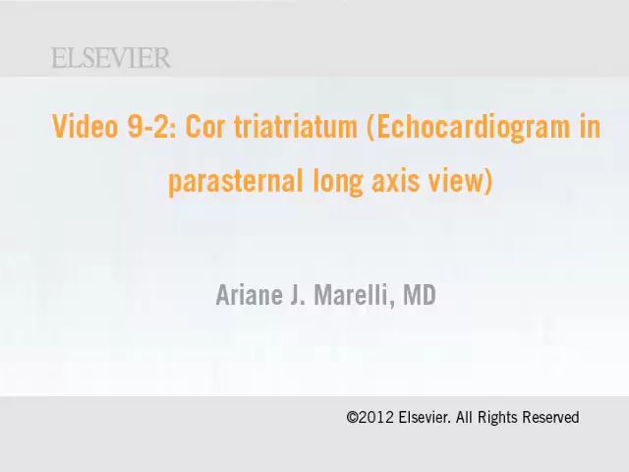

Slide 74
Treatment:
  Medical management in patients with RHF/ pulmonary edema.
  Surgical resection of cor triatriatum membrane under CPB is treatment of choice.
Prognosis: Related to size of the membrane orifice.
Niwayama’ survey: avg survival 3 1/3 mths when orifice < 3 mm and 16 years when > 3 mm.

Slide 75
Cor triatriatum Dexter
Rare type of triatrial heart.
Due to persistent embryonic right valve of the sinus venosus.
Venacavae and coronary sinus on one side of membrane and right atrial appendage and tricuspid orifice on other side.
One or more perforations in the membrane allow communication from one side to the other.

Slide 76
THANK YOU

Slide 77
Surgical approach for TAPVC correction are all except
Posterior
Superior
Right atrial
Inferior
Notes:
2.)

Slide 78
Commonest variety of PAPVC is
1.) RPVs to IVC
2.) LPVs to IVC
3.) LPVs to left innominate vein
4.) LPVs to coronary sinus.
Notes:
3.)

Slide 79
‘ Cottage Loaf’ heart on chest radiograph is characteristic of which of the following?
1.) Supracardiac TAPVC
2.) Infracardiac TAPVC
3.) Cardiac TAPVC
4.) Mixed TAPVC
Notes:
1.)

Slide 80
MOST COMMON site of anomalous connection in TAPVC
1.) IVC
2.) RA
3.) Innominate vein
4.) Coronary sinus
Notes:
3.)

Slide 81
TAPVC is the consequence of failure of canalization of pulmonary venous Channel in the mediastinum. TRUE /FALSE
1.) TRUE
2.) FALSE
Notes:
1.)

Slide 82
Failure to establish a normal connection between one or more of the pulmonary veins with the common pulmonary vein (CPV) before the connections with the splanchnic venous system have regressed causes
1.) PAPVC
2.) TAPVC
3.) TOF
4.)CPV ATRESIA
Notes:
3.)

